Slide 1
Unified Planning Work Program
MPO TRAINING 101

Slide 2

Overview/Schedule

Slide 3





Unified Planning Work Program (UPWP)
MPO's biennial planning work program
Includes tasks for 2 years
Identifies MPO's:
2
EVERY
Future activities
YEARS
Deliverables
Budget and funding sources
Schedule
Notes:
The UPWP…
Is the MPO’s biennial planning work program
Includes tasks for two (2) years
Identifies the MPO’s:
Activities to be undertaken
Deliverables
Budget & funding sources
Schedule

Slide 4
UPWP Content
Introduction
Organization and Management
Funding Tasks
Budget Tables
Appendix
Notes:
Introduction
Cost Analysis Certification Statement
Status of Transportation Planning
Planning Priorities
Public Participation Process
Organization and Management
Committees
Planning Area Boundary and Board Apportionment
UPWP Participants
General Consultant Services
Funding Tasks
Administration
System Planning
Project Planning
Budget Tables
Agency Participation
Funding Source
Appendix
Statements and Assurances
Planning Emphasis Areas
MPO Resolution
UPWP Comments

Slide 5

Unified Planning Work Program (UPWP) Budget Table
Guide for development
Linked budget
tables
UPWP Template
MPOs, FDOT, & federal
partners developed
statewide template
Implemented with UPWP cycle
Incorporates prior year de-obligations
The UPWP Template is available on the MPO Partner Site
Notes:
Working group of MPOs, FDOT, and federal partners developed a template for use across the state
Implemented with 22/23-23/24 UPWP cycle
The template will be used as the foundation of UPWPs moving forward
Updated to incorporate prior year de-obligations

Slide 6
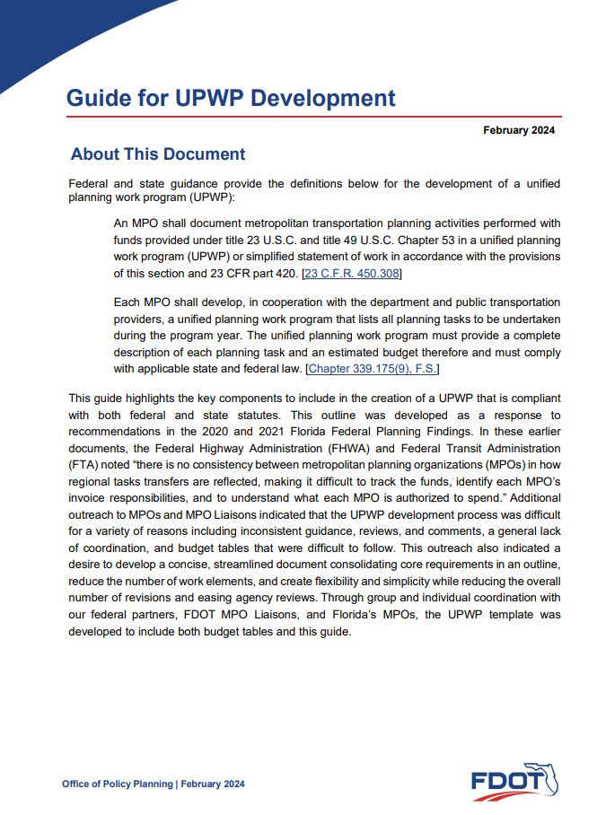
Guide for Development
Key components of the UPWP
Complying with Federal and State statutes
UPWP Revisions
The Guide for UPWP Development is available on the MPO Partner Site
Notes:
Highlights the key components to include in the creation of a UPWP that is compliant with both federal and state statutes
Elements and chapters to include in the UPWP
Provides guidance on how to address UPWP Revisions
Amendments
Modifications
Available on the MPO Partner Library

Slide 7
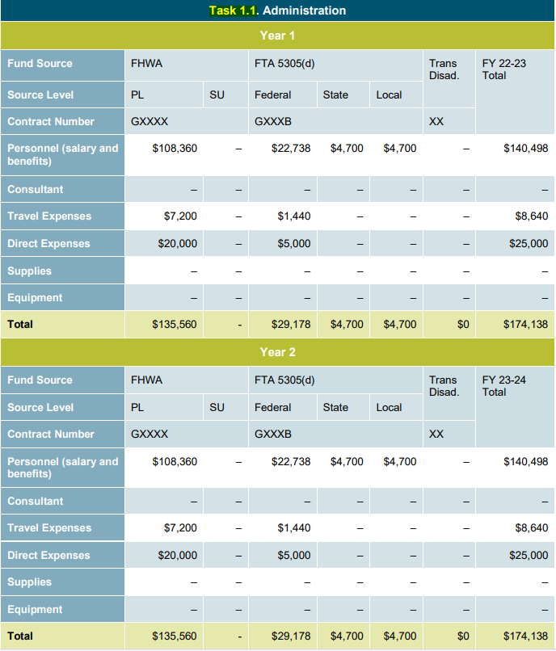
Sample Task Work Sheet
Notes:
Contract Number
Funding Sources
Source Level (Federal, State, Local)
FY Funding Source (Year 1 and Year 2)
Available on the MPO Partner Library

Slide 8
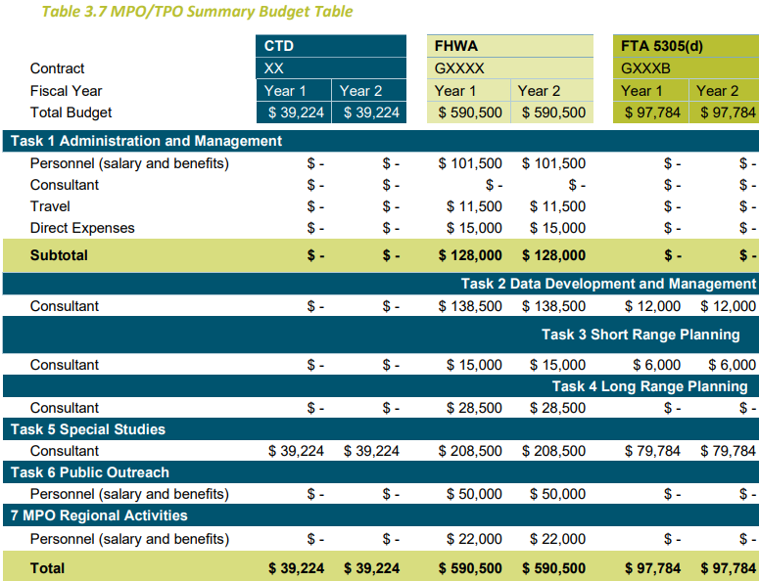
Summary Budget Table Example
Notes:
Contract Number
Funding Sources
Source Level (Federal, State, Local)
FY Funding Source (Year 1 and Year 2)
Available on the MPO Partner Library

Slide 9
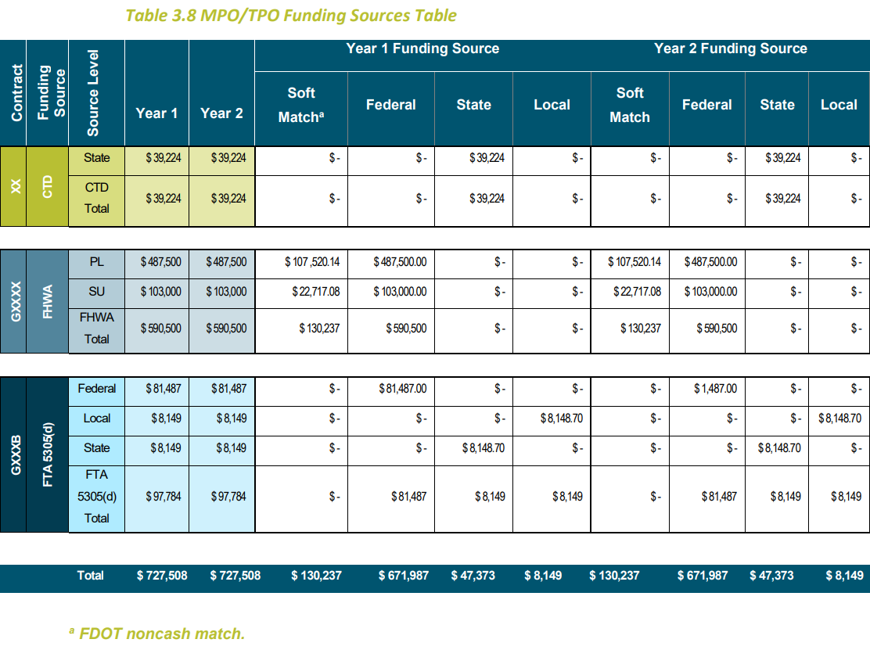
Funding Source Table Example

Slide 10
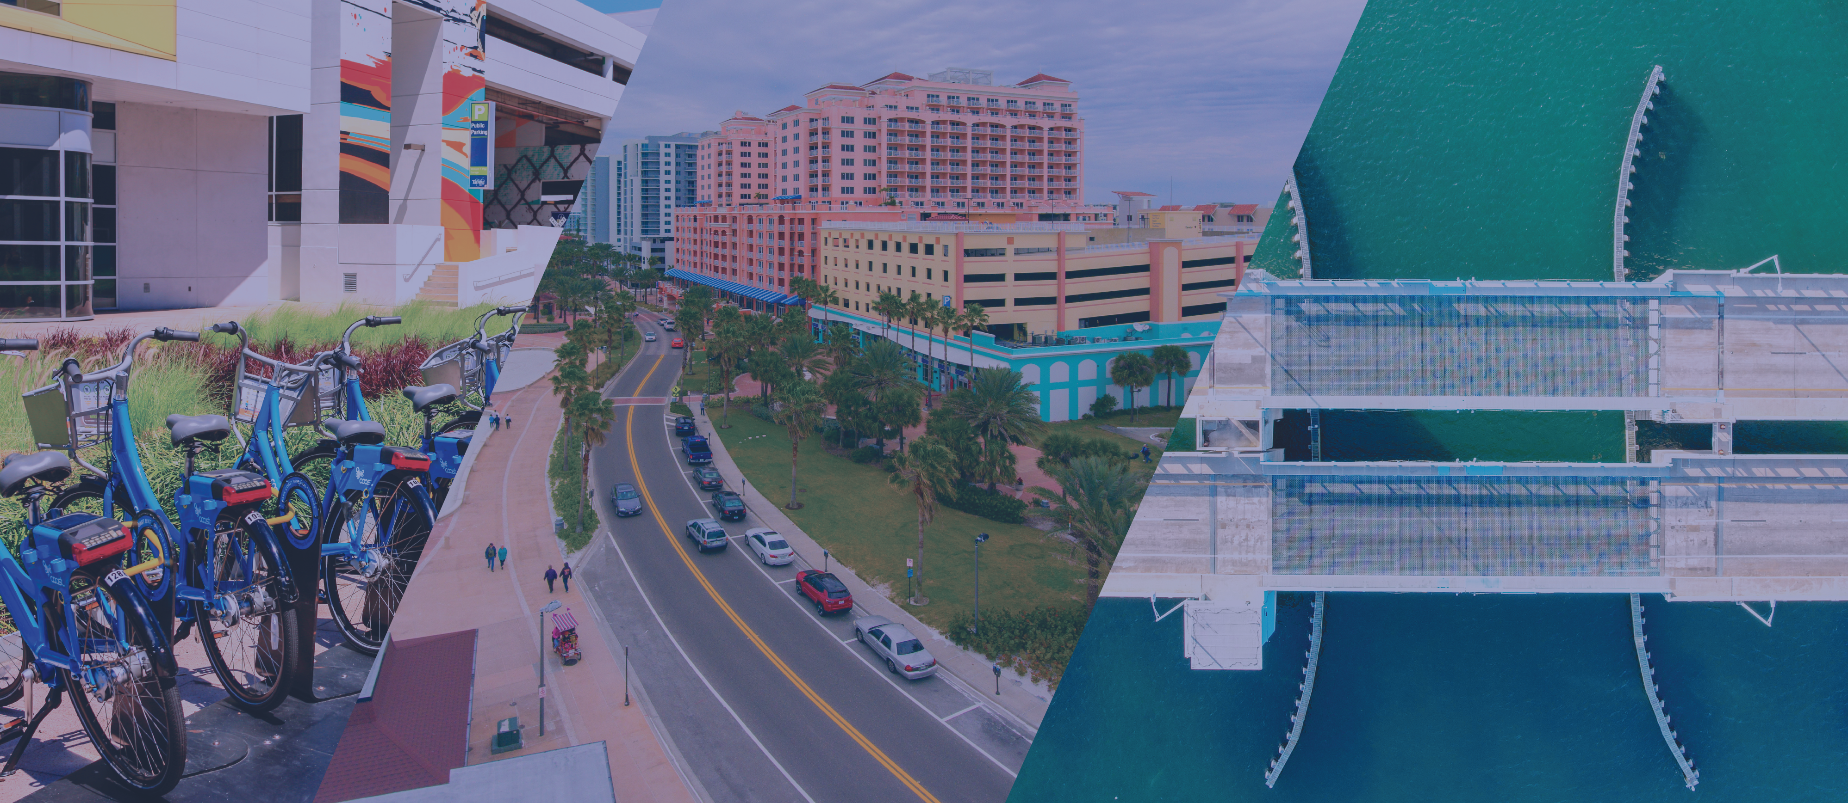
Unified Planning Work Program (UPWP) Schedule
DEC-FEB
(Year 2)
  Notify MPOs of Planning Emphasis Areas (if updated)
  Draft Allocations submitted to MPOs
  MPO develops draft UPWP
MARCH
15
  MPO submits Draft UPWP for review
  Draft is submitted into GAP
APRIL
15
  Comments provided
MAY
15
  MPO addresses all comments
  MPO adopts UPWP
  Final adopted/approved UPWP is submitted into GAP
Notes:
December/February (year 2)
Planning Emphasis Area’s released, MPOs notified
MPOs notified of UPWP requirements
Draft PL/5305(d) Allocations submitted to MPOs
MPOs develop draft UPWP
No later than March 15
MPOs submits draft UPWP to review agencies
No later than April 15
District provides their comments and other agency comments back to the MPO. FHWA and FTA are copied on the District’s comments.
No later than May 15
MPO addresses all comments and adopts Final UPWP.
MPOs submit final UPWP to District.

Slide 11
Unified Planning Work Program (UPWP) Schedule
Within 10 working days
District Liaison reviews MPO adopted UPWP using UPWP Review Checklist
JUNE
1
  District recommends approval
JUNE
  District requests PL fund authorization
Note: If funds are not included in Final approved UPWP by July 1, an amendment to add those funds in the new UPWP is required.
JUNE
30
  MPO & District Liaison resolve outstanding issues
  FHWA & FTA approve/reject Final UPWP
Notes:
Within 10 working days of adopted final UPWP
District Liaison reviews Final UPWP, identifying any outstanding issues using the UWP Review Checklist
UPWP Review Checklist in available on the Liaison Toolkit
No later than June 1
District transmits Final UPWP to FHWA, FTA and Central Office recommending approval, disapproval, or conditional approval
During June
A request from FDOT to authorize the PL funds is made so that the MPO is able to charge to UPWP activities on July 1st
No later than June 30
MPO and District Liaison must resolve any outstanding issues or funding could be delayed
June 30
FHWA and FTA approve/reject MPO Final UPWP
Added based on MPO Handbook Update:
Note: Section 3.9.2.1 (UPWP Amendments for PL funds that the MPO Chose to De-Obligate before UPWP Close Out) – updated section to state if the funds are not included in the final new UPWP by July 1, the MPO must process an amendment to add those funds in the new UPWP. (February 28, 2022)

Slide 12
Revisions

Slide 13
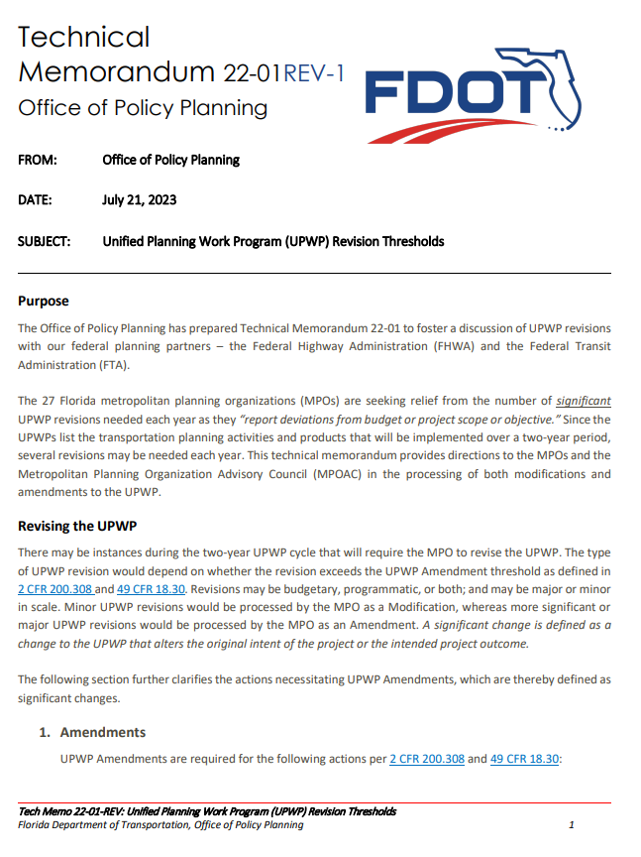
UPWP Revisions: Modification v. Amendment
Technical Memorandum 22-01
UPWP Revision Thresholds
  Amendments
    Financial
    Non-Financial
  Modifications

Slide 14
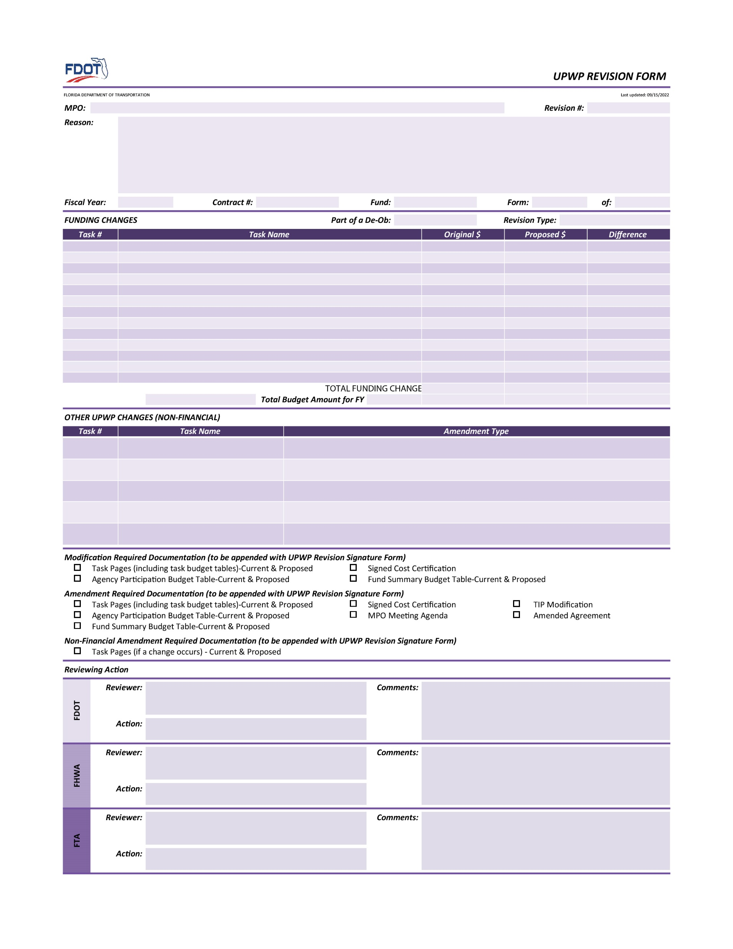
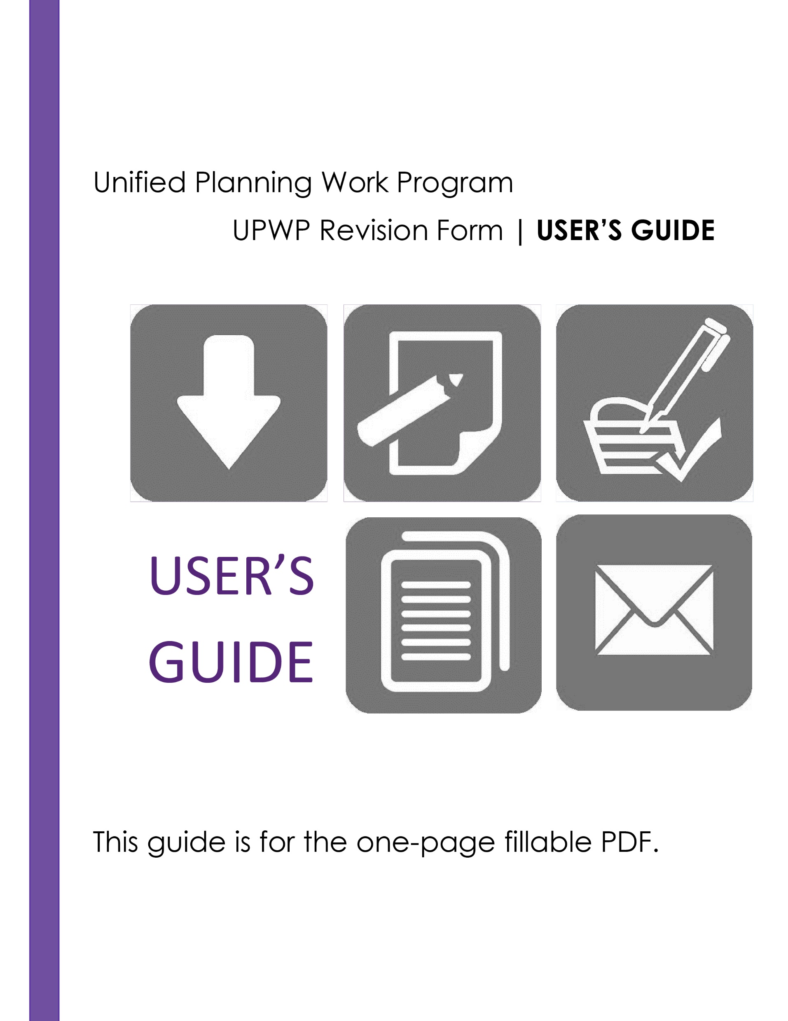
Unified Planning Work Program (UPWP) Revision Form and Guidance
Available on Partner Site
Notes:
Changes the FHWA or FTA approved budget
or
Changes the scope of the FHWA or FTA work task(s)
or
Add or delete a work task(s)
UPWP Amendments require an AMENDMENT to the MPO Agreement as well.
UPWP Amendment requires:
•MPO complete UPWP Revision form
•MPO board approves Amendment and forwards: Revision form, Board Minutes/resolution, original & proposed task page from UPWP & original & proposed UPWP budget tables to District Liaison
•District Liaison approves Amendment
•FHWA or FTA (which ever agency is appropriate) approves the Amendment

Slide 15

Unified Planning Work Program (UPWP) Amendments (Financial)
Increases to the approved budget
Transfer between tasks ≥ $100,000 or 10%
Reducing task > 50%
Changes to scope of work
Add/delete tasks
Addition of costs requiring prior approval
Amendments require an update
to the FDOT/MPO Agreement
Notes:
Increases the FHWA or FTA approved budget
A transfer between tasks/sub-tasks that exceeds a combined amount equal or greater than $100,000 OR 10% of the total budget, whichever is more restrictive
Reducing the budget of a task/sub-task more than 50 percent, or to the point a task/sub-task could not be accomplished as it was originally approved
Changes the scope of the FHWA or FTA work task(s)
Add or delete a work task(s)
Including costs that require prior approval (e.g. capital and equipment purchases $5,000 and above per unit cost)
UPWP Amendments require an AMENDMENT to the MPO Agreement as well.

Slide 16

Unified Planning Work Program (UPWP) Amendment (Non-Financial)
Does not change the financial amount
Examples include:
Changes in the scope of the program/task
Change in Executive Director
Extension of performance period
Sub awarding, transferring, or contracting out UPWP activities
Disengagement from projects
Notes:
Do not change the financial amount
Examples include:
Change in the scope or objective of the program or task
Change in key person (Executive Director)
Extension of the period of performance past the approved work program period
Sub awarding, transferring, or contracting out any of the activities in the UPWP
Disengaging from a project for more than 3 months, or a 25 percent reduction in time devoted to the project by the approved project director or principal investigator

Slide 17




Unified Planning Work Program (UPWP) Amendments
UPWP Revision form & supporting documentation
MPO board adoption
UPWP Amendment requires:
District MPO Liaison recommends approval
FHWA / FTA approval
Notes:
UPWP Amendment requires:
MPO complete UPWP Revision form
MPO board approves Amendment and forwards: Revision form, Board Minutes/resolution, original & proposed task page from UPWP & original & proposed UPWP budget tables to District Liaison
District Liaison approves Amendment
FHWA or FTA (which ever agency is appropriate) approves the Amendment
Supporting documentation (including revised pages)
Original and proposed Task Pages (including task budget tables)
Fund Summary Budget Table
Agency Participation Budget Table
Signed Cost Certification
MPO Meeting Agenda
TIP modification

Slide 18

Unified Planning Work Program (UPWP) Modifications
Do Not..
  Change approved budget
  Change scope of work task(s)
  Add or delete work task(s)
Notes:
UPWP Modifications do not:
Change the FHWA or FTA approved budget
Change the scope of the FHWA or FTA work task(s)
Add or delete a work task(s)

Slide 19
Unified Planning Work Program (UPWP) Modifications
UPWP Modification Requirements:
UPWP Revision form & supporting documentation
Notification of FHWA / FTA
Notification of District MPO Liaison
Notes:
UPWP Modifications requires:
MPO complete UPWP Revision form
Identification of pages that were revised (included with revision form)
Notification from the MPO to the District Liaison of the change
Notification from District Liaison to FHWA of the change (District Liaison forward notice to FHWA)
No formal approval is required

Slide 20
Summary
Resources for Creating UPWP
UPWP Budget Table Template
Guide for UPWP Development
UPWP Revisions
Amendments (Financial and Non-Financial) v. Modifications
UPWP Revision Form and Guidance
Notes:
Resources for creating the UPWP

Slide 21


Recap
What we reviewed:
UPWP overview and schedule
Amendments and modifications
Resources for creating and revising the UPWP
Notes:
Recap – What we reviewed:
UPWP overview and schedule
Amendments and modifications
Resources for creating and revising the UPWP

Slide 22
Resources
MPO Handbook
MPO Partner Library
  UPWP Guide
  UPWP Checklist
  UPWP Budget Tables
  UPWP Revision
  Form & Guidance
  UPWP Tech Memos

