Slide 2
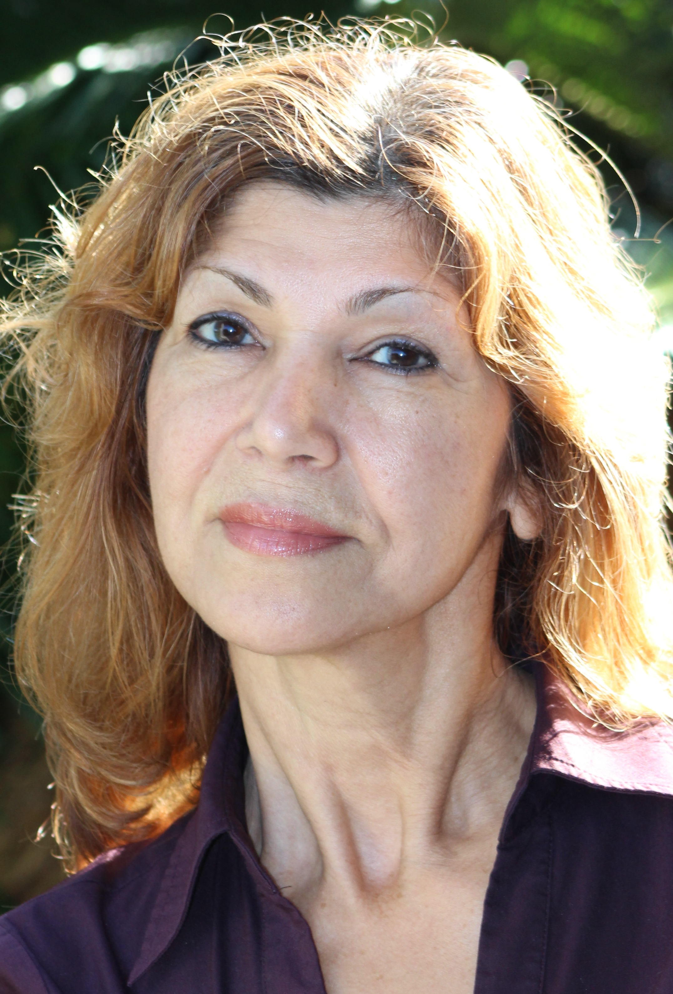
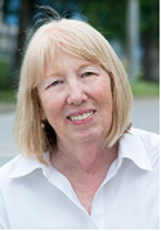
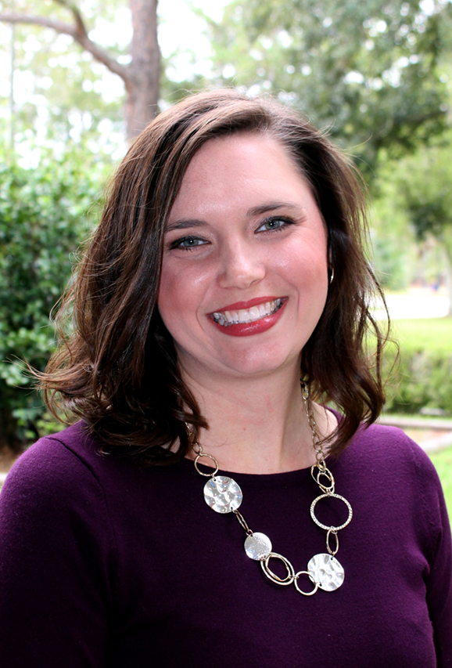
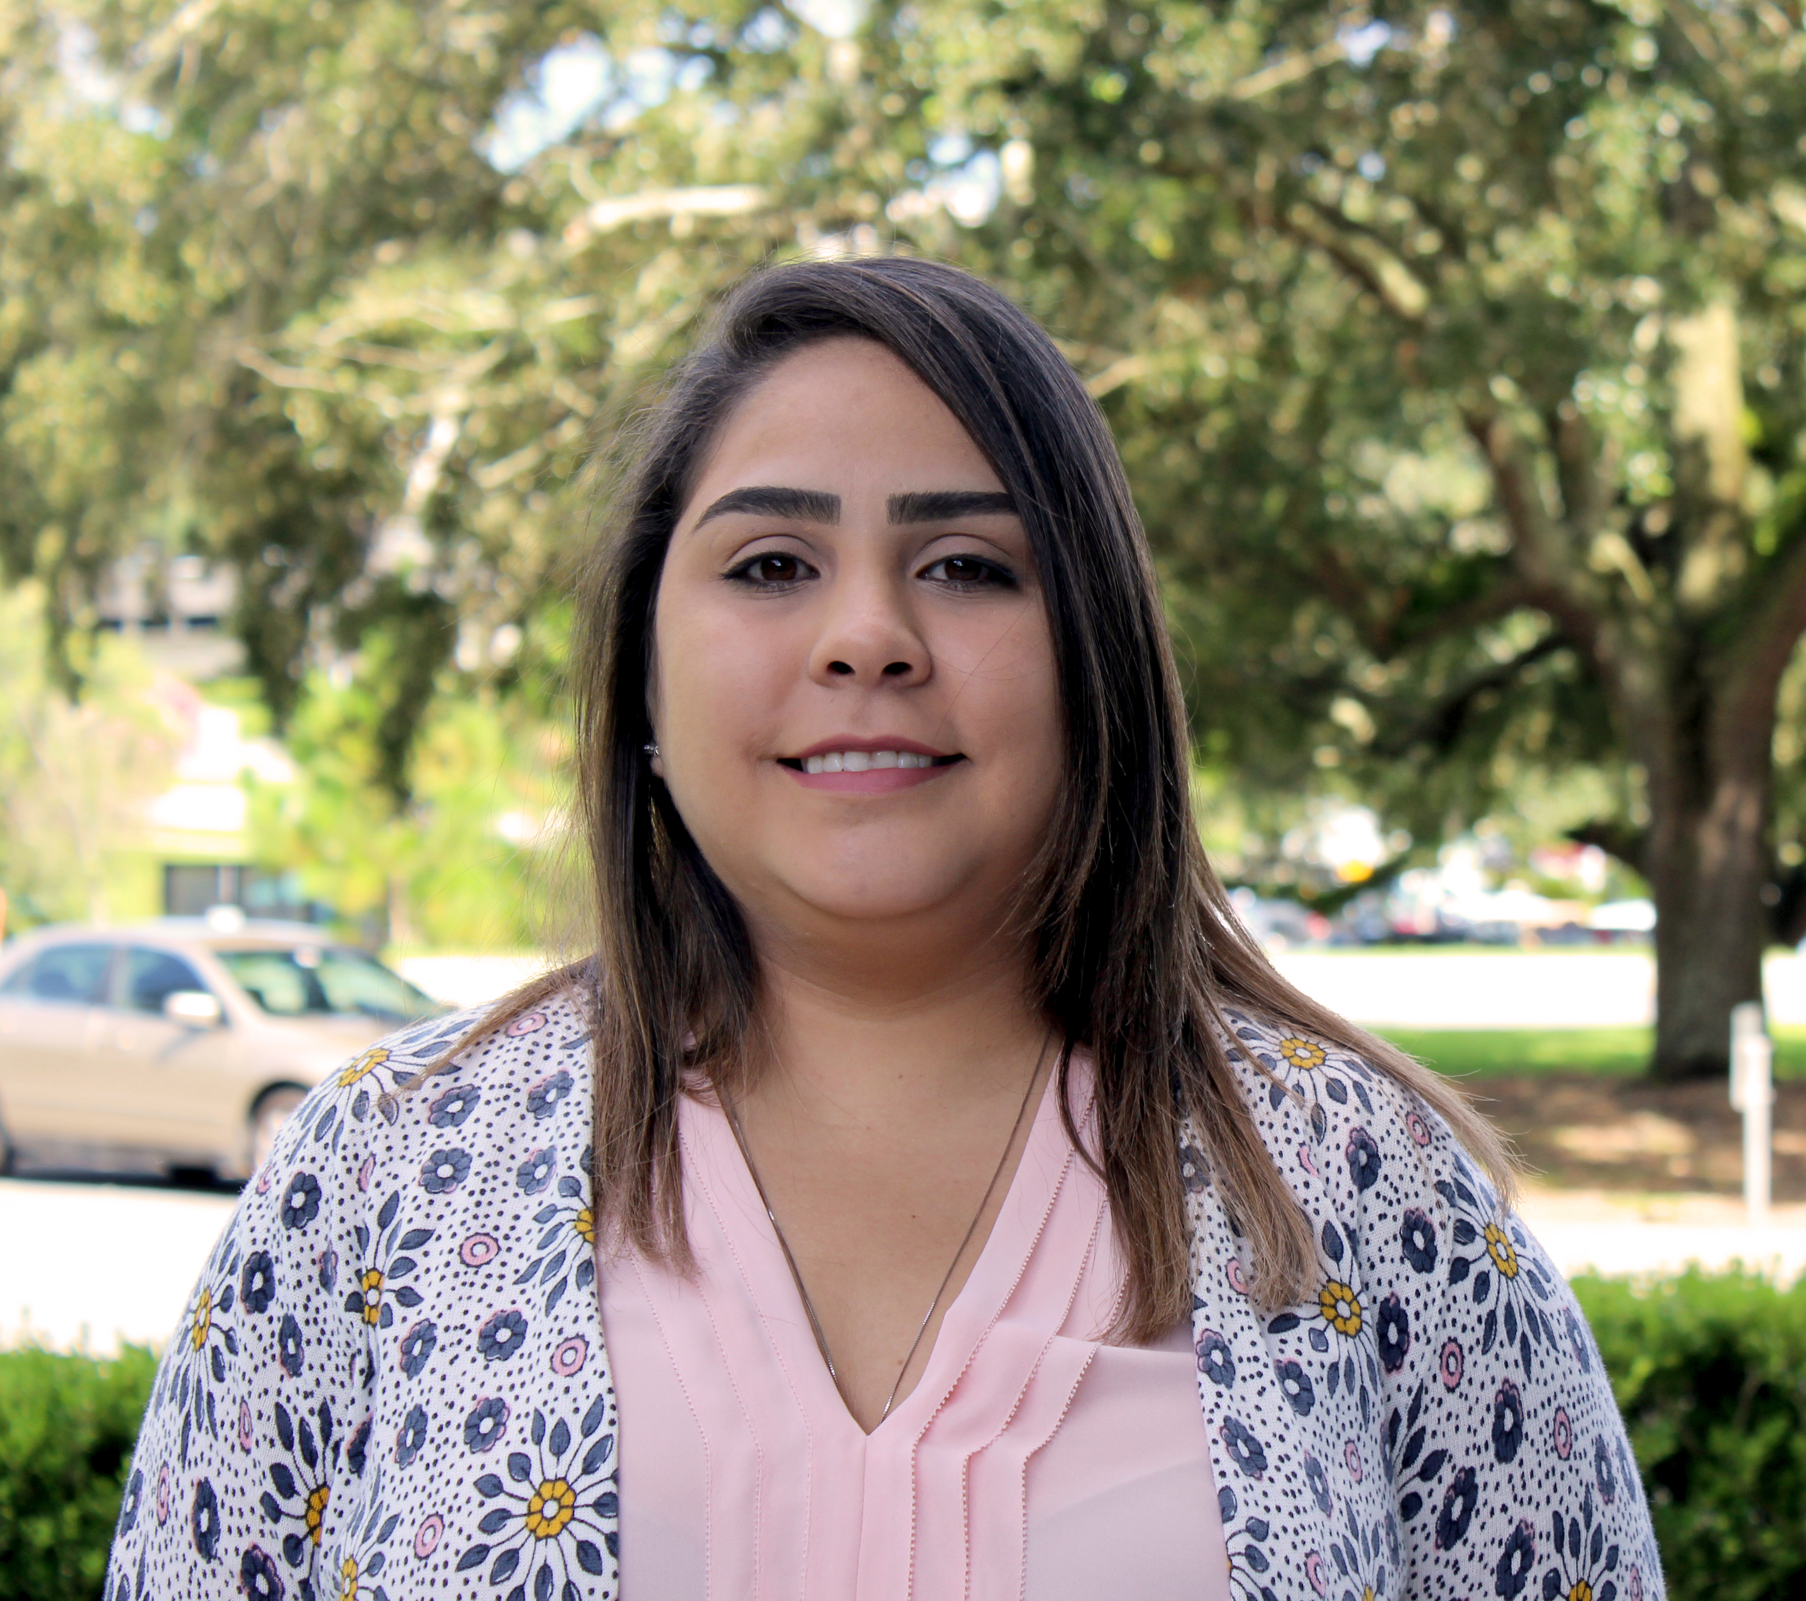
Webinar Staff
Gina Bonyani
Rusty Ennemoser
Jenna Bowman
Karla Matos

Slide 3
Agenda
How to Participate
Credits and Webinar Material
Public Involvement for Access Management
Questions
Contact Info

Slide 4
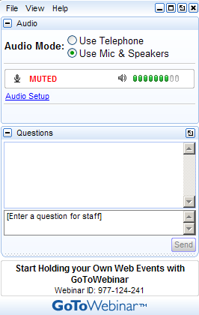
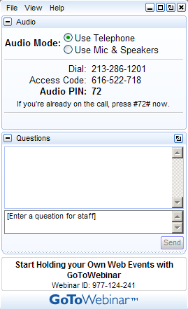
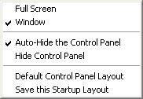
How to Participate Today
Open and close your Panel
View, Select, and Test your audio
Submit text questions
Raise your hand
Q&A addressed throughout the webinar

Slide 5

The FDOT Access Management Webinar Series 2019-2020 have been scheduled for the following dates:
Tue, Aug, 27, 2019 | 2:00PM - 3:30PM EDT
Tue, Nov 20, 2019 | 2:00PM - 3:30PM EST
Tue, Feb 11, 2020 | 2:00PM - 3:30PM EST
Tue, May 12, 2020 | 2:00PM - 3:30PM EDT
NEXT!

Slide 6


Credits Information
Credits will be distributed four to five business days after the webinar, through Learning Curve.
  PDH’s Credits, AICP Credits Information, and Course Certificates
Your participation will be recorded by GoToWebinar.
  You will need to attend to the entire webinar with the unique link provided by GoToWebinar.

Slide 7
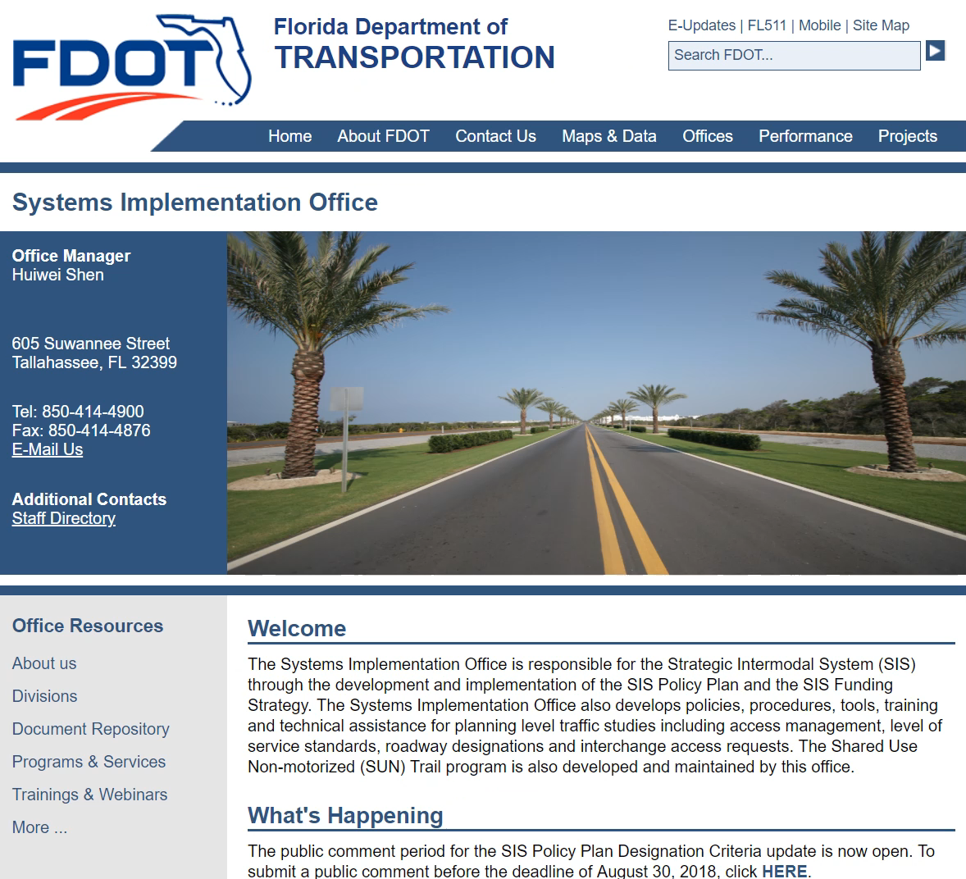
Webinar Material
Webinar materials will be sent via the Learning Curve System.
Recorded webinars and presentation material will be posted on the Systems Implementation Office website:
  Training & Webinars
    Access Management

Slide 8

Poll Questions

Slide 9
What organization do you Represent?
FDOT
Local Government
Private Firm
Other

Slide 10

Today’s Webinar
Public Involvement for Access Management
Wednesday, November 20, 2019
2:00PM – 3:30 PM, EDT
Credits: 1.5
Speaker:
Rusty Ennemoser, PhD
FDOT Statewide Public Involvement and Community Resources Coordinator

Slide 11
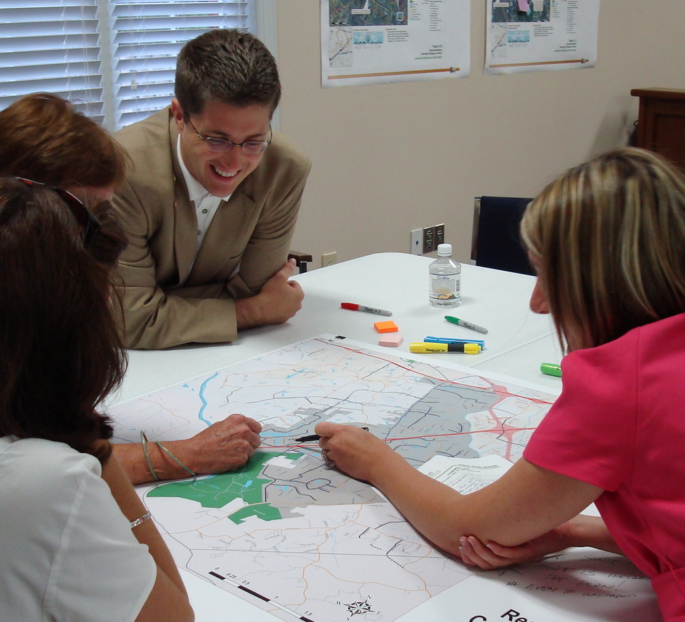
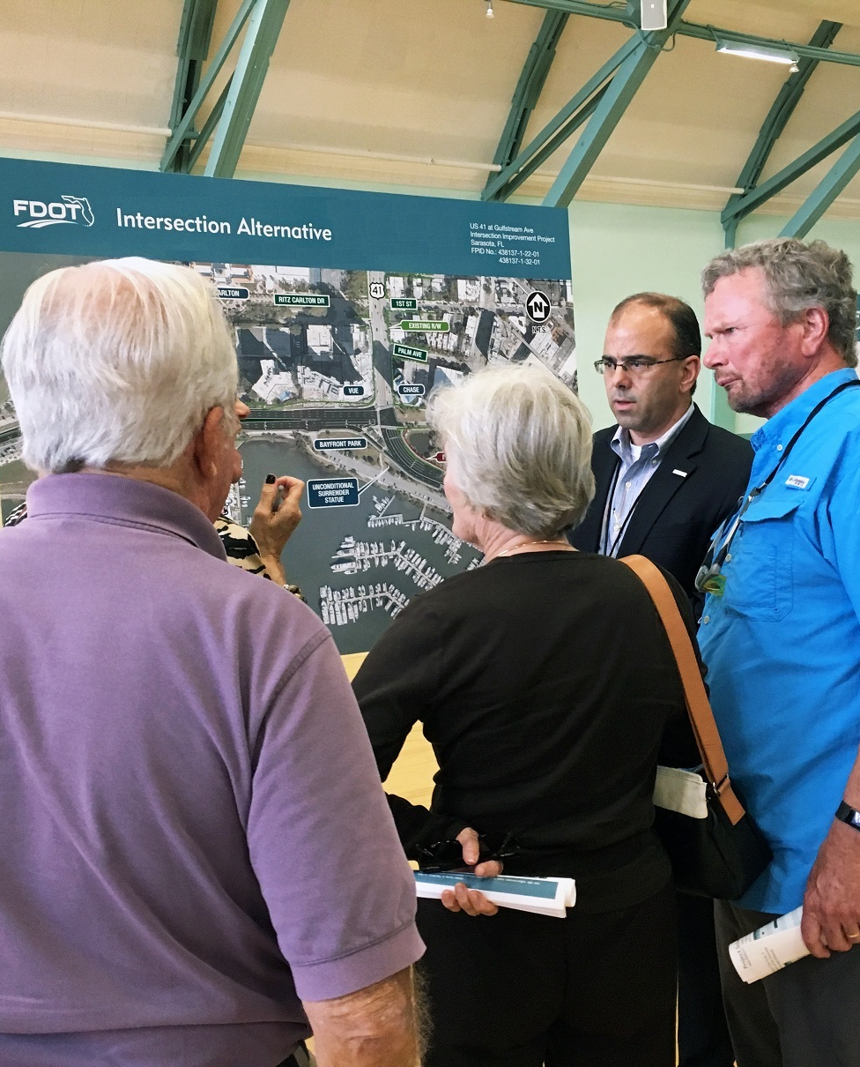
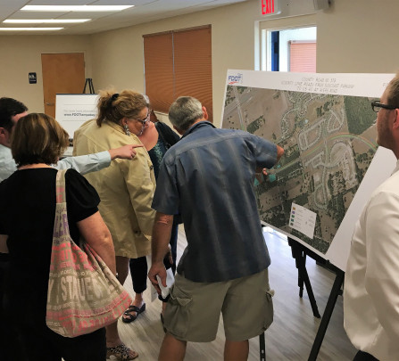

Public Involvement for
Access Management
November 20, 2019
Access Management Webinar Series

Slide 12
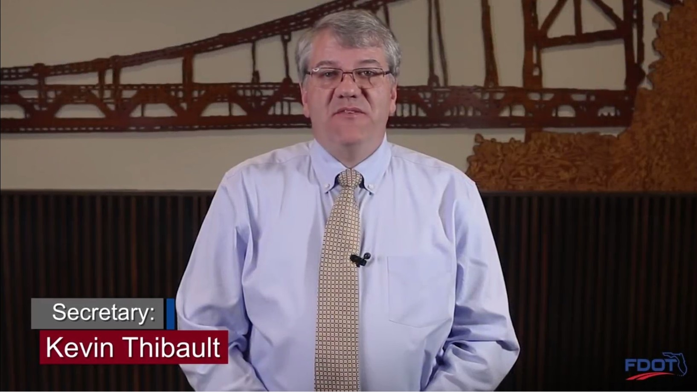
Secretary Thibault

Slide 13
FDOT Public Involvement Policy
“…It is the policy of the Florida Department of Transportation (Department) to use every possible opportunity to engage with and involve the public when planning, designing, constructing, and maintaining transportation facilities and services to meet the State’s transportation needs.”
#000-525-050-g

Slide 14
Why we do public involvement
The participation of the public is an integral part of the transportation process and results in
  Early and continuous opportunities for public input
  Consideration of public needs and preferences
  Informed decisions through collaborative efforts
  Mutual understanding and trust between the Department and its partners

Slide 15
Public Involvement by Phase
Planning
PD&E
Construction
Design
Public involvement in planning is about direction (where are we going in the future?)
Public involvement in PD&E is about alternatives and making a final recommendation.
Public involvement in Design is about specific features, design elements, and impacts.
Public involvement in Construction is about communicating lane closures, detours, and construction duration.

Slide 16
Florida Statute 335.199 (The Bennett Bill/SB 1842)
Whenever the Department of Transportation proposes any project on the State Highway System which will divide a state highway, erect median barriers modifying currently available vehicle turning movements, or have the effect of closing or modifying an existing access to an abutting property owner, the Department shall notify all affected property owners, municipalities, and counties at least 180 days before the design of the project is finalized. The Department’s notice shall provide a written explanation regarding the need for the project and indicate that all affected parties will be given an opportunity to provide comments to the department regarding potential impacts of the change.

Slide 17
Florida Statute 335.199
(2)(a) If the project is within the boundaries of a municipality, the notification shall be issued in writing to the chief elected official of the municipality. If the project is in the unincorporated area of a county, the notification shall be issued in writing to the chief elected official of the county.
(b) The Department must also consult with the applicable local government on its final design proposal if the department intends to divide a state highway, erect median barriers, or close or modify existing access to abutting commercial business properties. The local government may present the department with alternatives that relieve impacts to such business properties.

Slide 18
Florida Statute 335.199
(3) The Department shall hold at least one public hearing in the jurisdiction where the project is located and receive public input to determine how the project will affect access to businesses and the potential economic impact of the project on the local business community.
(4) The Department must review all comments from the public hearing and take the comments and any alternatives presented by a local government under subsection (2) into consideration in the final design of the highway project.
History.—ss. 1, 2, ch. 2010-281; SJR 10-A, 2010 Special Session A.

Slide 19
Step 1: Ask yourself:
1. Is the proposed modification on a state highway?
2. Will the modification modify currently available vehicle turning movements?
3. Was this modification shown to the public during PD&E?

Slide 20
If the answer to #1 and #2 is YES
You must notify all affected property owners and municipalities 180 days before the project is let that the Department intends to change the median opening.
You must hold at least one public hearing to receive input on how the project will affect access to adjacent properties and the potential economic impact.

Slide 21
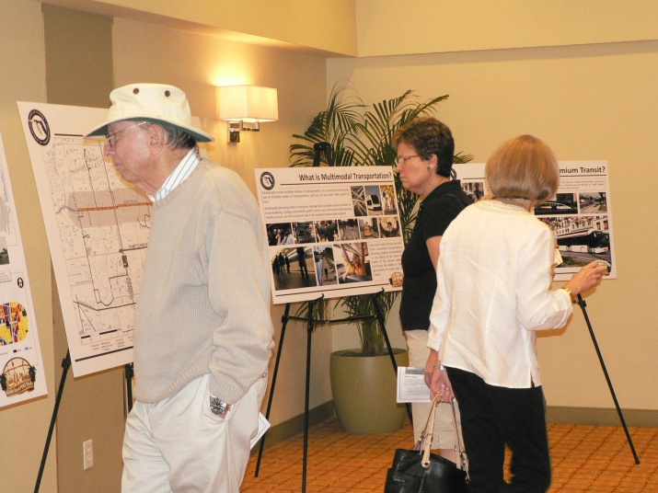
Was it presented to the public during PD&E?
If the answer to #3 is YES, you don’t have to have a public hearing.

Slide 22

What is a stakeholder?
A person or business that has an interest or investment
(a “stake”) in something and who is impacted by and cares about how it turns out.

Slide 23
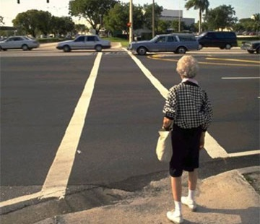
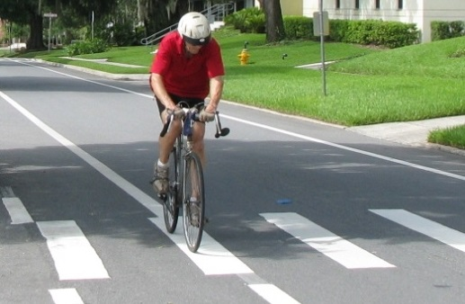
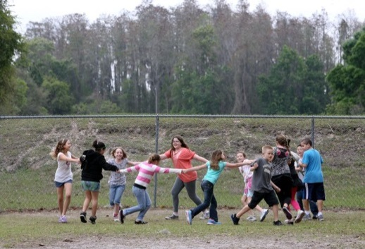
Who are the stakeholders?
Residents (property owners and renters)
Businesses (owners and employees)
Elected officials and agency representatives
Emergency services (police and fire)
Bus/Transit operators
Commuters/users

Slide 24


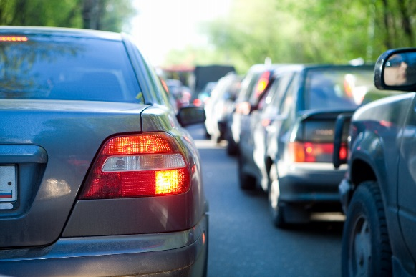
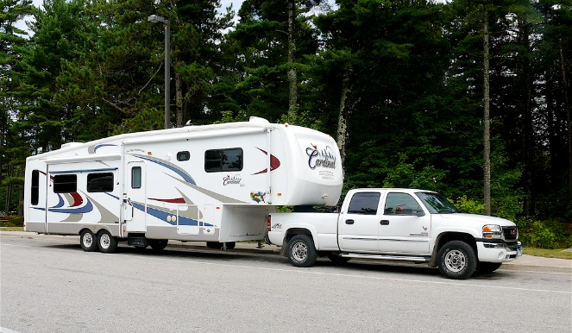
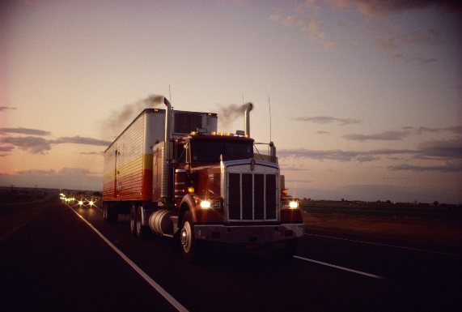
Also Think About the Users of a Facility
Local
Regional
Trucks
Bicyclists
Pedestrians

Slide 25
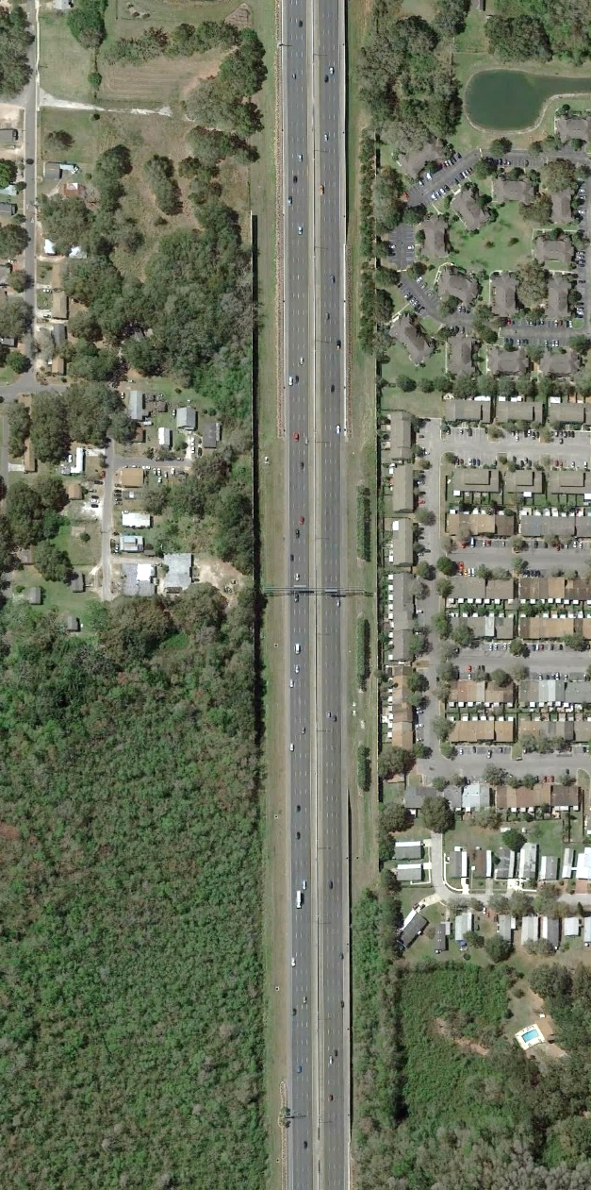
State Law Guidance on Notifying the Public
Area within 300’ of Centerline
Minimum 300 feet from centerline
And
Those determined to be substantially affected environmentally, economically, socially, or safety wise
25

Slide 26
A three-pronged approach to finding stakeholders
Windshield Survey – Field Visits
Socioeconomic and GIS data
  U.S. Census http://www.census.gov
  American Communities Survey
  County or municipal GIS layers
    Demographic data (beyond census)
    Parcel/Ownership data
    Property value data
    Community features (churches, schools, parks)
  Sociocultural Data Report
Talk to local government planners/engineers and community groups

Slide 27
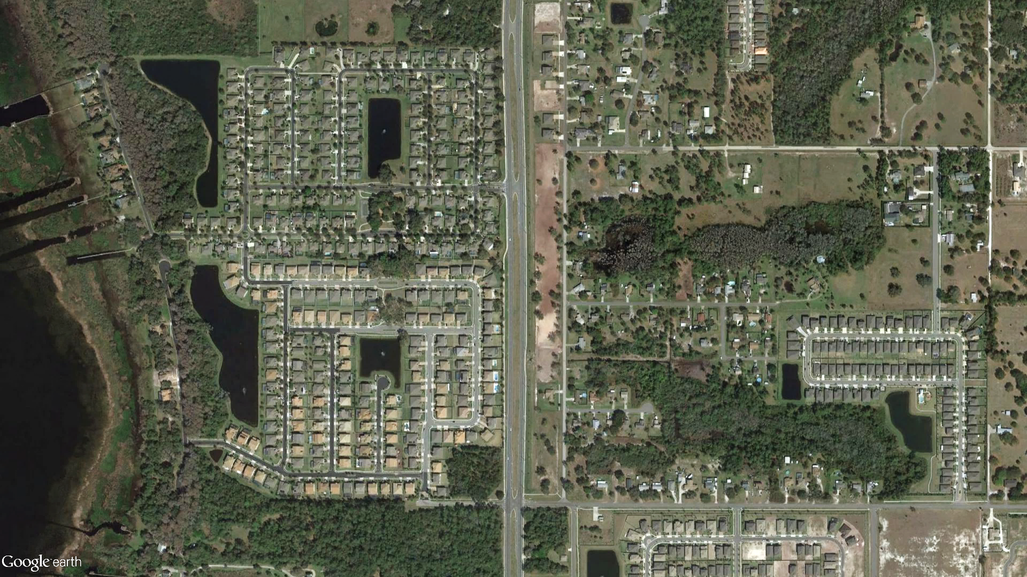

Consider Who is Affected
Properties within 300’ of centerline

Slide 28
Public Hearing for Median Modifications
Two approved formats
  Traditional public hearing within the project area
  A virtual public hearing in conjunction with a face-to-face hearing

Slide 29
What is a Virtual Public Hearing (VPH)?
A VPH is a free, live presentation, or webinar, over the internet that is also held concurrently at one or more viewing locations. District 7 conducts them as follows:
1) District Headquarters – “Host” location
  Must be either the Auditorium, or Executive or Pelican Conference rooms
2) Community Viewing Location
  (libraries, recreation centers, etc.)
3) Online from any computer.
  Only these users need to register by visiting the website indicated on the notification letter. It will look like this: https://www2.gotomeeting.com/register/878761226

Slide 30
Elements of the Streamlined VPH Process
Notification requirements:
  Minimum 500-foot radius at each proposed median change
  All federal, state, and local government elected officials in which the project resides
  All local government agencies (Engineering, Parks & Recreation, Emergency Response, etc.)
  All property owners and tenants
PowerPoint focused on medians only
Fact sheet and comment sheet are the only handouts created

Slide 31
Benefits of the VPH Process
More inclusive
  Allows participation via on-line component the traditional public hearing process does not
  Provides access to those without computers at the community viewing location and the district headquarters
  PowerPoint presentation can be emailed to anyone not able to attend if requested
Cost effective
  Technology reduces the need for display boards and a court reporter
  PowerPoint presentation slides = Display Boards
  Comment capture during webinar = Court reporter

Slide 32
Virtual Public Meeting Regulation
State Rule Chapter 28-109, FAC Conducting Proceedings by Communications Media Technology (CMT)
  Must make it possible for any member of the public to attend
  Cannot be conducted if the technology won’t permit all interested persons to attend
  If there is a technical problem, meeting must be stopped until problems are corrected
  Notification has to be the same as a non-CMT meeting and comply with statutes

Slide 33
FDOT Virtual Meetings Process
Virtual public meetings are supplemental to face-to-face meetings
Currently allowed for limited purposes
Must be conducted from a location where people can easily attend, preferably in the project area
The physical location(s) must follow all Title VI, ADA requirements and be staffed by FDOT personnel
Presentation must be available on request
Comment period is 10 days
Must comply with all department and statutory notification requirements

Slide 34
FDOT Meeting Notification Process
Letter of invitation to local government agencies at least 25 days before the public hearing date.
All affected property owners, tenants, and businesses must be notified of the hearing at least 21 days before the hearing.
Advertisement in the Florida Administrative Register and on the Department’s website at least 7 days in advance.
Press releases are coordinated through the District Communications Office.

Slide 35
When is a Virtual Public Hearing appropriate?
Is there general acceptance among stakeholders for the proposed change?
Is there general acceptance among local and/or county staff about the proposed change?
Are the people affected able to or willing to participate through the internet?

Slide 36
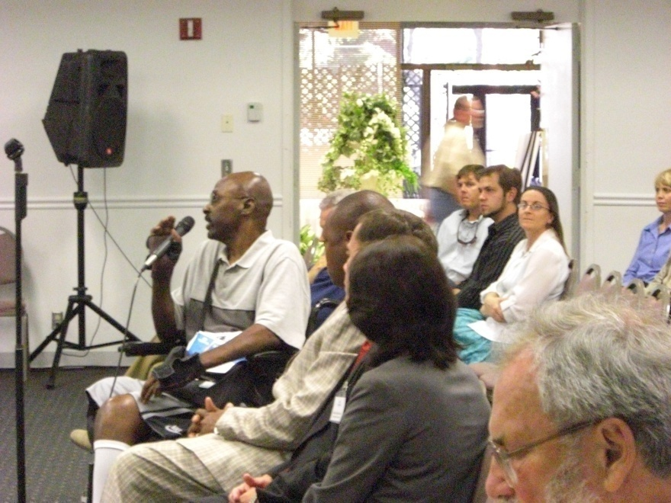
Considerations
Time of day
Day of the week
Computer accessibility
Physical location availability in
the project area
  Must be ADA-compliant

Slide 37
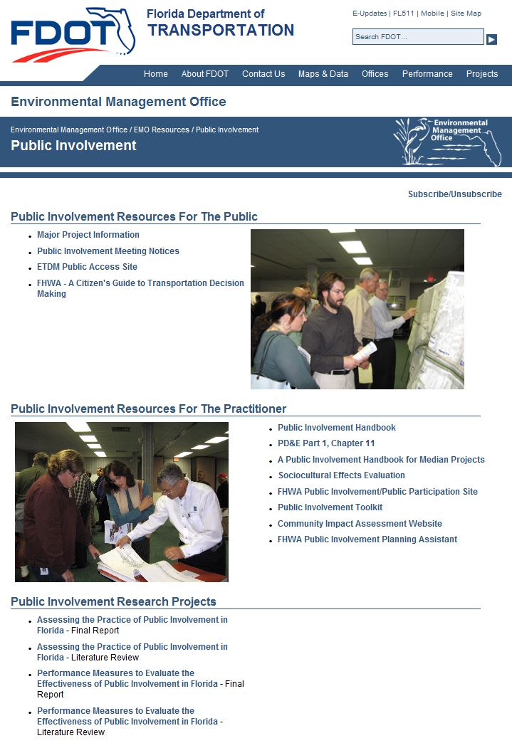
Public Involvement Resources
FDOT’s Public Involvement page:
Public Involvement Handbook
PD&E Public Involvement, Chapter 11
Florida Design Manual, Chapter 104

Slide 38
What is the Florida Statute number that mandates a public hearing for median changes?
120.525
335.199
414.537
I have no clue

Slide 39
How many public hearings is FDOT required to hold for a median modification?
2
1
0
4

Slide 40
When a local government wants to do a median change on a state highway, who is responsible?
The local Government
The Department
No one
A committee

Slide 41

Questions
Rusty Ennemoser
Statewide Public Involvement and Community Resources Coordinator- FDOT
Rusty.Ennemoser@dot.state.fl.us
(850)-414-5337
Thank you!

Slide 42
Course Details
Survey through GoToWebinar
FBPE Provider Number: 0003533
FBPE Course Number: 0003151
APA Course Web Page https://www.planning.org/events/eventsingle/9189607/
APA Course Number: 9189607
AICP/PDH Credits Provided: 1.50

Slide 43
Contact Info
Gina.Bonyani@dot.state.fl.us
Jenna.Bowman@dot.state.fl.us
Karla.Matos@dot.state.fl.us

