Slide 2


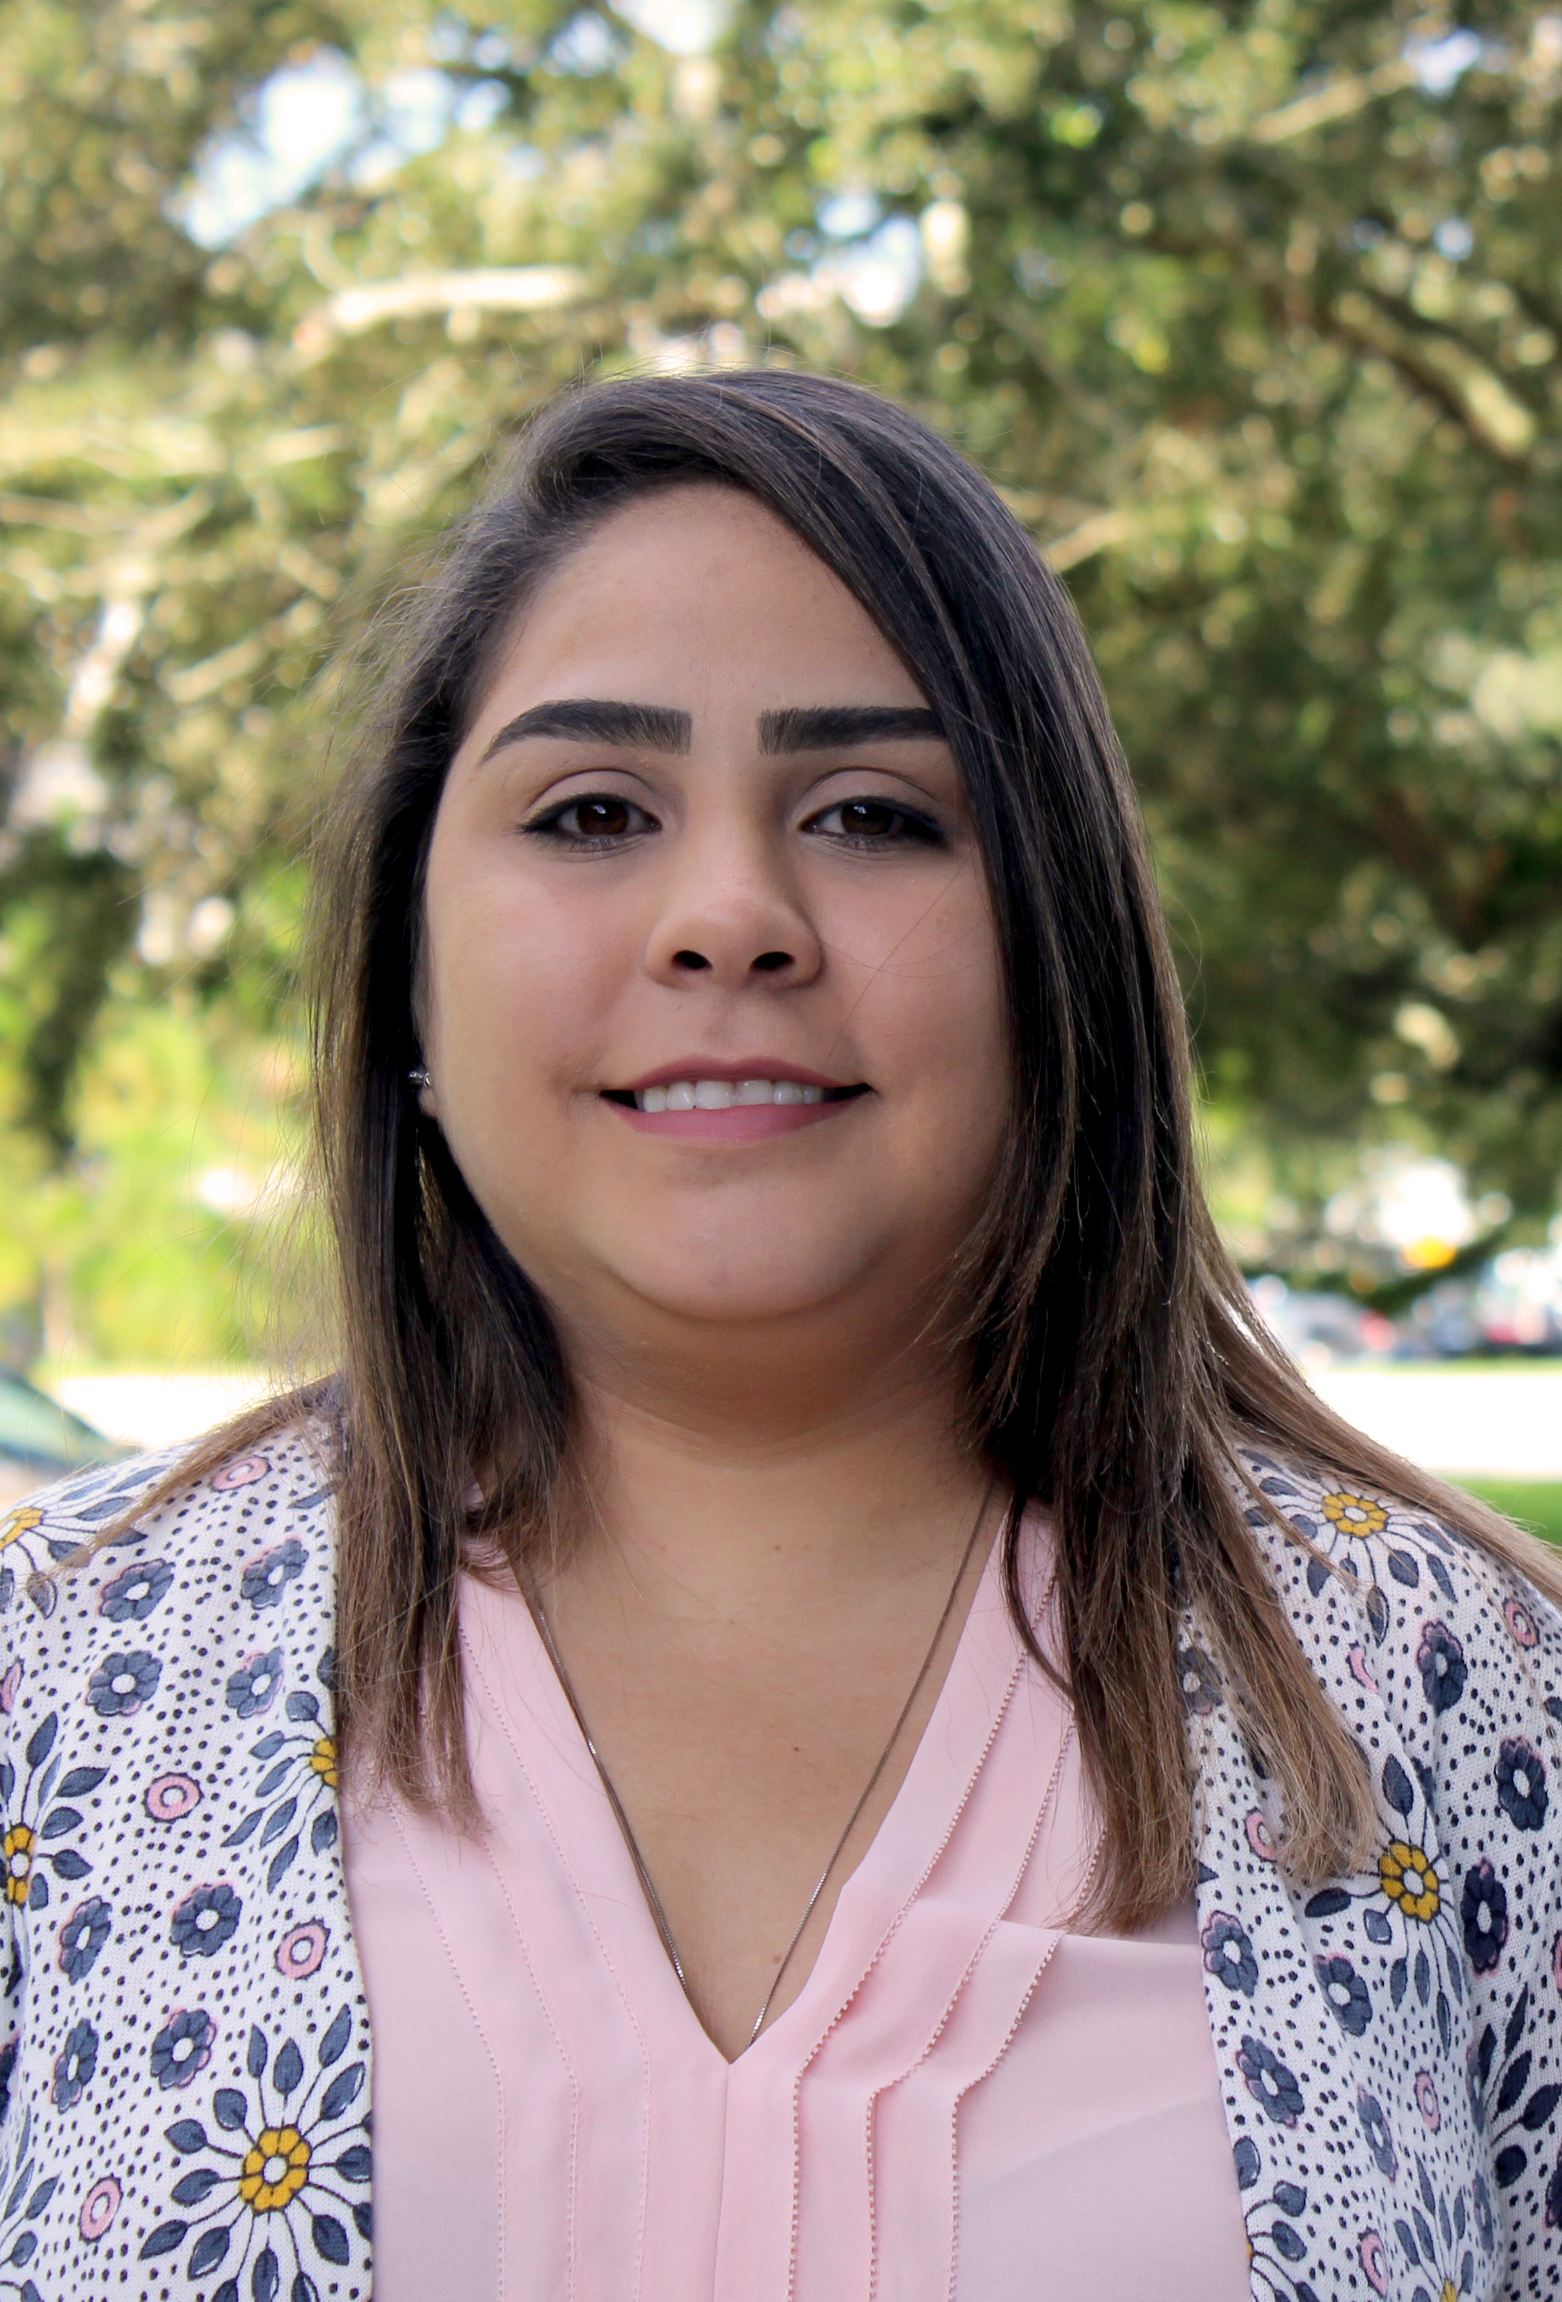
Webinar Staff
Gina Bonyani
Maria Overton
Karla Matos

Slide 3
Agenda
How to Participate
Credits and Webinar Material
Introduction to Access Management
Questions
Contact Info

Slide 4
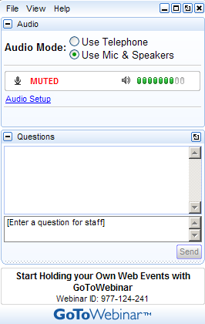
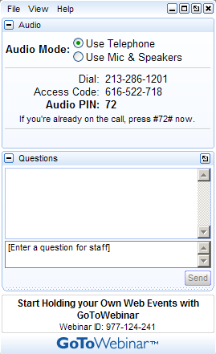
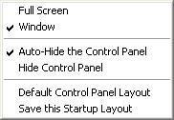
How to Participate Today
Open and close your Panel
View, Select, and Test your audio
Submit text questions
Raise your hand
Q&A addressed throughout the webinar

Slide 5

The FDOT Access Management Webinar Series 2019-2020 have been scheduled for the following dates:
Tue, Aug, 27, 2019 | 2:00PM - 3:30PM EDT
Tue, Nov 12, 2019 | 2:00PM - 3:30PM EST
Tue, Feb 11, 2020 | 2:00PM - 3:30PM EST
Tue, May 12, 2020 | 2:00PM - 3:30PM EDT
NEXT!

Slide 6

Learning Curve
FDOT’s Systems Implementation Office is utilizing the Learning Curve system for participant communications and management of the Statewide Access Management Quarterly Webinar.

Slide 7


Credits Information
Credits will be distributed four to five business days after the webinar, through Learning Curve.
  PDH’s Credits, AICP Credits Information, and Course Certificates
Your participation will be recorded by GoToWebinar.
  You will need to attend to the entire webinar with the unique link provided by GoToWebinar.

Slide 8
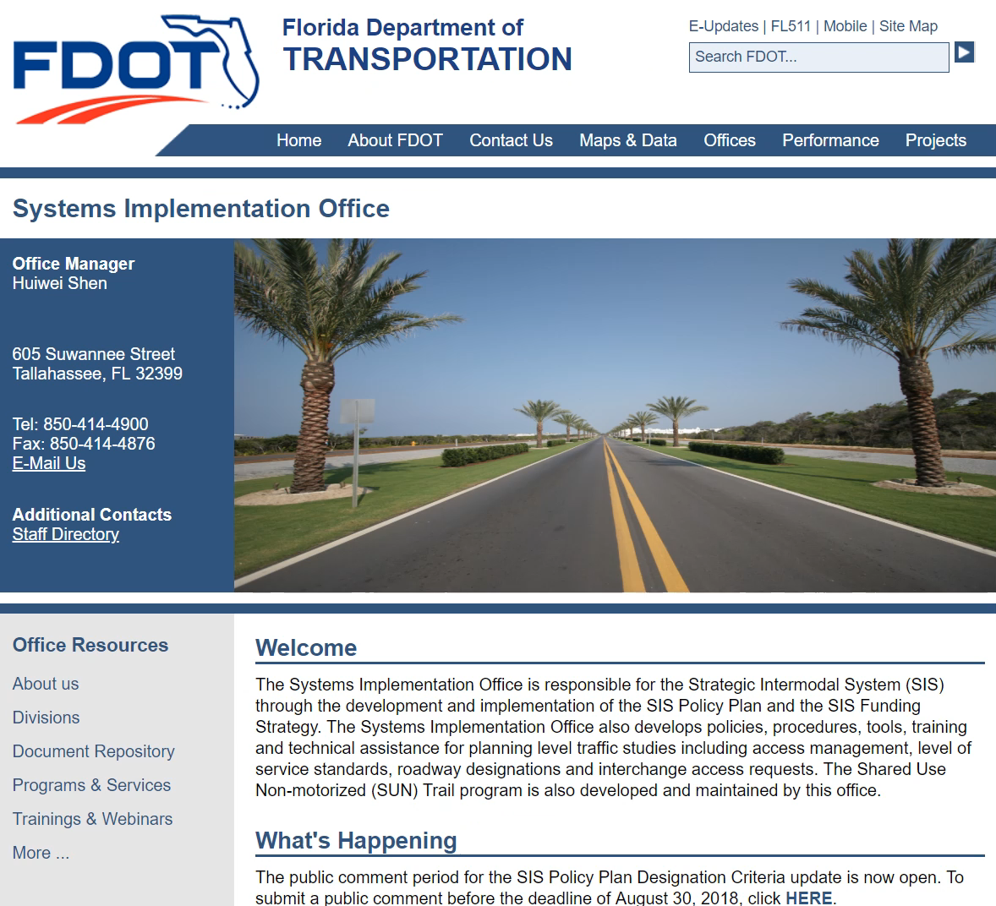
Webinar Material
Webinar materials will be sent via the Learning Curve System.
Recorded webinars and presentation material will be posted on the Systems Implementation Office website:
  Training & Webinars
    Access Management

Slide 9

Poll Questions

Slide 10
What organization do you Represent?
FDOT
Local Government
Private Firm
Other

Slide 11
How familiar are you with Access Management?
Very Familiar
Somewhat Familiar
Not Familiar

Slide 12

Today’s Webinar
Introduction to Access Management
Tuesday, August 27, 2019
2:00PM – 3:30 PM, EDT
Credits: 1.5
Speaker:
Gina Bonyani, Transportation Planner | FDOT

Slide 13
What is Access Management
Access management involves the location, spacing, and design of driveways, medians, median openings, traffic signals, and interchanges.
The roadway network must be viewed as a system of all the features mentioned above, not as one isolated element.

Slide 14
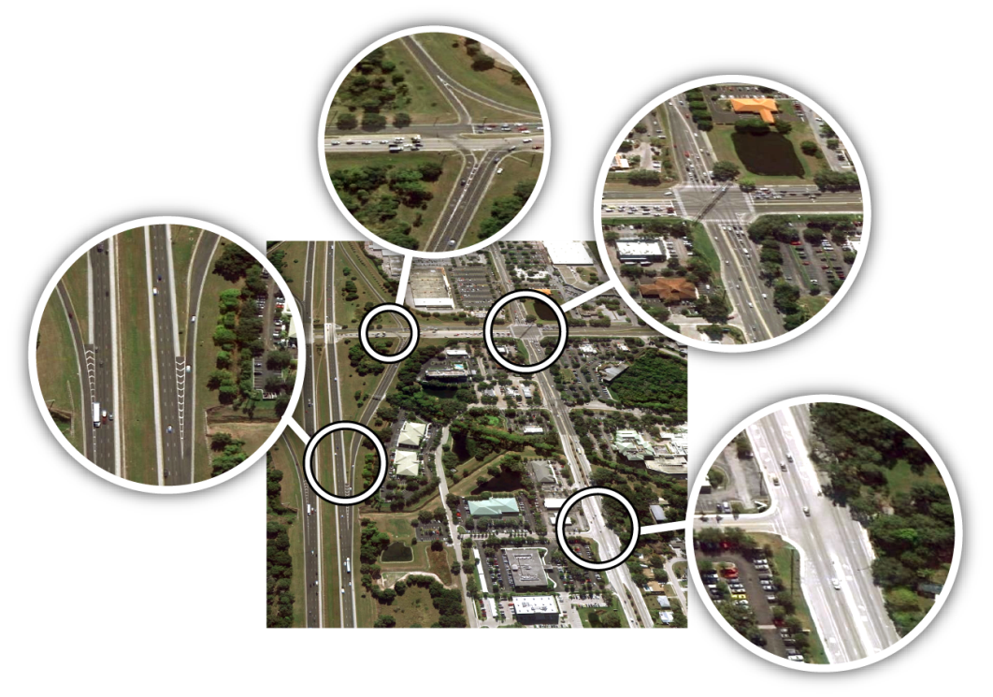
Components
Driveways
Medians
Median openings
  Full access
  Directional
Signals
Interchanges
Median Openings
Traffic
Signals
Driveways
Interchange Ramps

Slide 15
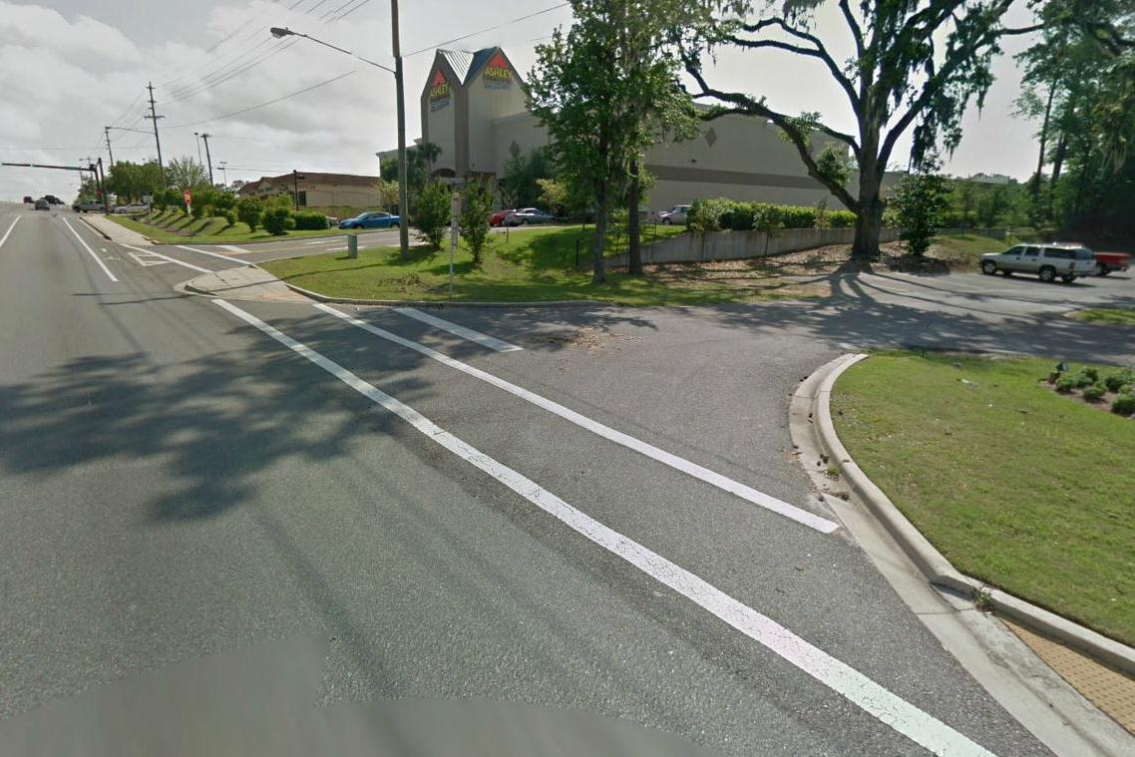

Slide 16
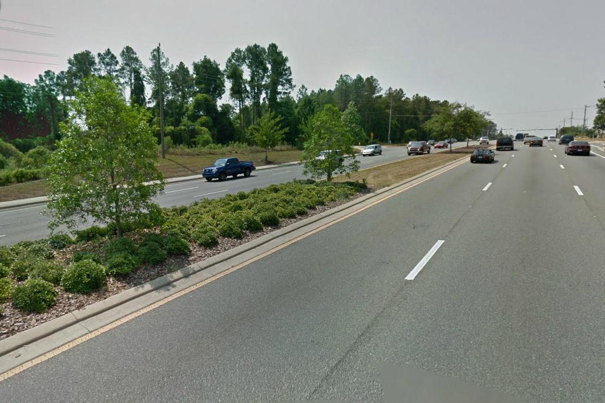

Slide 17
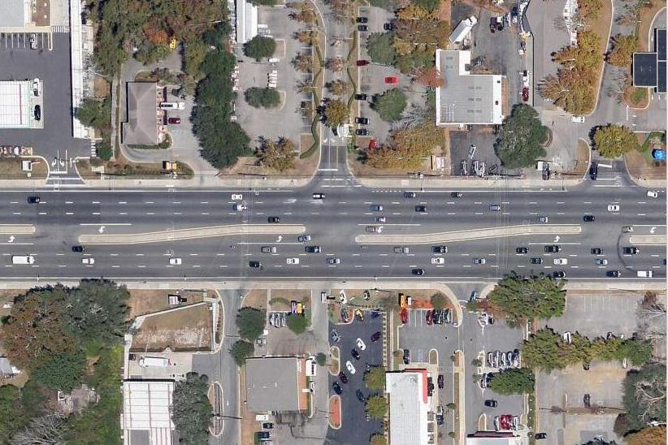

Slide 18
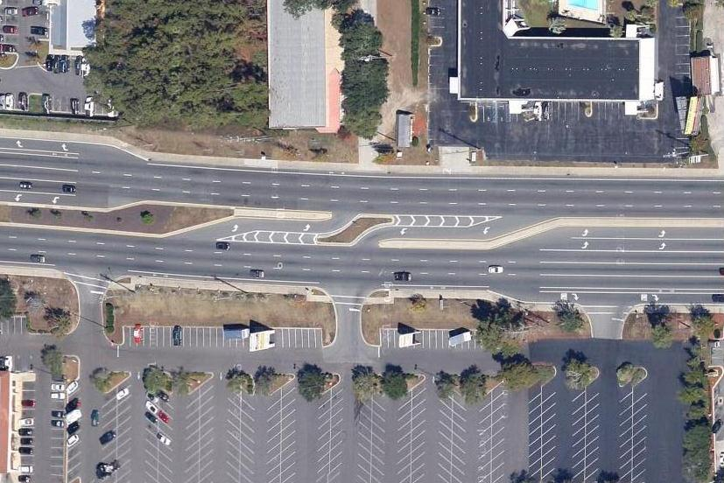
1
2
3

Slide 19
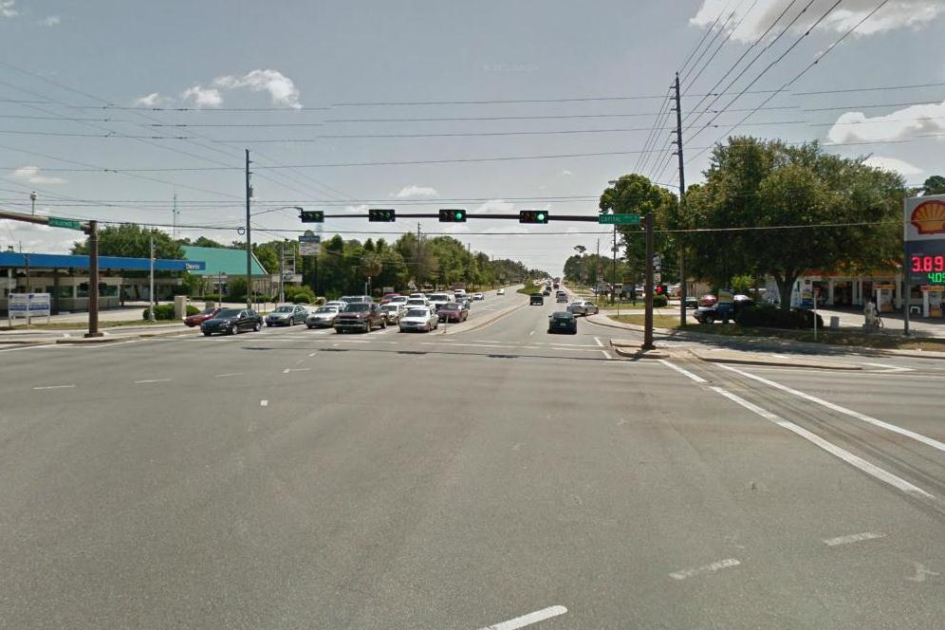

Slide 20
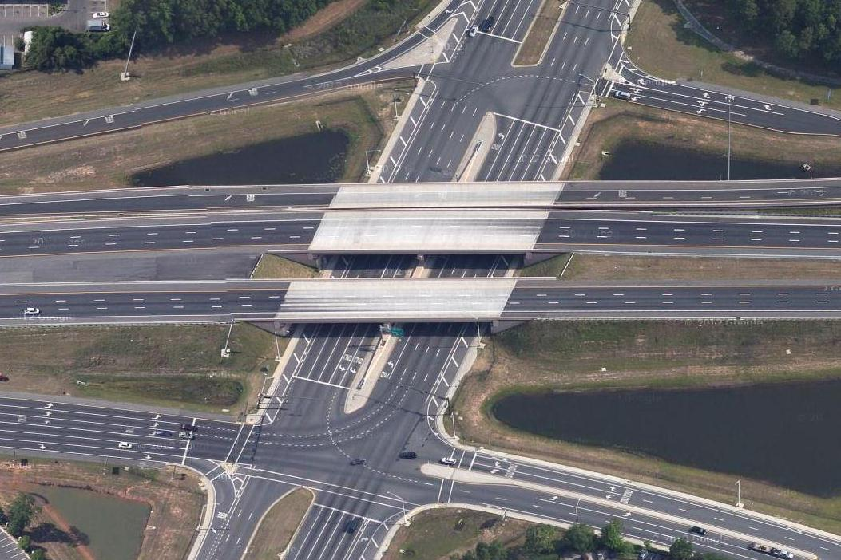

Slide 21
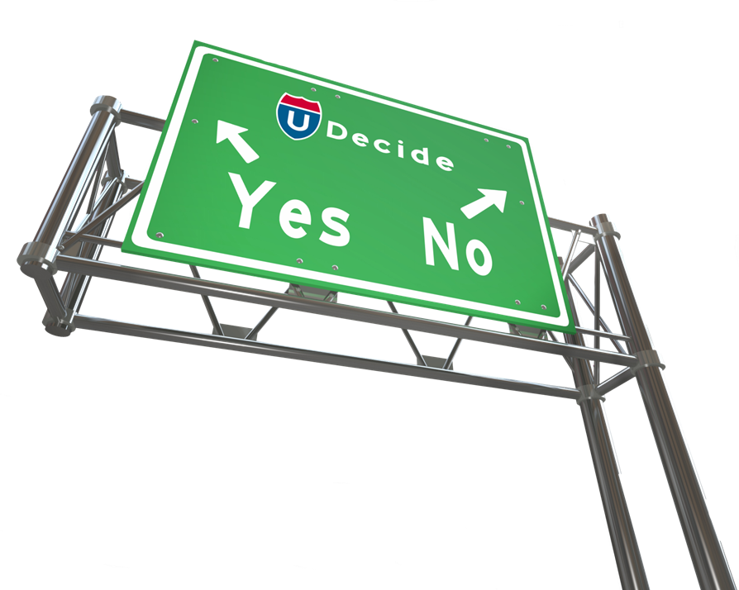
Why is Access Management
Important?
Access management provides safe and efficient
transportation facilities for all roadway users

Slide 22

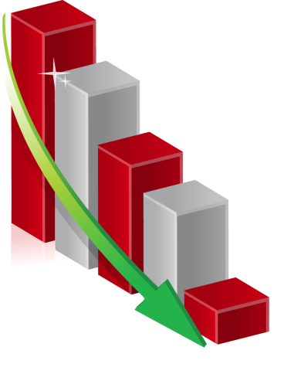
Benefits
As driveways increase,
crashes increase
Access management helps to:
  Reduce conflicts
  Enhance safety
  Lessen severity of crashes
  Improve mobility
  Increase connectivity
  Develop aesthetics
As driveways increase,
capacity decreases

Slide 23

Goals
Passenger cars
Pedestrians
Cyclists
Transit
Trucks

Slide 24
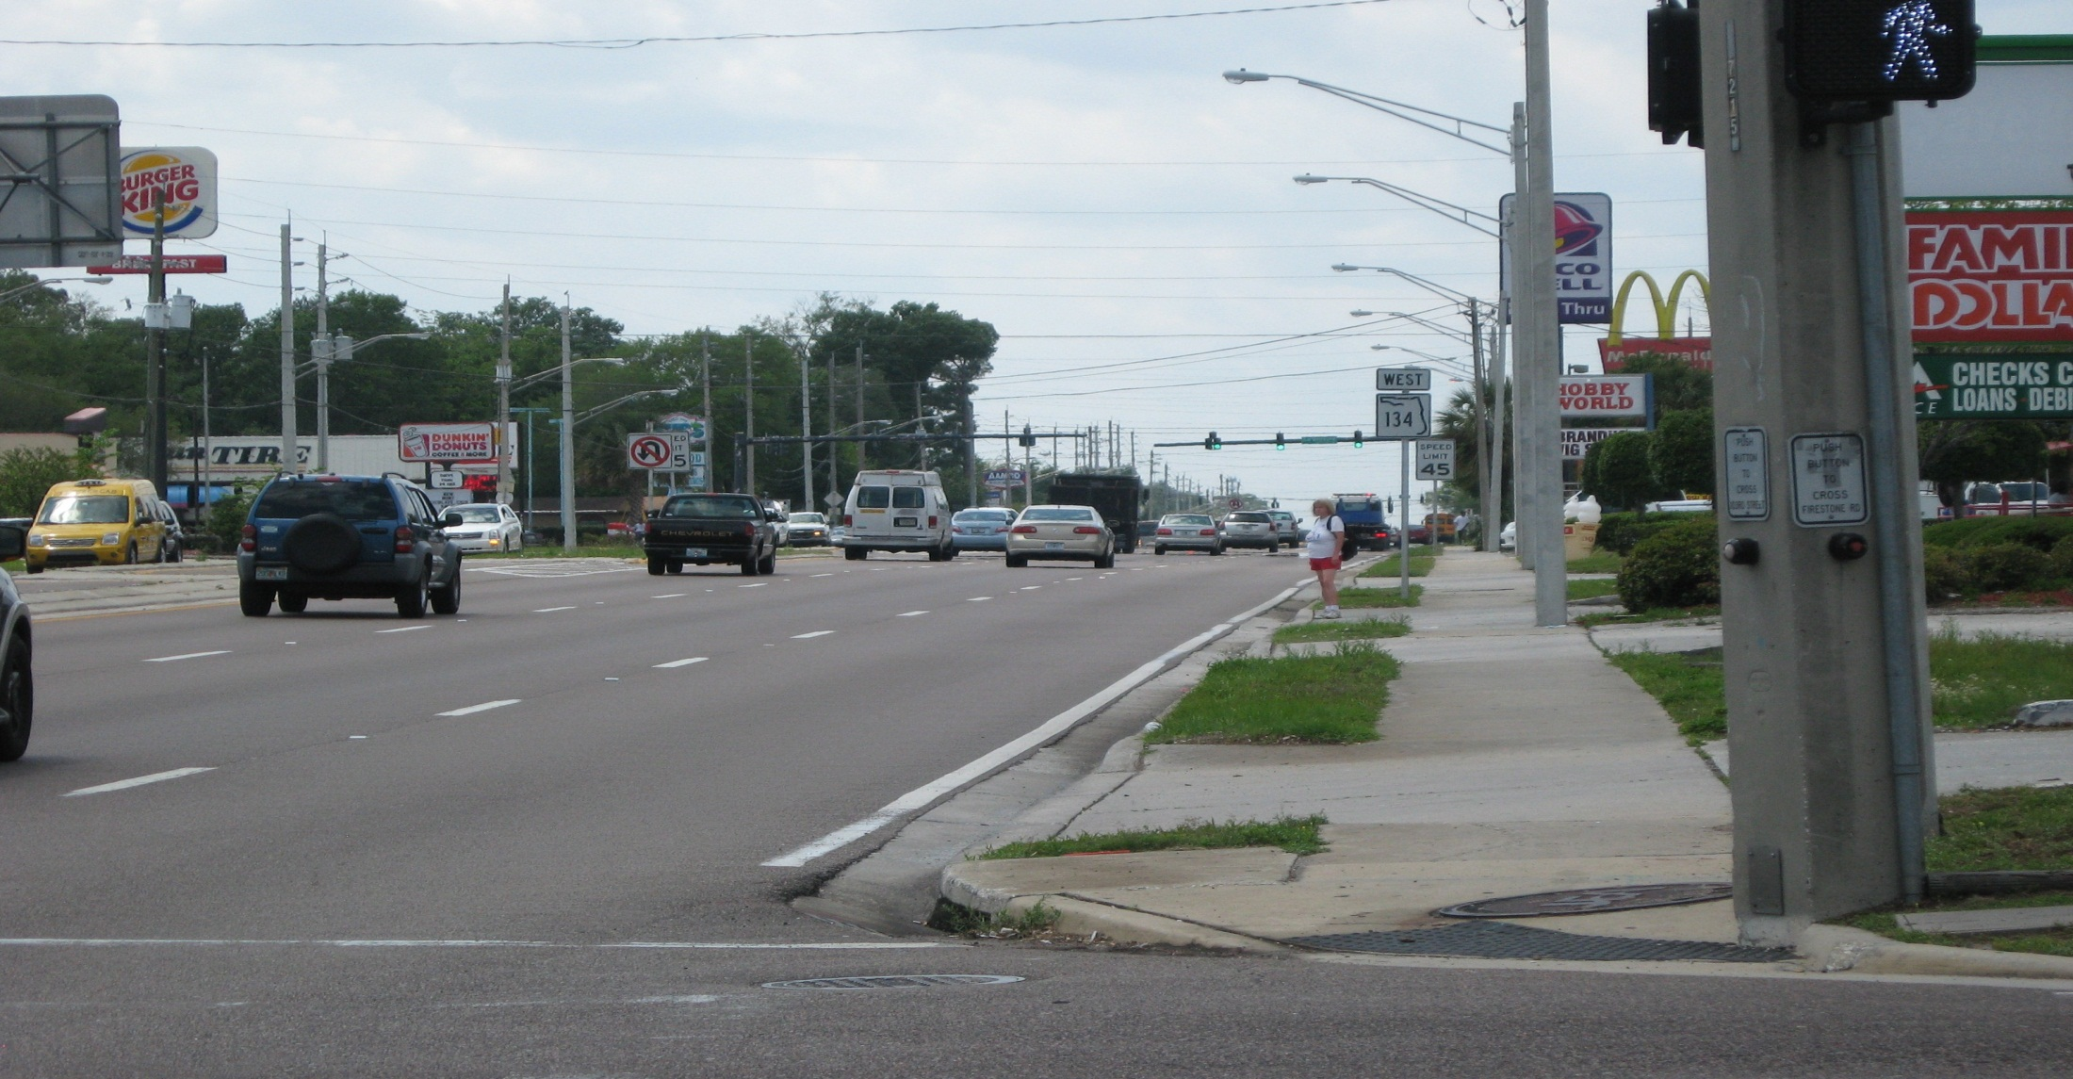

Slide 25
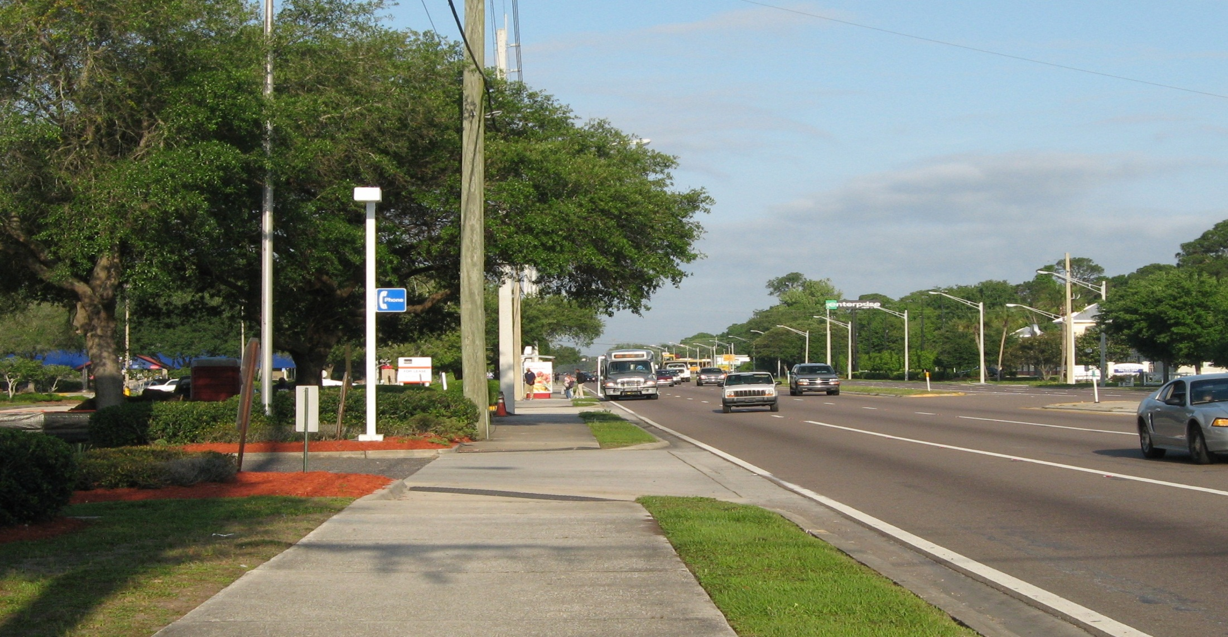

Slide 26
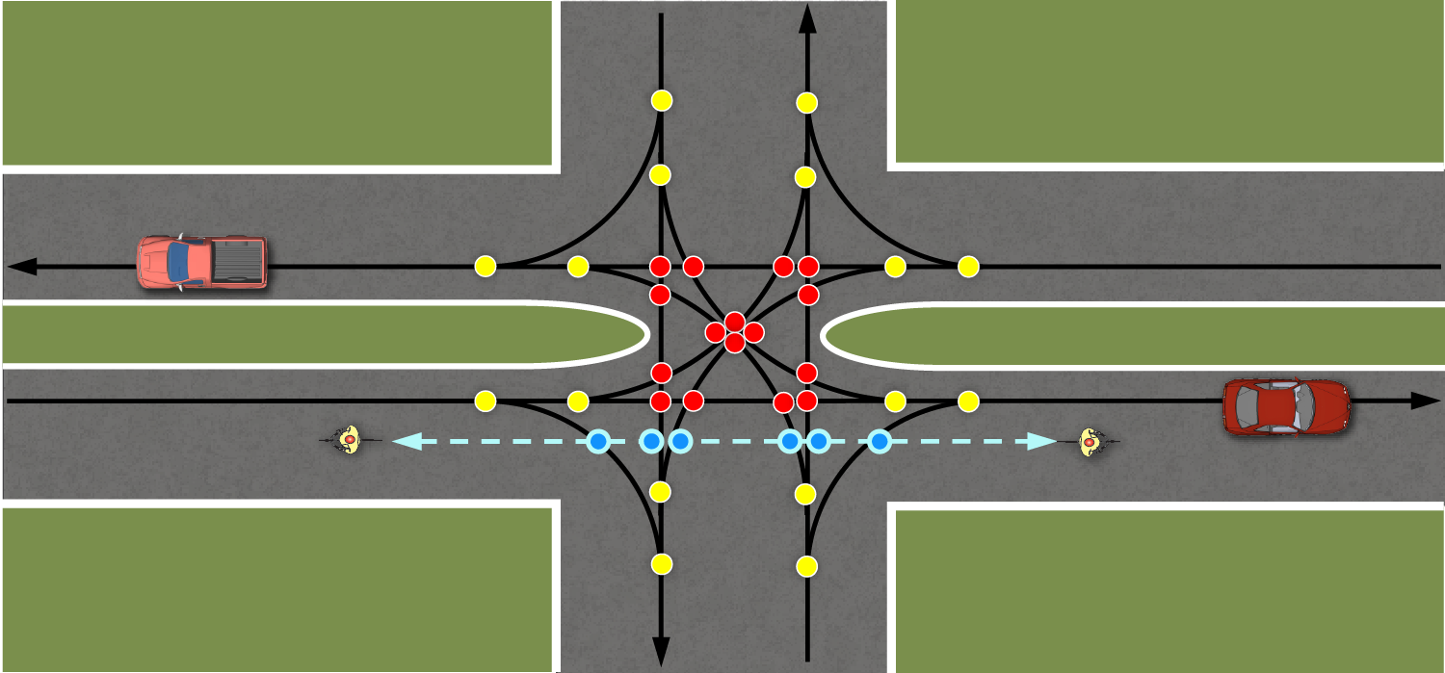
Conflict Points
HIGH CONFLICT
Full unsignalized median opening

Slide 27
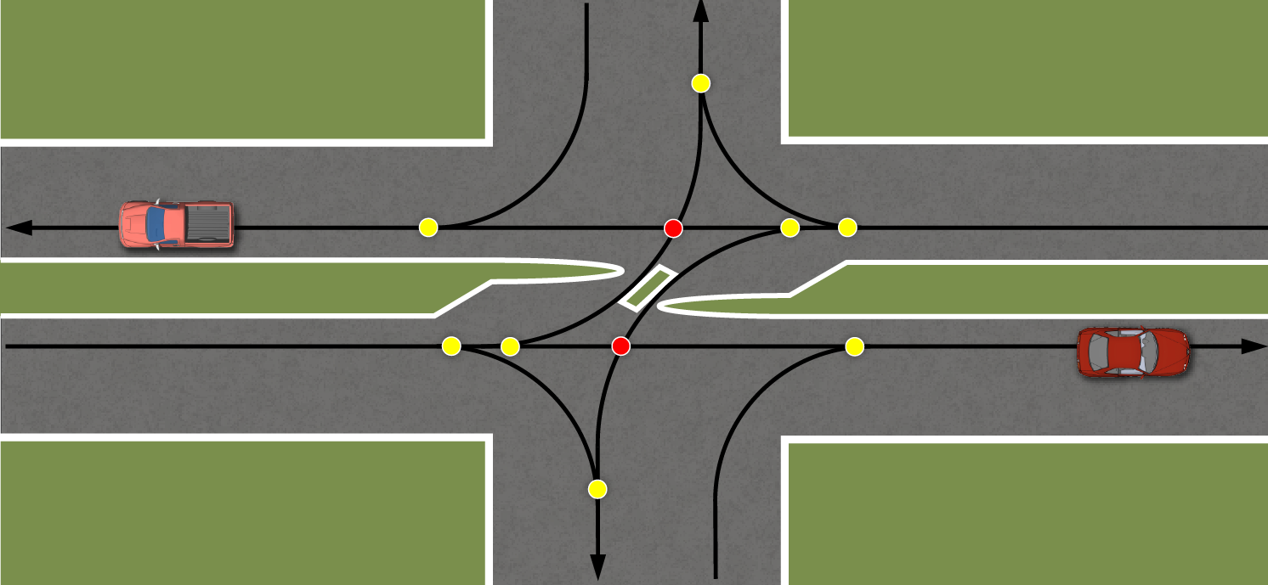
Less Conflict Points
Directional median opening

Slide 28
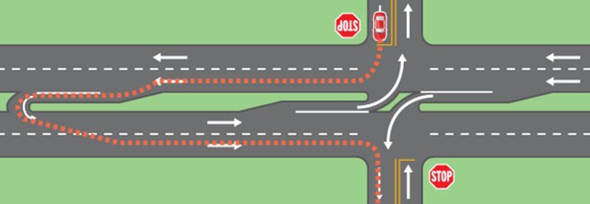
RCUT(Restricted Crossing U-Turn)

Slide 29
Guiding Principles
Limit the number of conflict points
  Reduce the number of median openings
  Provide directional median openings
  Consolidate driveways to reduce frequency
Look at conflict points from a network perspective

Slide 30
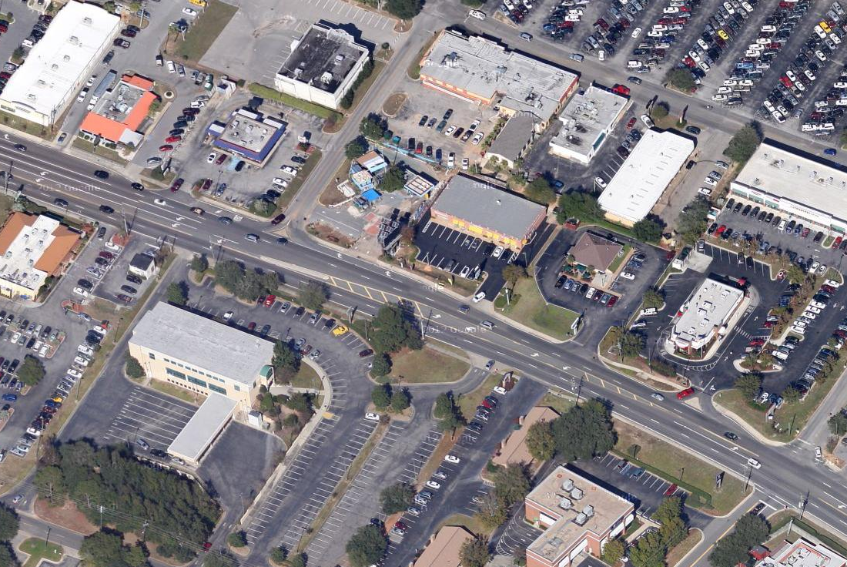
Raised median installation
Full median
opening

Slide 31
Guiding Principles
Separate the conflict points for all modes of transportation
  Driveway spacing
  Median opening spacing
  Traffic signal spacing
  Distance of driveway/median opening/signal from interchange ramps

Slide 32
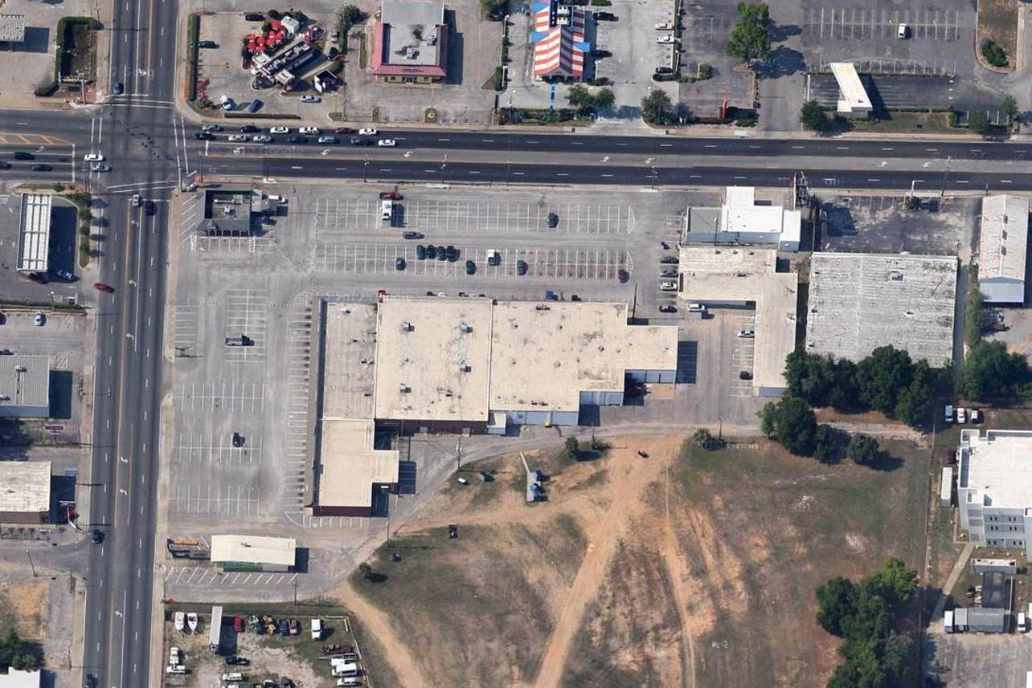
DRIVEWAYS

Slide 33
CONSOLIDATED DRIVEWAYS
Separating Conflict Points

Slide 34
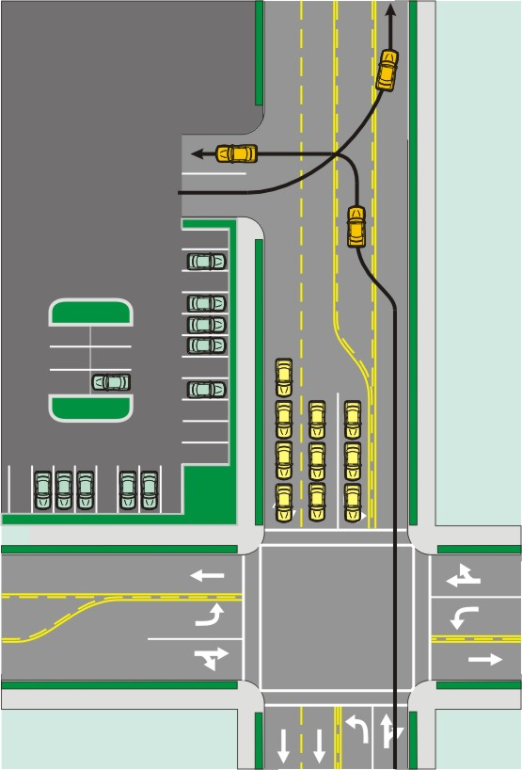
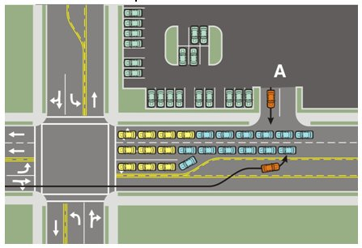
Site Circulation
Vehicular Queuing
  Existing Traffic Conditions
  Future Traffic Conditions

Slide 35
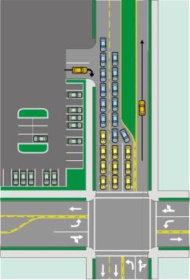
Site Circulation
Vehicular Queuing
  Existing Traffic Conditions
  Future Traffic Conditions
Median Modification
  Eliminates main street left turn access
  Side street right in/right out

Slide 36
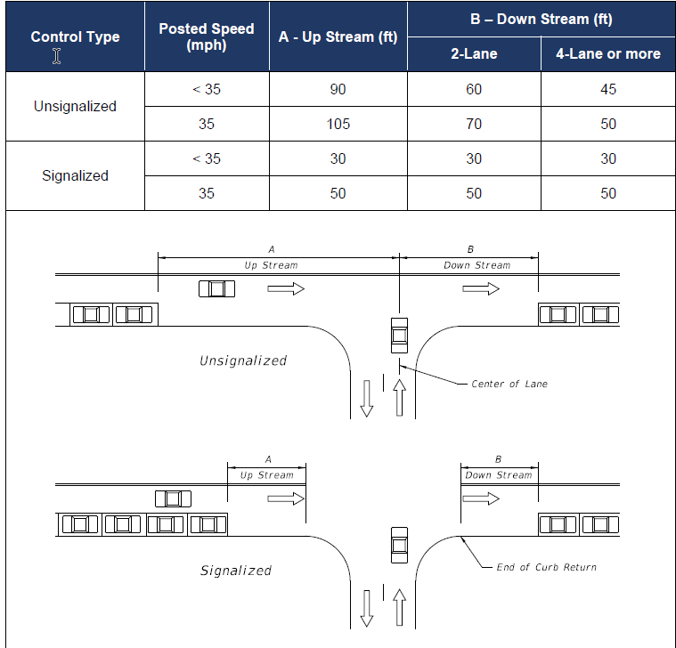
Parking Restrictions

Slide 37

Highway Safety Manual
Methodologies for predicting average crash frequency given certain roadway characteristics
Factors to be applied to reduce crashes

Slide 38
Highway Safety Manual
Example: suburban 4-lane arterial at 45 mph
Undivided (no median)
5.8 crashes/year/mile
Undivided with driveways
11.5 crashes/year/mile
Divided with 10’ median
3.9 crashes/year/mile
Divided with driveways
4.9 crashes/year/mile

Slide 39
Highway Safety Manual
Crash Modification Factors
  CMF is the percentage of crashes remaining after an improvement, i.e. 0.90 means 10% reduction in crashes
  Examples of factors for access management improvements:
Add Median
CMF=0.75
25% fewer crashes
Widen Median 10ft.
CMF=0.85
15% fewer crashes
Reduce Access Points
CMF=0.70
30% fewer crashes
Install Signal
CMF=0.75
25% fewer crashes

Slide 40
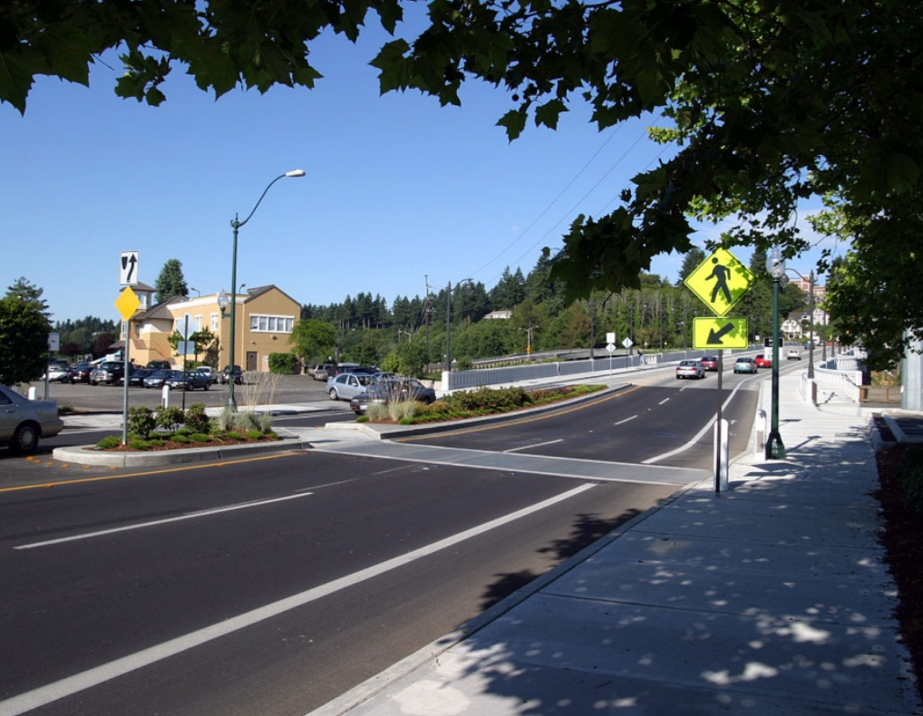

What are the Access
Management Standards?
The FDOT Access Management standards are established in Florida Administrative Code Chapter 14-97, otherwise known as Rule 14-97.
John McWilliams, South Florida

Slide 41
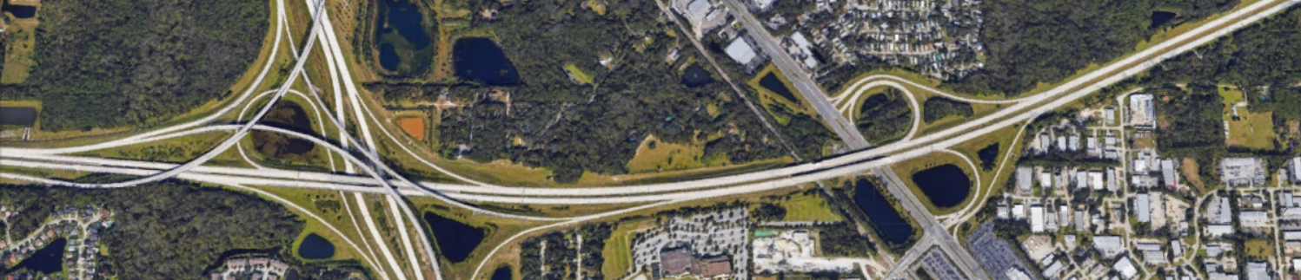
Rule 14-97: Table 1
Access Management Standards for Limited Access Facilities
Access Class | Area Type | Segment Location | Interchange Spacing (MILES)
1 | Area Type 1 | CBD & CBD Fringe For Cities In Urbanized Areas | 1.0
 | Area Type 2 | Existing Urbanized Areas Other Than Area Type 1 | 2.0
 | Area Type 3 | Transitioning Urbanized Areas And Urban Areas Other Than Area Type 1 or 2 | 3.0
 | Area Type 4 | Rural Areas | 6.0

Slide 42
Rule 14-97: Table 2
Access Management Standards for Arterials
Access Class | Medians | Connection Spacing (FEET) |  | Median Opening Spacing (FEET) |  | Signal Spacing (FEET)
 |  | > 45 mph | ≤ 45 mph | Directional | Full
2 | Restrictive with Service Roads | 1320 | 660 | 1320 | 2640 | 2640
3 | Restrictive | 600 | 440 | 1320 | 2640 | 2640
4 | Non-Restrictive | 660 | 440 |  |  | 2640
5 | Restrictive | 440 | 245 | 660 | *2640/ 1320 | *2640/ 1320
6 | Non-Restrictive | 440 | 245 |  |  | 1320
7 | Both | 125 |  | 330 | 660 | 1320
Typically Undeveloped
Typically Developed
*2640 feet for > 45 mph; 1320 feet for <45mph
“Restrictive”= Physically prevent vehicle crossing
“Non-Restrictive”= Allow turns across at any point

Slide 43
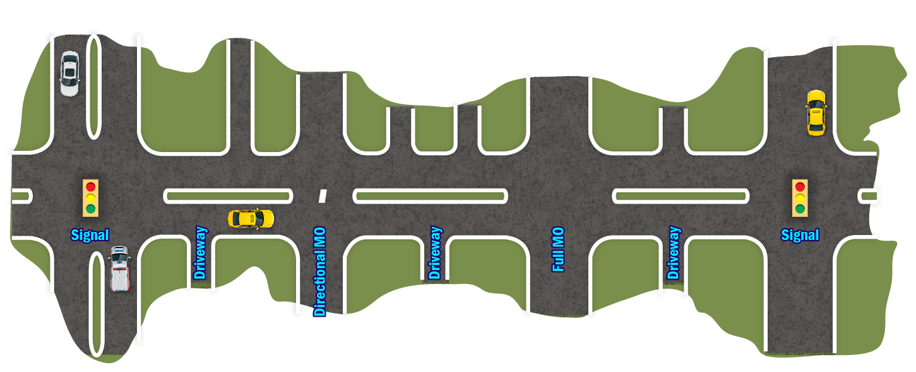
Measuring Spacing
Signal Spacing
Directional Spacing
Full Spacing
Connection Spacing
Directional Spacing

Slide 44
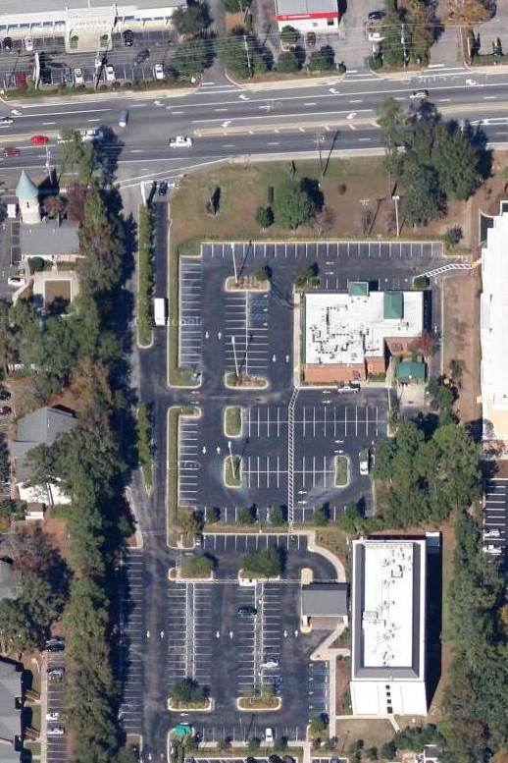
Right to Access
Must provide reasonable access to roadway
  What does “reasonable” mean?
  How is it defined?
  Does everyone get a driveway?
An owner has a right to property access but not a right to direct left turn.

Slide 45
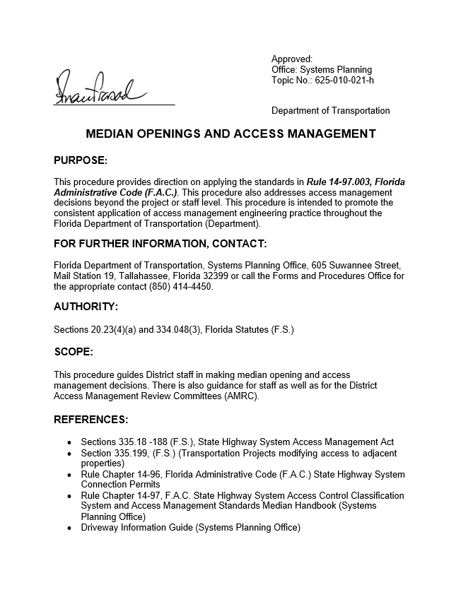
FDOT Procedures
Systems Implementation Office
Topic No. 625-010-021-h: Median Openings and Access Management
Under Review!
https://fms.fdot.gov/

Slide 46
Procedures
Each district shall have an Access Management Review Committee (AMRC) to review deviations from spacing standards of more than 10%
The AMRC is appointed by the District Secretary and consists of head level positions (District Design Engineer, District Planning Manager, etc.) and meetings are given public notice
>10% Deviation
Review by AMRC

Slide 47
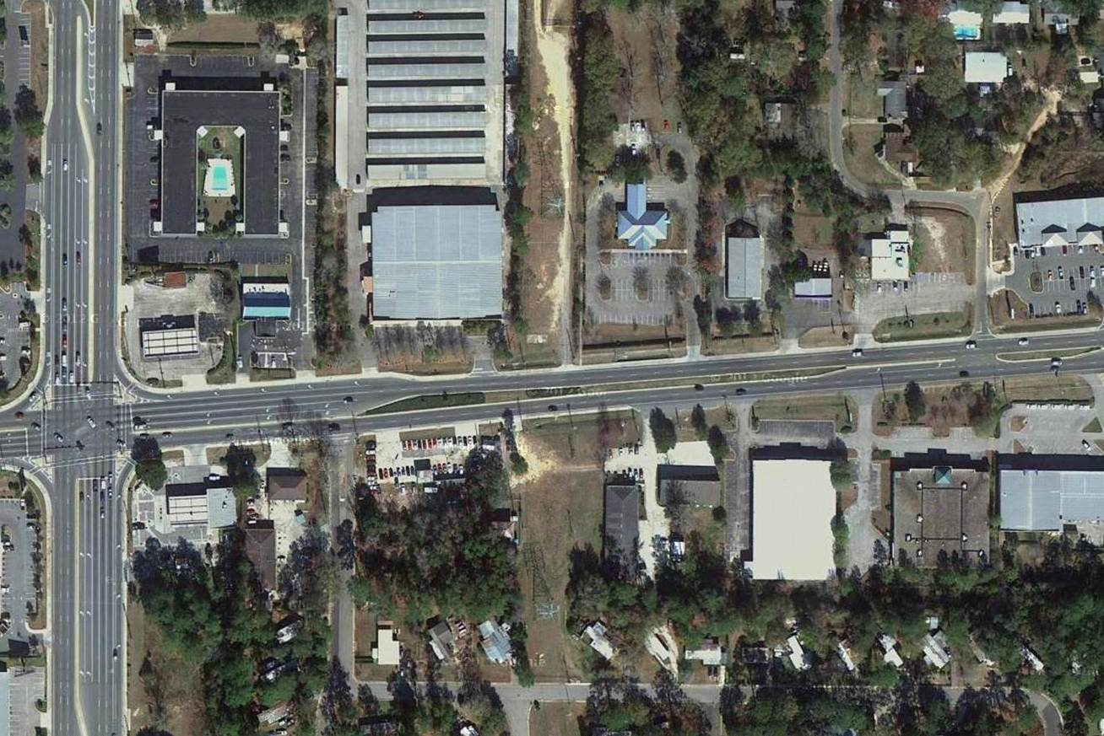
Site B must be reviewed by AMRC
560 ft spacing
= 15% deviation
650 ft spacing
= 1.5% deviation
Site A
Site B

Slide 48
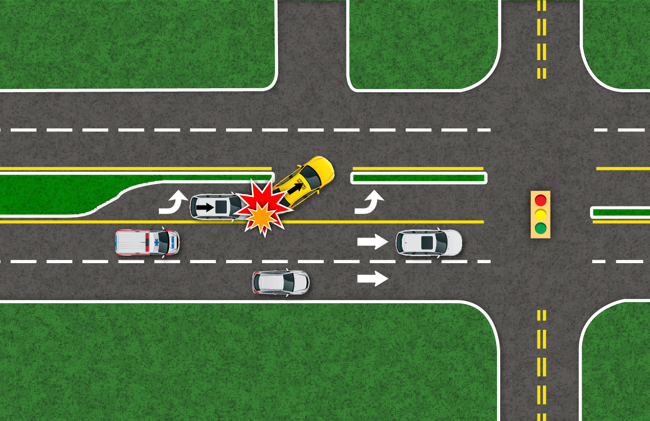
Procedures
Avoid median openings
across left-turn lanes

Slide 49
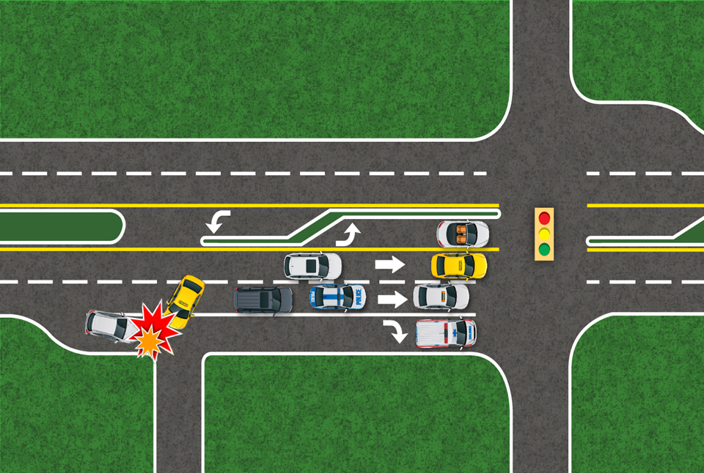
Procedures
Avoid median openings
across right-turn lanes

Slide 50
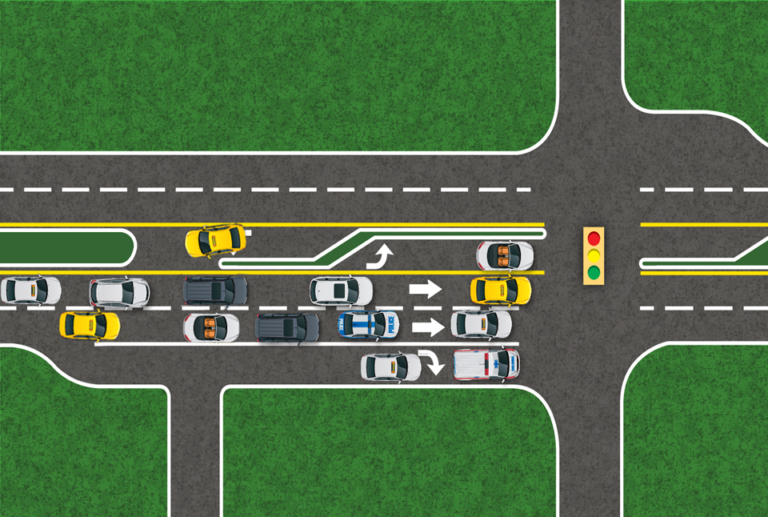
Procedures
Avoid median openings
across recurring queues

Slide 51

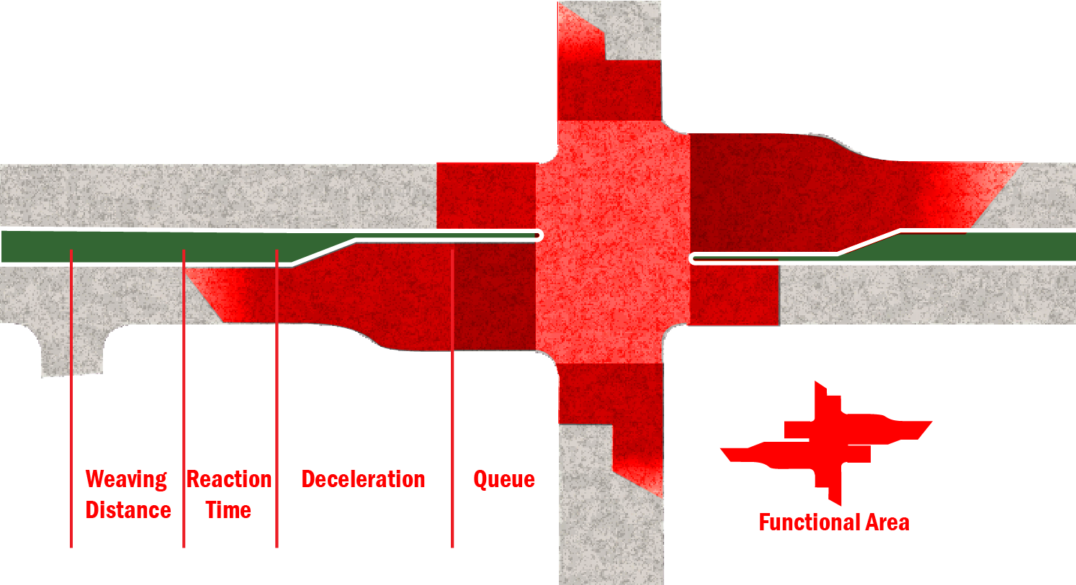
Procedures
Avoid median openings
within functional area of
signalized intersection

Slide 52
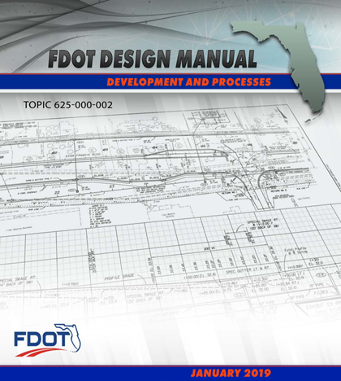
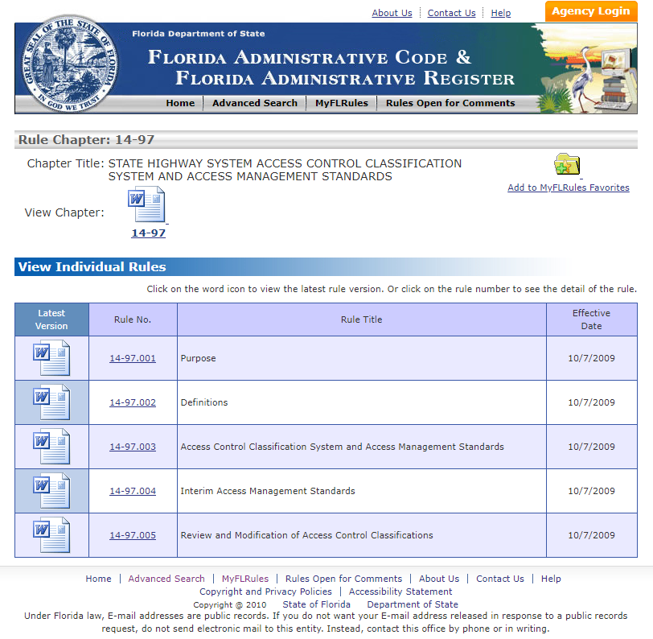
Design criteria and Rules
FDM Chapter 214 provides driveway design criteria and requirements for connections to the State Highway System.
Florida Administrative Code (F.A.C.):
  Rule 14-96 (State Highway Connection Permits)
  Rule 14-97, F.A.C. (State Highway System Access Control Classification System and Access Management Standards).

Slide 53
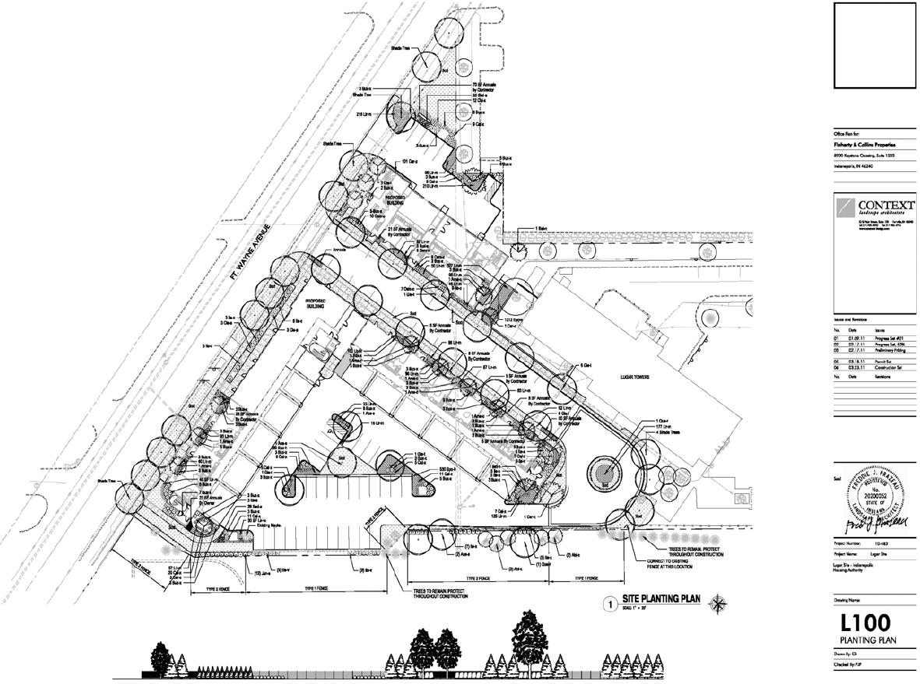
Access Management and Site Design
Successful access management involves more than regulation of median openings and driveways; it can also be achieved by thoughtful planning during the site design process and coordination with developers.

Slide 54

Inter-Parcel Access
Inter-parcel access can be developed between adjacent parcels or large multi-use properties
  Improves connectivity
  Reduces number of driveways on major streets
  Enhances bicycle/pedestrian access

Slide 55
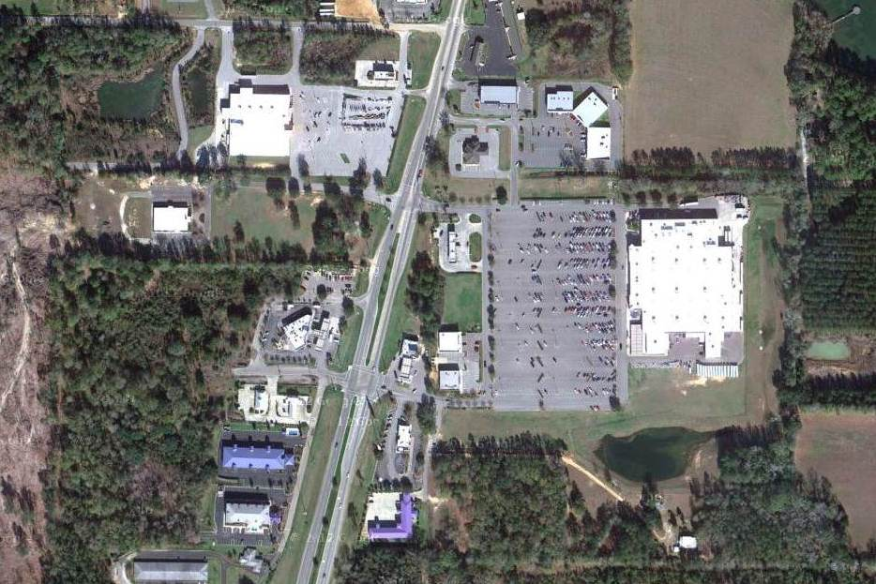
Adjacent Development
1
Plaza
4
2
3
5
6

Slide 56
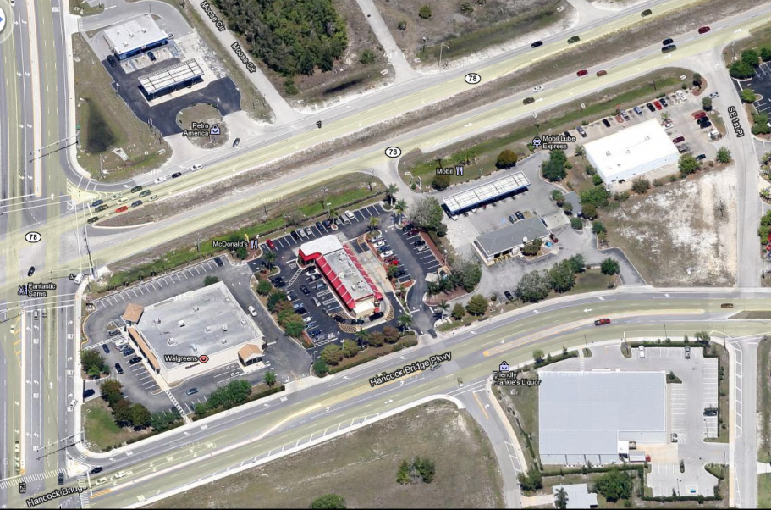
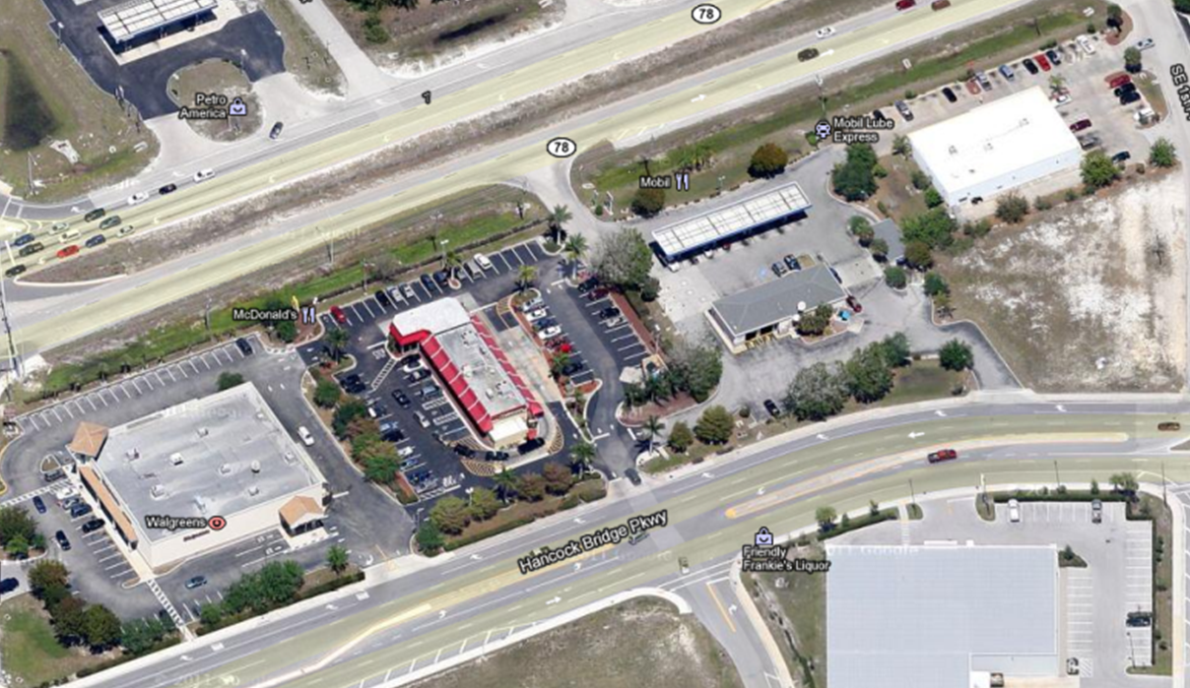
One driveway serves Walgreens, McDonalds, and two service stations

Slide 57
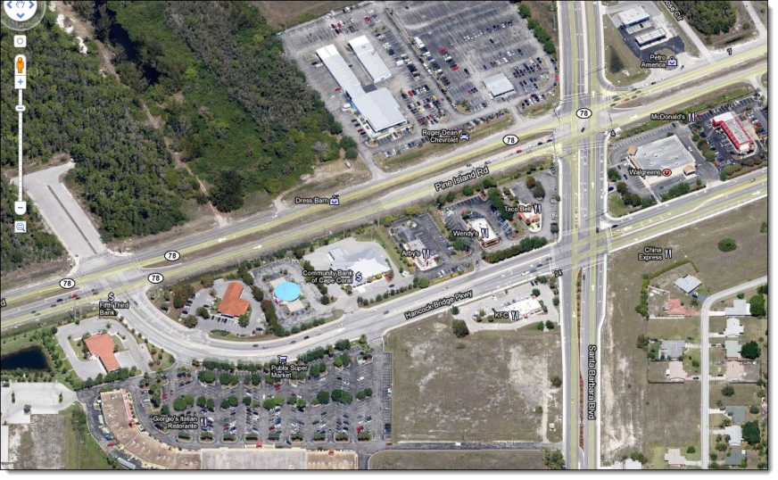
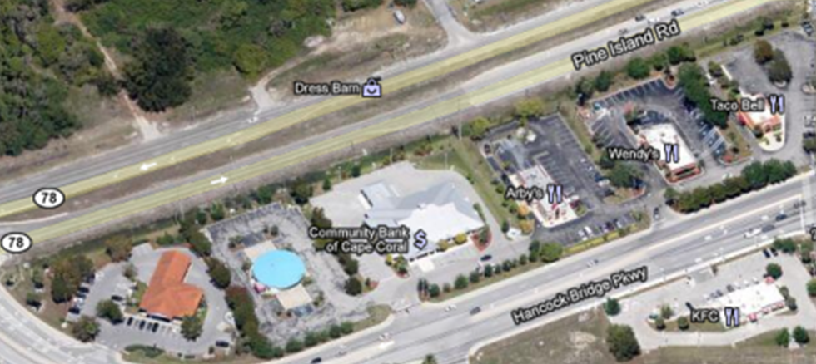
No driveways

Slide 58
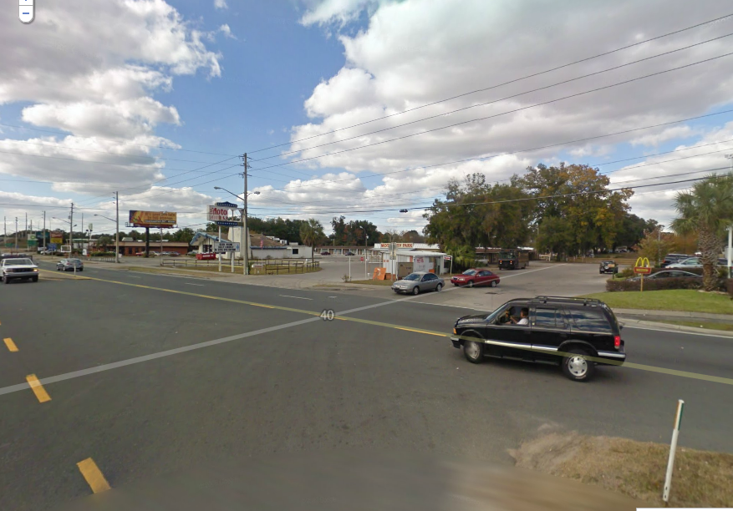
Unconnected development
entrances

Slide 59
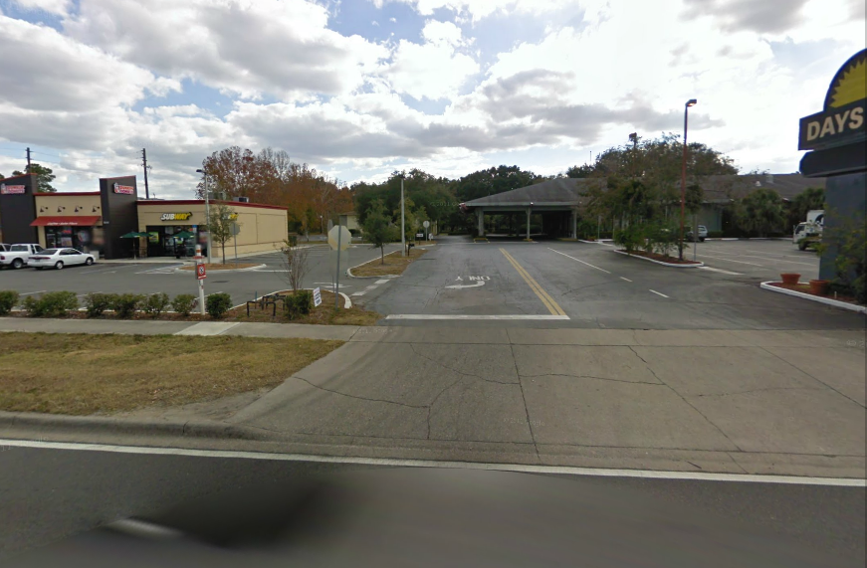
Leads to a unified development

Slide 60
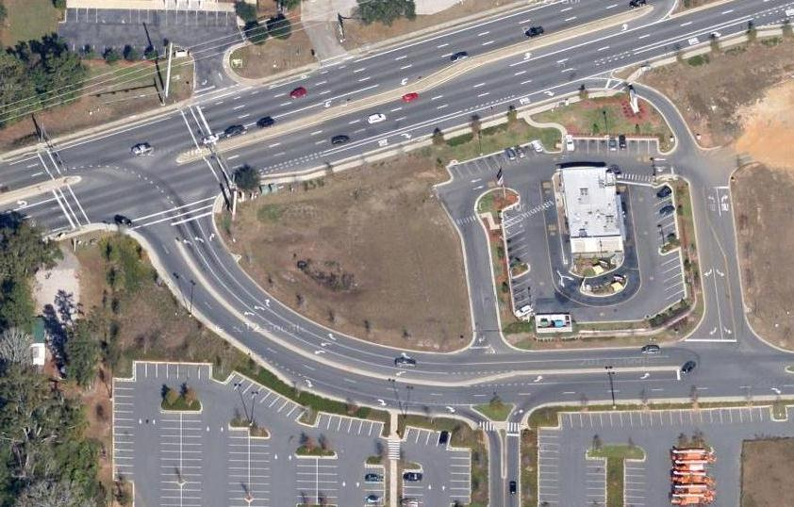

Slide 61
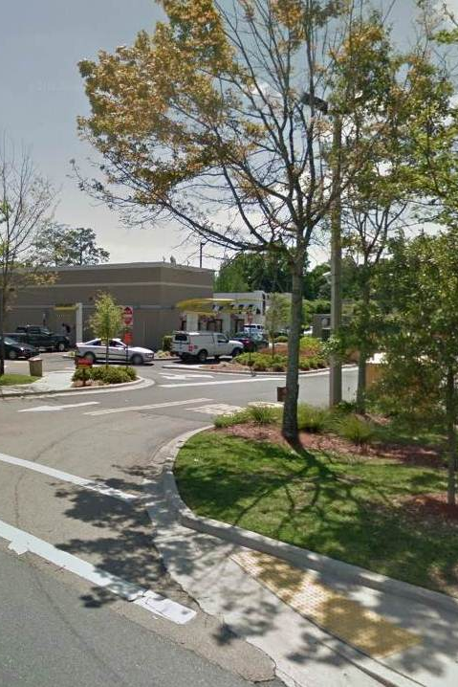
Concept Illustrations
Some examples of actual facilities with good design and some with only vehicles in mind.
Can you tell which is good and which is bad?

Slide 62
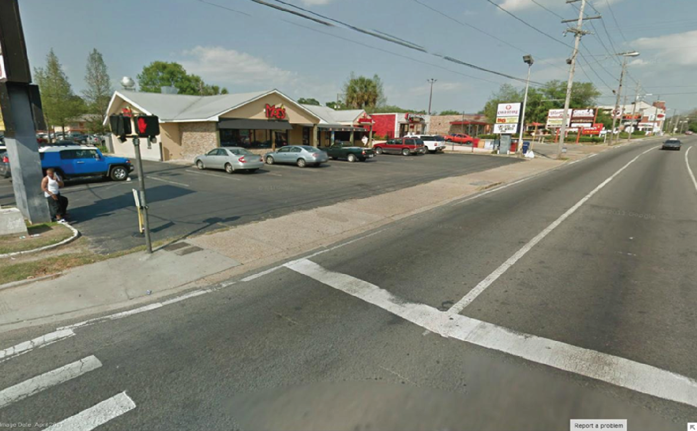
Conflict Potential

Slide 63
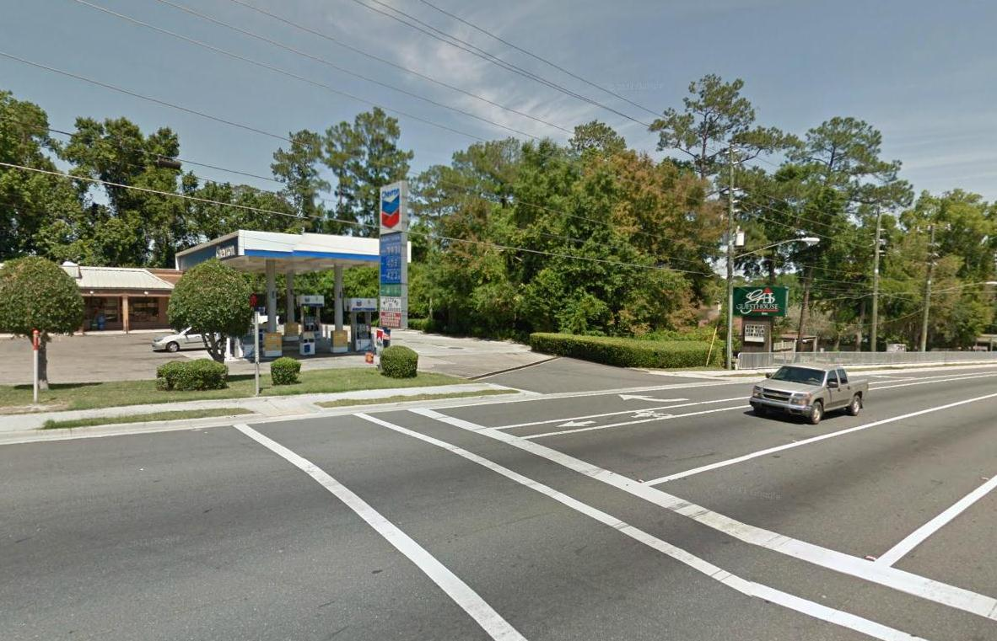
Driveway
Intersection

Slide 64
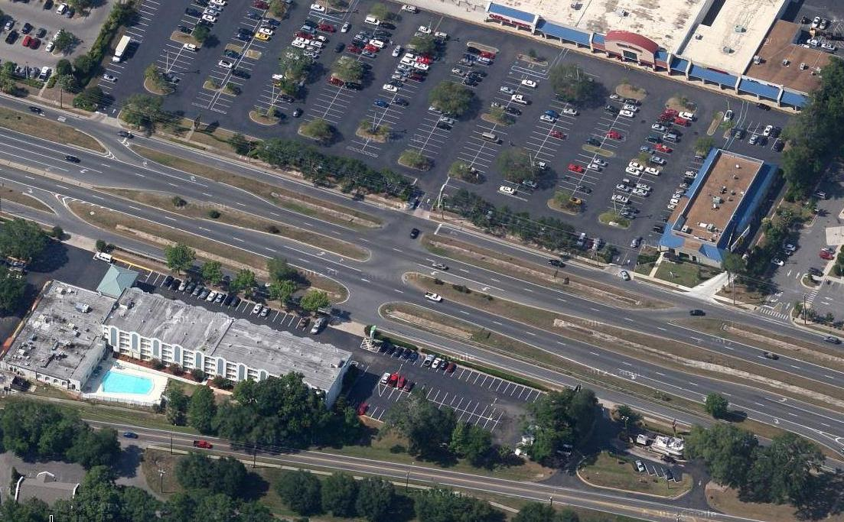

Slide 65


Slide 66


Slide 67



Guides Being Combined
DRAFT
Median Handbook
Driveways Information Guide
Access Management Guidebook

Slide 68
Resources
FDOT, Access Management Guidebook (Driveway and Median)
https://www.fdot.gov/planning/systems
Florida Design Manual
https://www.fdot.gov/roadway/fdm/default.shtm
FHWA Access Management
https://ops.fhwa.dot.gov/access_mgmt/index.htm

Slide 69

Questions
Gina Bonyani
Transportation Planner- FDOT
Gina.Bonyani@dot.state.fl.us

Slide 70
Course Details
Survey through GoToWebinar
FDOT FBPE Provider Number: 0003533
APA Course Web Page https://www.planning.org/events/eventsingle/9182414/
APA Course Number: 9182414
AICP/PDH Credits Provided: 1.50

Slide 71
Contact Info
Gina.Bonyani@dot.state.fl.us
Maria.Overton@dot.state.fl.us
Karla.Matos@dot.state.fl.us

