Slide 1


Interchange Access Request Safety Procedure
Webinar
Systems Implementation Office
March 8, 2018

Slide 2

Discussion Topics
Background
  FHWA Policy
  Interchange Access Request User’s Guide
Safety Analysis Methodology
  Overview
  Methodology Letter of Understanding Requirements
  Existing Conditions
  Interchange Operational Analysis Report
  Interchange Modification Report
  Interchange Justification Report
Project Examples
  I-4 at Saxon Boulevard IOAR
  I-75 at Martin Luther King Boulevard IMR
  I-75 at CR 514 IJR

Slide 3

Housekeeping
Presentation Material
  The presentation slides and projects spreadsheets will be available on the FDOT website
  http://www.fdot.gov/planning/systems/training.shtm
We encourage participation
  Questions may be asked using the chat panel
  Questions will be answered during the webinar and breaks
PDH/AICP Credits
  1.5 Credits available

Slide 4






FDOT Central Office Team
Maria Overton, PE
  Systems Management Manger, FDOT Systems Implementation Office, Maria.Overton@dot.state.fl.us, 850-414-4909
Andrew Young
  Statewide Interchange Review Coordinator, FDOT Systems Implementation Office, Andrew.Young@dot.state.fl.us, 850-414-4582
Bikram Wadhawan, PE, PTOE
  Hanson, Consultant FDOT Systems Implementation Office, Bwadhawan@hanson-inc.com, 904-423-5369
Becca Wagner
  Hanson, Consultant FDOT Systems Implementation Office, Bwagner@hanson-inc.com, 309-691-0902
Andrew Ladage
  Hanson, Consultant FDOT Systems Implementation Office, ALadage@hanson-inc.com, 904-418-5124

Slide 5
Acronyms
Term | Acronym
Annual Average Daily Traffic | AADT
Benefit Cost Analysis | BCA
Collector-Distributor Roadway | C-D Roadway
Crash Modification Factor | CMF
Diverging Diamond Interchange | DDI
Empirical Bayes Method | EB Method
Federal Highway Administration | FHWA
Florida Department of Transportation | FDOT
Highway Safety Manual | HSM
Interchange Access Request | IAR
Interchange Access Request User’s Guide | IARUG
Interchange Justification Report | IJR
Interchange Modification Report | IMR
Interchange Operational Analysis Report | IOAR
Methodology Letter of Understanding | MLOU
Safety Performance Factor | SPF

Slide 6

Background

Slide 7
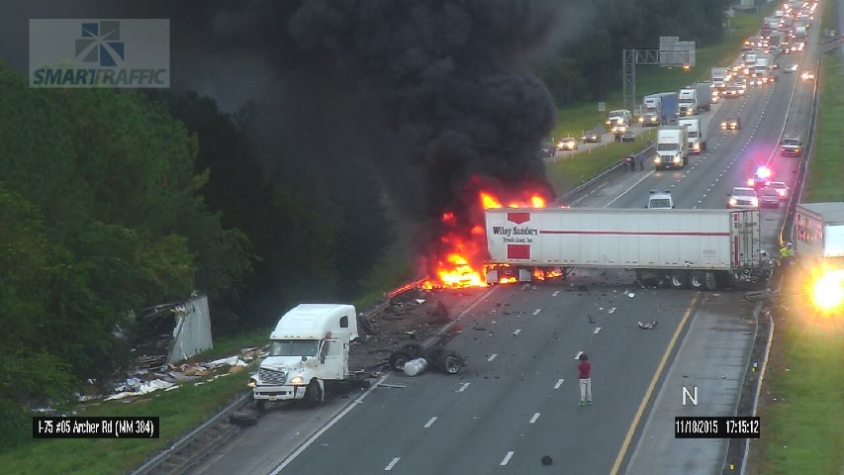
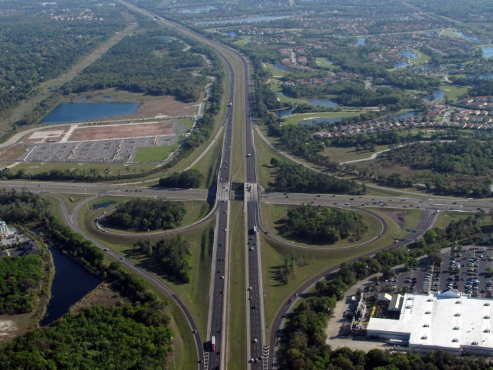
Interchange Access Requests
Requests for new or modified access to
  Interstate Highway System
  Non-interstate limited access facilities on the State Highway System (SHS)
An Interchange Access Request (IAR) shows that a proposed interchange proposal is Safety, Operational and Engineering (SO&E) viable

Slide 8

FHWA’s Interstate System Access Policy
The FHWA Policy statement entitled “Access to the Interstate System”
  Published in Federal Register on October 22, 1990
  Last modified May 22, 2017
  Replaces the old August 2009 Policy
The May 2017 FHWA Policy statement
  Focuses on Safety, Operational and Engineering viability
All new and ongoing IARs must adequately address the FHWA Policy Points
  FHWA Policy Point 1: The request does not have a significant adverse impact on the operation and safety of the freeway system

Slide 9
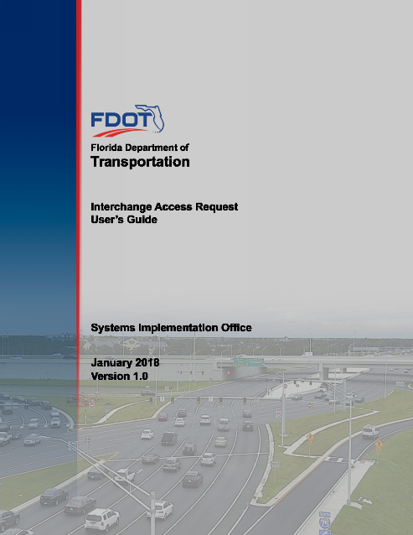
Interchange Access Request User’s Guide
First released in December 2002
  Updated March 2015
Current version released January 2018
includes updated
  Safety analysis methodology
The updated safety analysis methodology is summarized in Section 3.3 of the IARUG
  Follows the safety analysis procedures based on HSM
Available online at
  http://www.fdot.gov/planning/systems/programs/sm/intjus/

Slide 10
Safety Analysis Overview
The level of safety analysis performed is determined by the type of IAR
  The type of IAR is specified in the MLOU
  The safety analysis requirements must also be specified in the MLOU
Three common IAR documents
The study limits of safety analysis are the same as for operational analysis
The safety analysis for proposed conditions should document how the access request proposal would improve the identified safety problems
Interchange Justification Report (IJR)
  Proposed new full or partial interchange
Interchange Modification Report (IMR)
  Significant modification to existing interchange
Interchange Operational Analysis Report (IOAR)
  Minor modification to existing interchange

Slide 11
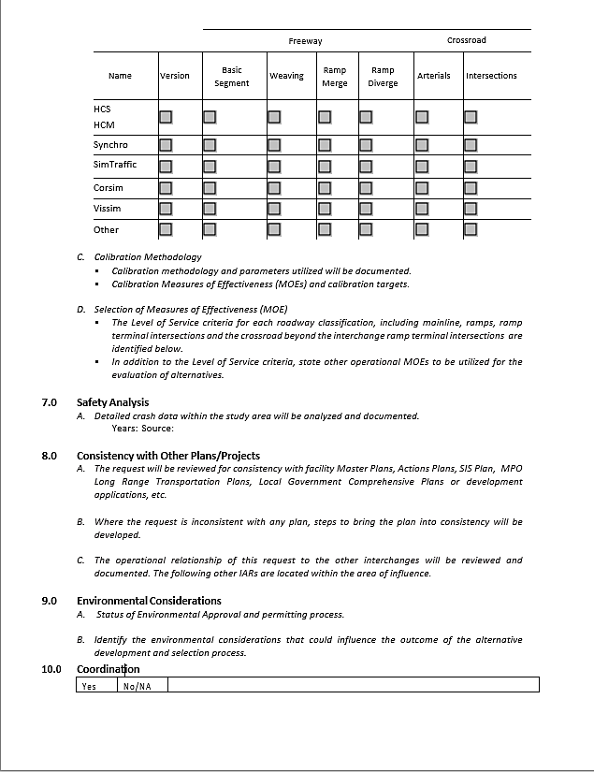
Requirements in MLOU
Section 7.0 in the MLOU
  Safety Analysis
The safety analysis methodology shall be documented and agreed to in the MLOU
Minimum 5 years of historical crash data
The MLOU shall state an understanding that either a quantitative analysis for an IOAR, IMR, or IJR will be required
If the project will perform a Benefit Cost Analysis, it must be specified in the MLOU

Slide 12
Requirements in MLOU
The following safety performance measures must be stated in the MLOU
  Crash rate
  Crash frequency
  Reduction in crashes
  Benefit Cost Ratio (as applicable)

Slide 13
Safety Analysis Methodology

Slide 14
Safety Analysis Types
IJR
Calculation of Crash Rates
Crash Diagrams
Description of Existing Crash Trends
Safety Performance Functions
Crash Reduction Estimation (CMFs)
Benefit Cost Analysis
Documentation
IMR
Calculation of Crash Rates
Crash Diagrams
Description of Existing Crash Trends
Safety Performance Functions
Empirical Bayes Method
Crash Reduction Estimation (CMFs)
Benefit Cost Analysis
Documentation
IOAR
Calculation of Crash Rates
Crash Diagrams
Description of Existing Crash Trends
Crash Reduction Estimation (CMFs)
Documentation
Existing Conditions
Calculation of Crash Rates
Crash Diagrams
Description of Existing Crash Trends
Documentation
Safety analysis based on the procedures in the Highway Safety Manual (HSM)

Slide 15
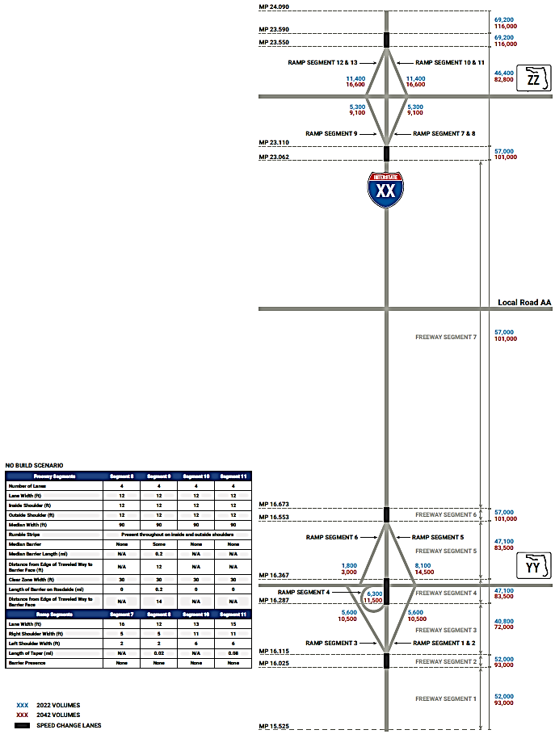
Segmentation Process
Specify the Area of Influence for safety analysis
  The study limits of safety analysis are the same as for operational analysis.
Crash Data should be collected according to the segmentation of the project
Rule: move along a reference line, begin new segment where there is a change in segment type
Safety analysis should be specific to the proposed improvements
Freeway Mainline Segment
Merge Area Segment
On-Ramp Area Segment
Ramp Terminal Intersection
Off-Ramp Area Segment
Diverge Area Segment
Freeway Mainline Segment

Slide 16
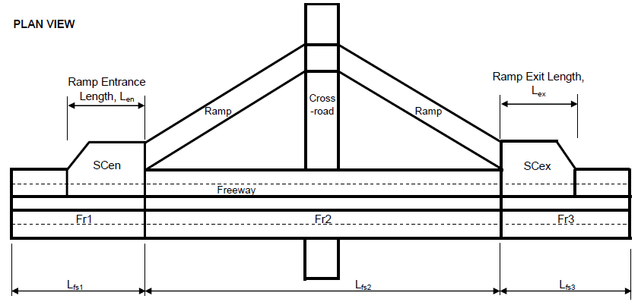
Segmentation Process
Freeway segmentation process
  Merge area
  Freeway mainline
  Diverge area
Source: Highway Safety Manual 1st Edition, Chapter 18, Figure 18-10

Slide 17
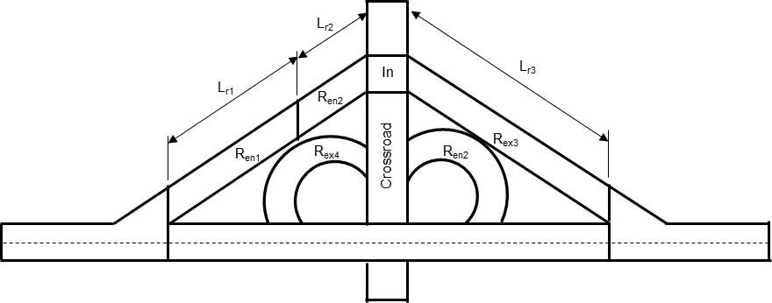
Segmentation Process
Ramp segmentation process
  Crossroad segment
  Study intersections
  Interchange ramps
Source: Highway Safety Manual 1st Edition, Chapter 19, Figure 19-10

Slide 18
Existing Conditions
IJR
Calculation of Crash Rates
Crash Diagrams
Description of Existing Crash Trends
Safety Performance Functions
Crash Reduction Estimation (CMFs)
Benefit Cost Analysis
Documentation
IMR
Calculation of Crash Rates
Crash Diagrams
Description of Existing Crash Trends
Safety Performance Functions
Empirical Bayes Method
Crash Reduction Estimation (CMFs)
Benefit Cost Analysis
Documentation
IOAR
Calculation of Crash Rates
Crash Diagrams
Description of Existing Crash Trends
Crash Reduction Estimation (CMFs)
Documentation
Existing Conditions
Calculation of Crash Rates
Crash Diagrams
Description of Existing Crash Trends
Documentation

Slide 19

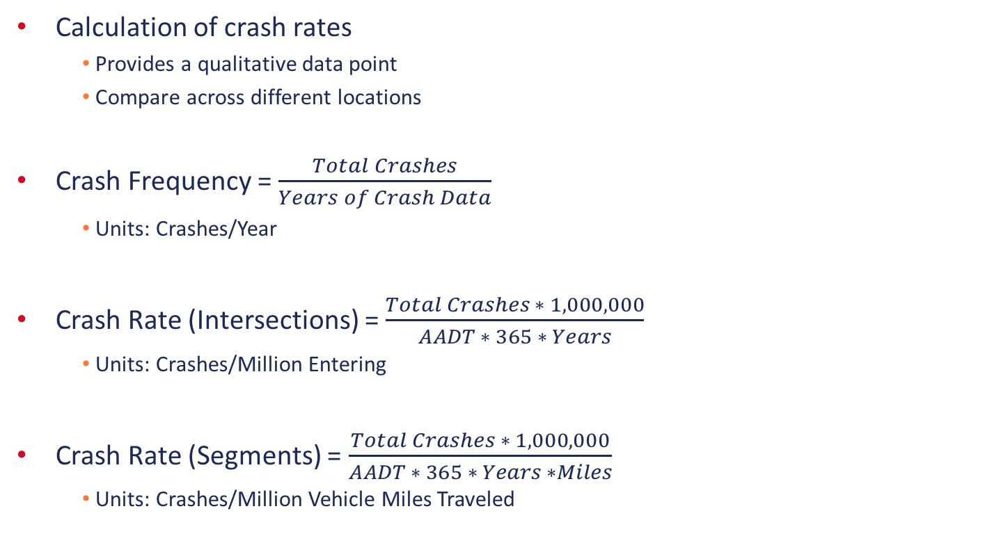
Calculation of Crash Rates
Calculation of crash rates
  Provides a qualitative data point
  Compare across different locations
Crash Frequency = $\frac{Total Crashes}{Years of Crash Data}$
  Units: Crashes/Year
Crash Rate (Intersections) = $\frac{Total Crashes ∗ 1,000,000}{AADT ∗ 365 ∗ Years}$
  Units: Crashes/Million Entering
Crash Rate (Segments) = $\frac{Total Crashes ∗ 1,000,000}{AADT ∗ 365 ∗ Years ∗Miles}$
  Units: Crashes/Million Vehicle Miles Traveled
Existing Conditions
Calculation of Crash Rates
Crash Diagrams
Description of Existing Crash Trends
Documentation

Slide 20
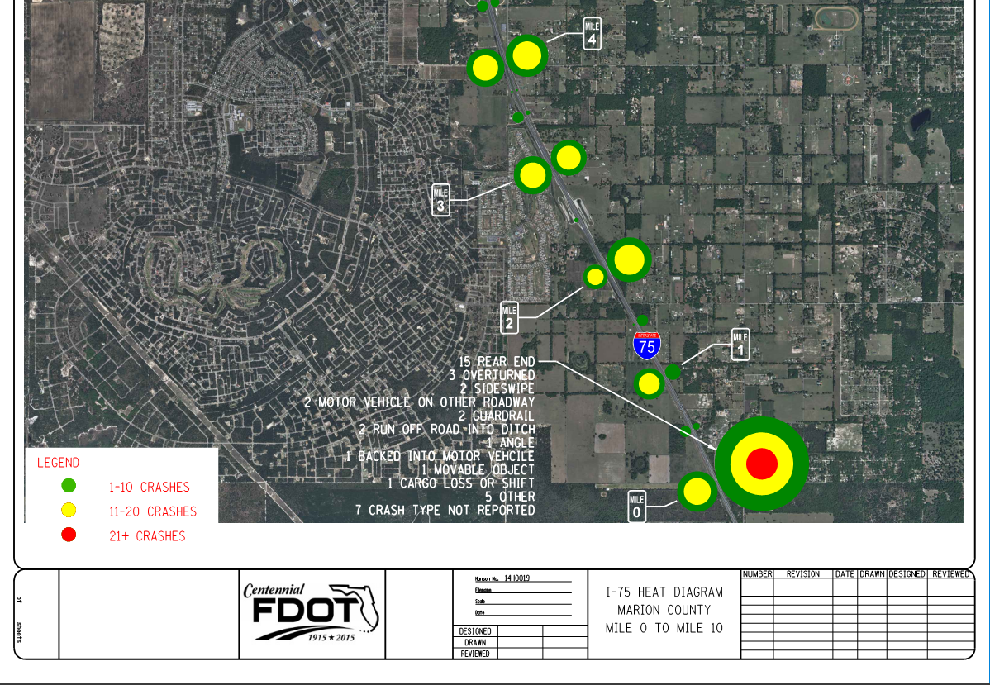
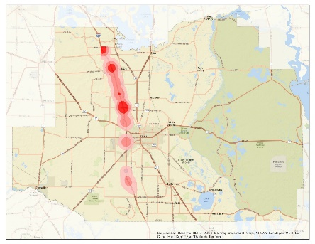
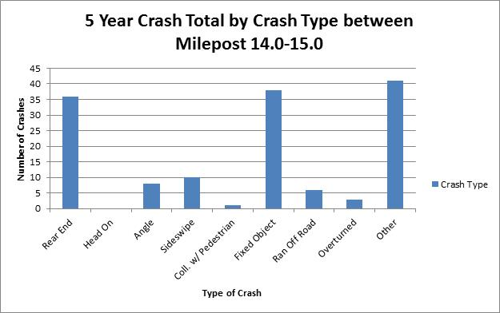
Crash Diagrams &
Description of Existing Crash Trends
Crash diagrams
  Show crashes graphically
  Can be performed by GIS or by hand
Types of crash diagrams include
  Heat maps
  Bar charts
  Pie charts
  Other maps graphically showing the high crash locations along a system or at an interchange
Provide a description of the existing crash trends observed using the historical crash data
Existing Conditions
Calculation of Crash Rates
Crash Diagrams
Description of Existing Crash Trends
Documentation

Slide 21

Documentation
Include the following documentation when discussing the existing conditions crash analysis:
Existing crash data
Calculated crash frequencies and rates
Crash diagrams
Description of existing crash trends
Existing Conditions
Calculation of Crash Rates
Crash Diagrams
Description of Existing Crash Trends
Documentation

Slide 22
Interchange Operational Analysis Report (IOAR)
IJR
Calculation of Crash Rates
Crash Diagrams
Description of Existing Crash Trends
Safety Performance Functions
Crash Reduction Estimation (CMFs)
Benefit Cost Analysis
Documentation
IMR
Calculation of Crash Rates
Crash Diagrams
Description of Existing Crash Trends
Safety Performance Functions
Empirical Bayes Method
Crash Reduction Estimation (CMFs)
Benefit Cost Analysis
Documentation
IOAR
Calculation of Crash Rates
Crash Diagrams
Description of Existing Crash Trends
Crash Reduction Estimation (CMFs)
Documentation
Existing Conditions
Calculation of Crash Rates
Crash Diagrams
Description of Existing Crash Trends
Documentation

Slide 23
Crash Reduction Estimation (CMFs)
Crash Modification Factors (CMFs) provide an estimated reduction in crashes for safety improvements
CMFs are available via:
  Crash Modification Factors Clearinghouse funded by FHWA
    http://www.cmfclearinghouse.org/index.cfm
  Highway Safety Manual (HSM)
Some common CMFs that can be applied to IARs
CMFs may not exist for each improvement
Countermeasure | CMF
Add continuous auxiliary lane for weaving between entrance ramp and exit ramp | 0.79
Change spacing between two ramp terminals at diamond interchange from X feet to Y feet | = 100 * (1 - e^{0.014308(Y-X)})
Convert diamond interchange to DDI or DCD | 0.67
Design diamond, trumpet, or cloverleaf interchange with crossroad above freeway | 0.96
Divided vs. undivided cross road at diamond interchange ramps | 0.53
Install a traffic signal | 0.61
Provide left turn on 1 approach | 0.93
Provide right turn on 1 approach | 0.96
IOAR
Calculation of Crash Rates
Crash Diagrams
Description of Existing Crash Trends
Crash Reduction Estimation (CMFs)
Documentation

Slide 24

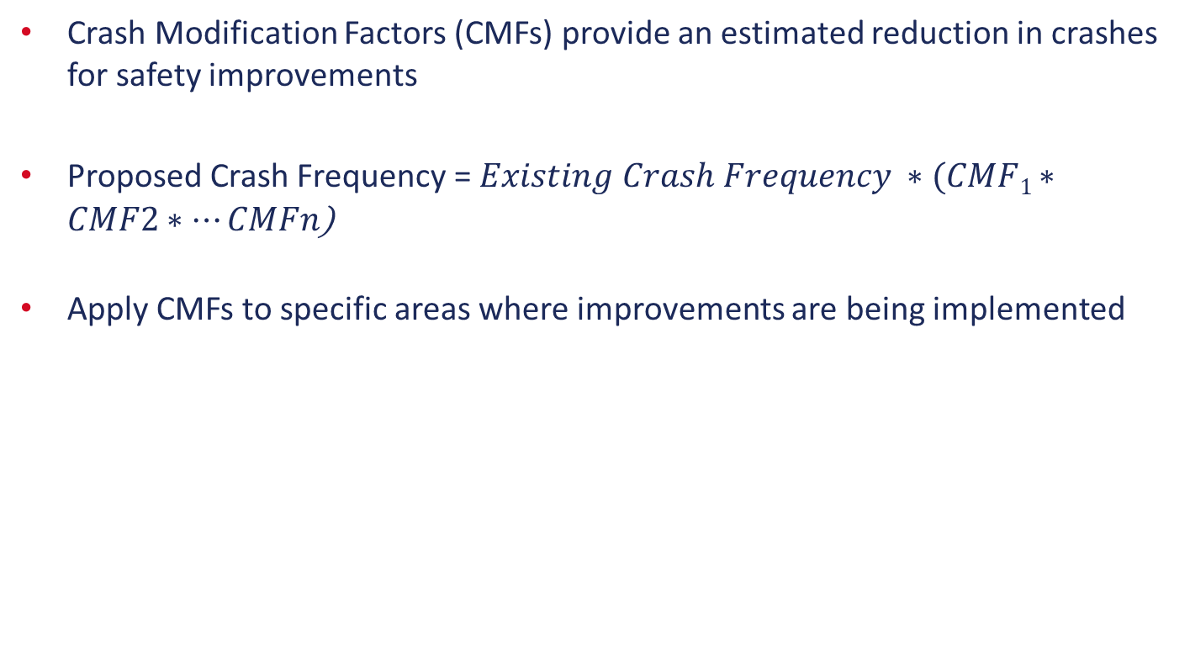
Crash Reduction Estimation (CMFs)
Crash Modification Factors (CMFs) provide an estimated reduction in crashes for safety improvements
Proposed Crash Frequency = $Existing Crash Frequency ∗(CMF1∗CMF2∗…CMFn$)
Apply CMFs to specific areas where improvements are being implemented
IOAR
Calculation of Crash Rates
Crash Diagrams
Description of Existing Crash Trends
Crash Reduction Estimation (CMFs)
Documentation

Slide 25
Documentation
Include the following documentation in the IOAR:
Existing crash data
Calculated crash frequencies and rates
Crash diagrams
Description of existing crash trends
Summary of CMFs applied
Estimated crash reduction
  Do not assign a monetary value without performing Empirical Bayes Method
IOAR
Calculation of Crash Rates
Crash Diagrams
Description of Existing Crash Trends
Crash Reduction Estimation (CMFs)
Documentation

Slide 26
Interchange Modification Report (IMR)
IJR
Calculation of Crash Rates
Crash Diagrams
Description of Existing Crash Trends
Safety Performance Functions
Crash Reduction Estimation (CMFs)
Benefit Cost Analysis
Documentation
IMR
Calculation of Crash Rates
Crash Diagrams
Description of Existing Crash Trends
Safety Performance Functions
Empirical Bayes Method
Crash Reduction Estimation (CMFs)
Benefit Cost Analysis
Documentation
IOAR
Calculation of Crash Rates
Crash Diagrams
Description of Existing Crash Trends
Crash Reduction Estimation (CMFs)
Documentation
Existing Conditions
Calculation of Crash Rates
Crash Diagrams
Description of Existing Crash Trends
Documentation

Slide 27
Safety Performance Functions
A safety performance function (SPF) is an equation used to calculate the expected number of crashes per year at a location as a function of exposure and, in some cases, roadway or intersection characteristics
  Predicts crash frequency
Safety Performance Functions equations incorporate
  Annual Average Daily Traffic (AADT)
  Sight Characteristics (i.e. Number of Lanes, Merge/Diverge Type, Intersection Type)
  Existing Condition Crash Modification Factors (i.e. Turn Lanes, Presence of TWLTL, Flashing Yellow Arrow Indications)
Needed only for facilities where alternatives are being considered
IMR
Calculation of Crash Rates
Crash Diagrams
Description of Existing Crash Trends
Safety Performance Functions
Empirical Bayes Method
Crash Reduction Estimation (CMFs)
Benefit Cost Analysis
Documentation

Slide 28
Safety Performance Functions
Predicted Crash Frequency
N_{predicted} =
SPF x (CMF1 x CMF2 x ….) x C
where:
SPF = Safety Performance Function
CMF = Crash Modification Factors
C = Local Calibration Factor
IMR
Calculation of Crash Rates
Crash Diagrams
Description of Existing Crash Trends
Safety Performance Functions
Empirical Bayes Method
Crash Reduction Estimation (CMFs)
Benefit Cost Analysis
Documentation

Slide 29

Safety Performance Functions
Calculating the SPF for each facility crash type has 4 steps:
  Base Equation (N_{bimv}=…)
  SPF Coefficients (Total, FI, PDO Coefficients to use in Base Equation)
  Balancing Fatal-Injury and Property Damage Only
  Distribution of Crash Type
SPF equations, CMFs and Coefficients can be found in the HSM Part 2
SPF calculations performed using Spreadsheets
  Will be available on the FDOT website
  http://www.fdot.gov/planning/systems/training.shtm
IMR
Calculation of Crash Rates
Crash Diagrams
Description of Existing Crash Trends
Safety Performance Functions
Empirical Bayes Method
Crash Reduction Estimation (CMFs)
Benefit Cost Analysis
Documentation

Slide 30
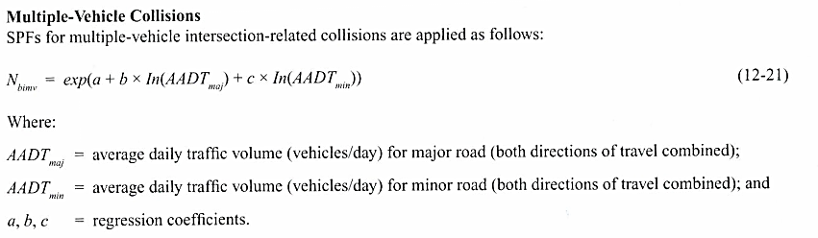
Safety Performance Functions
Step 1: Base Equation (N_{bimv}=…)
  Crash/collision type: Intersection Multiple Vehicle Crashes
Source: Highway Safety Manual 1st Edition, Chapter 12
IMR
Calculation of Crash Rates
Crash Diagrams
Description of Existing Crash Trends
Safety Performance Functions
Empirical Bayes Method
Crash Reduction Estimation (CMFs)
Benefit Cost Analysis
Documentation

Slide 31
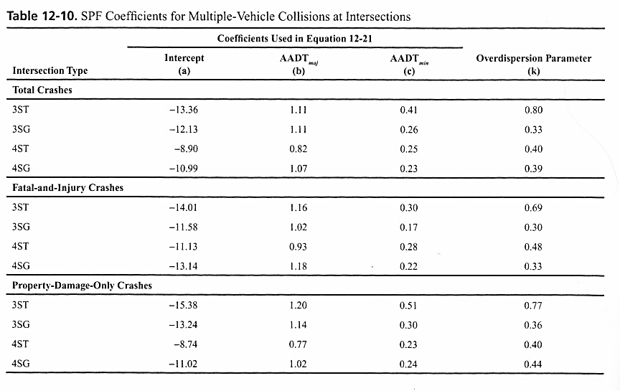
Safety Performance Functions
Step 2: SPF Coefficients (Total, FI, PDO Coefficients to use in Base Equation)
  Crash/collision type: Intersection Multiple Vehicle Crashes
Source: Highway Safety Manual 1st Edition, Chapter 12
IMR
Calculation of Crash Rates
Crash Diagrams
Description of Existing Crash Trends
Safety Performance Functions
Empirical Bayes Method
Crash Reduction Estimation (CMFs)
Benefit Cost Analysis
Documentation

Slide 32
Safety Performance Functions
Step 2: SPF Coefficients (Total, FI, PDO Coefficients to use in Base Equation)
  Crash/collision type: Intersection Multiple Vehicle Crashes
Source: Highway Safety Manual 1st Edition, Chapter 12
IMR
Calculation of Crash Rates
Crash Diagrams
Description of Existing Crash Trends
Safety Performance Functions
Empirical Bayes Method
Crash Reduction Estimation (CMFs)
Benefit Cost Analysis
Documentation

Slide 33
Safety Performance Functions
Step 3: Balancing Fatal/Injury and Property Damage Only crashes
  Crash/collision type: Intersection Multiple Vehicle Crashes
$N_{bimv(FI)}=N_{bimv(total)} ∗(\frac{{N^{′}}_{bimv\left(FI\right)}}{{N^{′}}_{bimv\left(FI\right)}+{N^{′}}_{bimv\left(PDO\right)}})$ (12-22)
$N_{bimv(PDO)}=N_{bimv(total)} − N_{bimv(FI)}$ (12-23)
Source: Highway Safety Manual 1st Edition, Chapter 12
IMR
Calculation of Crash Rates
Crash Diagrams
Description of Existing Crash Trends
Safety Performance Functions
Empirical Bayes Method
Crash Reduction Estimation (CMFs)
Benefit Cost Analysis
Documentation

Slide 34
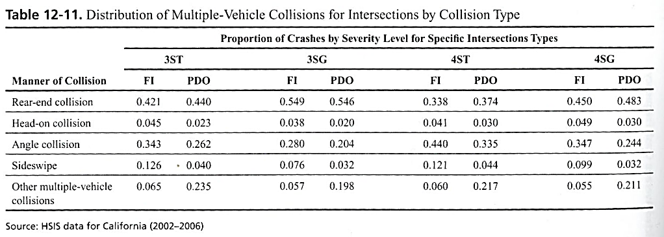
Safety Performance Functions
Step 4: distribution of crash types
  Crash/collision type: Intersection Multiple Vehicle Crashes
Source: Highway Safety Manual 1st Edition, Chapter 12
IMR
Calculation of Crash Rates
Crash Diagrams
Description of Existing Crash Trends
Safety Performance Functions
Empirical Bayes Method
Crash Reduction Estimation (CMFs)
Benefit Cost Analysis
Documentation

Slide 35
Safety Performance Functions
After completing the 4 steps, apply the Crash Modification Factors (CMFs)
The CMF(s) is applied to the SPF in predicted crash frequency only for existing conditions
Each SPF has certain CMFs that can be applied
Calculations performed using Spreadsheets
N_{predicted} =
SPF x (CMF1 x CMF2 x ….) x C
where:
SPF = Safety Performance Function
CMF = Crash Modification Factors
C = Local Calibration Factor
IMR
Calculation of Crash Rates
Crash Diagrams
Description of Existing Crash Trends
Safety Performance Functions
Empirical Bayes Method
Crash Reduction Estimation (CMFs)
Benefit Cost Analysis
Documentation

Slide 36
Empirical Bayes Method
Empirical Bayes Method
  Combines Predicted Crash Frequency with Observed Crash Frequency to determine Expected Crash Frequency
  Improves the statistical reliability
Observed Crash Frequency
  Existing crash data collected
Predicted Crash Frequency
  Calculated using the Safety Performance Function (SPF)
Expected Crash Frequency
  Calculated from the Observed and Predicted crash frequency
Observed Crash Frequency
Expected Crash Frequency
Predicted Crash Frequency
IMR
Calculation of Crash Rates
Crash Diagrams
Description of Existing Crash Trends
Safety Performance Functions
Empirical Bayes Method
Crash Reduction Estimation (CMFs)
Benefit Cost Analysis
Documentation

Slide 37
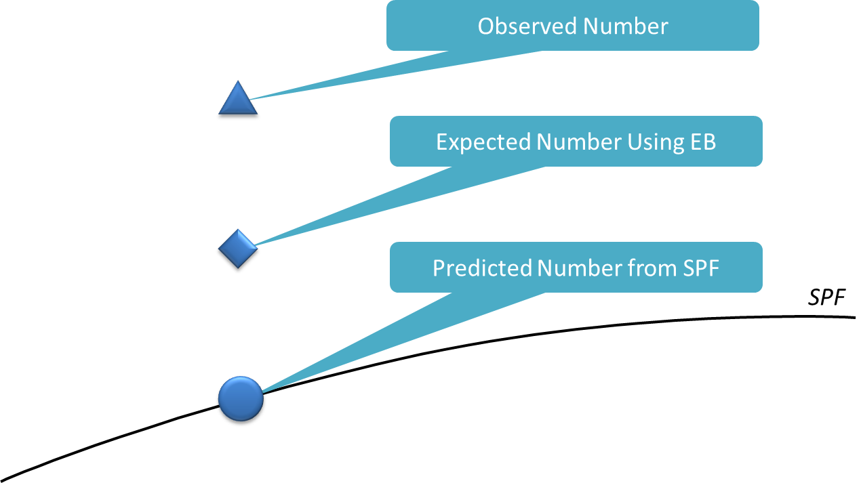

Empirical Bayes Method
$Number of expected crashes=w ∗ N_{predicted}+\left(1−w\right)∗ N_{observed}$
  Where: $w=\frac{1}{1+k ∗(N_{predicted} ∗ Study Years)}$
  K = overdispersion parameter (associated with SPF) – can be found in HSM Part 2
Crash Frequency
AADT
IMR
Calculation of Crash Rates
Crash Diagrams
Description of Existing Crash Trends
Safety Performance Functions
Empirical Bayes Method
Crash Reduction Estimation (CMFs)
Benefit Cost Analysis
Documentation

Slide 38
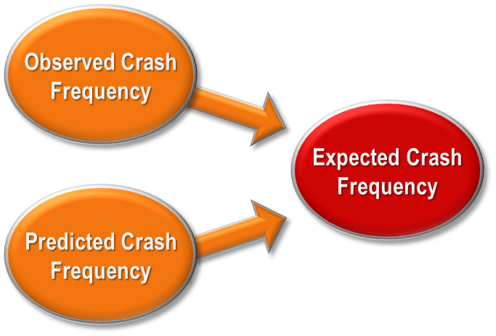
Empirical Bayes Method
Empirical Bayes Method Summary
  The higher the weight value, the more confidence is put on Predicted Crashes compared to Observed Crashes
  Longer Study Period (Higher N_{predicted} Total) = More Confidence in Observed Crashes
  Longer Study Areas (Higher N_{predicted} Total) = More Confidence in Observed Crashes
  Higher K Value, better SPF = More Confidence in Predicted Crashes
IMR
Calculation of Crash Rates
Crash Diagrams
Description of Existing Crash Trends
Safety Performance Functions
Empirical Bayes Method
Crash Reduction Estimation (CMFs)
Benefit Cost Analysis
Documentation

Slide 39
Benefit Cost Analysis
Benefit Cost Analysis (BCA) requires Empirical Bayes Method
Assign dollar value to crashes prevented
Divide benefits by cost
FDOT KABCO Crash Costs 2011-2015
Cost Severity | Compressive Crash Cost
Fatal (K) | $10,560,000
Severe Injury (A) | $599,040
Moderate Injury (B) | $162,240
Minor Injury (C) | $100,800
Property Damage Only (O) | $7,600
Source: Florida Department of Transportation State Safety Office’s Crash Analysis Reporting (CAR) System, analysis years 2011 through 2015
IMR
Calculation of Crash Rates
Crash Diagrams
Description of Existing Crash Trends
Safety Performance Functions
Empirical Bayes Method
Crash Reduction Estimation (CMFs)
Benefit Cost Analysis
Documentation

Slide 40
Documentation
Include the following documentation in the IMR:
Existing crash data
Calculated crash frequencies and rates
Crash diagrams
Description of existing crash trends
Summary of SPFs and EB Method
Summary of CMFs applied
Total benefit of project
IMR
Calculation of Crash Rates
Crash Diagrams
Description of Existing Crash Trends
Safety Performance Functions
Empirical Bayes Method
Crash Reduction Estimation (CMFs)
Benefit Cost Analysis
Documentation

Slide 41
Interchange Justification Report (IJR)
Empirical Bayes method not required in an IJR
IJR
Calculation of Crash Rates
Crash Diagrams
Description of Existing Crash Trends
Safety Performance Functions
Crash Reduction Estimation (CMFs)
Benefit Cost Analysis
Documentation
IMR
Calculation of Crash Rates
Crash Diagrams
Description of Existing Crash Trends
Safety Performance Functions
Empirical Bayes Method
Crash Reduction Estimation (CMFs)
Benefit Cost Analysis
Documentation
IOAR
Calculation of Crash Rates
Crash Diagrams
Description of Existing Crash Trends
Crash Reduction Estimation (CMFs)
Documentation
Existing Conditions
Calculation of Crash Rates
Crash Diagrams
Description of Existing Crash Trends
Documentation

Slide 42
Questions?

Slide 43
Project Examples

Slide 44
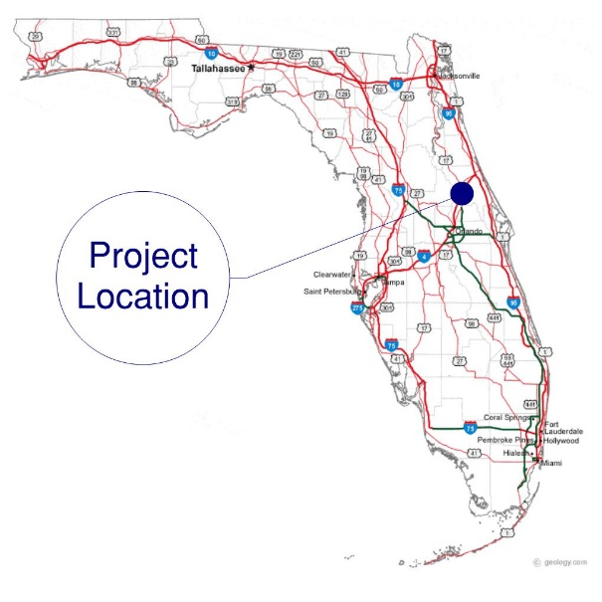
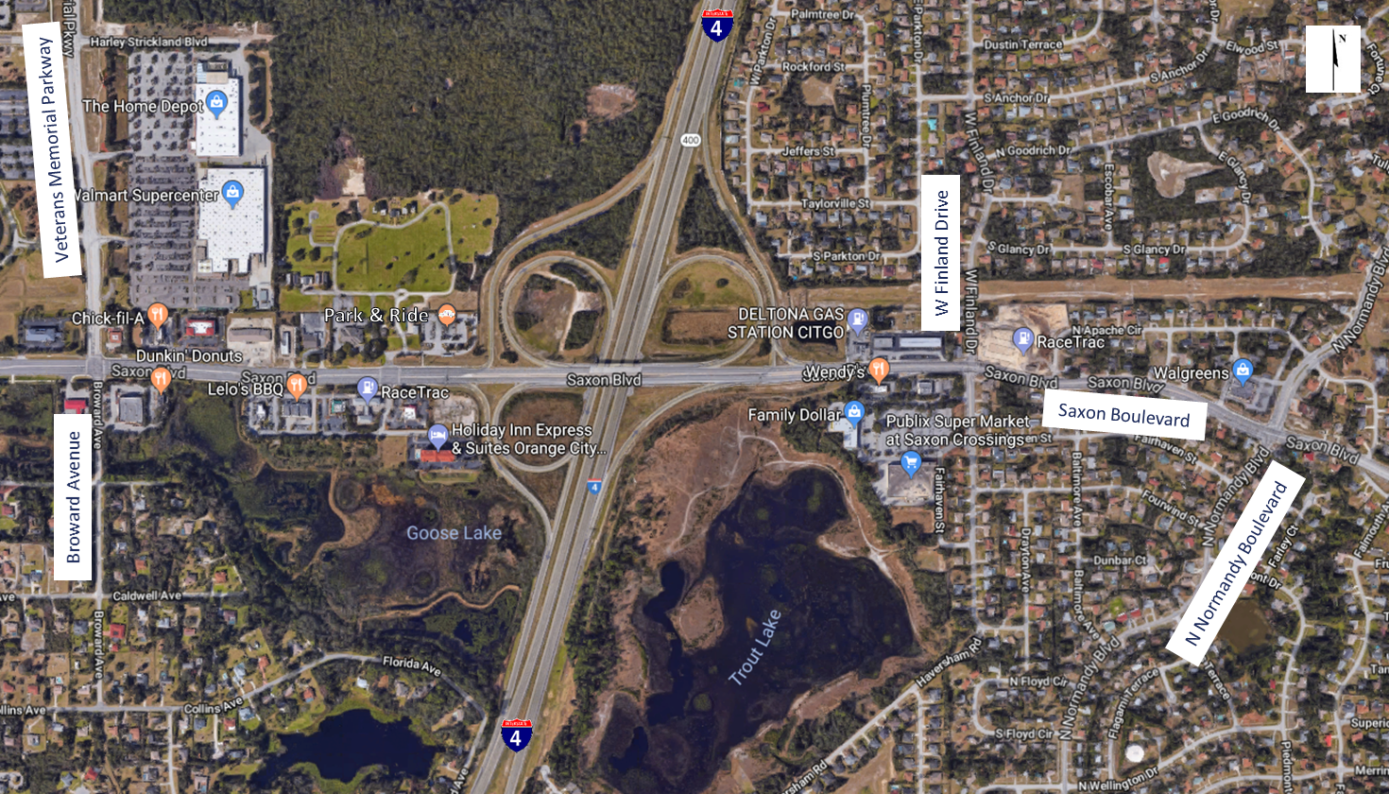
IOAR Example
I-4 at Saxon Boulevard

Slide 45
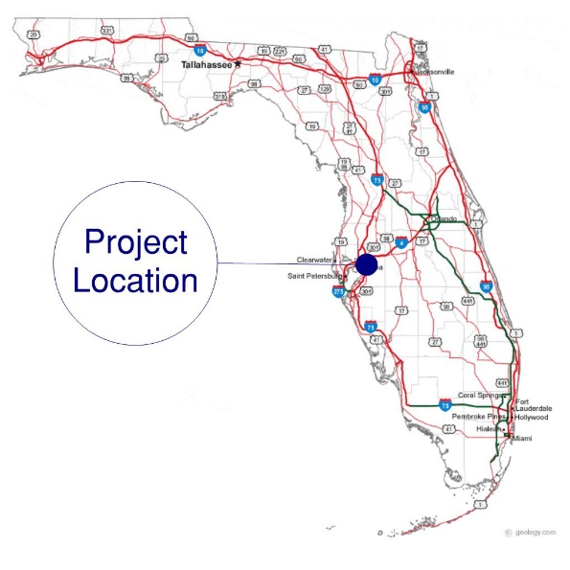
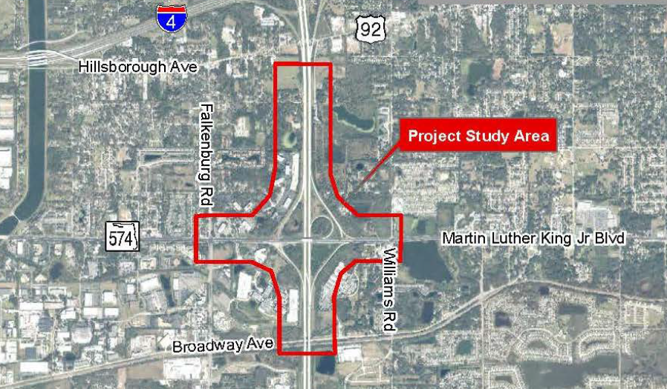
IMR Example
I-75 at Martin Luther King Boulevard

Slide 46
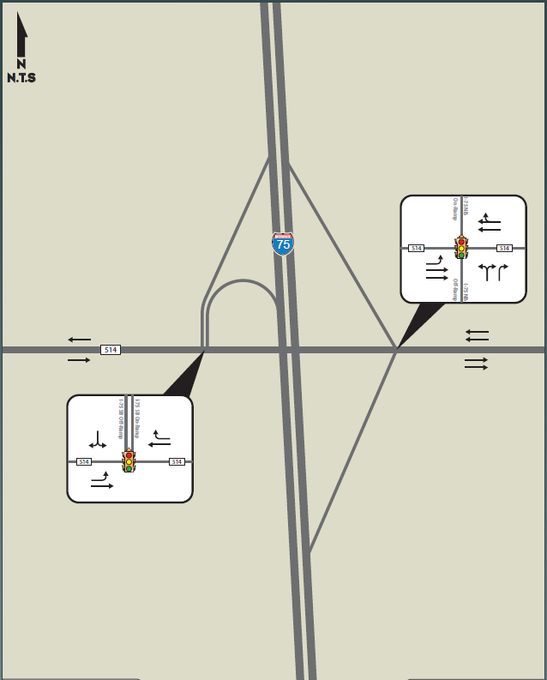
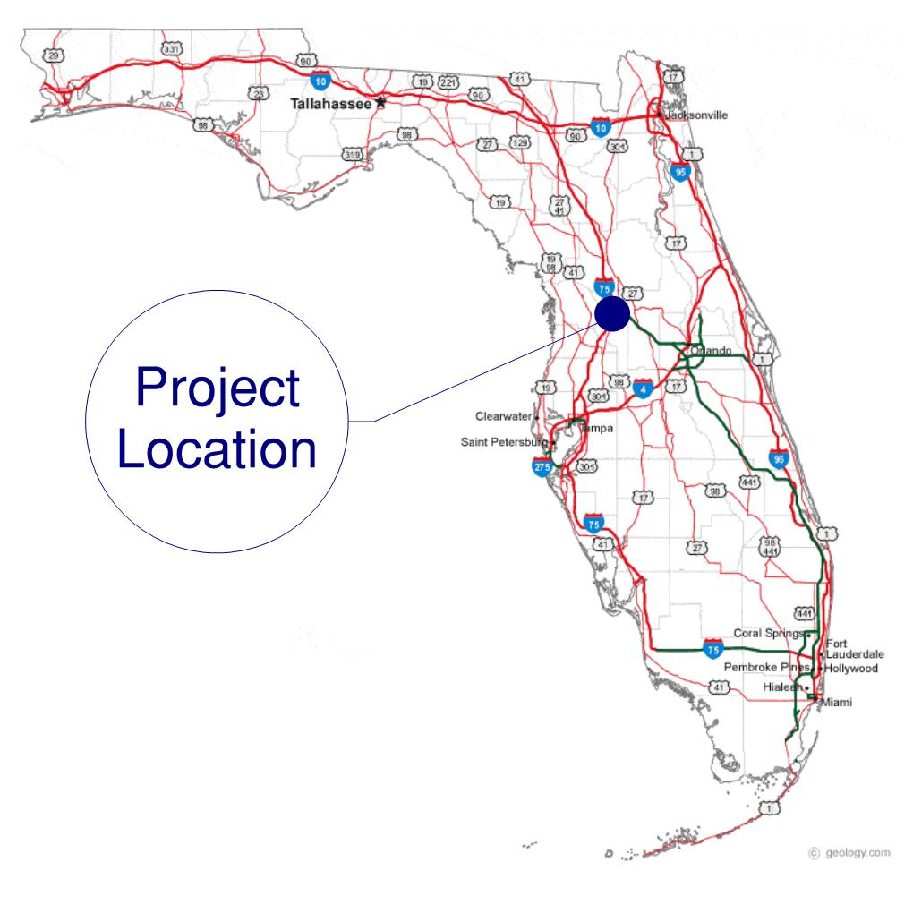
IJR Example
I-75 at CR 514

Slide 47
Example 1:
I-4 at Saxon Boulevard IOAR

Slide 48
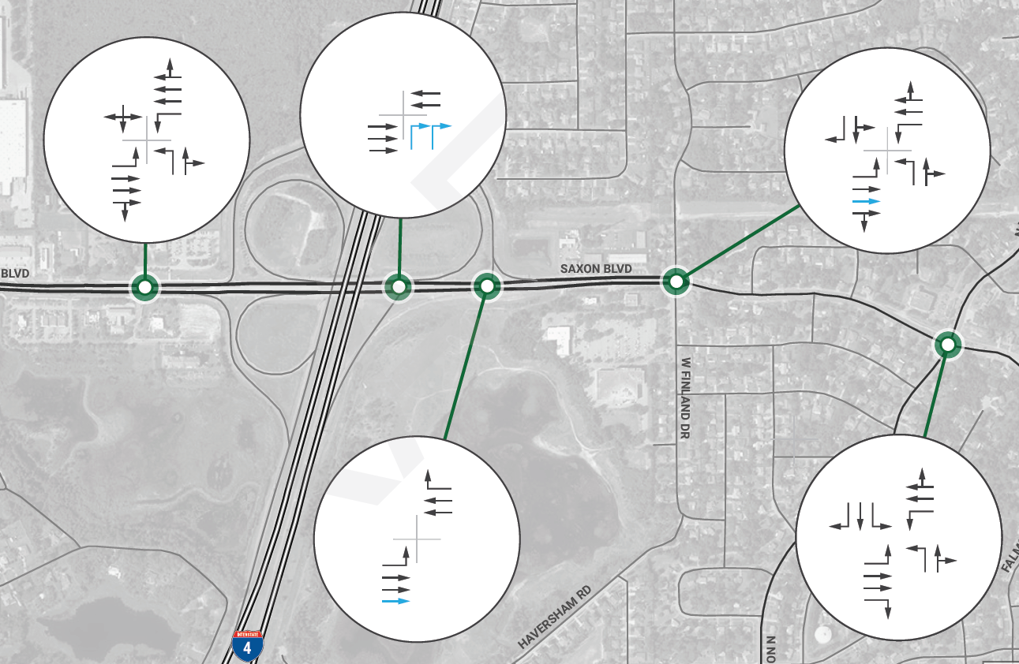
Project Summary
Project location
  Volusia County
Existing conditions
  Partial Cloverleaf
  Loop ramp in all quadrants except
  southeast quadrant
Major recommended improvements
  Signalize the I-4 eastbound off-ramp right turn movement
  Additional eastbound through lane on Saxon Boulevard between the eastbound off-ramp and Normandy Boulevard
Example 1: I-4 at Saxon Boulevard IOAR

Slide 49
Tasks Required
Benefit Cost Analysis is not required for this IOAR safety analysis
IJR
Calculation of Crash Rates
Crash Diagrams
Description of Existing Crash Trends
Safety Performance Functions
Crash Reduction Estimation (CMFs)
Benefit Cost Analysis
Documentation
Example 1: I-4 at Saxon Boulevard IOAR
IMR
Calculation of Crash Rates
Crash Diagrams
Description of Existing Crash Trends
Safety Performance Functions
Empirical Bayes Method
Crash Reduction Estimation (CMFs)
Benefit Cost Analysis
Documentation
IOAR
Calculation of Crash Rates
Crash Diagrams
Description of Existing Crash Trends
Crash Reduction Estimation (CMFs)
Documentation

Slide 50
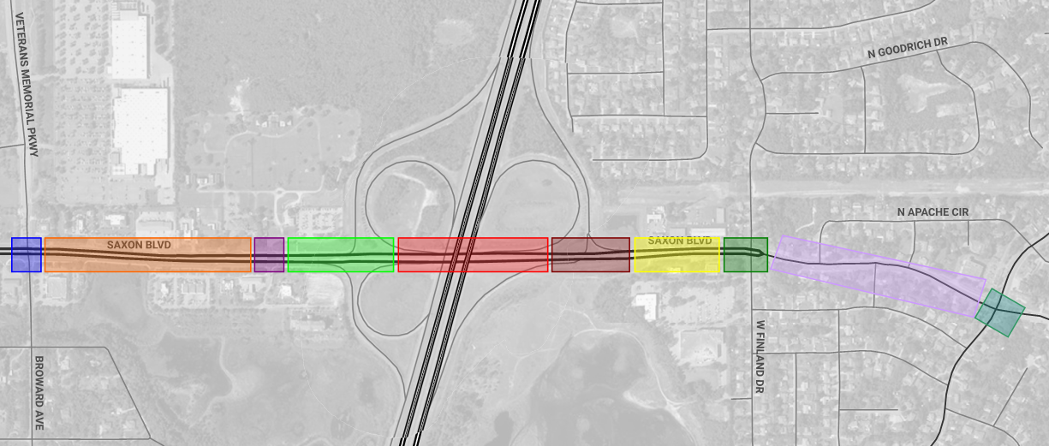
Segmentation Process
This project focused primarily on the arterial capacity and I-4 eastbound off-ramp signalization
Focus on project improvements only for safety analysis
Example 1: I-4 at Saxon Boulevard IOAR
Veterans
Memorial Parkway
Park & Ride
I-4 WB Ramps to I-4 EB Ramps
I-4 EB Ramps to Finland Drive
Finland Drive to Normandy Blvd.
Veterans Memorial Parkway to Park & Ride
I-4 WB Ramps
I-4 EB Ramps
Finland Drive
Normandy Blvd.

Slide 51
Existing Crash Data
Crashes Divided by Location (Segmentation)
 |  | Veterans Memorial Parkway | Veterans Memorial Parkway to Park&Ride | Park&Ride | I-4 WB Ramps | I-4 WB Ramps to I-4 EB Ramps | I-4 EB Ramps | I-4 EB Ramps to Finland Drive | Finland Drive | Finland Drive to Normandy Blvd. | Normandy Blvd.
5-Year Crash History | Fatality | 1 | 0 | 0 | 0 | 0 | 0 | 0 | 0 | 1 | 0
 | Injury | 42 | 5 | 21 | 3 | 1 | 19 | 8 | 25 | 7 | 29
 | PDO | 59 | 12 | 14 | 14 | 1 | 17 | 16 | 36 | 4 | 35
 | Total | 102 | 17 | 35 | 17 | 2 | 36 | 24 | 61 | 12 | 64
Example 1: I-4 at Saxon Boulevard IOAR
3-5 Years of Crash Data Required
Focus on project improvements only for safety analysis

Slide 52
Calculation of Crash Rates
Example 1: I-4 at Saxon Boulevard IOAR
IOAR
Calculation of Crash Rates
Crash Diagrams
Description of Existing Crash Trends
Crash Reduction Estimation (CMFs)
Documentation
IOAR
Calculation of Crash Rates
Crash Diagrams
Description of Existing Crash Trends
Crash Reduction Estimation (CMFs)
Documentation

Slide 53
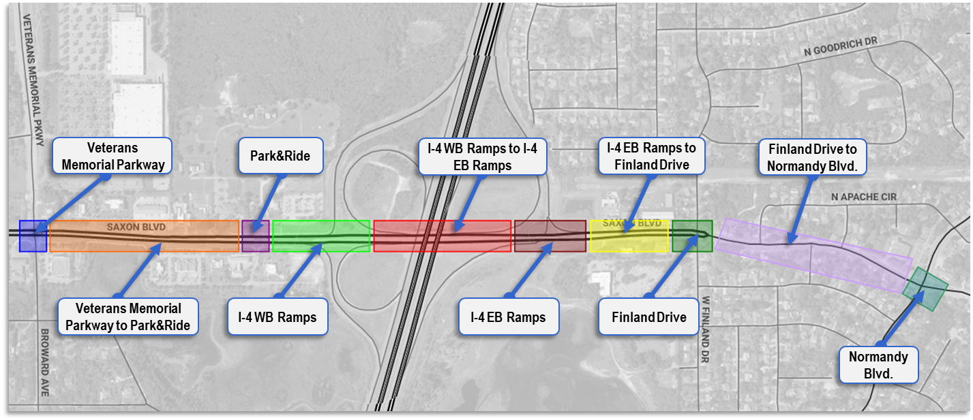
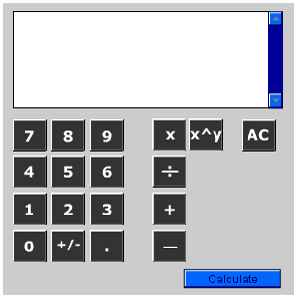
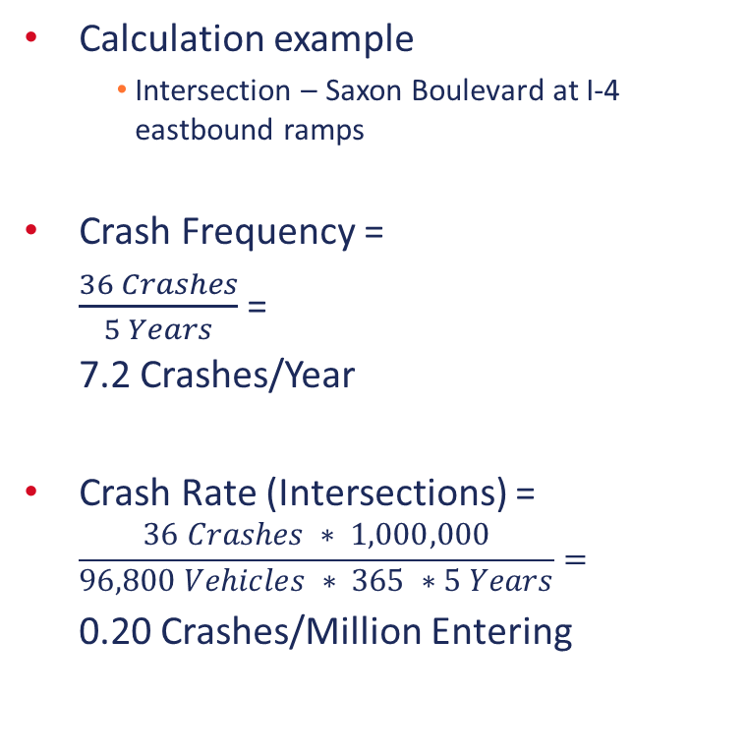


Calculation of Crash Rates
Calculation example
  Intersection – Saxon Boulevard at I-4 eastbound ramps
Crash Frequency =
$\frac{36 Crashes}{5 Years}$ =
7.2 Crashes/Year
Crash Rate (Intersections) =
$$\frac{36 Crashes ∗ 1,000,000}{96,800 Vehicles ∗ 365 ∗5 Years}=$$
0.20 Crashes/Million Entering
Example 1: I-4 at Saxon Boulevard IOAR
$\frac{36 ∗ 1000000}{96800 ∗ 365 ∗ 5}$ = 0.2
$\frac{36}{5}$ = 7.2

Slide 54
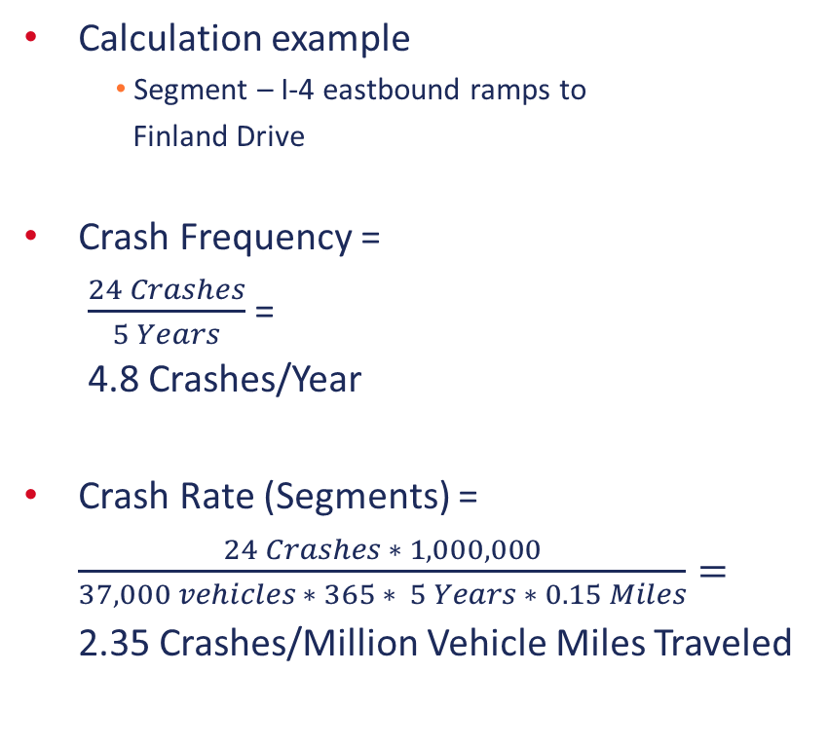


Calculation of Crash Rates
Calculation example
  Segment – I-4 eastbound ramps to
  Finland Drive
Crash Frequency =
$\frac{24 Crashes}{5 Years}$ =
4.8 Crashes/Year
Crash Rate (Segments) =
$\frac{24 Crashes ∗ 1,000,000}{37,000 vehicles ∗ 365 ∗ 5 Years ∗ 0.15 Miles}=$
2.35 Crashes/Million Vehicle Miles Traveled
Example 1: I-4 at Saxon Boulevard IOAR
$\frac{24}{5}$ = 4.8
$\frac{24 ∗ 1000000}{37000 ∗ 365 ∗ 5 ∗0.15}$ = 2.35
IOAR
Calculation of Crash Rates
Crash Diagrams
Description of Existing Crash Trends
Crash Reduction Estimation (CMFs)
Documentation

Slide 55
Calculation of Crash Rates
 |  | Veterans Memorial Parkway | Veterans Memorial Parkway to Park&Ride | Park&Ride | I-4 WB Ramps | I-4 WB Ramps to I-4 EB Ramps | I-4 EB Ramps | I-4 EB Ramps to Finland Drive | Finland Drive | Finland Drive to Normany Blvd | Normandy Blvd
5-Year Crash History | Fatality | 1 | 0 | 0 | 0 | 0 | 0 | 0 | 0 | 1 | 0
 | Injury | 42 | 5 | 21 | 3 | 1 | 19 | 8 | 25 | 7 | 29
 | PDO | 59 | 12 | 14 | 14 | 1 | 17 | 16 | 36 | 4 | 35
 | Total | 102 | 17 | 35 | 17 | 2 | 36 | 24 | 61 | 12 | 64
Daily Entering |  | 50,800 | 41,000 | 41,400 | 46,300 | 41,000 | 96,800 | 37,000 | 39,500 | 37,000 | 49,300
Segment Length |  |  | 1,700' |  |  | 1,400' |  | 800' |  | 1,800'
Crash Frequency |  | 20.4 | 3.4 | 7 | 3.4 | 0.4 | 7.2 | 4.8 | 12.2 | 2.4 | 12.8
Crash Rate |  | 1.10 | 0.71 | 0.46 | 0.20 | 0.10 | 0.20 | 2.35 | 0.85 | 0.52 | 0.71
Example 1: I-4 at Saxon Boulevard IOAR
Focus on project improvements only for safety analysis
IOAR
Calculation of Crash Rates
Crash Diagrams
Description of Existing Crash Trends
Crash Reduction Estimation (CMFs)
Documentation

Slide 56
Crash Diagrams
Example 1: I-4 at Saxon Boulevard IOAR
IOAR
Calculation of Crash Rates
Crash Diagrams
Description of Existing Crash Trends
Crash Reduction Estimation (CMFs)
Documentation
IOAR
Calculation of Crash Rates
Crash Diagrams
Description of Existing Crash Trends
Crash Reduction Estimation (CMFs)
Documentation

Slide 57
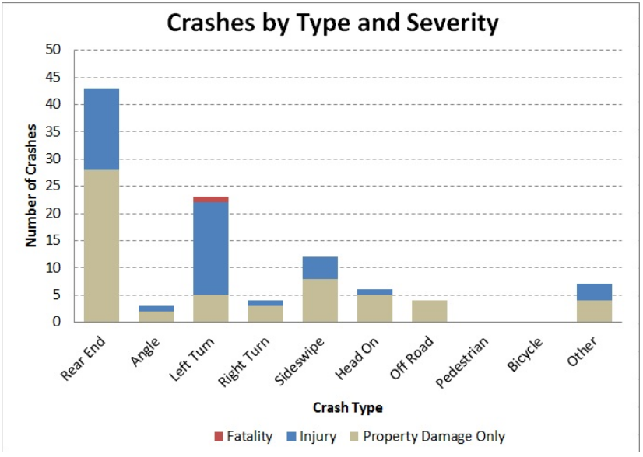
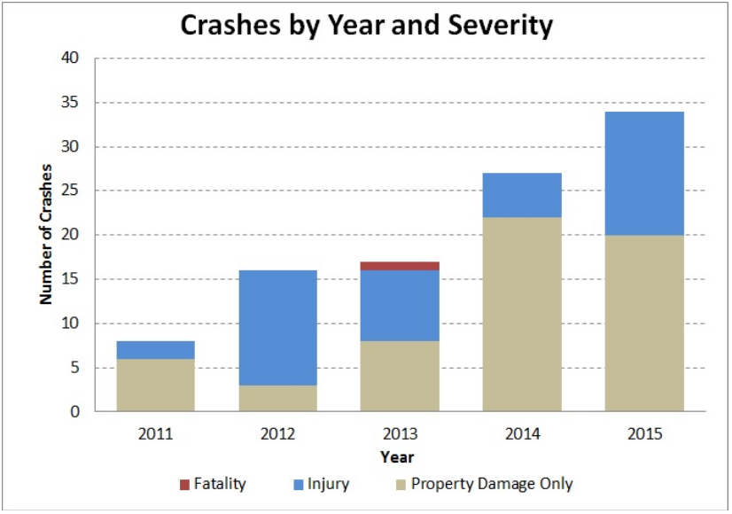
Crash Diagrams
Example 1: I-4 at Saxon Boulevard IOAR
IOAR
Calculation of Crash Rates
Crash Diagrams
Description of Existing Crash Trends
Crash Reduction Estimation (CMFs)
Documentation

Slide 58
Description of Existing Crash Trends
Example 1: I-4 at Saxon Boulevard IOAR
IOAR
Calculation of Crash Rates
Crash Diagrams
Description of Existing Crash Trends
Crash Reduction Estimation (CMFs)
Documentation
IOAR
Calculation of Crash Rates
Crash Diagrams
Description of Existing Crash Trends
Crash Reduction Estimation (CMFs)
Documentation

Slide 59
Description of Existing Crash Trends
During the five-year crash analysis period (2011-2015), 102 crashes were reported at Saxon Boulevard at Veterans Memorial Parkway. Of the 102 crashes, 42 crashes (41 percent) were injury related and 59 crashes (58 percent) resulted in PDO. One (1) fatal crash was reported during the crash analysis period at this location. Other crash metrics at this intersection include:
  Rear End was the highest crash types (43 crashes) – 15 being injury related;
  Left Turn crashes were the second highest crash type (23 crashes) – 17 injury related and 1 fatality; and
  30 crashes (29 percent) occurred at night.
During the five-year crash analysis period (2011-2015), 64 crashes were reported at Saxon Boulevard at Normandy Boulevard. Of the 64 crashes, 29 crashes (45 percent) were injury related and 35 crashes (5 percent) resulted in PDO. No fatal crashes were reported during the crash analysis period at this location. Other crash metrics at this intersection include:
  Rear end crashes were the highest crash type (30 crashes) – 10 being injury related;
  Left turn crashes were the second highest crash type (14 crashes) – 10 being injury related; and
  25 crashes (39 percent) occurred at night.
Example 1: I-4 at Saxon Boulevard IOAR
IOAR
Calculation of Crash Rates
Crash Diagrams
Description of Existing Crash Trends
Crash Reduction Estimation (CMFs)
Documentation

Slide 60
Crash Reduction Estimation (CMFs)
Example 1: I-4 at Saxon Boulevard IOAR
IOAR
Calculation of Crash Rates
Crash Diagrams
Description of Existing Crash Trends
Crash Reduction Estimation (CMFs)
Documentation
IOAR
Calculation of Crash Rates
Crash Diagrams
Description of Existing Crash Trends
Crash Reduction Estimation (CMFs)
Documentation

Slide 61
Crash Reduction Estimation (CMFs)
Major recommended improvements
  Signalize the I-4 eastbound off-ramp right turn movement
  Additional eastbound through lane on Saxon Boulevard between the eastbound off-ramp and Normandy Boulevard
Research CMFs for the recommended improvements
Crash Modification Factors may not exist for each improvement
Example 1: I-4 at Saxon Boulevard IOAR
New Signal
Additional
Eastbound Lane
IOAR
Calculation of Crash Rates
Crash Diagrams
Description of Existing Crash Trends
Crash Reduction Estimation (CMFs)
Documentation

Slide 62
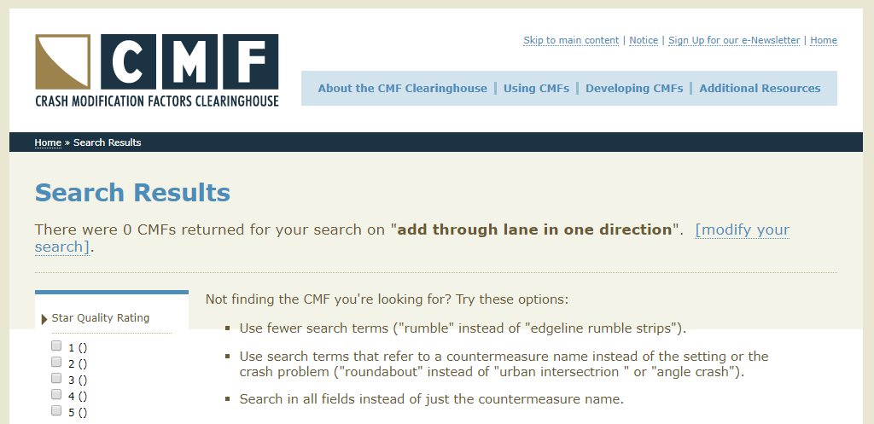
Crash Reduction Estimation (CMFs)
Major recommended improvement
  Additional eastbound through lane on Saxon Boulevard between the eastbound off-ramp and Normandy Boulevard
Example 1: I-4 at Saxon Boulevard IOAR
IOAR
Calculation of Crash Rates
Crash Diagrams
Description of Existing Crash Trends
Crash Reduction Estimation (CMFs)
Documentation

Slide 63
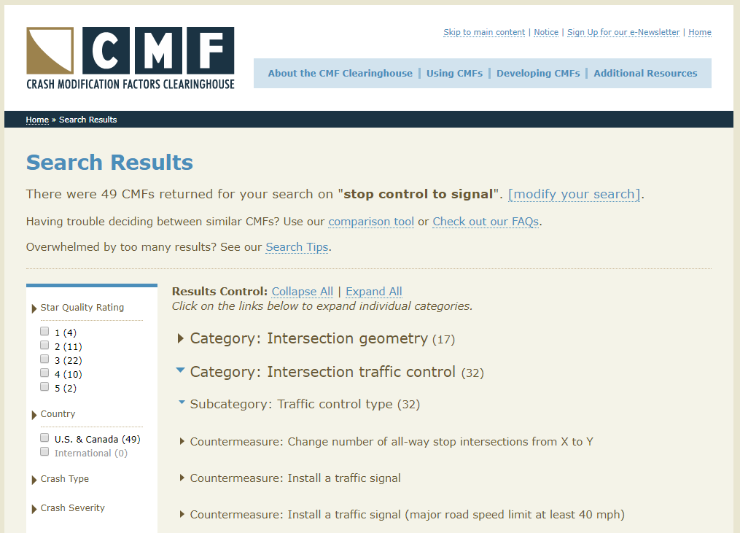
Crash Reduction Estimation (CMFs)
Major recommended improvement
  Signalize the eastbound off-ramp right turn movement
  Selection of CMFs requires engineering judgement and knowledge of project area
Example 1: I-4 at Saxon Boulevard IOAR
IOAR
Calculation of Crash Rates
Crash Diagrams
Description of Existing Crash Trends
Crash Reduction Estimation (CMFs)
Documentation

Slide 64
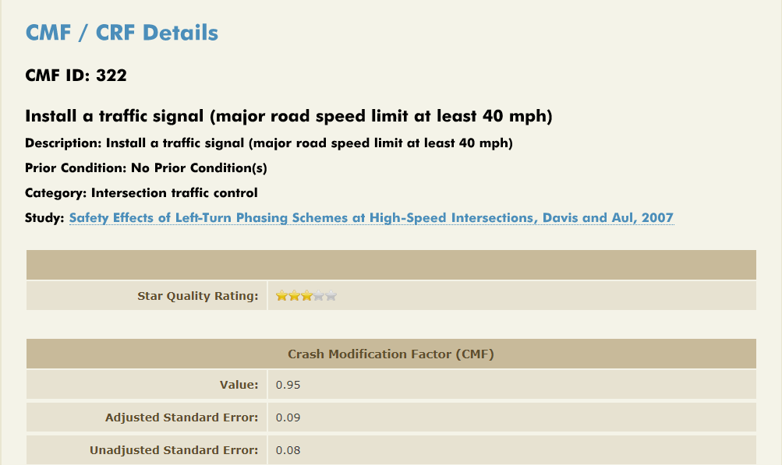
Crash Reduction Estimation (CMFs)
Recommended to use this CMF.
Example 1: I-4 at Saxon Boulevard IOAR
IOAR
Calculation of Crash Rates
Crash Diagrams
Description of Existing Crash Trends
Crash Reduction Estimation (CMFs)
Documentation

Slide 65
Crash Reduction Estimation (CMFs)
Apply CMF to appropriate segment that is being improved
 |  | Veterans Memorial Parkway | Veterans Memorial Parkway to Park&Ride | Park&Ride | I-4 WB Ramps | I-4 WB Ramps to I-4 EB Ramps | I-4 EB Ramps | I-4 EB Ramps to Finland Drive | Finland Drive | Finland Drive to Normany Blvd | Normandy Blvd
5-Year Crash History | Fatality | 1 | 0 | 0 | 0 | 0 | 0 | 0 | 0 | 1 | 0
 | Injury | 42 | 5 | 21 | 3 | 1 | 19 | 8 | 25 | 7 | 29
 | PDO | 59 | 12 | 14 | 14 | 1 | 17 | 16 | 36 | 4 | 35
 | Total | 102 | 17 | 35 | 17 | 2 | 36 | 24 | 61 | 12 | 64
Daily Entering |  | 50,800 | 41,000 | 41,400 | 46,300 | 41,000 | 96,800 | 37,000 | 39,500 | 37,000 | 49,300
Segment Length |  |  | 1,700' |  |  | 1,400' |  | 800' |  | 1,800'
Crash Frequency |  | 20.4 | 3.4 | 7 | 3.4 | 0.4 | 7.2 | 4.8 | 12.2 | 2.4 | 12.8
Crash Rate |  | 1.10 | 0.71 | 0.46 | 0.20 | 0.10 | 0.20 | 2.35 | 0.85 | 0.52 | 0.71
Example 1: I-4 at Saxon Boulevard IOAR
IOAR
Calculation of Crash Rates
Crash Diagrams
Description of Existing Crash Trends
Crash Reduction Estimation (CMFs)
Documentation

Slide 66

Crash Reduction Estimation (CMFs)
CMF for Converting Stop Control to Signal Control is 0.95
Existing Crash Frequency =
7.2 crashes/year
Proposed Crash Frequency = Existing Crash Frequency * (CMF₁ * CMF₂*…CMF_{n})
Proposed Crash Frequency = 7.20 * 0.95 = 6.84 crashes/year
Reduction in 0.36 crashes/year
Example 1: I-4 at Saxon Boulevard IOAR
$7$.2 * 0.95 = 6.84
7.2 – 6.84 = 0.36
IOAR
Calculation of Crash Rates
Crash Diagrams
Description of Existing Crash Trends
Crash Reduction Estimation (CMFs)
Documentation

Slide 67
Documentation
Example 1: I-4 at Saxon Boulevard IOAR
IOAR
Calculation of Crash Rates
Crash Diagrams
Description of Existing Crash Trends
Crash Reduction Estimation (CMFs)
Documentation
IOAR
Calculation of Crash Rates
Crash Diagrams
Description of Existing Crash Trends
Crash Reduction Estimation (CMFs)
Documentation

Slide 68
Example 2:
I-75 at Martin Luther King Boulevard IMR

Slide 69
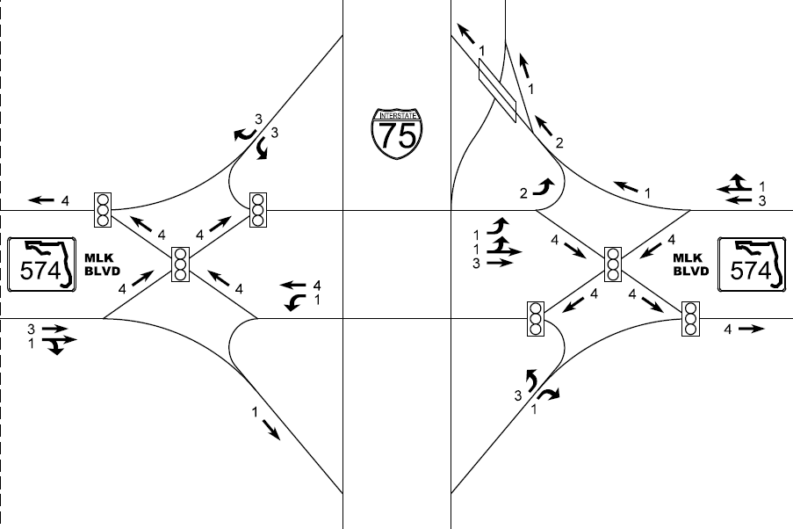
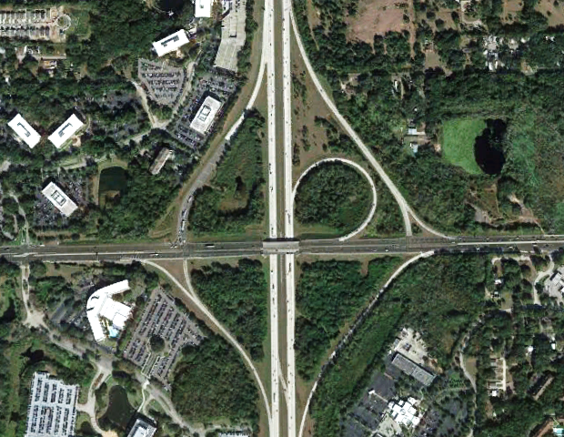

Project Summary
Project location
  Hillsborough County
Existing conditions
  Partial cloverleaf interchange
  Ramp terminals are signalized
  I-75 has 6 General Use Lanes
  Martin Luther King Boulevard
  has 6 lanes
Major recommended improvements
  Convert to existing interchange to Diverging Diamond Interchange (DDI)
  Build northbound Collector-Distributor (C-D) Road
Martin Luther King Jr. Boulevard
Example 2: I-75 at Martin Luther King Boulevard IMR

Slide 70
Tasks Required
Benefit Cost Analysis is required for this IMR safety analysis
IJR
Calculation of Crash Rates
Crash Diagrams
Description of Existing Crash Trends
Safety Performance Functions
Crash Reduction Estimation (CMFs)
Benefit Cost Analysis
Documentation
Example 2: I-75 at Martin Luther King Boulevard IMR
IMR
Calculation of Crash Rates
Crash Diagrams
Description of Existing Crash Trends
Safety Performance Functions
Empirical Bayes Method
Crash Reduction Estimation (CMFs)
Benefit Cost Analysis
Documentation
IOAR
Calculation of Crash Rates
Crash Diagrams
Description of Existing Crash Trends
Crash Reduction Estimation (CMFs)
Documentation

Slide 71
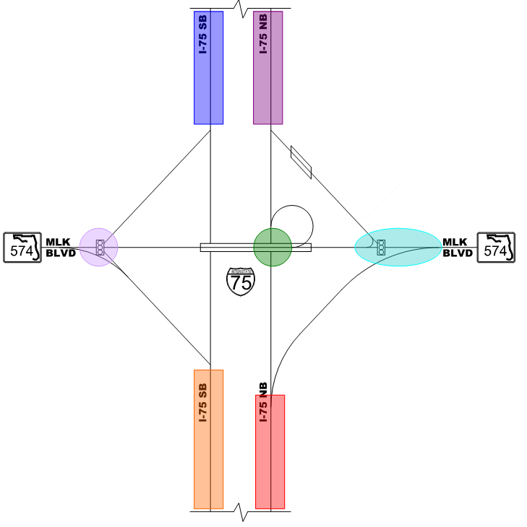
Segmentation Process
Segment the interstate and ramp terminals
  Northbound I-75 Diverge to Eastbound Martin Luther King Boulevard
  Northbound I-75 Diverge to Westbound Martin Luther King Boulevard
  Northbound Ramp Terminal
  Northbound I-75 to I-4 Weave
  Southbound I-75 to I-4 Weave
  Southbound Ramp Terminal
  Southbound I-75 Merge
SB I-75 to
I-4 Weave
NB I-75 to
I-4 Weave
SB Ramp Terminal
NB Ramp Terminal
Example 2: I-75 at Martin Luther King Boulevard IMR
NB I-75 Diverge to
WB MLK
SB I-75 Merge
NB I-75 Diverge to
EB MLK

Slide 72
Existing Crash Data
 |  | 5-Year Crash Total
 |  | Occupant Fell From Vehicle | Rear End | Sideswipe | Angle | Cargo | Head On | Fire | Guardrail | Concrete Barrier | Median Crossover | Overturned | Tree | Moveable Object | Motor Vehicle | Sign | Parked Car | Ditch | All Other | Unknown | None | Total
NB I-75 Diverge to EB MLK | Total | 0 | 15 | 2 | 3 | 0 | 2 | 0 | 5 | 0 | 1 | 1 | 0 | 0 | 1 | 0 | 1 | 1 | 2 | 1 | 0 | 35
 | FI | 0 | 5 | 1 | 1 | 0 | 2 | 0 | 2 | 0 | 0 | 1 | 0 | 0 | 0 | 0 | 0 | 0 | 1 | 0 | 0 | 13
 | PDO | 0 | 10 | 1 | 2 | 0 | 0 | 0 | 3 | 0 | 1 | 0 | 0 | 0 | 1 | 0 | 1 | 1 | 1 | 1 | 0 | 22
NB I-75 Diverge to WB MLK | Total | 0 | 33 | 7 | 2 | 0 | 0 | 0 | 3 | 1 | 0 | 2 | 3 | 0 | 2 | 1 | 0 | 0 | 6 | 1 | 2 | 63
 | FI | 0 | 13 | 3 | 2 | 0 | 0 | 0 | 1 | 0 | 0 | 1 | 1 | 0 | 1 | 0 | 0 | 0 | 2 | 0 | 1 | 25
 | PDO | 0 | 20 | 4 | 0 | 0 | 0 | 0 | 2 | 1 | 0 | 1 | 2 | 0 | 1 | 1 | 0 | 0 | 4 | 1 | 1 | 38
SB I-75 Merge | Total | 0 | 16 | 3 | 2 | 0 | 0 | 0 | 3 | 0 | 0 | 1 | 0 | 3 | 0 | 0 | 1 | 0 | 2 | 0 | 0 | 31
 | FI | 0 | 6 | 1 | 1 | 0 | 0 | 0 | 1 | 0 | 0 | 0 | 0 | 1 | 0 | 0 | 0 | 0 | 1 | 0 | 0 | 11
 | PDO | 0 | 10 | 2 | 1 | 0 | 0 | 0 | 2 | 0 | 0 | 1 | 0 | 2 | 0 | 0 | 1 | 0 | 1 | 0 | 0 | 20
NB I-75 to I-4 Weave | Total | 0 | 74 | 3 | 10 | 1 | 1 | 0 | 8 | 0 | 0 | 2 | 0 | 2 | 1 | 0 | 0 | 0 | 2 | 2 | 0 | 106
 | FI | 0 | 28 | 1 | 4 | 0 | 0 | 0 | 3 | 0 | 0 | 1 | 0 | 1 | 0 | 0 | 0 | 0 | 1 | 1 | 0 | 40
 | PDO | 0 | 46 | 2 | 6 | 1 | 1 | 0 | 5 | 0 | 0 | 1 | 0 | 1 | 1 | 0 | 0 | 0 | 1 | 1 | 0 | 66
SB I-75 to I-4 Weave | Total | 1 | 27 | 8 | 3 | 2 | 0 | 0 | 2 | 1 | 0 | 2 | 0 | 1 | 2 | 0 | 0 | 1 | 3 | 2 | 1 | 55
 | FI | 1 | 12 | 3 | 2 | 1 | 0 | 0 | 1 | 0 | 0 | 1 | 0 | 0 | 1 | 0 | 0 | 0 | 1 | 1 | 0 | 23
 | PDO | 0 | 15 | 5 | 1 | 1 | 0 | 0 | 1 | 1 | 0 | 1 | 0 | 1 | 1 | 0 | 0 | 1 | 2 | 1 | 1 | 32
NB Ramp Terminal | Total | 0 | 3 | 0 | 1 | 0 | 0 | 0 | 0 | 0 | 0 | 0 | 0 | 1 | 0 | 0 | 0 | 0 | 0 | 2 | 0 | 7
 | FI |  | 1 |  | 1 |  |  |  |  |  |  |  |  |  |  |  |  |  |  |  |  | 2
 | PDO |  | 2 |  |  |  |  |  |  |  |  |  |  | 1 |  |  |  |  |  | 2 |  | 5
SB Ramp Terminal | Total | 0 | 5 | 0 | 1 | 0 | 0 | 0 | 0 | 0 | 0 | 0 | 0 | 0 | 0 | 0 | 0 | 0 | 0 | 0 | 0 | 6
 | FI |  | 2 |  |  |  |  |  |  |  |  |  |  |  |  |  |  |  |  |  |  | 2
 | PDO |  | 3 |  | 1 |  |  |  |  |  |  |  |  |  |  |  |  |  |  |  |  | 4
Total | Total | 1 | 173 | 23 | 22 | 3 | 3 | 0 | 21 | 2 | 1 | 8 | 3 | 7 | 6 | 1 | 2 | 2 | 15 | 8 | 3 | 303
 | FI | 1 | 67 | 9 | 11 | 1 | 2 | 0 | 8 | 0 | 0 | 4 | 1 | 2 | 2 | 0 | 0 | 0 | 6 | 2 | 1 | 116
 | PDO | 0 | 106 | 14 | 11 | 2 | 1 | 0 | 13 | 2 | 1 | 4 | 2 | 5 | 4 | 1 | 2 | 2 | 9 | 6 | 2 | 187
Example 2: I-75 at Martin Luther King Boulevard IMR

Slide 73
Calculation of Crash Rates
Example 2: I-75 at Martin Luther King Boulevard IMR
IMR
Calculation of Crash Rates
Crash Diagrams
Description of Existing Crash Trends
Safety Performance Functions
Empirical Bayes Method
Crash Reduction Estimation (CMFs)
Benefit Cost Analysis
Documentation
IMR
Calculation of Crash Rates
Crash Diagrams
Description of Existing Crash Trends
Safety Performance Functions
Empirical Bayes Method
Crash Reduction Estimation (CMFs)
Benefit Cost Analysis
Documentation

Slide 74


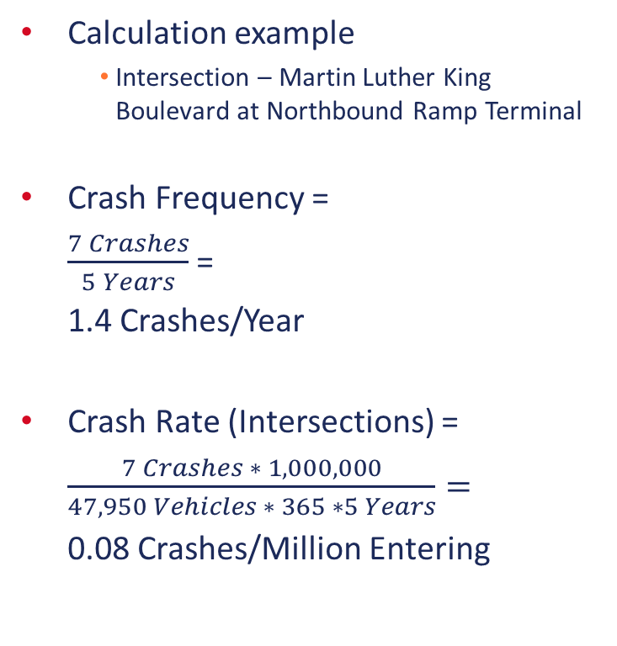
Calculation of Crash Rates
Calculation example
  Intersection – Martin Luther King Boulevard at Northbound Ramp Terminal
Crash Frequency =
$\frac{7 Crashes}{5 Years}$ =
1.4 Crashes/Year
Crash Rate (Intersections) =
$\frac{7 Crashes ∗ 1,000,000}{47,950 Vehicles ∗ 365 ∗5 Years}=$
0.08 Crashes/Million Entering
Example 2: I-75 at Martin Luther King Boulevard IMR
$\frac{7 ∗ 1000000}{47950 ∗ 365 ∗ 5}$ = 0.08
$\frac{7}{5}$ = 1.4

Slide 75


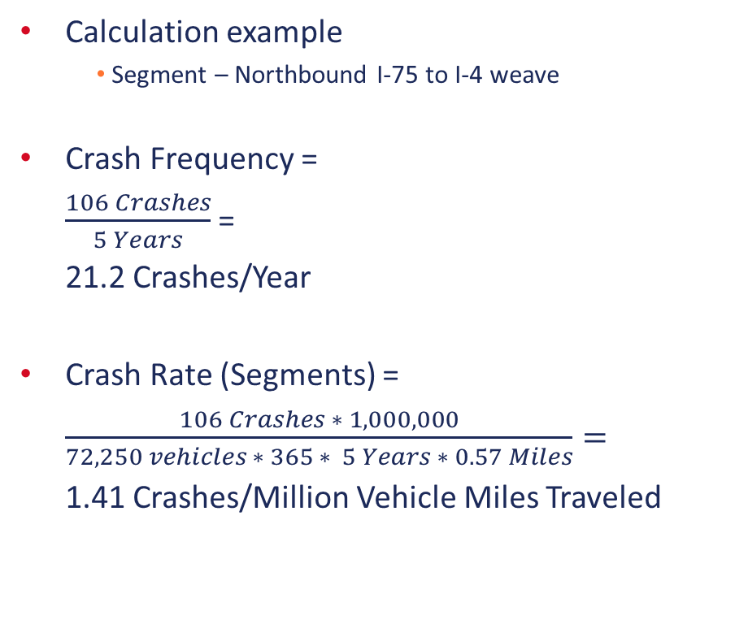
Calculation of Crash Rates
Calculation example
  Segment – Northbound I-75 to I-4 weave
Crash Frequency =
$\frac{106 Crashes}{5 Years}$ =
21.2 Crashes/Year
Crash Rate (Segments) =
$\frac{106 Crashes ∗ 1,000,000}{72,250 vehicles ∗ 365 ∗ 5 Years ∗ 0.57 Miles}=$
1.41 Crashes/Million Vehicle Miles Traveled
Example 2: I-75 at Martin Luther King Boulevard IMR
$\frac{106}{5}$ = 21.2
$\frac{106 ∗ 1000000}{72250 ∗ 365 ∗ 5 ∗0.57}$ = 1.41
IMR
Calculation of Crash Rates
Crash Diagrams
Description of Existing Crash Trends
Safety Performance Functions
Empirical Bayes Method
Crash Reduction Estimation (CMFs)
Benefit Cost Analysis
Documentation

Slide 76
Calculation of Crash Rates
 |  | 5-Year Crash Total | Crash Rates
 |  | Total | Daily Entering | Segment Length | Crash Frequency | Crash Rate
NB I-75 Diverge to EB MLK | Total | 35 | 69,750 | 1,500' | 7 | 0.97
 | FI | 13
 | PDO | 22
NB I-75 Diverge to WB MLK | Total | 63 | 65,850 | 1,500' | 12.6 | 1.85
 | FI | 25
 | PDO | 38
SB I-75 Merge | Total | 31 | 69,750 | 1,500' | 6.2 | 0.86
 | FI | 11
 | PDO | 20
NB I-75 to I-4 Weave | Total | 106 | 72,250 | 3,000' | 21.2 | 1.41
 | FI | 40
 | PDO | 66
SB I-75 to I-4 Weave | Total | 55 | 72,250 | 3,000' | 11 | 0.73
 | FI | 23
 | PDO | 32
NB Ramp Terminal | Total | 7 | 47,950 |  | 1.4 | 0.08
 | FI | 2
 | PDO | 5
SB Ramp Terminal | Total | 6 | 46,050 |  | 1.2 | 0.07
 | FI | 2
 | PDO | 4
Total | Total | 303
 | FI | 116
 | PDO | 187
Example 2: I-75 at Martin Luther King Boulevard IMR
IMR
Calculation of Crash Rates
Crash Diagrams
Description of Existing Crash Trends
Safety Performance Functions
Empirical Bayes Method
Crash Reduction Estimation (CMFs)
Benefit Cost Analysis
Documentation

Slide 77
Crash Diagrams
Example 2: I-75 at Martin Luther King Boulevard IMR
IMR
Calculation of Crash Rates
Crash Diagrams
Description of Existing Crash Trends
Safety Performance Functions
Empirical Bayes Method
Crash Reduction Estimation (CMFs)
Benefit Cost Analysis
Documentation
IMR
Calculation of Crash Rates
Crash Diagrams
Description of Existing Crash Trends
Safety Performance Functions
Empirical Bayes Method
Crash Reduction Estimation (CMFs)
Benefit Cost Analysis
Documentation

Slide 78
Crash Diagrams
Example 2: I-75 at Martin Luther King Boulevard IMR
IMR
Calculation of Crash Rates
Crash Diagrams
Description of Existing Crash Trends
Safety Performance Functions
Empirical Bayes Method
Crash Reduction Estimation (CMFs)
Benefit Cost Analysis
Documentation

Slide 79
Crash Diagrams
Example 2: I-75 at Martin Luther King Boulevard IMR
IMR
Calculation of Crash Rates
Crash Diagrams
Description of Existing Crash Trends
Safety Performance Functions
Empirical Bayes Method
Crash Reduction Estimation (CMFs)
Benefit Cost Analysis
Documentation

Slide 80
Description of Existing Crash Trends
Example 2: I-75 at Martin Luther King Boulevard IMR
IMR
Calculation of Crash Rates
Crash Diagrams
Description of Existing Crash Trends
Safety Performance Functions
Empirical Bayes Method
Crash Reduction Estimation (CMFs)
Benefit Cost Analysis
Documentation
IMR
Calculation of Crash Rates
Crash Diagrams
Description of Existing Crash Trends
Safety Performance Functions
Empirical Bayes Method
Crash Reduction Estimation (CMFs)
Benefit Cost Analysis
Documentation

Slide 81
Description of Existing Crash Trends
“The majority of the crashes are rear end, sideswipe, and angle.”
“In terms of severity, four fatalities occurred along the I-75 northbound direction and three occurred in the southbound direction.”
“The proposed alternatives with the I-4 traffic being removed from I-75 and being moved to a C-D road, and removal of the loop ramp has a potential for reducing the weaving area, the severe fatal crashes, and also will help in reducing the rear-end and sideswipe crashes, which are the main crashes along the I-75 within the interchange area. “
Example 2: I-75 at Martin Luther King Boulevard IMR
IMR
Calculation of Crash Rates
Crash Diagrams
Description of Existing Crash Trends
Safety Performance Functions
Empirical Bayes Method
Crash Reduction Estimation (CMFs)
Benefit Cost Analysis
Documentation

Slide 82
Safety Performance Functions
Example 2: I-75 at Martin Luther King Boulevard IMR
IMR
Calculation of Crash Rates
Crash Diagrams
Description of Existing Crash Trends
Safety Performance Functions
Empirical Bayes Method
Crash Reduction Estimation (CMFs)
Benefit Cost Analysis
Documentation
IMR
Calculation of Crash Rates
Crash Diagrams
Description of Existing Crash Trends
Safety Performance Functions
Empirical Bayes Method
Crash Reduction Estimation (CMFs)
Benefit Cost Analysis
Documentation

Slide 83
Safety Performance Functions
Vehicle Inputs
Terminal Type
Terminal Type Inputs
Vehicle SPF Coefficients
Example 2: I-75 at Martin Luther King Boulevard IMR
Vehicle N_{spf} Results
CMFs
Final Expected Crash Frequency
IMR
Calculation of Crash Rates
Crash Diagrams
Description of Existing Crash Trends
Safety Performance Functions
Empirical Bayes Method
Crash Reduction Estimation (CMFs)
Benefit Cost Analysis
Documentation

Slide 84
Safety Performance Functions
Vehicle Inputs
Lane Change Type
Lane Change Type Inputs
SPF Coefficients
Example 2: I-75 at Martin Luther King Boulevard IMR
N_{spf} Results
CMFs
Final Expected Crash Frequency
IMR
Calculation of Crash Rates
Crash Diagrams
Description of Existing Crash Trends
Safety Performance Functions
Empirical Bayes Method
Crash Reduction Estimation (CMFs)
Benefit Cost Analysis
Documentation

Slide 85
Safety Performance Functions
Safety Performance Function Summary
No Build Summary
 | FI | PDO | TOTAL
Segment from MLK to I-10 | 7.9 | 18.9 | 26.8
NB Diverge to EB MLK | 0.2 | 0.4 | 0.6
NB Diverge to WB MLK | 0.7 | 1.7 | 2.4
SB Merge from MLK | 0.6 | 1.1 | 1.7
NB Ramps | 0.2 | 0.4 | 0.7
SB Ramps | 0.3 | 0.5 | 0.7
Total | 9.9 | 23.1 | 33.0
IMR
Calculation of Crash Rates
Crash Diagrams
Description of Existing Crash Trends
Safety Performance Functions
Empirical Bayes Method
Crash Reduction Estimation (CMFs)
Benefit Cost Analysis
Documentation

Slide 86
Empirical Bayes Method
Example 2: I-75 at Martin Luther King Boulevard IMR
IMR
Calculation of Crash Rates
Crash Diagrams
Description of Existing Crash Trends
Safety Performance Functions
Empirical Bayes Method
Crash Reduction Estimation (CMFs)
Benefit Cost Analysis
Documentation
IMR
Calculation of Crash Rates
Crash Diagrams
Description of Existing Crash Trends
Safety Performance Functions
Empirical Bayes Method
Crash Reduction Estimation (CMFs)
Benefit Cost Analysis
Documentation

Slide 87
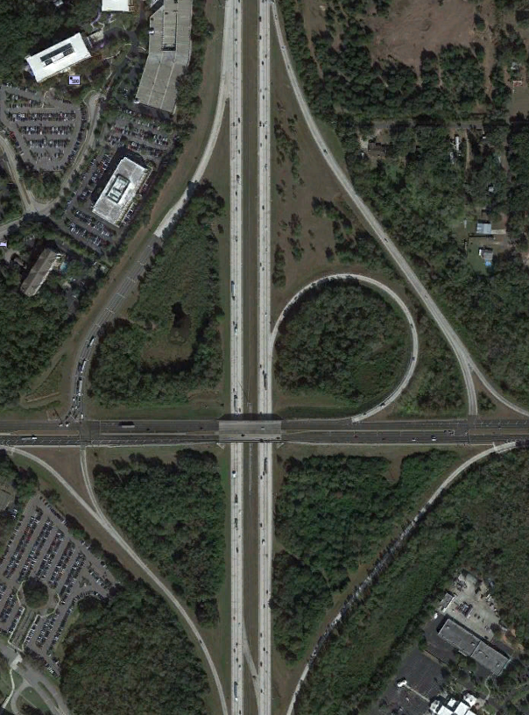
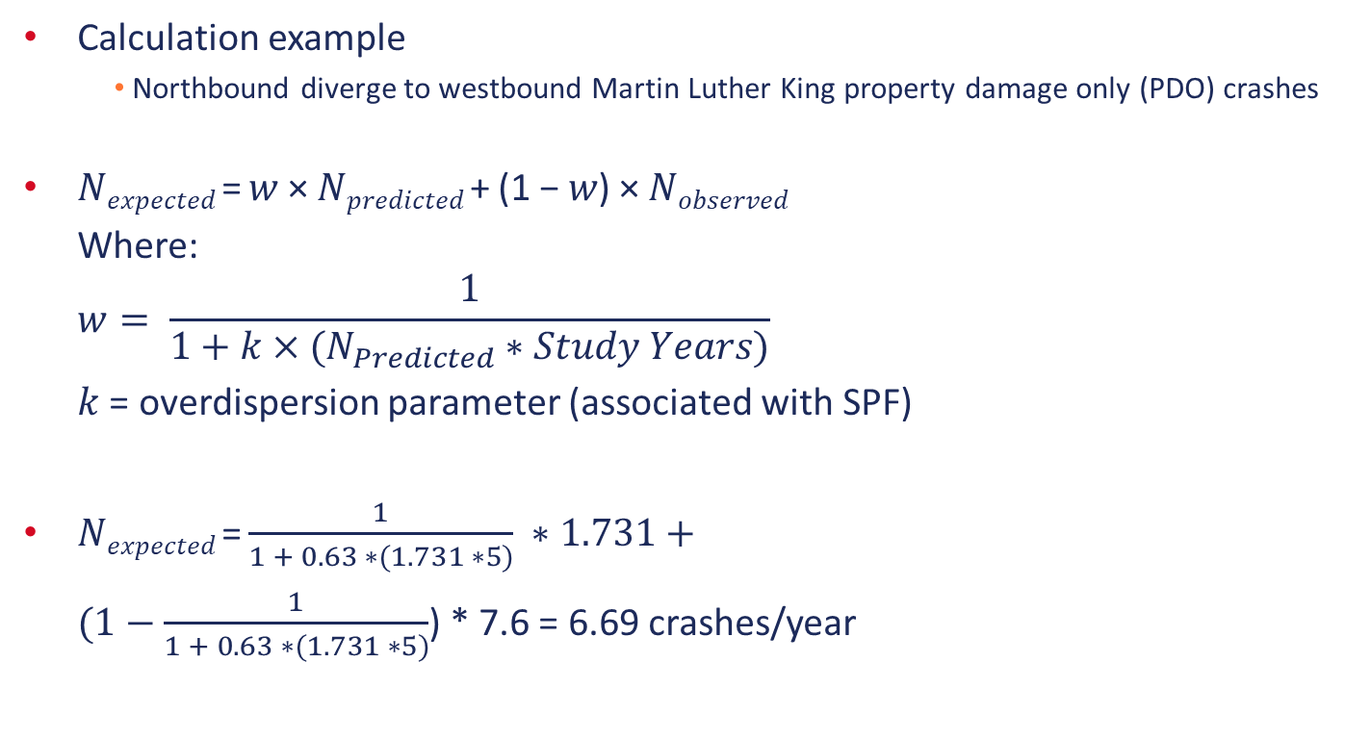
Empirical Bayes Method
Calculation example
  Northbound diverge to westbound Martin Luther King property damage only (PDO) crashes
𝑁_{𝑒𝑥𝑝𝑒𝑐𝑡𝑒𝑑} = 𝑤 × 𝑁_{𝑝𝑟𝑒𝑑𝑖𝑐𝑡𝑒𝑑} + (1 − 𝑤) × 𝑁_{𝑜𝑏𝑠𝑒𝑟𝑣𝑒𝑑}
Where:
$$w= \frac{1}{1+k×(N_{Predicted}∗Study Years)}$$
$k$ = overdispersion parameter (associated with SPF)
𝑁_{𝑒𝑥𝑝𝑒𝑐𝑡𝑒𝑑} = $\frac{1}{1 + 0.63 ∗(1.731 ∗5)} ∗1.731+$
$(1−\frac{1}{1 + 0.63 ∗(1.731 ∗5)}$) * 7.6 = 6.69 crashes/year
Example 2: I-75 at Martin Luther King Boulevard IMR
IMR
Calculation of Crash Rates
Crash Diagrams
Description of Existing Crash Trends
Safety Performance Functions
Empirical Bayes Method
Crash Reduction Estimation (CMFs)
Benefit Cost Analysis
Documentation

Slide 88
Empirical Bayes Method
 | Predicted Crash Totals |  | K Value |  | Weight |  | Observed Frequency |  | Expected Crash Frequency
 |  |  |  |  | 5 Year Study Period
 | FI | PDO | FI | PDO | FI | PDO | FI | PDO | FI | PDO
Freeway Segment (MLK to I-4) | 5.662 | 14.874 |  |  |  |  | 6.4 | 9.8 | 6.40 | 11.27
Multiple-Vehicle | 3.752 | 10.059 | 0.09 | 0.09 | 0.36 | 0.18 | 5.4 | 8.4 | 4.81 | 8.70
Single-Vehicle | 1.910 | 4.815 | 0.06 | 0.08 | 0.654 | 0.340 | 1.0 | 1.4 | 1.595 | 2.562
NB Diverge to EB MLK | 0.159 | 0.433 | 0.56 | 0.63 | 0.692 | 0.422 | 2.6 | 4.4 | 3.93 | 7.81
NB Diverge to WB MLK | 0.634 | 1.731 | 0.56 | 0.63 | 0.36 | 0.15 | 5.0 | 7.6 | 3.43 | 6.69
SB Merge | 0.273 | 0.867 | 0.04 | 0.04 | 1.00 | 1.00 | 2.2 | 4.0 | 0.27 | 0.87
NB Ramp Terminal | 0.223 | 0.245 | 0.11 | 0.25 | 1.00 | 1.00 | 0.4 | 1.0 | 0.22 | 0.25
SB Ramp Terminal | 0.248 | 0.406 | 0.09 | 0.14 | 0.90 | 0.78 | 0.4 | 0.8 | 0.26 | 0.49
Total | 7.20 | 18.56 |  |  |  |  | 17.0 | 27.6 | 10.59 | 19.56
Example 2: I-75 at Martin Luther King Boulevard IMR
IMR
Calculation of Crash Rates
Crash Diagrams
Description of Existing Crash Trends
Safety Performance Functions
Empirical Bayes Method
Crash Reduction Estimation (CMFs)
Benefit Cost Analysis
Documentation

Slide 89
Crash Reduction Estimations (CMFs)
Example 2: I-75 at Martin Luther King Boulevard IMR
IMR
Calculation of Crash Rates
Crash Diagrams
Description of Existing Crash Trends
Safety Performance Functions
Empirical Bayes Method
Crash Reduction Estimation (CMFs)
Benefit Cost Analysis
Documentation
IMR
Calculation of Crash Rates
Crash Diagrams
Description of Existing Crash Trends
Safety Performance Functions
Empirical Bayes Method
Crash Reduction Estimation (CMFs)
Benefit Cost Analysis
Documentation

Slide 90
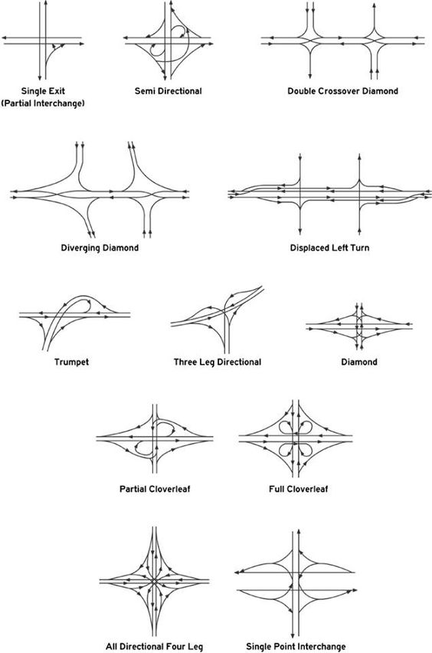
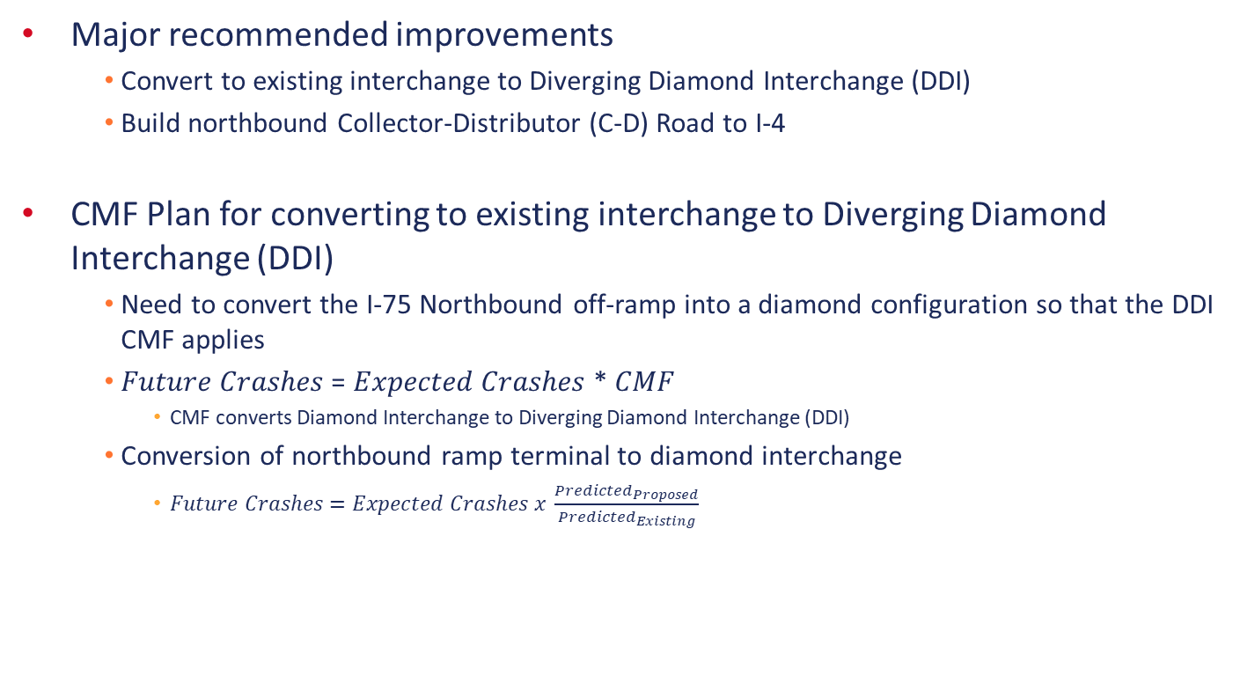
Crash Reduction Estimations (CMFs)
Major recommended improvements
  Convert to existing interchange to Diverging Diamond Interchange (DDI)
  Build northbound Collector-Distributor (C-D) Road to I-4
CMF Plan for converting to existing interchange to Diverging Diamond Interchange (DDI)
  Need to convert the I-75 Northbound off-ramp into a diamond configuration so that the DDI CMF applies
  𝐹𝑢𝑡𝑢𝑟𝑒 𝐶𝑟𝑎𝑠ℎ𝑒𝑠 = 𝐸𝑥𝑝𝑒𝑐𝑡𝑒𝑑 𝐶𝑟𝑎𝑠ℎ𝑒𝑠 * 𝐶𝑀𝐹
    CMF converts Diamond Interchange to Diverging Diamond Interchange (DDI)
  Conversion of northbound ramp terminal to diamond interchange
    $Future Crashes=Expected Crashes x \frac{{Predicted}_{Proposed}}{{Predicted}_{Existing}}$
Example 2: I-75 at Martin Luther King Boulevard IMR
IMR
Calculation of Crash Rates
Crash Diagrams
Description of Existing Crash Trends
Safety Performance Functions
Empirical Bayes Method
Crash Reduction Estimation (CMFs)
Benefit Cost Analysis
Documentation

Slide 91

Crash Reduction Estimations (CMFs)
Example 2: I-75 at Martin Luther King Boulevard IMR
Change Ramp Type in SPF Equations
$CMF=\frac{{Predicted}_{Proposed}}{{Predicted}_{Existing}}=\frac{0.901}{0.685}$ = 1.315
Predicted_{Existing} = 0.685
Predicted_{Proposed} = 0.901
IMR
Calculation of Crash Rates
Crash Diagrams
Description of Existing Crash Trends
Safety Performance Functions
Empirical Bayes Method
Crash Reduction Estimation (CMFs)
Benefit Cost Analysis
Documentation

Slide 92
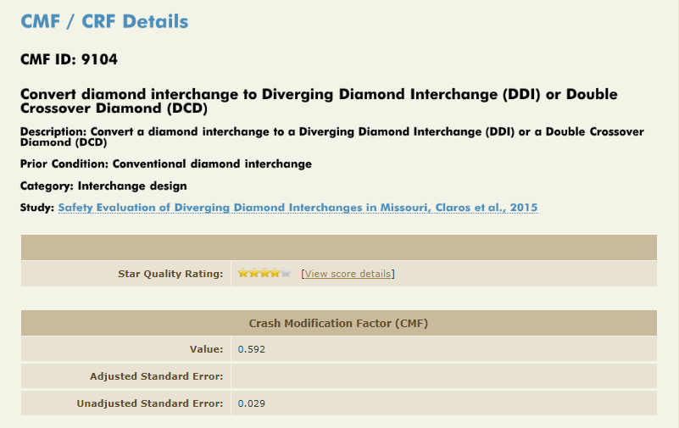
Crash Reduction Estimations (CMFs)
Major recommended improvements
  Convert to existing interchange to Diverging Diamond Interchange (DDI)
Example 2: I-75 at Martin Luther King Boulevard IMR
IMR
Calculation of Crash Rates
Crash Diagrams
Description of Existing Crash Trends
Safety Performance Functions
Empirical Bayes Method
Crash Reduction Estimation (CMFs)
Benefit Cost Analysis
Documentation

Slide 93
Crash Reduction Estimations (CMFs)
Major recommended improvements
  Build northbound Collector-Distributor (C-D) Road to I-4
Need to estimate safety benefit of No-Build C-D Road
First, complete SPF calculation for existing freeway segment – No C-D Road
Example 2: I-75 at Martin Luther King Boulevard IMR
SPF_{Existing Freeway Segment} = 26.876
IMR
Calculation of Crash Rates
Crash Diagrams
Description of Existing Crash Trends
Safety Performance Functions
Empirical Bayes Method
Crash Reduction Estimation (CMFs)
Benefit Cost Analysis
Documentation

Slide 94
Crash Reduction Estimations (CMFs)
  Second, complete SPF calculation for proposed freeway segment (fewer lanes) and proposed C-D road
Example 2: I-75 at Martin Luther King Boulevard IMR
SPF_{Proposed Freeway Segment} = 21.722
SPF_{C-D Road} = 0.378
IMR
Calculation of Crash Rates
Crash Diagrams
Description of Existing Crash Trends
Safety Performance Functions
Empirical Bayes Method
Crash Reduction Estimation (CMFs)
Benefit Cost Analysis
Documentation

Slide 95


Crash Reduction Estimations (CMFs)
Third, divide proposed SPF by existing SPF to determine final CMF
$CMF=\frac{{SPF}_{Proposed Freeway Segment }+{SPF}_{C−D Road }}{{SPF}_{Existing Freeway Segment }}$
$CMF=\frac{21.722 + 0.378}{26.876}$ = 0.822
Example 2: I-75 at Martin Luther King Boulevard IMR
$\frac{21.722 + 0.378}{26.876}$ = 0.822
IMR
Calculation of Crash Rates
Crash Diagrams
Description of Existing Crash Trends
Safety Performance Functions
Empirical Bayes Method
Crash Reduction Estimation (CMFs)
Benefit Cost Analysis
Documentation

Slide 96
Crash Reduction Estimations (CMFs)
Diamond to DDI CMF = 0.592
Loop Ramp to Diamond CMF = 1.315
Freeway to C-D Road CMF = 0.822
 |  | MLK Interchange |  |  |  |  | I-75 C-D Road | Total
 |  | NB Diverge to EB MLK | NB Diverge to WB MLK | SB Merge | NB Ramp Terminal | SB Ramp Terminal | Freeway Segment
Existing Condition Expected Crash Frequency | Fatal Injury | 3.93 | 3.43 | 0.27 | 0.22 | 0.26 | 6.40 | 14.52
 | PDO | 7.81 | 6.69 | 0.87 | 0.25 | 0.49 | 11.27 | 27.37
 | Total | 11.73 | 10.12 | 1.14 | 0.47 | 0.76 | 17.67 | 41.89
CMFs | Fatal Injury | 0.592 | 0.592 | 0.592 | 0.778 | 0.592 | 0.822
 | PDO | 0.592 | 0.592 | 0.592 | 0.778 | 0.592 | 0.822
Proposed Condition Expected Crash Frequency | Fatal Injury | 2.32 | 2.03 | 0.16 | 0.17 | 0.16 | 5.26 | 10.11
 | PDO | 4.62 | 3.96 | 0.51 | 0.19 | 0.29 | 9.26 | 18.84
 | Total | 6.95 | 5.99 | 0.67 | 0.36 | 0.45 | 15.52 | 28.95
Example 2: I-75 at Martin Luther King Boulevard IMR
0.592 * 1.315
IMR
Calculation of Crash Rates
Crash Diagrams
Description of Existing Crash Trends
Safety Performance Functions
Empirical Bayes Method
Crash Reduction Estimation (CMFs)
Benefit Cost Analysis
Documentation

Slide 97
Benefit Cost Analysis
Example 2: I-75 at Martin Luther King Boulevard IMR
IMR
Calculation of Crash Rates
Crash Diagrams
Description of Existing Crash Trends
Safety Performance Functions
Empirical Bayes Method
Crash Reduction Estimation (CMFs)
Benefit Cost Analysis
Documentation
IMR
Calculation of Crash Rates
Crash Diagrams
Description of Existing Crash Trends
Safety Performance Functions
Empirical Bayes Method
Crash Reduction Estimation (CMFs)
Benefit Cost Analysis
Documentation

Slide 98

Benefit Cost Analysis
Assign dollar amount to crash
  $450,000 per Fatal/Injury Crash
  $30,000 per Property Damage Only Crash
This project is expected to decrease crash cost per year by $2,240,400
  Fatal/Injury Crash Cost Reduction:
  $450,000 * (14.52 existing expected crashes – 10.11 proposed expected crashes) = $1,984,500
  Property Damage Only Crash Cost Reduction:
  $30,000 * (27.37 existing expected crashes – 18.84 proposed expected crashes) = $255,900
Include this benefit in benefit cost analysis
Example 2: I-75 at Martin Luther King Boulevard IMR
IMR
Calculation of Crash Rates
Crash Diagrams
Description of Existing Crash Trends
Safety Performance Functions
Empirical Bayes Method
Crash Reduction Estimation (CMFs)
Benefit Cost Analysis
Documentation

Slide 99
Documentation
Example 2: I-75 at Martin Luther King Boulevard IMR
IMR
Calculation of Crash Rates
Crash Diagrams
Description of Existing Crash Trends
Safety Performance Functions
Empirical Bayes Method
Crash Reduction Estimation (CMFs)
Benefit Cost Analysis
Documentation
IMR
Calculation of Crash Rates
Crash Diagrams
Description of Existing Crash Trends
Safety Performance Functions
Empirical Bayes Method
Crash Reduction Estimation (CMFs)
Benefit Cost Analysis
Documentation

Slide 100
Example 3:
I-75 at CR 514

Slide 101

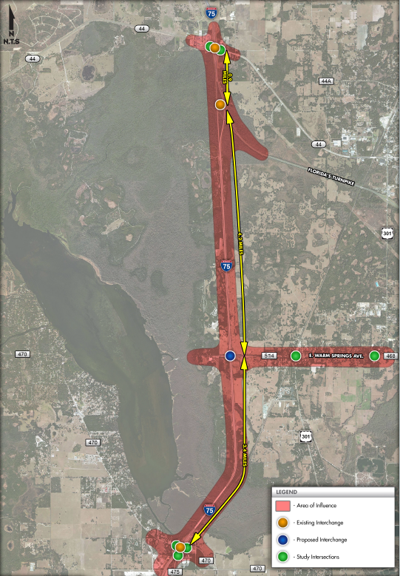
Project Summary
Project location
  Sumter County
Existing conditions
  I-75 has 4 General Use Lanes
  Area of influence includes
    I-75 at CR 470 interchange
    I-75 at Florida’s Turnpike interchange
    I-75 at SR 44
Major recommended improvements
  New partial cloverleaf interchange between CR 470 and Florida’s Turnpike along I-75
Example 3: I-75 at CR 514 IJR

Slide 102
Tasks Required
Benefit Cost Analysis is required for this IJR safety analysis
IJR
Calculation of Crash Rates
Crash Diagrams
Description of Existing Crash Trends
Safety Performance Functions
Crash Reduction Estimation (CMFs)
Benefit Cost Analysis
Documentation
Example 3: I-75 at CR 514 IJR
IMR
Calculation of Crash Rates
Crash Diagrams
Description of Existing Crash Trends
Safety Performance Functions
Empirical Bayes Method
Crash Reduction Estimation (CMFs)
Benefit Cost Analysis
Documentation
IOAR
Calculation of Crash Rates
Crash Diagrams
Description of Existing Crash Trends
Crash Reduction Estimation (CMFs)
Documentation

Slide 103
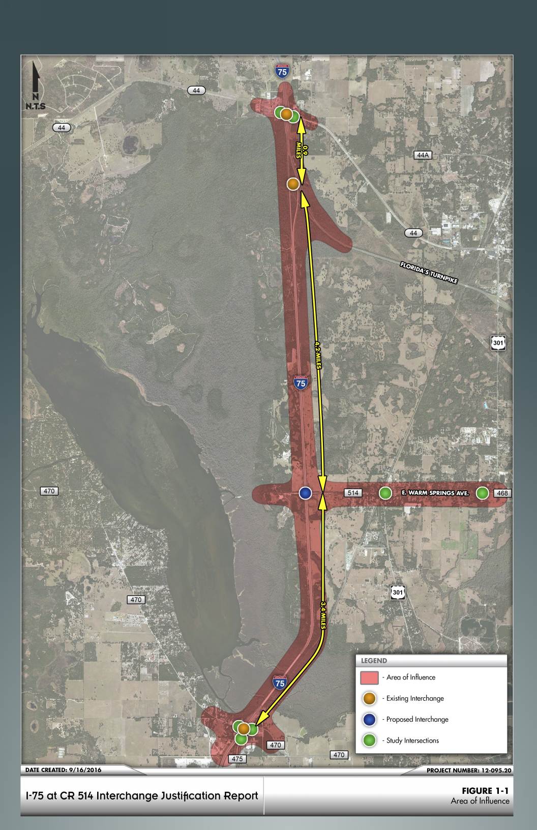
Segmentation Process
Include surrounding arterials, interchanges and freeway segments
  I-75 south of CR 470
  CR 470 interchange area
  I-75 between Florida's Turnpike and CR 470
  Florida’s Turnpike east of I-75
  SR 44 interchange area
  I-75 north of SR 44
I-75 north of SR 44
Florida’s Turnpike east of I-75
SR 44
Interchange area
Example 3: I-75 at CR 514 IJR
I-75 between Florida’s Turnpike and CR 470
CR 470
interchange area
I-75 south of CR 470

Slide 104

Segmentation Process
Diverge Area
44
Merge Area
Ramp Terminal –
NB Ramps
Adjacent Arterial (SR 44)
Example 3: I-75 at CR 514 IJR
Ramp Terminal –
SB Ramps
Merge Area
Adjacent Arterial (SR 44)
Diverge Area

Slide 105

Segmentation Process
470
Diverge Area
Merge Area
Example 3: I-75 at CR 514 IJR
Adjacent Arterial (CR 470)
Ramp Terminal –
NB Ramps
Ramp Terminal –
SB Ramps
Adjacent Arterial (CR 470)
Merge Area
Diverge Area

Slide 106
Existing Crash Data
3 Year Crash Data (2010-2012)
Roadway | Facility Type | Limits | Average AADT | # of Crashes
I-75 | Interstate | 1 mile S of CR 470 | 39,200 | 37
CR 470 | Arterial | 1/2 mile E & W of I-75 | 7,450 | 20
I-75 | Interstate | CR 470 to SR 44 | 40,690 | 199
SR 44 | Arterial | 1/2 mile E & W of I-75 | 10,950 | 52
I-75 | Interstate | 1 mile north of SR 44 | 65,000 | 22
Example 3: I-75 at CR 514 IJR

Slide 107
Calculation of Crash Rates
Example 3: I-75 at CR 514 IJR
IJR
Calculation of Crash Rates
Crash Diagrams
Description of Existing Crash Trends
Safety Performance Functions
Crash Reduction Estimation (CMFs)
Benefit Cost Analysis
Documentation
UR
Calculation of Crash Rates
Crash Diagrams
Description of Existing Crash Trends
Safety Performance Functions
Crash Reduction Estimation (CMFs)
Benefit Cost Analysis
Documentation

Slide 108
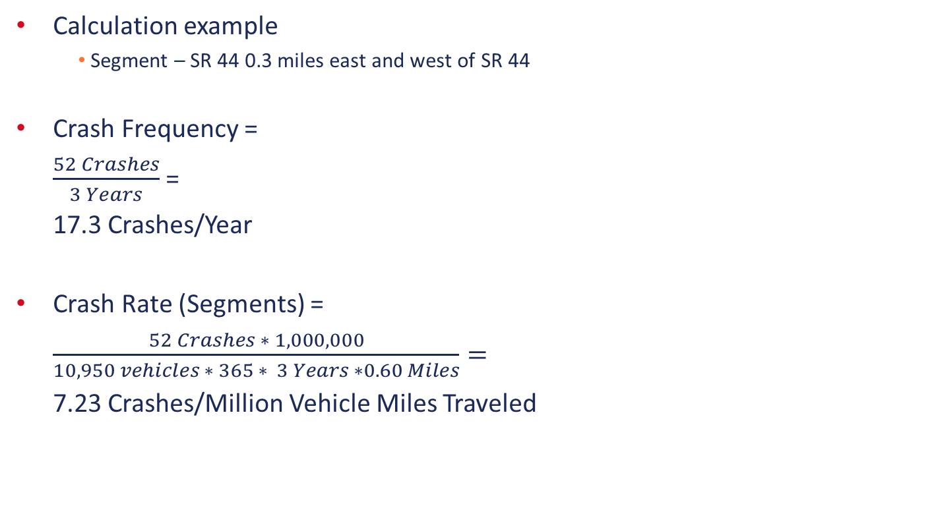


Calculation of Crash Rates
Calculation example
  Segment – SR 44 0.3 miles east and west of SR 44
Crash Frequency =
$\frac{52 Crashes}{3 Years}$ =
17.3 Crashes/Year
Crash Rate (Segments) =
$\frac{52 Crashes ∗ 1,000,000}{10,950 vehicles ∗ 365 ∗ 3 Years ∗0.60 Miles}=$
7.23 Crashes/Million Vehicle Miles Traveled
$\frac{52}{3}$ = 17.3
Example 3: I-75 at CR 514 IJR
$\frac{52 ∗ 1000000}{10950 ∗ 365 ∗3 ∗ 0.6}$ = 7.23

Slide 109
Calculation of Crash Rates
3 Year Crash Data (2010-2012)
Roadway | Facility Type | Limits | Average AADT | # of Crashes | Crash Frequency | Crash Rate
I-75 | Interstate | 1 mile S of CR 470 | 39,200 | 37 | 12.3 | 0.86
CR 470 | Arterial | 0.3 miles E & W of I-75 | 7,450 | 20 | 6.7 | 4.09
I-75 | Interstate | CR 470 to SR 44 | 40,690 | 199 | 66.3 | 0.50
SR 44 | Arterial | 0.3 miles E & W of I-75 | 10,950 | 52 | 17.3 | 7.23
I-75 | Interstate | 1 mile north of SR 44 | 65,000 | 22 | 7.3 | 0.31
Example 3: I-75 at CR 514 IJR
UR
Calculation of Crash Rates
Crash Diagrams
Description of Existing Crash Trends
Safety Performance Functions
Crash Reduction Estimation (CMFs)
Benefit Cost Analysis
Documentation

Slide 110
Crash Diagrams
Example 3: I-75 at CR 514 IJR
IJR
Calculation of Crash Rates
Crash Diagrams
Description of Existing Crash Trends
Safety Performance Functions
Crash Reduction Estimation (CMFs)
Benefit Cost Analysis
Documentation
UR
Calculation of Crash Rates
Crash Diagrams
Description of Existing Crash Trends
Safety Performance Functions
Crash Reduction Estimation (CMFs)
Benefit Cost Analysis
Documentation

Slide 111
Crash Diagrams
Example 3: I-75 at CR 514 IJR
Crash Frequency (Crashes/Year)
Miles of Crash Data
UR
Calculation of Crash Rates
Crash Diagrams
Description of Existing Crash Trends
Safety Performance Functions
Crash Reduction Estimation (CMFs)
Benefit Cost Analysis
Documentation

Slide 112
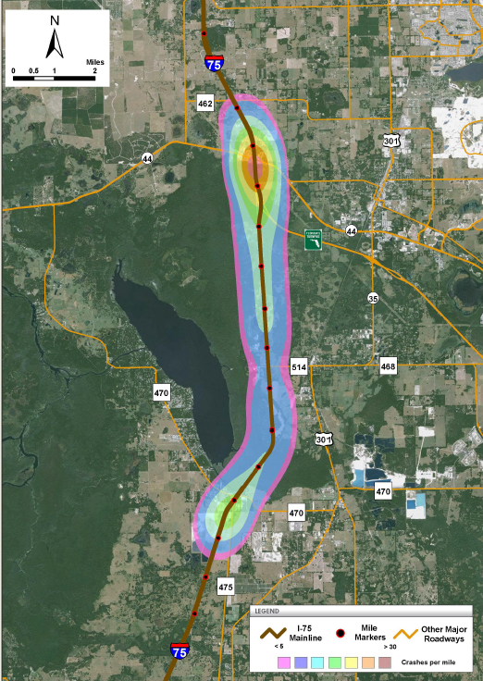

Crash Diagrams
Example 3: I-75 at CR 514 IJR
UR
Calculation of Crash Rates
Crash Diagrams
Description of Existing Crash Trends
Safety Performance Functions
Crash Reduction Estimation (CMFs)
Benefit Cost Analysis
Documentation

Slide 113
Description of Existing Crash Trends
Example 3: I-75 at CR 514 IJR
IJR
Calculation of Crash Rates
Crash Diagrams
Description of Existing Crash Trends
Safety Performance Functions
Crash Reduction Estimation (CMFs)
Benefit Cost Analysis
Documentation
UR
Calculation of Crash Rates
Crash Diagrams
Description of Existing Crash Trends
Safety Performance Functions
Crash Reduction Estimation (CMFs)
Benefit Cost Analysis
Documentation

Slide 114
Description of Existing Crash Trends
“According to crash reports obtained from the FDOT CARS database and Signal Four Analytics, a total of 52 crashes occurred during the three year crash period between 2010 and 2012 along the study segment of SR 44 including I-75 ramps and ramp terminal intersections. One of the crashes resulted in a fatality.”
“The majority of the crash types recorded are rear-end type crashes (41%), left-turn crashes (30%), and sideswipe crashes (16%). Majority of these crashes occurred at the ramp terminal intersections. The calculated crash rate of 7.23 crashes per million vehicles is higher than the statewide average crash rate for rural four-lane facilities of 0.555.”
Example 3: I-75 at CR 514 IJR
UR
Calculation of Crash Rates
Crash Diagrams
Description of Existing Crash Trends
Safety Performance Functions
Crash Reduction Estimation (CMFs)
Benefit Cost Analysis
Documentation

Slide 115
Safety Performance Functions
Example 3: I-75 at CR 514 IJR
IJR
Calculation of Crash Rates
Crash Diagrams
Description of Existing Crash Trends
Safety Performance Functions
Crash Reduction Estimation (CMFs)
Benefit Cost Analysis
Documentation
UR
Calculation of Crash Rates
Crash Diagrams
Description of Existing Crash Trends
Safety Performance Functions
Crash Reduction Estimation (CMFs)
Benefit Cost Analysis
Documentation

Slide 116



Safety Performance Functions
Projected change in traffic patterns must now be analyzed in order to develop SPFs
Example 3: I-75 at CR 514 IJR
No-Build
Build
UR
Calculation of Crash Rates
Crash Diagrams
Description of Existing Crash Trends
Safety Performance Functions
Crash Reduction Estimation (CMFs)
Benefit Cost Analysis
Documentation

Slide 117

Safety Performance Functions
Green locations indicate DECREASE in traffic between No-Build and Build Alternatives = LOWER SPF results
Red locations indicate INCREASE in traffic between No-Build and Build Alternatives = HIGHER SPF results
Example 3: I-75 at CR 514 IJR
UR
Calculation of Crash Rates
Crash Diagrams
Description of Existing Crash Trends
Safety Performance Functions
Crash Reduction Estimation (CMFs)
Benefit Cost Analysis
Documentation

Slide 118

Safety Performance Functions
When developing SPFs for a new interchange
  Use the Design Year traffic volumes
  Calculate a SPF for each section that has traffic changing significantly (increasing or decreasing) between the No-Build and Build Alternatives
  The study limits of safety analysis are the same as for operational analysis
  In order to see complete safety benefits of proposed interchange, must analyze the safety conditions at the adjacent interchanges
Example 3: I-75 at CR 514 IJR
UR
Calculation of Crash Rates
Crash Diagrams
Description of Existing Crash Trends
Safety Performance Functions
Crash Reduction Estimation (CMFs)
Benefit Cost Analysis
Documentation

Slide 119
Safety Performance Functions
Build Vehicle Inputs
Segment Type
Vehicle SPF Coefficients
FI and PDO Vehicle N_{SPF} Results
Example 3: I-75 at CR 514 IJR
Balanced Vehicle N_{spf} Results
CMFs
Final Expected Crash Frequency
UR
Calculation of Crash Rates
Crash Diagrams
Description of Existing Crash Trends
Safety Performance Functions
Crash Reduction Estimation (CMFs)
Benefit Cost Analysis
Documentation

Slide 120
Safety Performance Functions
No-Build Vehicle Inputs
Segment Type
Vehicle SPF Coefficients
FI and PDO Vehicle N_{SPF} Results
Example 3: I-75 at CR 514 IJR
Balanced Vehicle N_{spf} Results
CMFs
Final Expected Crash Frequency
UR
Calculation of Crash Rates
Crash Diagrams
Description of Existing Crash Trends
Safety Performance Functions
Crash Reduction Estimation (CMFs)
Benefit Cost Analysis
Documentation

Slide 121
Safety Performance Functions
Safety Performance Function Summary – No-Build vs. Build
Example 3: I-75 at CR 514 IJR
UR
Calculation of Crash Rates
Crash Diagrams
Description of Existing Crash Trends
Safety Performance Functions
Crash Reduction Estimation (CMFs)
Benefit Cost Analysis
Documentation

Slide 122
Safety Performance Functions
Safety Performance Function Summary
No-Build
  FI Crashes = 93.4 crashes
  PDO Crashes = 186.4 crashes
  Total = 279.8 crashes
Build
  FI Crashes = 90.5 crashes
  PDO Crashes = 176.8 crashes
  Total = 267.3 crashes
Reduction
  FI Crashes = 93.4 – 90.5 = 2.9 crashes
  PDO Crashes = 186.4 – 176.8 = 9.6 crashes
  Total = 279.8 – 267.3 = 12.5 crashes
279.8 – 267.3 = 12.5
186.4 – 176.8 = 9.6
93.4 – 90.5 = 2.9
Example 3: I-75 at CR 514 IJR
UR
Calculation of Crash Rates
Crash Diagrams
Description of Existing Crash Trends
Safety Performance Functions
Crash Reduction Estimation (CMFs)
Benefit Cost Analysis
Documentation

Slide 123
Crash Reduction Estimations (CMFs)
Example 3: I-75 at CR 514 IJR
IJR
Calculation of Crash Rates
Crash Diagrams
Description of Existing Crash Trends
Safety Performance Functions
Crash Reduction Estimation (CMFs)
Benefit Cost Analysis
Documentation
UR
Calculation of Crash Rates
Crash Diagrams
Description of Existing Crash Trends
Safety Performance Functions
Crash Reduction Estimation (CMFs)
Benefit Cost Analysis
Documentation

Slide 124

Crash Reduction Estimations (CMFs)
Major recommended improvements
  New interchange between CR 470 and SR 44 along I-75
If any CMFs will be applied to the adjacent interchanges or freeway segments, they can be applied directly to the Predicted Crash Frequency
No CMFs will be applied to the adjacent interchanges as a result of the new interchange at CR 514
Example 3: I-75 at CR 514 IJR
UR
Calculation of Crash Rates
Crash Diagrams
Description of Existing Crash Trends
Safety Performance Functions
Crash Reduction Estimation (CMFs)
Benefit Cost Analysis
Documentation

Slide 125
Benefit Cost Analysis
Example 3: I-75 at CR 514 IJR
IJR
Calculation of Crash Rates
Crash Diagrams
Description of Existing Crash Trends
Safety Performance Functions
Crash Reduction Estimation (CMFs)
Benefit Cost Analysis
Documentation
UR
Calculation of Crash Rates
Crash Diagrams
Description of Existing Crash Trends
Safety Performance Functions
Crash Reduction Estimation (CMFs)
Benefit Cost Analysis
Documentation

Slide 126

Benefit Cost Analysis
Assign dollar amount to crash
  $450,000 per Fatal/Injury Crash
  $30,000 per Property Damage Only Crash
This project is expected to decrease crash cost per year by $1,593,000
  Fatal/Injury Crash Cost Reduction:
  $450,000 * (93.4 existing expected crashes – 90.5 proposed expected crashes) = $1,305,000
  Property Damage Only Crash Cost Reduction:
  $30,000 * (186.4 existing expected crashes – 176.8 proposed expected crashes) = $288,000
Include this added benefit to mobility and
development benefits.
Example 3: I-75 at CR 514 IJR
UR
Calculation of Crash Rates
Crash Diagrams
Description of Existing Crash Trends
Safety Performance Functions
Crash Reduction Estimation (CMFs)
Benefit Cost Analysis
Documentation

Slide 127

Benefit Cost Analysis
In some cases, additional access – especially if it attracts new trips - may result in additional crashes
Any increase in crashes in the area needs to be balanced with other project objectives
  Project Purpose and Need
  Mobility and other project benefits
  Impact to transportation network if new access is not granted
Compare the added risk to the benefit in travel
time and mobility
Example 3: I-75 at CR 514 IJR
UR
Calculation of Crash Rates
Crash Diagrams
Description of Existing Crash Trends
Safety Performance Functions
Crash Reduction Estimation (CMFs)
Benefit Cost Analysis
Documentation

Slide 128
Documentation
Example 3: I-75 at CR 514 IJR
IJR
Calculation of Crash Rates
Crash Diagrams
Description of Existing Crash Trends
Safety Performance Functions
Crash Reduction Estimation (CMFs)
Benefit Cost Analysis
Documentation
UR
Calculation of Crash Rates
Crash Diagrams
Description of Existing Crash Trends
Safety Performance Functions
Crash Reduction Estimation (CMFs)
Benefit Cost Analysis
Documentation

Slide 129
Contact Information
Maria Overton, PE
  Systems Management Manager, FDOT Systems Implementation Office, Maria.Overton@dot.state.fl.us, 850-414-4909

Slide 130
Thank You!

