Slide 1

2015
Quality/Level of Service Training
Planning Level Analysis
June 2015

Slide 2
Introductions
INTRODUCTION
Martin Guttenplan
Andrew Young
Nathan Hicks
Lisa Colmenares
Notes:
Name, agency, and experience with QLOS

Slide 3

Housekeeping
INTRODUCTION
Questions—ask lots of them at any time!
  Acronyms – ask if you do not understand them
OFF
Restrooms
Set phones to vibrate/silent
Notes:
Added reminder for students to ask for us to translate any acronyms we use

Slide 4

www.dot.state.fl.us/planning/systems/programs/SM/los/pdfs/2013%20QLOS%20Handbook.pdf
INTRODUCTION
www.dot.state.fl.us/planning/systems/programs/sm/los/
Download PDF of Q/LOS Handbook

Slide 5

Overview of Course Material
INTRODUCTION
Traffic Concepts and Key Variables Affecting Level of Service (LOS)
Data Sources
Generalized Service Volume Tables
LOSPLAN
Monroe St. Video Data & QLOS Analysis
Freeway Analysis
Applications of QLOS & Wrap-Up
Notice the Page Curls
#
#

Slide 6
Agenda – Day One
INTRODUCTION
8:30 AM 1 Introductions and Key Concepts Andrew
9:00 AM 2 Input Variables Andrew
9:40 AM 3 Data Sources Nathan
10:10 AM Break
10:25 AM 4 Generalized Service Volume Tables Nathan
11:00 AM 5 Introduction to LOSPLAN Martin
11:45 AM Lunch
1:00 PM 6 HIGHPLAN Martin
1:30 PM 7 ARTPLAN Introduction Martin
2:15 PM Break
2:30 PM 8 ARTPLAN – Intermediate & Multimodal Martin
4:30 PM Adjourn

Slide 7
Agenda – Day Two
INTRODUCTION
8:30 AM 9 Multimodal LOS Review Martin
9:00 AM 10 ARTPLAN – Bus Analysis Martin
9:40 AM 11 Monroe Street Video Data Collection Martin
10:10 AM Break
10:25 AM 12 Monroe Street ARTPLAN analysis Martin
11:45 AM Lunch
1:00 PM 13 FREEPLAN – Freeway analysis Martin
2:30 PM Break
2:45 PM 14 Future Year Analysis, LOS Applications Martin
4:00 PM 15 Wrap-Up Martin
4:30 PM Adjourn

Slide 8



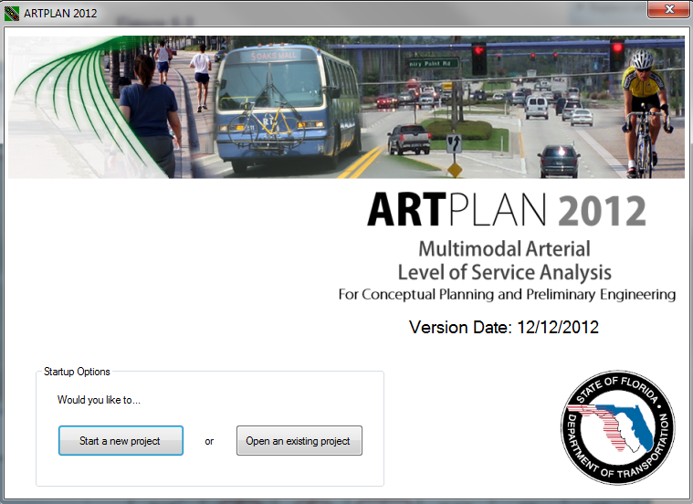
Course Objectives
INTRODUCTION
Move from understanding basic traffic concepts to hands-on capacity
and quality of service analysis
Gain proficiency in planning analysis
Gain proficiency in multimodal QOS
Understand the factors
that have the greatest impact on the results
Identify key differences
between LOSPLAN and other tools

Slide 9

INTRODUCTION
Quality/Level of Service
Introduction and Key Concepts
Agenda Item 1
Name
Agency
Experience with Q/LOS
Notes:
Name, agency, and experience with LOS

Slide 10

INTRODUCTION
Mission Statement
The department will provide a
safe transportation system
that ensures the mobility
of people and goods,
enhances economic prosperity
and preserves the quality of our environment and communities.

Slide 11

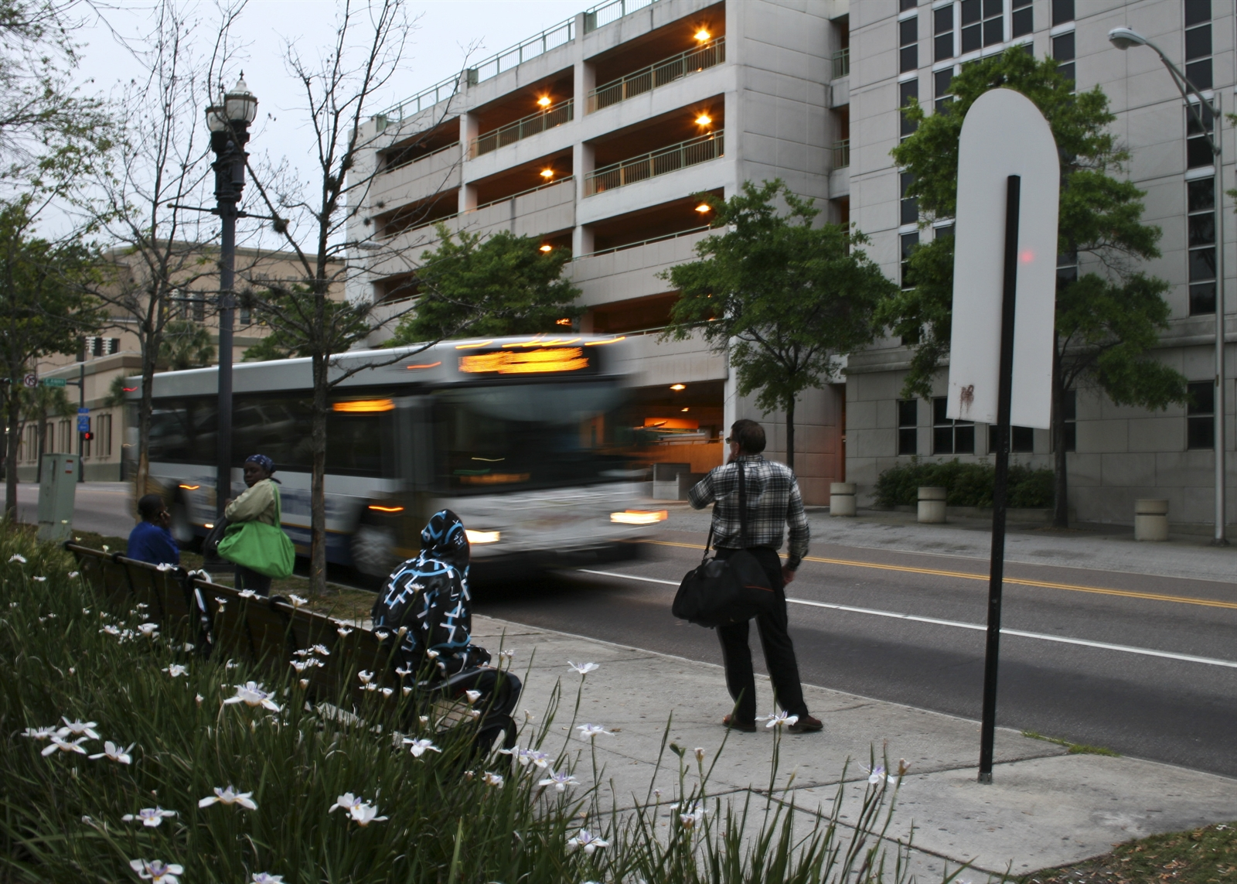
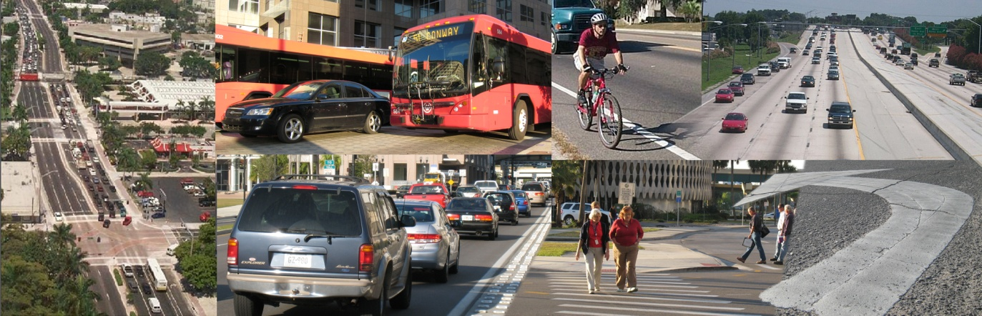
INTRODUCTION
Importance of Mobility
“Ensuring mobility for people and goods is transportation’s most essential function.”

Slide 12

4 Dimensions of Mobility
INTRODUCTION
To adequately address mobility,
all four dimensions
should be emphasized
and multiple
performance
measures used.
LOS
Capacity
Notes:
To adequately address mobility, all four dimensions should be emphasized and multiple performance measures used.

Slide 13
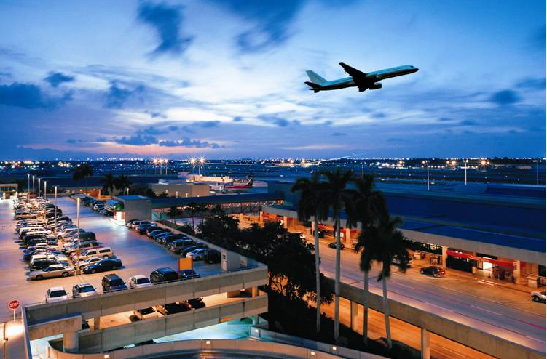
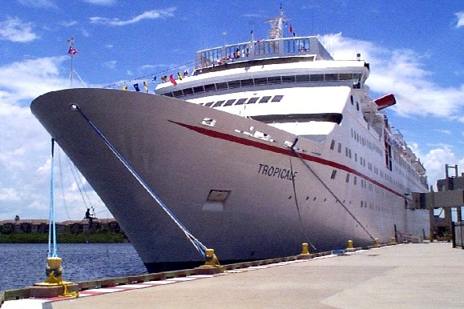
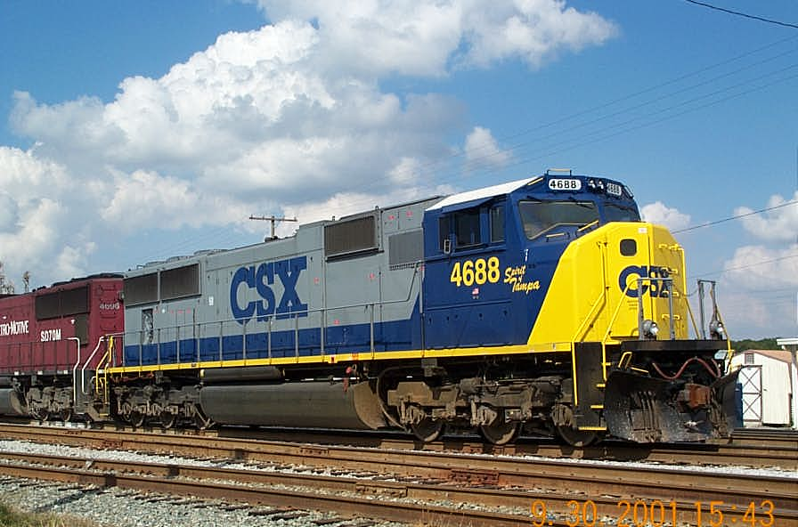

Concepts Apply to All Modes
INTRODUCTION

Slide 14
Quality of Service and Capacity Analyses
INTRODUCTION
LOS
Quality of service
and capacity analyses
are at the heart of “ensuring mobility of people and goods.”
Capacity
3

Slide 15


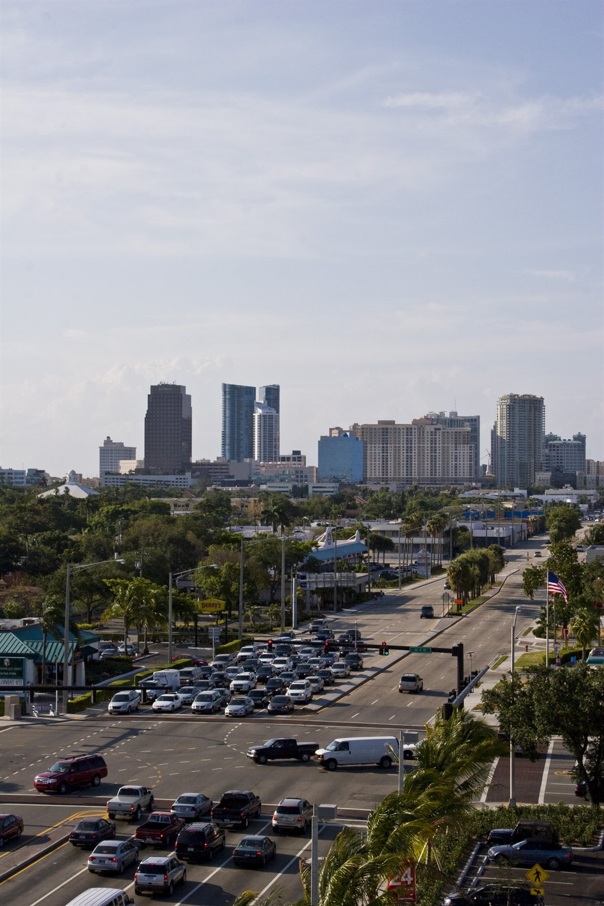
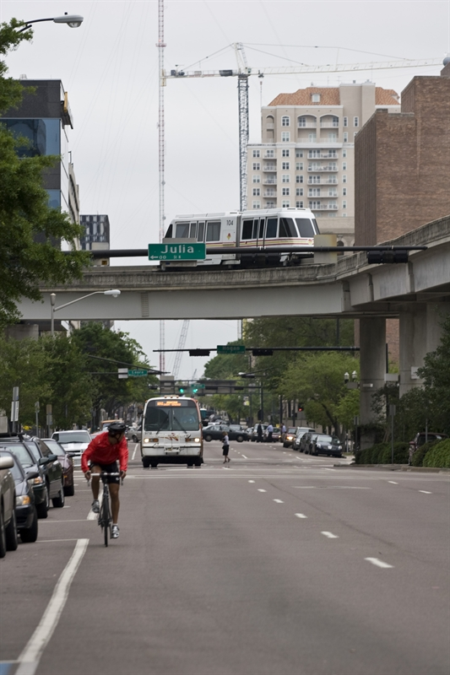
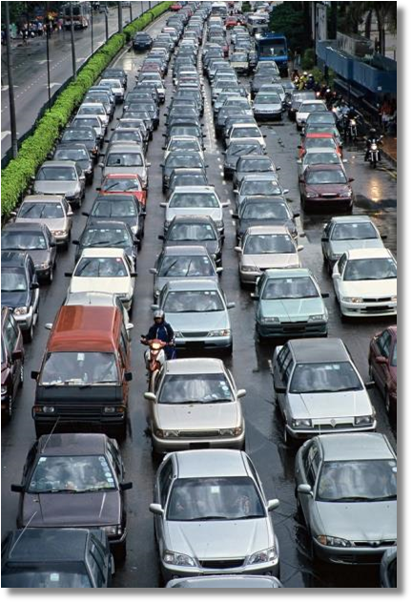
Five Important Definitions
INTRODUCTION
Quality of Service
Level of Service
Highway
Multimodal
Capacity
Notes:
Briefly go over the slide because the full definitions follow

Slide 16

Five Important Definitions
INTRODUCTION
Quality of Service
A traveler-based assessment of how well a service or facility is operating
3

Slide 17
Five Important Definitions
INTRODUCTION
Level of Service
LOS A-F should not be thought of as school grades.
A quantitative stratification of the “quality of service” of a service or facility into six letter grade levels with “A” describing the highest quality and “F” describing the lowest quality
3

Slide 18
Five Important Definitions
INTRODUCTION
Highway
Roadway with all transportation facilities (e.g., lanes, bus pull-outs, paved shoulders,
sidewalks, signals)
within the right of way

Slide 19
Five Important Definitions
INTRODUCTION
Capacity
The maximum number of vehicles that can pass a point during a specified time period under prevailing roadway, traffic, and control conditions
3

Slide 20

Five Important Definitions
INTRODUCTION
Rural
Capacity
The maximum number of vehicles that can pass a point during a specified time period under prevailing roadway, traffic, and control conditions
Notes:
This shows Irish rural capacity for their popular goods

Slide 21
Five Important Definitions
INTRODUCTION
Multimodal
More than one highway mode (auto, bicycle, bus, pedestrian, truck)

Slide 22

TRB’s Highway Capacity Manual is
“The National Document”
INTRODUCTION
Notes:
Provides quality of service, level of service, and capacity measures for highways and other modes

Slide 23


Positive Aspects and Limitations of the HCM
INTRODUCTION
Benchmark for highway quality of service and capacity analyses
Consensus of expert opinion
Too detailed /
not detailed enough
Does not cover other important mobility issues
  Travel demand (Quantity)
  Land use

Slide 24



Types of Analyses
INTRODUCTION
Planning
Default values for nearly all of the model inputs
Limited data requirements, general results
Operational
All or nearly all of the required model inputs
More data, more precise results
Design
To establish the detailed physical features
This course will focus on planning-level analysis

Slide 25
Which Tool is Appropriate?
INTRODUCTION
Increasing Degree of Detail and Accuracy
Generalized Planning
Conceptual Planning
Preliminary Engineering, Design and Operation
VISSIM / CORSIM
SYNCHRO
SIMTRAFFIC
Increasing Level of Analysis Effort and Complexity
SIDRA
HCM/HCS
LOSPLAN
GSVT
Deterministic/Analytical Tools
Microscopic Simulation Tools
Traffic Analysis Handbook
21

Slide 26
LOS - Operational, Conceptual and Generalized Planning Techniques
INTRODUCTION
Operational
Conceptual and
Generalized Planning
TCQSM
BLOS
PLOS
Notes:
TCQSM – Transit Capacity and Quality of Service Manual
BLOS – Bicycle Level of Service
PLOS – Pedestrian Level of Service

Slide 27
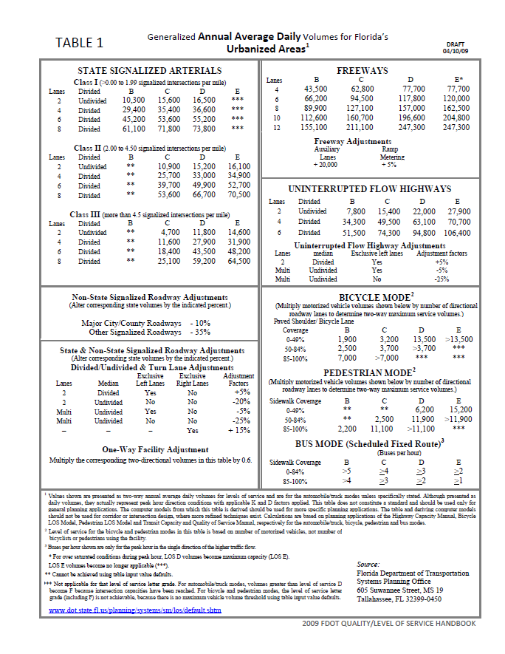

LOS Planning Analysis Tools
INTRODUCTION
Generalized
Planning
Tables
Q/LOS
Handbook
Conceptual
Software
http://www.dot.state.fl.us/planning/systems/programs/sm/los/default.shtm
Notes:
FDOT’s LOS planning tools can be found at the above web address. (fixed MG 11/2)

Slide 28
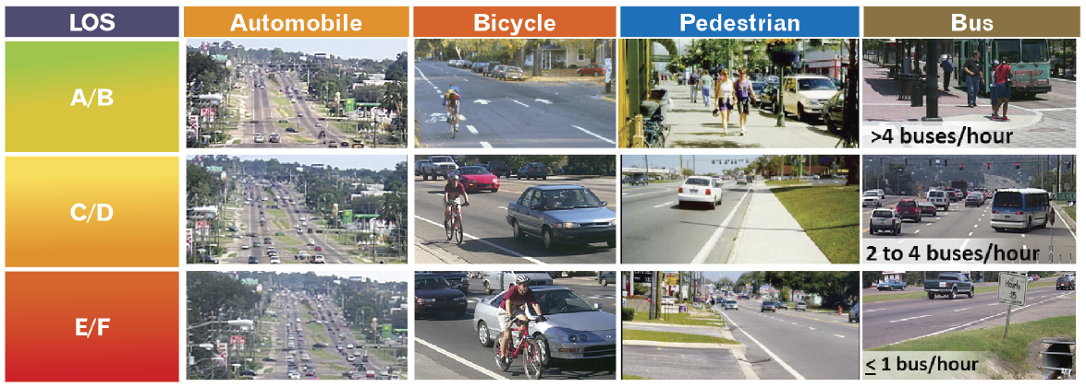
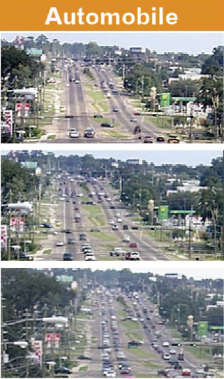
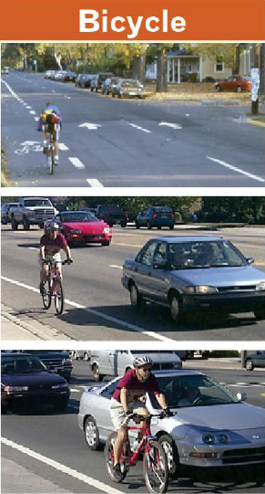
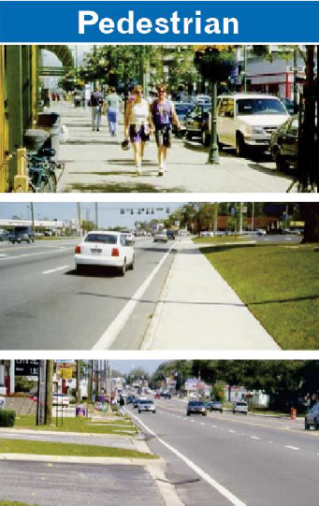
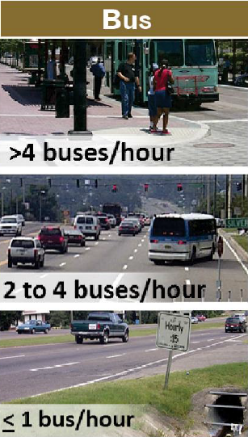
LOS and Capacity
INTRODUCTION
28

Slide 29
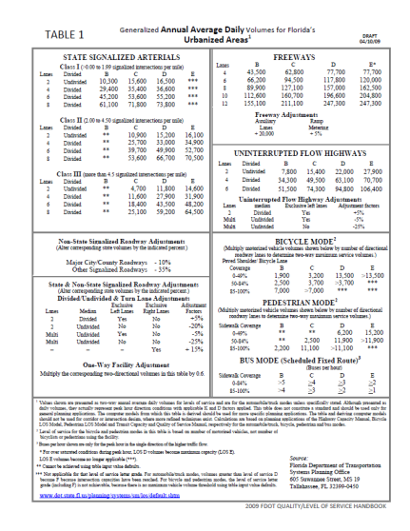

FDOT Guidance on Applying Capacity and LOS Tools
INTRODUCTION
Conceptual and
Generalized Planning
Decide on type of analysis
Operational
Pick the right capacity/LOS tool for analysis
Keep inputs comparable to the analysis and tool
7
Notes:
Do we need ball park figures and an overall assessment. OR are we designing to account for an exact condition?
Quicker and cheaper tools are more appropriate for generalized information, expensive and cumbersome tools are necessary for design and operational improvements
When moving from a generalized analysis to a conceptual analysis, all key roadway specific inputs should be provided, not just some of them
Analytical tools dealing with detailed design without addressing key conceptual planning variables are misleading

Slide 30
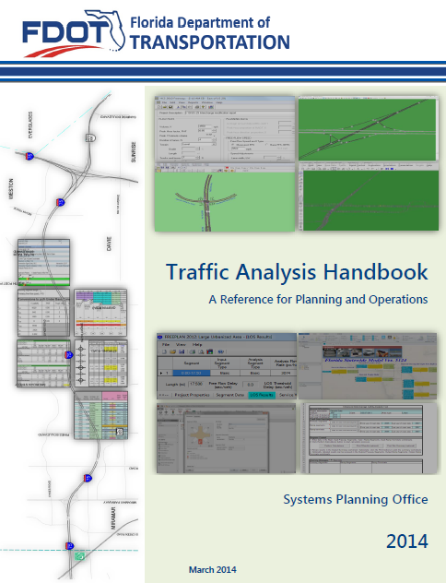
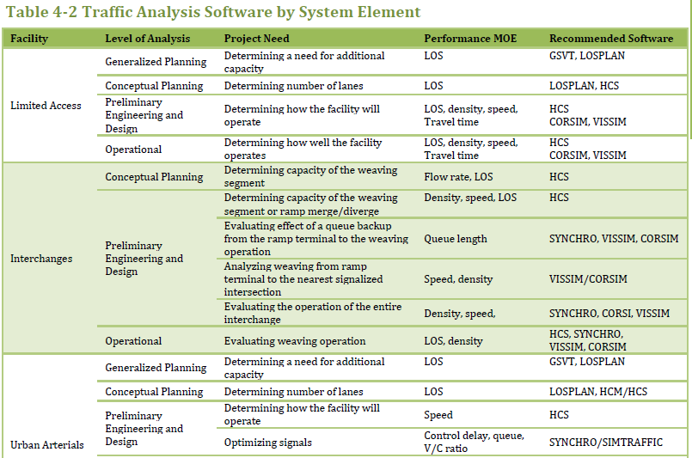
Traffic Analysis Handbook
INTRODUCTION

Slide 31
Types of Roadways
INTRODUCTION
Arterials
Freeways
Highways

Slide 32
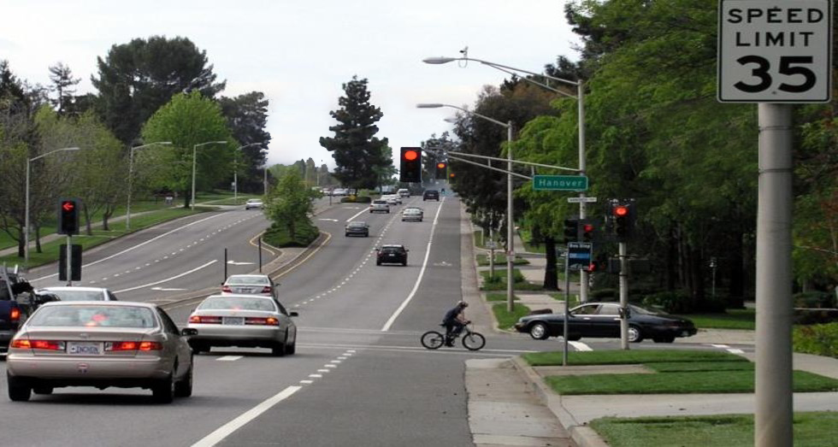
INTRODUCTION
Arterial (Types of Roadways)
Arterial Street
Speed limit
Signal
Signal Spacing
Sidewalks
Bus Stop
Bike Lanes
Street interrupted by traffic control devices (e.g. signals, STOP signs, or YIELD signs)
Average signalized intersection spacing less than or equal to two miles
Notes:
Street interrupted by traffic control devices (e.g. signals, STOP signs, or YIELD signs)
with an average signalized intersection spacing less than or equal to two miles

Slide 33
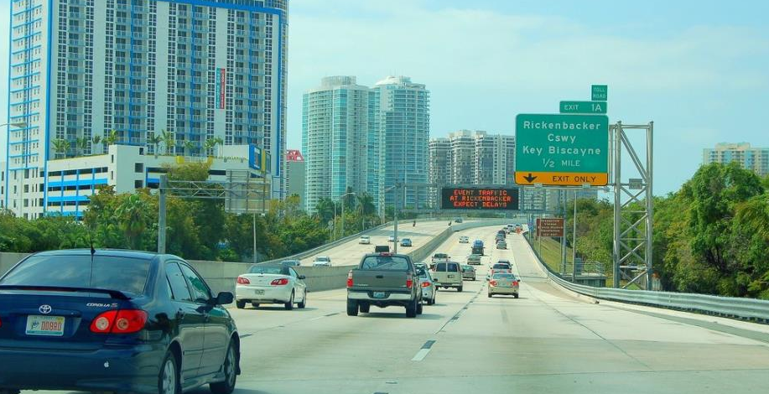
INTRODUCTION
Freeway (Types of Roadways)
A fully access-controlled, divided highway with a minimum of two lanes (and typically more) in each direction

Slide 34
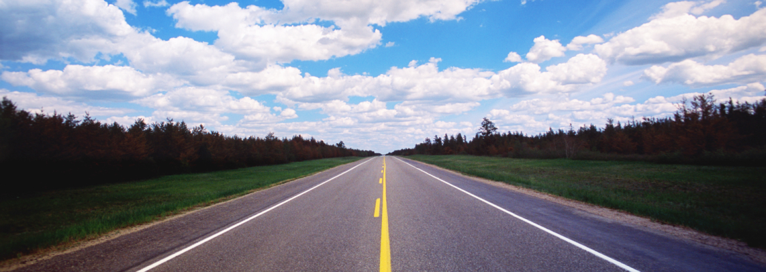
Uninterrupted Flow Highway Rural Two Lane
INTRODUCTION
Highway (Types of Roadways)
Generally uninterrupted flow roadways (may have driveways and isolated traffic signals) which may be further categorized as two-lane or multilane

Slide 35
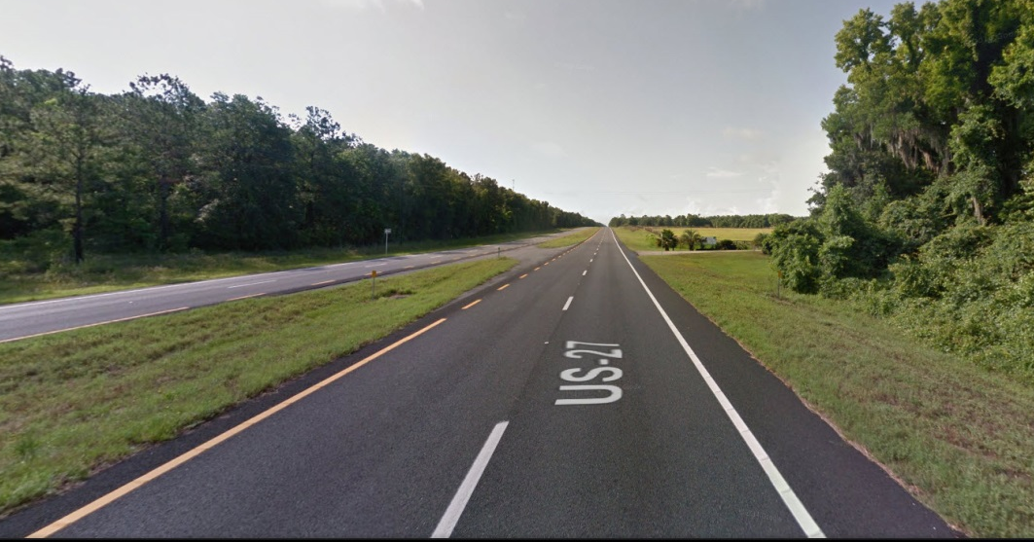
Uninterrupted Flow Highway Multilane Rural
INTRODUCTION
Highway (Types of Roadways)
Average signalized intersection spacing greater than two miles and are not freeways

Slide 36
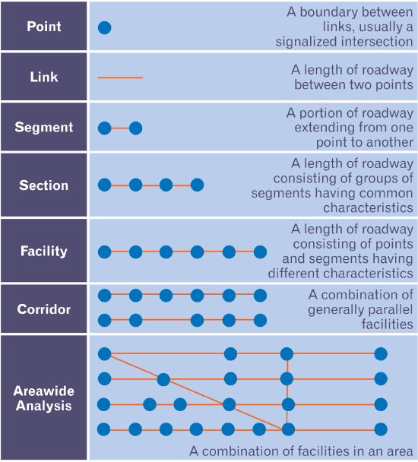
Generalized HCM Highway System Structure
INTRODUCTION
Highway System Structure
11

Slide 37
Segmentation
INTRODUCTION
Highway System Structure (Types of Roadways)
  This is based on:
    Driver perception
    Highway system structure
11
Notes:
Talk about the length of analysis being appropriate to the tool.
Based on
Driver perception
Highway system structure
Representative lengths
Urban arterial – 1.5-5.0 mi.
Urbanized freeway – 4-15 mi.

Slide 38

INTRODUCTION
QUESTIONS?

Slide 39
INPUT VARIABLES
ROADWAY
TRAFFIC
Input Variables
CONTROL
Agenda Item 2

Slide 40
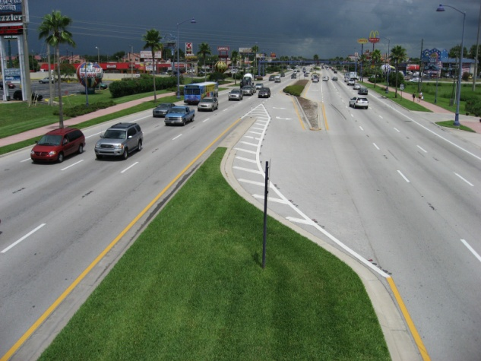
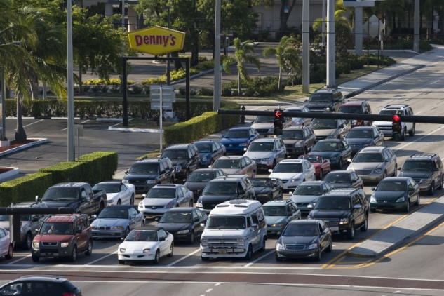
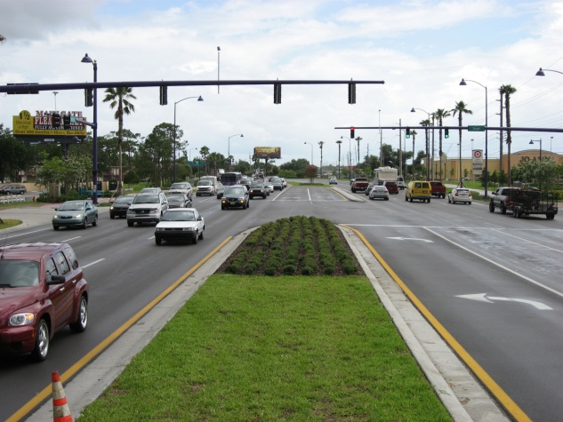
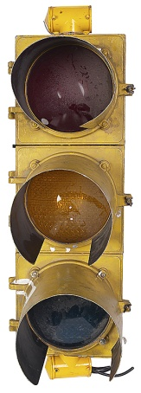
Affecting LOS and Capacity
INPUT VARIABLES
Roadway variables
Traffic variables
Control variables
53

Slide 41
Key Factors Affecting LOS and Capacity
INPUT VARIABLES
Roadway variables
Area Type
Laneage
Turn lanes
Sidewalks
Bicycle lanes
53

Slide 42
Key Factors Affecting LOS and Capacity
INPUT VARIABLES
Traffic variables
Daily/Hourly aspects
Directional aspects
Bus frequency
73

Slide 43
Key Factors Affecting LOS and Capacity
INPUT VARIABLES
Control variables
Control Type
Green time
Cycle length
89

Slide 44

Key Factors Which Highly Influence Results
INPUT VARIABLES
Avoid using defaults with these factors
Notes:
Highest Sensitivity – Referred to as Most Important Variables in the past
Put discussion in notes section
Exception – application
Planning analysis
Difference between existing conditions and possible future conditions

Slide 45
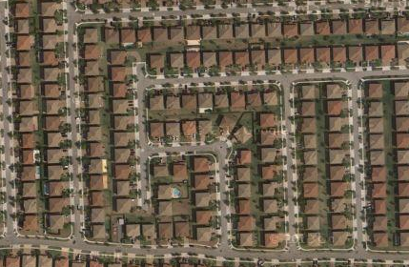
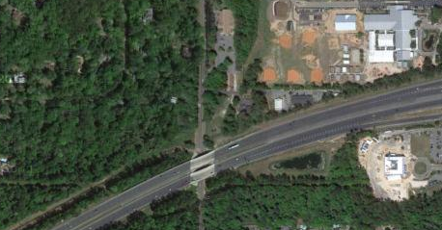
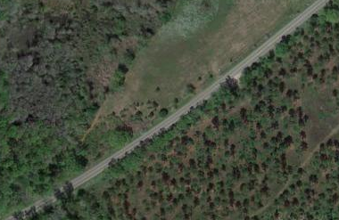
Key Factors Which Highly Influence Results
INPUT VARIABLES
!
Area Type
Auto
Multimodal
Number of lanes
Left turn lanes
AADT
K
D
Signal spacing
g/C
Paved shoulder/ bicycle lane
Sidewalk
Bus frequency
Urbanized
Transitioning/Urban
Rural
Notes:
Highest Sensitivity – Referred to as Most Important Variables in the past

Slide 46
ROADWAY
Key Factors Affecting LOS and Capacity
Roadway variables
Area Type
Laneage
Turn lanes
Sidewalks
Bicycle lanes
53

Slide 47
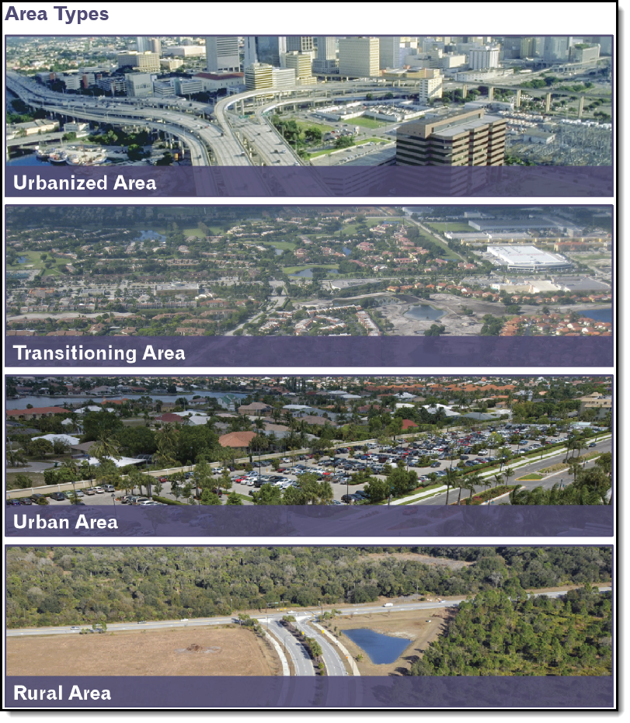
ROADWAY
Area Type
Large Urbanized
1,000,000+
Other Urbanized
50,000 - 1,000,000
Transitioning
Urban fringe, urbanized within 20 years
Urban
5,000 – 50,000
Rural Developed
< 5,000 with dev.
Rural Undeveloped
Little to no dev.
57
Notes:
Overview Slide – Detailed slides for each area type follow – Don’t spend much time here. Ask why it matters.
Different levels of roadway user expectations such as between Miami and Chipley
Delay is relative
Different driver behavior – headways vary

Slide 48
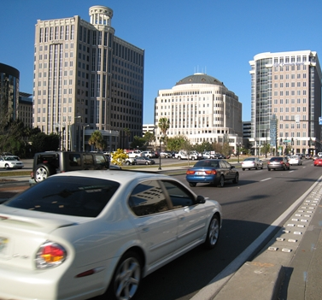
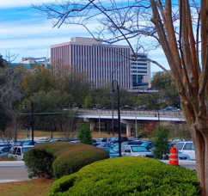
ROADWAY
Area Type
!
Orlando
Large Urbanized
1,000,000+ population
Covered by MPOs
Other Urbanized
Population: 50,000 - 1,000,000
Covered by MPOs other than those overseeing large urbanized areas
  Ft. Lauderdale 5. St. Petersburg
  Jacksonville 6. Tampa
  Miami 7. West Palm Beach
  Orlando
Tallahassee
58

Slide 49
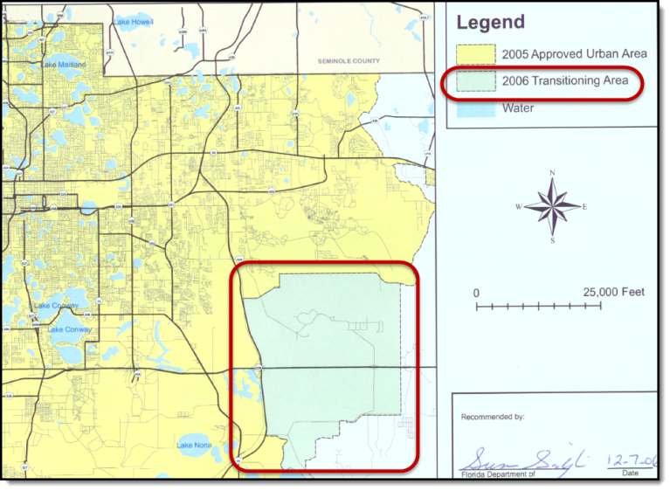
ROADWAY
Area Type
!
Transitioning
Area outside of, but contiguous to, an urbanized area
Expected to be urbanized or urban within the next 20 years based on growth characteristics
Example Transitioning Area from Metro Plan Orlando
59

Slide 50
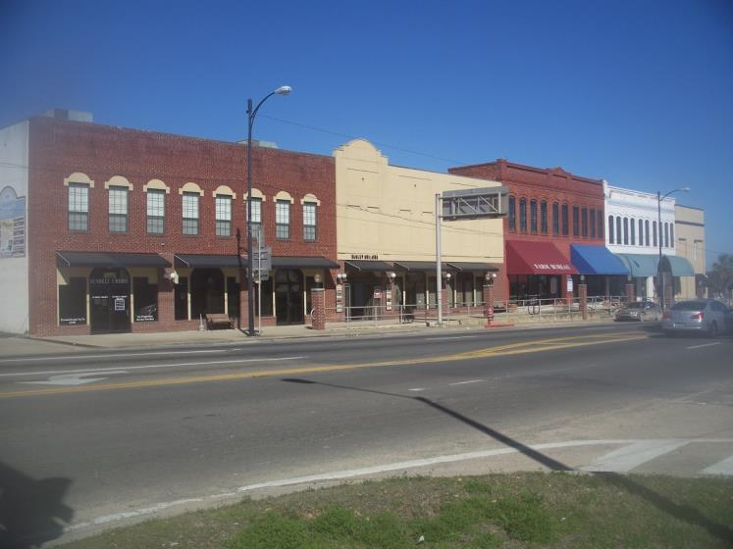
ROADWAY
Area Type
!
Historic Downtown Marianna
Urban
Areas with populations between 5,000 - 50,000 and not an urbanized area
60

Slide 51
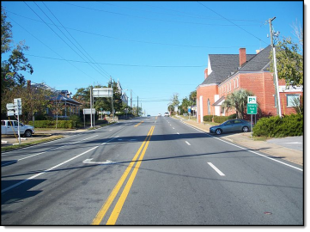
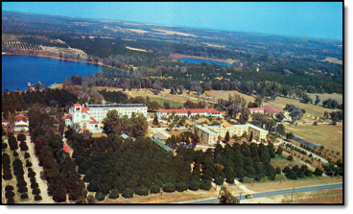
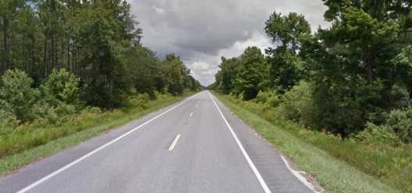
ROADWAY
Area Type
!
Rural Developed
Population less than 5,000
Exhibit some development, such as small cities
Rural Undeveloped
Contain little to no development
Chipley
St. Leo
Steinhatchee Area
60

Slide 52
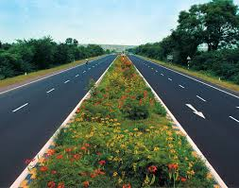

Number of Through Lanes
ROADWAY
!
61
Notes:
Make sure to clarify “through” lanes.

Slide 53
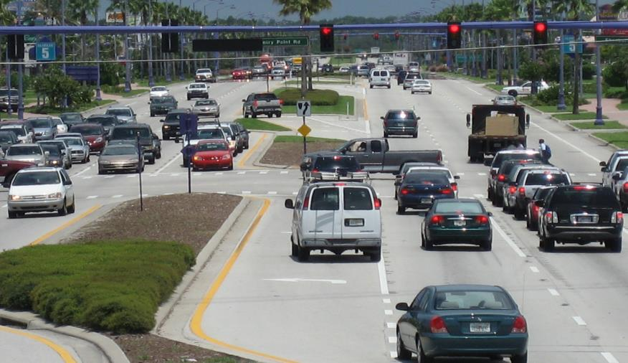
Exclusive Turn Lanes
ROADWAY
!
Turn lanes from which a turning-movement must be made, designated by solid line striping
67

Slide 54
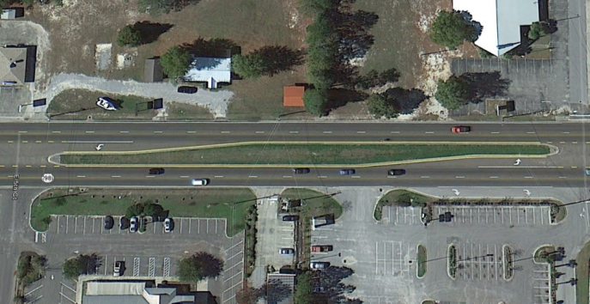
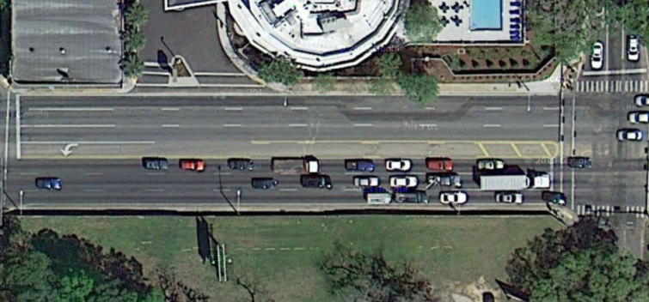
Median
ROADWAY
  A separating barrier between opposing directions of traffic
  Restrictive
  – A raised or grassed area at least 10’ wide
  Non-restrictive
  – A painted at-grade area at least 10’ wide
“Undivided” refers to no median
“Divided” can include either a restrictive or non-restrictive median
65
Notes:
Also used for multimodal analysis for crossing difficulty

Slide 55
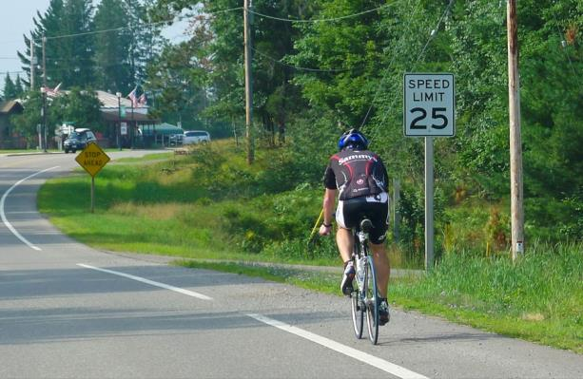
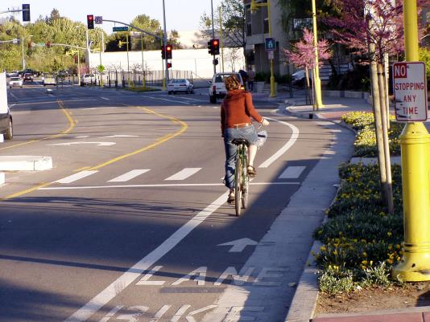
Bicycles
ROADWAY
!
Paved Shoulder / Bicycle Lane
A bicycling area typically four feet wide or greater and separated from the outer motorized vehicle through lane by a solid pavement marking
105
Notes:
The new Department standard for Bike Lanes is 7’, which is a 5’ lane and a 2’ buffer.

Slide 56
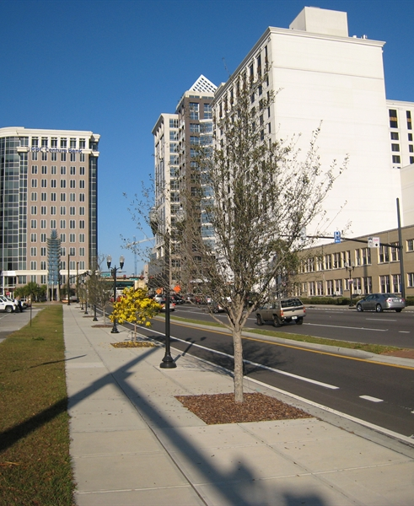
Pedestrians
ROADWAY
!
Sidewalk
Paved walkway at the side of a roadway, typically 5 feet in width (on the directional side of the arterial being analyzed)
108

Slide 57
TRAFFIC
Key Factors Affecting LOS and Capacity
Traffic variables
Daily/Hourly aspects
Directional aspects
Bus frequency
73

Slide 58

Annual Average Daily Traffic
TRAFFIC
!
Total traffic volume in both directions on a highway segment for one year divided by the number of days in a year
AADT
  Most used of all traffic parameters
77
Notes:
Ask why it is the most used

Slide 59
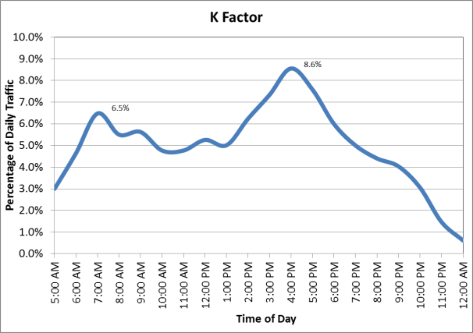
K-factor
TRAFFIC
!
The proportion of AADT that occurs during the peak hour
Morning Peak:
.065*10000= 650
Evening Peak:
.086*10000= 860
79

Slide 60
TRAFFIC
K-factor
!
Standard K
FDOT policy sets the K-factor as a fixed parameter rather than a variable
It is set based on area type and facility type
*Core freeways have a lower K-factor
79
Notes:
Mention MMTD K factor and cover in detail in multimodal section?

Slide 61
TRAFFIC
D-factor
!
The proportion of traffic moving in the peak direction of travel on a given roadway during the peak hour
EB
WB
The minimum allowable
D-factor is 0.51 for all area types
The D-factor has a sensitivity such that a 1% increase in D-factor produces a 2% decrease in allowable daily service volume
82
Notes:
Some explanation of D200?

Slide 62
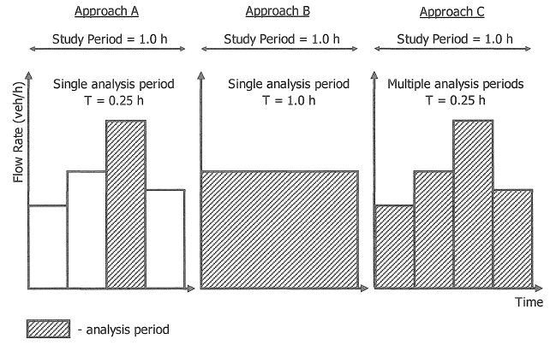
Peak Hour Factor (PHF)
TRAFFIC
A measure of traffic demand fluctuation within the analysis hour.
1.0
FDOT recommends using a PHF of 1.0 for all planning level analyses
82

Slide 63
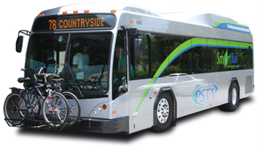

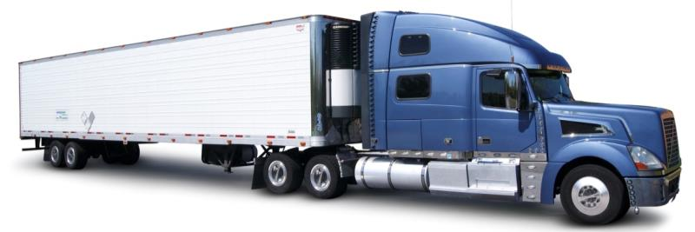
TRAFFIC
Percent (%) Heavy Vehicles
The percent of trucks and other heavy vehicles with more than four wheels touching the pavement during normal operation.
84
Notes:
Though sensitivity is not typically very high for auto LOS, it can play a large role in bicycle LOS particularly at higher speeds

Slide 64
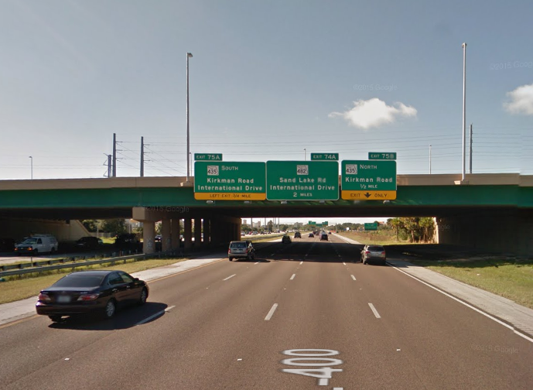
Local Adjustment Factor
TRAFFIC
Accounts for driver aggression, hurriedness, and familiarity with the facility. It reflects lower capacities for different area types.
*Input in FREEPLAN and HIGPLAN
Drivers exiting Florida’s Turnpike see two signs for International Drive.
85
Notes:
We will go over some of the default local adjustment factors that are used in the tables when we get to that unit.

Slide 65

Bus Frequency
TRAFFIC
!
The number of scheduled fixed route buses which can stop on a given roadway segment in one direction of flow in a one-hour time period.
Express buses with no potential of stopping along a roadway are not included.
110

Slide 66
CONTROL
Key Factors Affecting LOS and Capacity
Control variables
Control Type
Green time
Cycle length
89

Slide 67
CONTROL
Number of Signalized Intersections
!
Signal Spacing
The distance between consecutive traffic signals along a facility, measured from stop bar to stop bar in the direction of analysis
Signal Spacing
92
Notes:
Frank - cha

Slide 68
Arrival Type
CONTROL
A generalized categorization of the quality of progression between signalized intersections, ranging from 1 to 6
Uncoordinated signals are represented by arrival type 3, and coordinated signals are represented by arrival type 4 or higher
Coordinated
Uncoordinated
95

Slide 69

Signal Type
CONTROL
  Pretimed
  – Uses a preset sequence of phase times with no use of vehicle detection
  Coordinated Actuated
  – Uses a fixed cycle length while the amount of green time for the main street through phase varies, utilizing unused time from the minor phases.
  Fully Actuated
  – Uses vehicle detection for all signal phases on both the main and side street approaches
96

Slide 70
Cycle Length
CONTROL
  The total time for the signal to complete one complete sequence of indications
97

Slide 71
Cycle Length
CONTROL
The amount of time (in seconds) that is provided to service all movements at a signalized intersection
50 seconds
40 seconds
10 s
32 s
10 s
22 s
10 s
32 s
10 s
22 s
90 seconds
97
Notes:
A cycle length should provide sufficient capacity at the critical intersection(s) and provide progression through the system

Slide 72

Green Time
CONTROL
Green Time
  the amount of time within a given phase during which the green indication is present (G)
Notes:
Usually mainline through movement

Slide 73
Basic Signal Operations Terms
CONTROL
Lost Time - The amount of time during which the intersection is not used effectively. (L). Default is 4 seconds per movement.

Slide 74
Basic Signal Operations Terms
CONTROL
!
Effective Green Ratio (g/C)
The ratio of the effective green time of a phase to the cycle length
Indicates the proportion of the cycle length that traffic may move through the intersection for a particular movement
Pretimed Signals
g/C ≈ G/C
Actuated Signals
g/C ≈ (G+4)/C
98
Notes:
Ask – “Why is this so important?”
For actuated signals, the 4 seconds is additional time allocated to the through movement as a result of unused time from other movements

Slide 75

Signal Timing
CONTROL
  Through g/C
  Left g/C
100

Slide 76


Left-Turn Phasing
CONTROL
Protected turn – Green arrow
Permissive turn – Green ball (or flashing yellow arrow) where left turns have to yield to oncoming traffic
Protected + Permissive turn – Starts as green arrow, changes to green ball (or vice versa)

Slide 77
INPUT VARIABLES
ROADWAY
TRAFFIC
QUESTIONS?
CONTROL

Slide 78
Data Sources
Agenda Item 3
Notes:
This next section discusses where and how to gather the data necessary for a Q/LOS analysis.

Slide 79




Data Sources
The goal of this segment of training is to successfully locate the key input parameters for a given roadway
using free sources
Florida Traffic Online http://www2.dot.state.fl.us/FloridaTrafficOnline/viewer.html
Florida Transportation Information DVD
Google
Google Maps / Google Earth
Road Characteristics Inventory http://www.dot.state.fl.us/planning/statistics/gis/
Notes:
These are the main resources that you can use to gather the data for a Q/LOS analysis. As we work through this section, you will see how each of these are involved.

Slide 80
Most Important Variables - Reminder
!
Data Sources
Area Type
Auto
Multimodal
Number of lanes
Left turn lanes
AADT
K
D
Signal spacing
g/C
Paved shoulder/ bicycle Lane
Sidewalk
Bus frequency
Urbanized
Transitioning/Urban
Rural
Notes:
Multimodal data sources will be discussed when the topics are presented in detail

Slide 81
Area Type
Data Sources
Transitioning areas are adjacent and contiguous to an urbanized area and may become urbanized in the next 20 years based on growth characteristics
Urban areas are developed cities that are not within contiguous to an urbanized area, and have a population between 5,000-50,000
59

Slide 82
Area Type
Data Sources
If the population is less than 5,000:
View the area on an aerial software (Google Maps or Earth)
If there is little or no development present, the area type is rural undeveloped
If the area appears to be developed with residential or commercial developments, the area type is rural developed

Slide 83
Area Type
Data Sources
Ask District LOS Coordinator - particularly for transitioning area
If available, obtain area type GIS data
Determine if your study roadway is within the urbanized boundary of an MPO
If within MPO but outside the urbanized boundary, confirm location using this interactive MPO/Urban area map (http://transport.cfgis.org/). Turn on Urban areas 2012 and MPO Boundaries under RCI 2012 and Jurisdictional Boundaries, found under the base data tab
58

Slide 84

Area Type (TransPort)
Data Sources
Example: Mahan Dr. & Dempsey Mayo Rd. (Tallahassee)

Slide 85


Area Type (TransPort)
Data Sources
Example: Mahan Dr. & Dempsey Mayo Rd. (Tallahassee)
Intersection is within the urban/urbanized boundary (pink)
Area type is
other urbanized

Slide 86


Florida Transportation Information (FTI) video

Slide 87


Florida Transportation Information DVD
Notes:
(allow several minutes to load) – Do early in exercise
Run demo live w/disk also

Slide 88


Percent Heavy Vehicles (From back of GSVTs)
Data Sources
Example for a core freeway in an urbanized area
% Heavy Vehicles = 4.0
Notes:
FDOT does not recommend using the T-factor in FDOT’s Florida Traffic Online. That factor is properly used for roadway pavement design.
Rules of thumb have been applied to that T-factor to convert to a design hour; however, the factors on the back of the tables are more applicable for peak hour traffic – 2013 Q/LOS handbook pg 84

Slide 89
Example 1
Data Sources
Find the following parameters for Interstate I-4 in Orlando (D5) between Princeton St and Par St:
Area Type
Peak Direction
AADT
K-Factor
D-Factor
% Heavy Vehicles
Notes:
Our first example will be a section of I-4 in Orlando. We want to determine the area type, peak direction, AADT, K factor, D factor and % heavy vehicles.

Slide 90

Example 1
Data Sources
Area Type
Notes:
This is the particular section of I-4 where we want to collect data.

Slide 91

Data Sources Example Problem
Data Sources
Example 1
Area Type
The study roadway is in Orlando, FL:
Notes:
This is a map from MetroPlan Orlando that shows the section of I-4 being located within an Urbanized area.

Slide 92
Data Sources Example Problem
Data Sources
Example 1
Area Type
The study roadway (I-4) is within the urbanized area of the map
Orlando is classified as an urbanized area
Side note: Orlando is one of the 7 urbanized areas the State of
Florida considers a “Large Urbanized” area
Notes:
Orlando is one of the 7 large urbanized areas here in Florida.

Slide 93

Data Sources Example Problem
Data Sources
Example 1
District 5 Urban/Transitioning Area Maps
Notes:
There are maps that show urban/urbanized areas for all of Florida, but some districts have detailed maps showing transitioning areas as well. This is one for Orange County, FL showing the transitioning area for 2006.

Slide 94
Data Sources Example Problem
Data Sources
Example 1
Determine:
AADT
K-Factor
D-Factor
Peak Direction
% Heavy Vehicles
Notes:
Now that we’ve determined area type, let’s move onto some of the othes.

Slide 95



Data Sources Example Problem
Data Sources
Example 1
Notes:
These next slides will show us how find much of the information for Example 1 using the Florida Transportation Information DVD.
The first thing you want to do is run the FTI DVD. After it has finished opening, you will want to go to the top and click on “Find” and search for Orlando.

Slide 96

Data Sources
Example 1
Notes:
Once you are looking at Orlando, you will want to click on the Highway symbol on the toolbar on the top to help you find I-4 and 408. This will turn on the symbols and numbers for all highways and interstates in that area.

Slide 97


Data Sources
Example 1
Notes:
Once you have found the area, you will want to click on the information icon and then on the green square that lies on I-4 and is in between Par and Princeton St. This will show you AADT, K factor, D factor, as well as other road characteristic information.

Slide 98

Data Sources
Example 1
Notes:
While you are still clicked onto the I-4 site, you will want to go to the Reports tab and then to “Historical AADT Data”. This will open up the AADT for that site from the previous years. It also shows you the K and D factors, and the number of cars in each direction (ultimately the peak direction).
In the previous slide, you may have seen something called T(24) Daily. This is called the T factor and the 2013 Q/LOS Handbook does NOT recommend using the it to determine % heavy vehicles, but rather to use the back of the generalized service volume tables as shown next.

Slide 99
Data Sources Example Problem
Data Sources
Example 1
% Heavy Vehicles = 4.0
Notes:
That factor is properly used for roadway pavement design. Rules of thumb have been applied to that T-factor to convert to a design hour; however, the factors on the back of the tables are more applicable for peak hour traffic.

Slide 100



Why do we recommend ½ of daily trucks?
During Peak Hour
  More passenger vehicles
  Same or slightly fewer trucks
Peak
Non Peak
Notes:
The main reason we

Slide 101

Data Sources
Example 1
Answers
Area Type = Urbanized
AADT = 183,500
K-Factor = 8.0
D-Factor = 52.3
Peak Direction = EB
% Heavy Vehicles = 4.0
Answers
Area Type =
AADT =
K-Factor =
D-Factor =
Peak Direction =
% Heavy Vehicles =

Slide 102


Data Sources
Workshop 1
SR 699
Between Park
Blvd and SR 666
Redington
Beach (D7 – north of Madera Beach)
Identify:
Area Type
AADT, K-Factor,
D-Factor
Peak Direction
% Heavy Vehicles
Notes:
Showing animation to give participants an idea of the area

Slide 103


Data Sources
Workshop 1

Slide 104

Data Sources
Workshop 1

Slide 105


Data Sources
Workshop 1

Slide 106

Data Sources
Workshop 1

Slide 107
Data Sources
Workshop 1
Answers
Area Type = Other Urbanized
AADT = 16,647
K-Factor = 9.0
D-Factor = 52.3
Peak Direction = NB
% Heavy Vehicles = 1.0
Answers
Area Type =
AADT =
K-Factor =
D-Factor =
Peak Direction =
% Heavy Vehicles =

Slide 108
Format of the Training Modules
Explain the program’s uses
Identify strengths and limitations
Identify when other tools should be used
Required inputs
Example problem(s)
  Sensitivity example
Workshops

Slide 109

Generalized Service Volume Tables
Generalized Service Volume Tables
Agenda Item 4
Notes:
One of the advantages of being at the FDOT for as long as I have, since 1985 is that I was actually around when we developed the first generalized service volume tables. It was an exciting time for us the 1985 highway capacity manual was a big departure from the capacity manual for the past.
For the first time the concept of having an arterial level of service was considered. In the past all analysis was done on a single signal or movement within a signal.
This isn't to say that there was never any concept of how well a system of signals worked, it's just that they never had a level of service applied to them.

Slide 110
Generalized Service Volume Tables
Generalized Service Volume Tables
Provide a rough estimate of capacity and LOS
Use the same rules as LOSPLAN software and the Q/LOS Handbook
FDOT supported and statewide acceptable for PLANNING only
Notes:
The longer I'm in this field, the more I believe in simple applications as a start to almost any analysis.
The general service volume tables is one of the best examples in providing this first estimate of level of service.
These tables were truly built from the bottom up with the basis coming from the HIGHWAY CAPACITY MANUAL; but using the LOS plan software and all the Florida-based settings and criteria.
Even though this is a rough estimating tool, I never sell it short,
if you are familiar with some of the more operational based tools and the data input, you might realize that one or two wrong inputs can leave you way off base in the final analysis.
That is why I feel that the use of the generalized service volume tables in particular and the level of service software produced by DOT are excellent first step and also a tool to measure the reasonableness of future analysis.

Slide 111
Generalized Service Volume Tables
Generalized Service Volume Tables
Provide estimates of maximum service volumes for various Florida roadway types
Allow analysts to quickly and easily estimate LOS from volumes and estimate capacity
Represent average roadway conditions for the state
Notes:
In this slide you see three words that are in bold they are
estimate
average
quickly
Don't forget that as you move on to the use of these tables.

Slide 112
Generalized Service Volume Tables
Generalized Service Volume Tables
Results are rough estimates
Simplified planning level assumptions are made, therefore the tables must not be used for actual design or operation of facilities
Limitations
Notes:
To recap what we have just said, It is important to realize that planning is the appropriate place to use these tables.
Think if you had an entire study area to calculate and all you had was daily traffic…this is the tool
But they should not be used for any design or operations.

Slide 113

Assumptions
Generalized Service Volume Tables
Reflect typical conditions on Florida roadways
Notes:
If you have experience in using the highway capacity manual or any of the other many detailed programs on the market, you will know that there are many decisions on the defaults that you must use as you go through the analysis.
Over 30 years of studying Florida's traffic characteristics gave us a good idea of what default values we could put in these tables, not only saving the analyst time and trouble, but just as important we felt that the defaults used in these tables were better than many of the defaults that were being used 30 years ago.
I can tell you that the people who studied thousands of hours of traffic data did not try to be either liberal nor conservative but really tried to be as accurate to the average conditions to be used in planning

Slide 114
Threshold Differences
Rural freeways based on UF Research
Two class system
Average travel speed
Percent base free flow speed
Notes:
Before we go any further on this subject we need to point out to you that these tables were based on the major concepts found in the Highway Capacity Manual however, there are some important differences between the methodologies of the Highway Capacity Manual and LOSPLAN.
FDOT staff studied thousands of hours of real Florida data to determine some of the best inputs .
There are three notable differences from the HCM and the output of these generalized service tables.
The FDOT generalized tables uses a
two class system for arterials to simplify the analysis process, however we feel there are certain advantages to using the two class system that we provide.
Also we at DOT decided to continue using
average travel speed as the main determinant of arterial level of service rather than the more difficult to grasp the concept of percent base free flow speed.
For Freeways Florida researchers and FDOT staff decided particular highway densities used for Freeway level of service did not really represent the way actual drivers experienced travel in the rural areas.

Slide 115


LOS Thresholds
Generalized Service Volume Tables
Urbanized and Transitioning/Urban
Rural
Notes:
On the back of the tables you can see some of the differences between the highway capacity manual and the FDOT planning methodology.
First you'll see that the density figures for freeways of urbanized areas is the same as in the highway capacity manual, however looking below you'll see that there are different levels for the rural situation.
Research done by FDOT showed that the expectations of density in rural areas is different and therefore FDOT adjusted the densities for rural freeways
Going back to the table on top for urbanized areas you will see that the arterials are split into a class I and class II. These are based on the posted speed limit. Class 1 is posted speed limit 40 mph or higher, and class II is 35 mph posted or slower.
This comes from a disagreement between FDOT and the HCM committee over the best way to measure free flow speed.
HCM calls for a very detailed study and FDOT found that just adding 5 mph to the posted speed limit is just as accurate

Slide 116



Table Format
Generalized Service Volume Tables
AADT
Urbanized
Transitioning/
Urban
Rural
Tables 1-3
Peak Hour
Two-Way
Urbanized
Transitioning/
Urban
Rural
Tables 4-6
Peak Hour Directional
Urbanized
Transitioning/
Urban
Rural
Tables 7-9
Notes:
When you see the way the tables are organized you will see that they have been organized by some of the most used traffic factors in planning.
The first is Annual average daily traffic or AADT
the second is peak hour two-way traffic
and the third is peak hour directional traffic.
Since traffic conditions and expectations in different area types vary so do our inputs and criteria differ.
That is why you will see for each of these breakdowns of traffic AADT, peak hour two-way, and peak hour directional we have also divided the tables into
urbanized
transitioning, and what is known as “urban” (those communities that are over 5000 people but not in an urbanized area)
and rural

Slide 117



How the Tables Were Developed
Generalized Service Volume Tables
Collect Traffic Data
Calculate Values
Publish Tables
From roadways around the state
Using LOSPLAN and generalized assumed values for variables
Notes:
To recap much of what we just went over, first we took years to collect lots of traffic and highway data to create the best inputs for Florida conditions. Then we used the LOSPLAN calculation models to create the generalized tables.
After that we tried to find the best way to publish the tables so that people can use them easily and find out how we got all the numbers that are in there.

Slide 118
Organization of the Tables
Peak Hour Directional Volumes
Two-Way Peak Hour Volumes
Two-Way AADT Volumes
RURAL
RURAL
RURAL
TRANSITIONING
TRANSITIONING
TRANSITIONING
URBANIZED
URBANIZED
URBANIZED
Divide by
D Factor
Divide by
K Factor
The sets of Generalized Tables are internally consistent; all are based on peak hour peak direction analysis

Slide 119
Most Important Generalized Assumptions
Generalized Service Volume Tables
Standard K
Urbanized and Transitioning Area Standard K = 0.09
except core freeways = 0.085
Rural Area Standard K = 0.095
except rural freeways = 0.105
Peak Hour Factor (PHF) = 1.0
Directional Distribution Factor (D)
Ranges from .547 for urbanized freeways to .555 in rural areas
Ranges from .57 for transitioning arterials to .55 elsewhere.
Notes:
Now that you know some of the history behind the concept of the generalized tables, let's get into some more of the actual specifics of what are the most important assumptions.
The K factor is extremely important and one of the latest improvements that we have made to our calculations is what is known as the standard K. And that means that for most urbanized and transitioning areas we use a K factor of .09
You will see that there are some exceptions for the largest urban areas and rural areas.
The next is something called the peak hour factor or PHF. This is a measure of and I don't know any better way to say it “peakiness” of that highest peak hour.
If there is no variation for 15 minutes of the highest contiguous 4 - 15 minute periods than it would be a 1.0 which for planning purposes we will use.
The next important factor is the directional distribution factor or D. And you will see here some of the assumptions that were used for instances from our largest urbanized areas to rural.
As you can see for the largest urbanized areas the D factor or the percentage of vehicles in the peak hour going in one direction is smaller compared (or more balanced traffic) to the D factor found in rural areas and transitioning areas.

Slide 120

Table Footnote Abbreviations
Generalized Service Volume Tables
% tsf = Percent time spent following
% ffs = Percent of free flow speed
ats = Average travel speed
ru = Rural undeveloped
rd = Rural developed
Notes:
Using one of the urbanized tables we wanted to point out to you some of the important abbreviations that are used throughout and may not be well documented in the handbook.
%TSF is percent time spent following. This is used in the rural 2 Lane
% FFS is the percent of the free flow speed
ATS means average travel speed
RU stands for rural undeveloped
RD stands for rural developed

Slide 121
Table Footnote Abbreviations
Generalized Service Volume Tables
% tsf = Percent time spent following
% ffs = Percent of free flow speed
ats = Average travel speed
ru = Rural undeveloped
rd = Rural developed
Notes:
Using one of the urbanized tables we wanted to point out to you some of the important abbreviations that are used throughout and may not be well documented in the handbook.
%TSF is percent time spent following. This is used in the rural 2 Lane
% FFS is the percent of the free flow speed
ATS means average travel speed
RU stands for rural undeveloped
RD stands for rural developed

Slide 122
Table Footnote Abbreviations
Generalized Service Volume Tables
% tsf = Percent time spent following
% ffs = Percent of free flow speed
ats = Average travel speed
ru = Rural undeveloped
rd = Rural developed
Notes:
Using one of the urbanized tables we wanted to point out to you some of the important abbreviations that are used throughout and may not be well documented in the handbook.
%TSF is percent time spent following. This is used in the rural 2 Lane
% FFS is the percent of the free flow speed
ATS means average travel speed
RU stands for rural undeveloped
RD stands for rural developed

Slide 123



Generalized Service Volume Tables
Generalized Service Volume Tables
Back of the Tables
The back of that tables contain the input variables used in LOSPLAN to produce the generalized service volume tables
Rural Undeveloped
Notes:
One of the nicest features of the tables is the back of each table containing the inputs used to create the table on the front page.
The back of each table is your friend
<CLICK>Click through until “Rural Undeveloped” shows up in red
This is a screenshot of the LOSPLAN software run, which helped us create these tables
First you will see the uninterrupted flow facilities highways that are rural and in this case it’s a two lane with the posted speed of 55 miles an hour and these will correspond with the inputs you see in the screenshot from LOSPLAN.

Slide 124


Generalized Service Volume Tables
Service Volumes From HIGHPLAN
Notes:
<<<Click until the rounded rectangles are visible:
So taking these same figures you will now make a comparison to the two-lane rural highways and see the direct comparison between the output of LOS plan and one of the rows of our tables

Slide 125


Asterisks on the Tables
Generalized Service Volume Tables
Generalized Service Volume Tables
Notes:
Like many of the Florida DOT products we have to have some caveats, fine print, and asterisks. This helps explain some of the symbols you will see when you use these tables.
The one asterisks means that that level of service cannot be achieved using the values that we ran for the table. For example A 40 mile-per-hour average speed might not be possible during the peak hours given the signal spacing
The two asterisks is another symbol which means that one of the other criteria in the level of service has broken down.
For instance you will see some that LOSD “tops out” at 17,700. This means everything over 17,700 or D really turns into an F

Slide 126
Process for Using Tables
Determine time period of traffic volumes
Determine area type
Determine mode
Generalized Service Volume Tables
Annual Average Daily
Peak Hour Two-Way
Peak Hour Directional
Urbanized
Transitioning/ Urban
Rural
  Developed
  Undeveloped
Automobile
Bicycle
Pedestrian
Bus
Notes:
Look at your table package
So first you want to determine what time your analysis is in
Then you determine the area type
And then you choose which modes you're going to study

Slide 127

Process for Using Tables
Generalized Service Volume Tables
Automobile Mode
Bicycle Mode
Pedestrian Mode
Bus Mode
Key Variables
Facility Type
Number and type of lanes
Key Variables
Paved shoulder/ bicycle lane coverage
Number of motorized vehicles
Key Variables
Sidewalk coverage
Number of motorized vehicles
Key Variables
Bus frequency
Sidewalk coverage
Notes:
You must be aware of the key variables in order to do the best analysis using the tables.
For the automobile mode it is the
type of highway and the
number and type of lanes
For the bicycle mode you need to know something about
whether there is a bicycle lane or shoulder
and the number of vehicles whizzing by the cyclist
For the pedestrian mode
sidewalk coverage
and the number of automobiles driving by are the key variables
And for the bus mode, the key variables are
the frequency of the bus
and the sidewalk coverage for ease of pedestrians to get into the bus

Slide 128
Example 1.A
Generalized Service Volume Tables
Determine the max. service volume for LOS E:
In terms of AADT
In a core urbanized area
For a 8-lane freeway

Slide 129

I-4 Through Orlando, FL

Slide 130


Example 1.A
Generalized Service Volume Tables
Determine the max. service volume for LOS E:
In terms of AADT
In a core urbanized area
For a 8-lane freeway
LOS E 176,600

Slide 131




Freeways
Generalized Service Volume Tables
Notes:
Now many of these tables contain adjustments.
<Click until the Freeway adjustment is seen>>>
In this case were to use an adjustment for what is known as a freeway auxiliary Lane.
An auxiliary Lane is the feature you see in many of our large urban areas along freeways.
This would actually allow a person to get on the freeway and drive to the next interchange without actually having to merge into the actual freeway through lanes.
Since these are such a good safety and capacity feature they are being retrofitted more and more in our more congested areas.
In this case this would simply add 20,000 vehicles per day to the maximum service volume
<<CLICK>>

Slide 132

Example 1.B
Generalized Service Volume Tables
Determine the max. service volume for LOS E:
In terms of AADT
In a core urbanized area
For a 8-lane freeway
Auxiliary lanes in both directions
176,600 + 20,000 = 196,600
LOS E 196,600

Slide 133
Example 2.A
Generalized Service Volume Tables
Determine the auto LOS:
In terms of peak hour directional volumes
In a rural undeveloped area
For an uninterrupted flow highway with:
  2 lanes (one in each direction)
  No median/undivided
  No passing lanes
  Peak hour directional volume is 440
Notes:
This is a rural 2-lane roadway
And we are looking at the peak hour in one direction

Slide 134


Slide 135


Example 2.A
Generalized Service Volume Tables
Determine the auto LOS:
In terms of peak hour directional volumes
In a rural undeveloped area
For an uninterrupted flow highway with:
  2 lanes (one in each direction)
  No median/undivided
  No passing lanes
  Peak hour directional volume is 450
Answer
LOS D
Notes:
This is a rural 2-lane roadway
And we are looking at the peak hour in one direction

Slide 136

Example 2.B
Generalized Service Volume Tables
Determine the auto LOS:
In terms of peak hour directional volumes
In a rural undeveloped area
For an uninterrupted flow highway with:
  2 lanes (one in each direction)
  20% passing lane
  No median/undivided
  Peak hour directional volume is 450
430 * 1.2 ≈ 540
Answer
LOS C
Notes:
This is a rural 2-lane roadway
And we are looking at the peak hour in one direction

Slide 137


Uninterrupted Flow Highways
Generalized Service Volume Tables
Notes:
Highways vs “freeways”
Most are RURAL 2-lane and RURAL multilane

Slide 138


Other Adjustments
Generalized Service Volume Tables
Non-State Signalized Roadways
Divided/ Undivided
Turn Lanes
One-Way
Adjustments for State and Non-State Signalized Roadways

Slide 139
Example 3
Generalized Service Volume Tables
Example 7
Determine the auto LOS:
In terms of peak hour directional volumes
In an urban/transitioning area
For a non-state signalized roadway with:
  45 mph speed limit
  6 lanes (3 in each direction)
  Peak hour directional volume of 2,500
Notes:
Non-State Arterial Adjustment

Slide 140



Example 3
Generalized Service Volume Tables
Example 7
Determine the auto LOS:
In terms of peak hour directional volumes
In an urban/transitioning area
For a non-state signalized roadway with:
  45 mph speed limit
  6 lanes (3 in each direction)
  Peak hour directional volume of 2,500
Answer
LOS F
2,740 * 0.9 ≈ 2,450
Notes:
Non-State Arterial Adjustment

Slide 141

Multimodal LOS
Generalized Service Volume Tables
Multiply motorized vehicle volumes by # of directional roadway lanes to determine 2-way max service volumes.
Bicycle Mode
Based on:
Paved shoulder/bicycle lane coverage
Number of motorized vehicles

Slide 142

Multimodal LOS
Generalized Service Volume Tables
Multiply motorized vehicle volumes by # of directional roadway lanes to determine 2-way max service volumes.
Pedestrian Mode
Based on:
Sidewalk coverage
Number of motorized vehicles

Slide 143

Multimodal LOS
Generalized Service Volume Tables
Bus Mode
Based on:
Bus frequency
Sidewalk coverage

Slide 144
Example 4
Generalized Service Volume Tables
Determine the bicycle, pedestrian, and bus LOS:
In terms of AADT
In an urbanized area
For a state signalized arterial with:
  2 lanes
  AADT=13,000
  3 buses/hour
  90% bike lane coverage
  40% sidewalk coverage

Slide 145


Example 4.A
Generalized Service Volume Tables
Determine the bicycle LOS:
In terms of AADT
In an urbanized area
For a state signalized arterial with:
  2 lanes
  AADT=13,000
  3 buses/hour
  90% bike lane coverage
  40% sidewalk coverage
Bike Mode
LOS C

Slide 146

Example 4.B
Generalized Service Volume Tables
Determine the pedestrian LOS:
In terms of AADT
In an urbanized area
For a state signalized arterial with:
  2 lanes
  AADT=13,000
  3 buses/hour
  90% bike lane coverage
  40% sidewalk coverage
Ped. Mode
LOS F

Slide 147

Example 4.C
Generalized Service Volume Tables
Determine the bus LOS:
In terms of AADT
In an urbanized area
For a state signalized arterial with:
  2 lanes
  AADT=13,000
  3 buses/hour
  90% bike lane coverage
  40% sidewalk coverage
Bus Mode
LOS D

Slide 148
Example 5
Generalized Service Volume Tables
Determine the auto LOS:
In terms of AADT
In an urban/transitioning area (pop. 12,000)
For an undivided state arterial with:
  30 mph speed limit
  2 lanes
  6,000 AADT
  No left turn lanes

Slide 149


Slide 150



Example 5
Generalized Service Volume Tables
Determine the auto LOS:
In terms of AADT
In an urban/transitioning area (pop. 12,000)
For an undivided state arterial with:
  30 mph speed limit
  No left turn lanes
  2 lanes
  6,000 AADT
Answer
LOS D
6,500 * 0.80 = 5,200

Slide 151
Example 6
Generalized Service Volume Tables
Determine the auto LOS:
In terms of AADT
In an urban/transitioning area
For a state signalized arterial with:
  4 lanes
  No median
  35 mph speed limit
  Exclusive left turn lanes
  AADT of 28,000
Notes:
Median Adjustment (Webinar A-3 FIX!)

Slide 152



Example 6
Generalized Service Volume Tables
Answer
LOS E
Determine the auto LOS:
In terms of AADT
In an urban/transitioning area
For a state signalized arterial with:
  4 lanes
  No median
  35 mph speed limit
28,800 * 0.95 = 27,360
  Exclusive left turn lanes
  AADT of 28,000
Notes:
Median Adjustment (Webinar A-3 FIX)

Slide 153
Example 7
Generalized Service Volume Tables
Example 8
Determine the max. service volume for LOS E:
In terms of AADT
In an urbanized area
For a state signalized arterial with
  One-way
  2 lanes in travel direction
  30 mph speed limit
Notes:
One way adjustment

Slide 154


Example 7
Generalized Service Volume Tables
Determine the max. service volume for LOS E:
In terms of AADT
In an urbanized area
For a state signalized arterial with
  One-way
  2 lanes in travel direction
  30 mph speed limit
33,800 * 0.6 = 20,280
20,280
LOS E
Notes:
One way adjustment

Slide 155

Local Government can Create Own Tables
Generalized Service Volume Tables
Lookup table for local system
Lee County

Slide 156

The Tables Are Not Biased
Generalized Service Volume Tables
Overstates Deficiencies
Understates Deficiencies
Conservative
Liberal
Realistic
Theoretically, 50% of roads have higher service volumes while 50% have lower service volumes
86
Notes:
Some people think the tables are too conservative

Slide 157


LOSPLAN
Agenda Item 5

Slide 158


LOSPLAN
Conceptual planning tool
More detail, greater flexibility compared to Generalized Service Volume Tables
Consistent with the Generalized Service Volume Tables and the Q/LOS Handbook
FDOT supported and statewide acceptable for PLANNING only
137

Slide 159



Capabilities
LOSPLAN
Allows for planning-level multimodal LOS and capacity analysis with minimal input requirements
Allows “what if” comparisons showing the interactions of modes upon each other
Provides facility specific service volume tables for auto, bike, pedestrian, and bus based on model inputs

Slide 160
Limitations
LOSPLAN
Although considered good generalized and conceptual planning tools
The software programs are not detailed enough for PD&E traffic analysis, final design, or operational analysis work, and should not be used for those purposes

Slide 161
Key Differences Between Other Tools
ARTPLAN
Requires significantly fewer inputs than other tools such as HCS, TRANSYT-7F, and CORSIM
Uses average travel speed rather than percent base free flow speed as the primary service measure
NUMBER OF INPUTS COMPARISON:
Input
HCS Streets 2010
ARTPLAN
Turning Movements/Volume
12
3
Signal Timing Parameters
75+
5

Slide 162
Key Differences Between Other Tools
HIGHPLAN
Uses two classes of two-lane highways rather than three, as HCS uses
Uses a modified version of the multilane speed-flow curves developed for the HCM, extending beyond the 60 mph maximum
Approximately the same number of inputs as HCS, but simplified approximation of free flow speed
146

Slide 163
Key Differences Between Other Tools
FREEPLAN
Includes extensions to the HCM methodology for planning purposes
Relies on revised density thresholds differing from the HCM density thresholds
Basic segments in FREEPLAN require 9 inputs as opposed to 11 in HCS facilities
143

Slide 164
LOSPLAN
DEFINITIONS
Study Period – The time frame for which the traffic demand on the roadway is being studied
LOSPLAN offers three options
for the study period:
  Standard K
  – Florida’s Standard K-factor based on area type and facility type
  K_{other}
  – A study period other than that represented by Florida’s Standard K-Factor
  Dir Hr Demand Vol
  – Allows the analyst to enter directional hourly demand volumes
Provide documentation if using K_{other} or Dir Hr Demand Vol
79
Notes:
Provide documentation if using K other or Dir Hr Demand Vol

Slide 165

Documentation
LOSPLAN
Help feature – context sensitive
F1 Key
Full details of the analysis methodologies contained in the LOSPLAN programs can be found in the computations documentation at: www.losplan.net

Slide 166


Agenda Item 6
Notes:
Gina mentioned that we may want to use the Highplan module as a “break” during the ARTPLAN section

Slide 167
HIGHPLAN
Uses
Roadways with average signalized intersection spacing greater than 2 - 3 miles
Can perform three types of highway analysis:
  Two-Lane Segment
  Multilane Segment
  Two-Lane Facility
146

Slide 168
HIGHPLAN
Strengths
Requires only basic geometry and volume information for LOS estimation
Incorporates Florida specific adjustments
Limitations
Only supports analysis of multilane segments, not multilane facilities
Not capable of non-automobile LOS evaluation

Slide 169
HIGHPLAN
When to use other tools
When conducting operational or design level analysis
Multimodal analysis

Slide 170
HIGHPLAN - Definitions
Number of Lanes
Number of through lanes in both directions for the entire roadway cross-section; exclude left turn lanes and center two-way left turn lanes.

Slide 171

HIGHPLAN - Definitions
Percent No Passing Zones
Percent of a two-lane highway where passing is prohibited in the analysis direction
72
Notes:
-20% factor; Combined with median adjustment (+5%), modifies peak hour volume.

Slide 172

HIGHPLAN - Definitions
Passing Lane
Short lane (approximately 1 mile) added to provide passing opportunities in one direction of travel on a two-lane highway
71
Notes:
-20% factor; Combined with median adjustment (+5%), modifies peak hour volume.

Slide 173
HIGHPLAN
Example 1 Two-Lane Segment
SR 24 between US 19/US 98 & SR 500, near Gainesville
Rural undeveloped area type
EB peak direction
45 mph posted speed limit
11.3 mile segment
4% no passing zones
No median

Slide 174


Slide 175


Slide 176


Slide 177
HIGHPLAN
Example 1 Two-Lane Segment
SR 24 between US 19/US 98 & SR 500, near Gainesville
Rural undeveloped area type
EB peak direction
45 mph posted speed limit
11.3 mile segment
4% no passing zones
No median

Slide 178
HIGHPLAN
Workshop 1 Two-Lane Segment
SR 62 between Saffold Rd & SR 37, Parrish/Wauchula
Rural undeveloped area type
EB peak direction
60 mph posted speed limit
10.9 mile segment
11% no passing zones
No median

Slide 179


Slide 180


Slide 181


Slide 182
HIGHPLAN
Workshop 1 Two-Lane Segment
SR 62 between Saffold Rd & SR 37, Parrish/Wauchula
Rural undeveloped area type
EB peak direction
60 mph posted speed limit
10.9 mile segment
11% no passing zones
No median

Slide 183
HIGHPLAN
Workshop 2 Multilane Segment
US 19/27 between Avalon Rd & CR 14, Lamont
Rural undeveloped area type
NB peak direction
4-lane highway
65 mph posted speed limit
12.6 mile segment
Median present

Slide 184


Slide 185


Slide 186


Slide 187
HIGHPLAN
Workshop 2 Multilane Segment
US 19/27 between Avalon Rd & CR 14, Lamont
Rural undeveloped area type
NB peak direction
4-lane highway
65 mph posted speed limit
12.6 mile segment
Median present

Slide 188

Agenda Item 7

Slide 189
ARTPLAN
Uses
Can perform three types of arterial analysis:
  Single Intersection
  Segments
  Facilities
Provides LOS for four modes:
  Auto
  Bicycle
  Pedestrian
  Bus

Slide 190
Strengths
Much fewer inputs than HCS Streets
Input data is easy to obtain
Provides multimodal analysis with limited required information
Notes:
Add graphics

Slide 191
Multimodal Analysis
Input
HCS Streets 2010
ARTPLAN
Pedestrian Parameters
76
16
Bicycle Parameters
42
6
Bus Parameters
24
4
Number of Pedestrian/Bicycle/Bus Inputs

Slide 192


Roadway Class
  Class 1 – Arterials with a posted speed of
  40 mph or greater
  Class 2 – Arterials with a posted speed of
  35 mph or less
Notes:
HCM 2010 has no separate roadway classes

Slide 193

Importance of Signalized Intersections
What part of an arterial really determines capacity?
Getting signalized intersection data correct is critical for capacity and LOS analyses

Slide 194
Number of through lanes
In ARTPLAN and FREEPLAN, the number of through lanes in the analysis direction is an input
61

Slide 195

Number of Signalized Intersections
Only one intersection at the ends of the facility should be counted
Peak Direction
93
Notes:
To avoid double counting generally, FDOT recommends including the last intersection within the analysis and
ignoring the first, or entry, intersection. This allows the analysis to include the effects of delay, backup, and LOS from the last
intersection for the facility under study.

Slide 196
Number of Through Lanes
Arterials
  Counted at signalized intersections,
  Through and shared-right-turn lanes
Add-on / Drop-off lanes must be of reasonable lengths
Freeways – Counted “mid-block”
Notes:
ARTPLAN also has inputs for the # of lanes on the segment screen

Slide 197

Turn Lanes
ROADWAY
Number of Left/Right Turn Only Lanes
Percent Left/Right Turns – percentage of vehicles performing a left or right-turning movement on the approach to a signalized intersection
Total Left Turn Storage – The total amount of storage length in feet for exclusive left turn lanes
125’

Slide 198

On-Street Parking
  Impacts both link running time as well as bicycle and pedestrian LOS
Parking Activity
  Low
  Medium
  High
Notes:
Low = 20% occupied, Medium = 50% occupied, High = 80% occupied

Slide 199
Inputting g/C
ARTPLAN requires two inputs for g/C:
Through g/C
Left
g/C

Slide 200
Computing Percent Turns
10% Left
100
500
400
1,000
500
400
100
10% Right
100
= 10%
1,000

Slide 201
ARTPLAN
Example 1 Planning-Level Inputs, Auto Only
Mahan Drive and Dempsey Mayo Road, Tallahassee
Fully actuated signal, protected only phasing
Percent turns (L = 5%)
Restrictive median
45 mph
D-Factor | % Hvy Vhcls
71.3 | 1.0
Segment | AADT | Left Turn Storage Length
Buck Lake Rd | 18,100 | 185’
Dempsey Mayo Rd | 18,100 | 135’
Dempsey Mayo Rd
N
Peak Direction
US 90 (Mahan Dr)
Buck Lake Rd
1,040’
1,650’

Slide 202


Slide 203

ARTPLAN
Example #1 Planning-Level Inputs, Auto Only
Mahan Drive and Dempsey Mayo Road, Tallahassee

Slide 204


Slide 205
ARTPLAN
Example 1 Planning-Level Inputs, Auto Only
Mahan Drive and Dempsey Mayo Road, Tallahassee
Fully actuated signal, protected only phasing
Percent turns (L = 5%)
Restrictive median
45 mph
D-Factor | % Hvy Vhcls
71.3 | 1.0
Segment | AADT | Left Turn Storage Length
Buck Lake Rd | 18,100 | 185’
Dempsey Mayo Rd | 18,100 | 135’
Dempsey Mayo Rd
N
Peak Direction
US 90 (Mahan Dr)
Buck Lake Rd
1,040’
1,650’

Slide 206
ARTPLAN
Workshop 1 Planning-Level Inputs, Auto Only
SR 22 between Transmitter Rd & Bob Little Rd
Fully actuated signal, protected lefts only
Posted speed = 45 mph
No median
Segment | AADT | Left Turn Storage Length
Transmitter Rd | 10,500 | 325’
Bob Little Pkwy | 11,300 | 125’
Transmitter Rd
Peak Direction
SR 22
Bob Little Pkwy
N
2,735’
2,620’
AADT = 10,500
AADT = 11,300

Slide 207


Slide 208


Slide 209


Slide 210
ARTPLAN
Workshop 1 Planning-Level Inputs, Auto Only
SR 22 between Transmitter Rd & Bob Little Rd
Fully actuated signal, protected lefts only
Posted speed = 45 mph
No median
Segment | AADT | Left Turn Storage Length
Transmitter Rd | 10,500 | 325’
Bob Little Pkwy | 11,300 | 125’
Transmitter Rd
Peak Direction
SR 22
Bob Little Pkwy
N
2,735’
2,620’
AADT = 10,500
AADT = 11,300

Slide 211

ARTPLAN
Workshop 2 Planning-Level Inputs, Auto Only
SR 222 between SR 121& US 441/SR 441
Coordinated/actuated
Posted speed = 45 mph
Bounded by major intersections on each end
Non-restrictive median
Segment | % Left Turns | % Right Turns | Left Turn Storage
SR 121 | 12 | 12 | 510’
29th Terr. | 5 | 5 | 150’
24th Blvd. | 5 | 5 | 175’
19th St. | 5 | 5 | 150’
US 441 | 10 | 12 | 135’
5,270’
2,020’
2,415’
3,500’
2,625’
AADT=27,000
AADT=27,000
AADT=25,000
AADT=25,000
AADT=25,500
Peak Direction
N

Slide 212


Slide 213


Slide 214


Slide 215
ARTPLAN
Workshop 2 Planning-Level Inputs, Auto Only
SR 222 between SR 121& US 441/SR 441
Coordinated/actuated
Posted speed = 45 mph
Bounded by major intersections on each end
Non-restrictive median
Segment | % Left Turns | % Right Turns | Left Turn Storage
SR 121 | 12 | 12 | 510’
29th Terr. | 5 | 5 | 150’
24th Blvd. | 5 | 5 | 175’
19th St. | 5 | 5 | 150’
US 441 | 10 | 12 | 135’
5,270’
2,020’
2,415’
3,500’
2,625’
AADT=27,000
AADT=27,000
AADT=25,000
AADT=25,000
AADT=25,500
Peak Direction
N

Slide 216
ARTPLAN
Save data file for multimodal analysis in next unit
Workshop 3 Known Inputs & Multimodal Analysis
State Route 924 between NW 27th Ave & NW 17th Ave, Miami
Non-restrictive median west of 27th Ave
40 mph posted speed limit
Segment | AADT | % Left Turns | % Right Turns | Left Turn Storage
NW 27th Ave | 41500 | 8 | 12 | 195’
Westview CC | 41500 | 5 | 0 | 155’
NW 22nd Ave | 41500 | 5 | 12 | 185’
NW 17th Ave | 41500 | 12 | 12 | 450’
Peak Direction
NW 27th Ave
Westview Country Club
NW 22nd Ave
NW 17th Ave
SR 924
N
540’
1,050’
1,685’
2,635’

Slide 217


Slide 218


Slide 219


Slide 220
ARTPLAN
Save data file for multimodal analysis in next unit
Workshop 3 Known Inputs & Multimodal Analysis
State Route 924 between NW 27th Ave & NW 17th Ave, Miami
Non-restrictive median west of 27th Ave
40 mph posted speed limit
Segment | AADT | % Left Turns | % Right Turns | Left Turn Storage
NW 27th Ave | 41500 | 8 | 12 | 195’
Westview CC | 41500 | 5 | 0 | 155’
NW 22nd Ave | 41500 | 5 | 12 | 185’
NW 17th Ave | 41500 | 12 | 12 | 450’
Peak Direction
NW 27th Ave
Westview Country Club
NW 22nd Ave
NW 17th Ave
SR 924
N
540’
1,050’
1,685’
2,635’

Slide 221
QUESTIONS?

Slide 222
Multimodal LOS
Agenda Item 8
AGENDA ITEM 8
Notes:
May be in Day 2
All the original multimodal analysis equations and methodologies were done in Florida. Pedestrian model was developed in Pensacola and the Bike model in Tampa

Slide 223



Is the purpose of the roadway to serve automobiles or people?

Slide 224
139
Notes:
Check for more updated version

Slide 225
Bicycle/Pedestrian/Bus
Level of Service Analyses

Slide 226

Bicycle LOS
What’s the LOS?
Notes:
Update this sequence

Slide 227

Bicycle LOS
Notes:
Whats the LOS here

Slide 228

Bicycle LOS
228
Notes:
How about now (LOS)?

Slide 229

+ video 60 seconds
Different segment types
May have for next week
Bicycle LOS

Slide 230

Bicycle LOS
Outside Lane Width - Width, in feet, of a roadway’s outside motorized vehicle through lane, not including the gutter
Notes:
Wide – greater than or equal to 13.5 feet, with 14 feet being the assumed value in ARTPLAN;
■■Typical – greater than or equal to 11 feet and less than 13.5 feet, with 12 being the assumed value in ARTPLAN; and
■■Narrow – less than 11 feet, with 10 feet being the assumed value in ARTPLAN.

Slide 231

Bicycle LOS
!
Paved Shoulder / Bicycle Lane – A bicycling area at least three feet wide* and separated from the outer motorized vehicle through lane by a solid pavement marking
* ARTPLAN assumes a width of 5’ if selected
Andy Hamilton, PBIC
Notes:
Change bike lane pic – not green lane, not buffered bike lane

Slide 232



7 ft. Bike Lane
Gainesville, FL

Slide 233

Bicycle LOS
Pavement Condition - classification of the roadway surface where bicycling usually occurs
  Desirable - new or recently resurfaced
  Typical - light gray color, the surface appears worn, and may have some cracks; however, the ride for the bicyclist is fairly smooth
  Undesirable - noticeable cracks,
  broken pavement, or ruts

Slide 234

Bicycle LOS
Side Path - Off-street dedicated bicycle and pedestrian path (ARTPLAN analyzes bicycles only)
Side Path Separation - distance between the side path and the outside edge of the roadway
Notes:
Include dimension lines on photo for separation

Slide 235

Bicycle LOS

Slide 236



Bicycle LOS
A/B
Developed in Tampa in 1996
Now applied to more than 200,000 miles throughout U.S.
Published by TRB (# 1578)
C/D
E/F
Notes:
May need to update to more recent work, or at least reference it being the source of the HCM 2010 BLOS

Slide 237

Factors Affecting Bicycling Quality of Service
Bicycle LOS
Proximity of bicyclists to motorized vehicles
  Paved shoulder
  Bicycle lane
Motorized vehicle
  Volume
  Speed
  Type
Pavement condition
On-street parking

Slide 238
Bicycle LOS
BLOS =
Where:
BLOS = Bicycle level of service score
ln = Natural log
Vol ₁₅ = Volume of directional motorized vehicles in the peak 15
minute time period
L = Total number of directional thru lanes
SP_{t} = Effective speed factor = 1.1199 In(SPp - 20) + 0.8103
SP_{p} = Posted speed limit (a surrogate for average running speed)
HV = percentage of heavy vehicles
PR₅ = FHWA’s five point pavement surface condition rating
W_{e} = Average effective width of outside thru lane
Notes:
Check to make sure this equation is up to date

Slide 239
Bicycle LOS
LOS | Score
A | < 2.0
B | < 2.75
C | < 3.5
D | < 4.25
E | < 5.0
F | > 5.0
HCM 2010 Exhibit 17-4
LOS Criteria: Bicycle Mode
27

Slide 240
Conceptual Planning Level of Analysis
Bicycle LOS
Input factors
  Paved shoulder/bicycle lane (y/n)
  Outside lane width
  Traffic volume
  Motorized vehicle speed
  Motorized vehicle mix
  Pavement condition
Bicycle LOS is an integrated module in ARTPLAN
Notes:
Add new inputs

Slide 241

Is the Bicycle Lane/Paved Shoulder at least 3 feet?
Bicycle LOS

Slide 242

Outside Lane Width
Bicycle LOS
12 Feet – (Typical)

Slide 243


Pavement Condition
Bicycle LOS
Desirable
Typical
Undesirable

Slide 244
Potential Applications of Bicycle LOS
Bicycle LOS
Projects Funding Priority
Facility Alternatives Testing
Bicycle Network Planning
Comprehensive Planning
Corridor Selection & Suitability Maps
Travel Demand Modeling

Slide 245


Ohio Bicycle Trunk Routes
Bicycle LOS
Criteria
Shoulder Width
Lane width
Pavement conditions
Speed limits
Car and truck volumes
Existing bike facilities
Notes:
Centroids were defined as any population center greater than 50,000
We then created connections from one centroid to the other.
We then identified routes that seem to make the most sense which include on road and off road segments.
We then used ARTPLAN to see how these potential routes would perform.

Slide 246
ARTPLAN: Bicycle LOS Example
Bicycle LOS
Instructions
Open a new ARTPLAN file and input the variables on the following slide
Notes:
UPDATE

Slide 247
Example 1
Bicycle LOS
What is the Bike LOS?
What is the Bike LOS if a bike lane were added?
If the speed limit were changed to 25 mph (no bike lane)?
E (4.27)
Area type: Large Urbanized
  Class 2 arterial
ARTPLAN defaults
3 Signals, 2 segments
Through g/C: .44
Facility: 4-lane divided
K Factor: .09
D Factor: .55
AADT: 30,000
Bike lanes : None
LOS =
LOS =
B (2.57)
LOS =
LOS =
D (4.10)
LOS =
LOS =

Slide 248



Pedestrian LOS
Notes:
What would you say the LOS is here?

Slide 249



Factors Affecting Pedestrian Quality of Service
Pedestrian LOS
Presence of a sidewalk
Lateral separation of pedestrians and motorized vehicles
  Includes presence of barriers and buffers, i.e. parked cars, trees
Motorized vehicle
  Volume
  Speed

Slide 250


Input Variables
Pedestrian LOS
Sidewalk - paved walkway at the side of a roadway, typically 5 feet in width (on the directional side of the arterial being analyzed)
Sidewalk Protective Barrier
- Physical barriers of at least 3’ high and spacing of 20’ or less that separate pedestrians from vehicles, such as planted trees and on-street parking.
Notes:
May want to update lower image with more closely spaced trees

Slide 251

Pedestrian LOS
Input Variables
Sidewalk/Roadway Separation
- lateral distance in feet from the outside edge of pavement (before the gutter pan) to the inside edge of the sidewalk
Notes:
Point to the lip of the gutter pan and the inside edge of the sidewalk closest to the roadway. The arrows are not placed to scale.

Slide 252


Pedestrian LOS
Model developed in 2000 from FDOT sponsored research in Pensacola
A/B
C/D
E/F
28

Slide 253
Pedestrian LOS
Ped LOS =
Where:
PLOS = Pedestrian level of service score
ln = Natural log
W_{ol} = Width of outside lane
W_{l} = Width of shoulder or bicycle lane
f_{p} = On-street parking effect coefficient (=0.20)
%OSP = Percent of segment with occupied on-street parking
f_{b} = Buffer area barrier coefficient
(=5.37 for trees spaced 20 feet on center)
W_{b} = Buffer width
(distance between edge of pavement and sidewalk, feet)
fs_{w} = Sidewalk presence coefficient (= 6 – 0.3Ws)
W_{s} = Width of sidewalk
Vol₁₅ = Volume of motorized vehicles in the peak 15 minute period
L = Total number of directional thru lanes
SPD = Average running speed of motorized vehicles traffic (mi/hr)
Notes:
Check to make sure this is up to date

Slide 254
Pedestrian LOS
LOS | Score
A | < 2.0
B | < 2.75
C | < 3.5
D | < 4.25
E | < 5.0
F | > 5.0
HCM 2010 Exhibit 17-3
LOS Criteria: Pedestrian Mode
27

Slide 255
Pedestrian LOS
Input factors
  Sidewalk (y/n)
  Sidewalk/roadway separation
  Sidewalk/roadway separation barrier
  Traffic volume
  Motorized vehicle speed
Pedestrian LOS is an integrated module in ARTPLAN
Notes:
Update

Slide 256

Pedestrian Sub Link Screen
Pedestrian LOS
Allows for coding changes in sidewalks along a segment

Slide 257
Potential Applications
Pedestrian LOS
Projects Funding Priority
Facility Alternatives Testing
Pedestrian Network Planning
Comprehensive Planning
Corridor Selection Mapping
Travel Demand Modeling

Slide 258
Pedestrian LOS
City of Tampa
Pedestrian LOS Grades
258
Central Business
District
Notes:
UPDATE - These roadways represent the collectors and above

Slide 259


Colorado Springs MPO LRTP Networks
Pedestrian LOS
PLOS changes from 2005 to 2035 model roadway network

Slide 260
ARTPLAN: Pedestrian LOS Example
Pedestrian LOS
Instructions
Open a new ARTPLAN file and input the variables on the following slide
Notes:
UPDATE

Slide 261
Example 1
Pedestrian LOS
What is the pedestrian LOS?
What is the pedestrian LOS if a sidewalk with typical separation were added to the
  2nd segment only?
  Whole facility?
Area type: Large Urbanized
Opening ARTPLAN defaults
Facility:
  Class 2 arterial
Number of Signals: 3
Through g/C: .44
4-lane divided
K Factor: .09
D Factor: .565
AADT of 34,000
Sidewalk : None
5.33 F
LOS
4.67 E
2nd Seg.
3.73 D
Whole fac.

Slide 262
Agenda – Day Two
8:30 AM 9 Multimodal LOS Review
9:00 AM 10 ARTPLAN – Bus Analysis
9:40 AM 11 Monroe Street Video Data Collection
10:10 AM Break
10:25 AM 12 Monroe Street ARTPLAN analysis
11:45 AM Lunch
1:00 PM 13 FREEPLAN – Freeway analysis
2:30 PM Break
2:45 PM 14 Future Year Analysis, LOS Applications
4:00 PM 15 Wrap-Up
4:30 PM Adjourn

Slide 263
ARTPLAN – Bus Analysis
Agenda Item 10

Slide 264



Bus LOS
A/B
C/D
E/F
28

Slide 265

Bus LOS
42

Slide 266




Key Factors Affecting Transit QOS
Bus LOS
Availability
(bus frequency)
  Passenger loading
Pedestrian LOS (accessibility)
  Mid-block crossing difficulty
Bus Stop Amenities
110

Slide 267
Conceptual Planning
Bus LOS
Performance measure
  Adjusted bus frequency
Input factors
  Bus frequency
  Passenger Loading
  Bus stop type and amenities
  Pedestrian access factors
    Pedestrian LOS (calculated within ARTPLAN)
    Crossing difficulty (calculated within ARTPLAN)
Bus LOS is an integrated module in ARTPLAN
Notes:
Frank, please combine/fix w previous slide

Slide 268
Headways
Bus LOS
Level of Service | Adjusted Service Frequency (Vehicles/hour) | Headway (minutes) | Comments
A | >6.0 | <10 | Passengers do not need schedules
B | 4.01 to 6.0 | 10 to 14 | Frequent service, passengers consult schedules
C | 3.0 to 4.0 | 15 to 20 | Maximum desirable time to wait if transit vehicle missed
D | 2.0 to 2.99 | 21 to 30 | Service unattractive to choice riders
E | 1.0 to 1.99 | 31 to 60 | Service available during hour
F | <1.0 | >60 | Service unattractive to all riders

Slide 269
Bus Frequency Adjustments
Bus LOS
Pedestrian LOS | Adjustment Factor
Pedestrian LOS A | 1.15
Pedestrian LOS B | 1.10
Pedestrian LOS C | 1.05
Pedestrian LOS D | 1.00
Pedestrian LOS E | 0.80
Pedestrian LOS F | 0.55
43

Slide 270



Input Variables
Bus LOS
Bus Stop Amenities
  Excellent – Shelter and bench
  Good – Shelter, no bench
  Fair – Bench, no shelter
  Poor – No bench or shelter
Bus Stop Type
  Typical – Dwell time approximately 15 s
  Major – Dwell time approximately 35 s
Bus Stop Amenities | Adjustment Factor
Excellent | 1.1
Good | 1.0
Fair | 1.0
Poor | 0.9
110

Slide 271

Input Variables
Bus LOS
Passenger Load Factor
  Passengers divided by seats (0 - 300%)
Passenger Load Factor | Adjustment Factor
<30% | 1.05
<70% | 1.00
<100% | 0.95
>100% | 0.85
111

Slide 272
Bus LOS
Example 1
Area type: Large Urbanized
Opening ARTPLAN defaults
Facility:
  4-lane divided Class 1 arterial
AADT of 34,000
K Factor: .09
D Factor: .565
Number of Signals: 4
Through g/C: .45
Bus frequency: 3
Bus Stop Amenities: Excellent
Speed = 45mph
What is Bus LOS?
LOS =
3.29 C
LOS =
Notes:
One change from LOSPLAN2009 is that “span of service” is no longer a variable included in the calculations

Slide 273
Bus LOS
Workshop 4.A
With inputs from Bus LOS Example #1 and the following bus inputs: What is the Bus Level of Service for each segment and the facility as a whole?
From | To | Buses/Hr in peak direction | Existence of Sidewalk | Passenger Load | Stop Amenities
Easy | First | 3 | Yes | 50% | Excellent
First | Second | 2 | Yes | 60% | Excellent
Second | Third | 2 | No | 60% | Excellent
Third | Mulberry | 1 | No | 75% | Excellent
Freq. =
3.47 C
Freq. =
2.31 D
Freq. =
1.27 E
Freq. =
0.60 F
Overall LOS =
1.91 E
Overall LOS =

Slide 274
Bus LOS
Workshop 4.B
With inputs from Bus LOS Example #1 and the following bus inputs: What is the Bus Level of Service for each segment and the facility as a whole?
From | To | Buses/Hr in peak direction | Existence of Sidewalk | Passenger Load | Stop Amenities
Easy | First | 2 | Yes | 110% | Excellent
First | Second | 2 | Yes | 80% | Excellent
Second | Third | 2 | No | 80% | Excellent
Third | Mulberry | 2 | No | 110% | Excellent
Freq. =
1.96 E
Freq. =
2.19 D
Freq. =
1.21 E
Freq. =
1.08 E
Overall LOS =
1.61 E
Overall LOS =

Slide 275
Bus LOS
Workshop 4.C
With inputs from Bus LOS Example #1 and the following bus inputs: What is the Bus Level of Service for each segment and the facility as a whole?
From | To | Buses/Hr in peak direction | Existence of Sidewalk | Passenger Load | Stop Amenities
Easy | First | 3 | Yes | 50% | Excellent
First | Second | 2 | Yes | 60% | Good
Second | Third | 2 | No | 60% | Fair
Third | Mulberry | 1 | No | 75% | Poor
Freq. =
3.47 C
Freq. =
2.10 D
Freq. =
1.16 E
Freq. =
0.49 F
Overall LOS =
1.80 E
Overall LOS =

Slide 276
ARTPLAN
Bus LOS
Use data file saved from Workshop 3 in ARTPLAN unit for the following Workshop 5
Workshop 5 Known Inputs & Multimodal Analysis
State Route 924 between 27th Ave & 17th Ave, Miami
Non-restrictive median west of 27th Ave
40 mph posted speed limit
Segment | Sidewalk | Buses per hour | Load Factor
NW 27th Ave | Yes | 2 | .8
Westview CC | Yes | 2 | .8
NW 22nd Ave | No | 3 | .6
NW 17th Ave | Yes | 3 | .6
Peak Direction
Westview Country Club
17th Ave
N
27th Ave
22nd Ave
SR 924
540’
1,050’
1,685’
2,635’
Notes:
Frank – this just shows that we are using the data file from workshop 4 earlier.

Slide 278
ARTPLAN
Bus LOS
Use data file saved from Workshop 3 in ARTPLAN unit for the following Workshop 5
Workshop 5 Known Inputs & Multimodal Analysis
State Route 924 between 27th Ave & 17th Ave, Miami
Non-restrictive median west of 27th Ave
40 mph posted speed limit
Segment | Sidewalk | Buses per hour | Load Factor
NW 27th Ave | Yes | 2 | .8
Westview CC | Yes | 2 | .8
NW 22nd Ave | No | 3 | .6
NW 17th Ave | Yes | 3 | .6
Peak Direction
Westview Country Club
17th Ave
N
27th Ave
22nd Ave
SR 924
540’
1,050’
1,685’
2,635’
Notes:
Frank – this just shows that we are using the data file from workshop 4 earlier.

Slide 279
QUESTIONS?

Slide 280
Monroe Street data collection
Agenda 11

Slide 281
Table Workshop
North Monroe

Slide 282

Data Collection Sheet

Slide 283
Monroe Street ARTPLAN ANALYSIS
AGENDA ITEM 12

Slide 284
Freeway Capacity and LOS Analysis
AGENDA ITEM 13
Notes:
EDIT THIS SEQUENCE

Slide 285

Strengths
  Requires only basic geometry and volume information for LOS estimation
  Includes extensions of HCM methodology for planning use
  Incorporates Florida specific adjustments

Slide 286
When to use other tools
When conducting operational or design level analysis

Slide 287
Point
  Off ramp gore
Subsegment
  Off ramp influence area
  Overpass/underpass
  On ramp influence area
Segment
  Basic
  Interchange influence area
Section
  Basic segment + next interchange influence area
Facility
  Combination of segments/sections
14
Notes:
HCm does not have subsegments and sections

Slide 288
Basic Segment
Interchange Influence Area (1 mi )
+
Basic Segment
> 528’
Off ramp
influence area
1500’
Overpass/underpass
Area
+ 2280’
On ramp
influence area
1500’
Interchange
approach
area
Overpass/underpass
Interchange
departure
area
Deceleration
lane area
Acceleration
lane area
Off ramp
gore
On ramp
gore
14
Notes:
Many of these areas are specifically identified in the state of Florida – The HCM does not recognize a reduction in capacity based on the presence of interchanges

Slide 289
Basic Segment
Interchange Segment
Section
Facility

Slide 290
Large urbanized
2-5 (typically 3) miles
Other urbanized
4-15 (typically 8)
Transitioning
4-15 miles
Rural
10-50 miles

Slide 291
Freeway Level of Service Analysis

Slide 292

Developed for planning applications
Calculates LOS for design concept and scope
Determines maximum service volumes
Identifies “hot spots”
Directly applicable to Florida
Matches well with Florida freeway capacities
Warnings if values are out of line
HCM Based

Slide 293
  Freeway operational features
    Auxiliary lanes
    Extensions of ramp acceleration and deceleration lanes
    Ramp metering
    Ramp terminal capacity check
Notes:
Highway capacity manual does not address these areas

Slide 294
Auxiliary Lane
Auxiliary Lane

Slide 295
1
Provide facility characteristics
Roadway
Traffic
Especially key input variables
2
Provide segment characteristics
Segment types
Ramp traffic / information
(if desired)
Ramp capacity check
(if desired)
3
Compute LOS
Analyze “hot spots” (if desired)
4
Compute
service volume table

Slide 296


Segment Length
Segment Types
  Basic
  On-Ramp
  Off-Ramp
  Ramp Overlap
  Weaving
  Toll Plaza
  Default Values

Slide 297


FREEPLAN Definitions
Acceleration Length – Measured from on-ramp gore to the end of the taper; Typically 1,000’
Deceleration Length – Measured from beginning of taper to off-ramp gore; typically 450’

Slide 298
288
FREEPLAN Definitions
Ramp Overlap - occurs when the influence area of an on-ramp and the influence area of an off-ramp extend into one another, creating an overlap in the influence areas; typically 3,000’ minus gore to gore distance
2,000’
On-Ramp
500’
Overlap
1,000’
Off-Ramp
500’
Influence Area
1,500’
Influence Area
1,500’

Slide 299

FREEPLAN Definitions
Ramp Metering – used to control the flow of vehicles entering the freeway from on-ramps, in an effort to reduce the turbulence in the merge area and delay the onset of a potential breakdown.
Notes:
Without ramp metering, FREEPLAN applies a capacity reduction of 100 and 200 veh/h/ln to each of the two outside lanes, in merge and diverge areas, respectively. With ramp metering, no capacity reduction is applied to the on-ramp merge areas.

Slide 300
Example 1
FREEPLAN
3 Lanes
I
Basic/Ramps/Ramp Overlap
I-4 between Princeton St & Lee Rd, Orlando
Large urbanized area type
Core freeway – K-factor of 8.0 (K_{other})
50 mph posted speed limit
1,035’ Offramp
H
465’ Overlap
G
1,035’ Onramp
F
1,620’ Basic
E
4 Lanes
1,500’ Offramp
D
3,060’ Basic
C
1,500’ Offramp
B
A
1,190’ Basic
138,250 AADT
Peak Direction
N

Slide 301


Slide 302


Slide 303


Slide 304
Example 1
FREEPLAN
3 Lanes
I
Basic/Ramps/Ramp Overlap
I-4 between Princeton St & Lee Rd, Orlando
Large urbanized area type
Core freeway – K-factor of 8.0 (K_{other})
50 mph posted speed limit
1,035’ Offramp
H
465’ Overlap
G
1,035’ Onramp
F
1,620’ Basic
E
4 Lanes
1,500’ Offramp
D
3,060’ Basic
C
1,500’ Offramp
B
A
1,190’ Basic
138,250 AADT
Peak Direction
N

Slide 305
FREEPLAN
A
4,450’ Basic
Workshop 1 Basic/Ramps/Weave
I-295 between St. Johns Bluff Rd & Town Center Pkwy, Jacksonville
Large urbanized area type
65 mph posted speed limit
One sided weave (Ramp to Ramp = 5%)
B
1,500’ Off-ramp
C
2,900’ Basic
D
3,310’ Weave
E
3,570’ Basic
75,000 AADT
F
2 Lanes
Peak Direction
N

Slide 306


Slide 307


Slide 308


Slide 309
FREEPLAN
A
4,450’ Basic
Workshop 1 Basic/Ramps/Weave
I-295 between St. Johns Bluff Rd & Town Center Pkwy, Jacksonville
Large urbanized area type
65 mph posted speed limit
One sided weave (Ramp to Ramp = 5%)
B
1,500’ Off-ramp
C
2,900’ Basic
D
3,310’ Weave
E
3,570’ Basic
75,000 AADT
F
2 Lanes
Peak Direction
N

Slide 310
FREEPLAN
F
Workshop 2 Basic/Ramps
I-75 between CR 673 & CR 470, Bushnell
Rural area type
70 mph posted speed limit
30,350’ Basic
E
D
1,500’ On-Ramp
1,930’ Basic
C
1,500’ Off-Ramp
B
26,815’ Basic
35,351 AADT
2 Lanes
A
Peak Direction
N

Slide 311


Slide 312


Slide 313


Slide 314
FREEPLAN
F
Workshop 2 Basic/Ramps
I-75 between CR 673 & CR 470, Bushnell
Rural area type
70 mph posted speed limit
30,350’ Basic
E
D
1,500’ On-Ramp
1,930’ Basic
C
1,500’ Off-Ramp
B
26,815’ Basic
35,351 AADT
2 Lanes
A
Peak Direction
N

Slide 315
FREEPLAN
H
Workshop 3 Basic/Ramps
I-95 between FL 104 & FL 102, Jacksonville
Large urbanized area type
70 mph posted speed limit
3,000’ Basic
4 Lanes
G
1,500’ On ramp
F
1,670’ Basic
E
1,500’ Off ramp
D
340’ Basic
3 Lanes
C
1,500’ Off ramp
B
5,100’ Basic
A
72,500 AADT
N
Peak Direction

Slide 316


Slide 317


Slide 318


Slide 319
FREEPLAN
H
Workshop 3 Basic/Ramps
I-95 between FL 104 & FL 102, Jacksonville
Large urbanized area type
70 mph posted speed limit
3,000’ Basic
4 Lanes
G
1,500’ On ramp
F
1,670’ Basic
E
1,500’ Off ramp
D
340’ Basic
3 Lanes
C
1,500’ Off ramp
B
5,100’ Basic
A
72,500 AADT
N
Peak Direction

Slide 320
FREEPLAN
Workshop 4 Basic/Ramps
I-75 between Royal Palm Blvd & Sheridan St, Weston
Large urbanized area type
70 mph posted speed limit
A
1,950’ Basic
B
1,500’ Off ramp
C
Peak Direction
940’ Basic
D
1,500’ Off ramp
E
2,190’ Basic
F
1,500’ On ramp
G
4,030’ Basic
150,250 AADT
H
4 Lanes
N

Slide 321


Slide 322


Slide 323


Slide 324
FREEPLAN
Workshop 4 Basic/Ramps
I-75 between Royal Palm Blvd & Sheridan St, Weston
Large urbanized area type
70 mph posted speed limit
A
1,950’ Basic
B
1,500’ Off ramp
C
Peak Direction
940’ Basic
D
1,500’ Off ramp
E
2,190’ Basic
F
1,500’ On ramp
G
4,030’ Basic
150,250 AADT
H
4 Lanes
N

Slide 325
QUESTIONS?

Slide 326
Applications
AGENDA ITEM 14

Slide 327

LOS APPLICATIONS
327
Notes:
Evaluate roadways from a multimodal perspective

Slide 328
Planning Uses of LOS Techniques
Site Impact
Future Year Analysis
What If Analysis
Transportation Concurrency
Notes:
Primary uses of LOS techniques: Initial problem identification, Delay calculation, Future year analysis, Assessing development impacts

Slide 329
Future Year Analysis
AADT
K
D
Control variables
113

Slide 330
Future Year Analysis
Conditions change –
what should we do?
Good Assumptions =
Good Results
Roadway variables
Traffic variables
Control variables

Slide 331
Future Year Analysis
Refer to QLOS Handbook and District LOS Coordinators
General rules of thumb
  Area type remains the same unless development enters new phase
  Through g/C typically goes down to .40 at major intersections
  Signal density usually increases
AADT
K
D
Control variables
113

Slide 332

Transportation Impact Handbook
Notes:
Add website link

Slide 333


Transportation Impact Handbook Website
Notes:
Add website link

Slide 334
Maximum Acceptable Capacity Volumes
Values higher than the following slides are seldom seen in Florida
Values should be demand volumes
Values should be based on an hourly analysis
Supporting documentation should be provided
119

Slide 335
Maximum Acceptable Capacity Volumes for Arterials
Large urbanized
1,000 vehicles per hour per lane (vphpl)
Other urbanized
950 vphpl
Transitioning
920 vphpl
Urban
920 vphpl
Rural
850 vphpl
119
Notes:
Software can be used to attain unreasonable answers, however these are the maximums that the Department will accept.

Slide 336
Maximum Acceptable Capacity Volumes for Freeways
Large urbanized
2,100 vphpl
(1900 vphpl if oversaturated)
Other urbanized
2,000 vphpl
(1900 vphpl if oversaturated)
Transitioning
1,900 vphpl
Urban
1,800 vphpl
Rural
1,800 vphpl
120

Slide 337
Maximum Acceptable Capacity Volumes for Highways
Two-lane
Developed 1,600 vphpl
Undeveloped 1,500 vphpl
Multilane
Developed 1,850 vphpl
Undeveloped 1,600 vphpl
121

Slide 338
Precursor to HCM Analysis
LOSPLAN or Generalized Tables screening.
  If facilities show problems then a more detailed analysis can follow

Slide 339

SIS Deficiencies/Priorities

Slide 340

Performance Measures Using LOS
Map 21
  % Travel Meeting LOS Criteria (peak hour, peak period, daily)
FDOT Mobility Performance Measures
  Average Travel Speed
  % Miles Severely Congested
  Pedestrian LOS
  Bicycle LOS

Slide 341
WRAP-UP
AGENDA ITEM 15

Slide 342

Course Objectives
Move from understanding basic traffic concepts to hands-on capacity
and quality of service analysis
Gain proficiency in planning analysis
Gain proficiency in multimodal QOS
Understand the factors
that have the greatest impact on the results
Identify key differences
between LOSPLAN and other tools

Slide 343
Wrap-Up
What did you learn that was particularly useful?
Do you have any suggestions for improving the training course?
Please complete your evaluation form!

Slide 344

Wrap-Up
Contact Information
Andrew Young
Andrew.Young@dot.state.fl.us
(850) 414-4582
Nathan Hicks
HicksNA@cdmsmith.com
(850) 414-4755
Martin Guttenplan
GuttenplanME@cdmsmith.com
(850) 386-9528

