Slide 1
Virtual Public Meeting
Attendee Guide
For the GoToWebinar Meeting Platform
###-###-####

Slide 2
Hello!
Thank you for your interest in participating in a virtual public meeting using the GoToWebinar meeting platform.
We hope this guide is helpful to you.
Virtual public meetings are recorded
A link to the recording will be emailed to everyone who registers for the meeting. It will also be posted at <project webpage>.

Slide 3
How do you plan to participate?
To view the meeting online, register for the meeting and you will receive a meeting link in a follow-up email.
To dial in on a telephone line to listen to the meeting, register for the meeting and receive the telephone number and PIN in the follow-up email.
The telephone number will also be listed in meeting notifications and at <project webpage>.
Download the PRESENTATION SLIDES
here

Slide 4
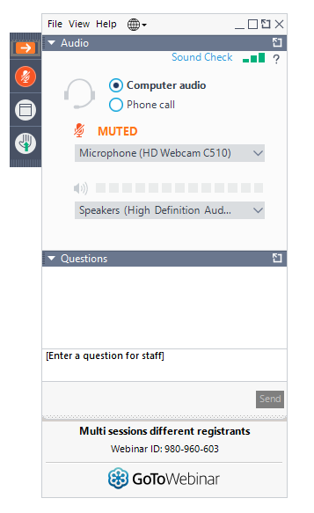
Join the meeting 10-15 minutes early to get situated.
If using the meeting link
If using the meeting link
AUDIO OPTION
1
AUDIO OPTION
2
Click link
Look for Control Panel
Select Computer Audio
Select your Microphone
Select your Speakers
Check sound
Click link
Select Phone Call
Dial phone #
Dial Access Code
Enter Audio PIN (links your registration to phone #)
This is the Questions box.

Slide 5
If you are dialing in directly and not using the online meeting link…
The Dial-in Number and Audio Access Code can be found in one of these places:
Email sent after you registered (includes Audio PIN unique to you)
FDOT meeting notice (letter, newsletter or newspaper advertisement)
<Project website>
<Add others as needed>

Slide 6
All Attendees will be placed in “listen-only” mode.
During the meeting
Welcome!
Thank you for joining us for today’s meeting.
Attendee webcams will be disabled. No one will be able to see you during the meeting.
If you used the meeting link…
If you dialed in directly…
You will see and hear the presentation.
If dialing in, mute the computer speaker and microphone to avoid audio feedback.
You will only hear the presentation.
Follow along with the presentation slides downloaded before the meeting at <project webpage>.

Slide 7
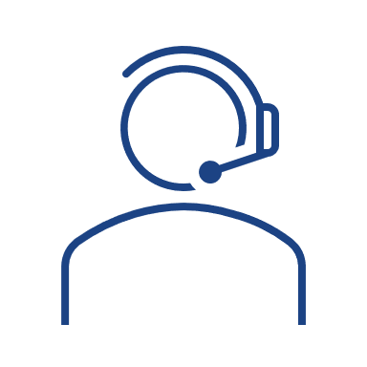
Submitting questions or comments
Look for the Questions box on the Control Panel.
Type your question or comment.
Click Send.
If the Raise Hand feature is used at the meeting…
meeting link users
Click the Raise Hand icon on the Control Panel to request to speak.
When unmuted by the Organizer, everyone will be able to hear you.
If you hear an echo, lower the volume on your speakers.
Questions and comments can also be submitted by mail, email, or telephone.
See FDOT contact information during the meeting, in meeting notifications and at <project webpage>.

Slide 8
Need help with anything
Please let us know.
Staff will be on-hand to assist during the meeting if you have a technical issue.
Type the issue in Questions box on the Control Panel and we will do our best to assist you.
You can also click Help on the Control Panel to access online instructions.
This is the Questions box.

