Slide 1
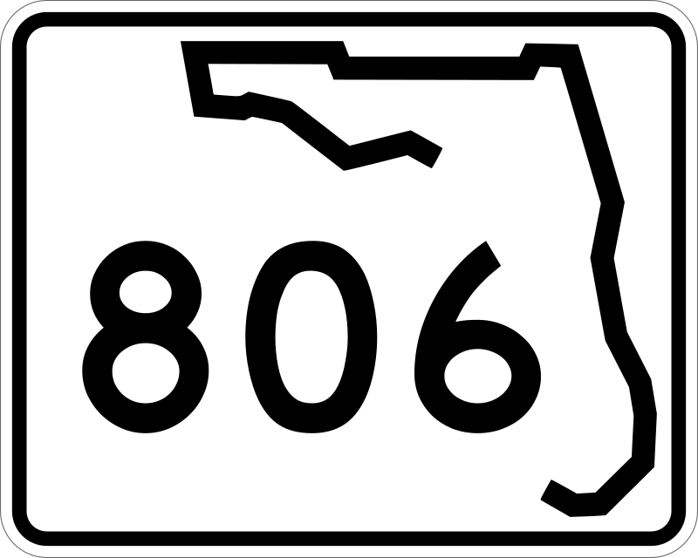
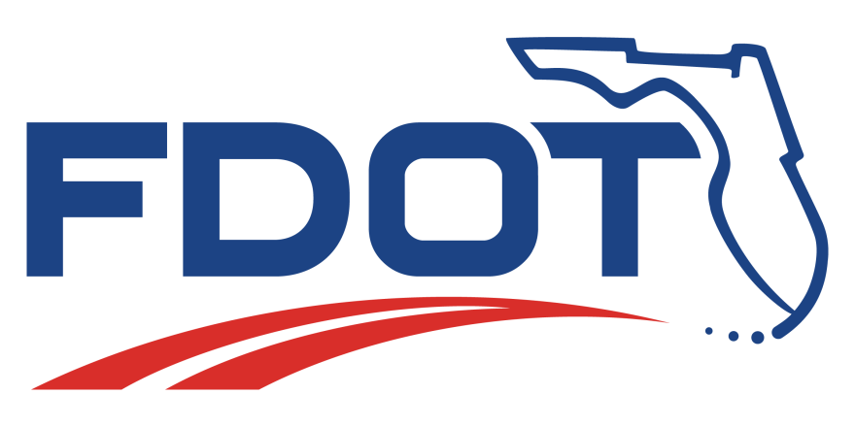
Federal-State Partnership
The environmental review, consultation, and other actions required by applicable federal environmental laws for this project are being, or have been, carried out by the FDOT pursuant to 23 U.S.C. 327 and a Memorandum of Understanding dated December 14, 2016, and executed by the Federal Highway Administration (FHWA) and FDOT.

