Slide 1


Transportation Regional Incentive Program
(TRIP)
Maria Showalter
Planning Specialist
TRIP Coordinator

Slide 2

What is TRIP?
The TRIP Program provides funding to improve regionally significant transportation facilities in regional transportation areas defined by Florida Statute 339.2819.
The purpose of the programing is to encourage regional planning by providing state matching funds for improvements to regionally significant transportation facilities identified and prioritized by regional partners.
Funds are allocated to Districts as specified in Florida Statute 201.15 to the State Transportation Trust Fund.
The Department shall provide a maximum of 50% of eligible cost for eligible projects also defined as a phase or combination of phases proposed for funding.

Slide 3
Definition of
REGIONAL:
A transportation project that is on a facility which serves regional transportation needs (such as access to and from the area outside of the region, major activity centers in the region, major planned developments such as new retail malls, sports complexes, etc., or transportation terminals) and would normally be included in the modeling of a TPO area transportation network, including at a minimum all principal arterial highways and all fixed guideway transit facilities that offer an alternative to regional highway travel.

Slide 4
Who is eligible to participate?
All MPOs, Counties, and Multi-County Transportation Authorities are eligible to participate, if they form partnerships.
    Two or more contiguous MPOs,
    One or more MPOs and one or more contiguous non - MPO Counties,
    Multi-county regional transportation authorities,
    Two or more contiguous non-MPO counties,
    MPOs comprised of three or more counties.

Slide 5
What are the responsibilities of the Partners?
Regional partners must develop an interlocal agreement that provides the following:
Includes development of the regional transportation plan;
Delineates the boundaries of the regional transportation area;
Provides the duration of the agreement and how it may be changed;
Describes the planning process, and defines a dispute resolution process.

Slide 6
Project requirements for TRIP funding
Must support facilities that…
  Serve national, statewide or regional functions
    Project must serve a regional need and the transportation facility must be noted within the RTA’s plan and map.
  Function as an integrated regional system
Must be supported by local planning efforts:
  Identified in Capital Improvement Element in the appropriate local government comprehensive plan;
  Project must be in compliance with the area TPO plans,
  Be in compliance with local corridor management policies within the comprehensive plan.
  Must be consistent with the Strategic Intermodal System; example: adding capacity
  Must have a commitment of local, regional or private matching funds, unless eligible for a match waiver.

Slide 7
Project PRIORITY outline
(F.S. 339-2819)
Provide connectivity to the Strategic Intermodal System
Support economic development and goods movement in rural areas of economic opportunity (RAO),
Are subject to local ordinances that establish corridor management techniques,
Improve connectivity between military installations and the Strategic Highway Network (STRAHNET) or the Strategic Rail Corridor Network (STRACNET), and
The extent to which local matching funds are available to be committed to the project.

Slide 8

Work Program Development Cycle
Standard Cycle
Accelerated Cycle
JULY
Final Adoption of Work Program (AD)
System opens for tentative activities (G1)
AUGUST-OCTOBER
Assimilation of the Tentative Work Program (G1)
NOVEMBER
System closes to balance the Tentative Work Program (G1)
DECEMBER
Hold Work Program E-Public Hearing & present tentative to the TPO’s
JANUARY
Secretary Review by Central Office & Florida Transportation Commission Assessment
FEBRUARY
Central Office submits Tentative to Governor’s Office & Legislature
MARCH
Statewide Public Hearing
Legislature Convenes
APRIL-JUNE
Address concerns and make final decisions
JULY
Final Adoption of Work Program (AD)
System opens for Tentative activities (G1)
AUGUST
Assimilation of the Tentative Work Program (G1)
SEPTEMBER
System closes to balance the
Tentative (G1)
OCTOBER
Hold Work Program E-Public Hearing & present Tentative (G1) to the TPO’s
NOVEMBER
Secretary Review by Central Office & Florida Transportation Commission Assessment
DECEMBER
Central Office submits Tentative (G1) to Governor’s Office & Legislature
JANUARY
Statewide Public Hearing
Legislature Convenes
FEBRUARY-JUNE
Address concerns and make final decisions

Slide 9
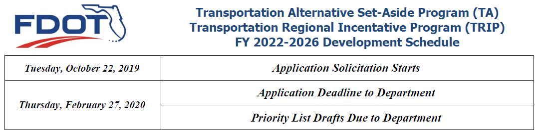
FY 2022 - 2026
Development Cycle
Emerald Coast Regional Council
Caitlin Cerame, AICP
850-332-7976, ext. 203
Caitlin.cerame@ecrc.org
Capital Regional Planning Council
Greg Burke, AICP
850-891-8626
Greg.burke@talgov.com

Slide 10
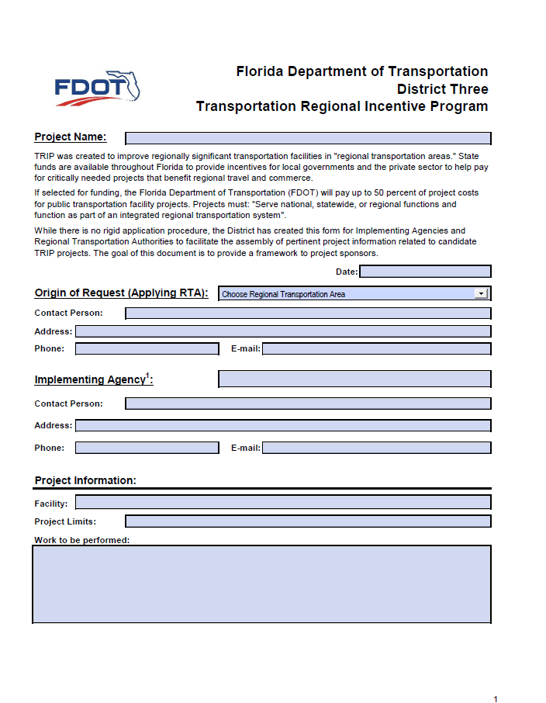
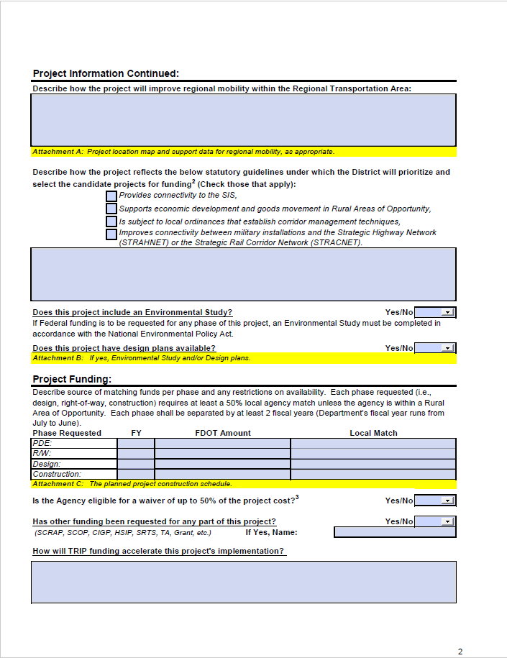
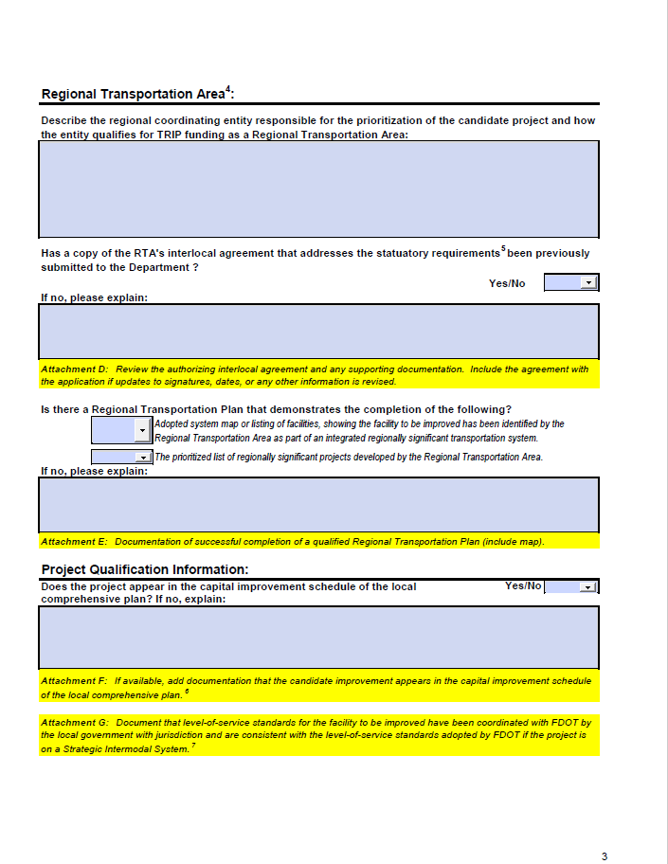
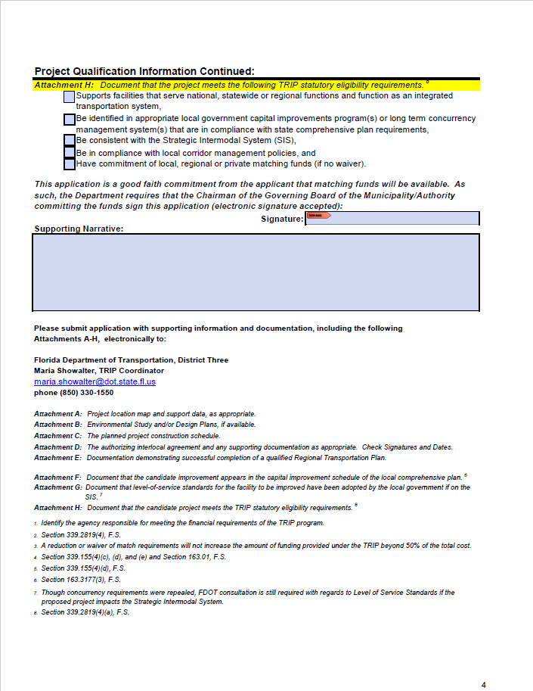
TRIP
Application

Slide 11
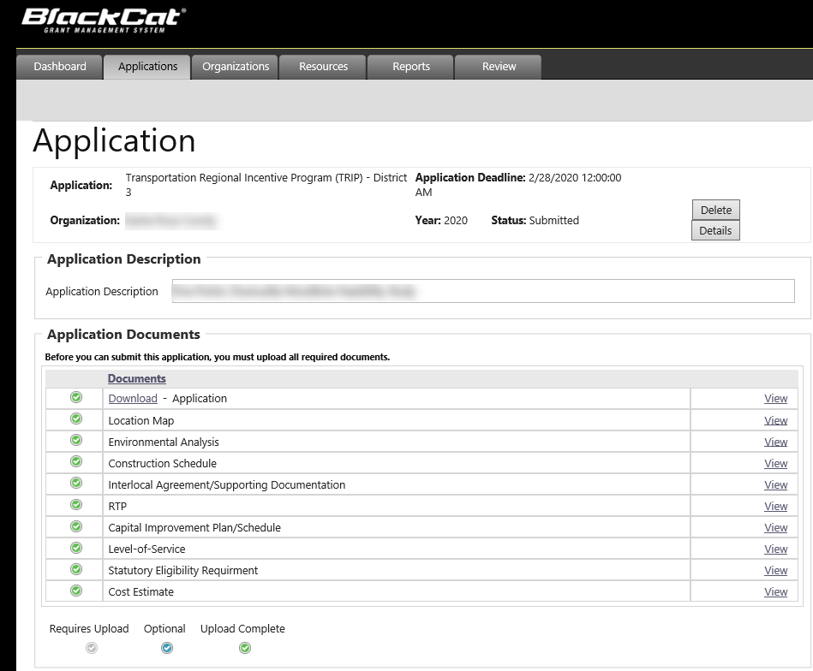
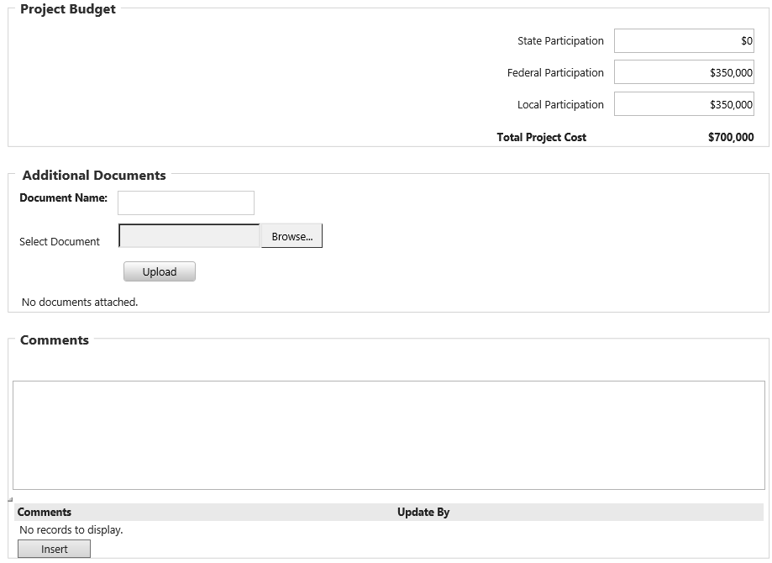
GAP
(Grant Application Process)
The Implementing Agency will need to submit and upload all requested information in the GAP system.

Slide 12
Frequently Asked Questions
Can a project be submitted for TRIP funds that does not originate from a Regional Transportation Plan?
No. The project must come from an approved Regional Transportation Plan.
What does it mean for a project to be "consistent with the Strategic Intermodal System Plan"?
Being consistent with the SIS means that the project serves a national, statewide, or regional function, and it serves an integral part of an interconnected regional network.
If an eligible rural county is granted a waiver or reduction for its share of the non-TRIP match of project costs, can TRIP funds be used to cover the balance?
In those instances where a match has been waived or reduced, the scope of the project will have to be reduced.
Who decides what is regionally significant and what are the criteria?
Regional transportation areas designate regionally significant facilities. The definition of "regionally significant" is expected to vary according to the characteristics and policies of each region. FDOT has provided guidance for these designations and identified characteristics for consideration. This information can be found within the resources webpage.

Slide 13
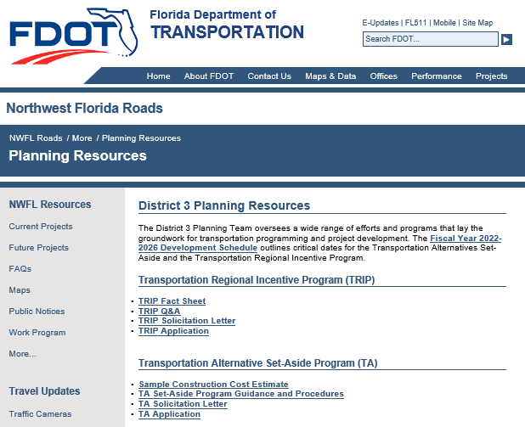
Maria Showalter
D3 TRIP Coordinator
850-330-1550
Maria.Showalter@dot.state.fl.us
Lorraine Moyle
State Local Programs Administrator
(850) 414-4383
Lorraine.Moyle@dot.state.fl.us
https://nwflroads.com/planning
https://www.fdot.gov/programmanagement/LP/TRIP/Default.shtm
Notes:
Questions or Comments
All information is posted within our NWFL roads website as well as presentation will be uploaded.
Please contact me with any questions.

