Slide 1



Transportation Regional Incentive Program
(TRIP)
Tanya Sanders Branton Planning Specialist
TRIP Coordinator

Slide 2

What is TRIP?
The TRIP Program provides funding to improve regionally significant transportation facilities in regional transportation areas defined by Florida Statute 339.2819.
The purpose of the programing is to encourage regional planning by providing state matching (50/50) funds for improvements to facilities that function as part of an integrated national, statewide, or regional transportation system.
Funds are allocated to Districts as specified in Florida Statute 201.15 to the State Transportation Trust Fund.
Applicants for TRIP funding must provide matching 50% or more and, if required, execute an interlocal agreement to ensure that TRIP funding will be exclusively used to improve facilities identified in the capital improvement element of a comprehensive plan that has been determined to be in compliant with Chapter 163, Part II, F.S.
Notes:
TRIP was established by the 2005 Legislature, to improve growth management planning and the provision of transportation and infrastructure.
This is NOT a grant program, rather a fund matching program for regionally-significant road and public transportation projects.
The funds are intended to provide incentives for critically needed projects that benefit regional travel and commerce.
Funding is allocated to the districts via statutory formula from
doc stamps
vehicle registration.
50% local match can be considered in-kind matches such as right of way donations and private funds available to the regional partners.
Some Rural counties qualify for a waiver or reduction of required 50% local match.

Slide 3
Definition of REGIONAL:
A transportation project that is on a facility which serves regional transportation needs (such as access to and from the area outside of the region, major activity centers in the region, major planned developments such as new retail malls, sports complexes, etc., or transportation terminals) and would normally be included in the modeling of a TPO area transportation network, including at a minimum all principal arterial highways and all fixed guideway transit facilities that offer an alternative to regional highway travel.
Notes:
One of the key aspects of TRIP is Regional significance.
To qualify as regionally significant a project will need to:
Be on a facility which serves regional transportation needs
Would normally be included in the traffic modeling of a TPO area transportation network

Slide 4
Who is eligible to participate?
All MPOs, Counties, and Multi-County Transportation Authorities are eligible to participate, if they form partnerships.
    MPOs comprised of three or more counties
    Two or more contiguous MPOs
    One or more MPO and one or more contiguous counties that are not MPO members
    Two or more contiguous counties that are not MPO members
    A multi-county regional transportation authority created by or pursuant to law
Notes:
All MPOs, Counties, and Multi-County Transportation Authorities are eligible to participate, if they form partnerships.
Within District 3 there are 4 Transportation Planning Organizations (TPO’s)
Emerald Coast Regional Planning Council (ECRC) :Florida-Alabama TPO, Okaloosa-Walton TPO, and Bay County TPO.
ECRC also oversees the Rural Regional Transportation Program for the following counties and areas which lie outside the TPO boundaries: Bay, Escambia, Gulf, Holmes, Santa Rosa, Walton, & Washington
Capital Regional Transportation Planning Agency (CRTPA): Gadsden, Leon, Jefferson and Wakulla Counties
Apalachee Regional Planning Council (ARPC)- Provides various technical, support and oversight services to rural areas in the following counties: Jackson, Calhoun, Gulf, Liberty, Gadsden, Franklin, Leon, Wakulla, Jefferson

Slide 5
What are the responsibilities of the Partners?
Regional partners must develop an interlocal agreement that provides the following:
Includes development of the regional transportation plan;
Delineates the boundaries of the regional transportation area;
Provides the duration of the agreement and how it may be changed;
Describes the planning process, and defines a dispute resolution process.
Notes:
Regional partners must develop an interlocal agreement that defines the partnership.

Slide 6
Project requirements for TRIP funding
Must support facilities that…
  Serve national, statewide or regional functions
    Project must serve a regional need and the transportation facility must be noted within the RTA’s plan and map.
  Function as an integrated regional system
Must be supported by local planning efforts:
  Identified in Capital Improvement Element in the appropriate local government comprehensive plan;
  Project must be in compliance with the area TPO plans,
  Be in compliance with local corridor management policies within the comprehensive plan.
  Must be consistent with the Strategic Intermodal System; example: adding capacity
  Must have a commitment of local, regional or private matching funds, unless eligible for a match waiver.
Notes:
This is the project criteria…consist of 4 must
Must support regional facilities
Must be supported by local planning efforts
Must be consistent with Strategic Intermodal Systems (SIS)
Must have a commitment of matching funds, unless eligible for a match waiver

Slide 7
Project PRIORITY outline
(F.S. 339-2819)
Provide connectivity to the Strategic Intermodal System
Support economic development and goods movement in rural areas of economic opportunity (RAO),
Are subject to local ordinances that establish corridor management techniques,
Improve connectivity between military installations and the Strategic Highway Network (STRAHNET) or the Strategic Rail Corridor Network (STRACNET), and
The extent to which local matching funds are available to be committed to the project.
Notes:
By law the Department must prioritize projects according to F.S. 339.2819.

Slide 8
Work Program Development Cycle
Standard Cycle
Accelerated Cycle
JULY
Final Adoption of Work Program (AD)
System opens for tentative activities (G1)
AUGUST-OCTOBER
Assimilation of the Tentative Work Program (G1)
NOVEMBER
System closes to balance the Tentative Work Program (G1)
DECEMBER
Hold Work Program E-Public Hearing & present tentative to the TPO’s
JANUARY
Secretary Review by Central Office & Florida Transportation Commission Assessment
FEBRUARY
Central Office submits Tentative to Governor’s Office & Legislature
MARCH
Statewide Public Hearing
Legislature Convenes
APRIL-JUNE
Address concerns and make final decisions
JULY
Final Adoption of Work Program (AD)
System opens for Tentative activities (G1)
AUGUST
Assimilation of the Tentative Work Program (G1)
SEPTEMBER
System closes to balance the
Tentative (G1)
OCTOBER
Hold Work Program E-Public Hearing & present Tentative (G1) to the TPO’s
NOVEMBER
Secretary Review by Central Office & Florida Transportation Commission Assessment
DECEMBER
Central Office submits Tentative (G1) to Governor’s Office & Legislature
JANUARY
Statewide Public Hearing
Legislature Convenes
FEBRUARY-JUNE
Address concerns and make final decisions
Notes:
This slide explains the Work Program Development cycle in its entirety.
The Accelerated cycle indicates when the Legislature sessions meets in January vs March, which in turns shortens the time to build the work program.
This shows in detail when the cycles begins and when it ends with comparison to standard cycle vs accelerated cycle.

Slide 9
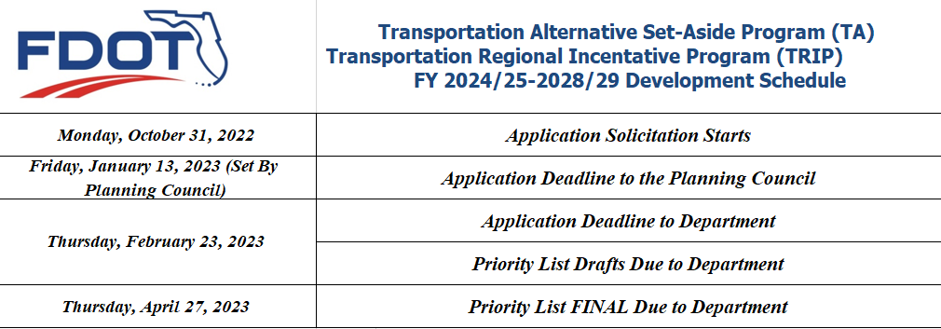
FY 2024/25 – 2028/29
Development Cycle
Emerald Coast Regional Council
Jill Nobles
850-332-7976, ext. 212
Jill.Nobles@ecrc.org
Capital Regional Planning Council
Greg Burke, AICP
850-891-8626
Greg.burke@talgov.com
Notes:
Dates and deadlines

Slide 10
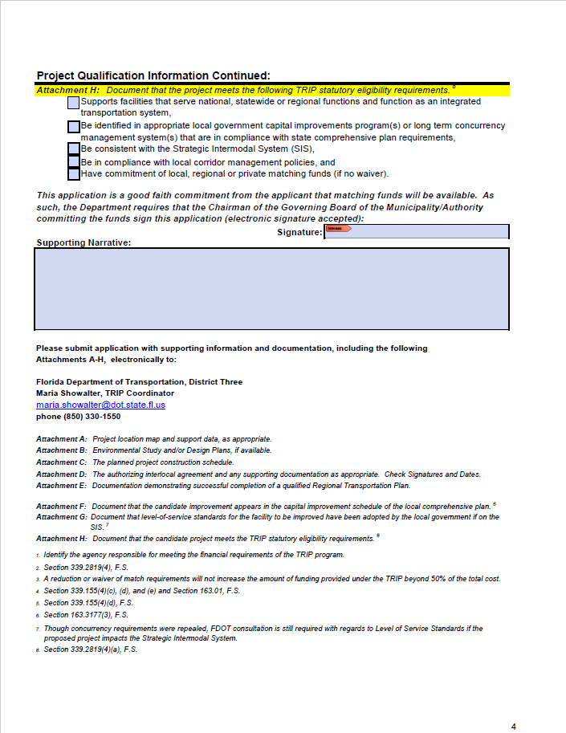
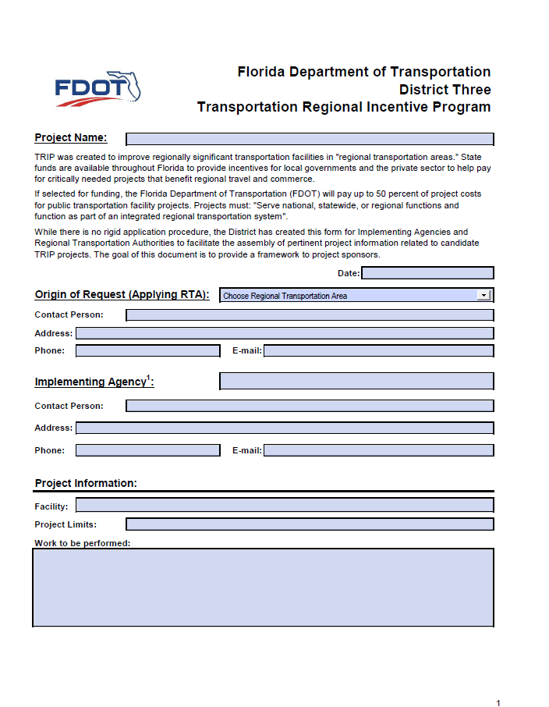
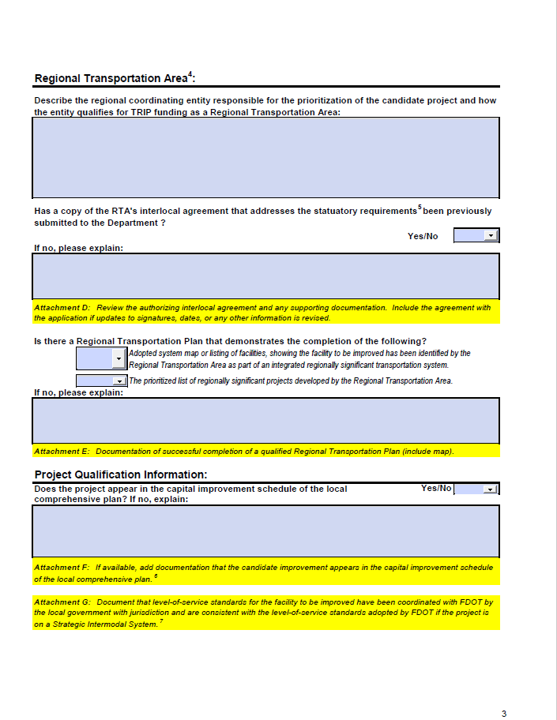
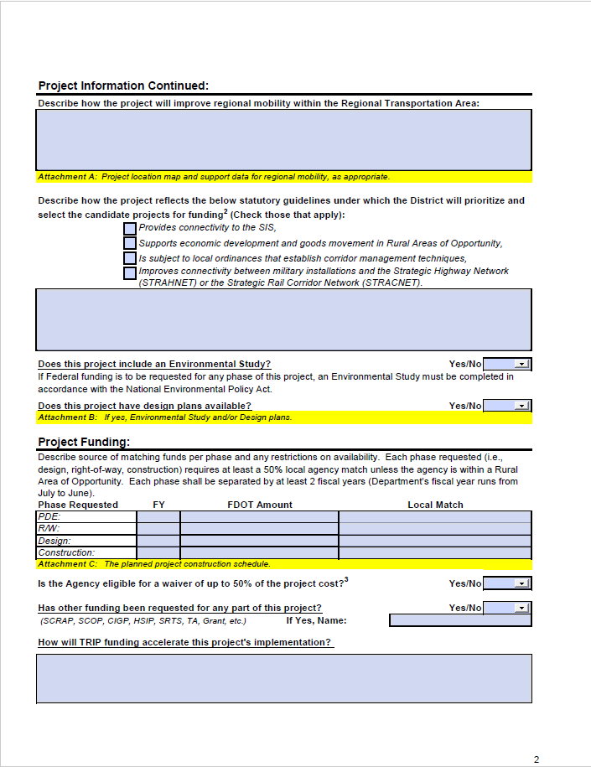
TRIP Application
Notes:
Solicitation for TRIP is open. Applications and all supporting documentation is to be submitted in in the Grant Application Process (GAP) System.

Slide 11
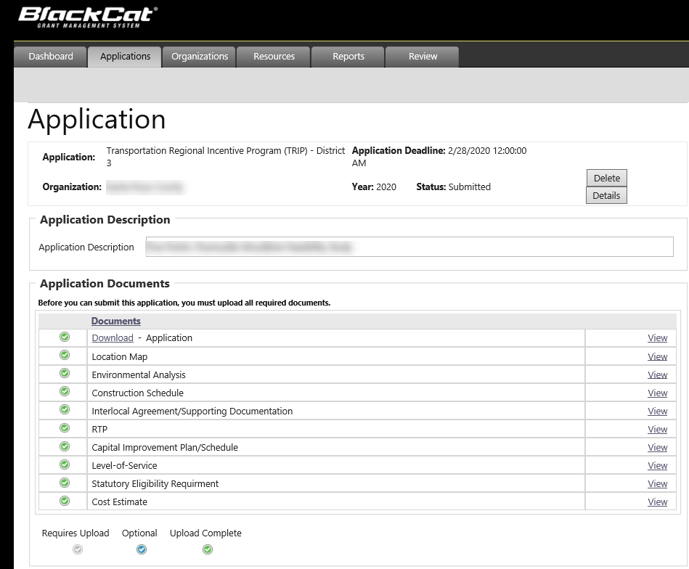
GAP
(Grant Application Process) System
2/23/2023
2022
The Implementing Agency will need to submit and upload all requested information in the GAP system.
Notes:
The Florida Grant Application Process (“GAP”) system, launched in 2021, is the authorized platform for the submission and receipt of applications for TRIP funding; and the management of agreements for the disbursement of TRIP funding awards made by the department. Required documents, which include project plans, agency certifications, project reports and invoices, performance monitoring and compliance documentation should also be stored and maintained in GAP.
Please make sure you have completed and submitted the TRIP application and all supporting documentation in the GAP system.

Slide 12
Can a project be submitted for TRIP funds that does not originate from a Regional Transportation Plan?
No. The project must come from an approved Regional Transportation Plan.
What does it mean for a project to be "consistent with the Strategic Intermodal System Plan"?
Being consistent with the SIS means that the project serves a national, statewide, or regional function, and it serves an integral part of an interconnected regional network.
If an eligible rural county is granted a waiver or reduction for its share of the non-TRIP match of project costs, can TRIP funds be used to cover the balance?
In those instances where a match has been waived or reduced, the scope of the project will have to be reduced.
Who decides what is regionally significant and what are the criteria?
Regional transportation areas designate regionally significant facilities. The definition of "regionally significant" is expected to vary according to the characteristics and policies of each region. FDOT has provided guidance for these designations and identified characteristics for consideration. This information can be found within the resources webpage.
Frequently Asked Questions
Notes:
Here are a few questions that come up every year.
Can a project be submitted for TRIP funds that doesn’t come from RTP?
NO. Project must be approved by the RTP
If an eligible rural county is granted a waiver or reduction of the local funds share, can TRIP funds be used to cover balance?
In those instances where match waiver or reduction is approved, the scope of the project will have to be reduced.
Who decides what is regionally significant?
RTP designates regionally significant facilities. FDOT provides guidance for these designations

Slide 13
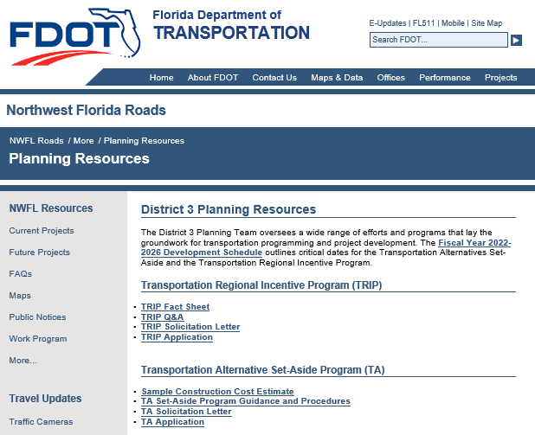
Tanya Sanders Branton
D3 TRIP Coordinator
850-330-1550
Tanya.Branton@dot.state.fl.us
Lorraine Moyle
State Local Programs Administrator
(850) 414-4383
Lorraine.Moyle@dot.state.fl.us
https://nwflroads.com/planning
https://www.fdot.gov/programmanagement/LP/TRIP/Default.shtm

