Slide 1
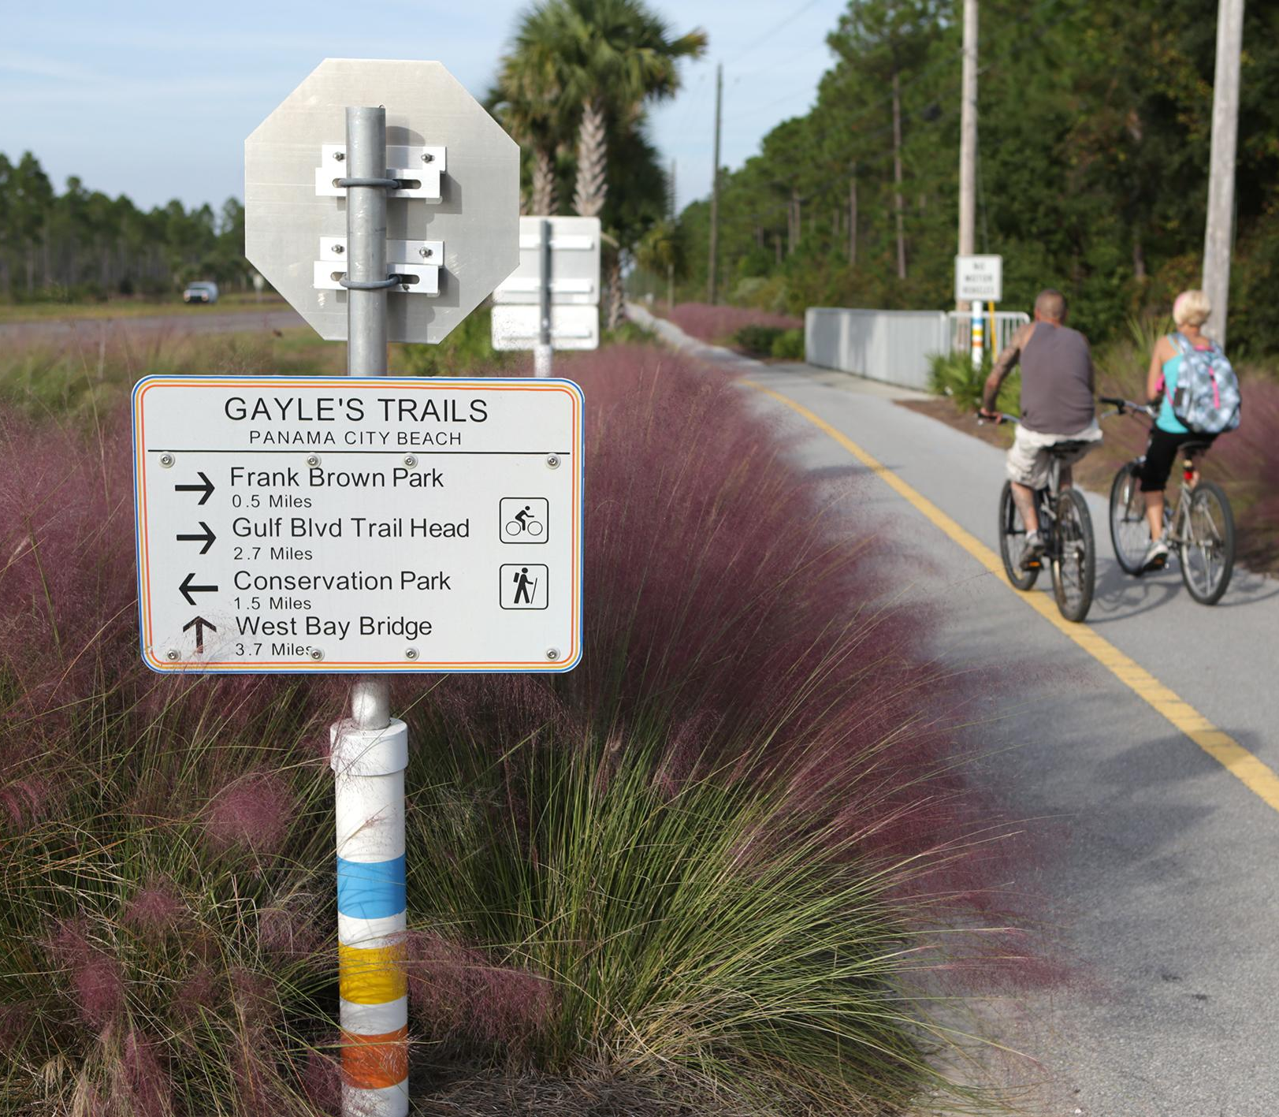

Transportation Alternatives
(TA) Set-aside
Maria Showalter
D3 TA Coordinator

Slide 2
What is TA set-aside?
Federal legislation was passed in December 2015 called FIXING
AMERICA'S SURFACE TRANSPORTATION (FAST) ACT
Effective 2016-2020
Replaces the Transportation Alternatives Program (TAP) with a set-aside of funds under the Surface Transportation Block Grant Program.
Now referred to as Transportation Alternatives (TA) Set-Aside.
Maintains TA eligible activities as set forth in Map-21.

Slide 3
Overview continued
Mandatory funding distribution based on population areas continues.
Requires that MPOs make project prioritizations in urban population areas.
Retains the 80% federal / 20% local match funding arrangement (toll credits apply).
Retains requirement for state competitive process.
TA projects are treated as projects on a Federal-aid highway.
TA eligible activities as established in MAP-21 remain the same.

Slide 4
Work Program Development Cycle
Standard Cycle
Accelerated Cycle
JULY
Final Adoption of Work Program (AD)
System opens for tentative activities (G1)
AUGUST-OCTOBER
Assimilation of the Tentative Work Program (G1)
NOVEMBER
System closes to balance the Tentative Work Program (G1)
DECEMBER
Hold Work Program E-Public Hearing & present tentative to the TPO’s
JANUARY
Secretary Review by Central Office & Florida Transportation Commission Assessment
FEBRUARY
Central Office submits Tentative to Governor’s Office & Legislature
MARCH
Statewide Public Hearing
Legislature Convenes
APRIL-JUNE
Address concerns and make final decisions
JULY
Final Adoption of Work Program (AD)
System opens for Tentative activities (G1)
AUGUST
Assimilation of the Tentative Work Program (G1)
SEPTEMBER
System closes to balance the
Tentative (G1)
OCTOBER
Hold Work Program E-Public Hearing & present Tentative (G1) to the TPO’s
NOVEMBER
Secretary Review by Central Office & Florida Transportation Commission Assessment
DECEMBER
Central Office submits Tentative (G1) to Governor’s Office & Legislature
JANUARY
Statewide Public Hearing
Legislature Convenes
FEBRUARY-JUNE
Address concerns and make final decisions

Slide 5
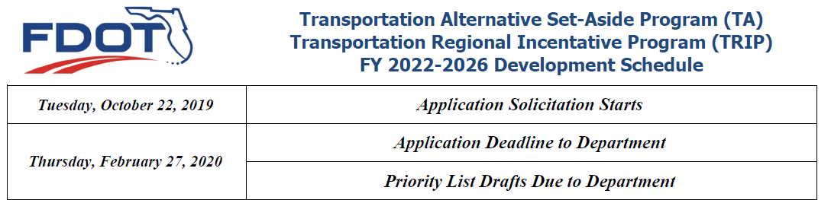
FY 2022 - 2026
Development Cycle
Emerald Coast Regional Council
Caitlin Cerame, AICP
850-332-7976, ext. 203
Caitlin.cerame@ecrc.org
Capital Regional Planning Council
Greg Burke, AICP
850-891-8626
Greg.burke@talgov.com

Slide 6
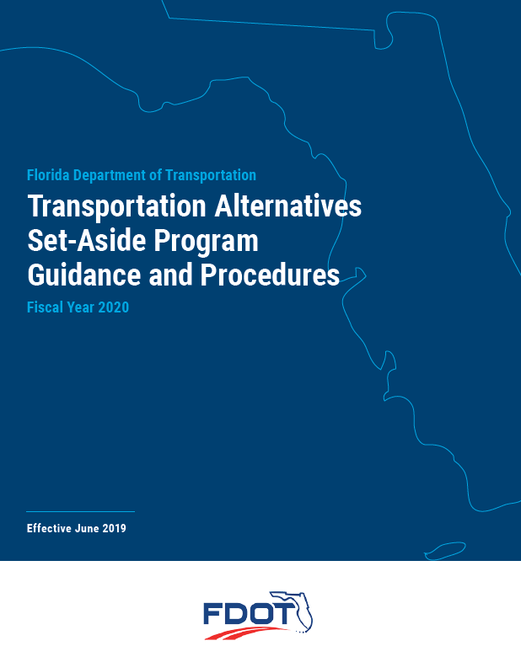
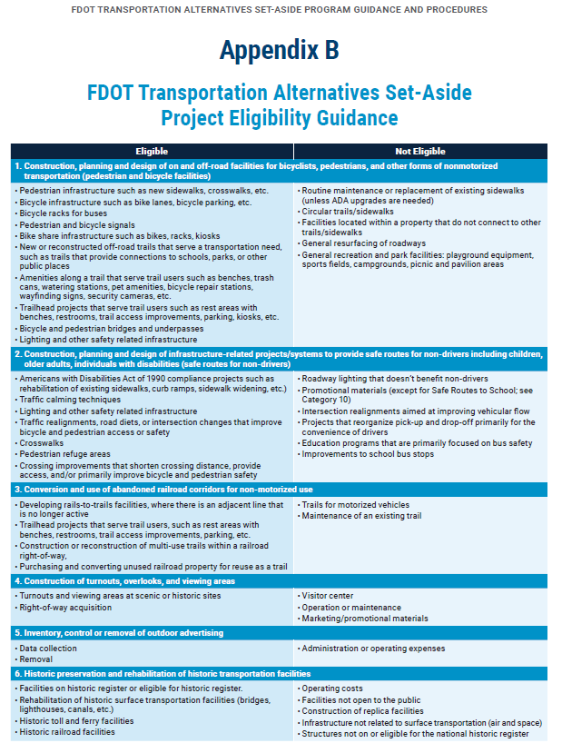
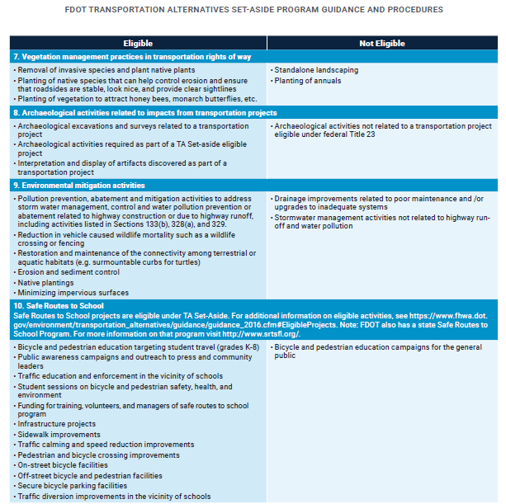
TA Set-Aside eligible/in-eligible activities

Slide 7
Frequently asked questions
SRTS – Safe Route to Schools
  For additional information on eligible activities contact District 3 Safety Office – Barbara Lee
  www.srtsfl.org
Maintenance or replacement of existing sidewalks except for ADA upgrades
General recreation and park facilities: playground equipment, sports fields, campgrounds, picnic and pavilion areas
Projects in the 5 year work program
Recent Construction

Slide 8
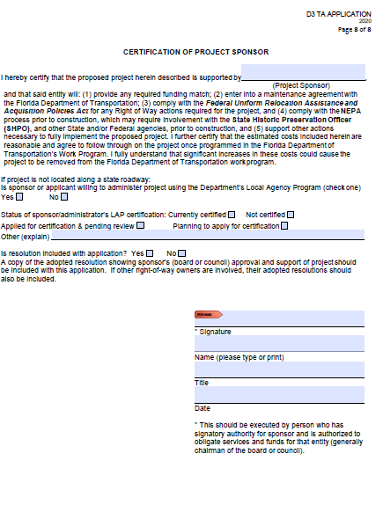
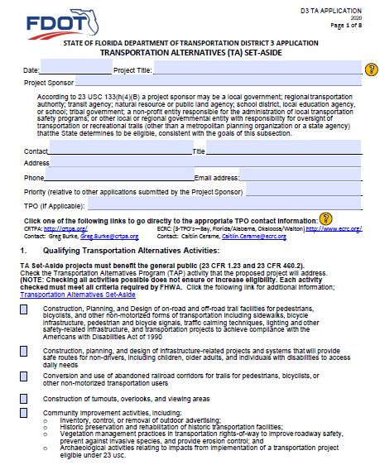
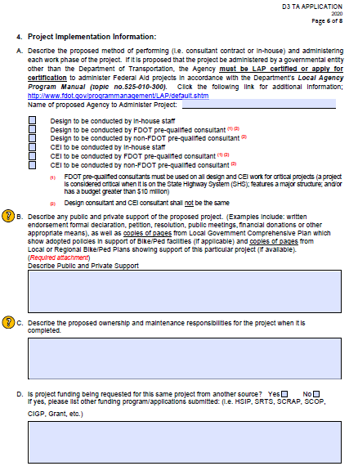
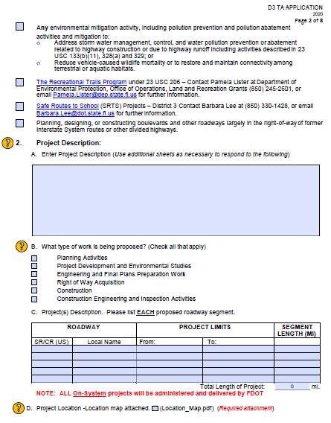
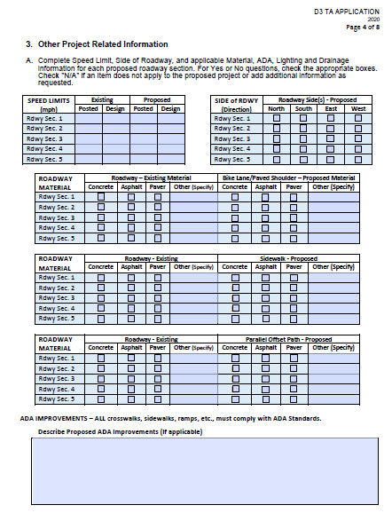
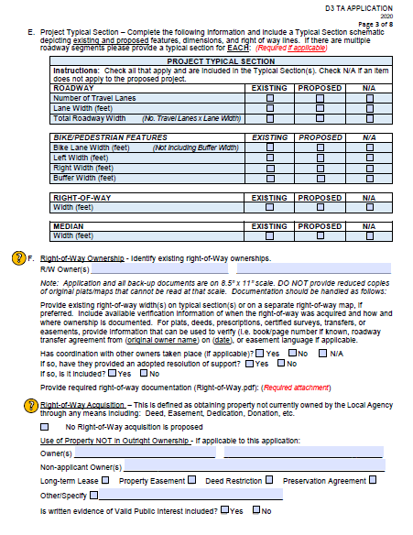
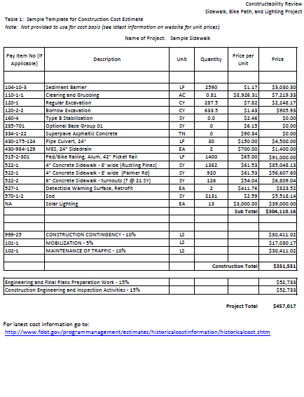
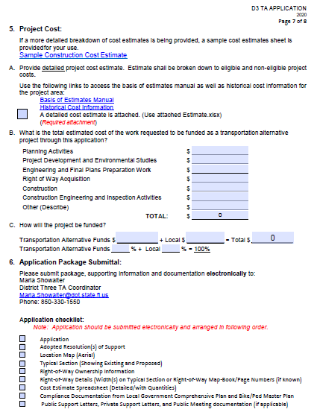
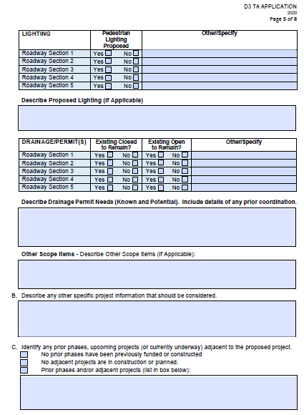
District3
TA Application

Slide 9
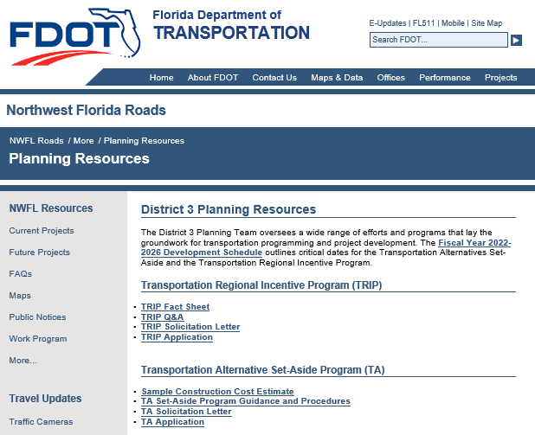
Maria Showalter
Florida Department of Transportation
District 3 Planning Specialist
TA Coordinator
(voice) 850-330-1550
(email) Maria.Showalter@dot.state.fl.us
https://nwflroads.com/planning
https://www.fhwa.dot.gov/fastact/factsheets/transportationalternativesfs.cfm

