Slide 1
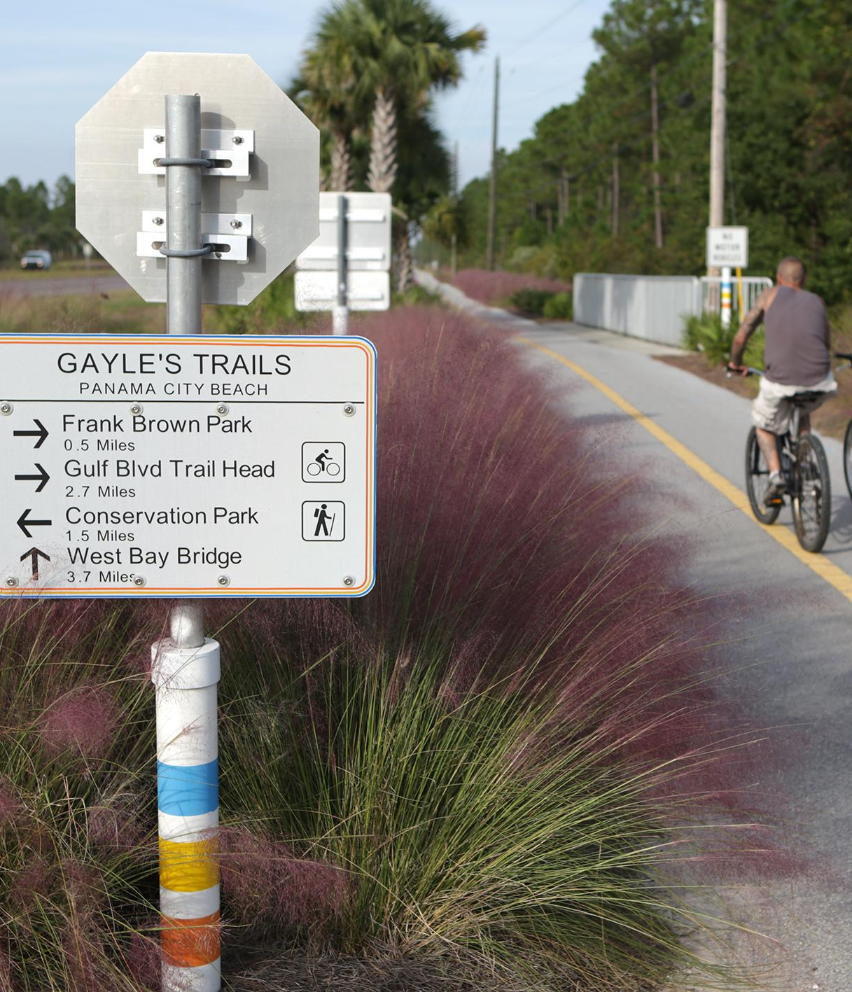





Transportation Alternatives
(TA) Set-Aside
Tanya Sanders Branton
D3 TA Coordinator

Slide 2
What Is TA Set-Aside?
First established by Congress as the Transportation Enhancement (TE) Program under the Intermodal Surface Transportation Efficiency Act (ISTEA) of 1991
Program continues under The Infrastructure Investment and Jobs Act (IIJA, also known as the Bipartisan Infrastructure Law) which took effect October 1, 2021.
  Increases focus for prioritizing connectivity
  Equitable access policies
  Safety
  Sustainability
Funding increases by providing 10 percent of the Surface Transportation Block Grant (STBG) rather than a reoccurring fixed dollar amount, resulting in an annual total allocation for TA that should increase 2%.
Notes:
First established by Congress as the Transportation Enhancement (TE) Program under the Intermodal Surface Transportation Efficiency Act (ISTEA) of 1991, TE continued under two subsequent federal laws.
In 2012 the Moving Ahead for Progress in the 21st Century Act (MAP 21) replaced TE activities with the Transportation Alternatives Program (TAP) and consolidated three previously separate programs, Transportation Enhancements, Safe Routes to Schools, and the Recreational Trails Program.
In 2015 the Fixing America’s Surface Transportation (FAST) Act replaced TAP with the Transportation Alternatives Set-Aside program (TA).
Overall, TA includes the same provisions as TAP while expanding eligibility and streamlining processes.
Funding for Safe Routes to Schools (SRTS) through TA is separate from Florida’s standalone SRTS Program, see: https://www.fdot.gov/Safety/programs/safe-routes.shtm
Administration of the Recreational Trails Program (RTP) in Florida is by the Department of Environmental Protection (DEP), Division of State Lands in compliance with the 62S-2, Florida Administrative Code.
For more information contact the DEP Land and Recreation Grants staff at 850-245-2501 or see: https://floridadep.gov/Grants

Slide 3
Overview Continued
Mandatory funding distribution based on population areas continues.
Requires that MPOs make project prioritizations in urban population areas.
Retains the 80% federal / 20% local match funding arrangement (toll credits apply).
Retains requirement for state competitive process.
TA projects are treated as projects on a Federal-aid highway.
Notes:
This slide highlights Funding, prioritizations, match requirements, and eligibilities.
This IS a federal funding program and requires a 80/20 soft match. There are toll credits available in Florida to make up the 20% for the locals
But keep in mind anything that is consider a match makes a project more favorable.
For additional information please visit the BIL website at https://www.fhwa.dot.gov/bipartisan-infrastructure-law/ta.cfm
or
FHWA’s guidance site on the TA program @ https://www.fhwa.dot.gov/environment/transportation_alternatives/

Slide 4


Program Overview
The FDOT TA Set-Aside is intended to fund a variety of small-scale transportation projects such as pedestrian and bicycle facilities, recreational trails, safe routes to school projects, community improvements such as historic preservation and vegetation management, and environmental mitigation related to stormwater and habitat connectivity

Slide 5
Who Can Apply?
Local governments
Regional transportation authorities
Transit agencies
Natural resource or public land agencies
School districts, local education agencies, or schools
Tribal governments
Non-profit entities responsible for local transportation safety programs
Any other local or regional governmental entity with responsibility for oversight of transportation or recreational trails (other than an MPO or a state agency) that the state determines to be eligible
Notes:
Under 23 USC 133(h)(4)(B), the eligible entities to receive TAP funds are Eligible Project Sponsors

Slide 6
Work Program Development Cycle
Standard Cycle
Accelerated Cycle
JULY
Final Adoption of Work Program (AD)
System opens for tentative activities (G1)
AUGUST-OCTOBER
Assimilation of the Tentative Work Program (G1)
NOVEMBER
System closes to balance the Tentative Work Program (G1)
DECEMBER
Hold Work Program E-Public Hearing & present tentative to the TPO’s
JANUARY
Secretary Review by Central Office & Florida Transportation Commission Assessment
FEBRUARY
Central Office submits Tentative to Governor’s Office & Legislature
MARCH
Statewide Public Hearing
Legislature Convenes
APRIL-JUNE
Address concerns and make final decisions
JULY
Final Adoption of Work Program (AD)
System opens for Tentative activities (G1)
AUGUST
Assimilation of the Tentative Work Program (G1)
SEPTEMBER
System closes to balance the
Tentative (G1)
OCTOBER
Hold Work Program E-Public Hearing & present Tentative (G1) to the TPO’s
NOVEMBER
Secretary Review by Central Office & Florida Transportation Commission Assessment
DECEMBER
Central Office submits Tentative (G1) to Governor’s Office & Legislature
JANUARY
Statewide Public Hearing
Legislature Convenes
FEBRUARY-JUNE
Address concerns and make final decisions
Notes:
This slide explains the Work Program Development cycle in its entirety.
The Accelerated cycle indicates when the Legislature sessions meets in January vs March, which in turns shortens the time to build the work program.
This shows in detail when the cycles begins and when it ends with comparison to standard cycle vs accelerated cycle.

Slide 7
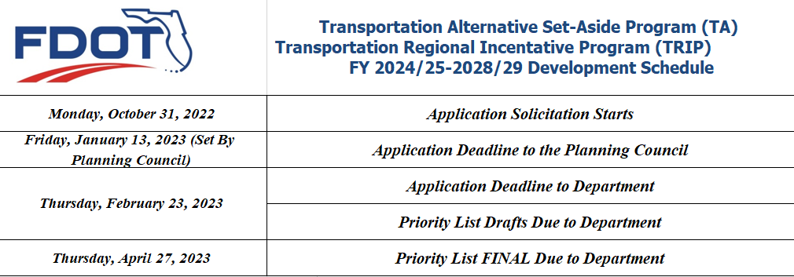
FY 2024/25 – 2028/29
Development Cycle
Emerald Coast Regional Council
Jill Nobles
850-332-7976, ext. 212
Jill.Nobles@ecrc.org
Capital Regional Planning Council
Greg Burke, AICP
850-891-8626
Greg.burke@talgov.com
Notes:
Dates and deadlines

Slide 8

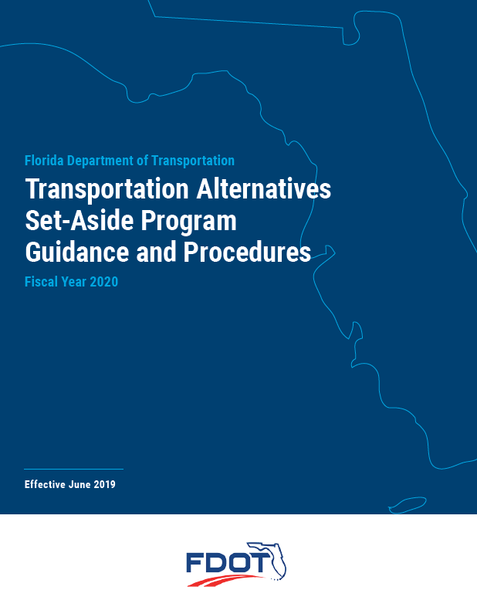
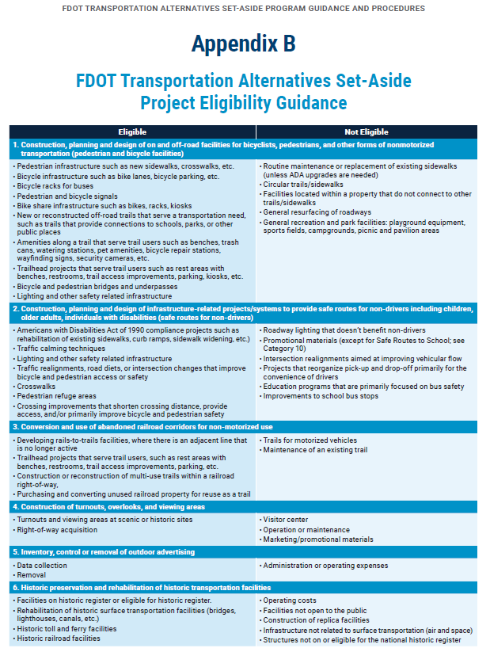
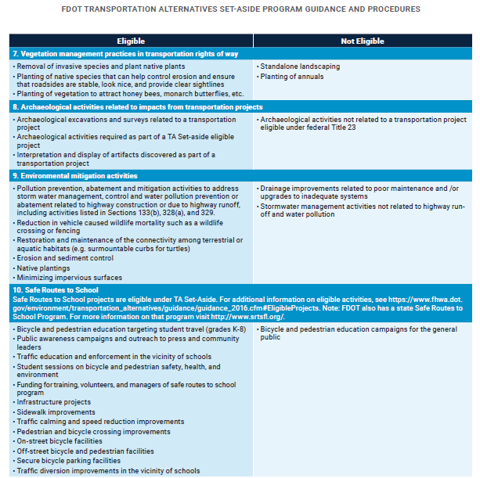

TA Set-Aside eligible/ineligible activities
Notes:
Detailed information about the TA Program can be found within the TA Set-Aside Program Guidance and Procedures, along with the eligible activities located in Appendix B.
This is the newest guidance that has been released from FDOT Central Office.
TA Project Eligible Activities consist of construction, planning and designing of on and off-road forms of nonmotorized activities and includes infrastructure related activities.
This guidance gives detailed information concerning the program and has examples of both eligible and ineligible activities.
These eligible activities can be found under TA Set-Aside Program Guidance and Procedures located on the D3 Planning Resources webpage.

Slide 9
What Are The Eligible Activities?
TA Set-Aside has 9 eligible activities
& must be related to surface Transportation
Construction, Planning and Design of on-road and off-road trail facilities for pedestrians, bicyclists and other non-motorized forms of transportation
    Examples: New Sidewalks, Bicycle infrastructure, Pedestrian and Bicycle signals, Americans with Disabilities Act of 1990 compliance projects
Construction, Planning and Design of infrastructure related projects and systems that will provide safe routes for non-drivers including children, older adults and individuals with disabilities.
    Examples: Crosswalks, Pedestrian refuge areas, Pedestrian lighting, ADA curb Ramps
Notes:
TA has 9 eligible actives and must be related to Surface Transportation. Some of the examples include new sidewalks, bicycle infrastructure bike ped signals, crosswalks, ped lighting

Slide 10
Eligible Activities Continued
Conversion of abandoned railroad corridors for trails for pedestrians, bicyclists or other non-motorized transportation users.
    Examples: Rails to Trails facilities
Construction of Turnouts, Overlooks and Viewing areas.
    Examples: Turnouts and viewing areas at scenic or historic sites
Inventory, Control or Removal of Outdoor Advertising.
Historic Preservation and Rehabilitation of historic transportation facilities.
    Examples: Rehabilitation of historic transportation facilities (bridges, lighthouses, canals, etc.), Historic toll and ferry facilities, Historic railroad facilities

Slide 11
Eligible Activities Continued
Vegetation Management Practices in transportation rights-of-way to improve safety, prevent invasive species and provide erosion control.
    Examples: Erosion Control, Vegetation management to improve roadway
    safety or Prevention of invasive species
Archaeological activities relating to impacts from the implementation of a transportation project.
Any environmental mitigation activity that includes:
    Pollution prevention, abatement and mitigation activities to address storm water management, control and water pollution prevention or abatement related to highway construction or due to highway runoff, including activities listed in Sections 133(b), 328(a), and 329.
    Reduction in vehicle caused wildlife mortality.
    Restoration and maintenance of the connectivity among terrestrial or
    aquatic habitats.
Notes:
Erosion control to improve roadway safety, mitigation actives to address storm water management.

Slide 12
Frequently Asked Questions
SRTS – Safe Route to Schools
  For additional information on eligible activities contact District 3 Safety Office – Gretchen Peoples
  www.srtsfl.org
  https://www.fdot.gov/Safety/programs/srts-workshop
X Maintenance or replacement of existing sidewalks except for ADA upgrades
X General recreation and park facilities: playground equipment, sports fields, campgrounds, picnic and pavilion areas
X Projects in the 5-year work program
X Recent Construction
Notes:
These are a few frequent questions
Safe Routes To School (SRTS) projects are eligible under TA. Eligible criteria can be found in the Appendix B as well. However, there is also a state Safe Routes To School (SRTS) program.
For more information the contact for D3 is Gretchen Peoples or you can visit the website posted on the slide.
This slide also lists ineligible activities.
Replacement of existing sidewalks is not eligible.
General recreation and park facilities: playground equipment, sports fields, campgrounds, picnic and pavilion areas
Projects in the 5-year work program and projects recently constructed are not eligible due to:
If already funded in the Work Program through another funding source, the Department will not review again to swap funding.
If an area has recently been constructed by locals or another program FDOT will not consider modifying or altering the completed work.

Slide 13
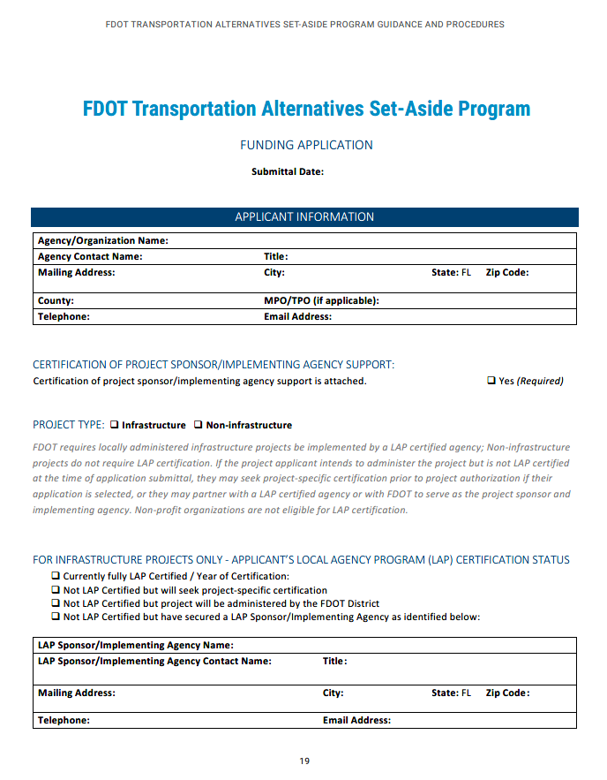
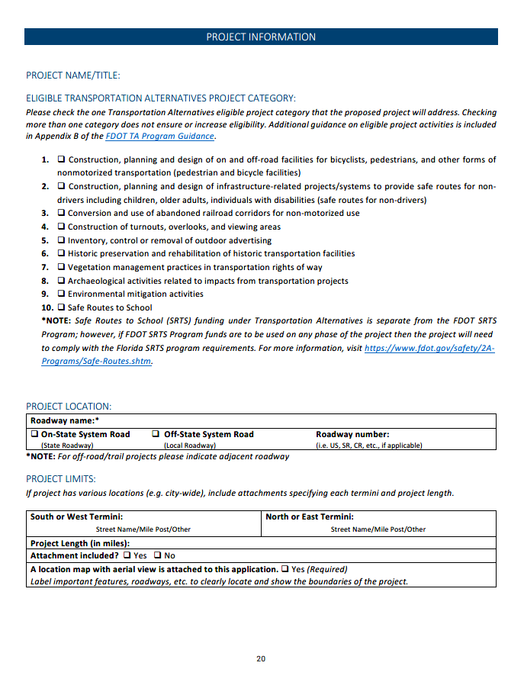
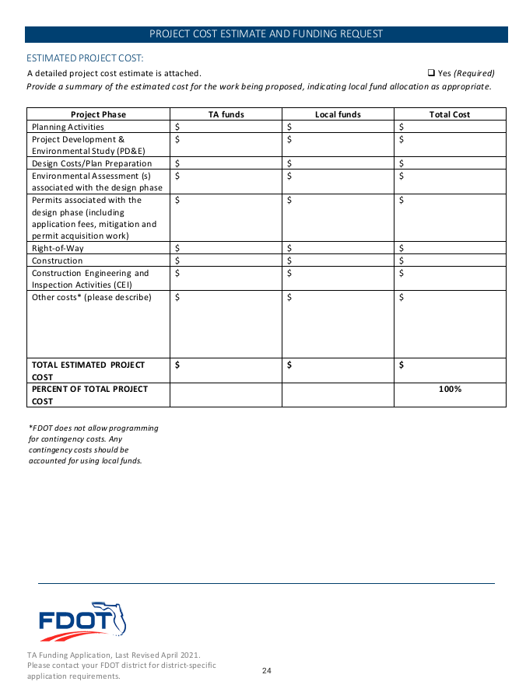
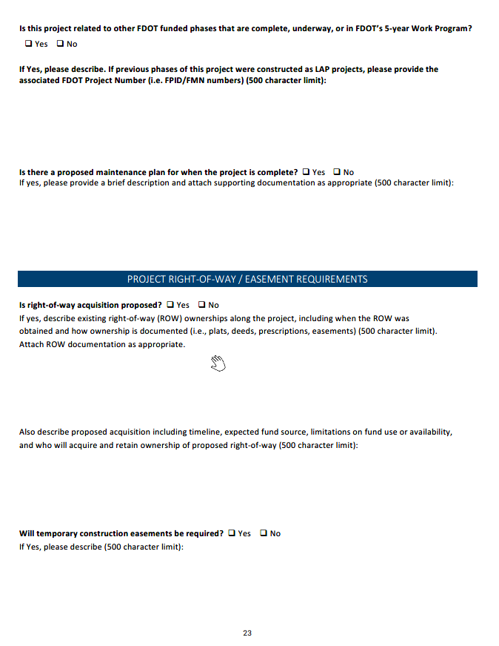
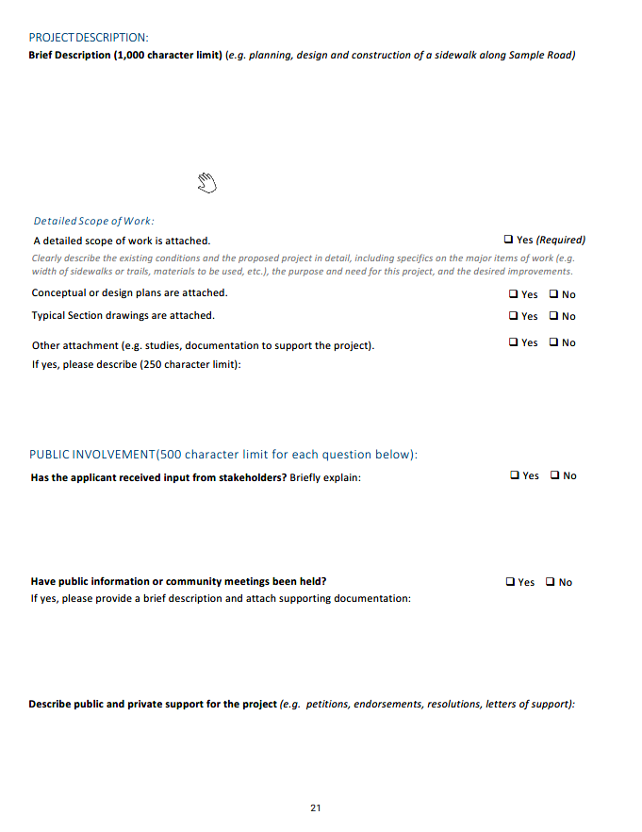
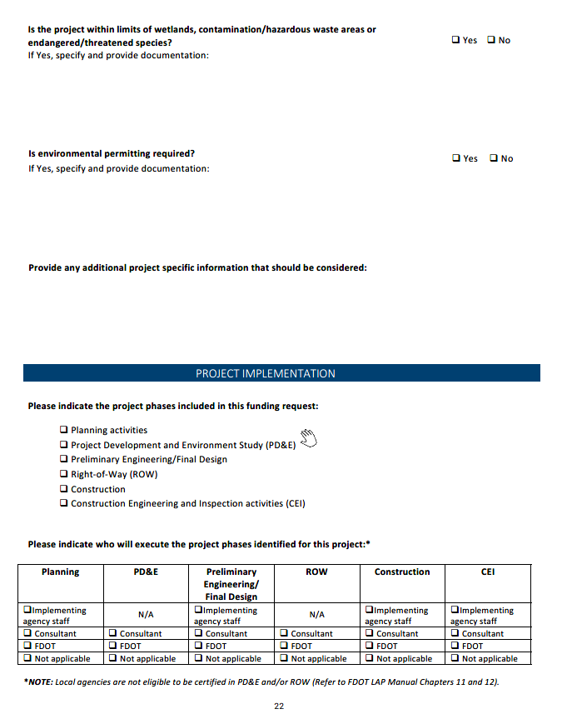
Statewide
TA Application
Notes:
FDOT has a STATEWIDE application
TA applications and supporting documents are to be uploaded in the GAP (Grant Application Program) System.

Slide 14
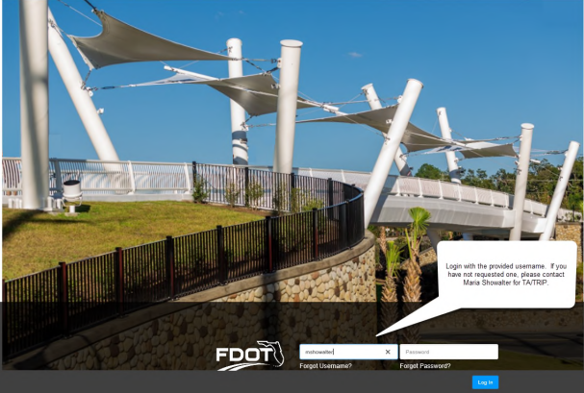
Grant Application Process (GAP) –FOR TA
FDOT application and support documents may be downloaded and submitted at www.flgap.com
GAP HELP Guide
Notes:
All TA Applications and supporting documentation is to be uploaded into the GAP system. . If you need access, you may request credentials by clicking the link at the bottom of the page that says, "Request User Access" or contact Tanya Branton, District TA Coordinator.
Please use your Chrome browser to open: http://www.flgap.com/
Application deadline for areas located within TPO/MPO Friday, January 13, 2023
Application deadline for areas located outside TPO/MPO areas Thursday, February 23, 2023

Slide 15
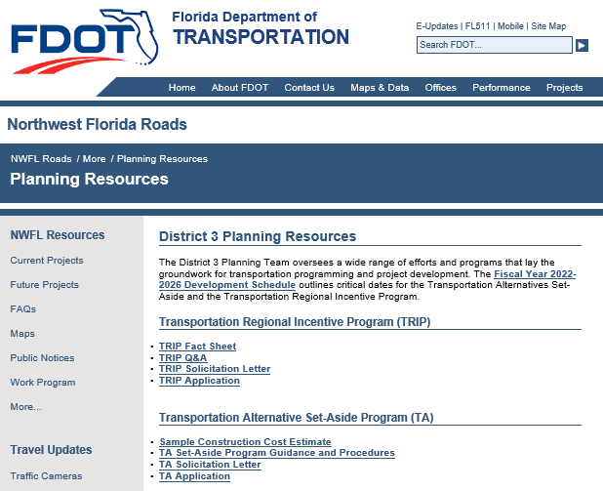
Tanya Sanders Branton
Florida Department of Transportation
District 3 Planning Specialist
TA Coordinator
(voice) 850-330-1550
(email) Tanya.branton@dot.state.fl.us
https://nwflroads.com/planning
https://www.fhwa.dot.gov/bipartisan-infrastructure-law/ta.cfm
Notes:
Additional Information on the TA Set-Aside Program Guidance and Procedure can also be found on District Three’s Resource site. The link is provided on the slide above. There is a link to the Bipartisan Infrastructure Law (BIL) TA information
Please feel free to contact Tanya Branton at the information listed above if you have questions or need further assistance.

