Slide 1

Shared-Use Nonmotorized
(SUN) Trail Program
Florida Department of
TRANSPORTATION

Slide 2



Shared-Use Nonmotorized (SUN) Trail Program
Created under Section 339.81, Florida Statute
$25 million annually funded from the redistribution of new vehicle tag revenues
To develop a statewide system of paved non-motorized trails for bicyclists and pedestrians (SUN Trail Network)
that are a priority established within the Florida Greenways & Trails System, Chapter 260, Florida Statute
People are more likely to shift from driving to bicycling if they feel safer and more comfortable in their environment.
Commuting Trends in Florida, Florida Department of Transportation (2016)
2
2
Florida Department of Transportation
Notes:
2
Legislation approved in both 2014 and 2015 codifies the Department’s role in the advancement of paved multiuse trails; $25 million annually to SUN Trail Program from the redistribution of new vehicle tag revenues (funding source 320.072, F.S.;
2015 Legislation: SUN Trail Authority (established program) = 339.81, F.S.
Excludes: sidewalks; loop trails wholly within a single park or natural area; water trails; the Florida National Scenic Trail;
and On-road facilities except:
Segments less than a ½ mile connecting two or more non-motorized trails; or on-road components of FKOSHT.
2014 Trail Legislation: 335.065(4), FS: set the stage but didn’t include funding
Directed DOT to give funding priority to trail projects identified by the FL Greenways & Trails Council as a priority within the Florida Greenways and Trails System, closes gaps, national/statewide/regional importance, & operated/maintained by an entity other that FDOT.
The FGTS Plan establishes Florida’s vision for a statewide trail network
THIS Statute is the FUNDING Authorization
Not one funding source will implement all trail needs. SUN Trail funding must be strategic.

Slide 3
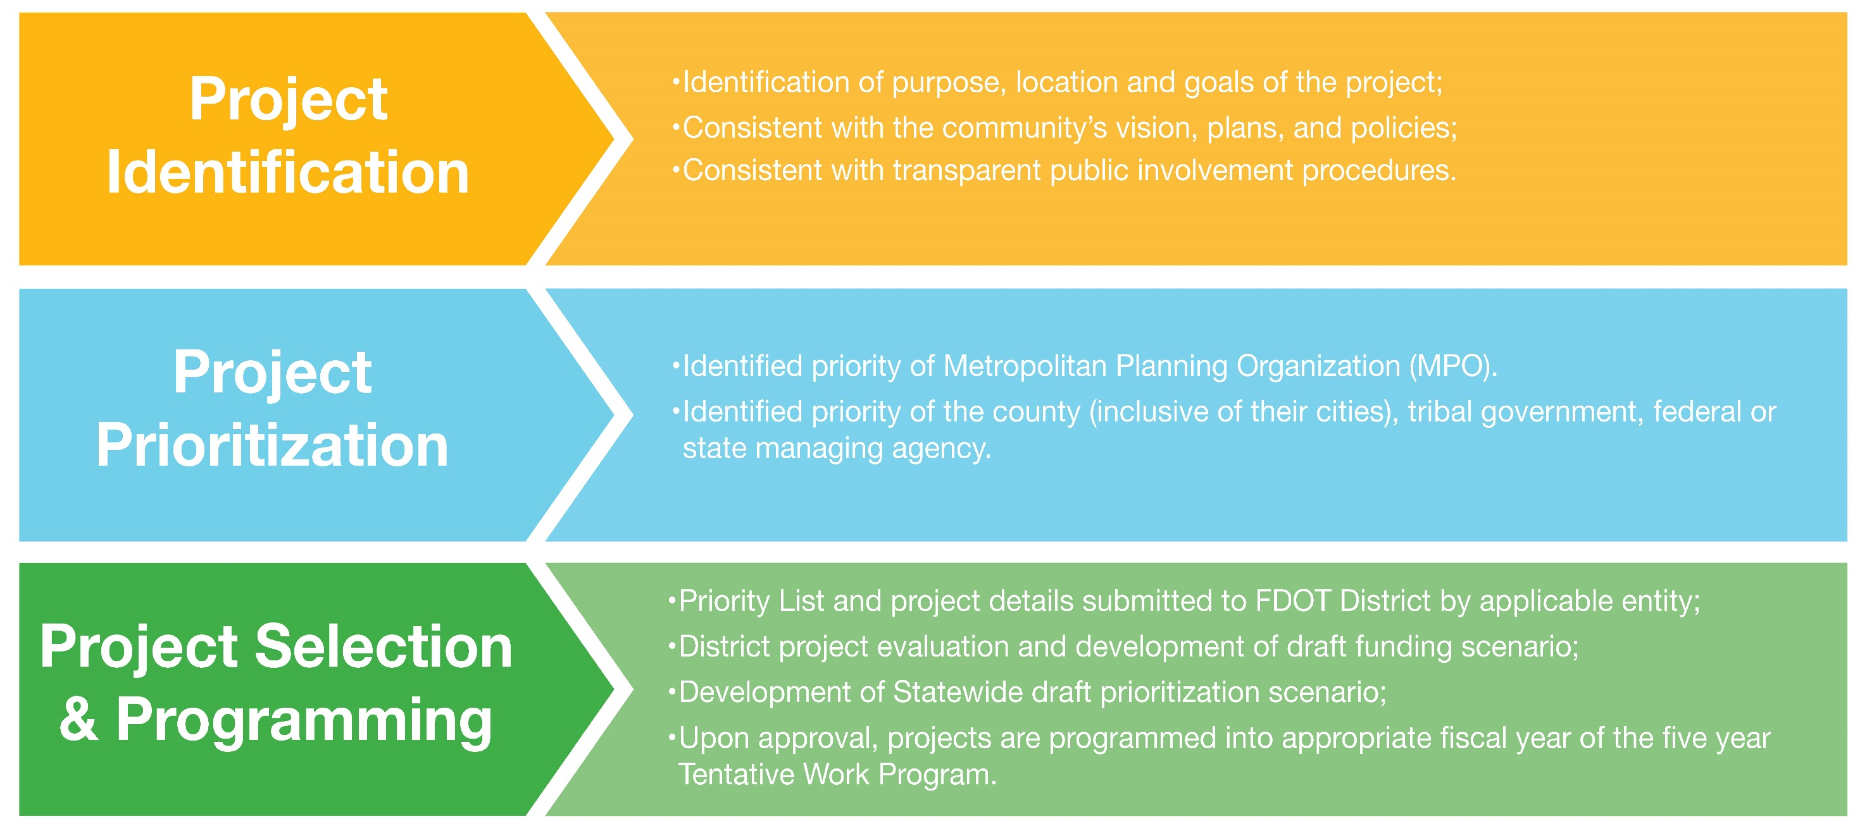
Evaluation, Prioritization and Selection of Projects
3
3
Florida Department of Transportation
Notes:
3

Slide 4
Beyond the next new 5th Year (FY 2025/2026)
Solicitation CLOSED at 5:00 p.m., Friday December 20, 2019
Grant Application Process (GAP)
All funding proposals will be received electronically through FDOTs integrated grant management system (GAP)
GAP will not allow submittals after the deadline
User access must be provided prior to the deadline or individuals will not be able to use GAP
DO NOT WAIT UNTIL THE LAST MINUTE TO PREPARE FOR NEXT CYCLE
4
4
Florida Department of Transportation
Notes:
4

Slide 5
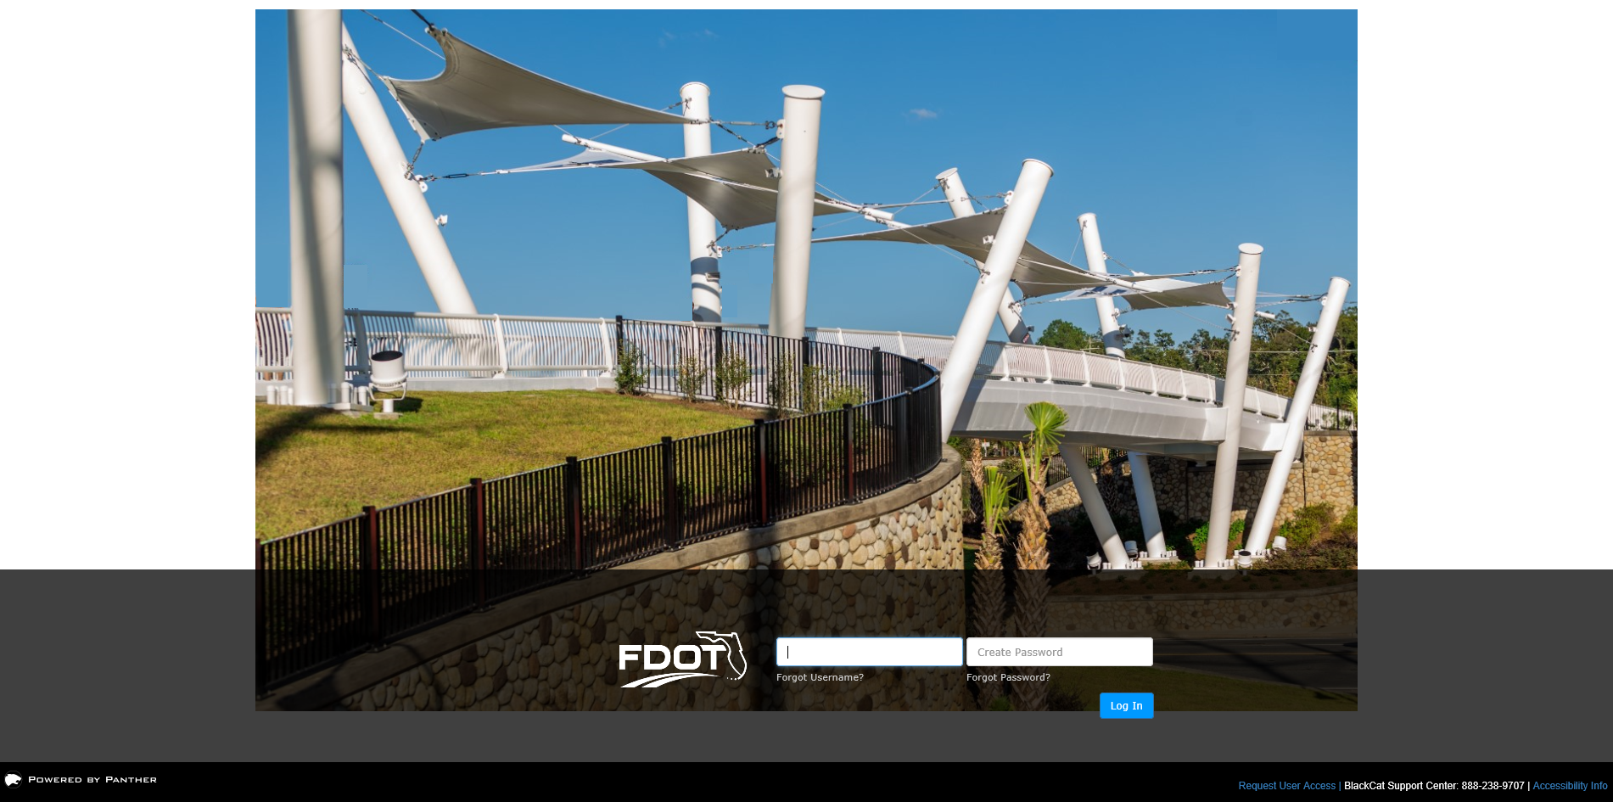
Use the Grant Application Process (GAP – integrated online management system)
Click here: https://www.flgap.com/
GAP System Support: 888-238-9707 or support@blackcatsupport.com
Log-in with your
Username and Password
or Agency staff may Request “User Access”
5
5
Florida Department of Transportation
Notes:
5
Here is another way to get to the external website - https://secure.blackcatgrants.com/Login.aspx?site=flgap
GAP is the replacement system for LAPIT, all current and active local agency users of LAPIT were exported to GAP and granted the ability to upload and download information in GAP. With that said, now we will go over some limitations to user access while the system is still under development on the next few slides.

Slide 6
Eligibility Criteria
Received project information during an open solicitation for SUN Trail funding requests
Documentation that the project will be developed as a paved multi-use trail within the SUN Trail network, which is aligned to the FTGS Priority Land Trail Network; at minimum, this will include transmittal of a map of the project limits within the SUN Trail network and applicable “Request for Funding” information.
Documentation provided that the project is a priority of the applicable jurisdiction; at minimum, this includes transmittal of an adopted prioritization list of projects and applicable “Request for Funding” information:
  If the project is within a boundary of a Metropolitan/Transportation Planning Organization (MPO), it must be a MPO priority.
  For areas outside of MPO boundaries, the project must be a priority of the county (inclusive of their municipalities), tribal government, federal or state agency.
Documentation that a non-FDOT governmental entity is formally committed to the operation and maintenance of the project (long-term trail manager), this will include applicable “Request for Funding” information; and
Documentation that the project is consistent with the applicable comprehensive plan(s), transportation plan(s), or the long-term management plan(s), this will include applicable project concurrency information.
6
6
Florida Department of Transportation
Notes:
6
Eligibility Criteria
Location within the SUN Trail network, to be developed as a paved trail
Prioritized by the applicable jurisdiction(s)
If the project is within a boundary of the Metropolitan Planning Organization/ Transportation Planning Organization/Transportation Planning Agency (MPO), it must be a MPO priority;
For areas outside of MPO boundaries, the project must be a priority of the county (inclusive of their municipalities), tribal government, federal or state agency.
A non-FDOT governmental entity is formally committed to the operation and maintenance of the project (long-term trail manager)
Consistent with the applicable comprehensive plan(s), transportation plan(s), or long-term management plan(s)

Slide 7
Selection Criteria
Projects with the greatest strengths will advance more quickly…
Project enhances the safety of bicyclists, pedestrians and motorists
Project is recognized as having regional, state or national importance
Additional financial contribution to the project
Project blends transportation modes by completing, improving or enhancing existing facilities to improve mobility
Construction readiness, continuation of project phasing, and protecting public investments
Project has a high level of documented public support
Project has a significant immediate impact to the quality of life by enhancing economic opportunities and providing connectivity to destinations
Project enhances or preserves environmental resources
Project facilitates an interconnected system by closing a gap between existing trails in the SUN Trail network
Project includes cost-saving elements
7
7
Florida Department of Transportation
Notes:
7
After selecting the St. Johns River-to-Sea Loop, the Florida Greenways and Trails Council voted on the prioritization of four other regional trail systems. Additional Regional Trail Systems, as prioritized:
Capital City to Sea Trails
Southwest Coastal Regional Trail
Heart of Florida Loop
East Coast Greenway-Southeast Florida
In the Individual trail category, an allocation to one project phase is not a guarantee of commitment to allocations for future project phases.
It is desirable and strategic to build on our prior investments. See the Selection Criteria for additional information.

Slide 8
Strategic, Effective and Efficient Investments
FDOT defines a multi-use trail as a paved, shared-use path, which is typically 12 feet wide, but may vary from 10 feet to 14 feet wide, or larger, depending upon physical or environmental constraints, or usage. In some areas of extreme constraints, such as at bridges or in environmentally sensitive lands, a multi-use trail may be as narrow as eight feet wide.
Generally, SUN Trail funded projects will be 12-foot wide, asphalt, multi-use trails
Pursuant to the legislation, Section 339.81, F.S., components funded through the SUN Trail program Will Not include:
Sidewalks; nature trails; loop trails wholly within a single park or natural area;
On-road facilities, such as bicycle lanes of routes other than on-road facilities that are no longer than one-half mile connecting two or more nonmotorized trails, if the provision of non-road facilities is infeasible and if such on-road facilities are signed and marked for nonmotorized use; an exception is made for on-road components of the Florida Keys Overseas Heritage Trail.
  To date, the SUN Trail program has not funded “on-road” (non-trail) facilities.
Unfunded SUN Trail needs exceed available SUN Trail funding
8
8
Florida Department of Transportation
Notes:
8

Slide 9
Ineligible Components Cont..
The SUN Trail program WILL NOT fund development of amenities associated with trail projects. Examples include but are not limited to the following:
Benches, trail furniture, seating areas, or tables;
Bicycle racks or lockers, bicycle air or repair stations;
Buildings or enclosed structures, restrooms, bathhouses, comfort stations, wayside structures, shade structures, concession stands, overlooks, fishing platforms, transit facilities, shelters, gazebos, or picnic pavilions;
Kiosks, interpretive panels, or placemaking signs (safety controls are an allowable cost);
Landscaping (trail stabilization is an allowable cost);
Litter or recycle receptacles, or doggie bag dispensers;
Parking areas, trailheads, or camping areas;
Playgrounds, fitness equipment or structures;
Promotional, marketing, or educational materials;
Sculptures, monuments, or art; and
Water fountains, splash zones, spigots, showers, water features, or irrigation equipment.
9
9
Florida Department of Transportation
Notes:
9
👍 Actively demonstrates stewardship of state resources
👍 Improves FDOT Credibility with EOG and Legislature
👍 Provides FDOT with the ability to place resources where they are actually needed

Slide 10
Design Standards for Trails
FDOT publishes design criteria for multi-use trails (shared-use paths) in both the FDOT Design Manual (FDM) and the Manual of Uniform Minimum Standards for Design, Construction and Maintenance for Streets and Highways (Florida Greenbook)
Projects in FDOTs ROW must follow the FDM design criteria along with FDOTs Standard Plans and Specifications
  FDM, click here: https://www.fdot.gov/roadway/fdm/Default.shtm
  Standard Plans and Specifications, click here: https://www.fdot.gov/design/standardplans/default.shtm
Projects located along non-FDOT owned ROW will follow design criteria found in the Florida Greenbook
  Florida Greenbook, click here: http://www.fdot.gov/roadway/FloridaGreenbook/FGB.shtm
At times the combination of funds used for a project, nature of work, or location along federally classified routes (such as the National Highway System) may trigger additional design requirements (e.g. FDOT STRUCTURES MANUAL ).
Traffic control devices are standardized. FDOT adopted the national Manual of Uniform Traffic Control Devices (MUTCD) 2009 edition with Revisions 1 and 2, May 2012
The entire MUTCD applies to SUN Trail projects
  Sections that are of particular value in designing multi-use trails include: Chapter 9B–shared use paths; Chapter 3B–pavement markings; Chapter 4F–pedestrian hybrid beacons; Section 4L.03–warning beacons (of a pedestrian’s presence); Section 4N.02–in-roadway warning lights at crosswalks; and Part 6 Temporary Traffic Control.
    MUTCD, click here: https://mutcd.fhwa.dot.gov/pdfs/2009r1r2/pdf_index.htm.
FDOTs Traffic Engineering Manual (TEM) contains additional requirements for traffic control devices along the state highway system.
  TEM, click here: https://www.fdot.gov/traffic/TrafficServices/Studies/TEM/TEM.shtm
10
10
Florida Department of Transportation
Notes:
10
What are traffic control devices?
Traffic control devices are signs, signals, markings, and other devices used to regulate, warn, or guide traffic, placed on, over, or adjacent to a street, highway, pedestrian facility, bikeway.

Slide 11

Florida Department of
TRANSPORTATION
c
Questions?
SUN Trail Contact:
District 3 Coordinator
Olen Pettis
(850) 330-1543
olen.pettis@dot.state.fl.us
https://nwflroads.com/planning
https://www.fdot.gov/planning/systems/SUNTrail/guidance.shtm

