Slide 1
District Three Approach
Starsky Harrell
Complete Street Coordinator

Slide 2
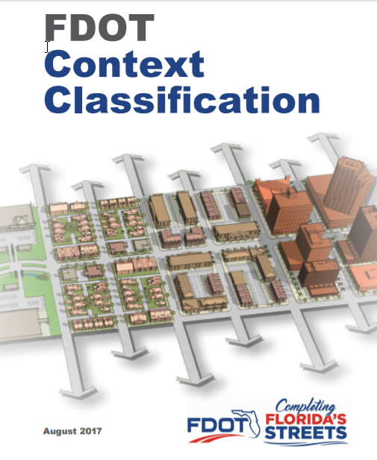
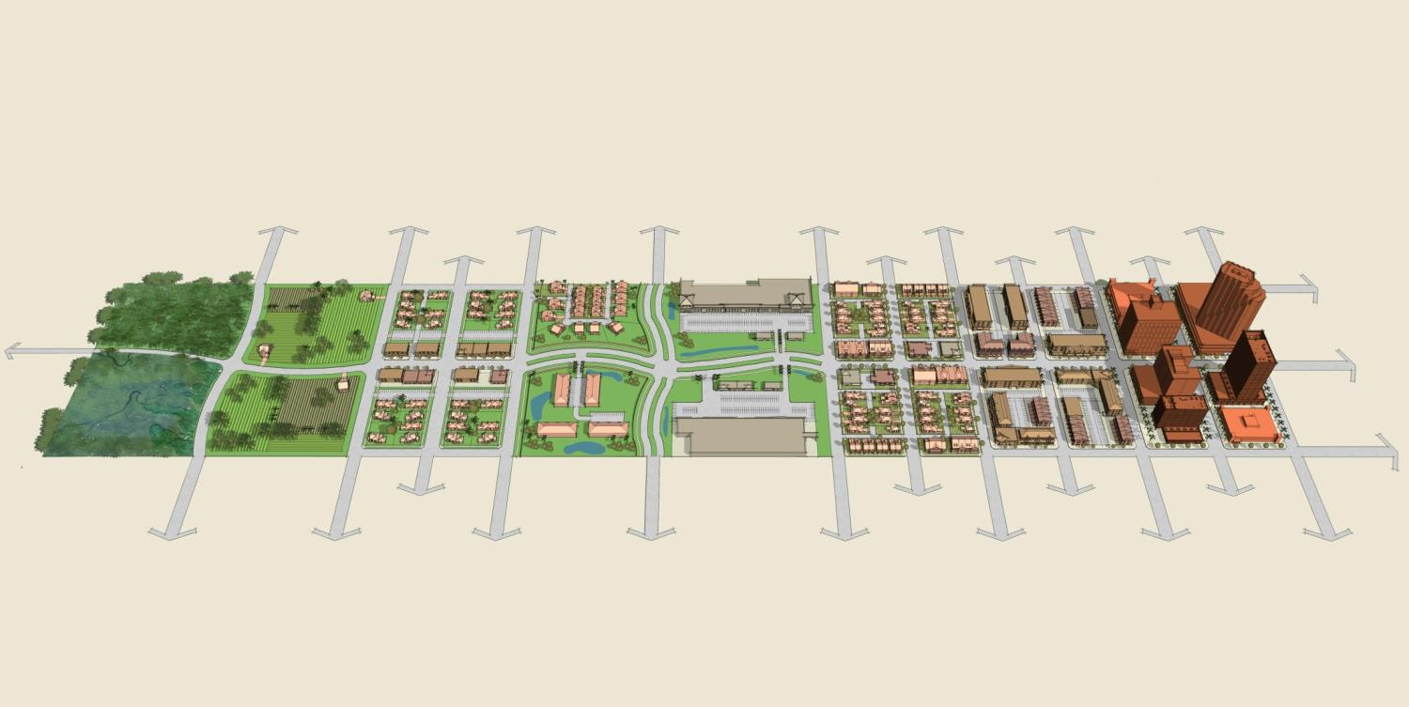
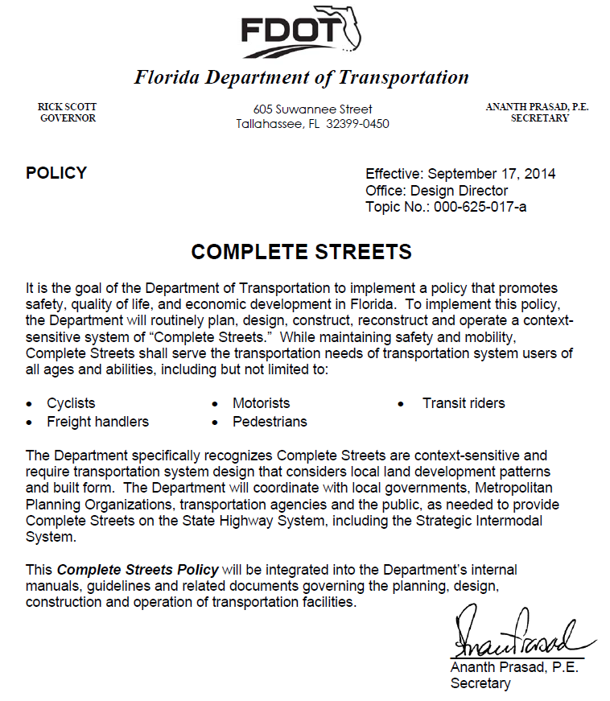
FDOT Complete Streets Overview
Complete Streets Policy - 2014
FDOT Context Classification Booklet - 2017
Context Classifications (C1-C6)

Slide 3
What are the FDOT Context Classifications?
C1-Natural
C2-Rural
C2T-Rural Town
C3R-Suburban Residential
C3C-Suburban Commercial
C4-Urban General
C5-Urban Center
C6-Urban Core

Slide 4
Complete Streets before Complete Streets
District Three’s Approach has always been to serve the transportation needs of the transportation system users of all ages and abilities, including:
  Cyclists
  Freight handlers
  Motorists
  Pedestrians
  Transit riders
Complete Streets has branded it

Slide 5
Complete Streets before Complete Streets
District Three Examples:
  Project Number 218630-2
  US 98 Navy Boulevard from SR295 to Bayou Chico Bridge
  Escambia County
  Project Development & Environmental Study (PD&E)
  Project Number 217875-4
  SR 390 from Jenks Avenue to SR 77
  Bay County
  Construction Letting Fiscal Year 2017/2018
  Project Number 424464-5
  SR 388 from SR 79 to east of Burnt Mill Creek
  Bay County
  Construction Letting Fiscal Year 2017/2018

Slide 6
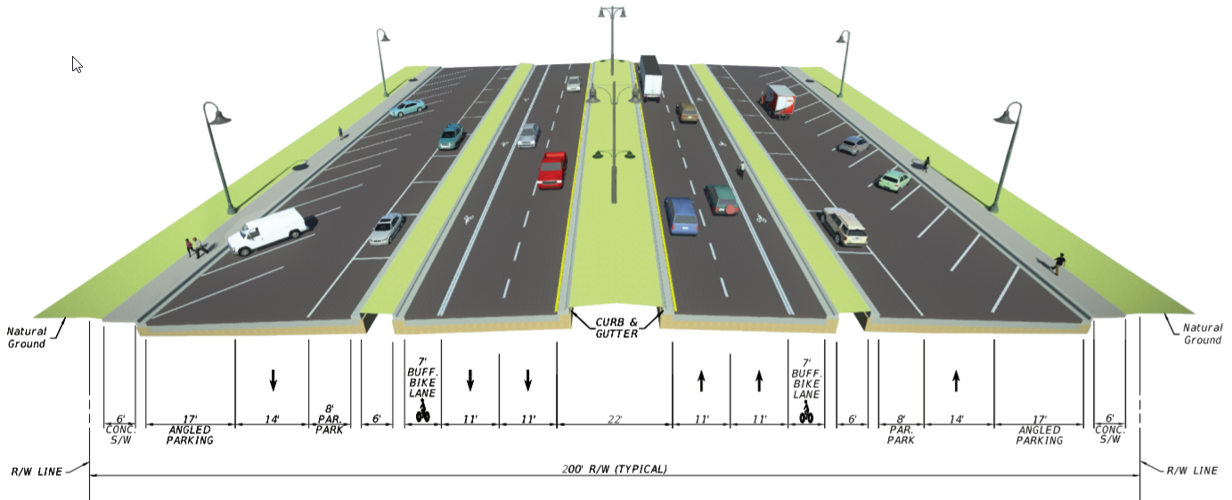
US 98 Navy Boulevard
Navy Boulevard Typical Section Example

Slide 7
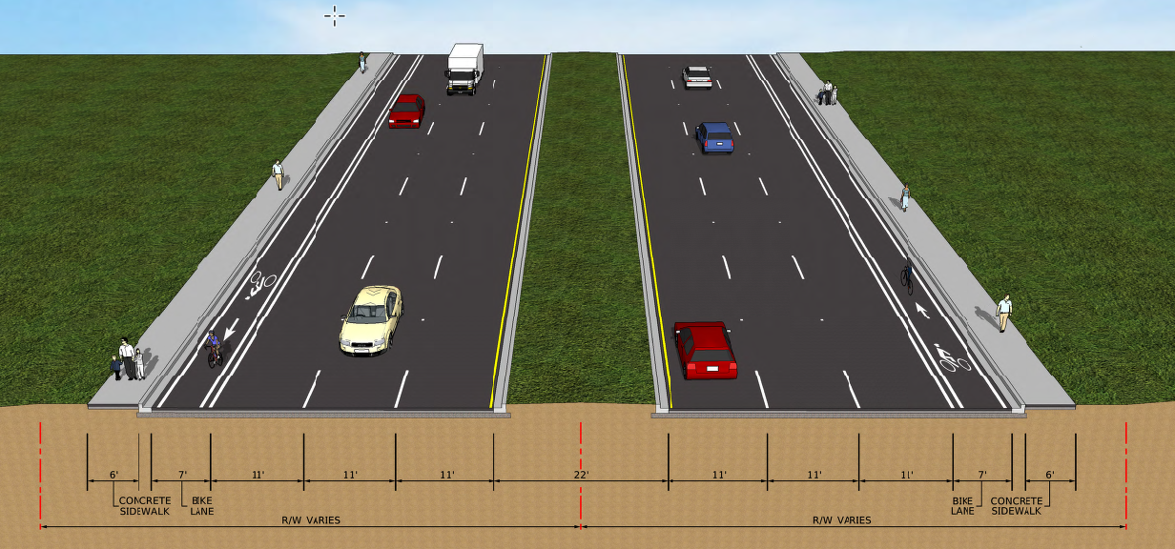
SR 390
Roadway Typical Section

Slide 8
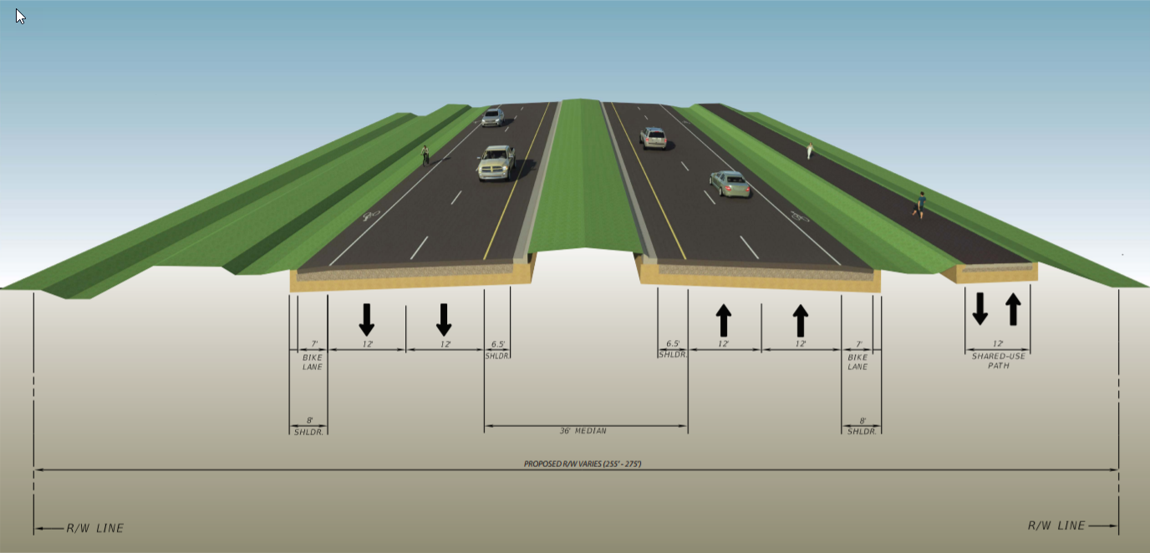
SR 388
Roadway Typical Section

Slide 9
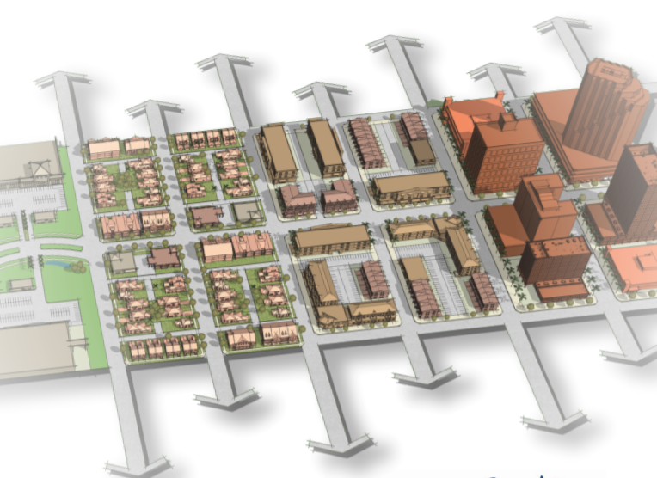
Current Context Classification – D3 Approach
Assign the Current Context Classification within the 3 year timeframe
Prioritization:
  State Highway System (SHS) Projects in Current Five Year Work Program
  Remaining Strategic Intermodal System (SIS roads), including off system roads
  Any remaining SHS roads

Slide 10
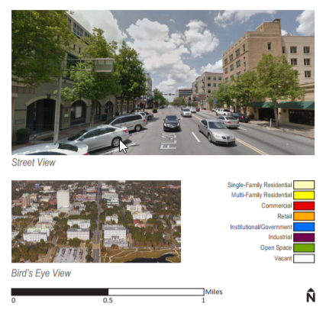
Current Context Classification – D3 Approach
Coordinate with TPO staff, Planning Councils and Local Government
Review of Current Context Classification assigned and continued coordination will occur during:
  Feasibility Studies
  Project Development & Environmental Studies
  Design Phase
Final determination is made by FDOT

Slide 11
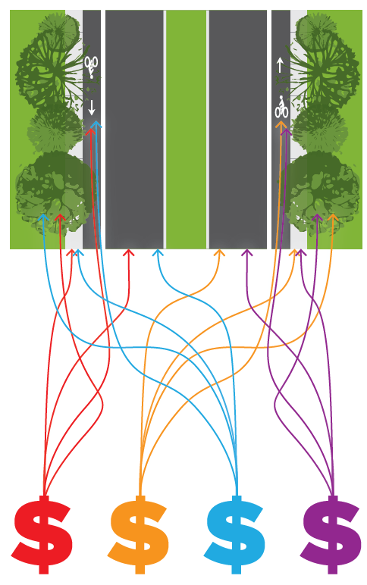
Relationship to PROJECTS
Resurfacing, Restoration, Rehabilitation (RRR)
Bridge
Safety
Major Capacity Projects

Slide 12
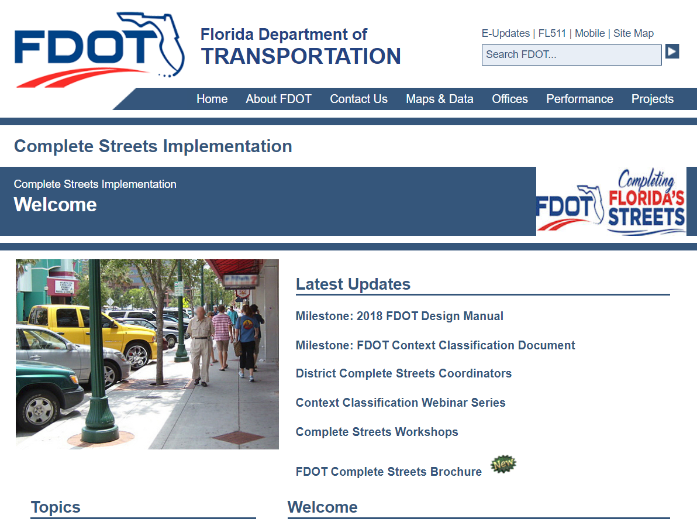
http://www.flcompletestreets.com

Slide 13
District Three Contact Information:
Starsky Harrell
Complete Streets Coordinator
(850) 330-1540
Starsky.Harrell@dot.state.fl.us

