Slide 1
Florida Freight Advisory Committee Meeting
May 2020
Notes:
Rickey – Welcome, Introduce Key Contacts and Call to Order

Slide 2
Agenda
Call to Order
Housekeeping
  New Member
  Bylaws Refresher
  Tentative Schedule
Recent FMO Initiatives
  2020 FMTP
  Truck Parking Study
  FMO Research Initiatives
COVID-19 Roundtable

Slide 3
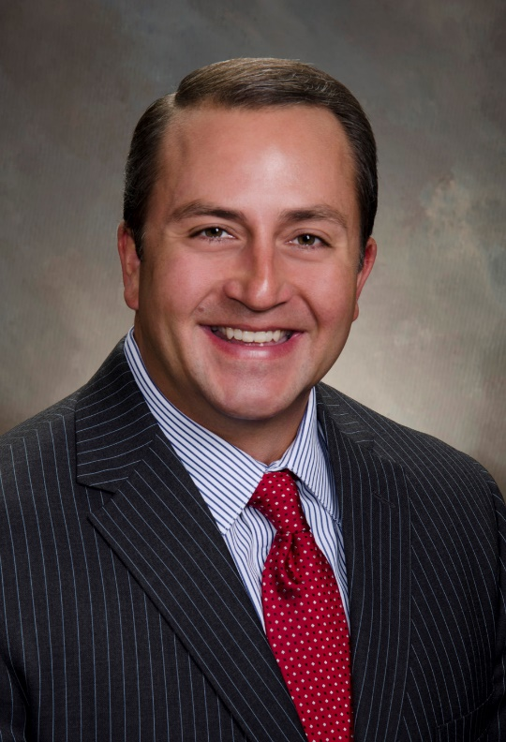
Eugene B. Conrad III
Title | Airport Director at Lakeland Linder International Airport
Experience | 2010-Present Airport Director, Lakeland Linder International Airport 2008-2010 Deputy Director, Marketing & Air Service Development Branson Airport, LLC 2002-2008 Air Service Coordinator/Airport Duty Supervisor, Dayton International Airport 2001-2002 Airport Operations Coordinator, Port Columbus International Airport
Education | BA in Aviation Management Certified Member, American Association of Airport Executives (AAAE)
Duration | 10+ Years
Contribution | Successfully navigated and negotiated a 50-year deal with Amazon to build a 280,000-square foot Amazon Air Gateway facility on the Lakeland Linder International Airport.

Slide 4
Bylaws Refresher

Slide 5
Recap
Last March, we updated the FLFAC bylaws to address membership turnover. An online poll determined that the committee wanted:
  a 3 year committee member cycle
  application submissions for replacing current committee members
  some sort of guidelines/benchmarks to remain on committee – attendance being primary guideline

Slide 6
Summary of Bylaw Changes
We decided to do a staggered approach to membership cycles to always have some “veteran” members onboard.
1.5 Years
1.5 Years
1 Full Committee Cycle = 3 Years
Half-Committee Cycle = 1.5 Years

Slide 7
Summary of Bylaw Changes
1.5 Years
1.5 Years
Every half-cycle (1.5 Years), the Committee will vote on a new Chair/Co-Chair, and half of the committee members will be replaced using an application process
The members that will be replaced will be those that have already served two half-cycle terms, or one full committee cycle

Slide 8
Summary of Bylaw Changes
This year, around September/October:
  We will be doing another cycle of staggered renewal.
  Those FLFAC members who joined the committee for the first time last March/April will remain on for another half-cycle (1.5 years).
  Those FLFAC members who elected to reapply last time will step down, and a group of new FLFAC members who are selected through application will join the committee for a 3 year cycle.
    If you have already been on the committee for a full cycle, you may still reapply, and in the event that there is space available on the committee, you may be selected again.
  A new chair/co-chair will be voted on.
Notes:
the goal is to end up with a ~50/50 split of returning members and new members to start the staggering cycle

Slide 9
Tentative Schedule
FLFAC #2, Webinar, Late July/Early August
  Theme: Data-Driven Approaches
    Optimization Study
    FMTP Implementation Update
    How can we help each other through data-sharing?
FLFAC #3, In-Person, Fall (Could combine w/ Florida Supply Chain Summit)
  Theme: Outreach/Engaging the Industry
    As a public agency, how can we bring more private stakeholders to the table?
    New FLFAC application window will open
Notes:
Intend to send letters by April 19, 2019

Slide 10
FMTP

Slide 11

Freight Mobility
and Trade Plan
Plan Update
April 2020

Slide 12
The Statewide Freight Plan

Slide 13

What is the FMTP?
The Freight Mobility & Trade Plan is a comprehensive plan that focuses on the movement of goods in, out, and around Florida
It provides an integrated analysis to examine needs and solutions in a cross-cutting, multi-functional approach

Slide 14
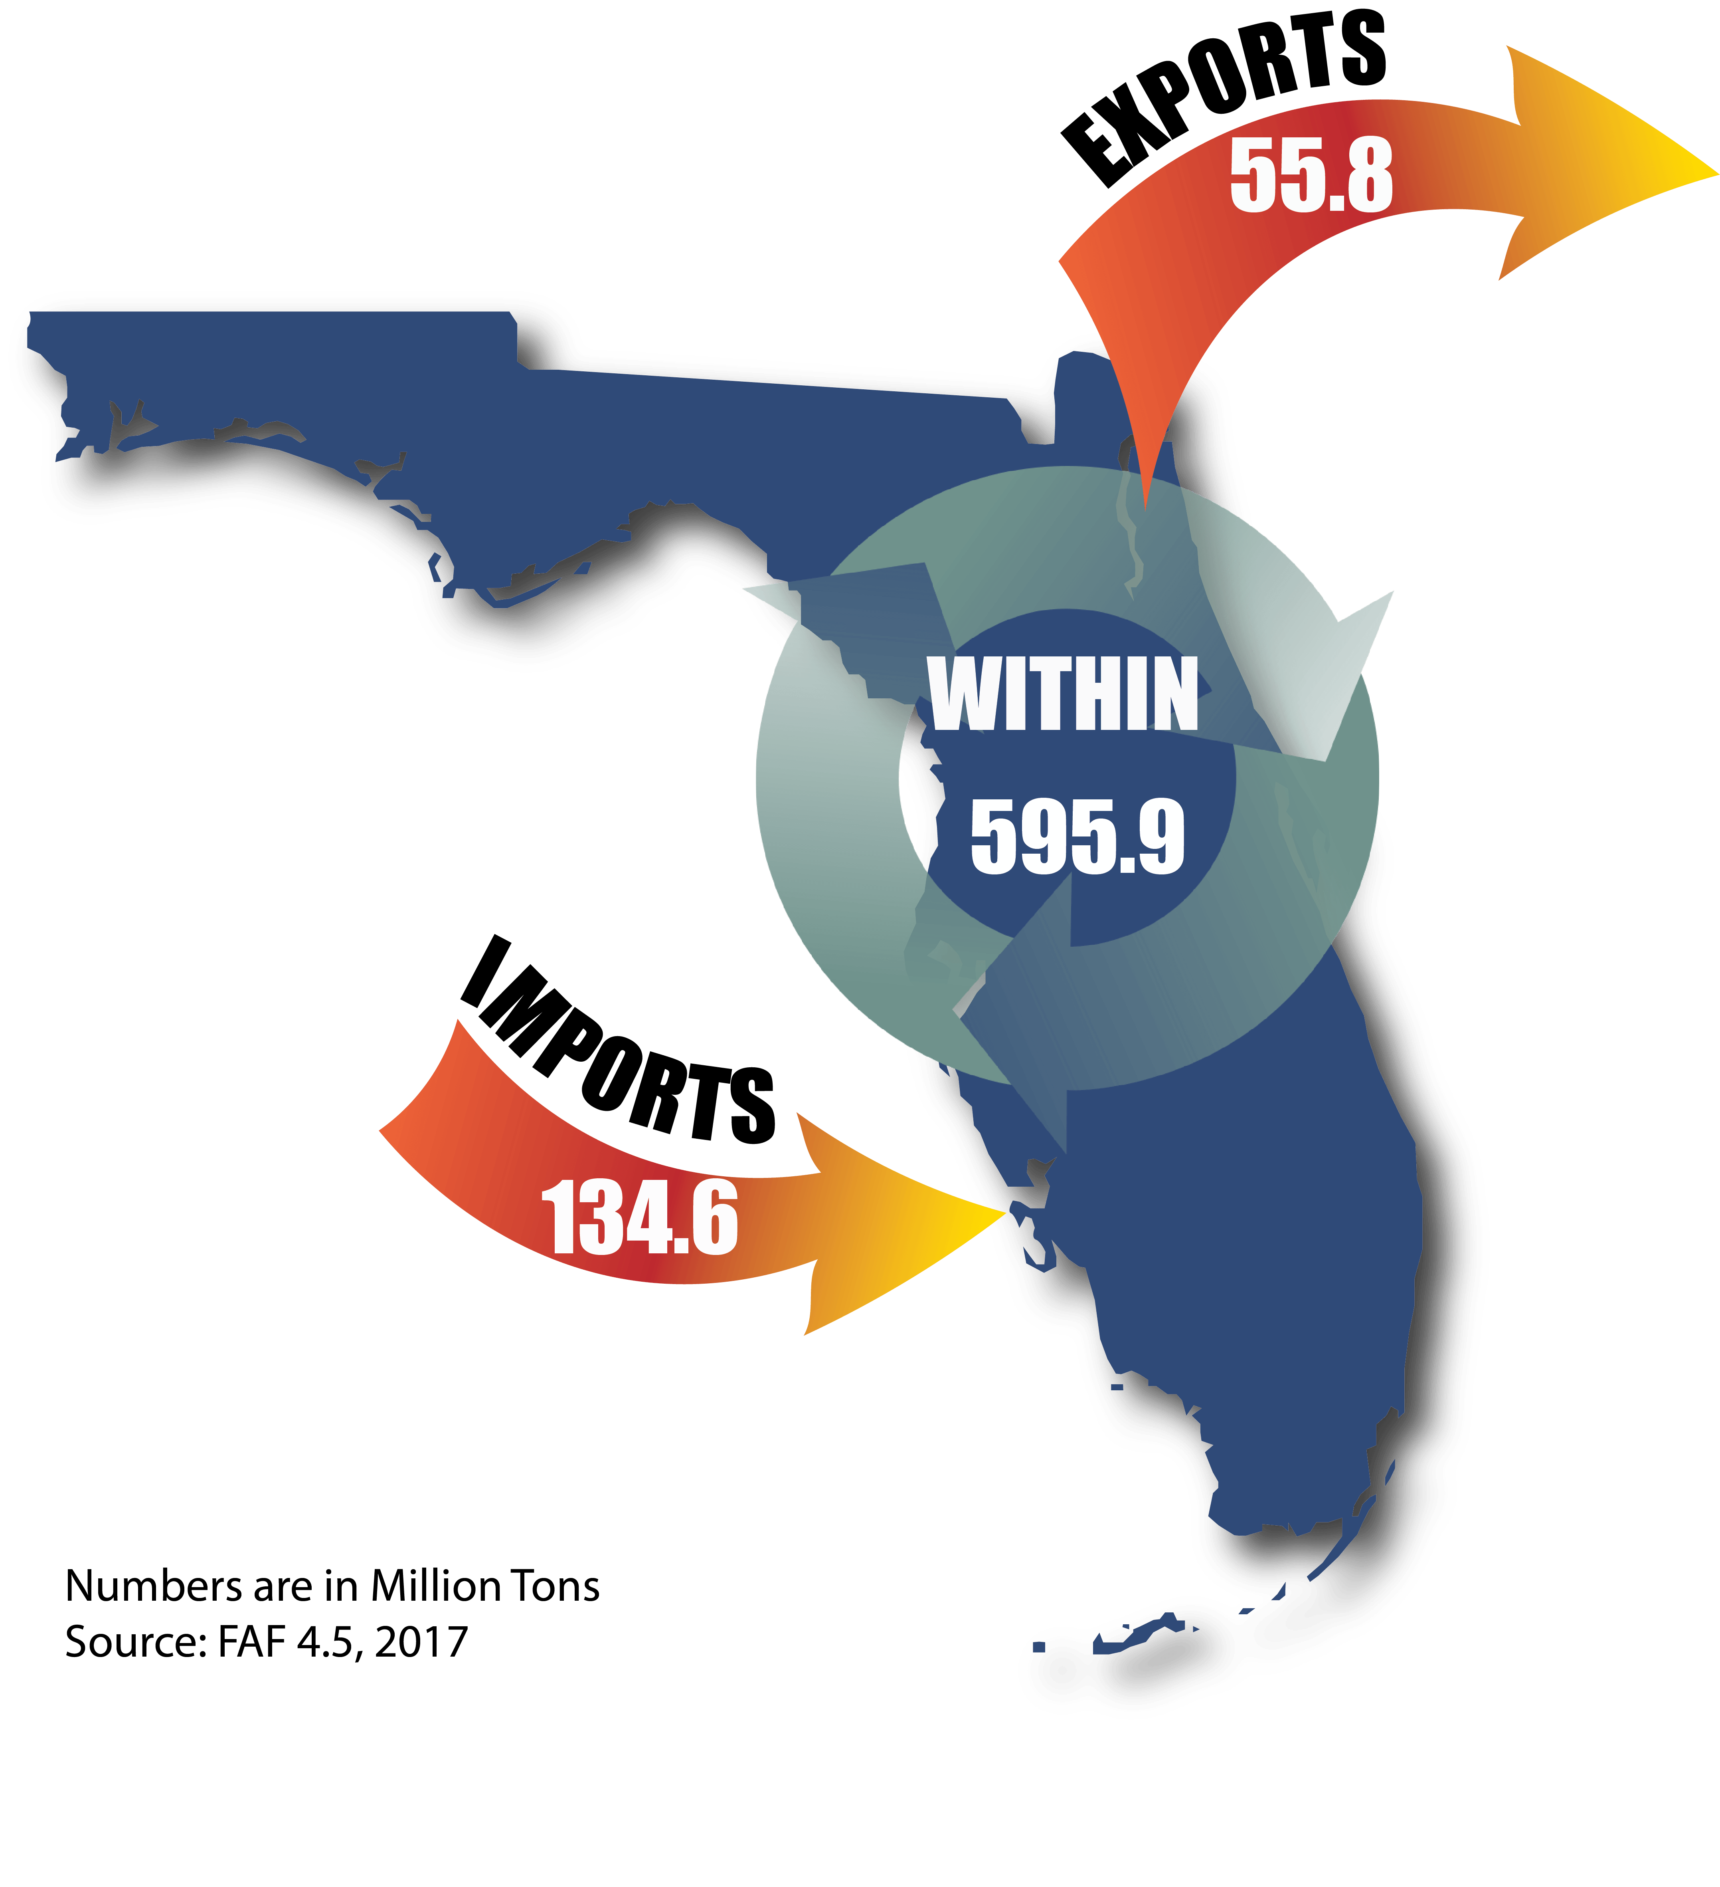
Freight Moves Florida
Freight impacts your everyday life
Florida’s freight system is critical to the economic vitality of the state
As the third most populous state in the U.S., Florida consumes a significant amount of goods and commodities
Florida is strategically positioned as a regional and national gateway

Slide 15
Why Plan for Freight?
Purpose
Characteristics
Cohesion
Insure efficient, reliable and safe freight mobility
  Identify freight mobility issues and needs
  Develop policies, programs and projects
  Support economic development and commercial trade
  Fulfill federal regulations
  Multimodal
  Intermodal connectivity
  Understandable & pragmatic
  Implementable plan
  Supports on-going planning
  Prioritization: Highest needs matched with project selection
  Supports LRTP
  Aligns with modal plans: Rail, Highway, Maritime, Space and Air
  Supports federal freight goals
  Provides support & guidance for local freight planning/District plans

Slide 16
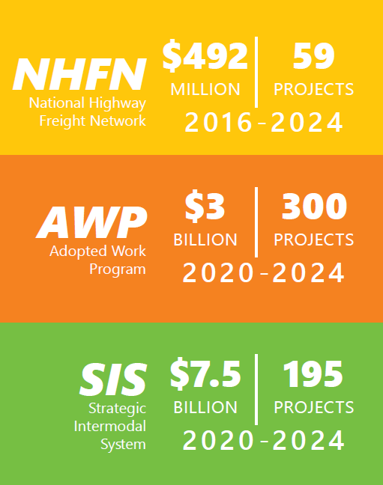
Investing for Success
Florida invests heavily into its transportation system to lead the way for freight now and into the future
The state leverages discretionary grant opportunities, the National Highway Freight Program and FDOT funds to support freight projects

Slide 17

A Brief History
Florida’s House Bill 599 directed the State to create a freight plan.
2013/14
2012
The Moving Ahead for Progress in the 21st Century Act (MAP-21) established national freight policy and goals and a formal national freight network.
Florida created its first Statewide Freight Plan in two parts; a Policy Element in 2013, and an Investment Element in 2014.
2015
2017
The Fixing America’s Surface Transportation (FAST) Act created a National Multimodal Freight Network (NMFN) and dedicating freight funding through the National Highway Freight Program (NHFP).
The Freight and Multimodal Operations (FMO) office was established within FDOT.
2020
This FMTP uses tactical and strategic approaches to implement immediate opportunities while positioning Florida for future possibilities.

Slide 18
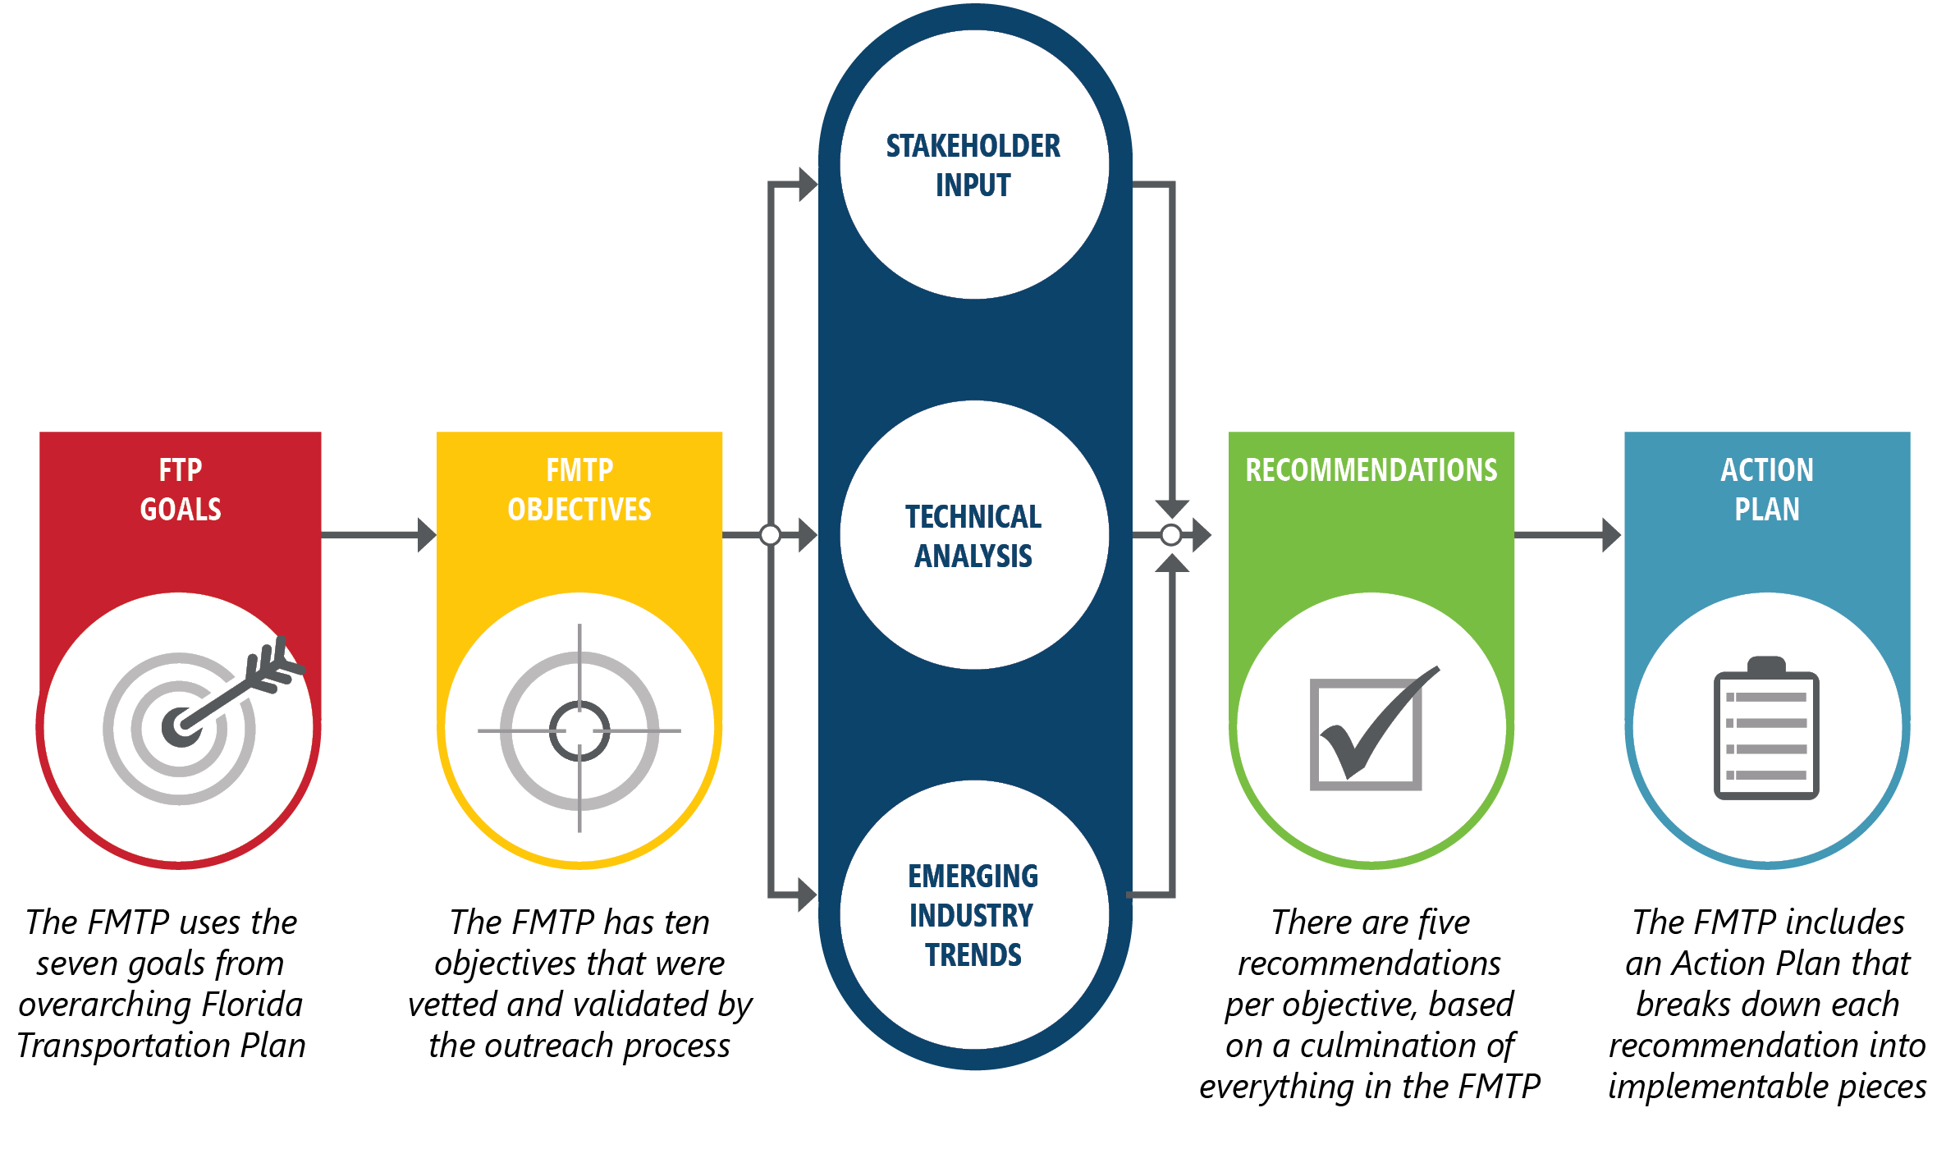
Goals to Action

Slide 19
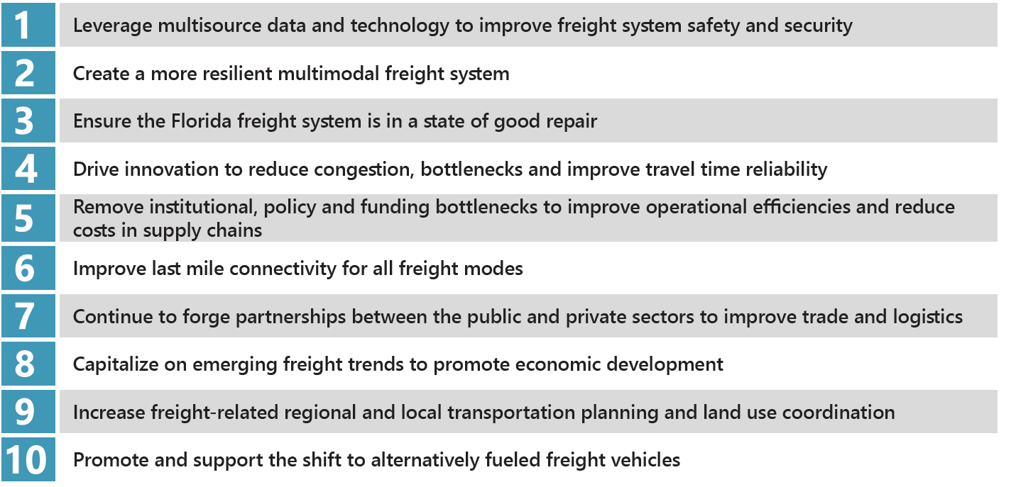
Plan Objectives

Slide 20
Stakeholder Input

Slide 21
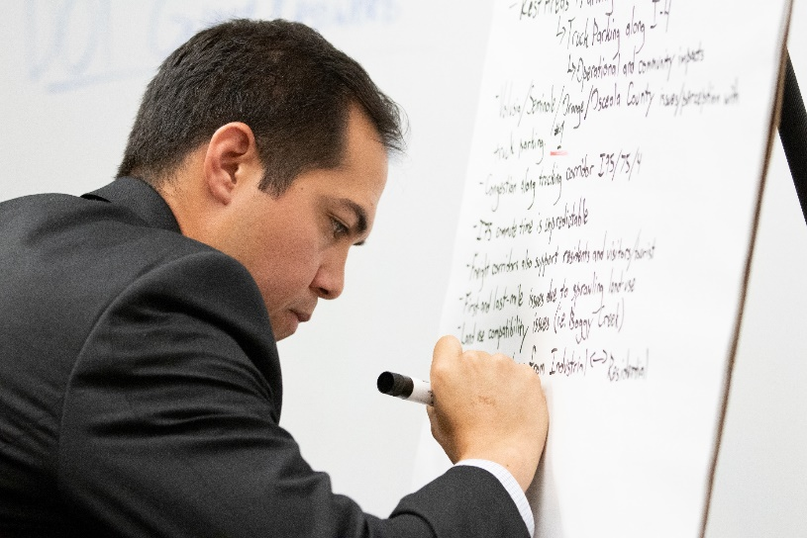
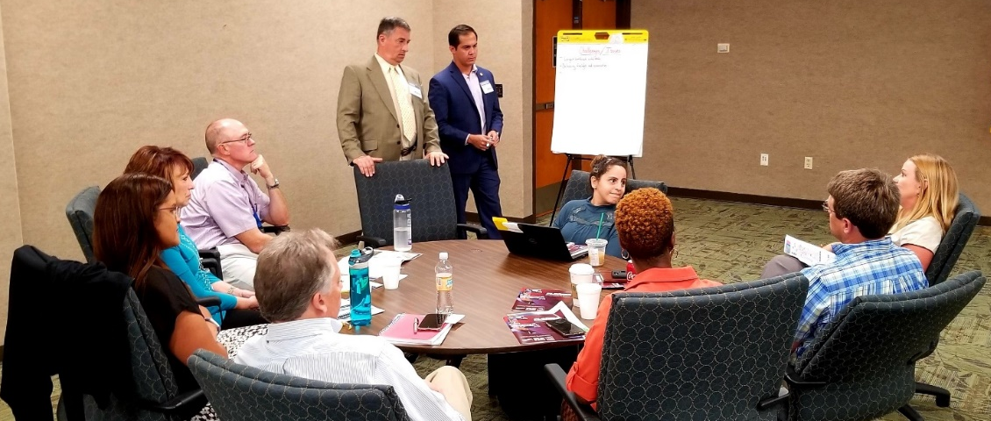
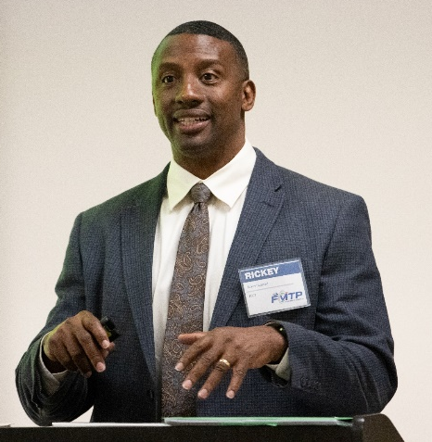
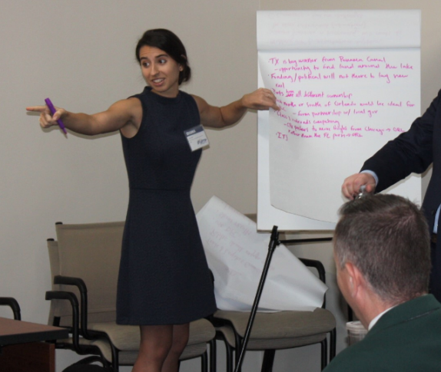
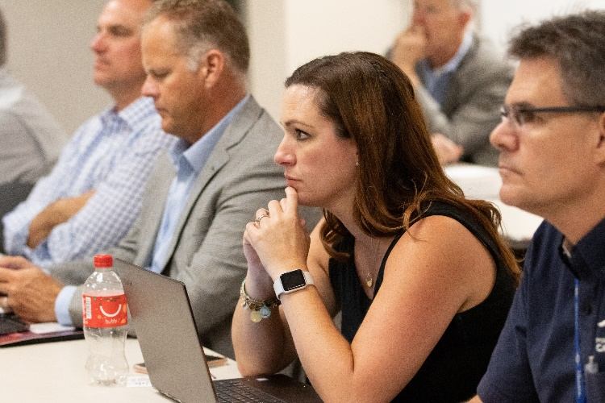

Slide 22
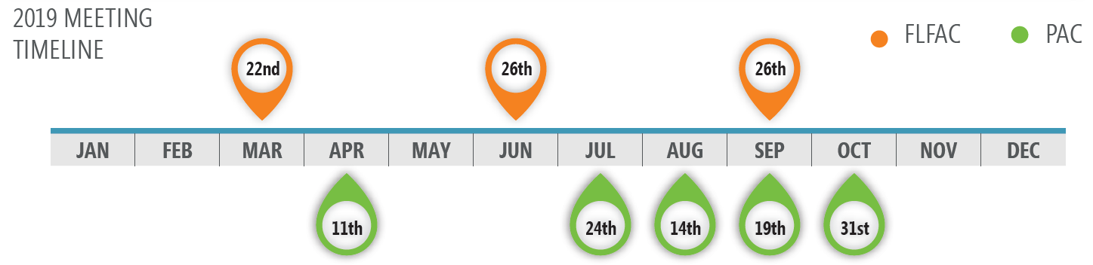
PAC & FLFAC Meetings
The Florida Freight Advisory Committee (FLFAC), consisting of public and private sector freight stakeholders, advised on freight-related priorities, issues, projects, and funding needs. The FLFAC ensured that the objectives and issues identified in the plan would effectively address Florida’s freight needs.
The Project Advisory Committee (PAC), an internal body consisting of representatives from FDOT offices related to freight, provided guidance on the development of the plan and helped validate the results along the way.

Slide 23
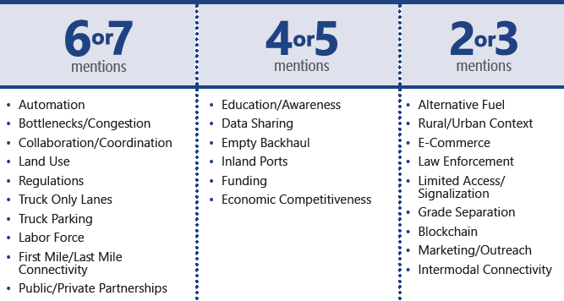
Regional Freight Forums
Regional freight forums were held in each FDOT District to give the public and stakeholders a venue to share knowledge, and explore freight issues and potential solutions.
Notes:
Key topics were placed into categories by how many Districts mentioned them.

Slide 24
Technical Analysis

Slide 25
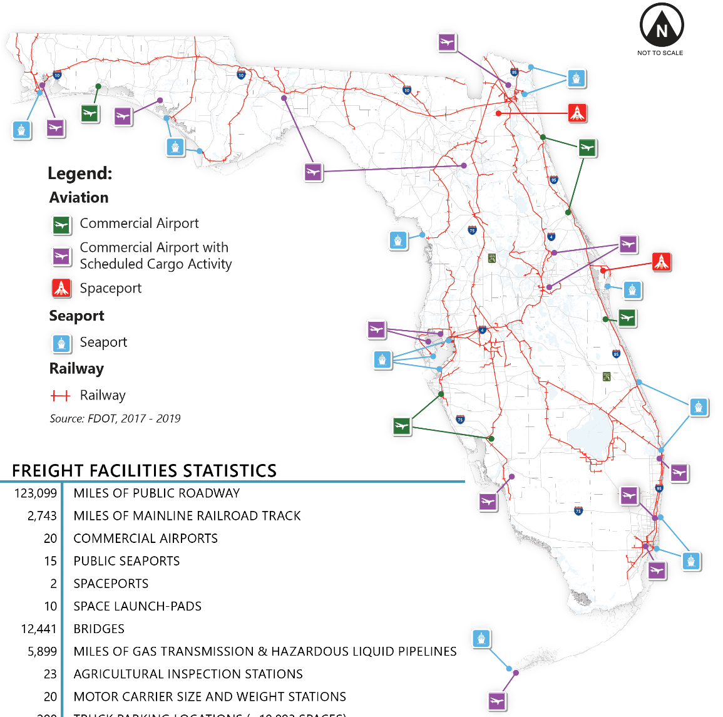
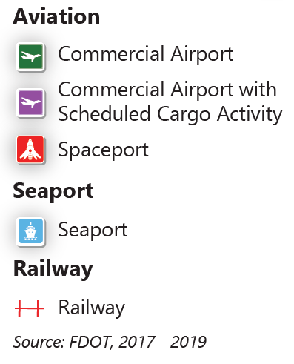
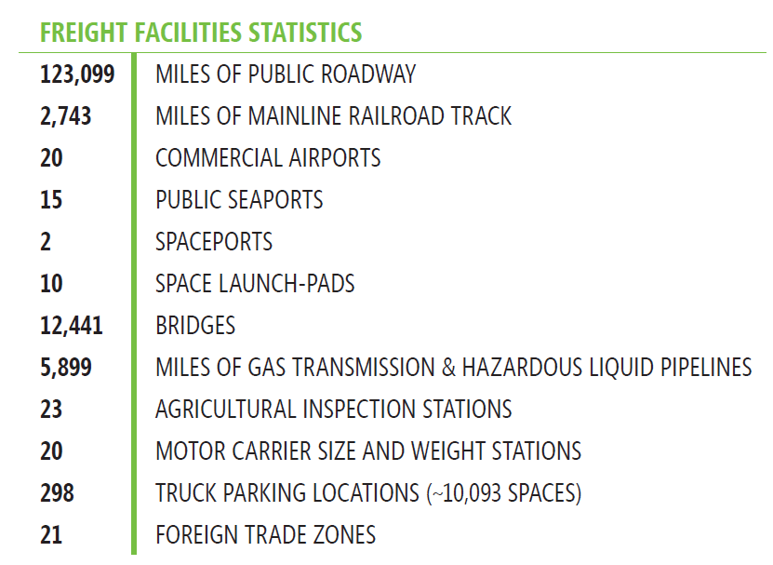
Assets
Florida’s multimodal freight and logistics infrastructure supports over 21 million residents and 126 million annual visitors while providing connectivity between freight modes

Slide 26
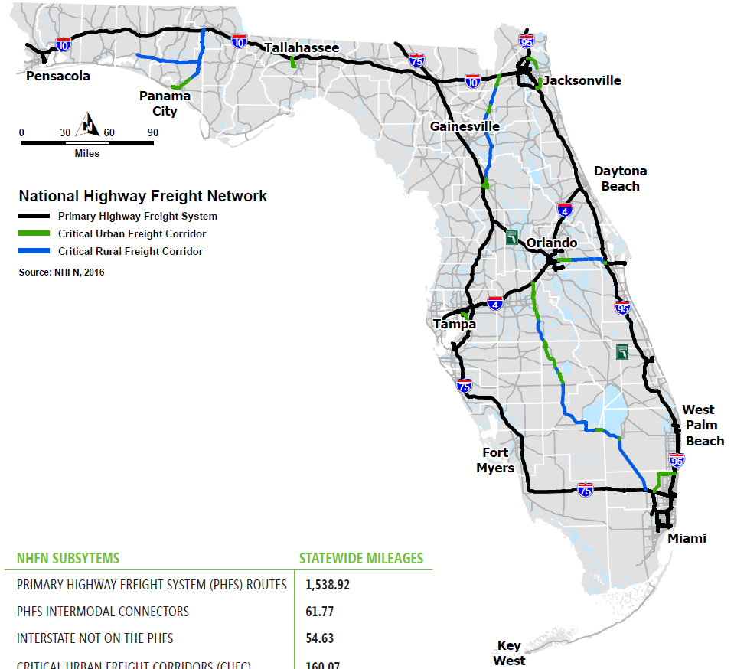
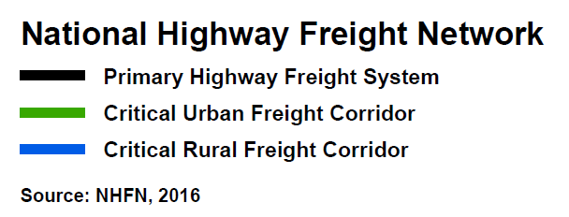
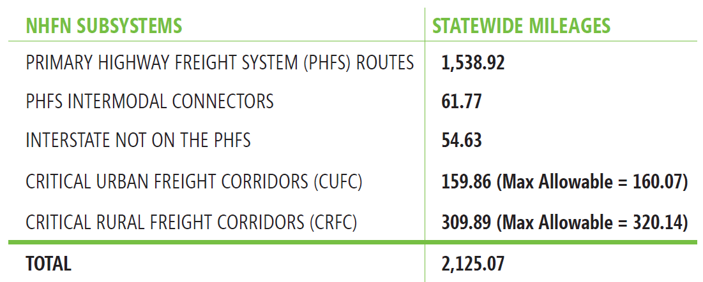
Networks
The National Highway Freight Network (NHFN) helps strategically direct resources toward improved system performance for efficient movement of freight on highways

Slide 27
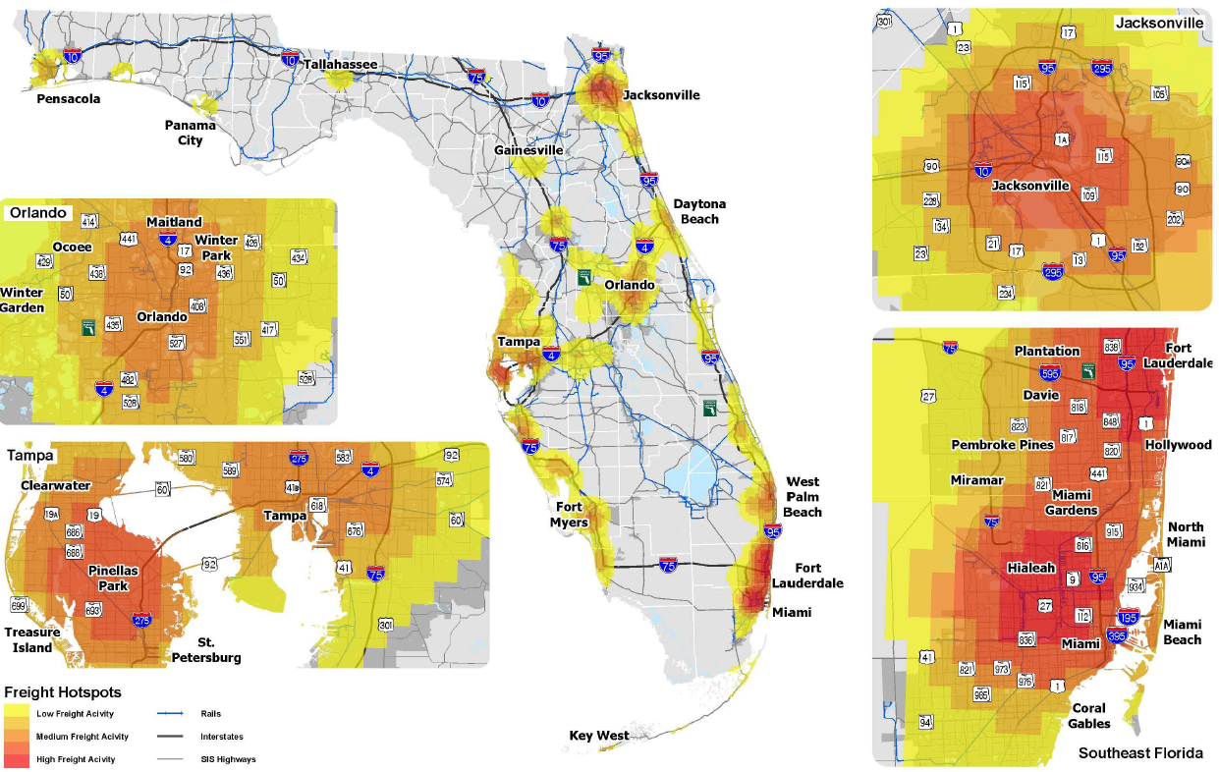
Freight Intensive
Areas
These clusters of freight facilities generate, distribute or attract large amounts of freight activity

Slide 28
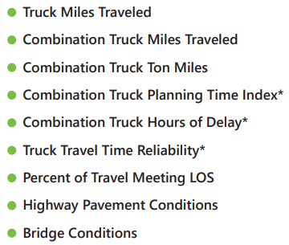
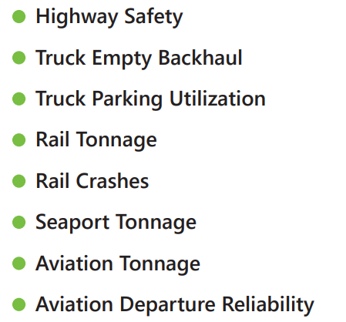


Performance Measures
Notes:
Performance measures are indicators of progress toward a desired level of future performance
A set of freight performance measures were developed consistent with the FDOT performance measures program and FDOT Source Book, and extend beyond the federal requirements
These measures also helped informed the FMTP project prioritization process

Slide 29
Analysis & Data Sets
Analysis | Data
Commodity Flow | FAF/ Modal Datasets
Performance Measures | TPM/ RCI/ HPMS/ Source Book
Bottleneck Analysis | NPMRDS
Travel Time Reliability | NPMRDS
Pavement Conditions | TPM datasets
Resiliency | FHWA Vulnerability Assessment and Adaptation Framework
Empty Back Haul | TTMS/ WIM Data
Freight Cluster Analysis | DOR and DEO Data
Truck Parking Analysis | ATRI and TPAS
Networks | NHFN, SIS, SHS,NHS
Hubs | Modal Hubs
Trend Analysis | Population, employment, visitors, economy, freight, modes
Safety Analysis | CARS and FARS
Energy/ Alternate Fuels | EV, LNG/ CNG, etc.
Panama Canal | FDOT Seaport Study
Trade Regulations | Foreign Trade, PIERS, BTS T-100
Scenario Analysis | Economy and technology
County Freight Profiles | IHS
Intermodal Connectors | ATRI, DEO, DOR, Truck traffic counts, HPMS and others
Rail Highway Grade Separation | FRA Safety + RHCI data
Humped Crossing | RHCI database
Notes:
These analyses were used or conducted for the FMTP
An important component of the FMTP update was to leverage the work of other offices/programs
A few analyses, like the County Freight Profiles, are still being developed as part of the ongoing updates

Slide 30
Industry Trends

Slide 31
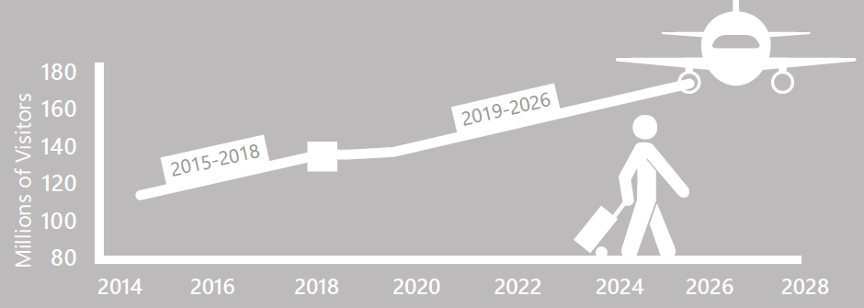
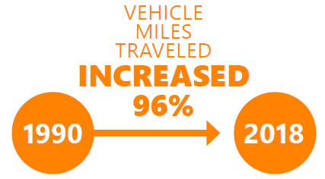
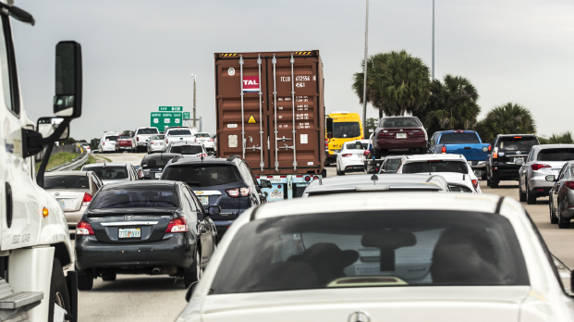
Freight Flows, Florida Grows
Florida’s population is expected to reach 27.4 million by 2040. The U.S. freight system moves approximately 63 tons of goods per person per year
Over 2.4 million people visit Florida each day. The tourism industry creates significant freight demand
A growing population + a growing economy = more trucks on the road. The number of truck trips has increased while the average length of haul has declined

Slide 32
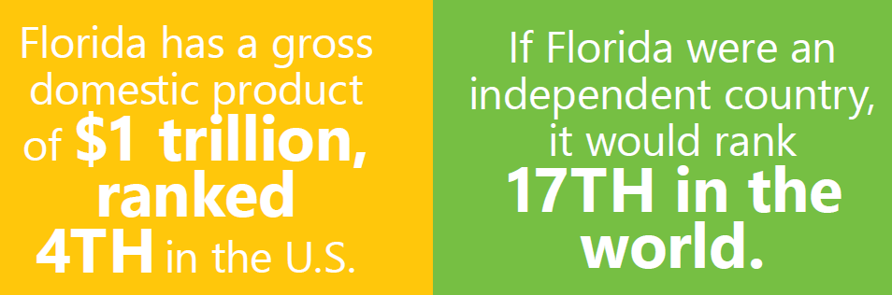
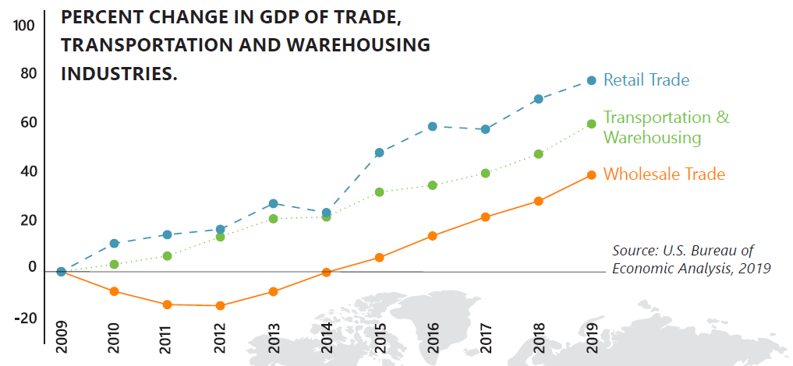
An Economy Built on Freight
The engine that powers Florida’s freight industry is its people. 55% of Florida’s 8.7 million employees work in industries related to freight
The trade sector of the Florida economy has seen a tremendous growth since 2009, including retail trade, transportation & warehousing, and wholesale trade

Slide 33

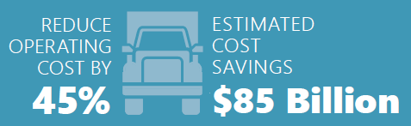

Freight & Technology
As e-commerce market share and rapid fulfillment expectations continue to grow, a shift is taking place from large delivery vehicles to smaller vans and personal vehicles
The implementation of full autonomy throughout the motor carrier freight system will create industry-wide savings
Nationally, fully electronic vehicles are projected to represent 8% of total automobiles sold by 2025

Slide 34
Top Challenges

Slide 35



Top Challenges
There are growing numbers of vehicles on the road creating a mix of truck and passenger traffic and leading to bottlenecks/congestion and unpredictability in travel times. In 2017, there were 19,100 daily truck hours of delay in Florida.
Congestion/Bottlenecks
In Florida, the limited availability of truck parking spaces has caused overcrowding and overflow at existing truck parking locations. Analysis found that during peak periods truck parking demand can exceed 150 percent in some areas of the state.
Truck parking
More than half of the trucks coming into the state between the years of 2015 and 2017 were full trucks, in comparison to nearly 38% that left the state during the same time period. While it is largely an economic issue outside of FDOT’s purview, addressing empty backhaul could reduce congestion/bottleneck issues, truck parking issues, costs, and environmental impacts for the commercial motor vehicle industry.
Empty Backhaul

Slide 36
Delivering A Difference
The continued success of Florida’s freight system depends upon addressing the state’s top challenges. The FMTP helps implement solutions.
The FMTP identifies the state’s top 100 bottlenecks. The geographic locations of these bottlenecks are factored into the prioritization of freight projects.
FDOT is rolling out a Truck Parking Availability System (TPAS), and the FMO Office is leading a research study to identify future needs and solutions. The FMTP recommendations build upon each of these initiatives.
The FMTP highlights the need for FDOT to continue to work with other agencies to promote manufacturing and greater trailer utilization to combat the imbalance.

Slide 37
Prioritization

Slide 38
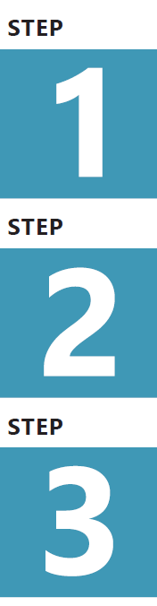
FMTP Prioritization
The FMTP helps to determine which projects submitted from around the state will receive funding from the National Highway Freight Program, and this FMTP created a new methodology for project prioritization
Identification of Projects
Project Classification and Funding Eligibility Screening
Quantitative and Qualitative Evaluation

Slide 39
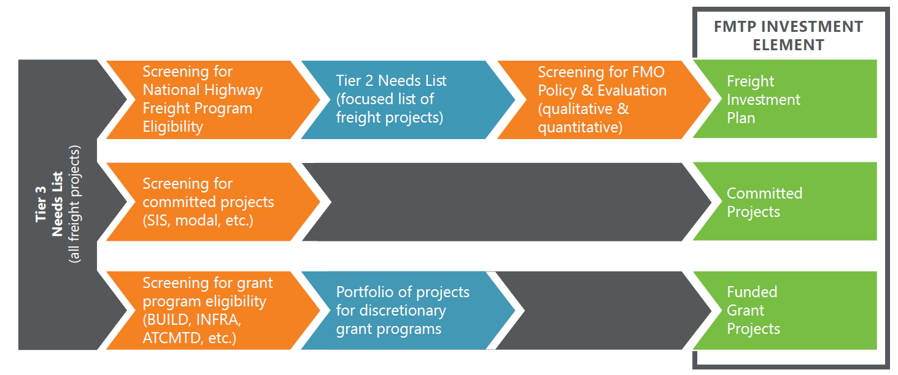
Screening Process

Slide 40
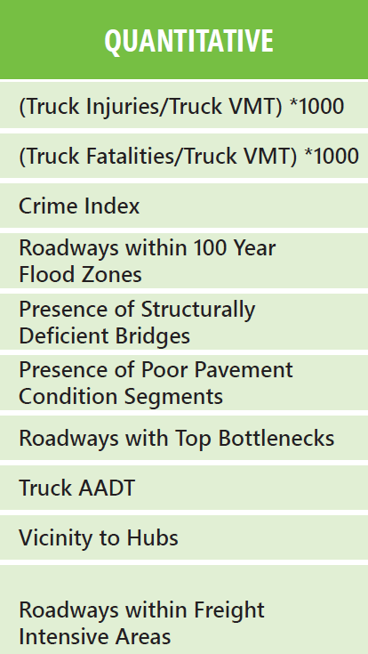
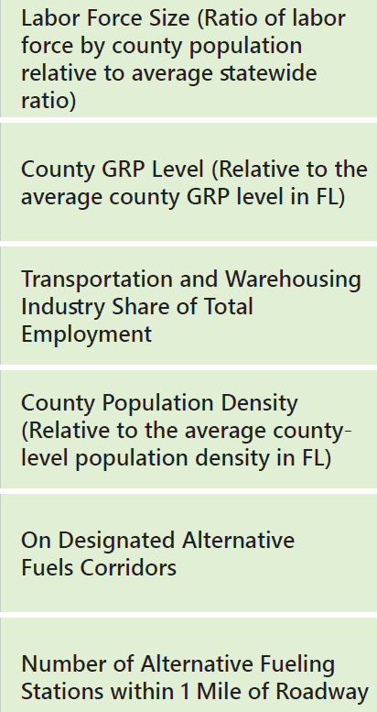
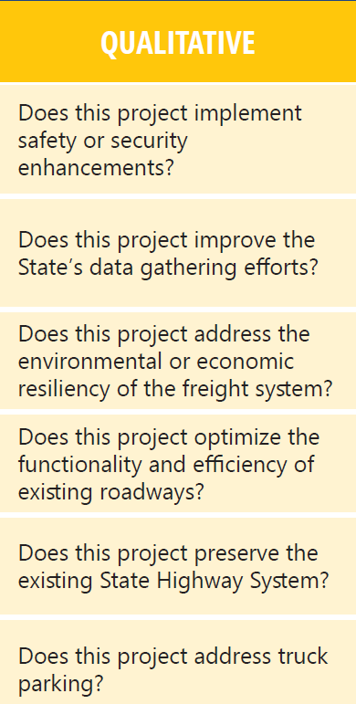
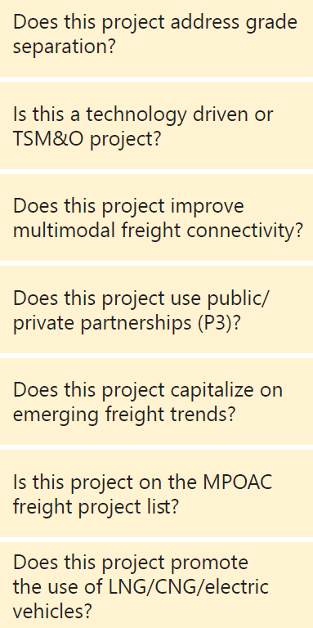
Scoring Process
Each project that meets the eligibility and screening requirements is scored in two parts
The quantitative score is based on geographical/ locational factors, while the qualitative score weighs a project's ability to effect FMO priorities

Slide 41
Getting to Action

Slide 42



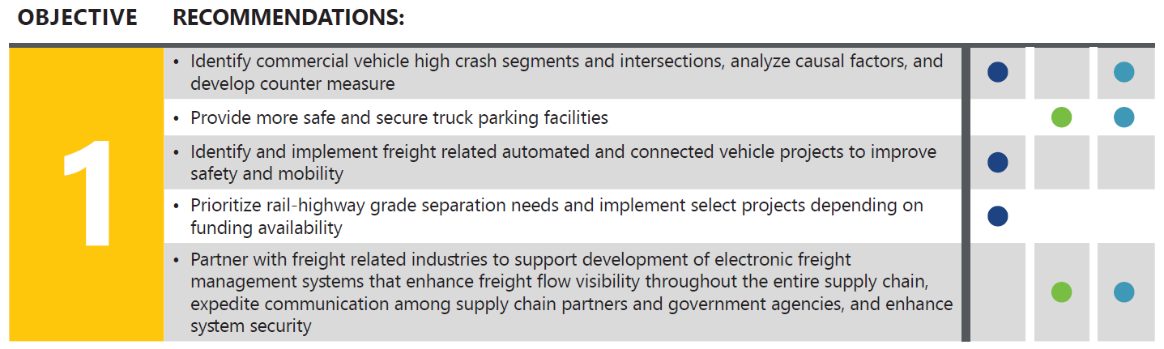
Recommendations
Each of the 10 objectives identified in the FMTP have 5 associated recommendations based on a combination of:

Slide 43

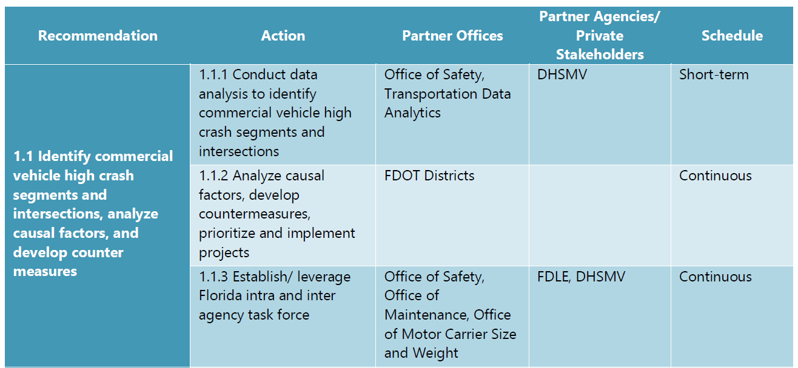
Action Items
Each of the 50 recommendations is broken down further into action steps for implementation, including partner offices/agencies and a timeframe for scheduling.

Slide 44
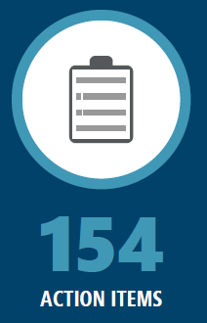
Implementation
The resulting 154 action items make up the action plan for implementation. The primary focus of the initial implementation phase will be:
Truck Parking
Freight Resiliency
Safety
Intermodal Connections
Electric Vehicle Adoption
For information on implementation progress, visit FDOT.gov/FMTP

Slide 45


Rickey Fitzgerald
Manager, Freight & Multimodal Operations
Florida Department of Transportation
605 Suwannee Street, MS 25
Tallahassee, FL 32399
850.414.4702 rickey.fitzgerald@dot.state.fl.us

Slide 46
Truck Parking

Slide 47
Statewide Truck Parking Study
Executive Briefing
March 10, 2020

Slide 48
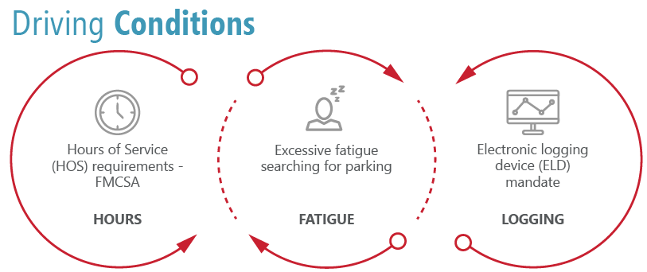
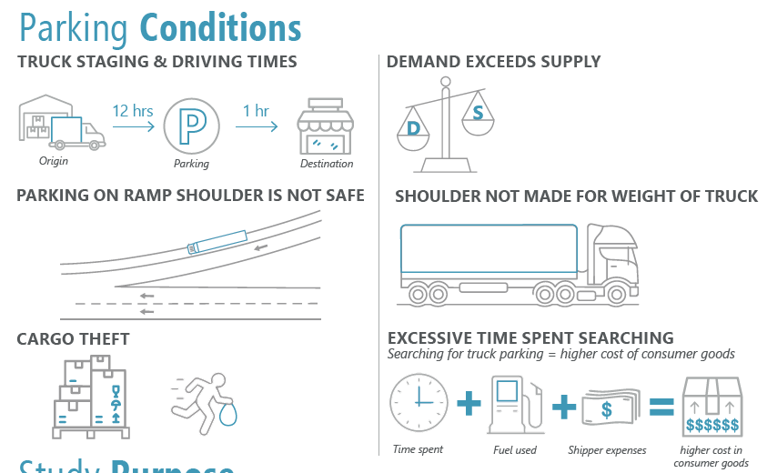
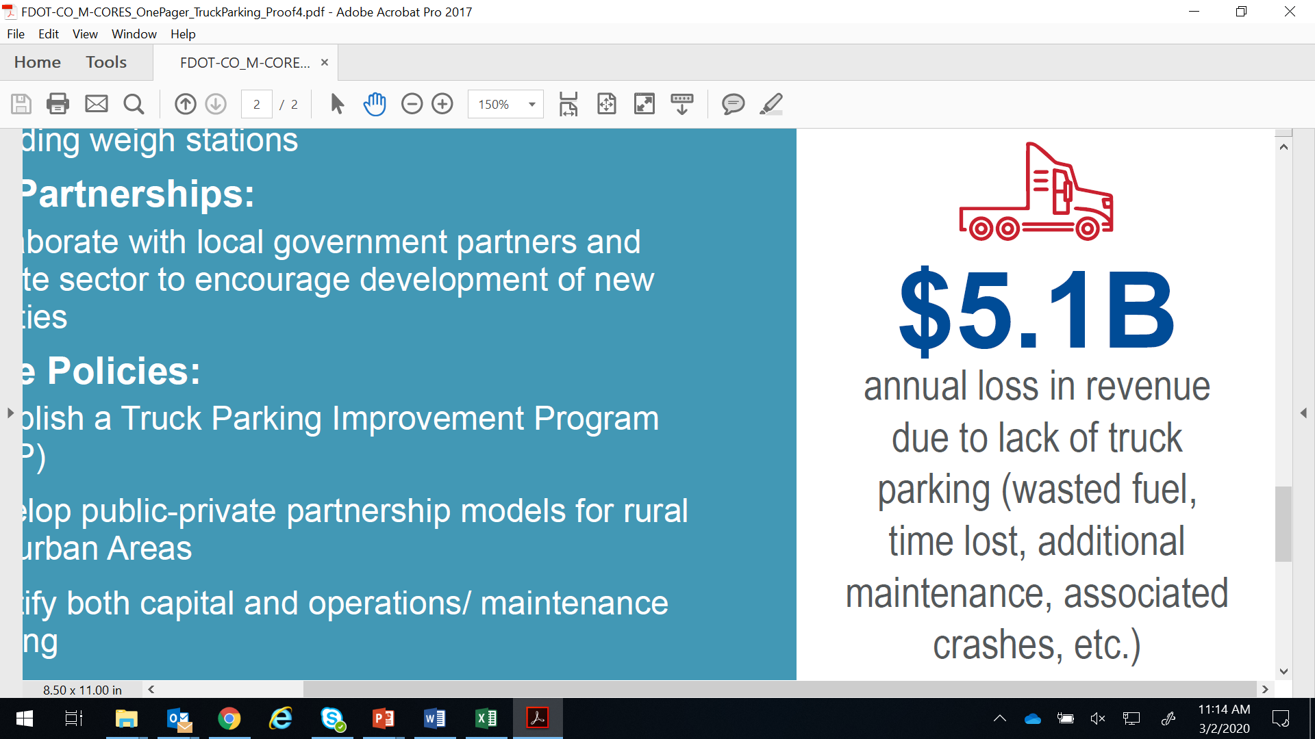
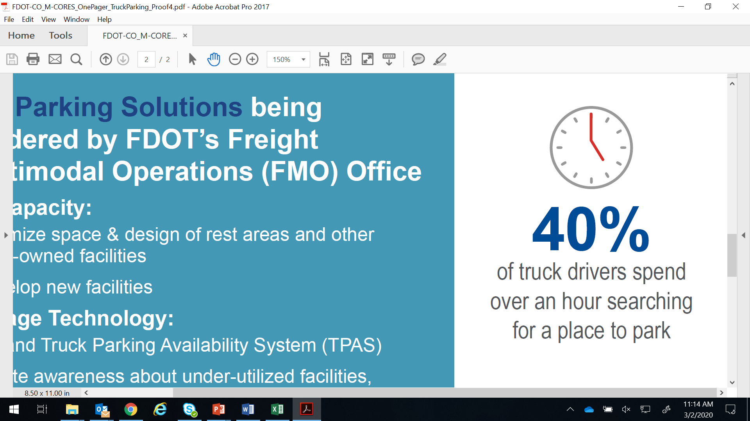
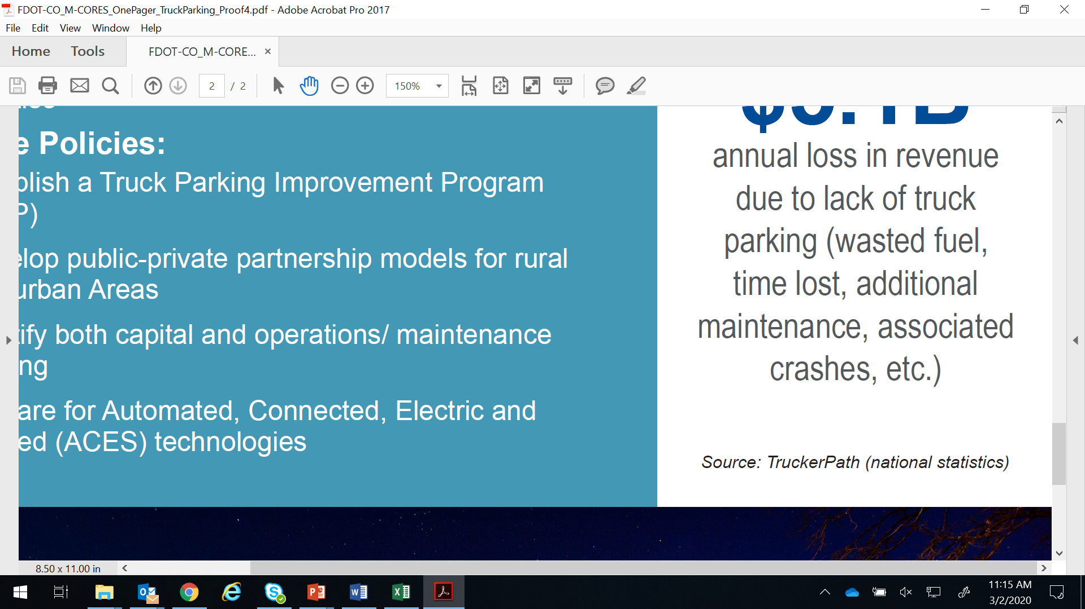
Critical Issue in the Trucking Industry
Safety issue – driver fatigue and unauthorized parking
Mobility issue – over-utilization and hindrance to moving goods
Economic issue – loss of revenue/ income, economic impact
Political issue – public perspective and local government challenges
Notes:
Add to political bullet. Volusia county adopted a policy stopping truck parking in the county
PERSONAL - *My wife doesn’t like driving by big trucks.

Slide 49
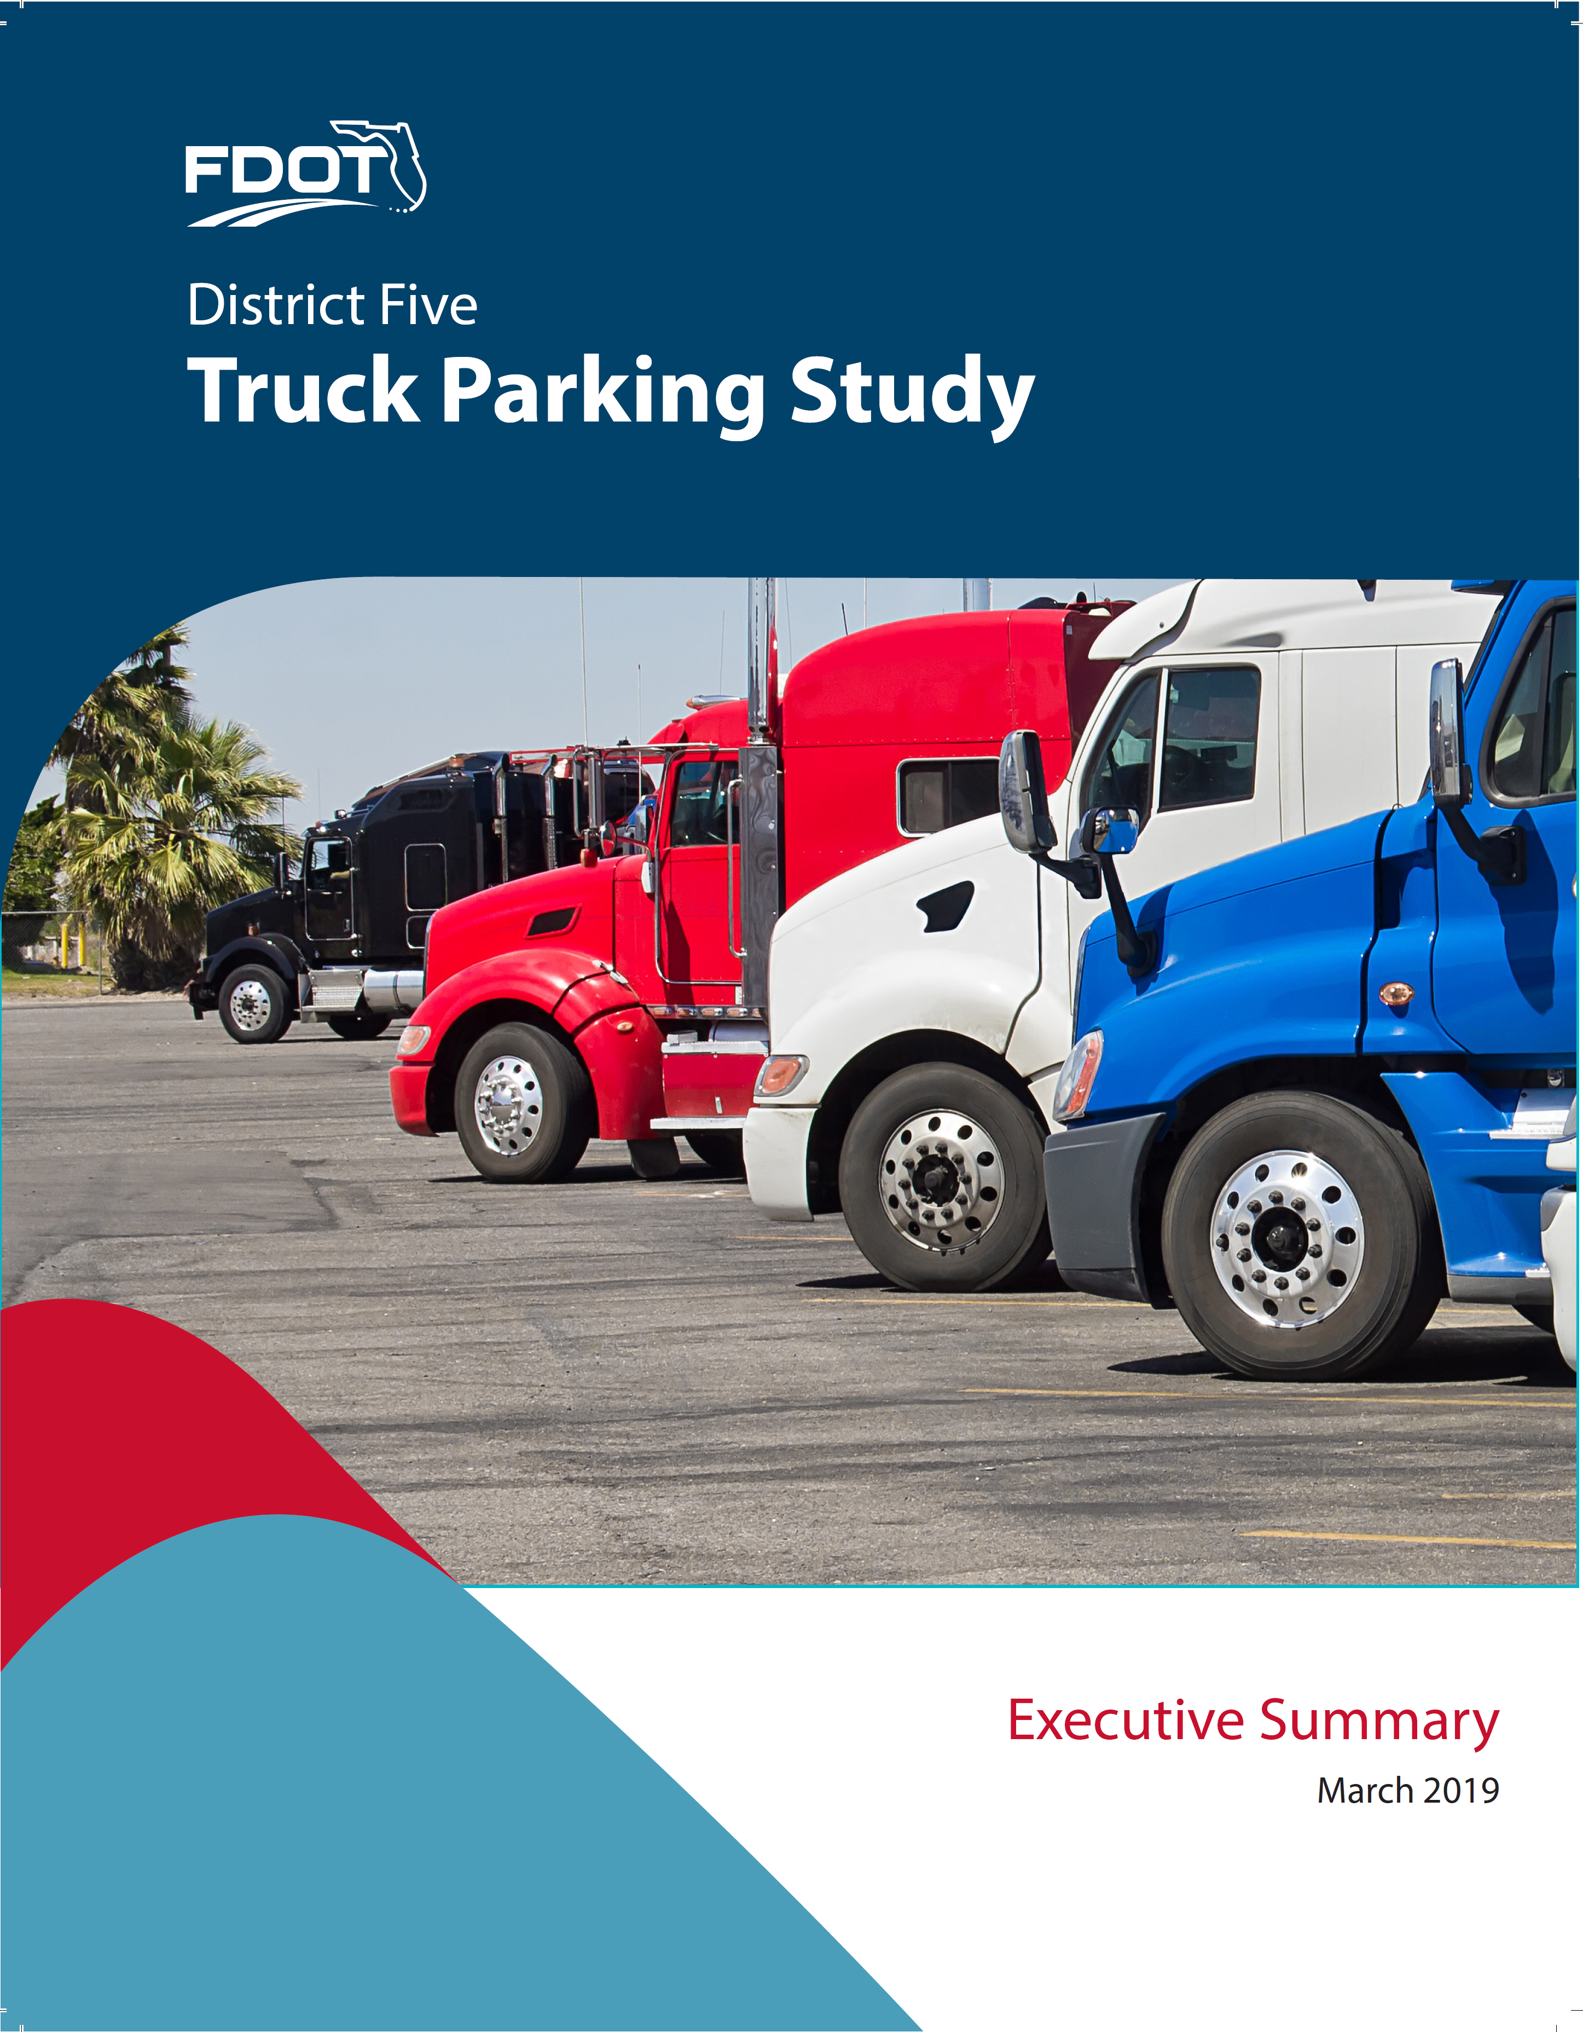
Purpose
Conduct systematic and objective evaluation from a statewide perspective
Complement District efforts – provide guidance and support
Respond to FHWA Jason’s Law Truck Parking Survey
Identify and prioritize critical needs
Pave pathway to implementation
Notes:
Bullet 2 - refer back to Orange County article on slide 2
Bullet 3 - security enhances political pressure.
PERSONAL - RELATE BACK TO WIFE

Slide 50
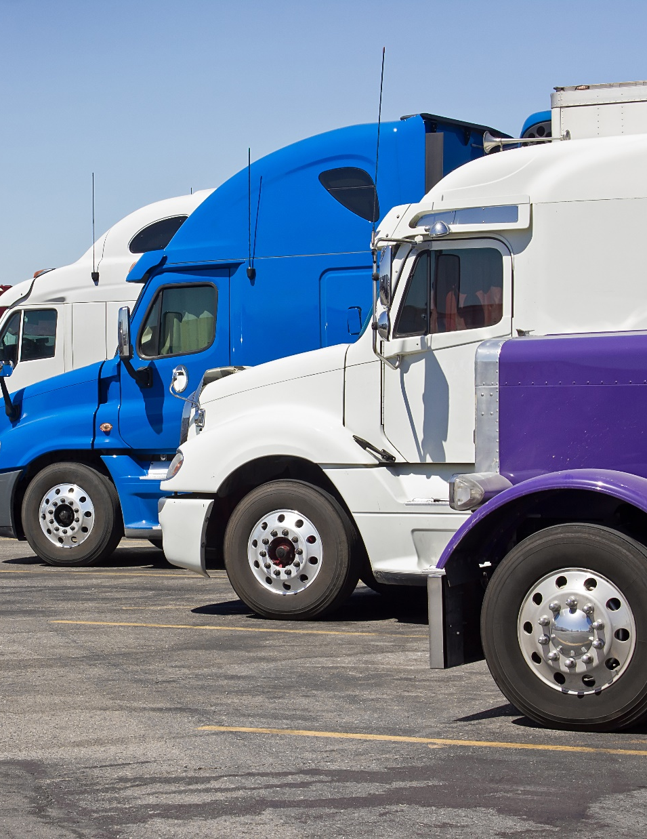
Approach
Literature review
    District studies/ efforts
    National best practices
  Analysis and prioritization
      Supply and demand conditions
      Priority areas of concern
Stakeholder input
    Districts
    Industry partners
  Solutions and recommendations
      Solutions and funding toolbox
      Implementation strategies
Notes:
But I really want to hit home with how we provide that customer service to the districts; to help prevent or dampen those political fires coming their way.

Slide 51
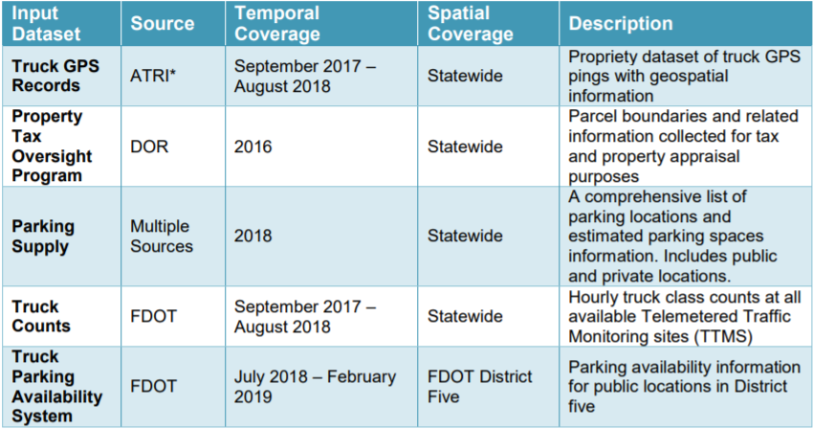
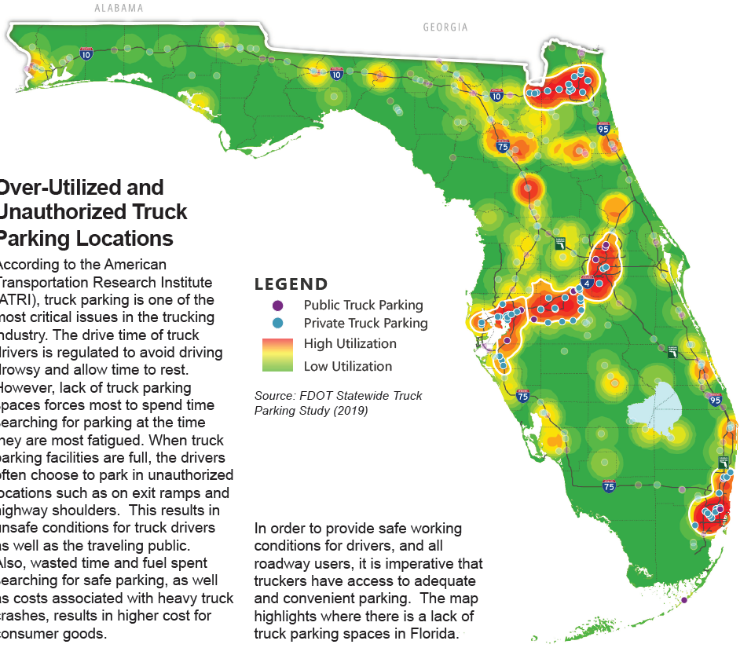
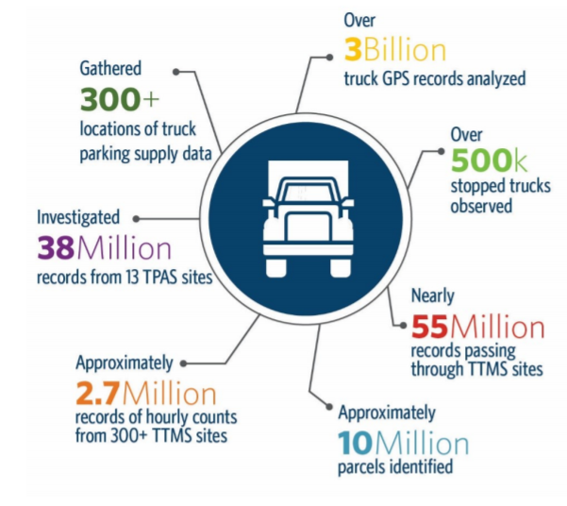
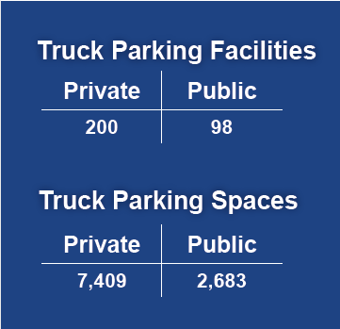
Supply and Demand Analyses
Over-utilized and unauthorized truck parking locations
GPS Data
Existing Supply

Slide 52
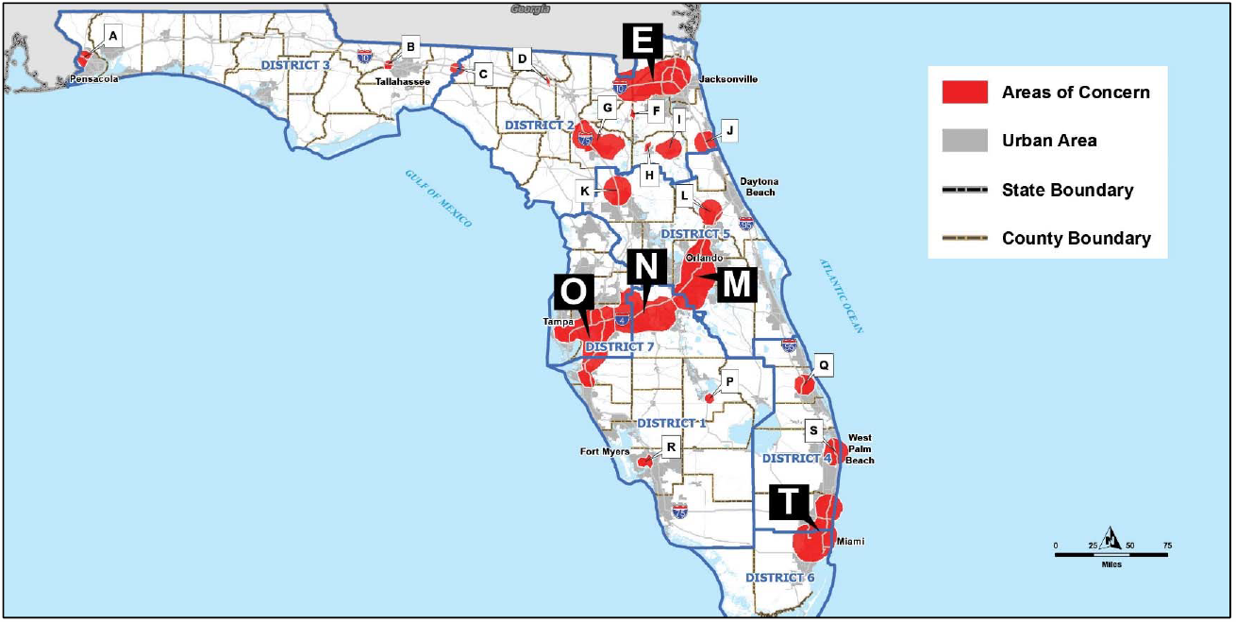
Priority Areas of Concern
Rank | Area of Concern | District | Annual Excess Truck Parking Demand (V) | Supply Parking Spaces Total (C) | V/C index
1 | M | 5 | 43,396 | 263 | 165
2 | O | 7 | 55,833 | 342 | 163
3 | N | 1 | 66,002 | 444 | 149
4 | E | 2 | 61,610 | 553 | 111
5 | T | 6 | 60,184 | 646 | 93
 | J | 2 | 19,339 | 141 | 137
 | S | 4 | 9,632 | 38 | 253
 | G | 2 | 5,620 | 6 | 937
 | P | 1 | 4,321 | 8 | 540
 | C | 3 | 4,209 | 21 | 200
 | K | 5 | 3,791 | 535 | 7
 | I | 2 | 3,429 | 6 | 572
 | A | 3 | 2,829 | 127 | 22
 | L | 5 | 2,780 | 0 | N/A
 | Q | 4 | 2,464 | 773 | 3
 | R | 1 | 1,421 | 0 | N/A
 | B | 3 | 381 | 278 | 1
 | H | 2 | 187 | 0 | N/A
 | D | 2 | 34 | 0 | N/A
 | F | 2 | 3 | 0 | N/A

Slide 53
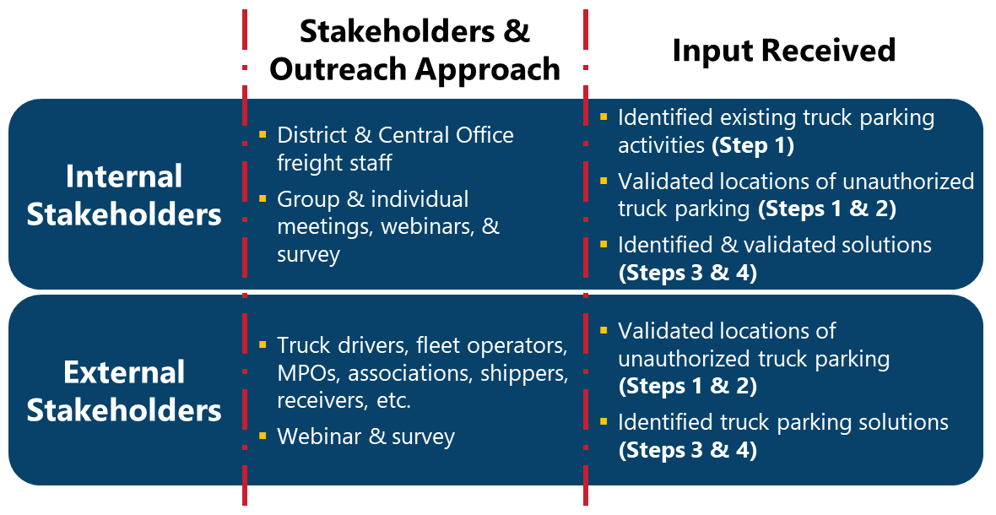
Outreach Efforts
Notes:
Thru the survey, we received over 100 responses, of which 51 identified themselves as independent owner-operators (truck drivers) while 48 identified themselves as working for a transporter or carrier (office support or truck driver).
One of the questions asked “Which of the following capacity strategies to alleviate truck parking issues make sense to you?”. 79 respondents answered “develop new public truck parking facilities near high demand private truck parking facilities” while 81 responded “develop new truck parking capacity at existing rest areas and other public parking facilities (new ROW acquisition or redesign within existing ROW)”.

Slide 54
Summary Recommendations
1) Add Capacity:
  Optimize space & design of rest areas and other state-owned facilities
  Develop new facilities
2) Leverage Technology:
  Expand Truck Parking Availability System (TPAS)
  Create awareness about under-utilized facilities, including weigh stations
3) Build Partnerships:
  Collaborate with local government partners and private sector to encourage development of new facilities
4) Update Policies:
  Establish a Truck Parking Improvement Program (TPIP)
  Develop public-private partnership models for rural and urban areas
  Identify both capital and operations/ maintenance funding
  Prepare for Automated, Connected, Electric and Shared (ACES) technologies

Slide 55

Discussion
1) Add Capacity:
  District efforts are underway
  Rest area long range plan being updated
2) Leverage Technology:
  TPAS being expanded and enhanced
3) Build Partnerships:
  Collaborate with local government partners and private sector to encourage development of new facilities
  Define Department roles and preferences
4) Update Policies:
  Establish a Truck Parking Improvement Program (TPIP)
    Create procedure
  Develop public-private partnership models for rural and urban areas
  Identify both capital and operations/ maintenance funding
    Eligible for NHFP and SIS capital funding
  Prepare for Automated, Connected, Electric and Shared (ACES) technologies

Slide 56
FMO Research Initiatives

Slide 57
On-Going Project
FSU Off-Hours Delivery Update:
  FDOT/USDOT/FSU Effort to discover improved efficiencies in last mile delivery through off-peak delivery timings
  New Focus: Improved pedestrian safety through optimized delivery and maintenance movement timings
    Less dense areas have smaller freight impacts, but freight safety is still a key driver in freight initiatives
    Further implications for rural/suburban freight delivery
  Data Efforts: A composite of data sources to identify pedestrian hot spots around campus on a time scale
    Student class size data
    Wi-fi access point data
Notes:
Holly
Lessons Learned
Dealing with too many projects can be cumbersome
Feedback from the Districts - prioritized projects list was the least useful part of the plan because of how quickly it became outdated
Definition of freight project wasn’t useful for implementation

Slide 58
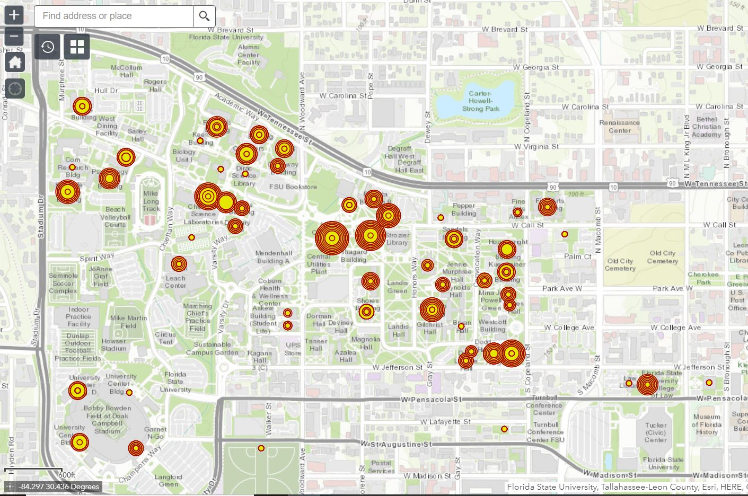
Off-Hours Campus Time-Scale

Slide 59
New Scopes Overview
Purpose: Verify and provide recommendations building off previous years Empty Backhaul studies and supporting current initiatives
  Land-Use studies
    After completing the Evaluation of Florida’s Inbound and Outbound Freight Imbalance study it was determined there is a correlation between land use and freight activity that may better inform recommendations on solutions to empty backhaul from an FDOT perspective
  Empty Backhaul
    Linked to the Evaluation of Florida’s Inbound and Outbound Freight Imbalance study completed in 2018 and the Land Use Analysis study starting this year, these analyses will work together to help identify and find solutions to the problems related to demand and application of freight connected resources.
  Current Rail crossing guidelines
    This analysis is linked to the Development of the Optimization Model for Improving Safety at Rail Crossings in Florida study completed this year. Both analyses will work together to help identify and find solutions to the problems related to eliminating hazards at RR crossings while minimizing overall traffic delays by improving safety and freight flows.
Notes:
Holly

Slide 60
New Scopes - Objectives
Identification of possible solutions for the Florida trade imbalance and Empty Backhauls
  1) Coordinate FDOT Districts to identify all current and previous research into Florida Empty Backhauls
  2) Conduct data analysis (WIM) to ensure previous studies are correct and current
  3) Analyze future manufacturing potential in major industries analyzed by Enterprise Florida comparative to future growth of population and skilled work force to determine future significance of change to empty backhauls balance.
  4) Create recommendations on possible industry partnership solutions
  5) Provide recommendations on effective policy to drive industry towards alternatives of backhaul movements, i.e. barges and rail.
  6) Provide recommendations on how drivers coming into the state can find work to leave the state with LTL or TL rather than empty
Notes:
Holly

Slide 61
New Scopes - Objectives
Land Use Analysis to Enhance Successful Logistics Activity Center Development in Florida
  Review/revise the criteria for identifying successful LAC development determined through the previously performed FDOT D7 study
  Identify optimal locations with high LAC development potential within Florida
  Develop GIS databases and maps for identified optimal locations with high LAC development potential
  Provide recommendations for enhancing identified optimal locations with high LAC development potential per their current land use
Notes:
Holly

Slide 62
New Scopes - Objectives
Improving Safety at Highway-Rail Grade Crossings in Florida while Maintaining Continuity of Passenger and Freight Flows: A Multi-Objective Approach
  Develop a multi-objective optimization model that can assist the FDOT personnel with identification of highway-rail grade crossings that have to be upgraded and selection of the appropriate upgrading type, considering the existing budget constraints.
  Analyze resource allocation decisions under conflicting objectives (i.e., minimize the overall hazard severity at highway-rail grade crossings vs. maximize passenger and freight flows).
  Develop a standalone application, which deploys the proposed multi-objective optimization model, in order to facilitate decision making.
  Conduct a set of case studies to demonstrate some important managerial insights from resource allocation among the highway-rail grade crossings in the State of Florida, given conflicting nature of the objectives considered.
  Improve safety of highway travelers in the State of Florida by reducing the potential hazard of highway-rail grade crossings.
  Ensure continuity of passenger and freight flows, reduce delays at highway-rail grade crossings, support economic development, and ensure prosperity of the state.
Notes:
Holly

Slide 63
Issues Surrounding Research
Off-Hours
  Lack of student population has put observational data gathering on hold
New Scopes
  Project leads are continuing to draft scopes
  Projects to move forward unless specific issues arise
    Issues to plan around:
      Travel restrictions
      Research Assistant campus access
      Current Data accuracy
Notes:
Holly

Slide 64
COVID-19 Roundtable

Slide 65
Rickey Fitzgerald
Manager, Freight & Multimodal Operations
Florida Department of Transportation
605 Suwannee Street, MS 25
Tallahassee, FL 32399
850.414.4702; rickey.fitzgerald@dot.state.fl.us

