Slide 1
Florida Metropolitan Planning Organization Advisory Council Policy and Technical Subcommittee Meeting
December 20, 2016

Slide 2
Call to Order
Peter Buchwald, Chair

Slide 3
Public Comments

Slide 4
New Calendar for 2017 Meetings
WHY?
Request to change the meeting dates of the Staff Directors Advisory Committee
One month before the Governing Board Meeting
Requires a change to the MPOAC Bylaws
Will allow the Staff Directors more direct input to the Governing Board agenda items

Slide 5
New Calendar Dates for 2017 Meetings
Assuming the First Thursday Methodology
As agreed to by MPOAC at the April 2016 Meeting
January – No change
2nd Quarter
April 6th Governing Board Meeting
March 2nd Staff Directors Meeting
3rd Quarter
July 19th Governing Board Meeting
Held in conjunction with Floridians for Better Transportation
June 1st Staff Directors Meeting
July 8th would not allow enough time to prepare a meeting packet for Governing Board
4th Quarter
November 6-7 – Planned Governing Board Meeting and Staff Directors
October 5th Staff Directors Meeting

Slide 6
Bylaws Revision
Carl Mikyska
Paul Gougelman

Slide 7
Looked over the bylaws comprehensively
Started with idea of Staff Directors meeting 1 month prior to Governing Board
Expanded definition of MPO, eliminated TPO definition
No more Chairperson, Chairman, etc – only Chair and Vice-Chair
Allow for two alternates to represent your organization at meetings
No more sub-committees, just committees
Align the appointment of leadership positions with elections
Flexibility in naming member organizations
Agendas distributed 10 days in advance of meeting

Slide 8
Direct PL Funding Update
Carl Mikyska

Slide 9
FDOT MPO Handbook Update
Sean Santalla, FDOT

Slide 10
Revenue Forecast Efforts
Martin Markovich, FDOT
Regina Colson, FDOT

Slide 11
Strategic Plan Implementation
Carl Mikyska

Slide 12
MPOAC Strategic Plan Working Groups

Slide 13
MPOAC Strategic Plan Working Groups Next Steps
Form 2 committees
Bike & Pedestrian Committee
Best Practices Committee
Select committee members and chair
Direct your Executive Director to work with each chair to develop a work plan for committee approval

Slide 14
FDOT Financial Risk Assessment of MPOs
Sean Santalla, FDOT

Slide 15
Legislative Policy Positions of MPOAC
Carl Mikyska

Slide 16
The MPOAC supports State Legislation that:
Implements the recommendations from the MPOAC transportation revenue study and other options for expanding transportation revenue sources.
Restores funding for the Transportation Regional Incentive Program in order to promote regional planning and project development through sustainable funding mechanisms, in addition to documentary stamp revenues.
Regulates distracted driving as a primary offense by prohibiting the use of electronic wireless communications devices and other similar distracting devices while operating a moving motor vehicle.
Allows Strategic Intermodal System (SIS) funds to be used on roads and other transportation facilities not designated on the SIS if the improvement will enhance mobility or support freight transportation on the SIS.
Establishes state funding for railroad crossings to improve safety and establish quiet zones.

Slide 17
Implements the recommendations from the MPOAC transportation revenue study and other options for expanding transportation revenue sources.
Key Recommendations:
Expand the Charter County and Regional Transportation System Surtax to allow municipalities over 150,000 in population (or the largest municipality in a county) and all counties located in MPO areas to enact up to a one cent local option surtax by referendum.
Index local option fuel taxes to the consumer price index in a manner similar to the current indexing of state fuel taxes.
Direct the Florida Department of Transportation to develop a plan and conduct one or more pilot tests to move Florida toward a Mileage Based User Fee, which protects individual privacy, in lieu of the traditional fuel tax.

Slide 18
Regulates distracted driving as a primary offense by prohibiting the use of electronic wireless communications devices and other similar distracting devices while operating a moving motor vehicle.
The 2013 Florida legislature enacted the “Florida Ban on Texting While Driving Law.” The law prohibits operation of a moving motor vehicle while manually typing, sending or reading interpersonal communication (texting, e-mailing, instant messaging, etc.) using a wireless communications device, with certain exceptions. The law provides for enforcement of the ban as a secondary offense, meaning a driver would have to be pulled over for some other violation to get a ticket for violating the ban on texting. The 2014 and 2015 Florida Legislatures underscored the severity of distracted driving by considering bills that would have substantially increased the penalty for distracted driving. This legislative proposal would seek to strengthen the enforcement mechanism for the texting while driving ban by making it a primary offense.

Slide 19
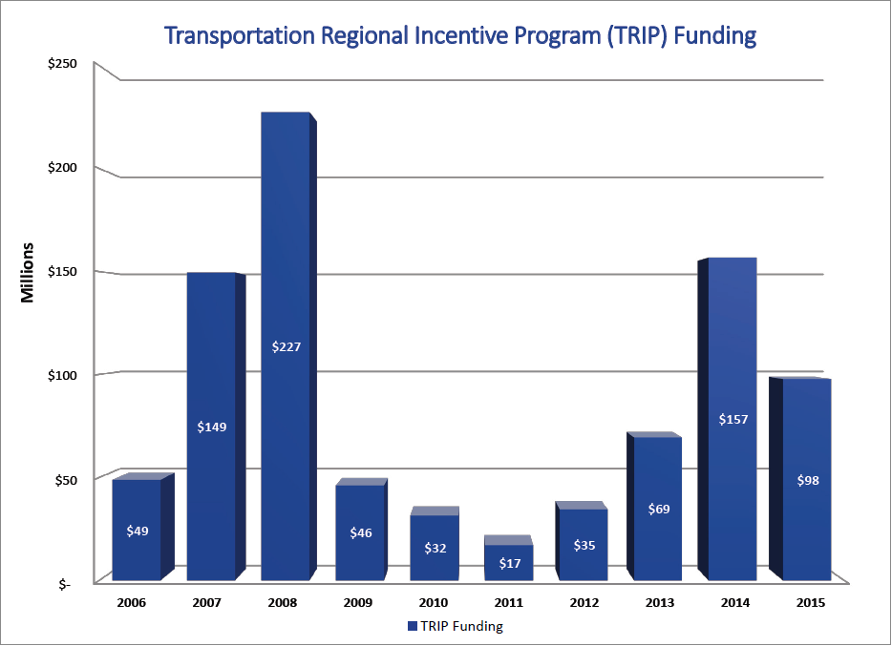
Restores funding for the Transportation Regional Incentive Program in order to promote regional planning and project development through sustainable funding mechanisms, in addition to documentary stamp revenues.

Slide 20
Allows Strategic Intermodal System (SIS) funds to be used on roads and other transportation facilities not designated on the SIS if the improvement will enhance mobility or support freight transportation on the SIS.
Current state law does not permit SIS funds to be spent on roads or other transportation facilities that are not part of the SIS, even if proposed improvements would directly benefit users of SIS facilities by enhancing mobility options or supporting freight movement in a SIS corridor. This legislative proposal would broaden the State’s ability to improve passenger and freight mobility on SIS corridors by making eligible the expenditure of SIS funds on non SIS roads and other transportation facilities where the benefit to users of SIS facilities can be demonstrated.

Slide 21
Establishes state funding for railroad crossings to improve safety and establish quiet zones.
This proposal recognizes growing economic activity at Florida’s ports and provides financial support to ensure the continued quality of life and safety in communities along increasingly busy rail corridors.

Slide 22
Autonomous and Electric Vehicles?
Include a supportive policy?
MPOAC supports the implementation of an electric vehicle charging network across Florida.
MPOAC supports the advancement of autonomous vehicles in Florida.

Slide 23
MPOAC Financial Guidelines for LRTPs
Jeff Kramer

Slide 24
LRTP Reviews
Jeff Kramer

Slide 25
FL LRTP Reviews
Jeff Kramer, AICP
MPOAC Policy and Technical Subcommittee l December 20, 2016

Slide 26
Background/Purpose
Prior Reviews in 1997, 2002, 2008 and 2013
Purpose:
Observations: identify current practices and compare to previous practices
Suggestions: prompt change in practice ahead of next update cycle
Estimate statewide shortfall in metropolitan areas

Slide 27
Example Changes in Practice
Statewide financial guidelines
Uniform LRTP horizon years; “Needs” plan guidance; Include TIP years
Shortfall estimate used to champion increased transportation spending
Basis for MPOAC Revenue Study and Policy Positions
Coordination between:
LRTPs, FTP and other state plans; input to FTP
Neighboring MPOs; regional coordination studies

Slide 28
Example Changes in Practice
Improved “user friendliness”
no model output; executive summaries; brochures
More descriptive LRTPs; fewer “sanitized” plans
Clearer linkages between LRTP projects and goals

Slide 29
2013 Sample Suggestions
Appropriate “needs” plan projects
Determine transit “needs” beyond the 10-year window of the TDP
Be clear about tradeoffs
More focus on freight movement
Scenario planning
Describe how public input informed decisions
Mitigation and adaptation strategies

Slide 30
Estimated Statewide Shortfall

Slide 31
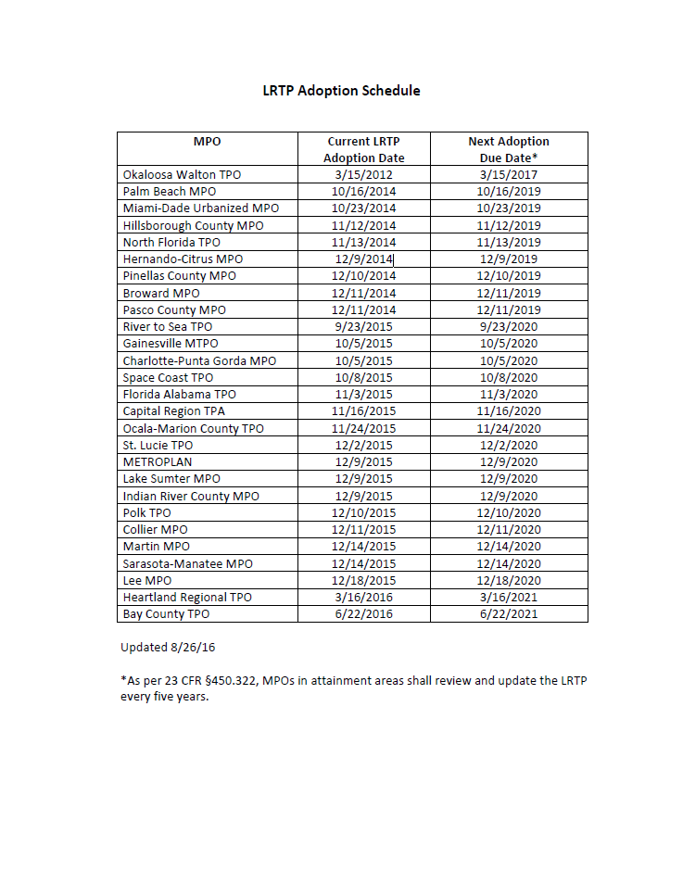
Timing to Review of 2040 LRTPs?
Last adopted 2040 LRTP
3/2017
First adopted 2045 LRTP
10/2019

Slide 32
What Would It Take?
Review all 27 MPO plans and supporting documentation
Follow-up with MPOs as needed
Develop generalized statewide observations and document unique practices
Develop shortfall model (Needs plan costs v. estimated revenues)
Estimate individual MPO shortfall
Estimate statewide shortfall

Slide 33
What Would It Take? – Part II
Approximate schedule
18 months
Approximate cost
$175k
Potential source of funding – PL reserve
Spread across 2 to 3 fiscal years

Slide 34
Questions?
Jeff Kramer
Center for Urban Transportation Research
University of South Florida
kramer@cutr.usf.edu
813-974-1397

Slide 35
Member Comments
Issues and comments for the good of the cause

Slide 36
Adjournment
Next meeting
Partnering with the 2017 Safe Streets Summit
January 26, 2017
Sunrise, Florida
DoubleTree by Hilton
13400 West Sunrise Boulevard, Sunrise, FL 33323

