Slide 1
Executive Director’s Report

Slide 2
Included in the agenda packet On Track
Budget

Slide 3
HB 7061 (Transportation) HB 7027 (Transportation) HB 1361 (Growth Management) SB 416 (Utilities) Start over on March 7, 2017
2016 Legislative Summaries
Four Main Bills Passed

Slide 4
HB 7061 (Transportation)
Was a General Bill by the Economic Affairs Committee
$25 M per year to FL Seaport Transportation and Economic Development Program
Transfers the Pinellas Bayway System from FDOT to the Turnpike
Establishes the Seaport Security Advisory Committee
Changes the SCOP (Small County Outreach Program)
From 150K Population to 170K Population
Requires FDOT to install roadside barriers which will shield bodies of water
Chloe’s Law
Makes several statutory changes to the operation and regulation of autonomous vehicles
Requires a study of Driver-Assistive Truck Platooning Technology
Establishes commercial megacycles and regulates them

Slide 5
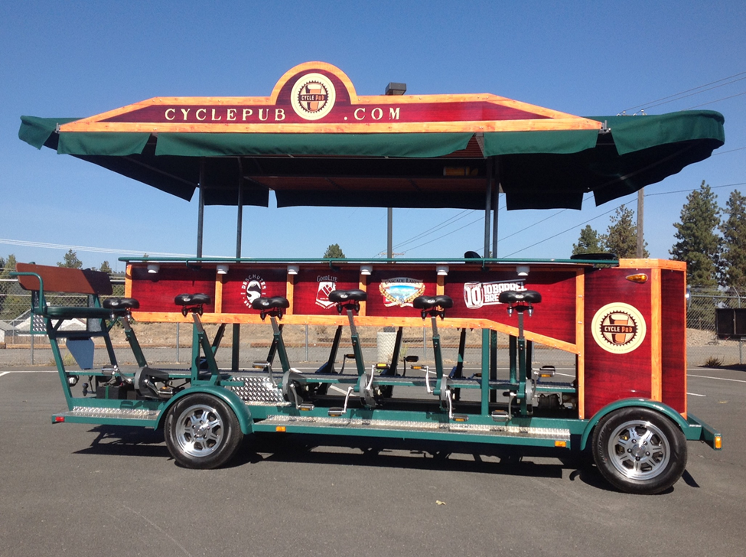
HB 7061 (Transportation) – Con’t
What is a Megacycle?

Slide 6
HB 7027 (Transportation)
NEPA Provision – FDOT may assume these responsibilities
Legislative Budget Commission has approval authority for Work Program Amendments that:
Add a project or phase
$3M minimum limit
Establishes the FDOT Financing Corporation
Board of Directors
Membership and Organization
Powers and Duties

Slide 7
HB 1361 (Growth Management)
Sector plan threshold changes from 15,000 acres to 5,000 acres
Allows local governments to approve land use changes to “essentially built-out” developments as long as there is not a net increase in impacts to public facilities
SB 416 (Utilities)
Shifts the cost of Utility Relocation from the Utility to local units of government

Slide 8
Traffic Engineering Definition
Follow-Up from previous meeting
Florida Board of Professional Engineers purview
Had worked on a definition – included many transportation planning activities
Withdrew definition
Not pursuing a definition
NC Case involving dentists and teeth whitening

