Slide 1

State of the System Report
SPACE COAST
TRANSPORTATION PLANNING
ORGANIZATION
MPOAC Noteworthy Practices Working Group
Notes:
Good morning.
A summary of the SOS was provided to this group when selecting projects for presentations that highlighted a little bit of what the SOS is and how it is used. Today’s presentation will provide a brief look into the evolution of the report and how it is integrated into the planning process.

Slide 2

Presentation Agenda
History of Report and use as Congestion Management System Process
What’s in the Report Today?
How to implement anywhere
Notes:
I will first cover the history of the report, which is important to highlight because it shows that as times change and new approaches and technology are introduced, the methodology can be updated to take into account both the data available and how it is reviewed and used. I will then cover what is analyzed in it today and what is needed to implement elsewhere.

Slide 3

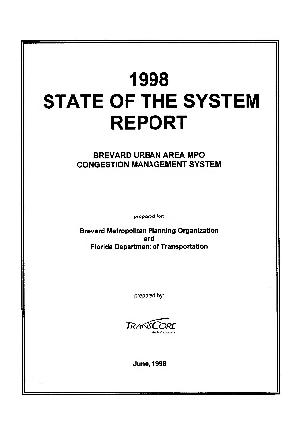
History
1994
Project Evaluation and Prioritization Process Developed
1998 – First State of the System Report Developed
  Focused on measuring congestion
  Technical Criteria used to score and rank roadway segments
    Severity of Congestion (40%)
    Severity of Future Congestion (10%)
    Number of Travelers Affected (10%)
    Intermodal Connectivity & Economic Significance (10%)
    Hurricane Evacuation (10%)
    Prior Funding Commitments (10%)
283 total segments ranked
Notes:
Credit must be given to Mr. Bob Kamm, our previous director, who had the vision to realize that looking at system performance from a technical approach, not only would meet the requirements for having a congestion management system, but also provided technical support for project selection, minimizing political influences in project priorities.
The original SOS was called the Project Evaluation and Prioritization Process, developed in 1994. Known as the PEPP, it took a couple of years, tweaking the criteria and getting the right data available and then in 1998, just over 20 years ago, the first official State of the System Report was published. At the time, the criteria were heavily focused on congestion. Other factors were considered in the overall score, but transportation projects were focused on reducing current and future congestion.
There were 283 segments evaluated and ranked. These segments were all on the functionally classified list and were chosen due to the TPO collecting traffic volumes to meet the concurrency requirements of the time.

Slide 4
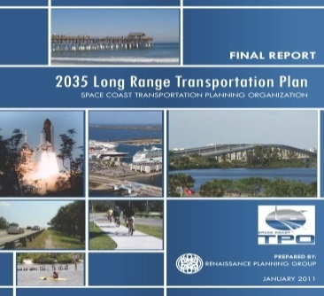

History
1999
Segments divided into FHIS (SIS) & Non-FHIS (Non-SIS)
Added Safety (crash rate) to criteria
2009
Updated to
2035 LRTP
2013
Revised Safety Score
(Severity and frequency)
Notes:
In 1999, the segments were divided into those on the Florida Intrastate Highway System (FIHS), now known as the Strategic Interstate System (SIS) and Non-FIHS or Non-SIS. This set up the report to be ready for the SIS program and funding process that was then passed by the Florida Legislature and Governor in 2003. The network includes the Florida Strategic Intermodal System (SIS), all State maintained arterials, major County arterials, and some local arterials and collectors. Safety was also a significant criteria added to the analysis in 1999. By 2013, we realized that just using the crash rate was causing significant fluctuations in segment rankings from year to year. We re-worked the safety score to then include both severity and frequency and increased its overall weight in the total scoring.

Slide 5
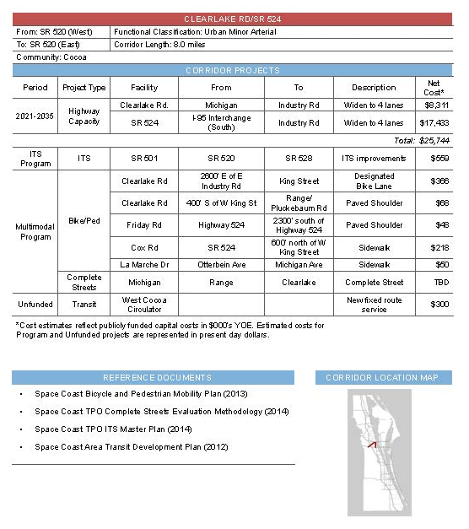
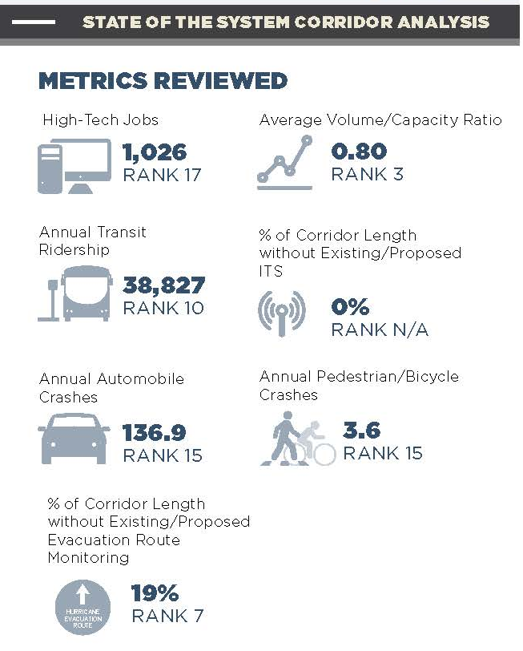
History
2015
Updated to 2040 LRTP
Over 500 Segments
2017
218 Corridors Analyzed
Piloted 16 Corridors
Notes:
By 2015, we updated our Long Range Plan and introduced the concept of corridors. For every corridor in the county, we developed a worksheet that summarized all the projects and studies that included the corridor and what both the needs and cost feasible projects were. So, to keep consistency in our plans, the SOS followed suit and we piloted 16 corridors in the county, combining segments into meaningful lengths that could be submitted as projects. As you can see we had grown to over 500 segments being analyzed.

Slide 6
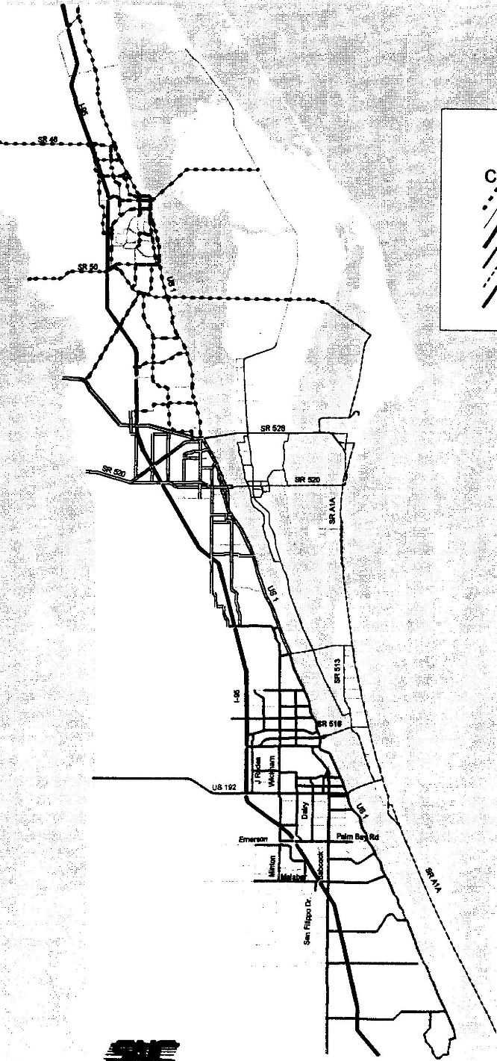
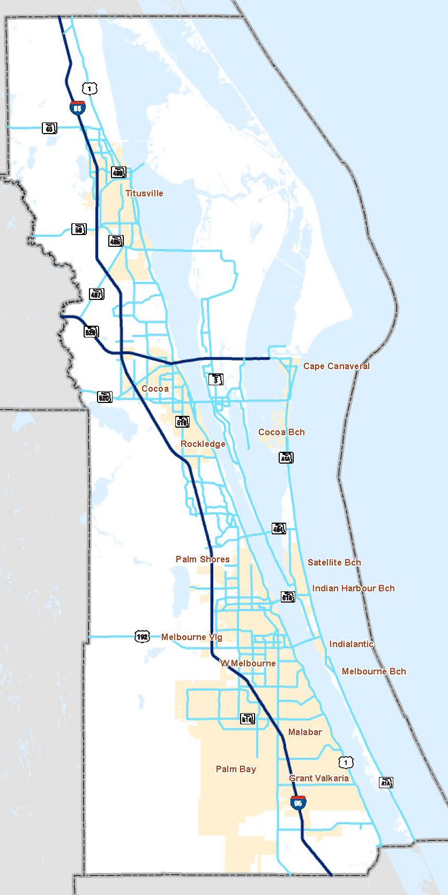
SOS
Network
1998
2017
Notes:
Here is a snapshot, that reflects both how technology has changed over the years. The SIS is in dark blue and the non-SIS SOS network is in light blue. The middle area and Palm Bay is where one can see how the roadway network has grown.

Slide 7
Corridors
TPO Studies/Plans
Long Range Transportation Plan
ITS Master Plan
Corridor Studies
Complete Streets
Bicycle/Pedestrian Mobility Plan
Countywide Safety Analysis/Safety Studies
ADA Bus Stop Analysis
Transit Development Plan
Holistic Summary
Capacity
Multi-Modal
Safety
Transit
Notes:
So, why look at corridors and rank based on each measure instead of just one overall score? It wasn’t just to be consistent with the LRTP. The corridor approach made sense from multiple aspects. Funding for projects has changed over the years and widening roads is no longer always an option. New technologies in ITS are available and everyone realized that bicyclist and pedestrians are part of the system. Knowing which corridor had what features already in place is extremely useful in determining what type of improvement to plan for.
The Space Coast TPO had been working on developing multiple plans and was at a point where these plans needed to be integrated, which is the purpose in the LRTP, to have a “megaplan” or corridors that reflected all needs.
In 2015, the TPO had a list of complete streets projects with the first project being completed in 2016. We also had adopted a bicycle/pedestrian mobility plan, and a new Intelligent Transportations Systems Master Plan. Integrated within all of these plans we had conducted safety studies. Crash data was now readily available through University of Florida’s Signal 4 system. And the safety projects are eligible for HSIP funding.
There were now various “pots” of funding for different types of projects. TA for bike/ped, HSIP for safety, SU was being used for smaller complete street projects and bike/ped. SIS facilities also has their own separate pot. So what we were seeing is that various transportation funding options were in categories, not just one source. We wanted a way to evaluate and rank our corridors based on these various ‘categories’. We also were well aware and watching how the new performance measures were coming out from Federal Highway, and requirements of the FAST Act. So all of this combined into a new approach to the SOS metrics and reporting.

Slide 8
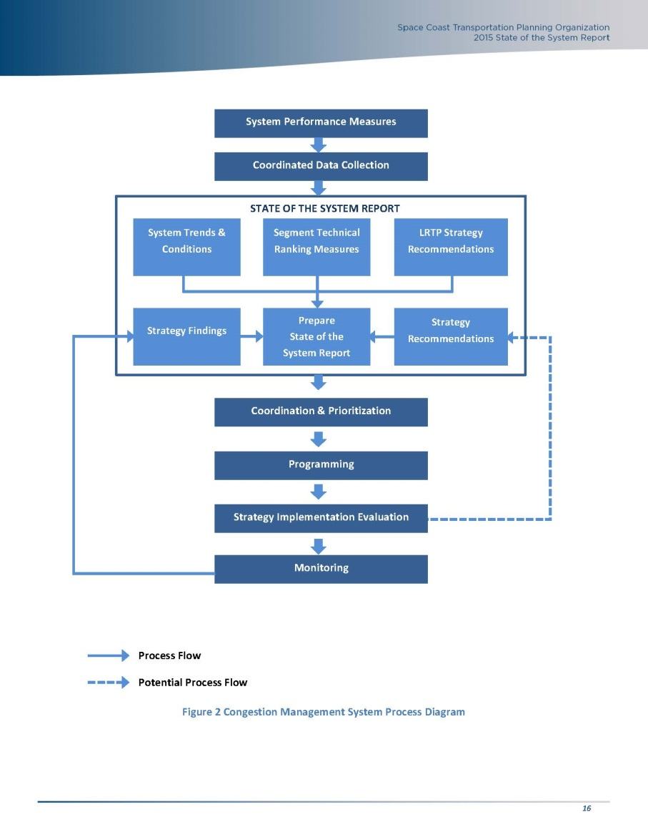
Congestion Management System Process
Notes:
We still keep the foundation of the SOS report being an integral part of our CMS. This chart shows how the SOS works in combination of our LRTP and Project Prioritization.

Slide 9
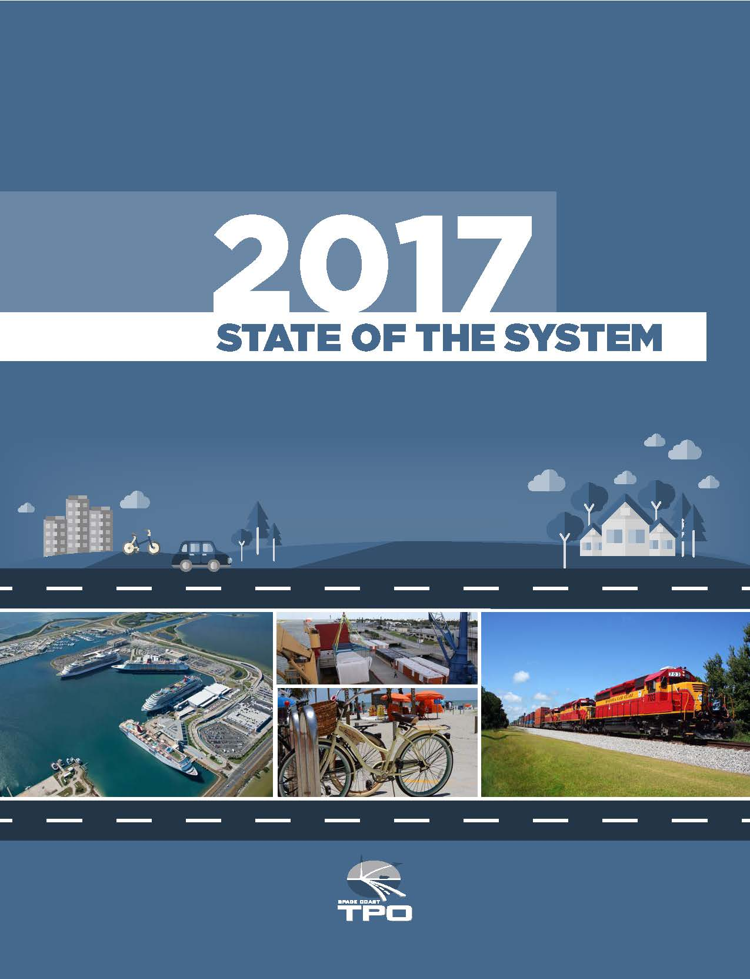
Today’s State of the System Report
  What is in the report today?
  Trends
  Corridor Measures & Ranking
  Safety Analysis
Notes:
I felt that this history of how we got to what we are doing today was important and that others who may be interested in implementing something similar they have an understanding that there are other methods that can be used.
So what exactly are we monitoring and analyzing today in our State of the System Report?
Today’s report includes a look at various trends and the corridor and safety analysis of corridors.

Slide 10
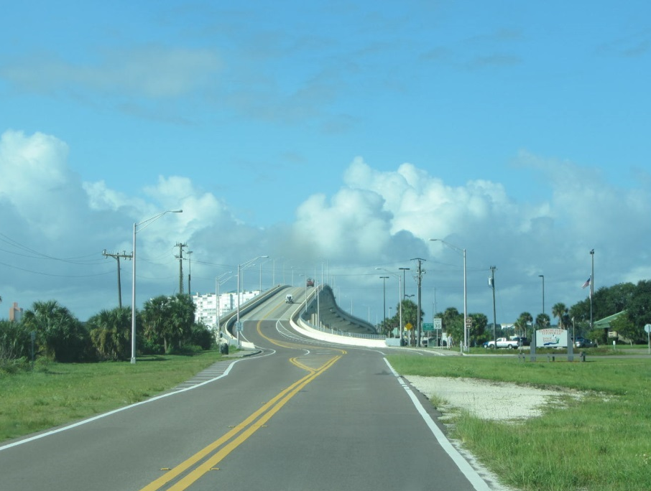
TRENDS SUMMARY
Notes:
First, a review of trends.

Slide 11


Trends Effecting System Usage
Population Growth Rates
Vehicle Registrations
Notes:
We have some general trends, that impact use of the transportation system. One is population growth and another is how many vehicle registrations there are. More vehicles , potentially more congestion. The chart shows that Brevard County is seeing a steady increase in population, similar to the State.

Slide 12


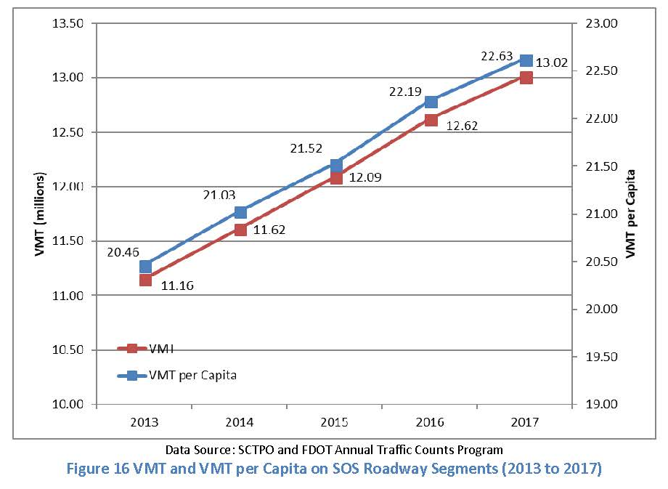
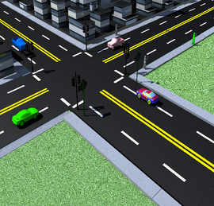
Vehicular Mobility Indicators
    Traffic Volumes
    Truck Traffic Volumes
    Vehicle Miles Traveled
    Congestion
    Interchange and Intersection Volumes
Notes:
Mobility indicators include traffic volumes, truck traffic VMT, congestion and we identify our busiest intersections and interchanges.

Slide 13





Modal Trends
Transit Mobility Indicators–
  Annual Transit Ridership
    Fixed Route
    Vanpool
    Demand Response
Orlando-Melbourne Airport
  Passenger Enplanements
Space
Canaveral Port Authority
  Cruise Passengers
  Cargo Tonnage
Notes:
Like every area, we have other modes too, but being the Space Coast, we have a few extras compared to those that are inland. We monitor transit ridership, activity at the Orlando-Melbourne International Airport, Cruise passengers (Port Canaveral being the 2nd busiest in the nation), cargo at the Port.
We are the only TPO in the state that also monitors space activities. The activity and commercial growth at the space center is not just an economic indicator, but one needs to realize from a planning perspective that the cargo on those launches has to get there by some mode of transportation.
All of these trends are included each year in the report and provide a glimpse into not just where we have been, but where we are going. Five year historical information is provided in the report.

Slide 14




Summary of Trends
 | Demographic trends show the third highest Countywide population growth since 2007
 | Traffic volumes increased in correlation with the population increase SOS roadway volumes increased 2.0% from 2016 to 2017
 | Overall transit ridership continued to decrease after seeing record passenger increases pre-2013
 | Orlando Melbourne International Airport continues to see increasing trend in number of passengers. 4.8% increase from 2013 to 2017
Notes:
For our 2017 report, this is the summary slide of our trends that is presented to our committee’s and board. The arrows show if the trend is going up or down compared to the desired trend and the color indicates whether it is good or bad trend. So, we could have a green down arrow that would be good to see traffic fatalities decreasing.

Slide 15



Summary of Trends
 | 14.1% increase in cruise passengers from 2013 to 2017
 | Canaveral Port Authority has seen extensive increase in cargo with its on-site facility improvements 54.6% in cargo tonnage from 2013 to 2017
 | Space Missions are returning to KSC and are projected to have a 670% increase by the year 2022 2013 = 10 Launches 2017 = 19 Launches 2022 = 67 Estimated Launches
Notes:
Here are some of those modal choices that most of you wouldn’t have.

Slide 16
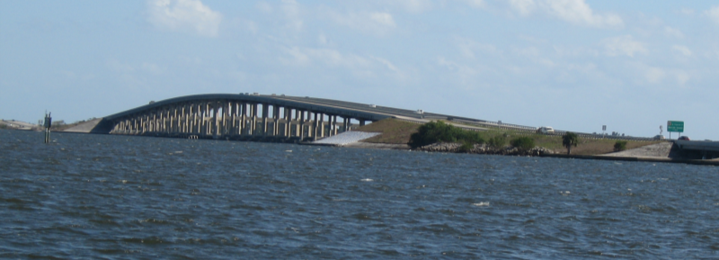
CORRIDOR ANALYSIS
Notes:
Next, is the actual corridor analysis.

Slide 17




Corridor Analysis Overview
Analysis focused on bridging gap between LRTP and Project Priorities
Reviewed 9 goals/measures along SOS roadways (except I-95)
3rd year of analysis; reviewed 218 total corridors
Performance monitoring of system – compare future years to the baseline and track the trends in relation to the goals/measures
Notes:
The corridor analysis approach focused on bridging the gap between our LRTP and the annual project priorities process. There are a total of nine goals/ measures conducted along 218 SOS corridors. The performance of the system is monitored comparing current and future years against the baseline trend established in 2015/16 and we track five year trends in relation to the goals and measures.

Slide 18
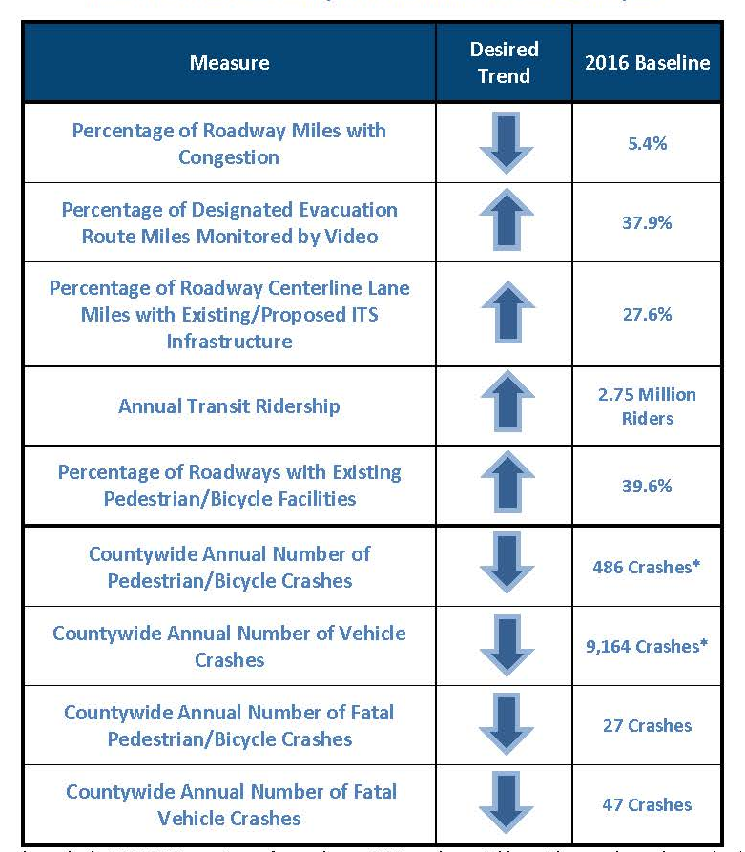
Desired
Trends
  2016 Established baseline of where the system was
  Identified desired trend
Notes:
Here is the table used showing all nine measures, what our baseline numbers were, when we started the corridor analysis and what our desired trend is for each.

Slide 19
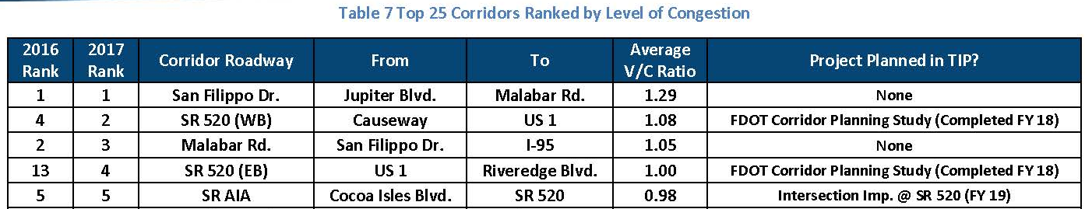
Roadway Congestion
  Analysis of current volume over capacity
  Presentation to committee’s and board included jurisdiction and maintaining agency information
  Are corridor improvements already being addressed in TIP?
    Used to assist locals when submitting project priority applications
Notes:
Remember each criteria or measure has its own ranking of corridors. The first measure is the oldest related to congestion. We take latest traffic volume over capacity of the corridor and if the ratio is .85 or higher, the corridor is considered congested. The table on this slide shows our top 5 highest congested corridors in 2017. Also, it includes whether or not the corridor has a project planned on it in the TIP. For the powerpoint given to our committees and board, we also include who’s jurisdiction the corridor is in and who is the maintaining agency. This information is very useful to determine what actions to take or if there is already something in the pipeline addressing the issue.

Slide 20
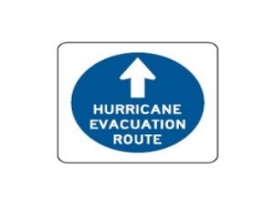
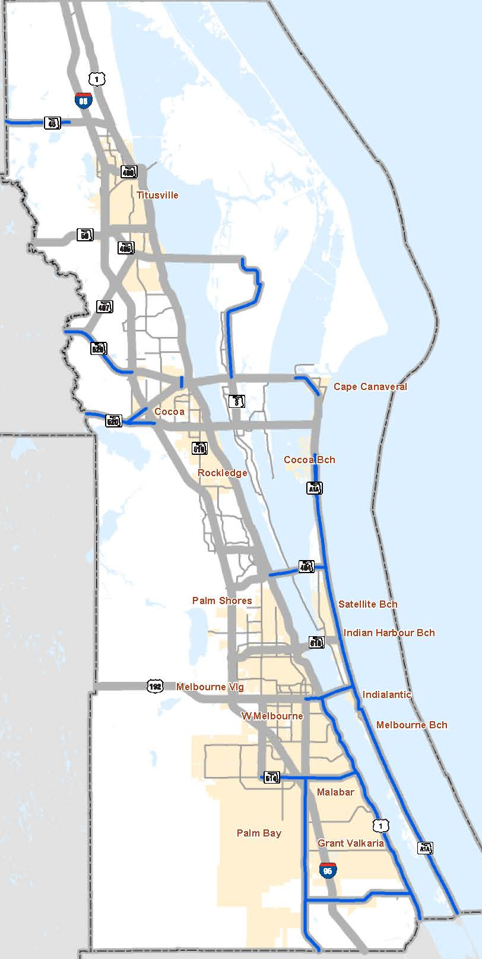
Evacuation Route Monitoring
Major Routes with No Monitoring
Roadway | Corridor | Jurisdiction | Maintaining Agency | TIP/ Priority
SR 3 | SR 528 to Space Commerce Way | Brevard County | FDOT | N
SR A1A | Indian River CL to One-Way Pairs | Multi | FDOT | N
Notes:
The next measure is percentage of designated evacuation route miles monitored by video. Being a coastal community, this criteria is very useful for planning and helping with where future TSM&O technologies should be implemented. If emergency operation funding or grants are available, the County can easily go to the list and see where there are needs, from a monitoring standpoint.

Slide 21

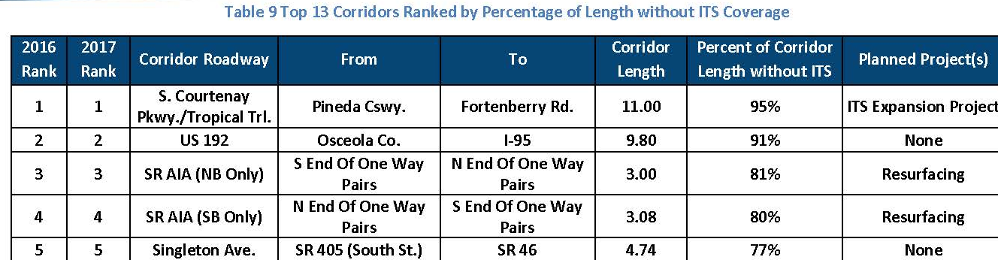
ITS Infrastructure
Notes:
Percentage of roadway centerline lane miles with existing/proposed ITS infrastructure – from TPO’s ITS Master Plan – identifies gaps in system and useful when district is planning projects. Note that the table also shows resurfacing which is an excellent opportunity to piggyback onto other projects to get infrastructure such as fiber included.

Slide 22
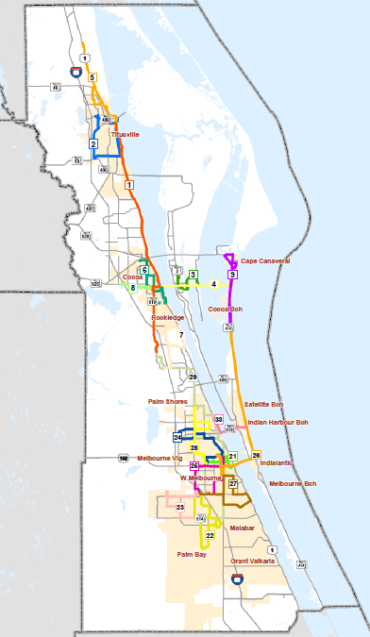
Transit Ridership
Route # | Roadway | Corridor | Ridership
4 | SR 520 | Humphrey Bridge to S. Banana | 123,298
4 | SR 520 | Merritt Island Causeway to SR A1A | 108,213
1 | US 1 | SR 528 to SR 405 | 74,768
1, 6, 8 | SR 520 | I-95 to US 1 | 49,575
TPO’s current ADA Bus Stop Analysis Update includes a route ridership survey. The 2018 data will provide detailed information by route and individual bus stop.
Notes:
The annual transit ridership measure: The data shows where routes are doing well; can be crossed referenced to lists of where bike/ped resources should be supported and put in place if not already built. Also useful to reference when resurfacing or another project arises as the ADA bus stop list can be used and stops upgraded.

Slide 23


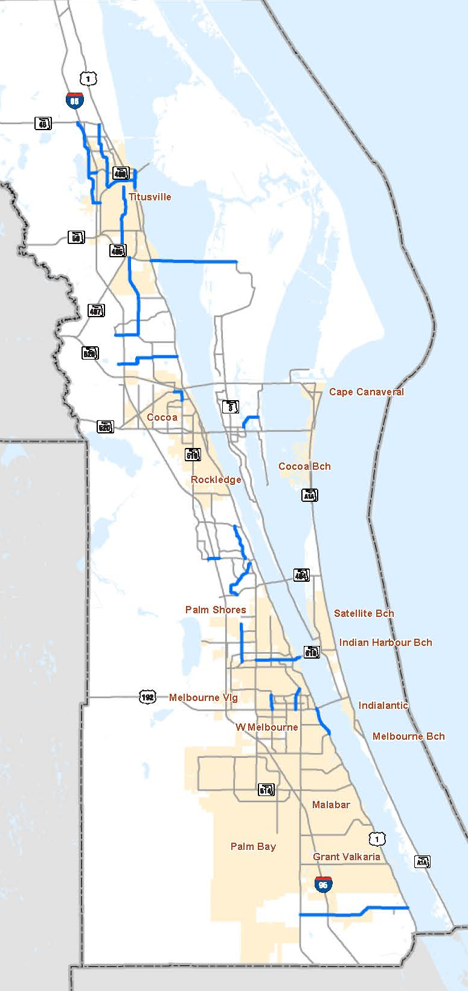
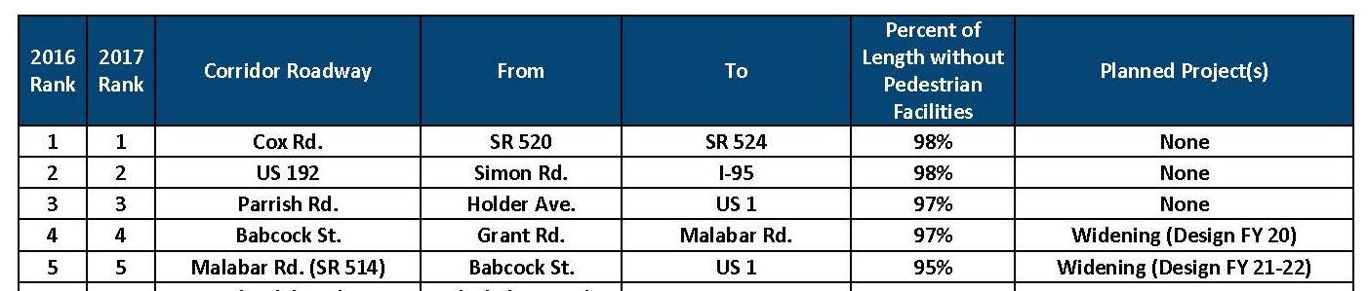
Bicycle/Pedestrian Facilities
  Corridors ranked by % of corridor without facilities.
  Bicyclist and Pedestrian facilities presented and ranked separately
Notes:
Brevard County, along with many other counties in Florida, is unfortunately ranked very high in bicycle and pedestrian crashes and fatalities. As such, these users and their facility needs are included as one of the measures. Corridors are ranked based upon the percentage of length the corridor is without facilities. Pedestrian and bicycle facilities are separated and ranked separately.

Slide 24
Baseline Corridor Measures
Measure | Desired Trend | 2016 Baseline | 2017 Baseline | Actual Trend
% Roadway Miles with Congestion |  | 5.4% | 7.8%
% Evacuation Route Miles Monitored |  | 37.9% | 37.9%
% Roadway Miles with Existing ITS Infrastructure |  | 27.6% | 27.2%
Annual Transit Ridership |  | 2.75 Million Riders | 2.54 Million Riders
% Roadways with Existing Ped/Bike Facilities |  | 39.6% | 38.6%
Notes:
In summary of the first five measures, we can view a snapshot of how the SOS network is performing.

Slide 25
SAFETY ANALYSIS
Notes:
The next four measures focus on safety.

Slide 26
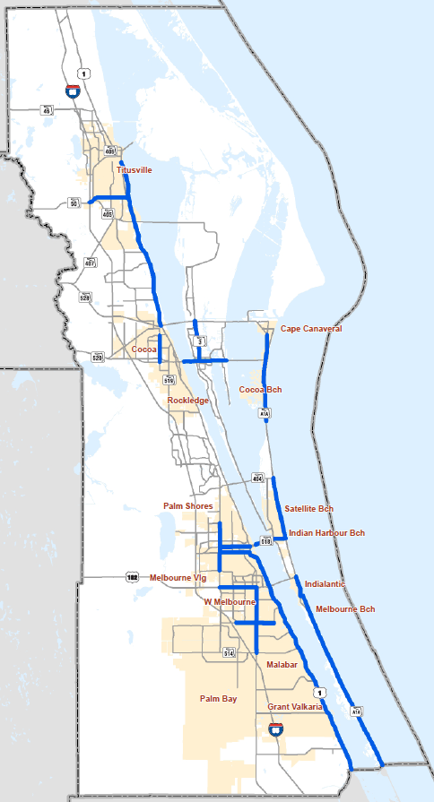
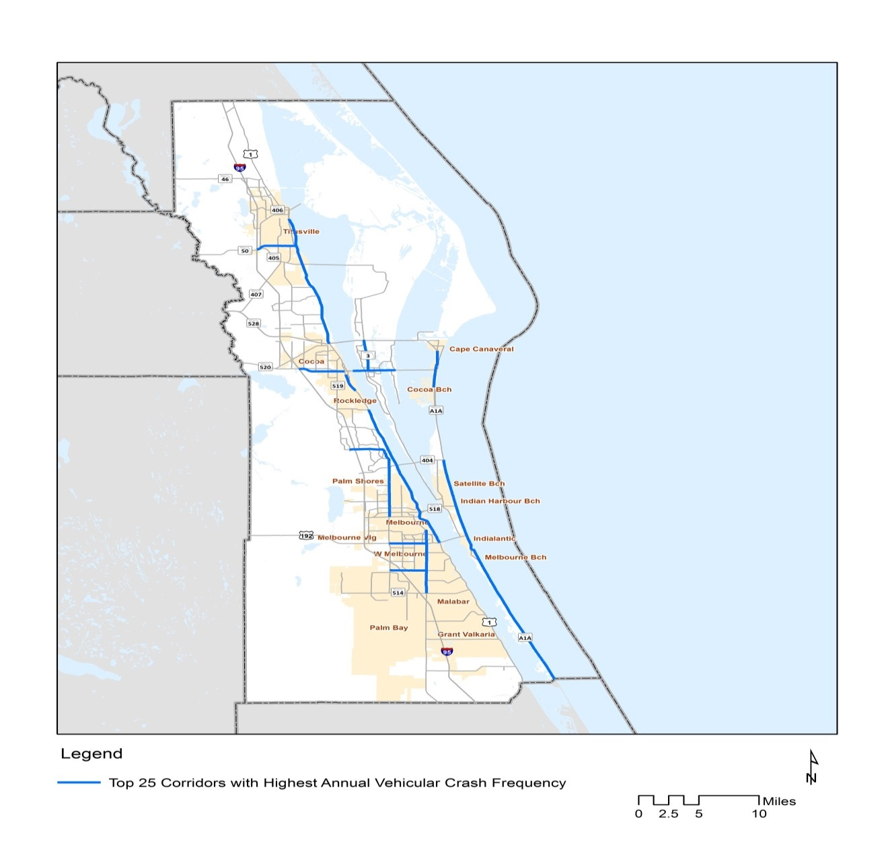
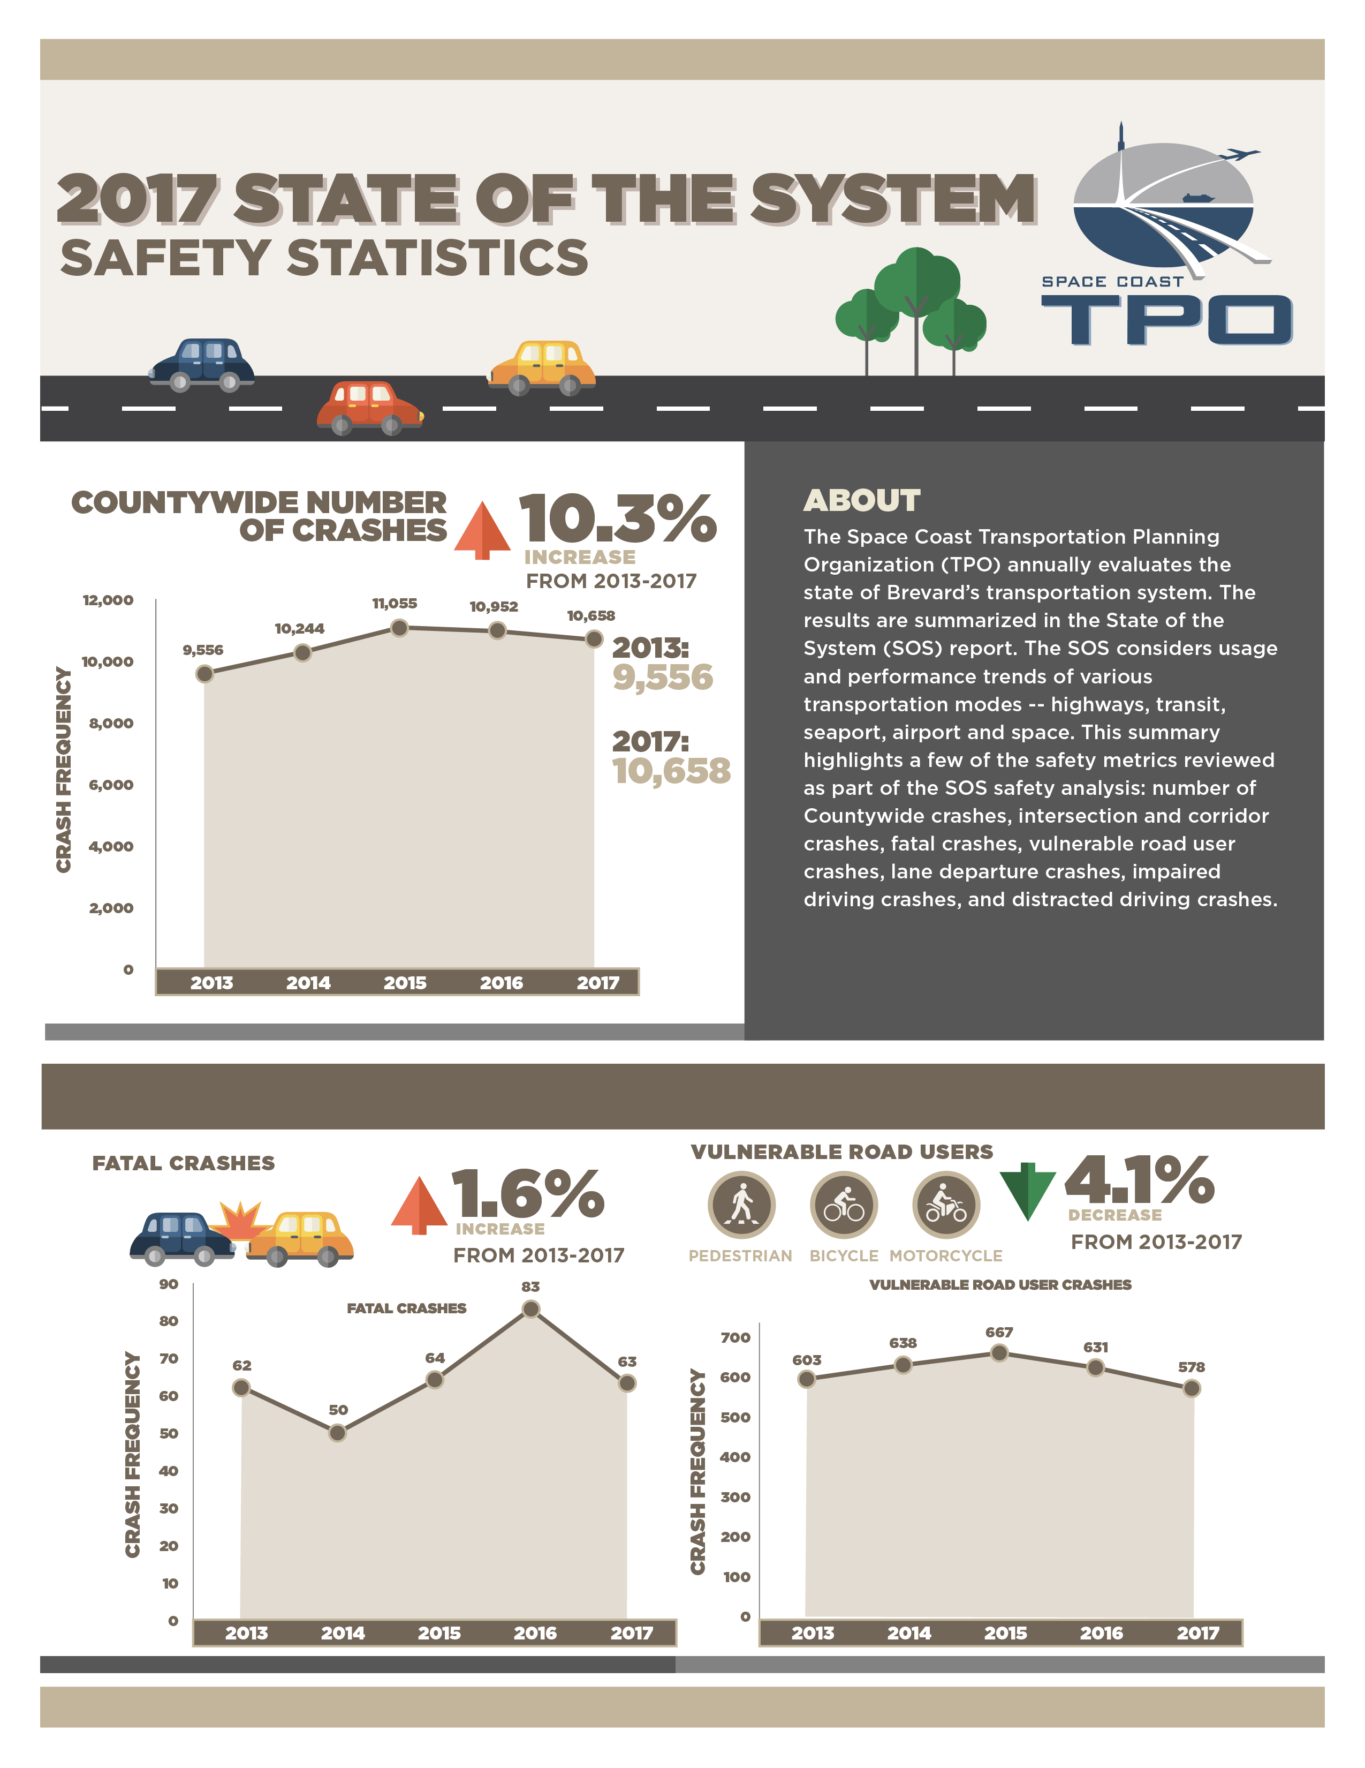

Overall Crash Trends
Overall Crash Frequency
#1 US 192 from Wickham to Babcock (199/year)
#2 SR 3 from SR 520 to SR 528 (179/year)
#3 Babcock Street from Palm Bay to US 192 (155/year)
Notes:
We have adjusted our reporting method to be consistent with the state and how the federal performance measures are being addressed. The first safety measure is just vehicle crash frequency. The number presented is the average over the latest five year reporting period.

Slide 27
Fatal & Vulnerable Users Crash Trends
Notes:
Within the safety analysis, we also include looking at overall trends. This includes fatal crashes and vulnerable road user crashes.

Slide 28
Annual Pedestrian Crashes
Roadway | Corridor | Crash Frequency | Jurisdiction | Maintaining Agency | TIP/Priority
#1 and #2 SR A1A | Cocoa Isles to N. Atlantic | 5.6 and 4.6/year | Cocoa Beach; Cape Canaveral | FDOT | Y-Intersection Improvements
#3 US 1 | SR 528 to SR 405 | 4.2/year | Titusville | FDOT | N
#4 Wickham | Sarno to Parkway | 4.0/year | Melbourne | Brevard County | Y-Corridor Study; Intersection Improvements
#5 Palm Bay | Babcock to RJ Conlan | 3.8/year | Palm Bay | Brevard County | N
Notes:
The number of pedestrian crashes on the corridors is reported as the average over the last five years, consistent with the Federal Performance Measure.

Slide 29
Annual Bicycle Crashes
Roadway | Corridor | Crash Frequency | Jurisdiction | Maintaining Agency | TIP/Priority
#1 US 192 | Wickham to Babcock | 6.4/year | West Melbourne; Melbourne | FDOT | Y – Intersection Improvements
(US 192 also ranked #1 in overall number of crashes at 199/year)
#2 SR 3 | SR 520 to SR 528 | 6.0/year | Brevard County | FDOT | Y – Lighting Project; Corridor Study
(SR 3 also ranked #2 in overall number of crashes at 179/year)
#3 and #4 SR A1A | Cocoa Isles to N. Atlantic | 5.6 and 5.0/year | Cocoa Beach; Cape Canaveral | FDOT | Y – Corridor Study; Intersection Improvements
#5 Babcock | Palm Bay to US 192 | 5.0/year | Melbourne | FDOT | Y – Corridor Study
(Babcock also ranked #3 in overall number of crashes at 155/year)
Notes:
For the frequency of bicycle crashes table, we also included cross references to corridors that also ranked high in overall crash frequency to reflect the correlation of crashes.

Slide 30
Baseline Corridor Safety Measures
Measure | Desired Trend | 2016 Baseline | 2017 Baseline | Actual Trend
Annual Ped/Bike Crashes (5 Year Average) |  | 486 Crashes | 507 Crashes
Annual Vehicle Crashes (5 Year Average) |  | 9,164 Crashes | 9,989 Crashes
Annual Fatal Ped/Bike Crashes (5 Year Average) |  | 27 Crashes | 30 Crashes
Annual Fatal Vehicle Crashes (5 Year Average) |  | 47 Crashes | 51 Crashes
Notes:
And in summary, we show how the actual trends compare to the desired trend for each measure.

Slide 31
SOS Program

Slide 32
Development Schedule
April/May
April – Scope Developed
May – NTP Issued
May/June
Prior calendar year traffic volumes collected, validated by May/June each year
July/August
Draft Analysis
Crash data obtained; update of data for all metrics; obtain modal data
September
Findings Presented; draft report
October
Final Report
SCTPO
Consultant Services Annual Cost = $63,000
Notes:
All of this work takes about six months. Annually, a scope is developed with a notice to proceed usually issued in May. Prior year traffic volumes should be validated and completed by this time and are supplied to our consultant. The summer months are used to compile and conduct the analysis and gather modal data. Findings are presented in September, which in most years, coincides with when we present our Project Priorities. This is done to show the link between the SOS data and support for the projects on the TPO’s priority list. The final report then, is published by the end of October.
Due to staffing limitations, the Space Coast TPO does use one of its general planning consultants, which is currently Kittelson & Associates, at a cost of $63,000.
The cost, however is only for the analysis and report. The TPO’s traffic data collection program which collects the volumes used in the SOS is about another $65,000 per year. Data is collected in January-March and then again in October-December.

Slide 33
Future
Impact of more data
Integrate real-time data = reliability of system performance
SCTPO hired GIS Transportation Data Analyst – some analysis to be performed in-house, result in reduction of consultant use
Notes:
What’s in the future? What are looking at doing next?
Technology will play a large role in provided more real time data. One area that can be better reported on is how well are our investments are performing after improvements are implemented? This is reviewed each year now but could become more elaborate.
Integration of more system performance if necessary.
We have just hired a GIS Transportation Data Analyst that will hopefully be able to perform more of the analysis in-house. And as technology advances continue, the state of the system can hopefully one day be just a click away with real time analysis and reliability.

Slide 34
Implementing in Your Area
Need good data
Crash data is now available from Signal 4
Identify network to analyze. Determine what corridors have existing data
Conduct in-house or outsource to a consultant
It’s another tool in the tool box, but is a really good one!
Include in your next UPWP
Notes:
Considering this could be something you want to start up and implement?
Key items to consider.
First, you need to find good data. The SCTPO was fortunate in that we have a long history of collecting traffic counts throughout the system. FDOT has increased their locations and can be a good starting point if one has no local data.
Crash data is now available from UofF Signal 4. CARS is also good, but will always lag further behind than signal 4.
Identify your network, be sure to have readily available data sources to use.
Determine what modes you want to monitor. Start building the file/framework to conduct the analysis. A standard format should be created so analysis can be easily duplicated from year to year. May want to consider hiring a consultant to perform, or at least to set up for first year.
Remember this is only a ‘snapshot’ in time of how system is performing. It’s another tool in the tool box, but is a really good one!
Finally, be sure to integrate into your planning processes and include in UPWP.

Slide 35
QUESTIONS ?

