Slide 1

Sarasota/Manatee MPO
April, 2019
Leigh Holt, Strategic Planning Manager

Slide 2
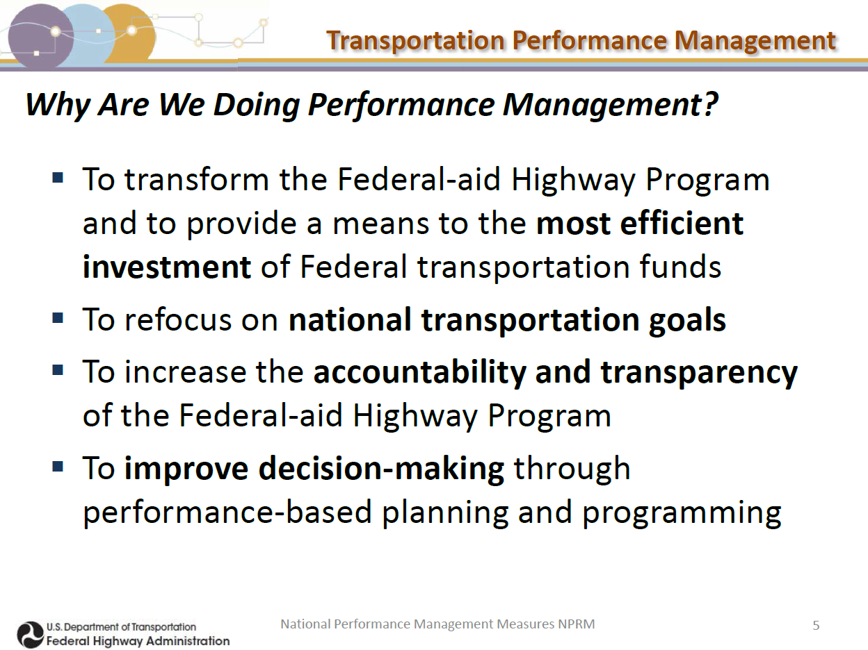
1. It’s the LAW so we HAVE TO


Slide 3
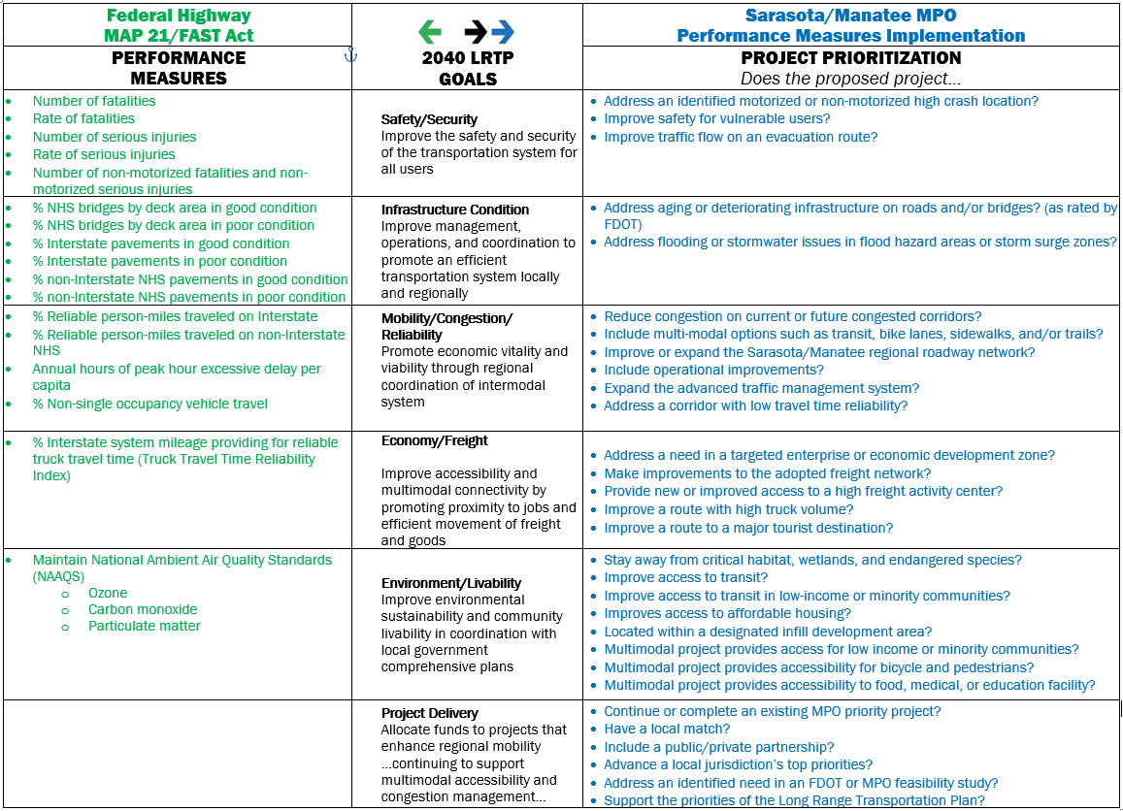
Number of fatalities Rate of fatalities Number of serious injuries Rate of serious injuries Number of non-motorized fatalities and non-motorized serious injuries | Safety/Security Improve the safety and security of the transportation system for all users | Address an identified motorized or non-motorized high crash location? Improve safety for vulnerable users? Improve traffic flow on an evacuation route?
% NHS bridges by deck area in good condition % NHS bridges by deck area in poor condition % Interstate pavements in good condition % Interstate pavements in poor condition % non-Interstate NHS pavements in good condition % non-Interstate NHS pavements in poor condition | Infrastructure Condition Improve management, operations, and coordination to promote an efficient transportation system locally and regionally | Address aging or deteriorating infrastructure on roads and/or bridges? (as rated by FDOT) Address flooding or stormwater issues in flood hazard areas or storm surge zones?
% Reliable person-miles traveled on Interstate % Reliable person-miles traveled on non-Interstate NHS Annual hours of peak hour excessive delay per capita % Non-single occupancy vehicle travel | Mobility/Congestion/ Reliability Promote economic vitality and viability through regional coordination of intermodal system | Reduce congestion on current or future congested corridors? Include multi-modal options such as transit, bike lanes, sidewalks, and/or trails? Improve or expand the Sarasota/Manatee regional roadway network? Include operational improvements? Expand the advanced traffic management system? Address a corridor with low travel time reliability?
% Interstate system mileage providing for reliable truck travel time (Truck Travel Time Reliability Index) | Economy/Freight Improve accessibility and multimodal connectivity by promoting proximity to jobs and efficient movement of freight and goods | Address a need in a targeted enterprise or economic development zone? Make improvements to the adopted freight network? Provide new or improved access to a high freight activity center? Improve a route with high truck volume? Improve a route to a major tourist destination?
Maintain National Ambient Air Quality Standards (NAAQS) Ozone Carbon monoxide Particulate matter | Environment/Livability Improve environmental sustainability and community livability in coordination with local government comprehensive plans | Stay away from critical habitat, wetlands, and endangered species? Improve access to transit? Improve access to transit in low-income or minority communities? Improves access to affordable housing? Located within a designated infill development area? Multimodal project provides access for low income or minority communities? Multimodal project provides accessibility for bicycle and pedestrians? Multimodal project provides accessibility to food, medical, or education facility?
 | Project Delivery Allocate funds to projects that enhance regional mobility …continuing to support multimodal accessibility and congestion management… | Continue or complete an existing MPO priority project? Have a local match? Include a public/private partnership? Advance a local jurisdiction’s top priorities? Address an identified need in an FDOT or MPO feasibility study? Support the priorities of the Long Range Transportation Plan?
Number of fatalities Rate of fatalities Number of serious injuries Rate of serious injuries Number of non-motorized fatalities and non-motorized serious injuries | Safety/Security Improve the safety and security of the transportation system for all users | Address an identified motorized or non-motorized high crash location? Improve safety for vulnerable users? Improve traffic flow on an evacuation route?
% NHS bridges by deck area in good condition % NHS bridges by deck area in poor condition % Interstate pavements in good condition % Interstate pavements in poor condition % non-Interstate NHS pavements in good condition % non-Interstate NHS pavements in poor condition | Infrastructure Condition Improve management, operations, and coordination to promote an efficient transportation system locally and regionally | Address aging or deteriorating infrastructure on roads and/or bridges? (as rated by FDOT) Address flooding or stormwater issues in flood hazard areas or storm surge zones?
% Reliable person-miles traveled on Interstate % Reliable person-miles traveled on non-Interstate NHS Annual hours of peak hour excessive delay per capita % Non-single occupancy vehicle travel | Mobility/Congestion/ Reliability Promote economic vitality and viability through regional coordination of intermodal system | Reduce congestion on current or future congested corridors? Include multi-modal options such as transit, bike lanes, sidewalks, and/or trails? Improve or expand the Sarasota/Manatee regional roadway network? Include operational improvements? Expand the advanced traffic management system? Address a corridor with low travel time reliability?
% Interstate system mileage providing for reliable truck travel time (Truck Travel Time Reliability Index) | Economy/Freight Improve accessibility and multimodal connectivity by promoting proximity to jobs and efficient movement of freight and goods | Address a need in a targeted enterprise or economic development zone? Make improvements to the adopted freight network? Provide new or improved access to a high freight activity center? Improve a route with high truck volume? Improve a route to a major tourist destination?
Maintain National Ambient Air Quality Standards (NAAQS) Ozone Carbon monoxide Particulate matter | Environment/Livability Improve environmental sustainability and community livability in coordination with local government comprehensive plans | Stay away from critical habitat, wetlands, and endangered species? Improve access to transit? Improve access to transit in low-income or minority communities? Improves access to affordable housing? Located within a designated infill development area? Multimodal project provides access for low income or minority communities? Multimodal project provides accessibility for bicycle and pedestrians? Multimodal project provides accessibility to food, medical, or education facility?
 | Project Delivery Allocate funds to projects that enhance regional mobility …continuing to support multimodal accessibility and congestion management… | Continue or complete an existing MPO priority project? Have a local match? Include a public/private partnership? Advance a local jurisdiction’s top priorities? Address an identified need in an FDOT or MPO feasibility study? Support the priorities of the Long Range Transportation Plan?
1. It’s the LAW so we HAVE TO

Slide 4
2. Make it about MONEY
Performance Measures
IMPLEMENTATION
Reviewed 2040 Long Range Transportation Plan Goals
Collected and analyzed consistent, readily available data
Aligned MPO project prioritization with mandated performance measures
Implemented new scoring criteria with call for projects
Continued sharing of information
Continued reporting results
  Invest resources in
  projects
  to achieve individual
  targets
  that collectively will make progress toward national
  goals.

Slide 5
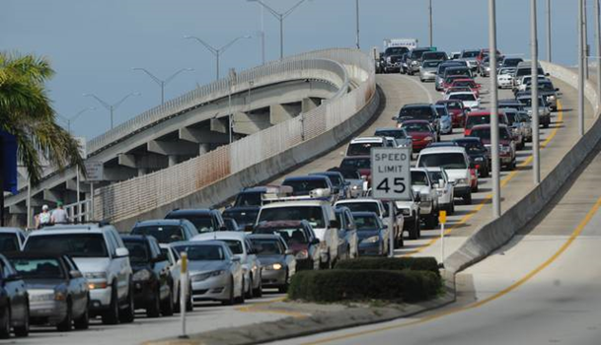
2. Make it about MONEY
SAFETY/SECURITY:
High Crash Location
Evacuation Route
INFRASTRUCTURE CONDITION:
Fair
MOBILITY/CONGESTION/RELIABILITY:
Low Reliability
High Congestion
ECONOMY/FREIGHT:
High Truck Volume
Major Commuter Route
ENVIRONMENT/LIVABILITY:
Storm Surge/Flood Zones
No Pedestrian/Bike Facilities
Desoto Bridge
$7.5 Million
for PD&E

Slide 6
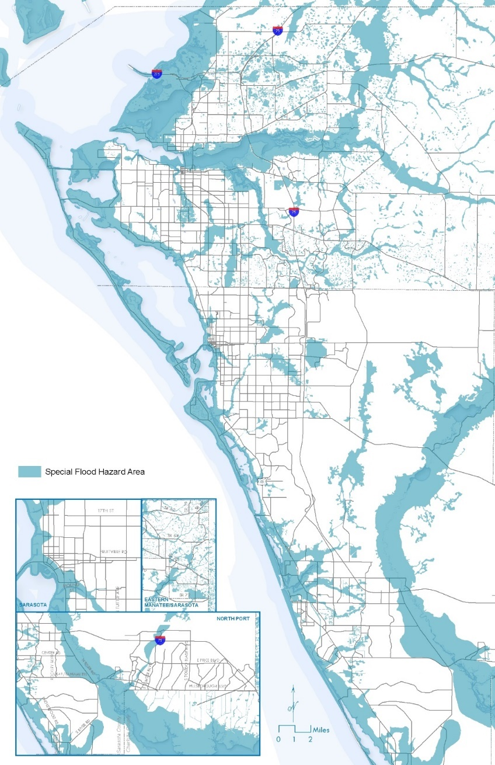
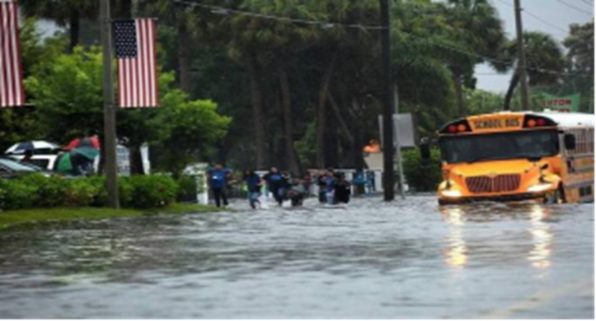
3. It’s a chance to CHANGE for the better
Special Flood Hazard Area
INFRASTRUCTURE CONDITION
Maintain highway infrastructure in a state of good repair
RESILIENCY: Improve the resiliency and reliability of the transportation system and reduce or mitigate stormwater impacts of surface transportation.
FAST Act

Slide 7
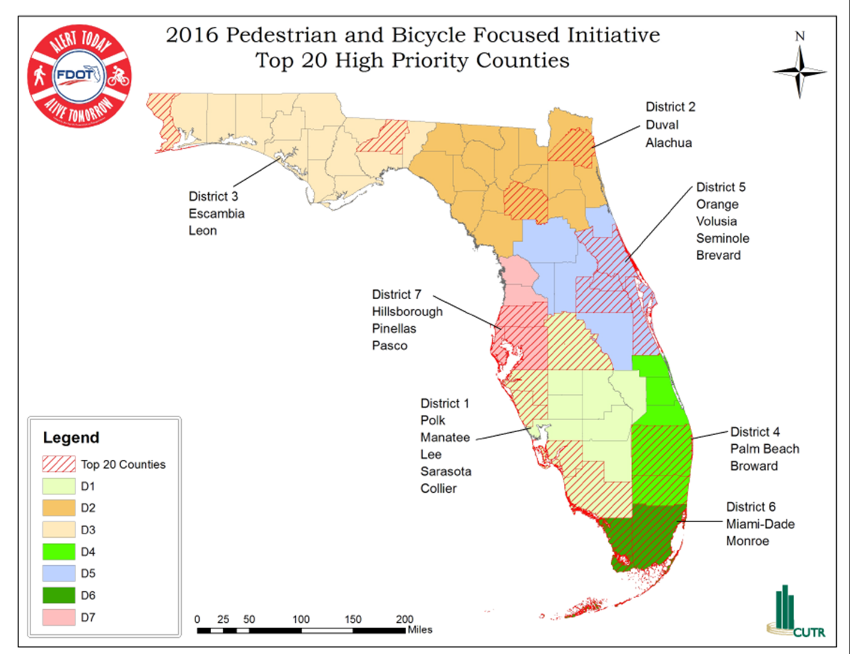
4. Take your TIME and tell the story
Florida Top 20 Counties
Pedestrian and Bicycle
Injuries and Deaths
MAP 21 / FAST Act SAFETY AND SECURITY
Significant reduction in traffic fatalities and serious injuries on all public roads
#4
Most dangerous metro area for walking in the United States
Dangerous by Design 2019

Slide 8
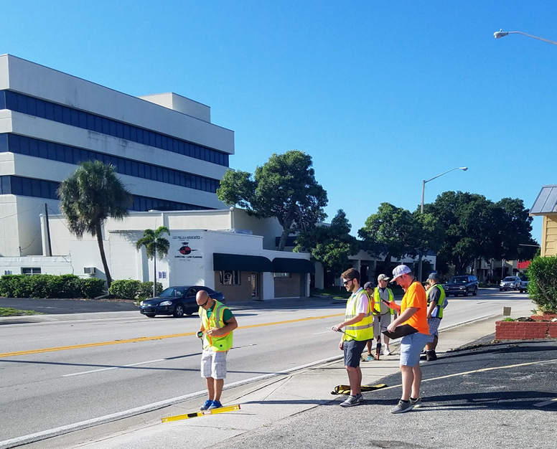

4. Take your TIME and tell the story
SAFETY TARGETS:
Number of fatalities
Rate of fatalities
Number of serious injuries
Rate of serious injuries
Number of non-motorized fatalities and non-motorized serious injuries
Safety Audits
$116,000 for Planning

Slide 9
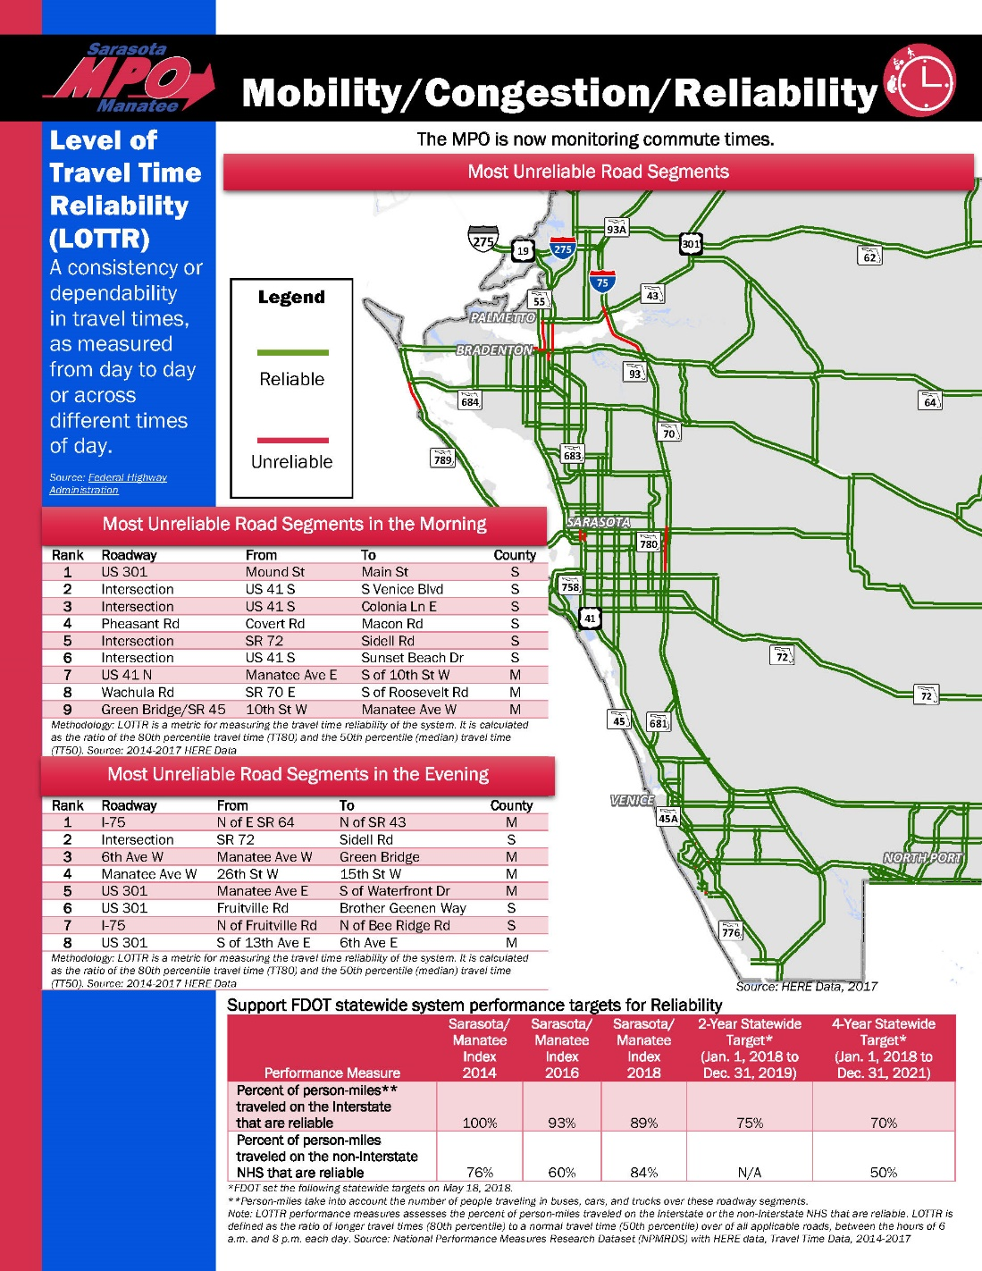
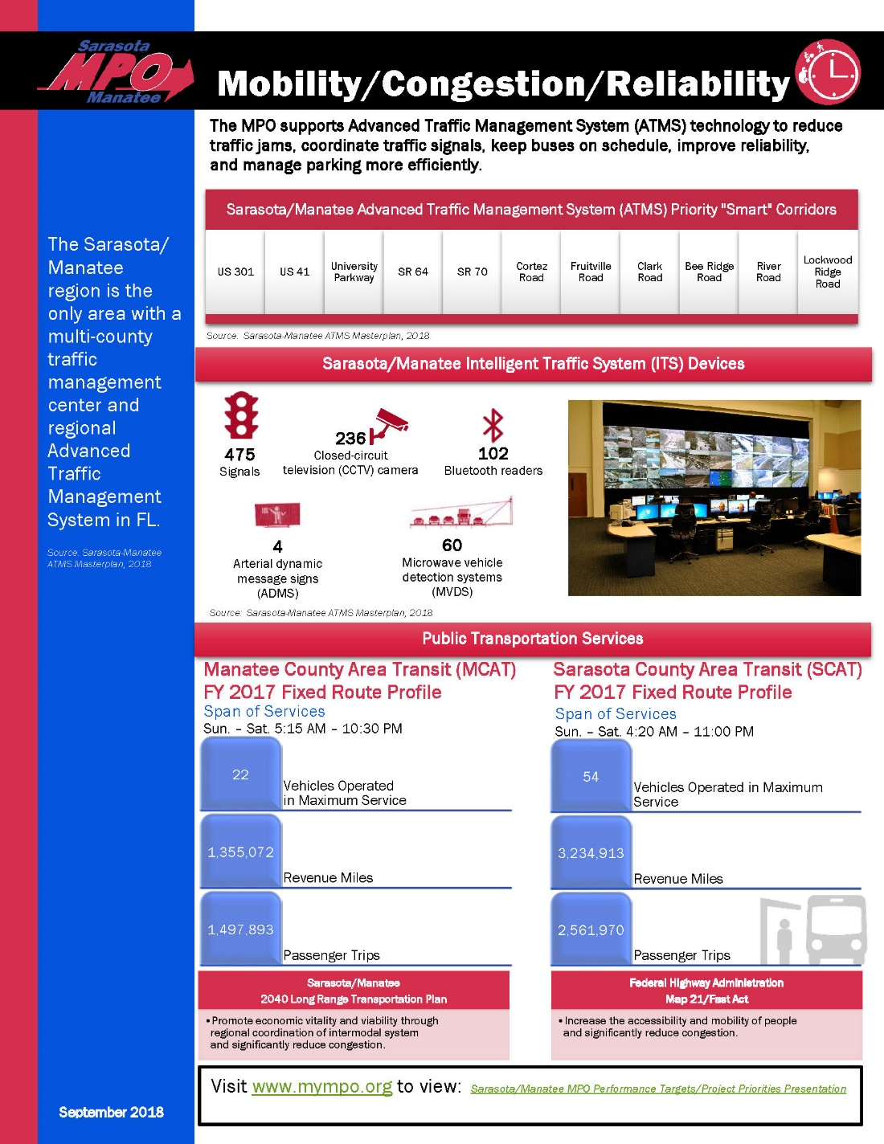
4. Take your TIME and tell the story
Notes:
Safety Fact Sheet
Here we highlighted key information from our Safety Report to keep the public informed
For example:
-Some characteristics of the Annual Average Crashes in both counties. Like modes and age group
-A Heat Map of our crash locations. Red being our highest crash locations
-Rate of Bike/Ped Injuries. Sarasota/Manatee county is above Florida’s average non-motorized injuries

Slide 10
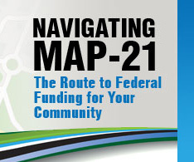
MAP-21 (2012)
Moving Ahead for Progress in the 21st Century Act
FAST Act (2015)
Fixing America’s Surface Transportation Act
5. Be the broken record. Be the broken record.
  Invest resources in projects
  to achieve individual targets that
  collectively will make progress
  toward national goals.
Notes:
- mandate

Slide 11


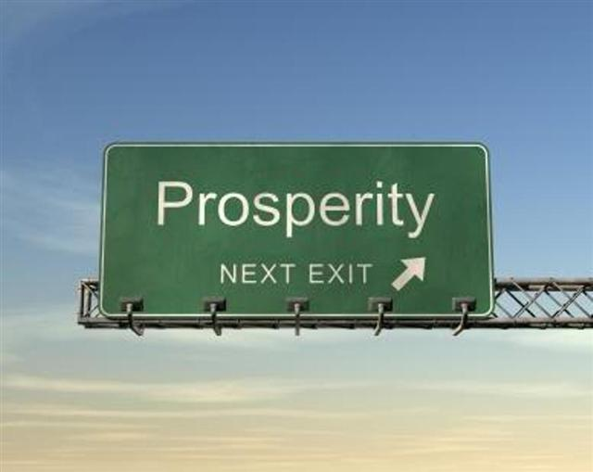
5. Be the broken record. Be the broken record.
  Invest resources in projects
  to achieve individual targets
  That collectively will make progress toward national
  goals.

Slide 12
6. Borrow from the BEST
2015 AMPO Annual Conference
Performance-Based Planning
Weighting Performance Measures as a
Method to Refine Project Evaluation
October 21, 2015
Chattanooga-Hamilton County/N. GA Transportation Planning Organization

Slide 13
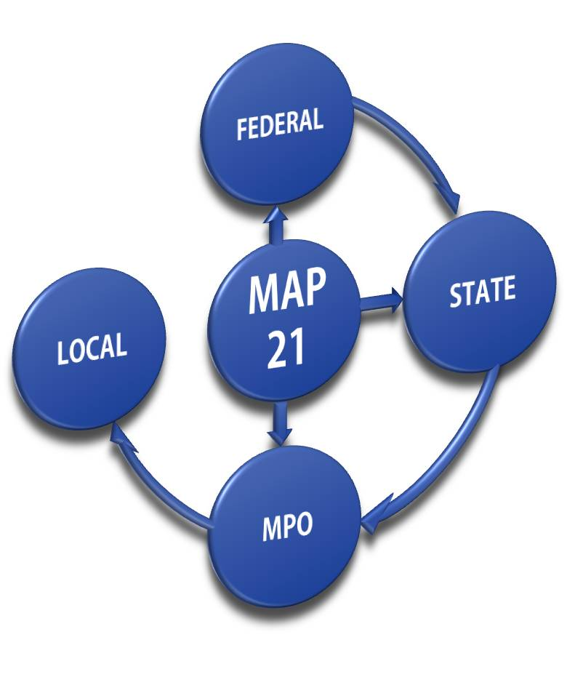

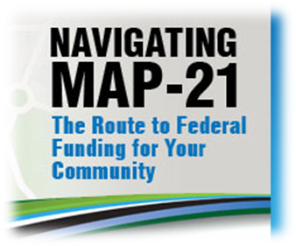




6. Borrow from the BEST
Chattanooga-Hamilton County/N. GA Transportation Planning Organization

Slide 14
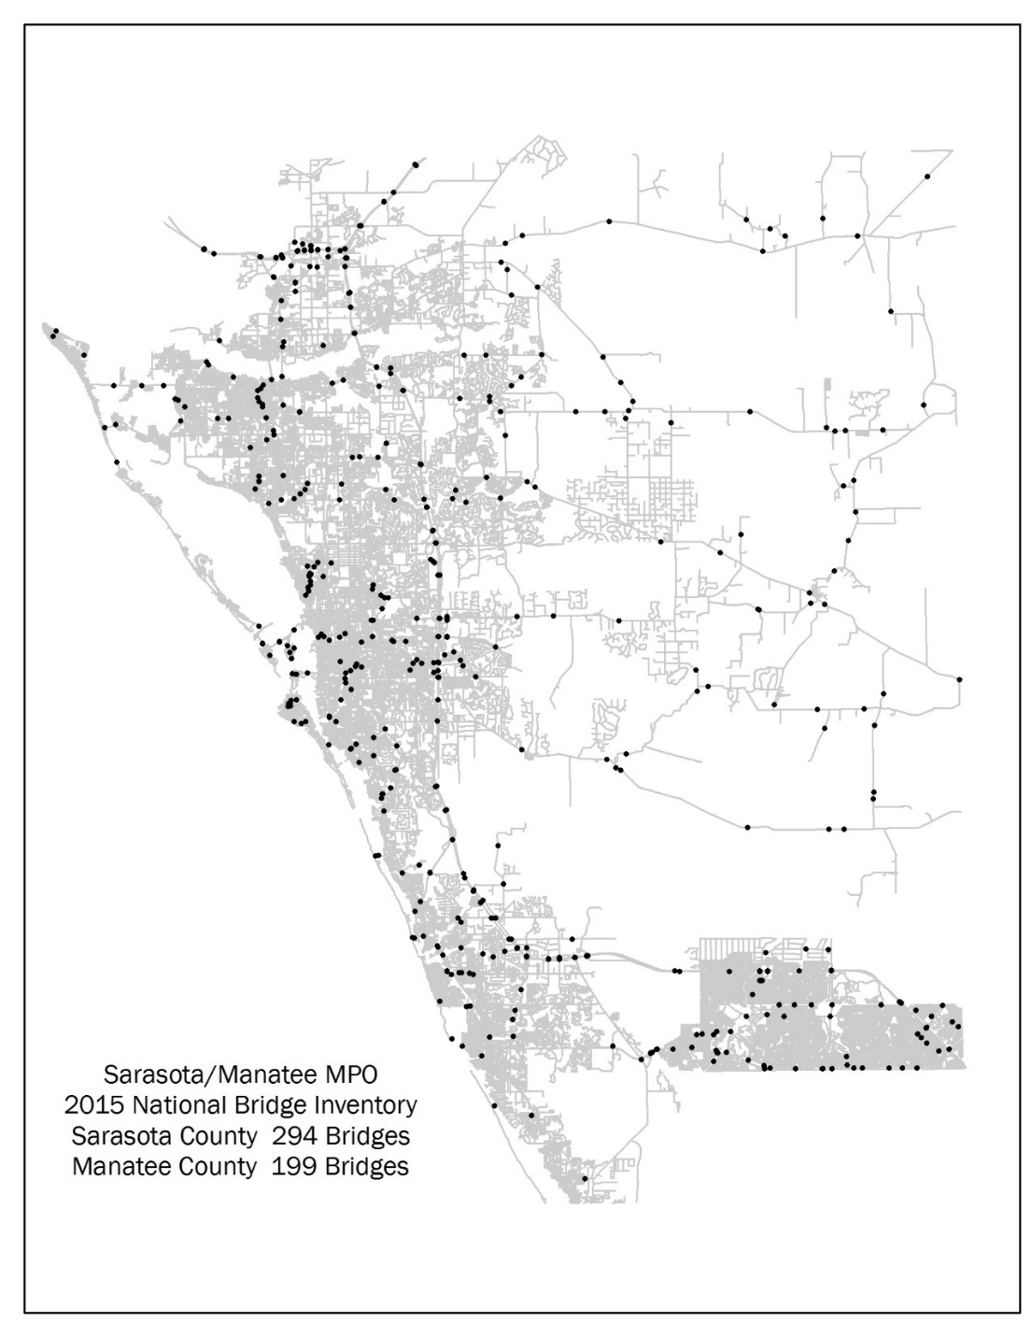
7. Dig for DATA
2015 National Bridge Inventory
  Readily available
  Easily understood
  Generally accepted
  Consistent across jurisdictions
  Supplemental to required datasets

Slide 15
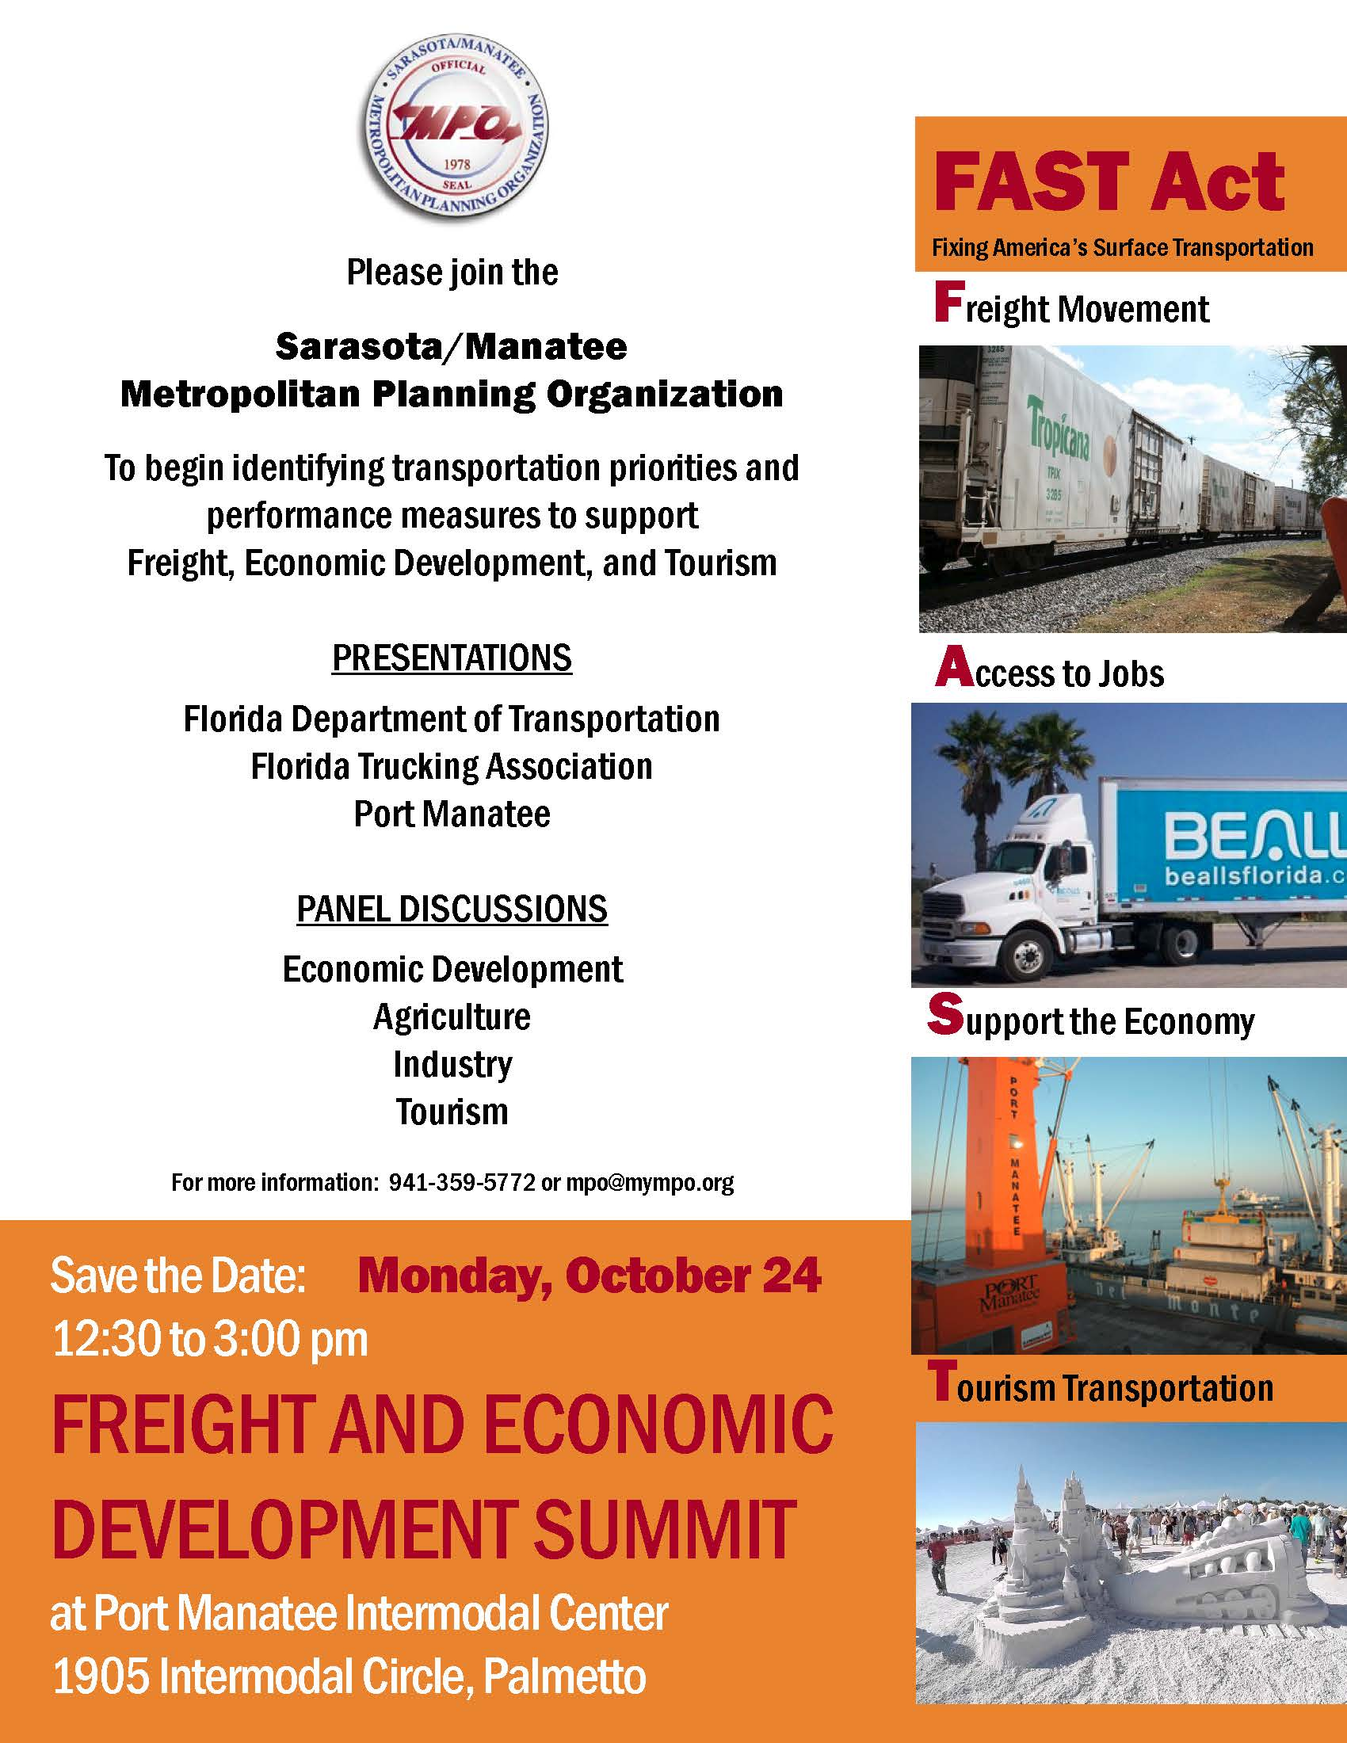
8. Seek out new STAKEHOLDERS

Slide 16
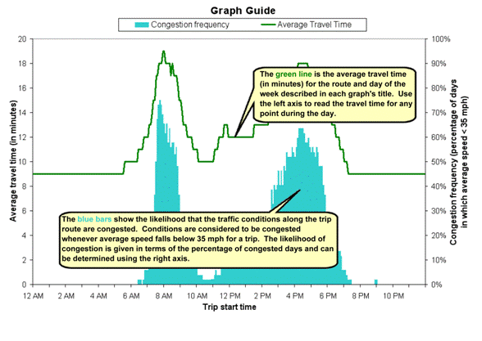
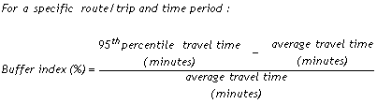
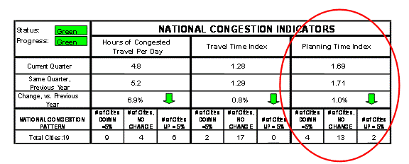

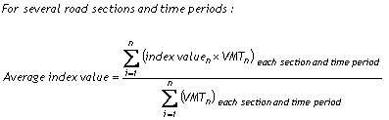
9. COMMITTEES are key
TECHNICAL ADVISORY
COMMITTEE WORKSHOPS
Board sub-commiTTEE

Slide 17
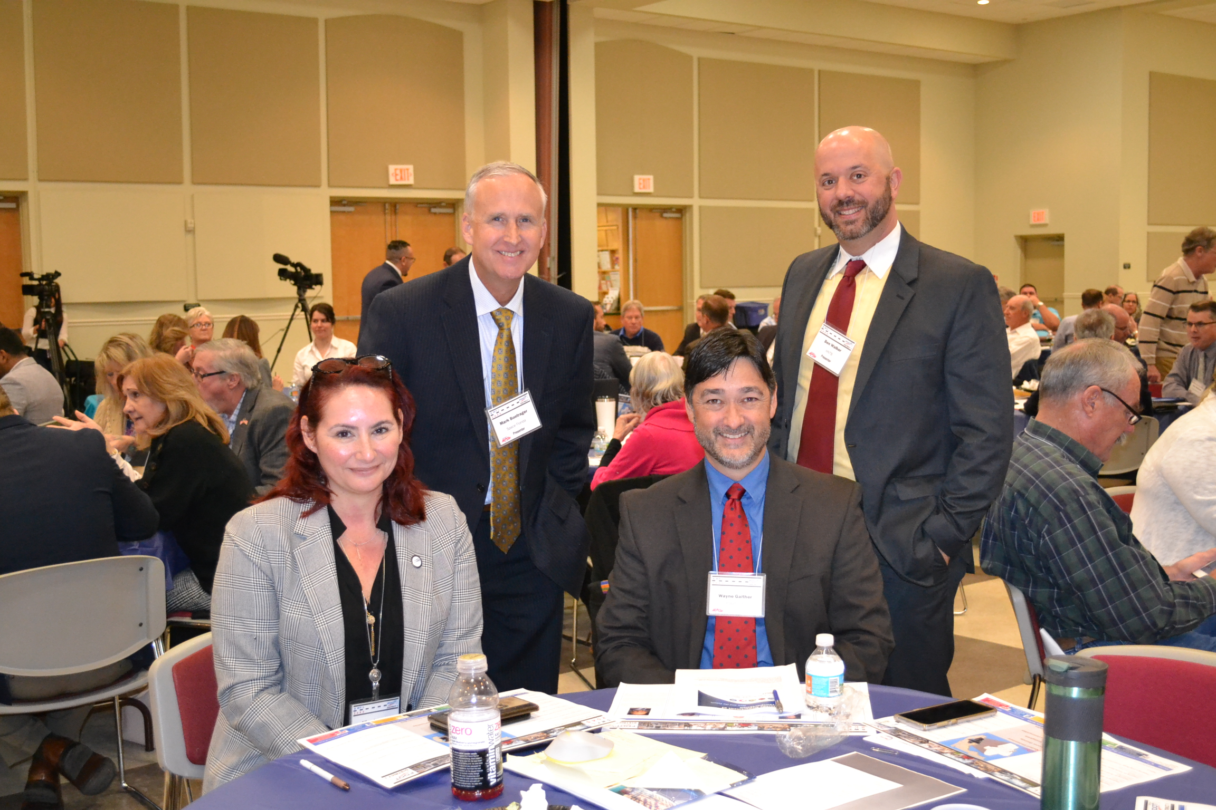
10. EXPERTS are always from out of town
  EXPERT RESOURCES
  AMPO
  Transportation for America
  FDOT
  MPOAC
  MPOs
  Universities
  State Transportation Organizations
  Regional Planning Councils
  Chambers of Commerce/Economic Development and Tourism Agencies

Slide 18
Sarasota/Manatee MPO www.mympo.org
Performance Measures

