Slide 1
West Palm Beach Tactical Urbanism
MPOAC Noteworthy Practices
April 30, 2019

Slide 2

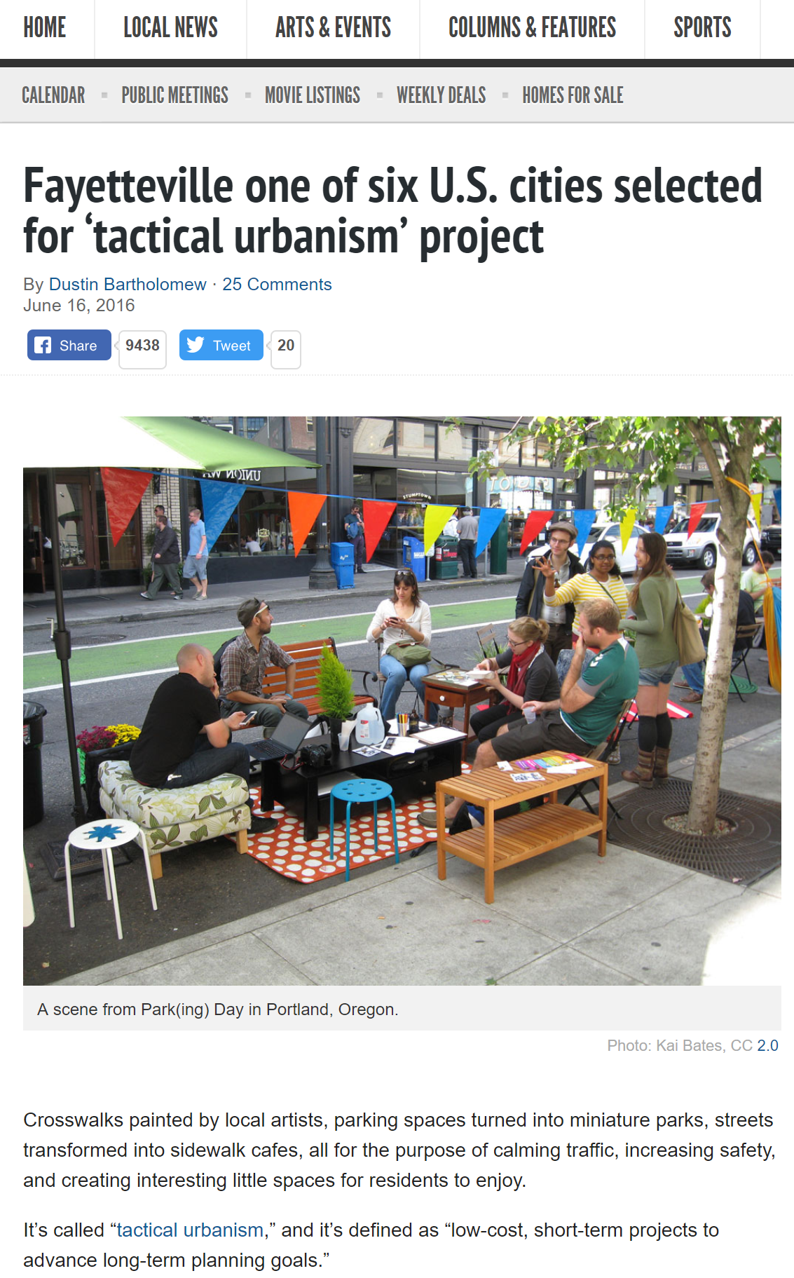
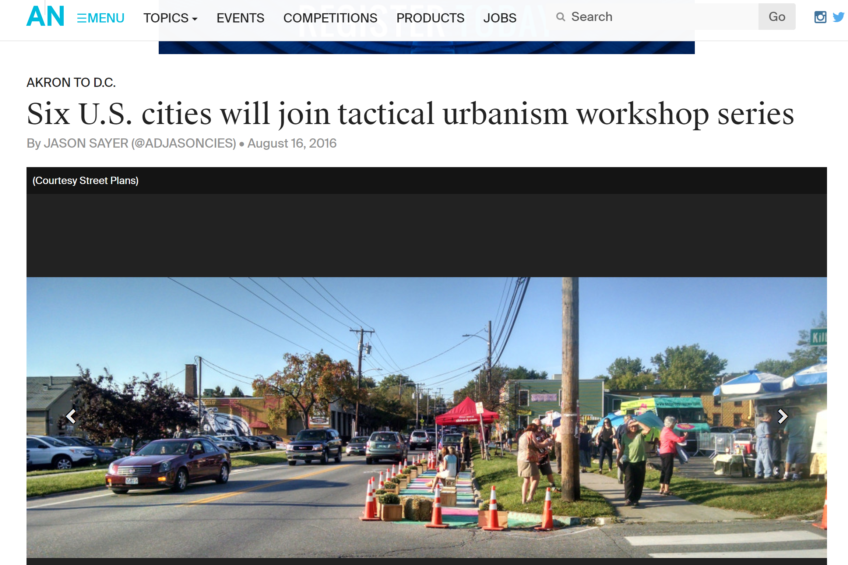
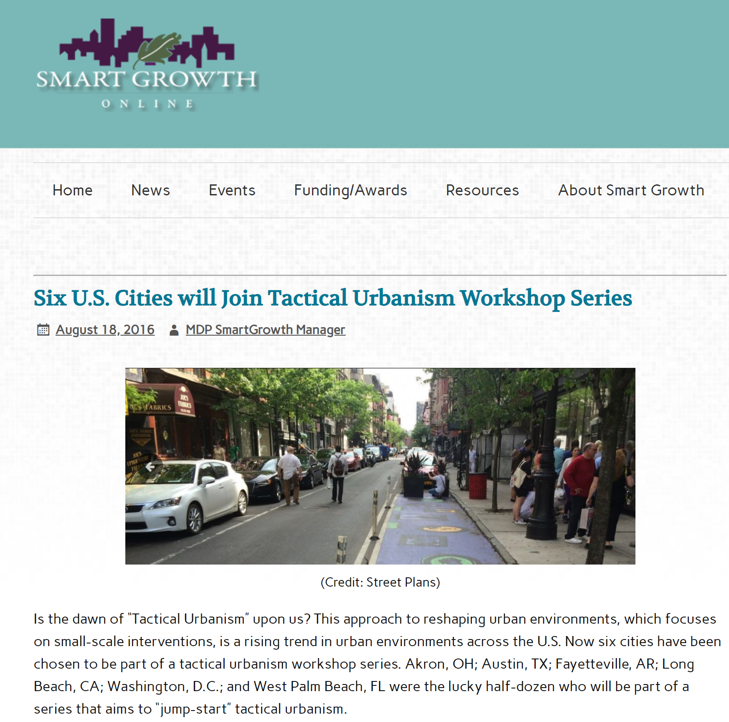
West Palm Beach Selected
6 cities selected to participate in a Tactical Urbanism project with the Street Plans Collaborative
    Akron, OH
    Austin, TX
    Fayetteville, AR
    Long Beach, CA
    Washington, DC
    West Palm Beach, FL
Notes:
In 2016-2017 West Palm Beach was selected as one of 6 cities out of 18 who applied to participate in a Tactical Urbanism project funded by the Knight Foundation and led by the Street Plans Collaborative:
Akron, OH
Austin, TX
Fayetteville, AR
Long Beach, CA
Washington, D.C.
West Palm Beach, FL

Slide 3
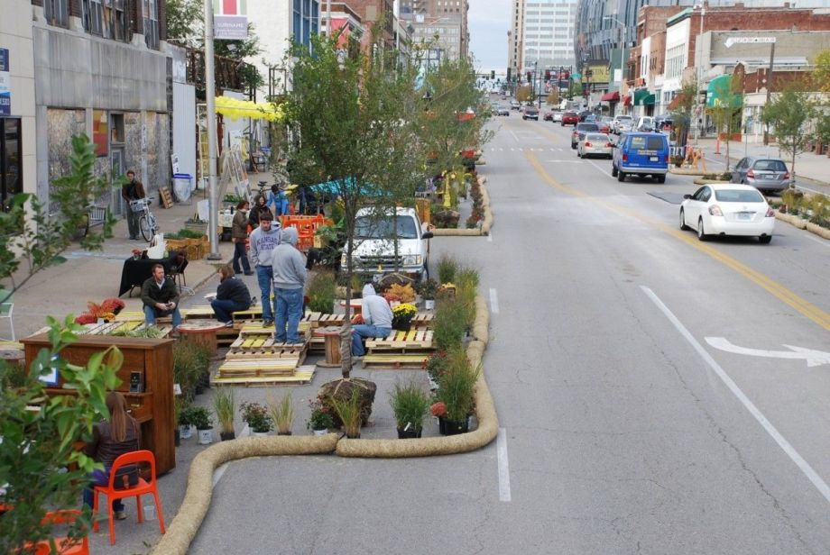
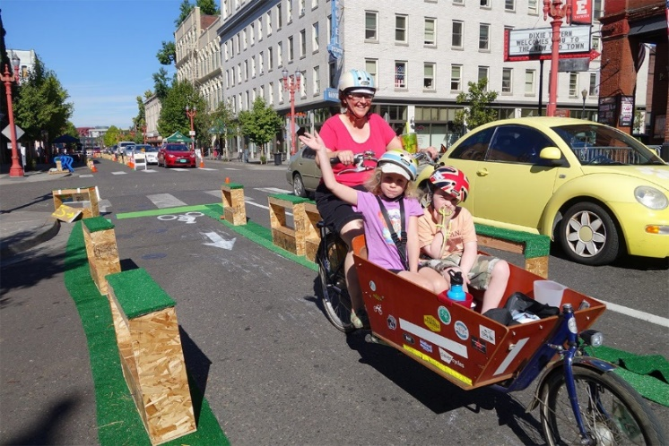
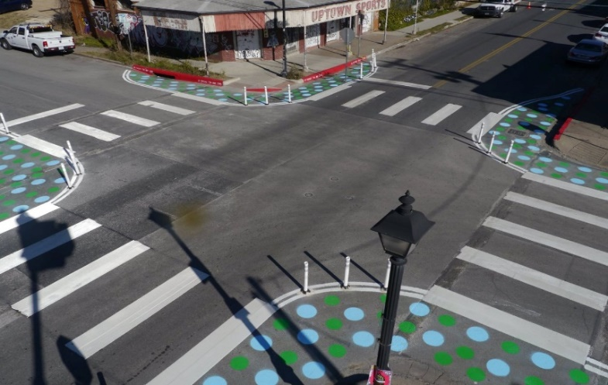
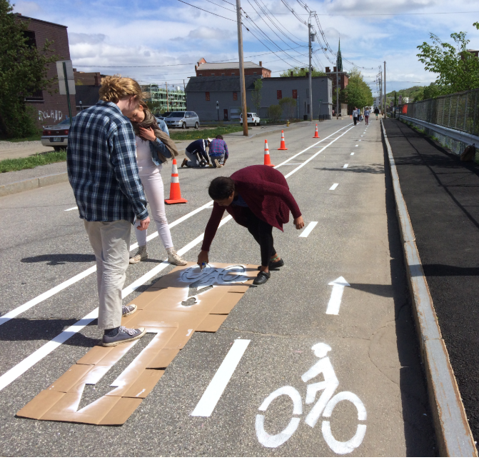
Tactical Urbanism
Low-cost, temporary changes to the built environment intended to improve local neighborhoods and gathering places to advance street safety and placemaking.
Notes:
Tactical urbanism is a type of low-cost, temporary changes to the built environment, usually in cities, intended to improve local neighborhoods and city gathering places. Ex. Pedestrian Plazas. Parklets. Pop-up Bike Lanes.
They can be used as a way to build community buy-in is to test out projects with low cost temporary interventions – sometimes referred to “Tactical Urbanism” or “Pop-Up projects” or “Pilot Projects” to test alternatives and impacts if the space were used in a different way

Slide 4
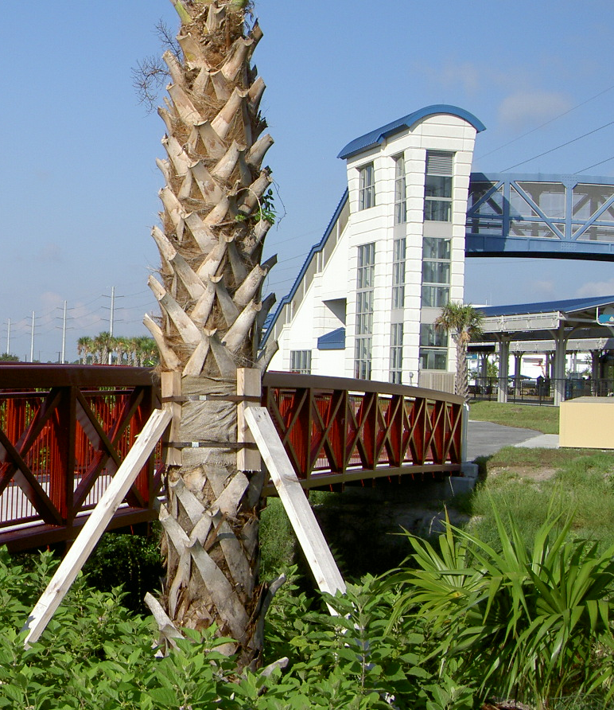
PALM BEACH TPA MISSION
To collaboratively plan, prioritize and fund the transportation system
Notes:
emphasize our mission statement and note that this was an opportunity to work collaboratively with one of our key partners even though we didn’t initiate the project

Slide 5
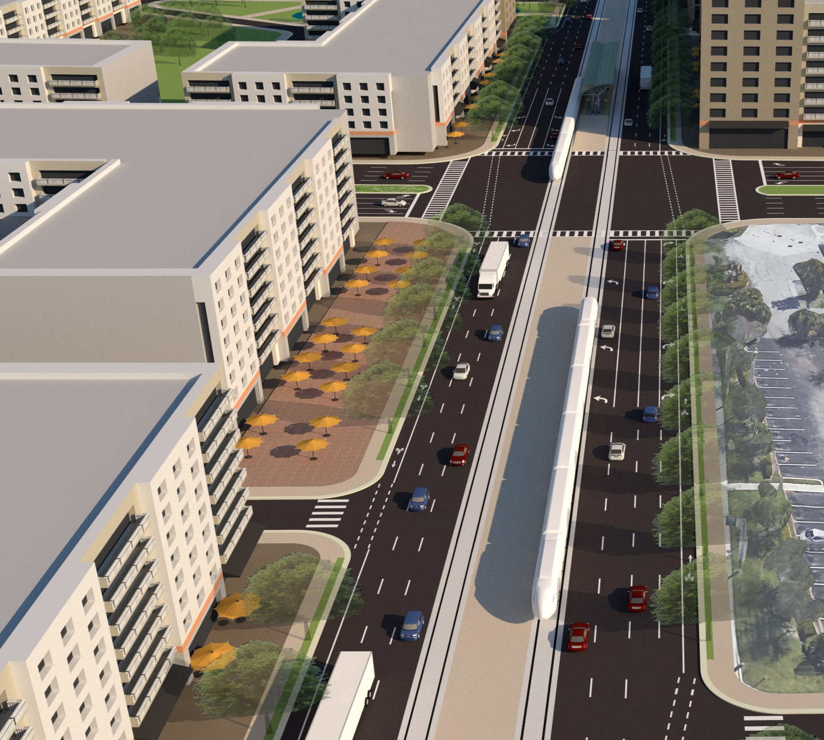
PALM BEACH TPA VISION
A safe, efficient,
and connected multimodal transportation system.

Slide 6
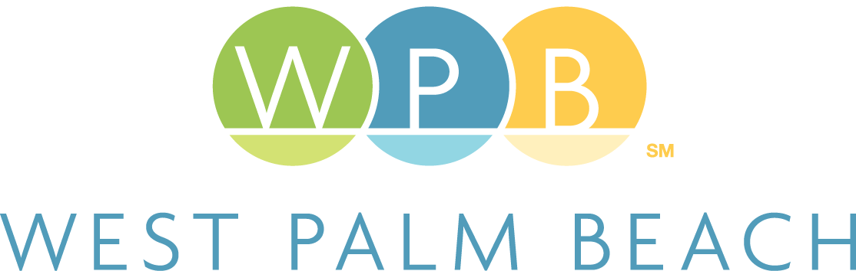
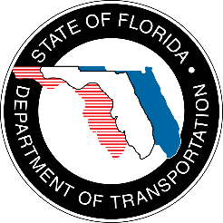
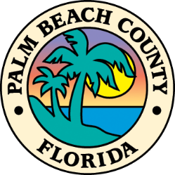

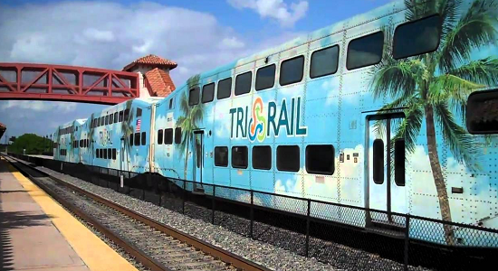
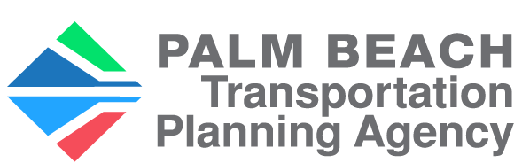
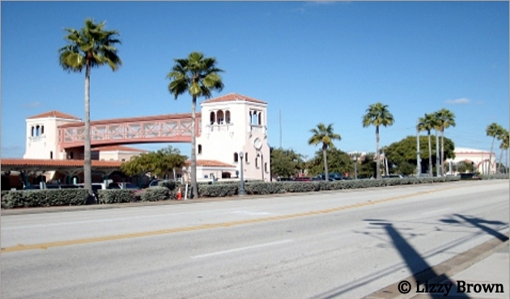
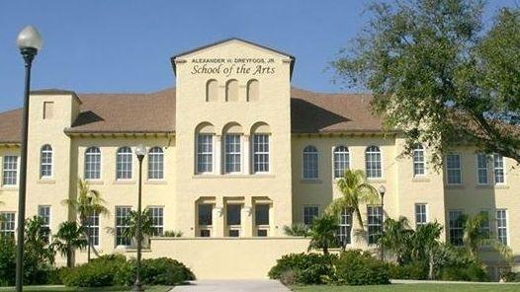
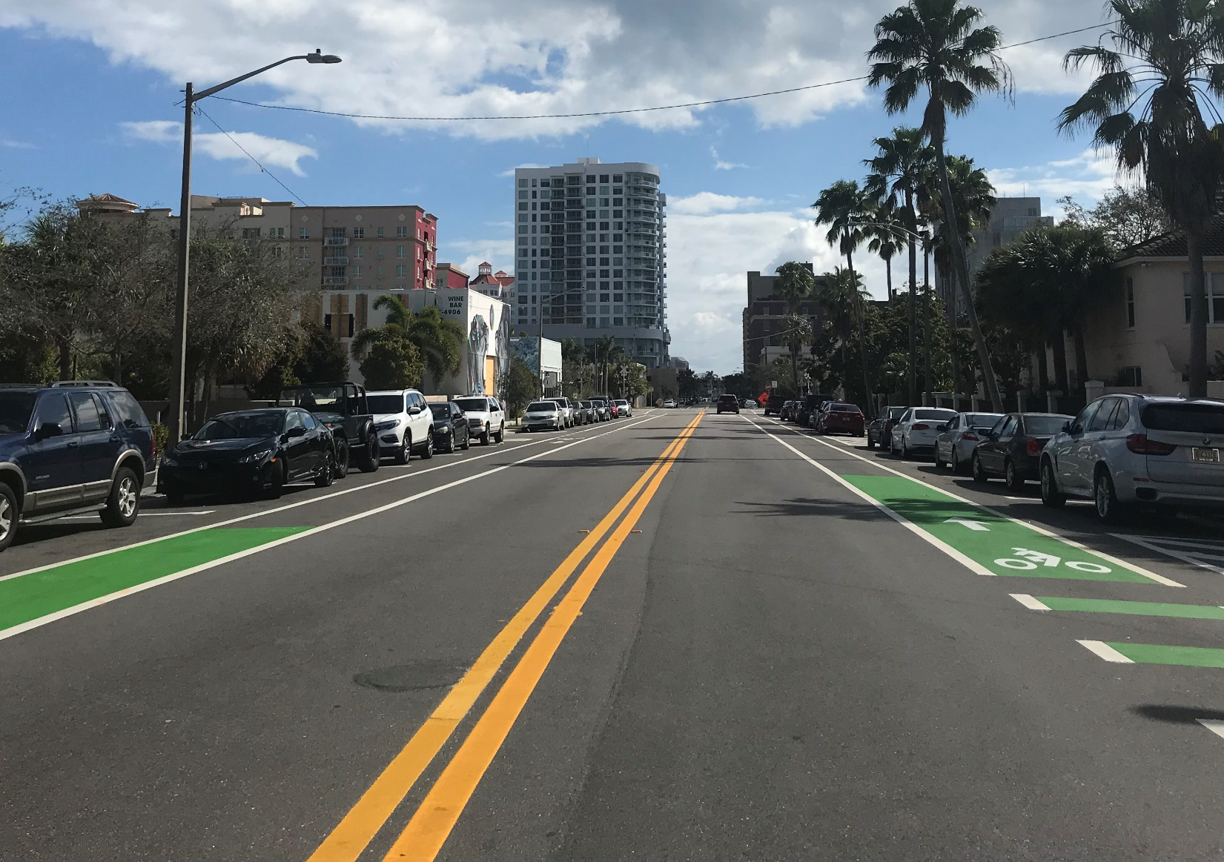
Collaboration
Stakeholder Participation
Project and site selection
Notes:
In an effort to advance Complete Streets and safety, the TPA worked collaboratively with the City of West Palm Beach to select and implement a Tactical Urbanism project.
This effort involved collaboration and participation from multiple stakeholders, including the City, TPA, FDOT, County Engineering and a local High School.
The TPA served on a planning committee led by the City to select the project and coordinate steps for implementation.
Ultimately, the City opted to implement the project on an intersection within its right-of-way because of timing and feasibility of getting approval within its agency vs. an outside agency, which resulted in a large mural at the intersection of South Tamarind Avenue and Fern Street to beautify the street, slow down cars, and make the intersection safer for bicyclists and pedestrians.
This intersection was especially important for safety, because it connects the West Palm Beach Tri-Rail Station and Palm Tran Intermodal Center to the Dreyfoos School of the Arts where hundreds of high school students ride transit every day and cross the intersection as part of their "first and last mile" trip to and from school.

Slide 7
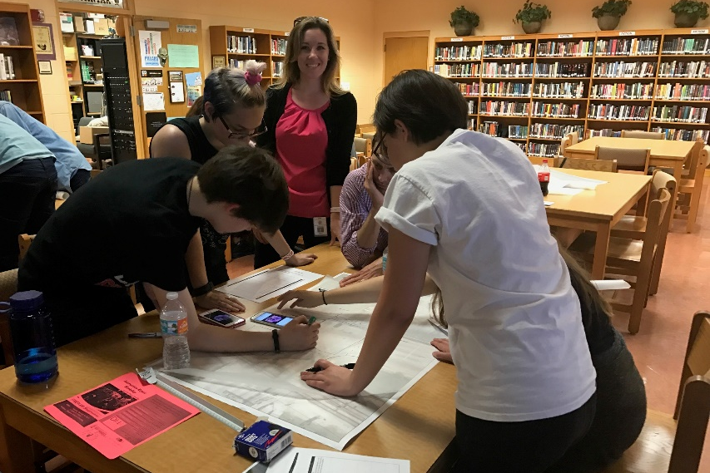
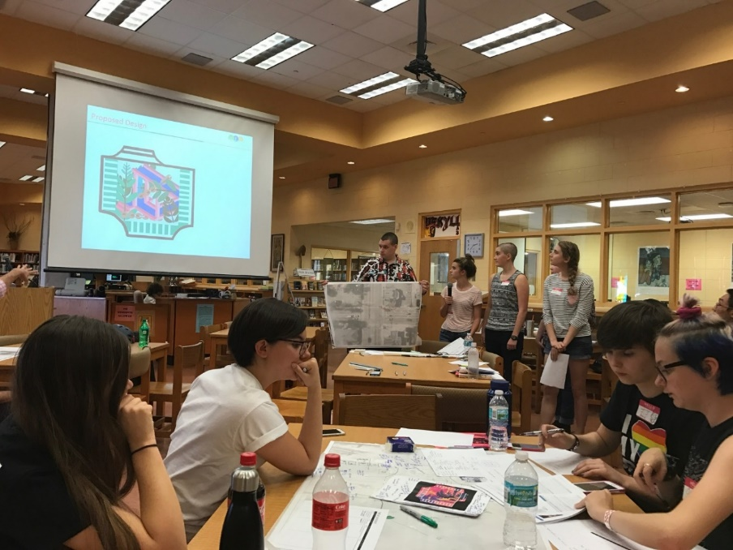
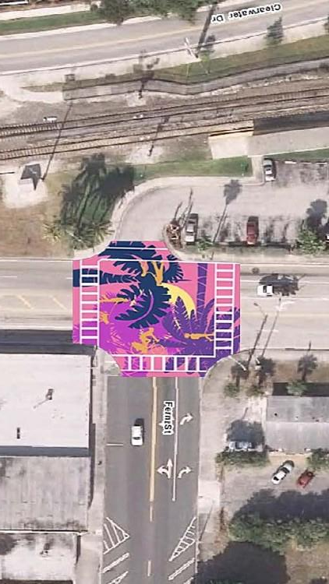
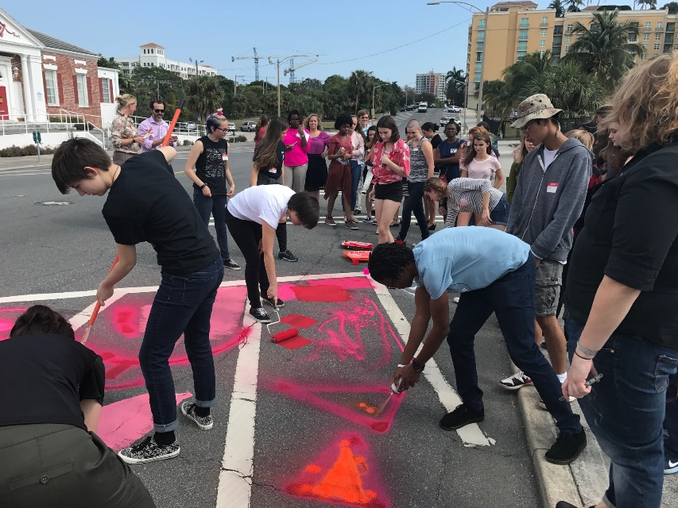
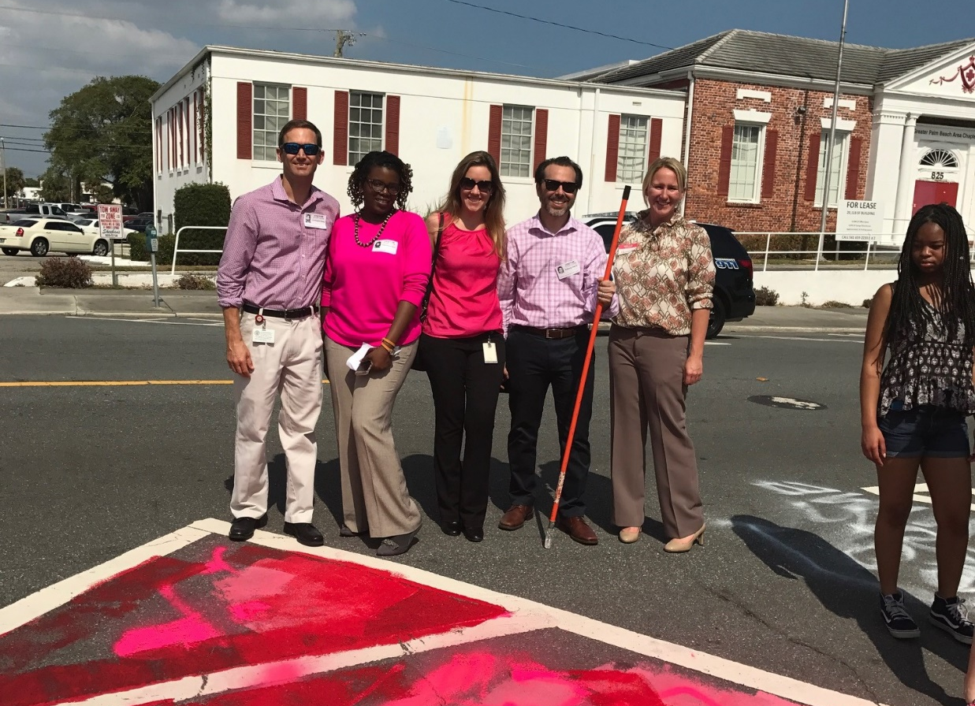
Tactical Urbanism Workshop
Notes:
The intersection mural artwork was designed by students from the Dreyfoos School of the Arts.
The City’s Art in Public Places Ordinance requires a specific process. As part of the learning process for the students, the intersection repair was treated like a formal “call for artists”. Through a class assignment, six groups of students developed designs. Street Plans Collaborative delivered a workshop to expand the City’s familiarity and comfort with planning and executing collaborative demonstration, pilot, and interim design projects.
The City, TPA, and School participated in the workshop and reviewed the six student designs as well as tested out project materials prior to project implementation.
Once details of each design were finalized, the six designs were then vetted through the City’s Art in Public Places Committee. One final design was selected as the winner that then required a formal City Commission approval in a public meeting.

Slide 8
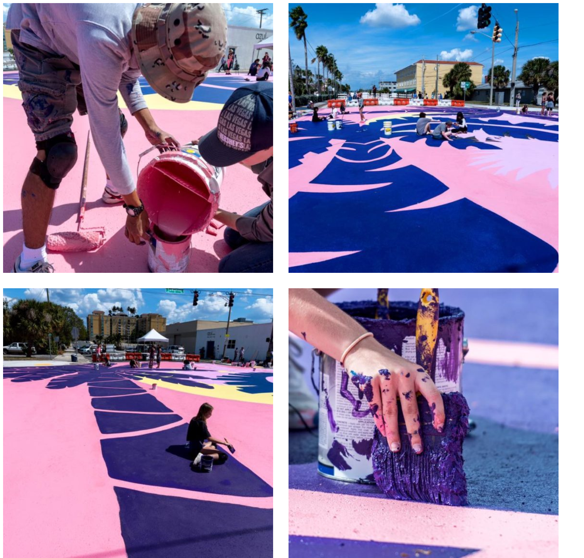
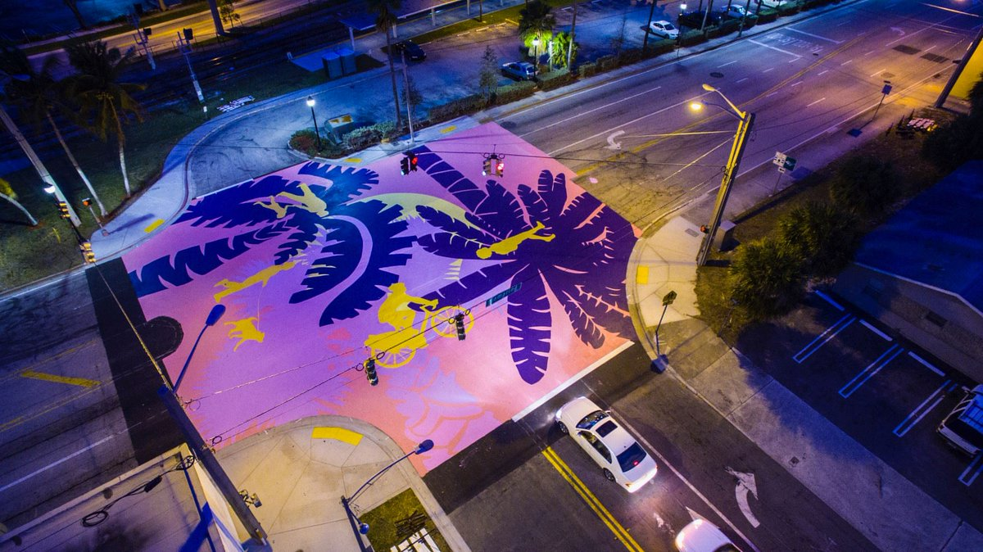
Implementation
Local News Coverage
Students / Volunteers
Notes:
Students and local volunteers helped implement the project, painting the intersection over the course of a weekend.

Slide 9
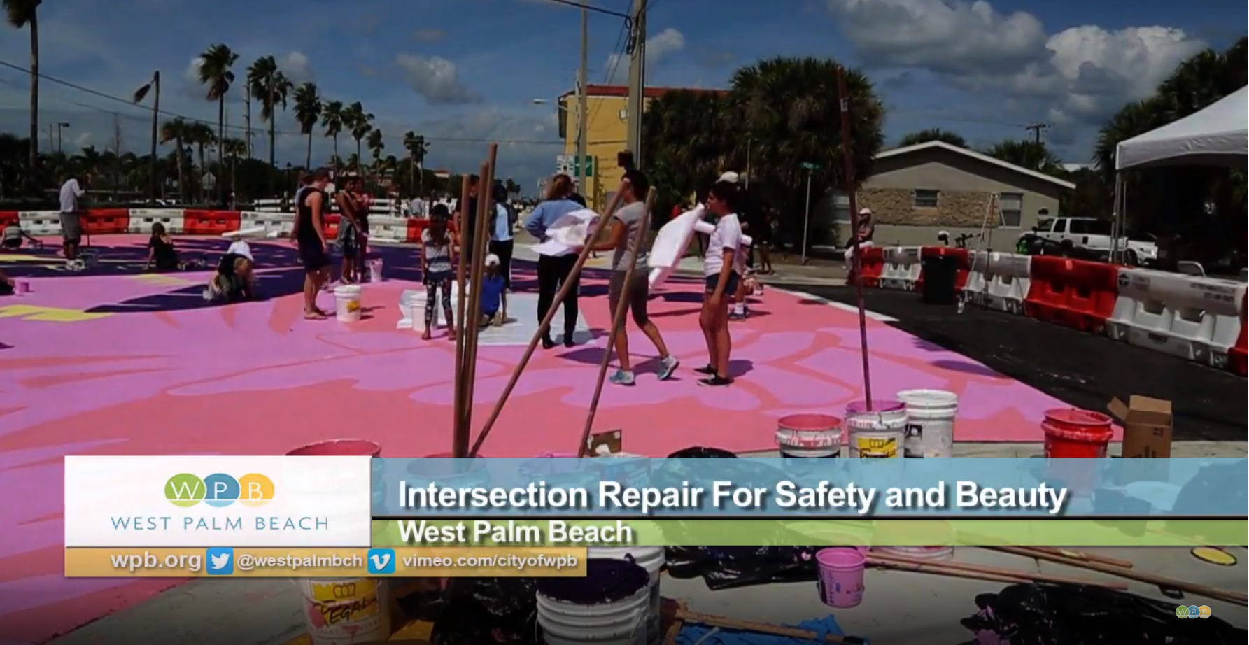
Intersection Repair
Notes:
https://www.youtube.com/watch?v=iweucvbAsMg

Slide 10
Lessons Learned (-’s)
Projects on other agency right-of-way require longer approval process
Research materials for durability, maintenance, slippery when wet?
Compliance with Manual on Uniform Traffic Control Devices (MUTCD)
Notes:
The project timeline was less than a year. The project team identified several potential locations to do a tactical urbanism project, including busy downtown locations at the intersections of Clematis and Quadrille or Rosemary and Okeechobee; however several of the proposed locations were on another agency’s right-of-way (FDOT or County), which required a longer process to get approval for a test project and the types of materials used (ex. Multiple paint colors).
Lesson Learned: To facilitate implementation, plan to do these projects on right-of-way that your agency owns / controls or that you can get the owner onboard. If you plan on the project being permanent, research durability of the project materials and plan to replace after (paint fade /dirty after how long?). Roadway Maintenance of Traffic (MOT) requirements can be an extreme challenge – make sure to check these prior to commitment.
Compliance with Manual on Uniform Traffic Control Devices (MUTCD) - FHWA

Slide 11
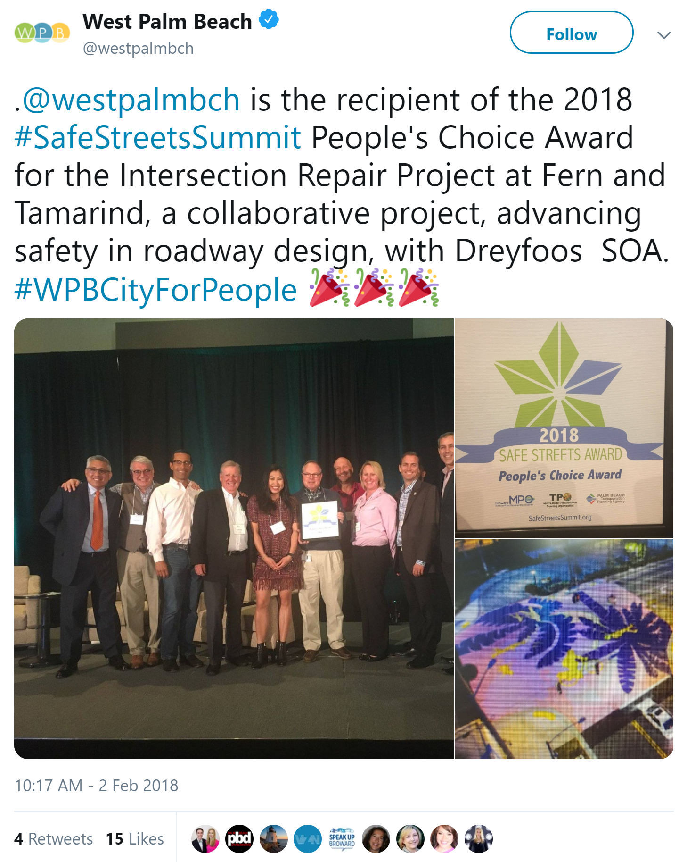
Lessons Learned (+’s)
Engage community, schools, businesses, volunteers
Safe Streets Summit 2018 People’s Choice Award
Motivation and friendly competition for local cities
Notes:
Fantastic participation from the local high school on design and implementation.
City promoted implementation event in local news and online and successfully attracted volunteers to participate.
Project won the “People’s Choice Award” for Palm Beach County at the 2018 Safe Streets Summit.
Project served as motivation and friendly competition among our other cities.
Lesson learned: Involve local community to help design and implement project.

Slide 12
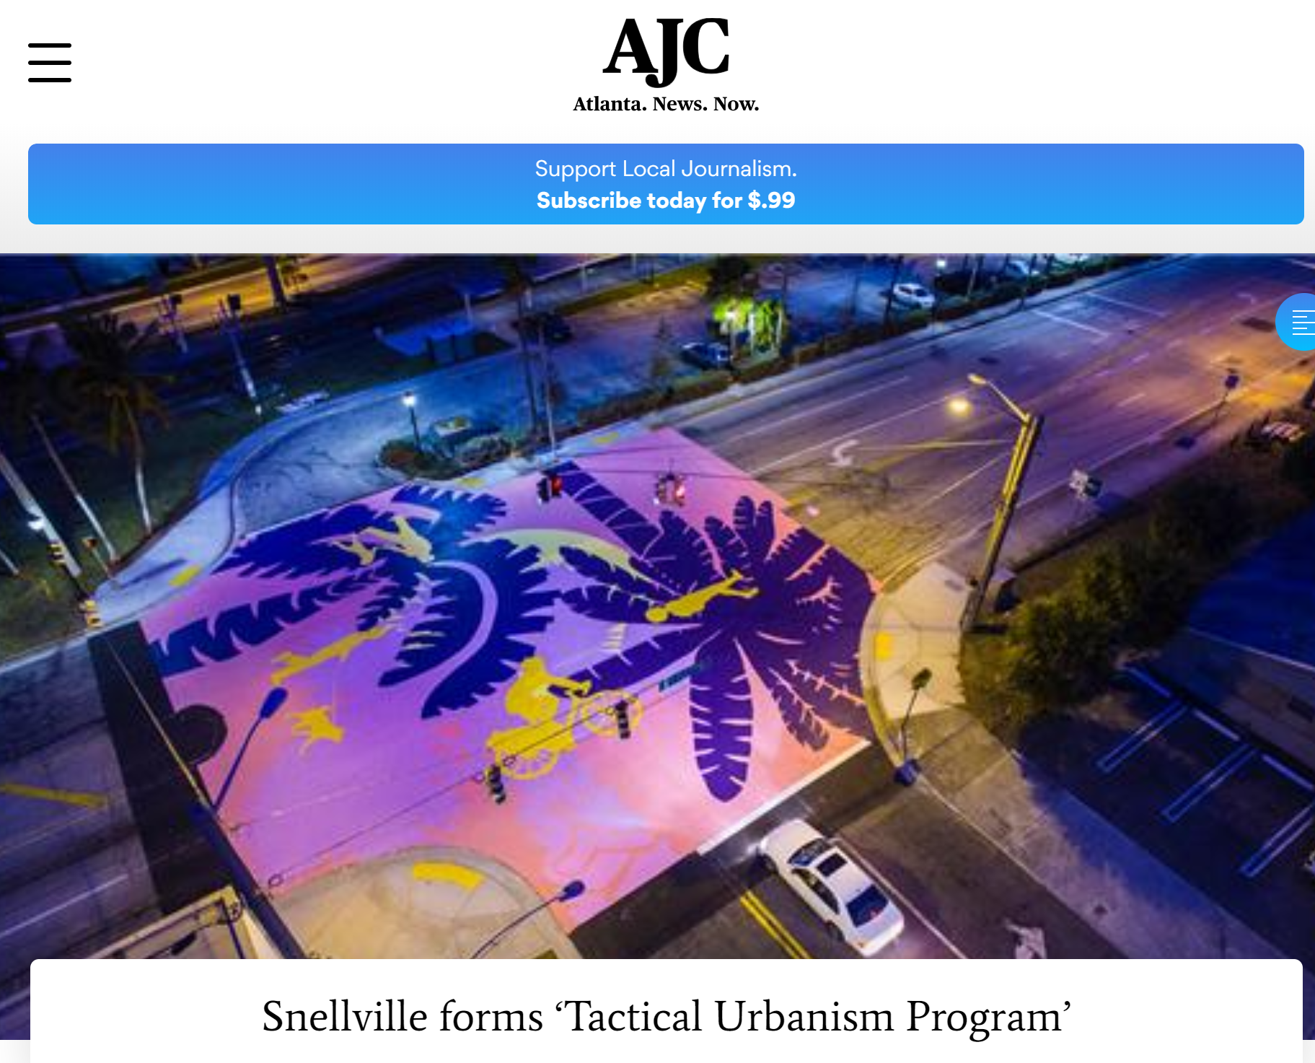
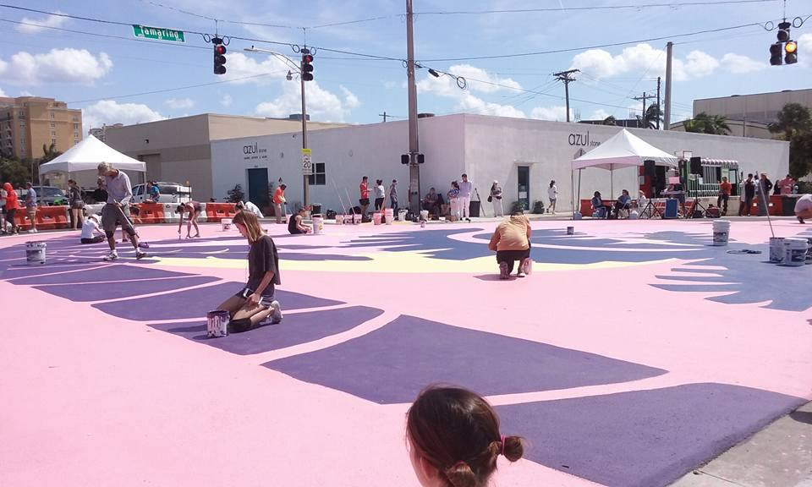
Key Takeaways
Support of temporary low cost projects can raise awareness and gain local buy-in, which can lead to a permanent project with lasting results.
Involve local community to help design, promote, and implement project.
Notes:
MPO’s should take away from this example that support of temporary projects can benefit a community by helping to raise awareness and gain local buy-in, which can lead to a permanent project with lasting results.

Slide 13
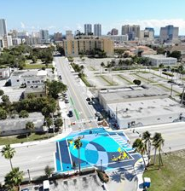
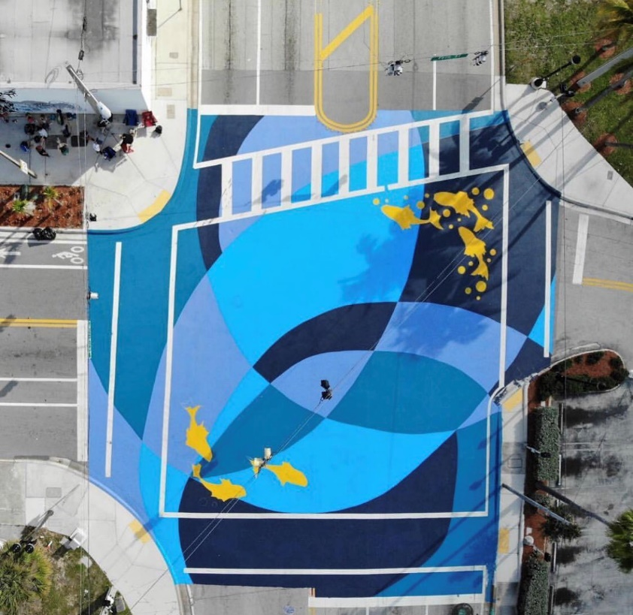
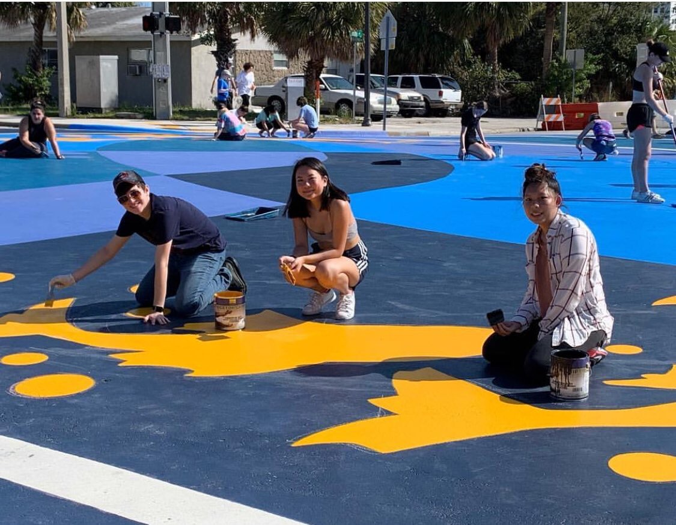
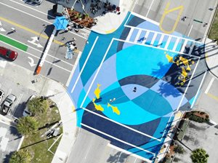
Success!
Notes:
Project was repainted with new design by students in early 2019.
Otherwise known as the City’s second ‘Intersection Repair’ project, ‘Migration’ is composed of brightly colored Florida reef fish swimming atop the intersection and overlapping lines of dark blue and purple colors mirroring the ocean currents. The design was created by students Gillian Dickinson, Isabelle Stratton, Megan Tachev, Dani Walters and Sophia Dawson and was installed February 16 – 17, 2019. The design reflects the changing perspectives and styles of the city and community while supporting local art students. The temporary artwork replaces the City’s original ‘Intersection Repair’ project installed at the same location two years ago.
The project’s goal is grounded in the principle that street-level art can improve the pedestrian experience, reinforce connections to the city’s downtown area, and serve as a visual reminder to motorists to slow down.
The location of the project—near the Tri-Rail station—is significant, because hundreds of Dreyfoos students ages 15 - 18 ride the train and cross through the intersection and four lanes of traffic to attend their school. It is hoped that this creative piece of art with multiple purposes will encourage motorists to slow down or consider alternative forms of transportation.
The project is funded through the City of West Palm Beach Office of Public Life in partnership with the City’s Art in Public Places (AiPP) program, Development Services Department, Engineering Services Department, Public Works Department, and Dreyfoos School of the Arts.

Slide 14
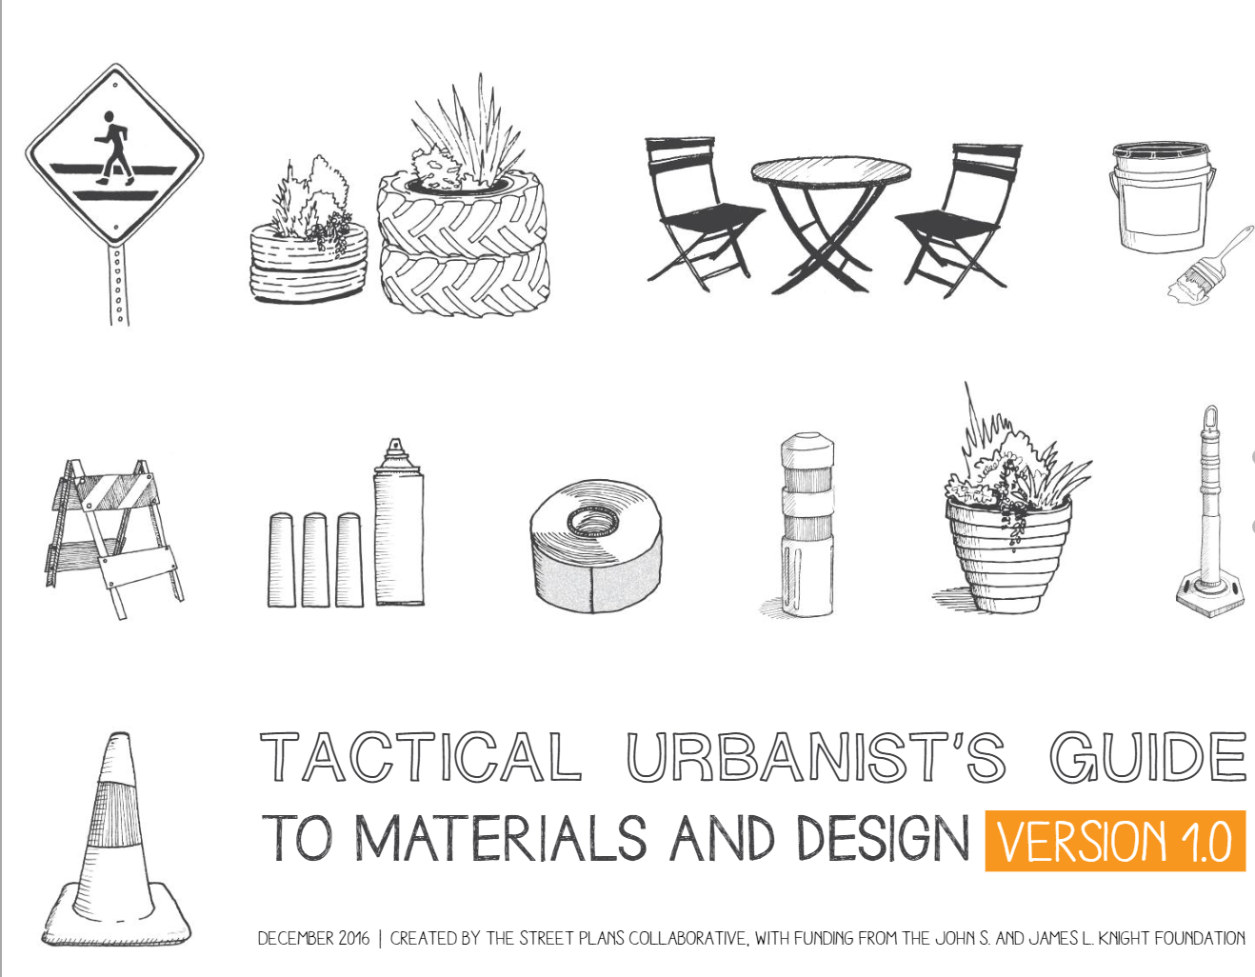
Feasibility for Other Agencies
Fairly easy, quick and low cost way to test out safety improvements
Must have approval of the right-of-way owner to implement
Tactical Urbanist’s Guide serves as a guidance manual : http://tacticalurbanismguide.com/
Notes:
Tactical Urbanism projects are a fairly easy, quick and low cost way to test out safety improvements; however you must have the approval of the right-of-way owner to implement. The “Tactical Urbanist’s Guide” serves as a guidance manual to implementing these types of projects: http://tacticalurbanismguide.com/

Slide 15
Thank you!
Valerie Neilson, AICP
Deputy Director of Multimodal Development
vneilson@palmbeachtpa.org

