Slide 1


Origin-Destination Survey
Utilizing Blue Toad Devices

Slide 2
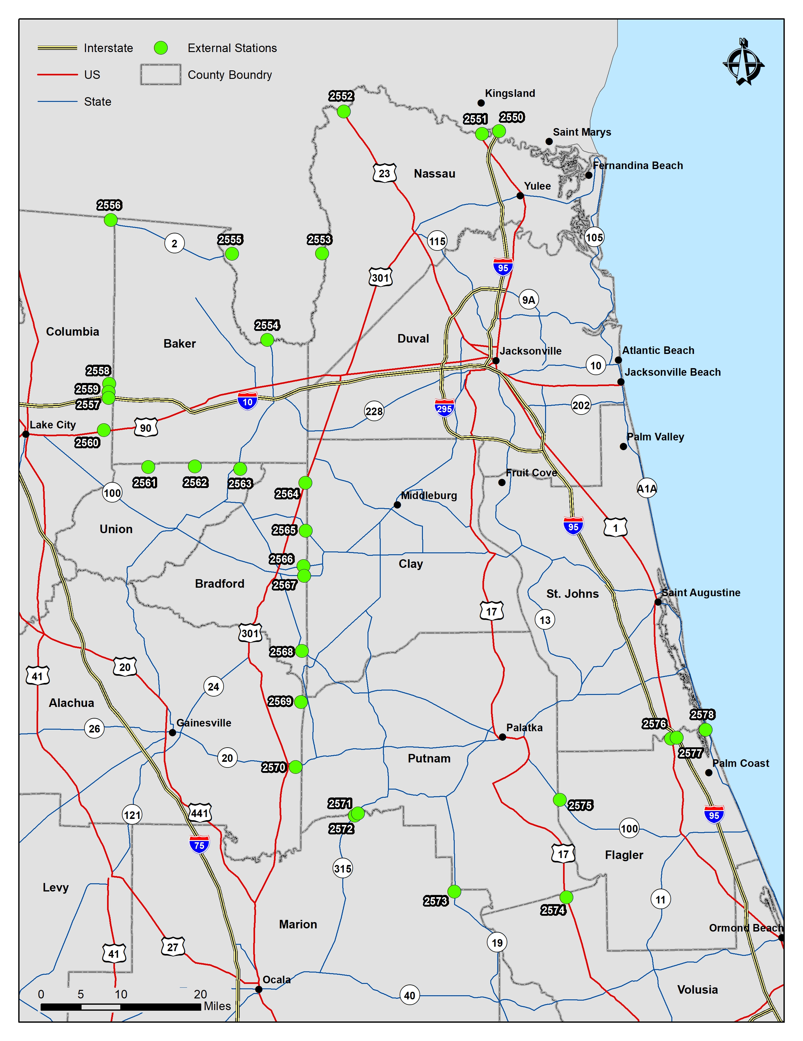
Purpose
Estimation of EXTERNAL TRIPS for model validation and calibration

Slide 3
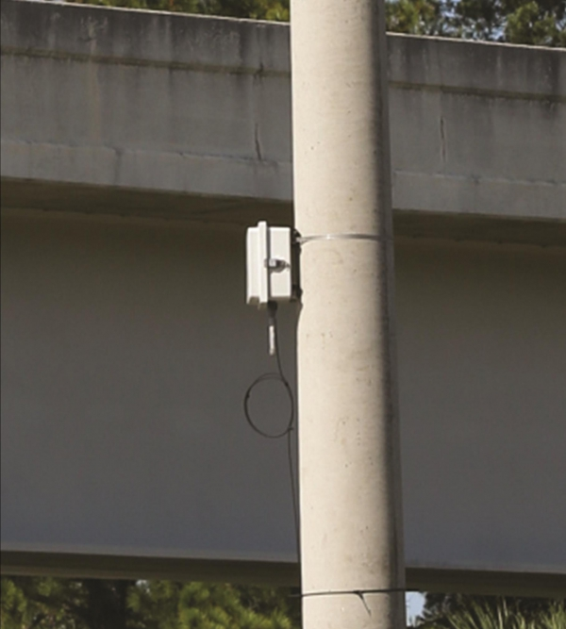
Methodology
140+ permanent devices deployed in the region
Temporary devices used at the cordon
Traffic counts (volume and classification)

Slide 4
Methodology
Data collection December 3-17, 2017
18 Locations

Slide 5
Methodology
When a Bluetooth device passes a BlueTOAD readers, the location and time are recorded. When the same MAC address passes another BlueTOAD reader, travel times and the counts of pairs can be recorded.

Slide 6
Methodology
Expansion factors used to factor BlueToad readings to traffic counts for all vehicles and trucks

Slide 7
Why?
Last O-D Study in 2000
Cost $100,000
Concurrent with Household Travel Survey

Slide 8
Next Step
Modeling consultant had to do additional work with the data, but successfully developed the required dataset

Slide 9
Contact Information
Denise Bunnewith
Planning Director
904.306.7510
dbunnewith@northfloridatpo.com
www.northfloridatpo.com

