Slide 1
What’s it Worth?

Slide 2
What’s it Worth?

Slide 3
What’s it Worth?

Slide 4
What’s it Worth?

Slide 5
What’s it Worth?

Slide 6
What’s it Worth?

Slide 7
FASP Update Process
Jim Halley, A.A.E., ACE
Aviation System Manager
FDOT Aviation and Spaceports Office

Slide 8
Today’s Flight Plan
Overview of aviation in Florida
Aviation system planning
The Florida Aviation System Plan (FASP)
  History
  Ongoing update
Aviation system planning at the local level
Your role in the FASP
Next steps

Slide 9
Aviation in Florida
8.5% of Florida’s GSP is from aviation-dependent businesses
Both the first scheduled airline flight and the first international flight took off in Florida
#1 state for aerospace manufacturing attractiveness
128 public use airports
Over 650 private use facilities
High return on investment
    2013/2014 to 2015/2016: 1.37
    2014/2017 to 2020/2021: 1.72
Over 50% of Florida’s visitors arrive by air

Slide 10
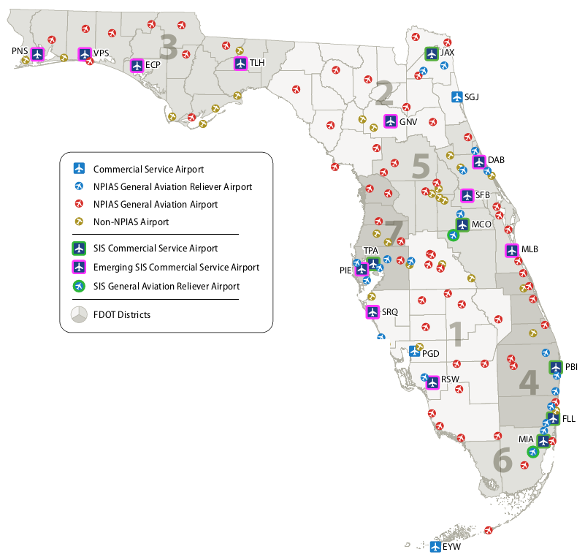
Florida’s Public Use Airport System

Slide 11
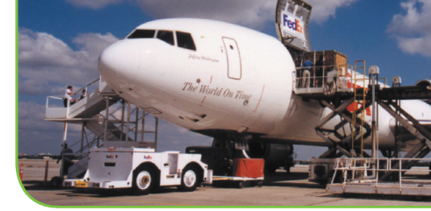
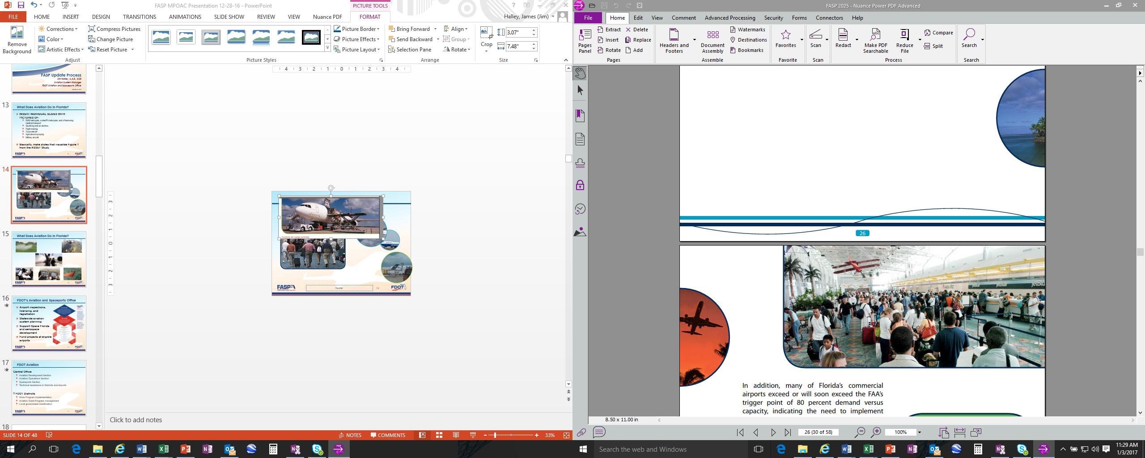
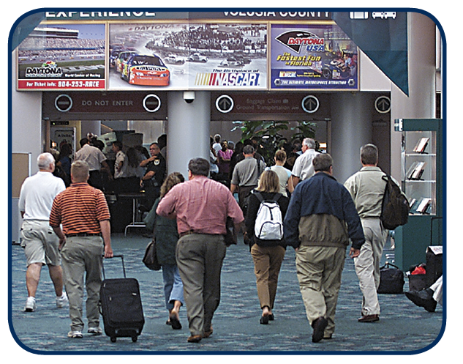
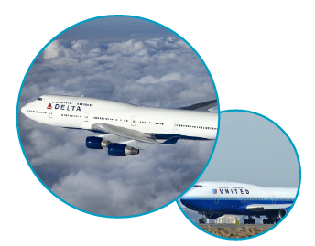
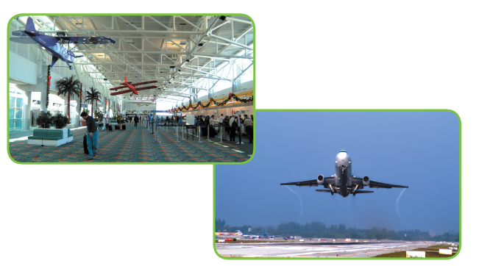
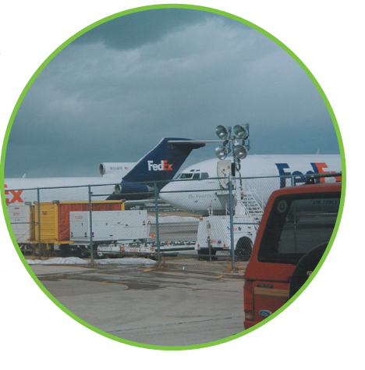
What Does Aviation Do in Florida?

Slide 12

What Does Aviation Do in Florida?

Slide 13
What is Airport System Planning?
Lots of definitions, none of which are right or wrong
Common themes exist:
    A viable, balanced system through integrated planning
    Identifying system needs (infrastructure, services, and facilities)
      Locally, regionally, statewide, and nationally
    Performance measures and tracking
    Examining interrelationships and interaction between airports
    Development needs to meet current and future demand (a.k.a. HOW MUCH WILL IT COST?!)
An airport vs. airport systems vs. THE airport system

Slide 14
Florida Aviation System Plan (FASP)
First FASP completed by the airports in 1992
    Major update in 2005 (first by FDOT)
    Minor update in 2012
Identifies goals, approaches, measurements, and recommendations
Strategic 20-year plan for developing the state’s 128 public use airports
    Analyze Florida’s system collectively
    Understand the relationships of the facilities and the demographics
    Compare current and future needs (demand) to current and future capacity
Currently being updated – FASP 2035

Slide 15
FASP 2035 Elements
Existing system evaluation
Development needs
Aviation issues
Decision-making guidance
Recommendations
Will examine:
    Regional capacity constraints
    Investment policies and priorities
    System utilization
    Best opportunities
    Development costs by District and statewide
Notes:
What are some general trends in aviation?
What is influencing aviation in Florida?
What is driving (or hampering) demand around the state?

Slide 16
How is the System Doing?
7 goals (different than but tied to the FTP’s goals)
    Supporting objectives
    Performance measures: how are we doing at what we can influence?
    Performance indicators: FDOT can’t influence but still help us evaluate
Development and validation of goals, objectives, and performance measures and indicators

Slide 17
FASP Update: Where Are We Now?
April 2015
August 2015
April 2016
September 2016
April 2017
July 2017








Slide 18
FASP Deliverables and Tools
Standard products
Functional tools
    4 tailored primers
    CFASPP regional overviews
    GIS
    Videos
Recommendations
    Policy
    Project prioritization
    Development by District and CFASPP region
    Guidance to other modes pertaining to aviation
Follow on FDOT projects and initiatives

Slide 19
Your Role In The FASP

Slide 20
So What Does This Mean to You?
Better understand the role aviation plays in your region
    As a transportation option
    Bringing in visitors
    What do airports need?
Better understand your role in Florida’s aviation system
Improve coordination between airport and regional planning
What are the trends and issues for aviation? How do they impact your regional policies, plans, and decisions?
What do airports and FDOT’s Aviation & Spaceports Office need to consider from your perspective?

Slide 21
Airport Funding Process Diagram
Developed from ACRP Project 03-31, Aligning Community Expectations with Airport Roles (to be ACRP Report 155 once finalized)
National Plan of Integrated Airport Systems: Defines system for FAA funding eligibility and airport development needs.
Airport Capital Improvement Plan (ACIP): Outlines detailed project funding, serves as the basis for AIP fund distribution.
Florida Aviation System Plan (State): Define airport roles within the system, including non-NPIAS airports.
Coordination: State (and regional) system plans provide policy guidance and technical direction to individual airports, along with forecast airport activity and a set of investment priorities. Individual airport master plans provide more detail for proposed improvements than what is contained in a system plan and may be used as a basis for altering priorities within the overall system plan.
Airport Master Plans (Local): Detailed long-term development plans for individual airports (often with 5-, 10-, and 20-year time horizons).
Airport Layout Plan A key product of the master planning process, provides a graphical depiction of the current and future runway. Required for AIP funding eligibility.
Coordination: The FAA develops criteria for inclusion in the NPIAS and coordinates a process of “feeding” up recommendations for inclusion of airports and projects from the state/regional system plans.
Updates: Updated biennially.
Updates: Interim updates every 2-5 years; formal review at least every 5 years.
Facilities Implementation and Capital Improvement Plans (CIP): Translates the master plan into line-item project components, with sufficient detail for resources planning (e.g. budgeting, timing, etc.). CIPs have a typical 3-5 year time horizon.
Updates: Updates for minor modifications. New plans when key underlying assumptions have changed. Must be kept up-to-date, including “as built” updates after project completion. May change from year-to-year in response to changing conditions; often more detailed in earlier years, to reflect the imprecision of longer-range improvement plans.

Slide 22

What Next?
Consider airports in your local and regional planning (it’s actually a statutory requirement)
Be an active stakeholder in Florida’s statewide, regional, and local airport planning processes
Help us understand what we need to consider from your perspective
Notes:
Chapter 163, F.S. – Intergovernmental Programs
Get involved in CFASPP
Include Aviation projects in the TIP
Know your local airport and its leaders

Slide 23
Questions?

Slide 24
Thank You
Jim Halley, A.A.E., ACE
Aviation System Manager
FDOT Aviation and Spaceports Office
(850) 414-4505
Jim.Halley@dot.state.fl.us www.fdot.gov/aviation www.cfaspp.com

