Slide 1
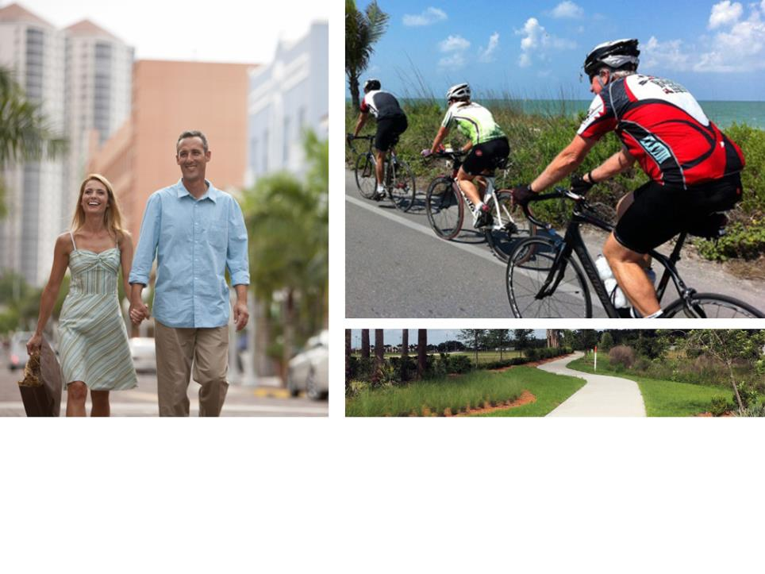
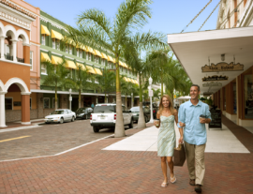
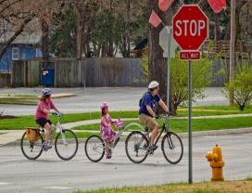
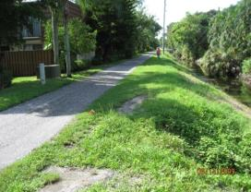



TIGER V Grant Award
Community Sustainability Advisory Committee Meeting
Lee County Administration Building
October 16, 2013
V GRANT

Slide 2
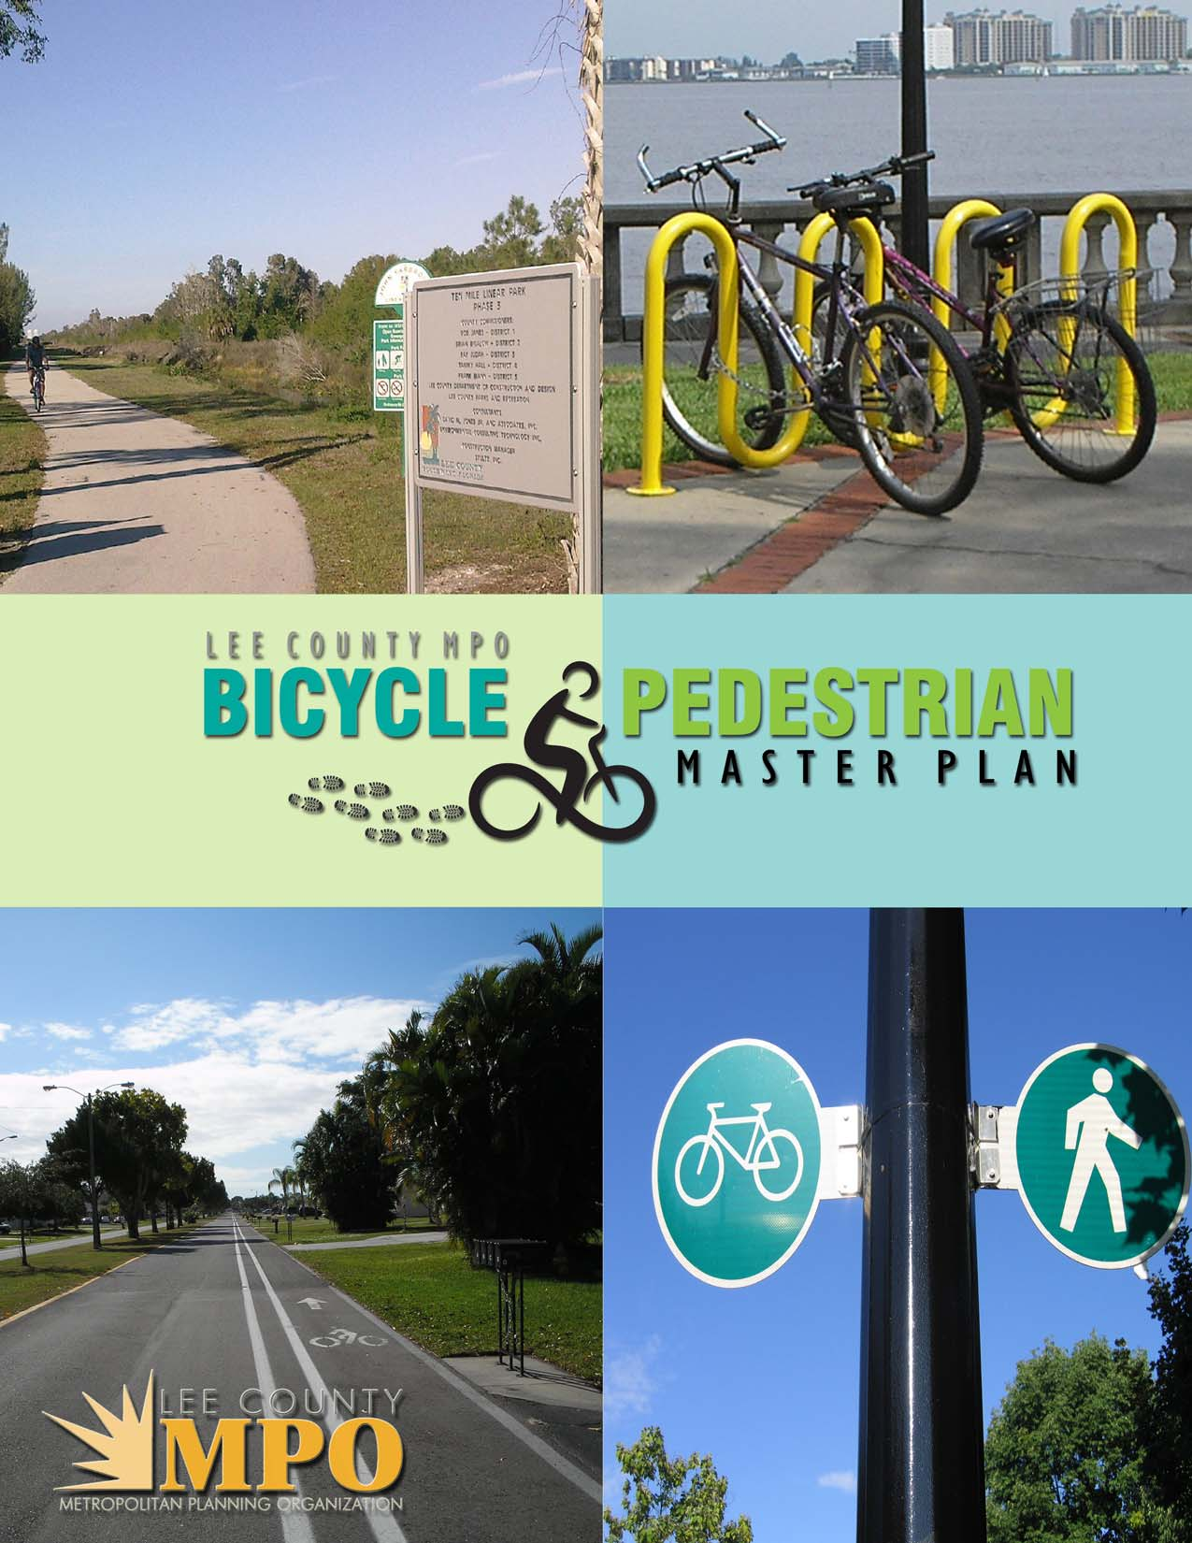
MPO Master plan adopted may 2010

Slide 3
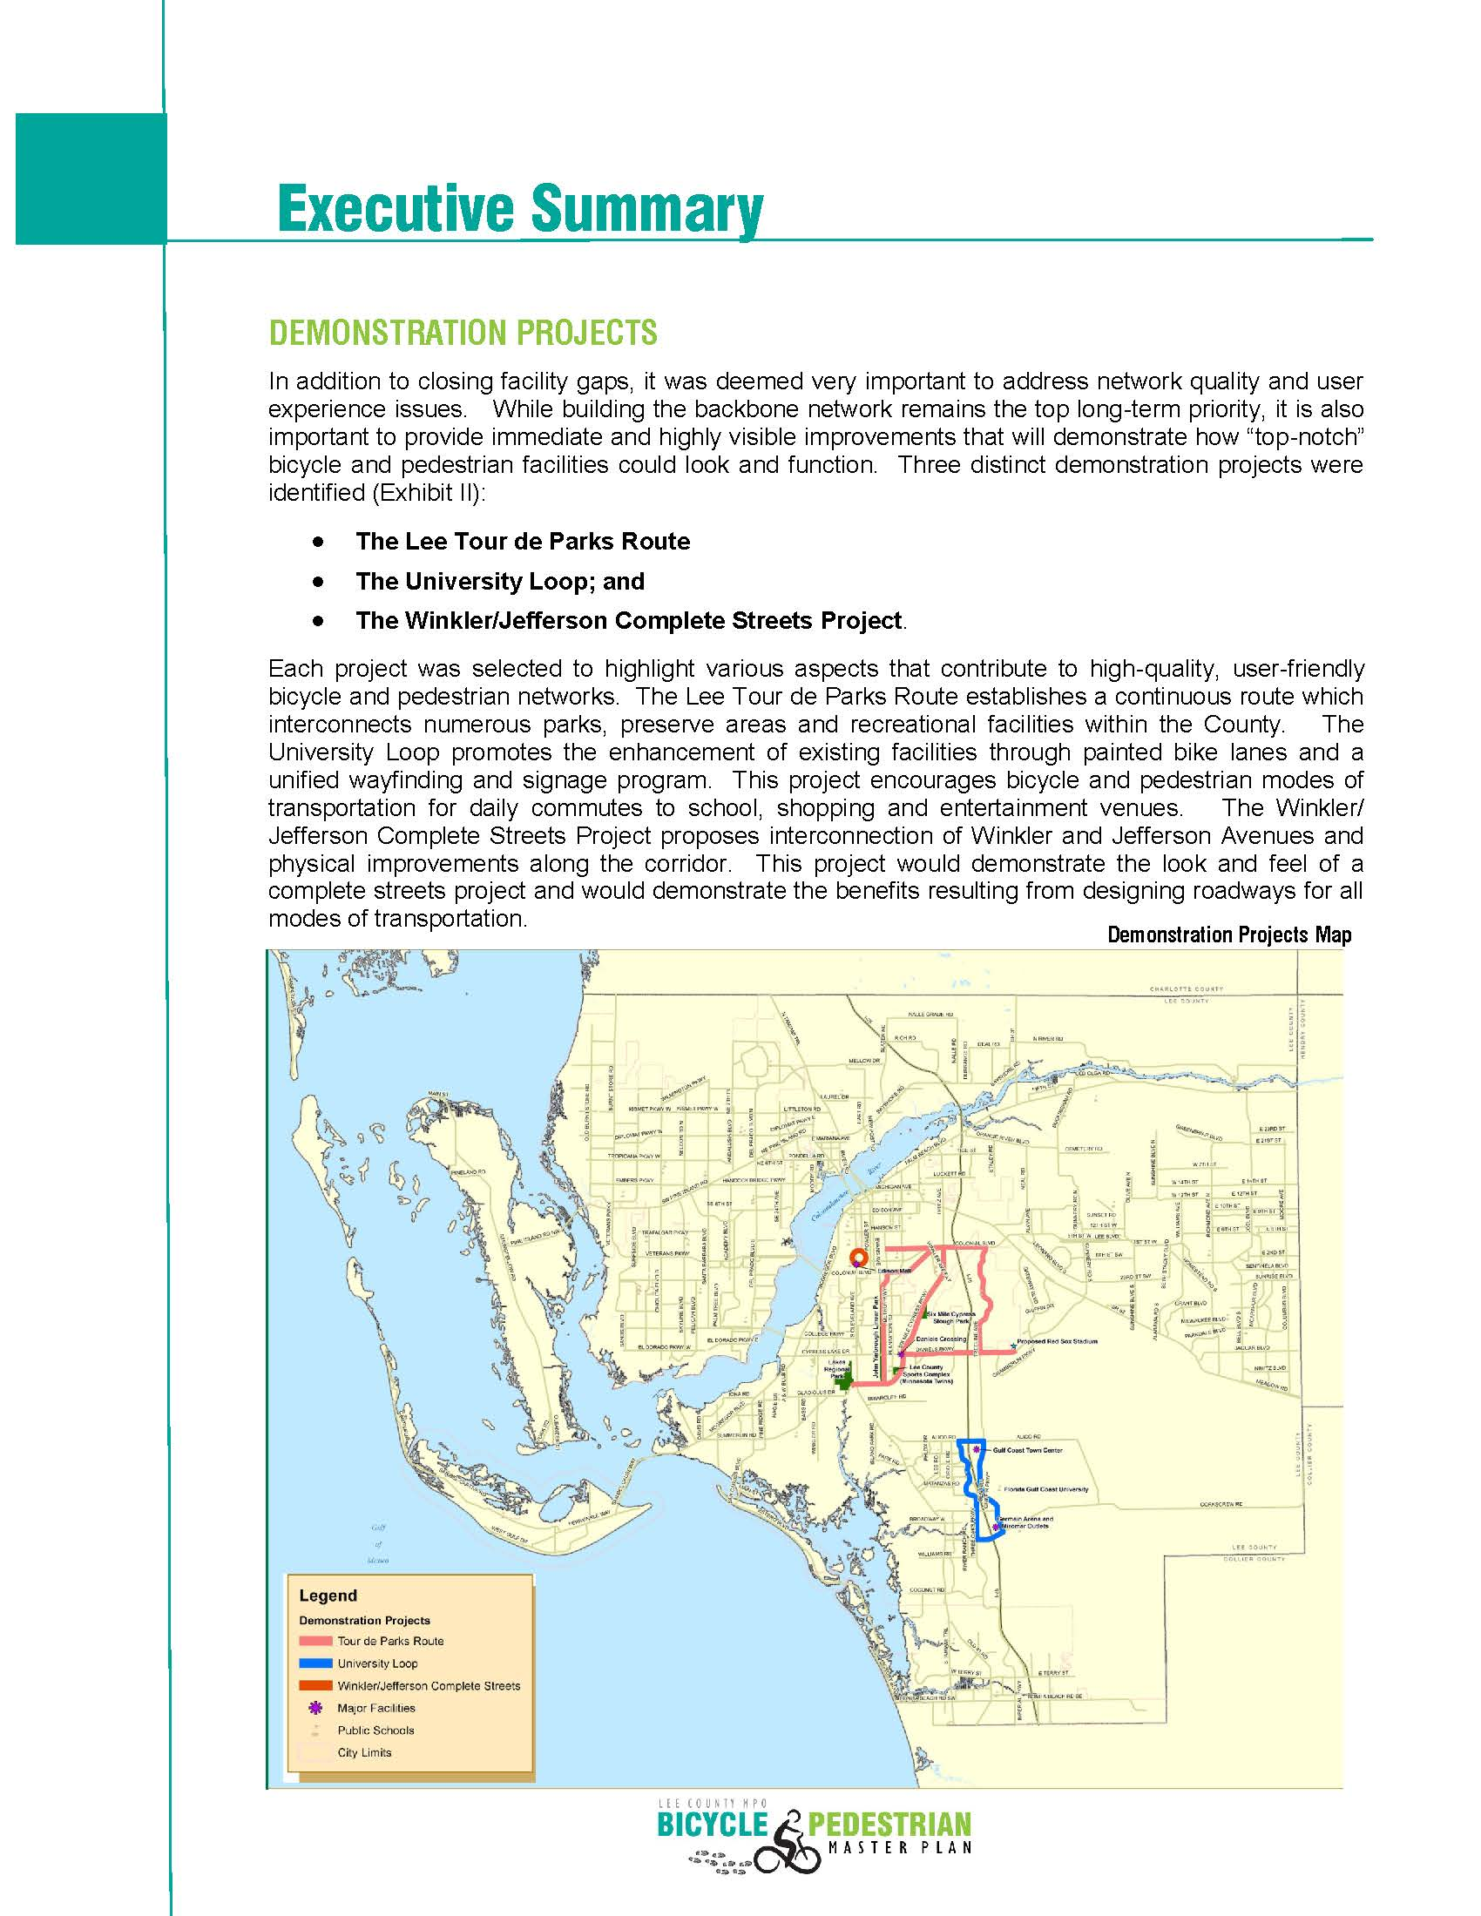

Slide 4
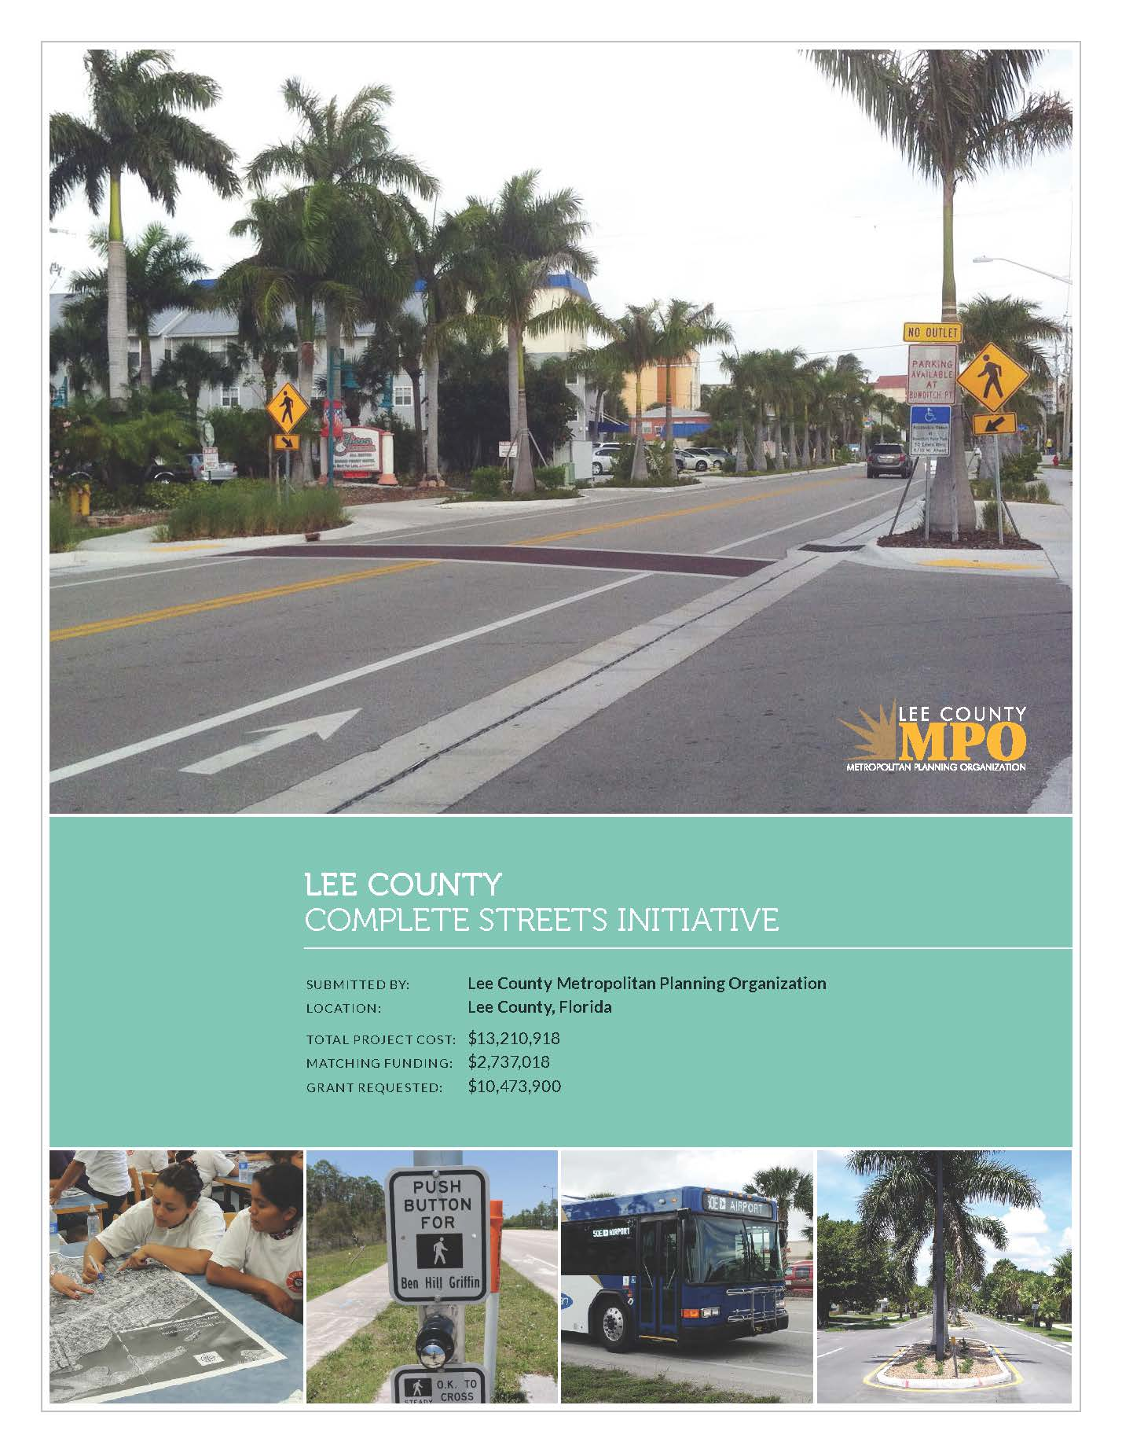

Slide 5
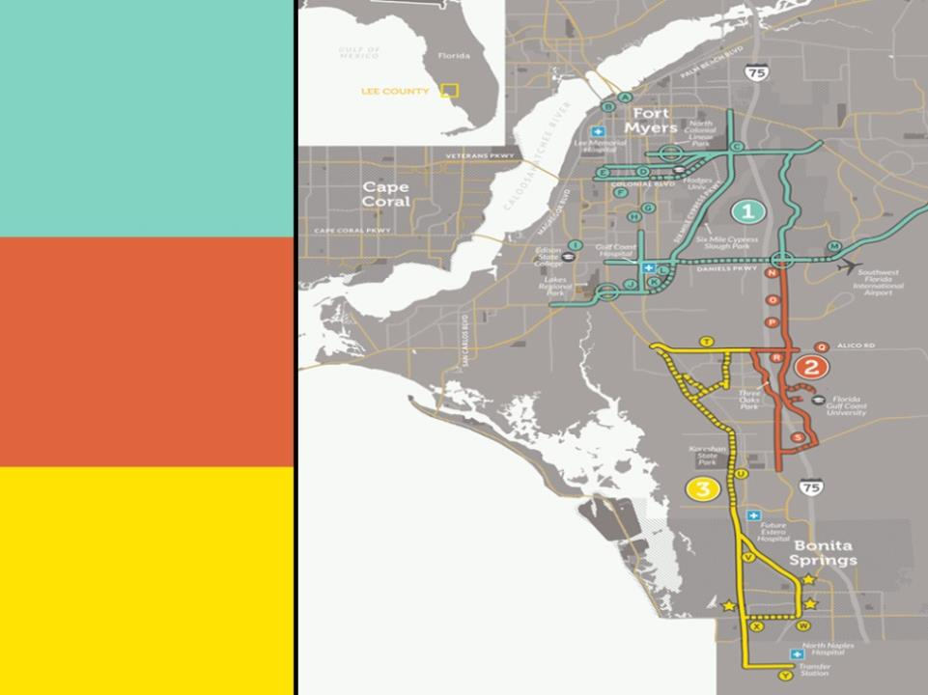
1
1
Tour de Parks
Loop
1
2
University
Loop
1
3
Bi-County
Connector
Notes:
What will this money do for Lee County?
It will complete three multi-modal transportation loops, connecting Fort Myers to Collier County through a series of bike, pedestrian and transit facilities. It will connect a number of parks, FGCU and the City of Bonita Springs through multiple modes of transportation, creating opportunities for physical activity, promoting access to employment and school, and providing a new way to access a number of recreational activities.

Slide 6
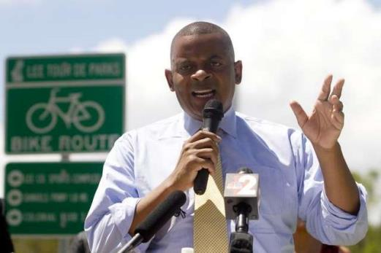
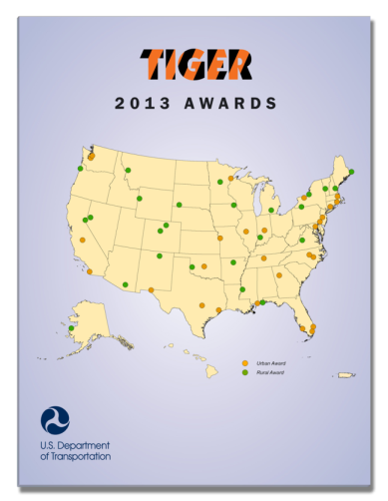
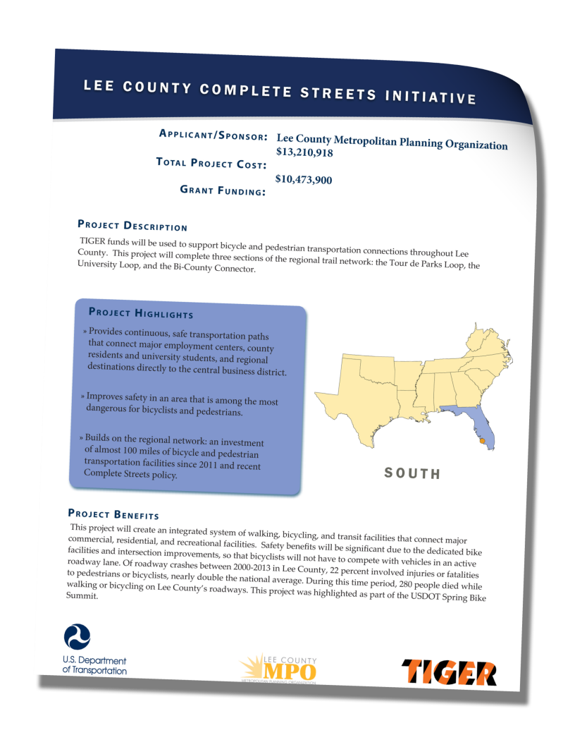
Notes:
In September, US Department of Transportation Secretary Anthony Foxx visited Lee County to announce the Metropolitan Planning Organization won $10.4 million in Transportation Investment Generating Economic Recovery funds. This is the fifth round of availability of these very competitive TIGER funds and the third time Lee has submitted. Given the more than 585 applications from all across the country requesting more than $9 Billion, Lee County being among the 52 communities awarded is extremely significant. These grants typically go to urban areas. This year the competition was even more fierce because more than half of the awards went to rural communities. The fact that Lee was awarded and that Secretary Foxx came in person to make the announcement is not a coincidence. It is the clear result of a community commitment to improving the safety, accessibility, and viability of our transportation system. In fact, improving our transportation system has become tied to so many community benefits, including improved health and safety, access to jobs and daily needs, tourism and economic development that it’s challenging to know who the applicant was in this case. All indications from national and state leadership suggests that this level of collaboration and commitment to improving our transportation system was key to Lee’s success.

Slide 7
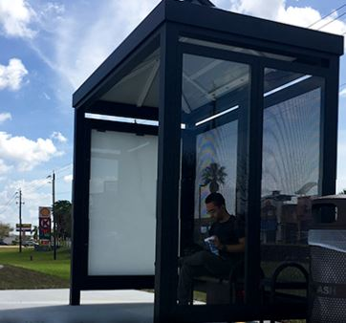
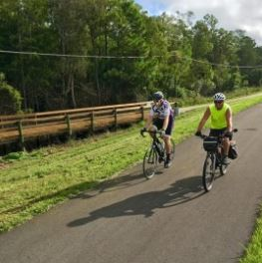
Design and Construct
Approximately 11.5 miles of pathways, sidewalks and bike lanes
Eleven bus shelters
Fabricate and install 234 wayfinding signs (180 sign posts)

Slide 8
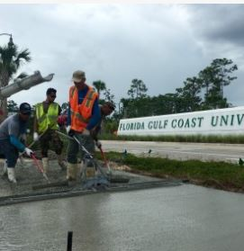
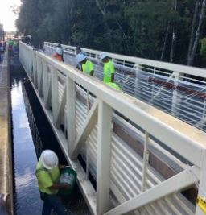
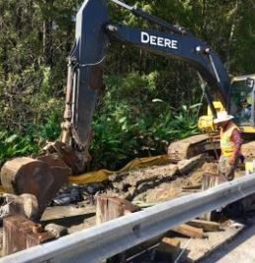
Project Team
CEI – Atkins
- Quest for Public Information
Design/Build – Owen Ames Kimbal
– Hole Montes Design/Permitting
FHWA, Lee MPO, Lee County, FDOT, Fort Myers, Estero, Bonita Springs, LeeTran and FGCU

Slide 9
What Worked
Developed conceptual plans – helped get one bid that came in lower than funding available
RFP for Construction Engineering Inspection firm before going out for Design/Build RFP
Timing of the bid – cost would be higher now
Constructed through design build – timing and delivery of project segments
Experienced team (CEI/Design/Contractor) – understand/meet the federal requirements
Lower bid provided opportunity to add wayfinding signage project

Slide 10
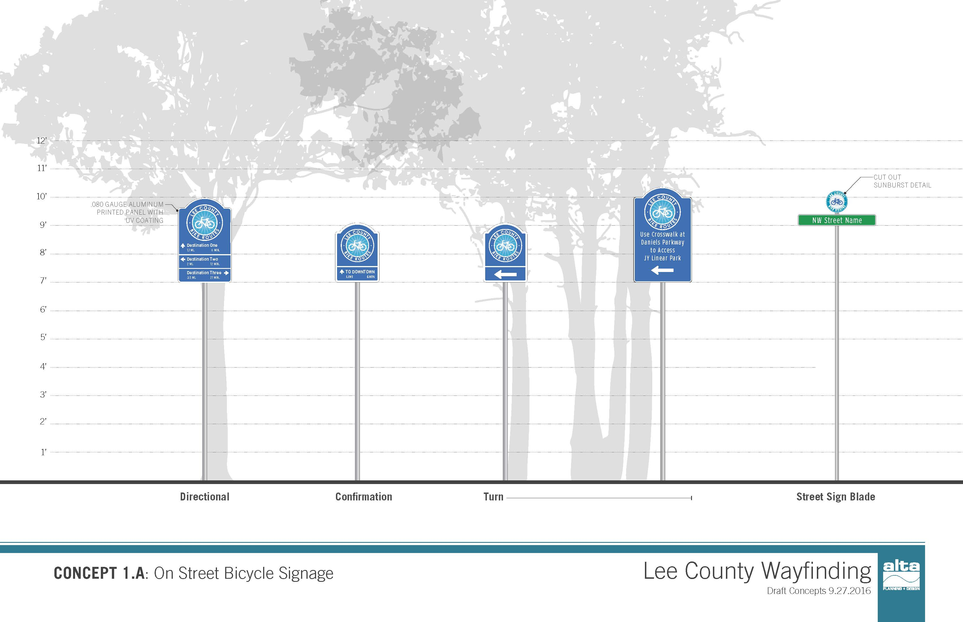

Slide 11
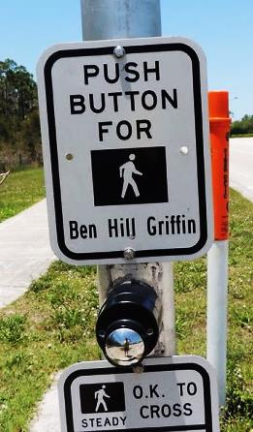
Innovative Features
V GRANT
MPO a direct recipient of TIGER project funding
MPO staff successfully managed and delivered the project
Constructed through a design build maximum price selection process
Obtained $1,000,000 line of credit to bridge invoicing/reimbursement time
Notes:
The timeline for the project is very short and our ability to successfully implement it in the allotted timeframe will determine if we actually receive the money. Therefore, it is important that we all understand the value of this opportunity so we can all work to ensure it’s successful implementation. Note: The grant agreement includes obligation of funds by the September date but our discussions with Federal Highway are shooting to have this done by the end of June 2014. Also, the grant agreement allows the funding to be available for liquidation and adjustment through September of 2019.

Slide 12
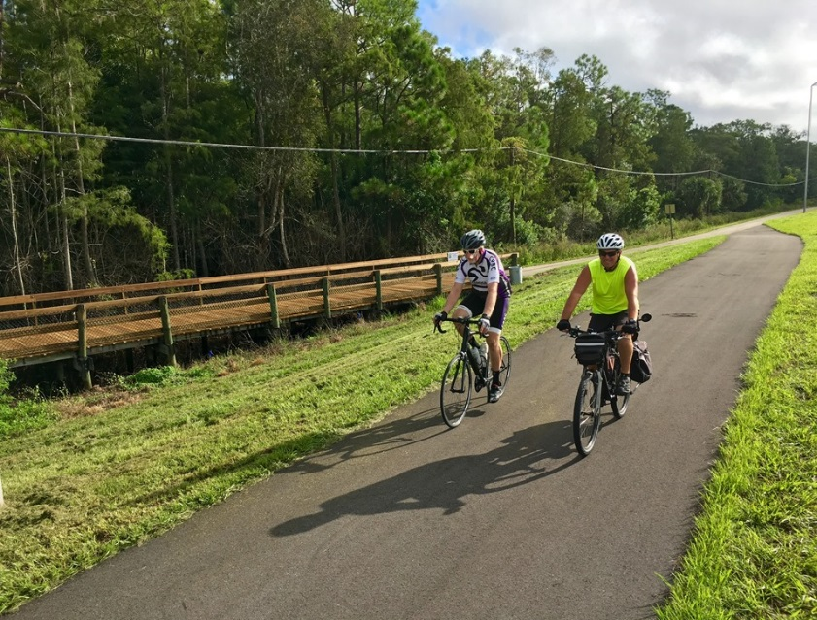
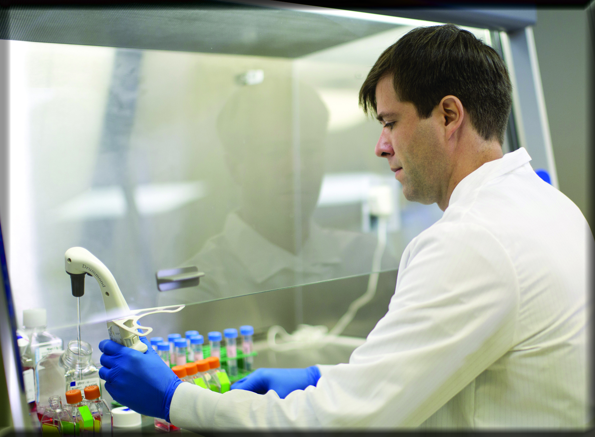
Collaborated with the Economic Development office to hold a Civic Hackathon with a theme for teams coming up with ways to collect facility usage data
More Competitive Business Climate
Notes:
All of these benefits create an improved quality of life and a more competitive Lee County. A slide that pulls that together for the Horizon Council Audience in terms of why they should care.

Slide 13

Used video detection to conduct bicycle and pedestrian counts as part of performance data collection requirements
Notes:
Communities that provide for a safe multi-modal transportation system tend to realize economic benefits. In Lee County’s case, we anticipate:

Slide 14
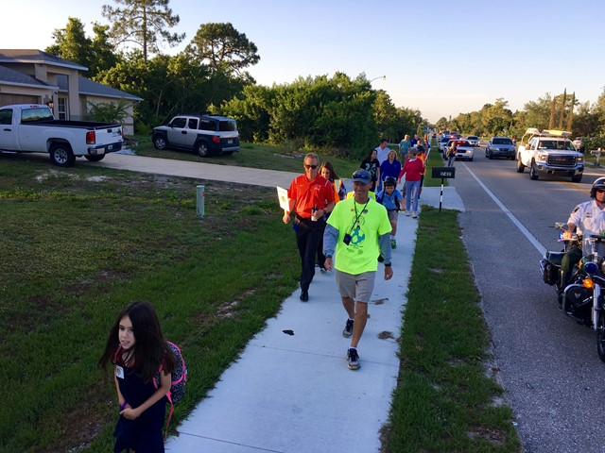
Conducted various kinds of public involvement activities, like a walk to school event on a completed segment and door hanger tags
A boost for our tourism industry…
Notes:
A boost for our tourism industry.
Lee County draws 5 million visitors each year who generate approximately $3B in positive economic impacts; one in every 5 Lee County residents is employed by the tourism industry. Nearly 20% of Lee County tourists ride a bicycle during their visit.

Slide 15
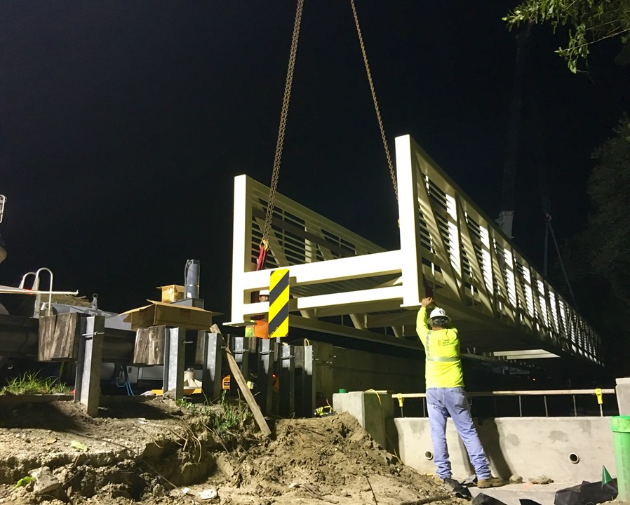
Pre-fabricated pedestrian bridge put together off-site to install at night to minimize traffic disruption
Projected
$9.6 million
savings in
road maintenance…
Notes:
The project will reduce roadway maintenance costs by $9.6 million.
The project is projected to reduce Vehicle Miles Traveled in Lee County by 49.6 million miles by 2035, while generating 22.8 million new bicycling trips and 16.7 million new walking trips.

Slide 16
Regional MPO partnering/collaboration to develop the project versus single entity
Projected
$9.6 million
savings in
road maintenance…
Notes:
The project will reduce roadway maintenance costs by $9.6 million.
The project is projected to reduce Vehicle Miles Traveled in Lee County by 49.6 million miles by 2035, while generating 22.8 million new bicycling trips and 16.7 million new walking trips.

Slide 17
Lessons Learned
Try to cover what could happen better in the original grant application
Plan for staff changes for all of the partners and how that could impact your project
Video every part of the project up front before construction (we only did a portion)
Remember that nobody is going to care about your project as much as you do

Slide 18
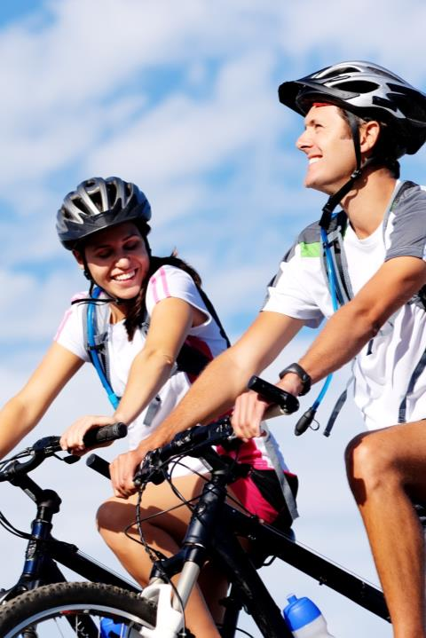
Questions & Comments
Notes:
The last slide should be
Don Scott & Tessa LeSage

