Slide 1

,

Slide 2
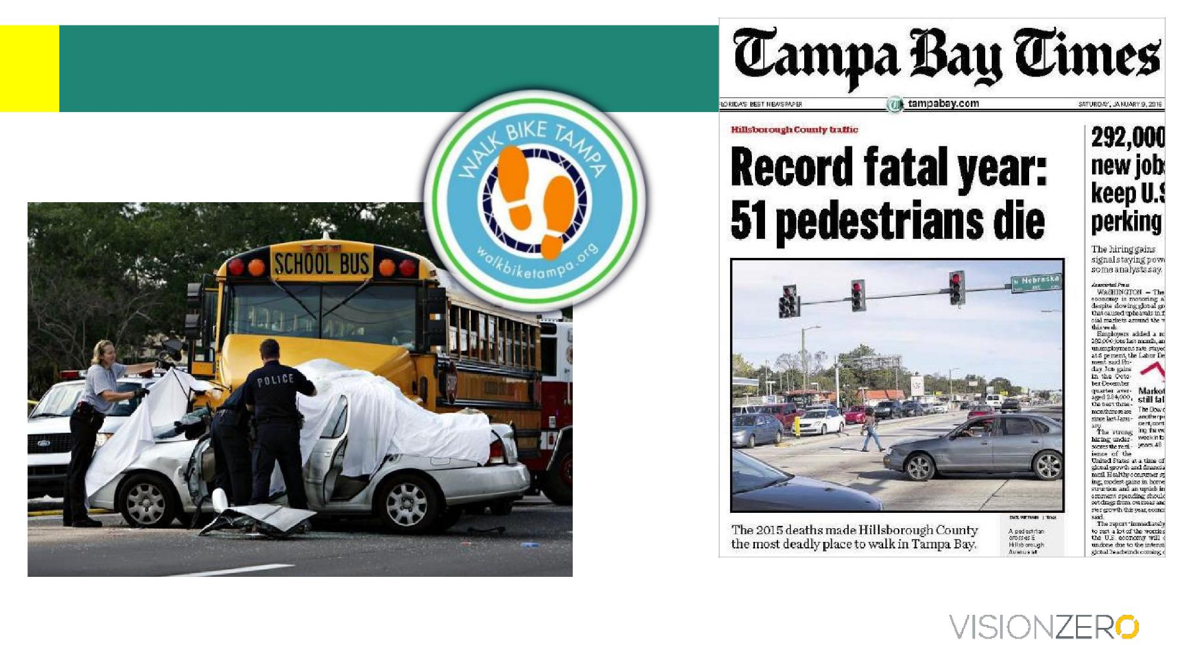
We have a problem to solve
http://www.tampabay.com/news/publicsafety/accidents/car-bus-crash-kills-one/441282
VISION ZERO IN HILLSBOROUGH COUNTY TODAY

Slide 3

What does the data tell us about our county?
For every 1 fatal crash, 8 incapacitating injury crashes. Altogether ~1500 /year.
75% of fatal crashes occur on roads with | posted speeds 40 mph +, | whether they involve
pedestrians, cyclists, or are strictly vehicular. 75% of fatal & incapacitating injury crashes occur on only
 | one-third of our roads.
33% of fatal crashes involve | aggressive driving. | (It’s 42% of fatal vehicular crashes.)
24% of fatal crashes involve lack of lighting. (It’s 39% of fatal pedestrian crashes.)
Pedestrian crashes that include injuries are more severe: one-third result in death or incapacitation. We average more than one pedestrian injury crash every day.
In the US, motor vehicle crashes are the leading cause of death for young people <35 yrs.

Slide 4
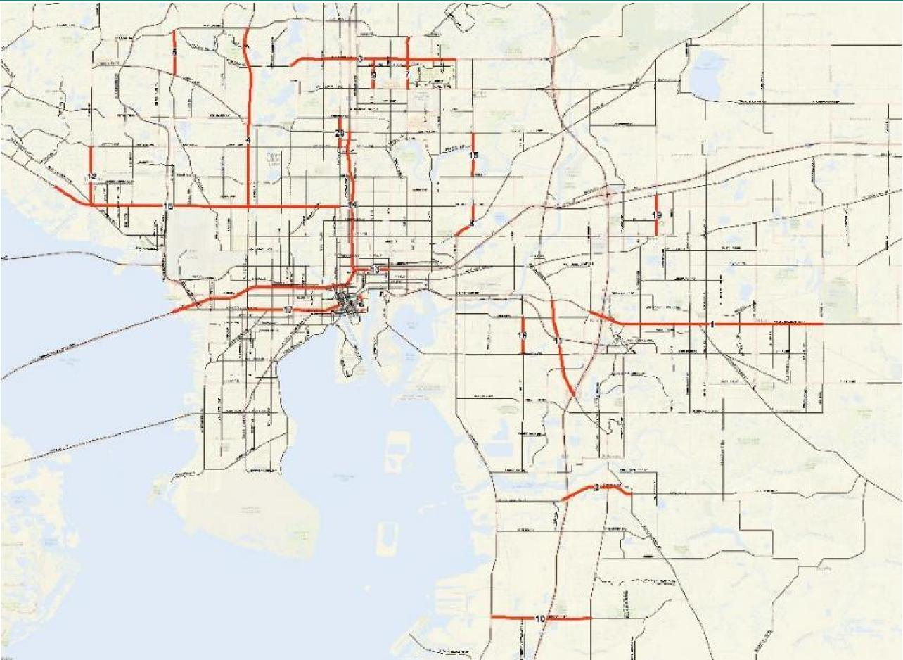
Focus resources
Top 20 corridors
63 miles of
roadway
(only 4% of our roads)
1030 severe
crashes in five
years
(not fender benders)
90’s-era
suburb
“Commuter college”
70’s-era
suburb
I-75 I-75
Down-
town
80’s-era
suburb
I-75 I-75

Slide 5
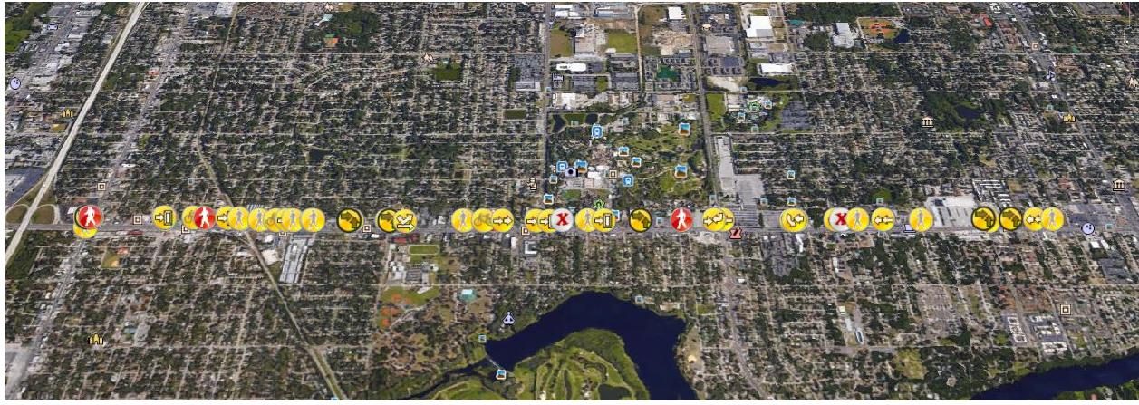
Posted speeds 40+ mph: three-quarters of fatal crashes
East Tampa, 45mph posted: Busch Boulevard
6-lane divided -- 15 fatalities & 110 serious injuries, 5 yrs

Slide 6
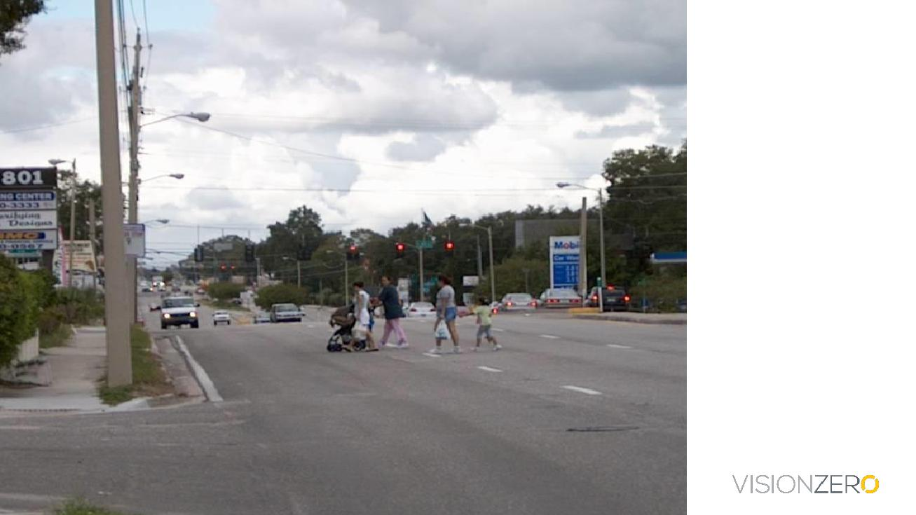
Why would anyone do this?

Slide 7
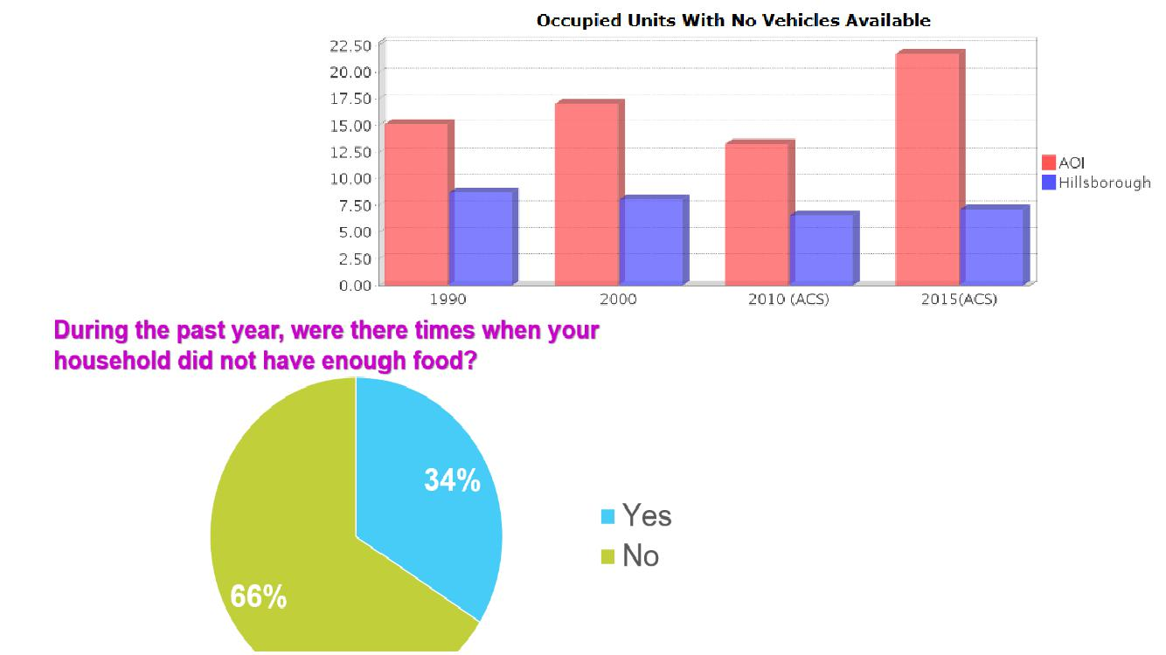
What if getting to the grocery store means crossing Busch Blvd? With bags? And kids?
What if the closest crosswalk is ¹/₄ mile away?

Slide 8
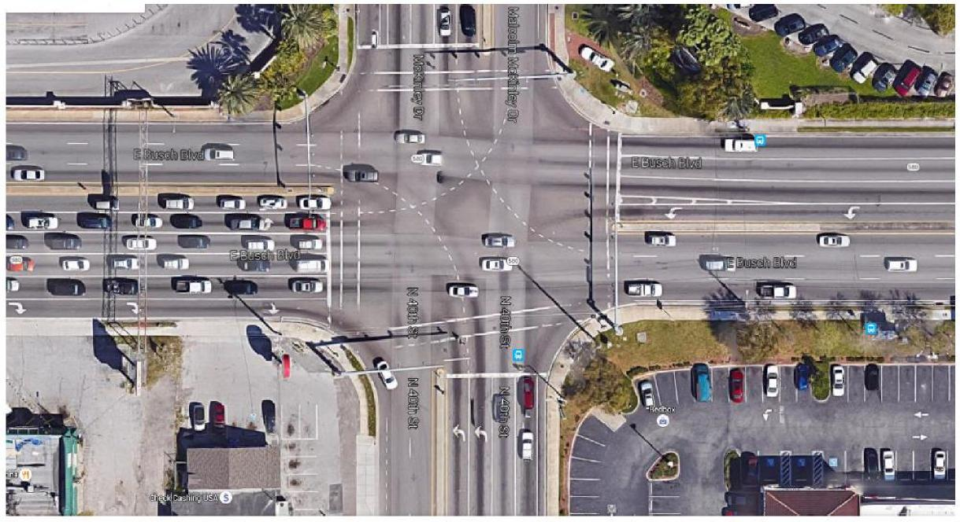
An example ...
Busch Blvd & 40th St
Tourists
USF students
Stores & employers
Popular bus route
Adjacent transit-oriented neighborhoods
Nine lanes to cross on Busch at this intersection
Posted speed limits: 45 mph
Distance to next signal-protected crosswalk: .6 mi
8

Slide 9

Lessons from other Vision Zero Communities
Traffic
violence is a
public health
crisis
VISION ZERO
is a national
movement
ZERO
is the right
number
We get what we build for
Storytelling is central
Reducing
speeds is
critical- and
possible
Implementation
& enforcement
must be
equitable
Data isn’t a
one-way
street
Not just about
individual
drivers
Ensure
everyone has
a voice
VISION ZERO CONCEPTS AND PRINCIPLES

Slide 10
Zero is the Right Number
Debbie Hersman, the president and CEO of the National Safety Council, “That’s the goal. We’ve done this with aviation—there have been several years with zero deaths in commercial aviation—and a lot of people thought that was impossible.”
“Railroad crossings are in nearly every city and town across America,” said (former) U.S. Transportation Secretary Anthony Foxx. “Federal Railroad Administrations new website is an important tool to help us achieve our goal of zero deaths at crossings and along tracks.”
In Oct. 2016, Federal Highway agreed! "Our vision is simple – zero fatalities on our roads," said U.S. Transportation Secretary Anthony Foxx. "

Slide 11
Why would an MPO establish a VZ program?
Create & build on existing relationships
Support prioritizing money for safety
Empower jurisdictional staff ready to enact change
Why not?!

Slide 12
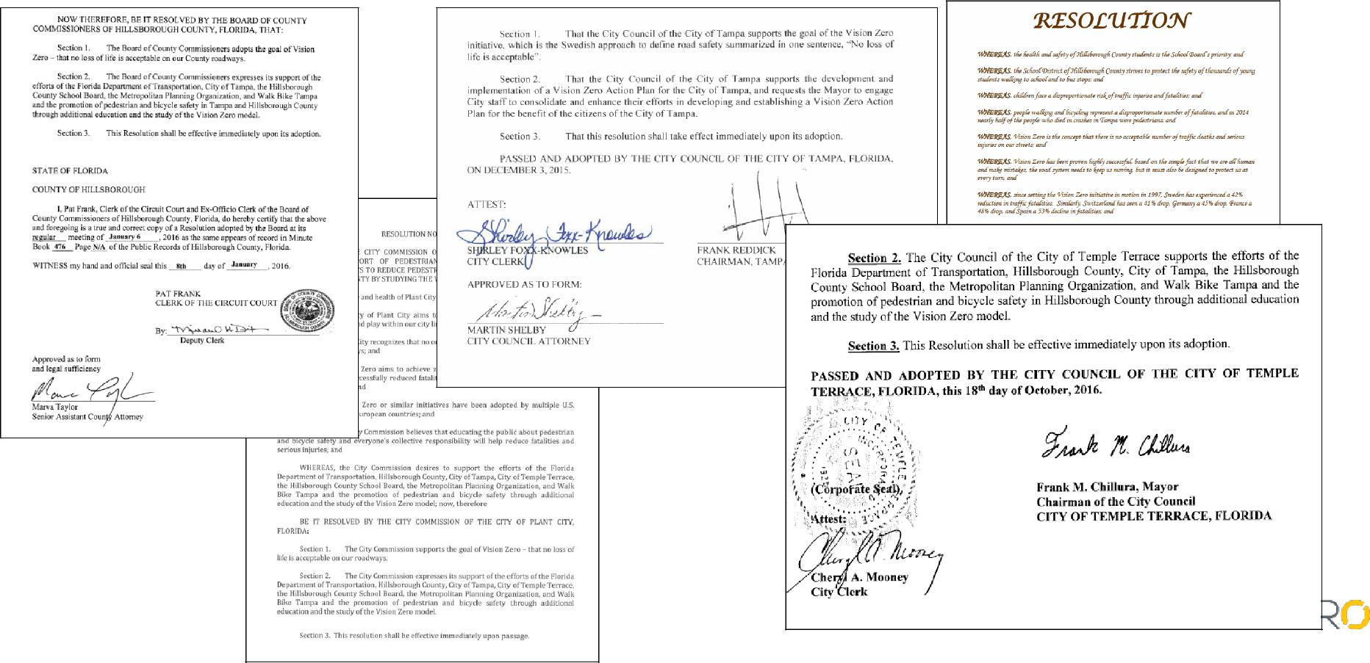
Vision Zero Resolutions

Slide 13
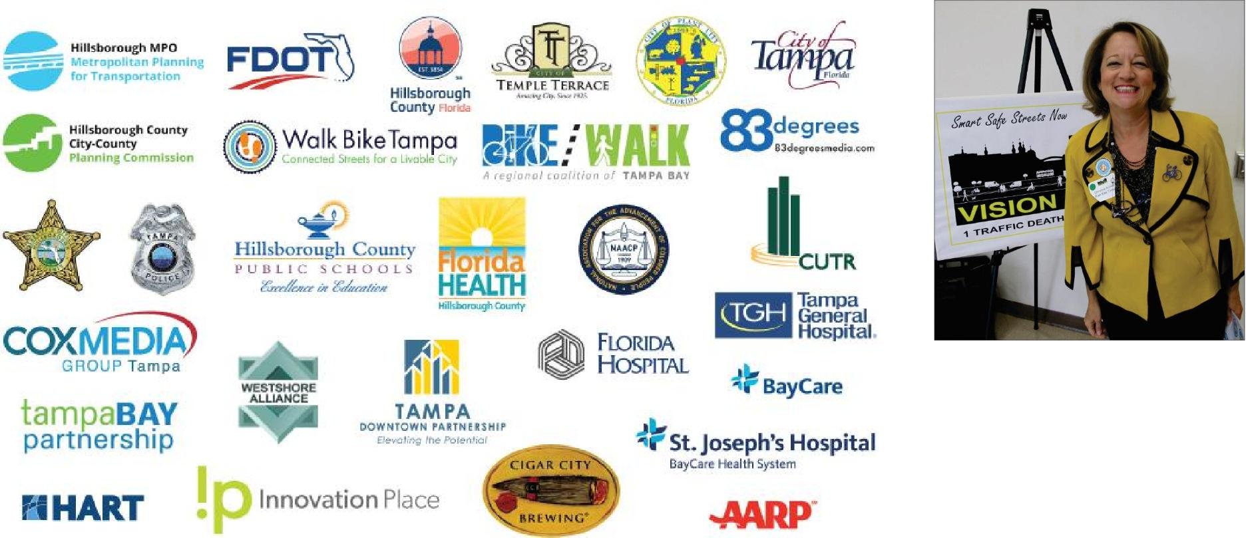

The Vision Zero Coalition
...and growing

Slide 14

Vision Zero Action Plan
Future is not like the past
Consistent & Fair
Paint Saves Lives
One message, many voices

Slide 15
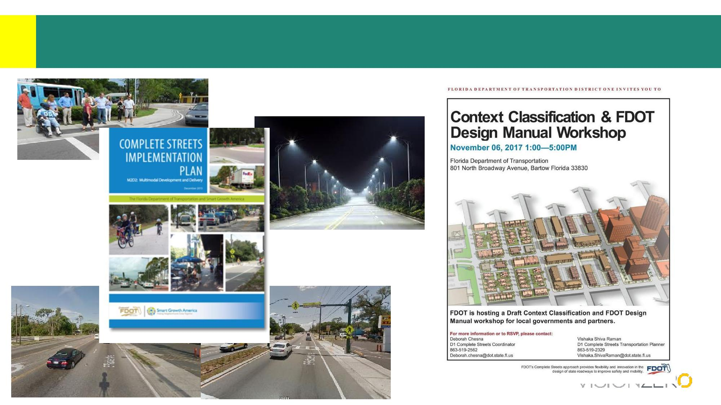
Future is Not Like the Past
Fletcher Avenue, Hillsborough County

Slide 16
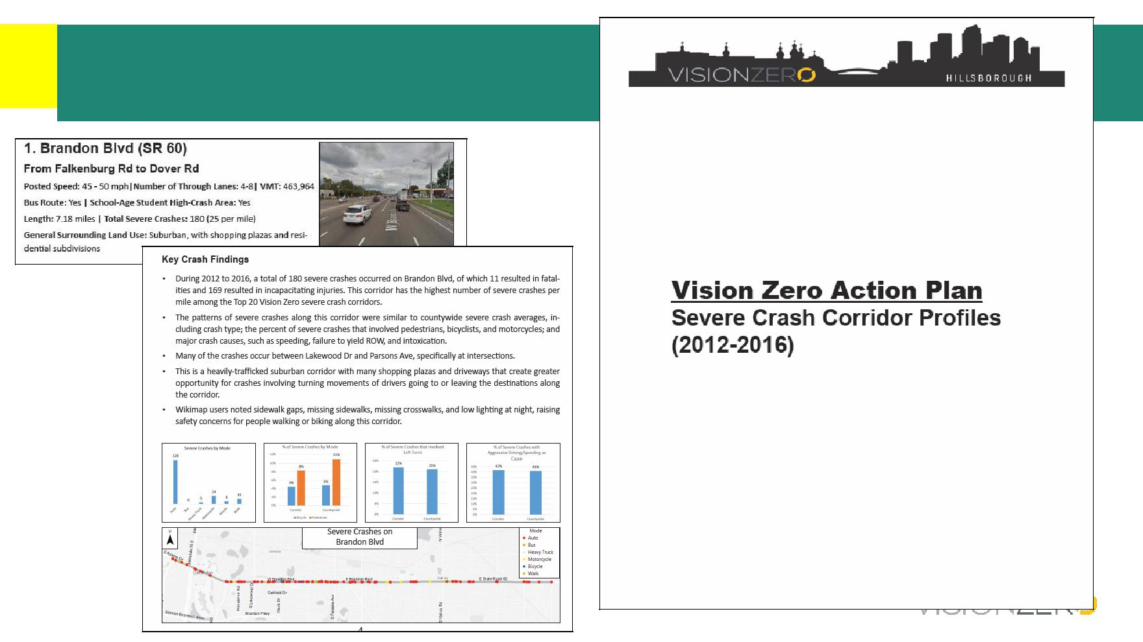
Corridor Profiles

Slide 17
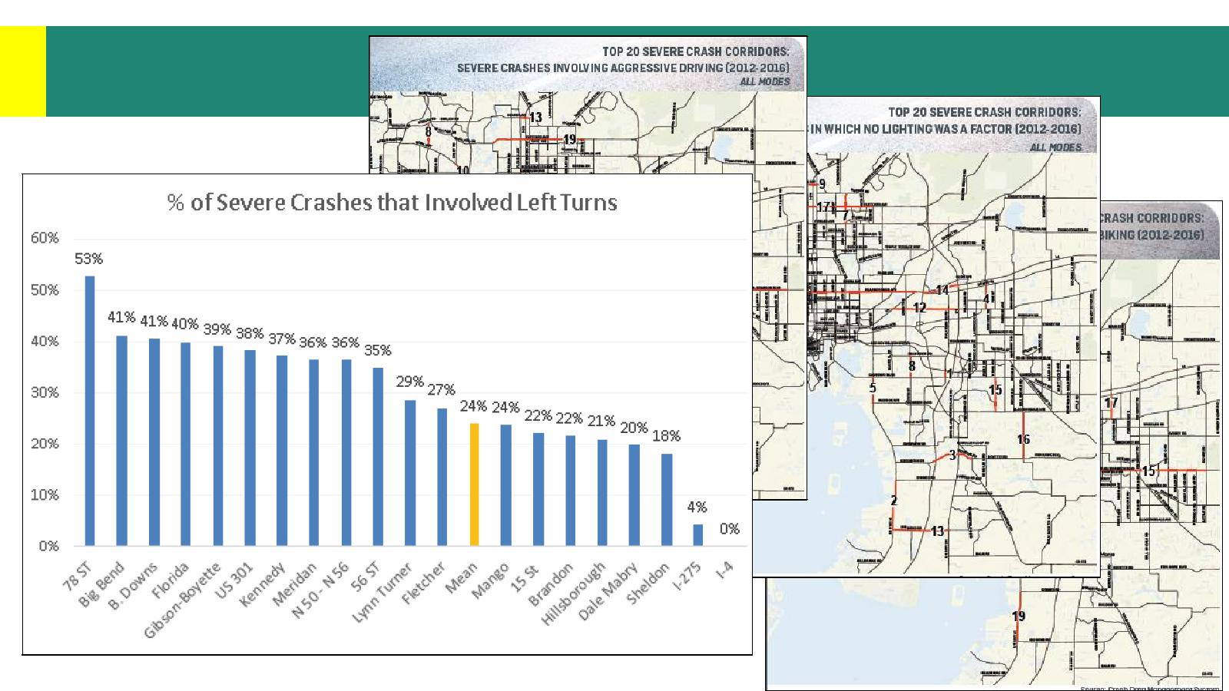
Data-Driven

Slide 18
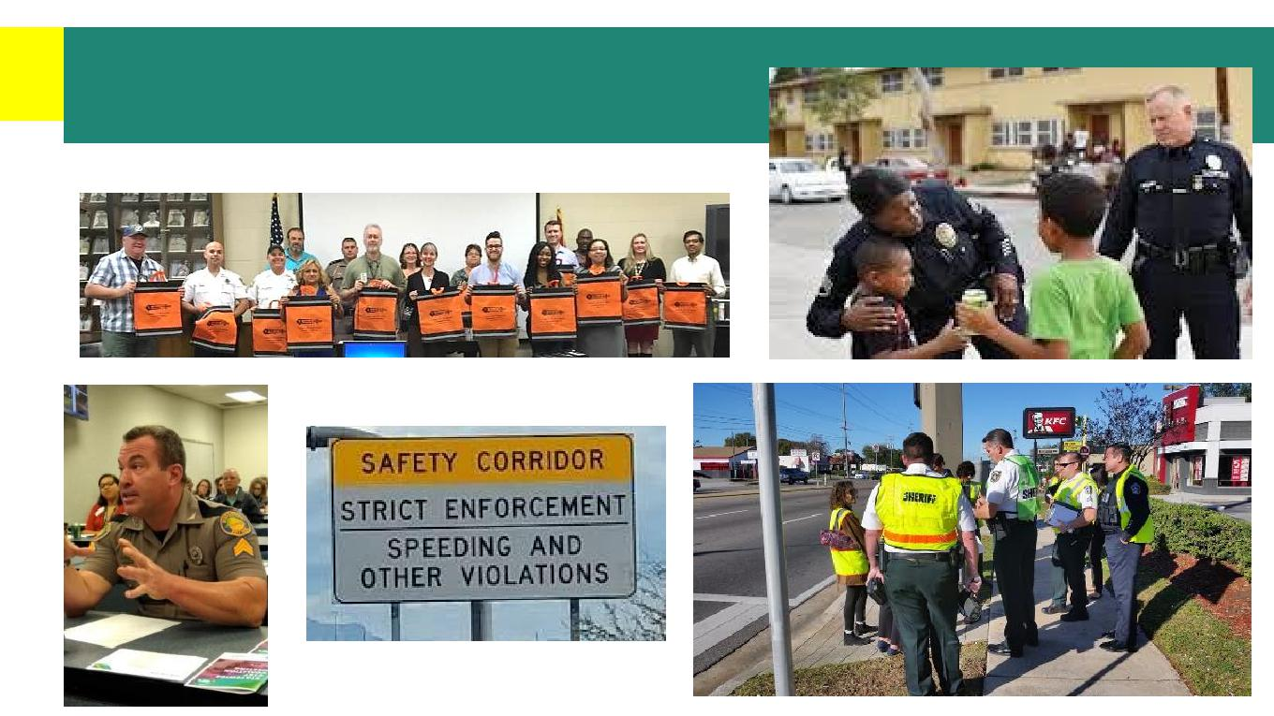
Consistent & Fair

Slide 19
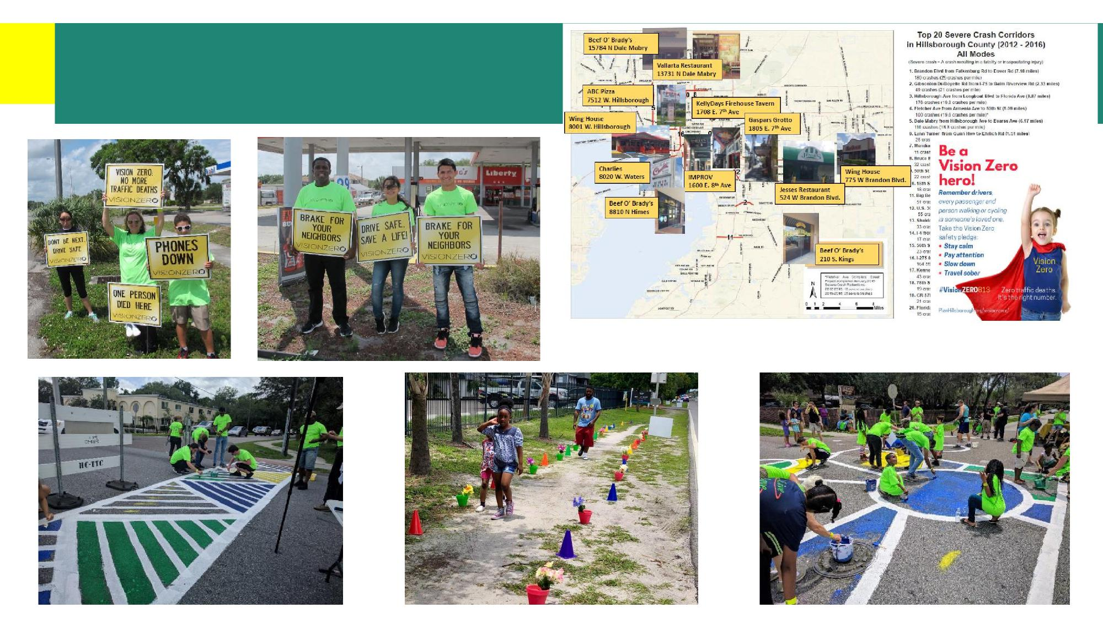
Consistent & Fair

Slide 20
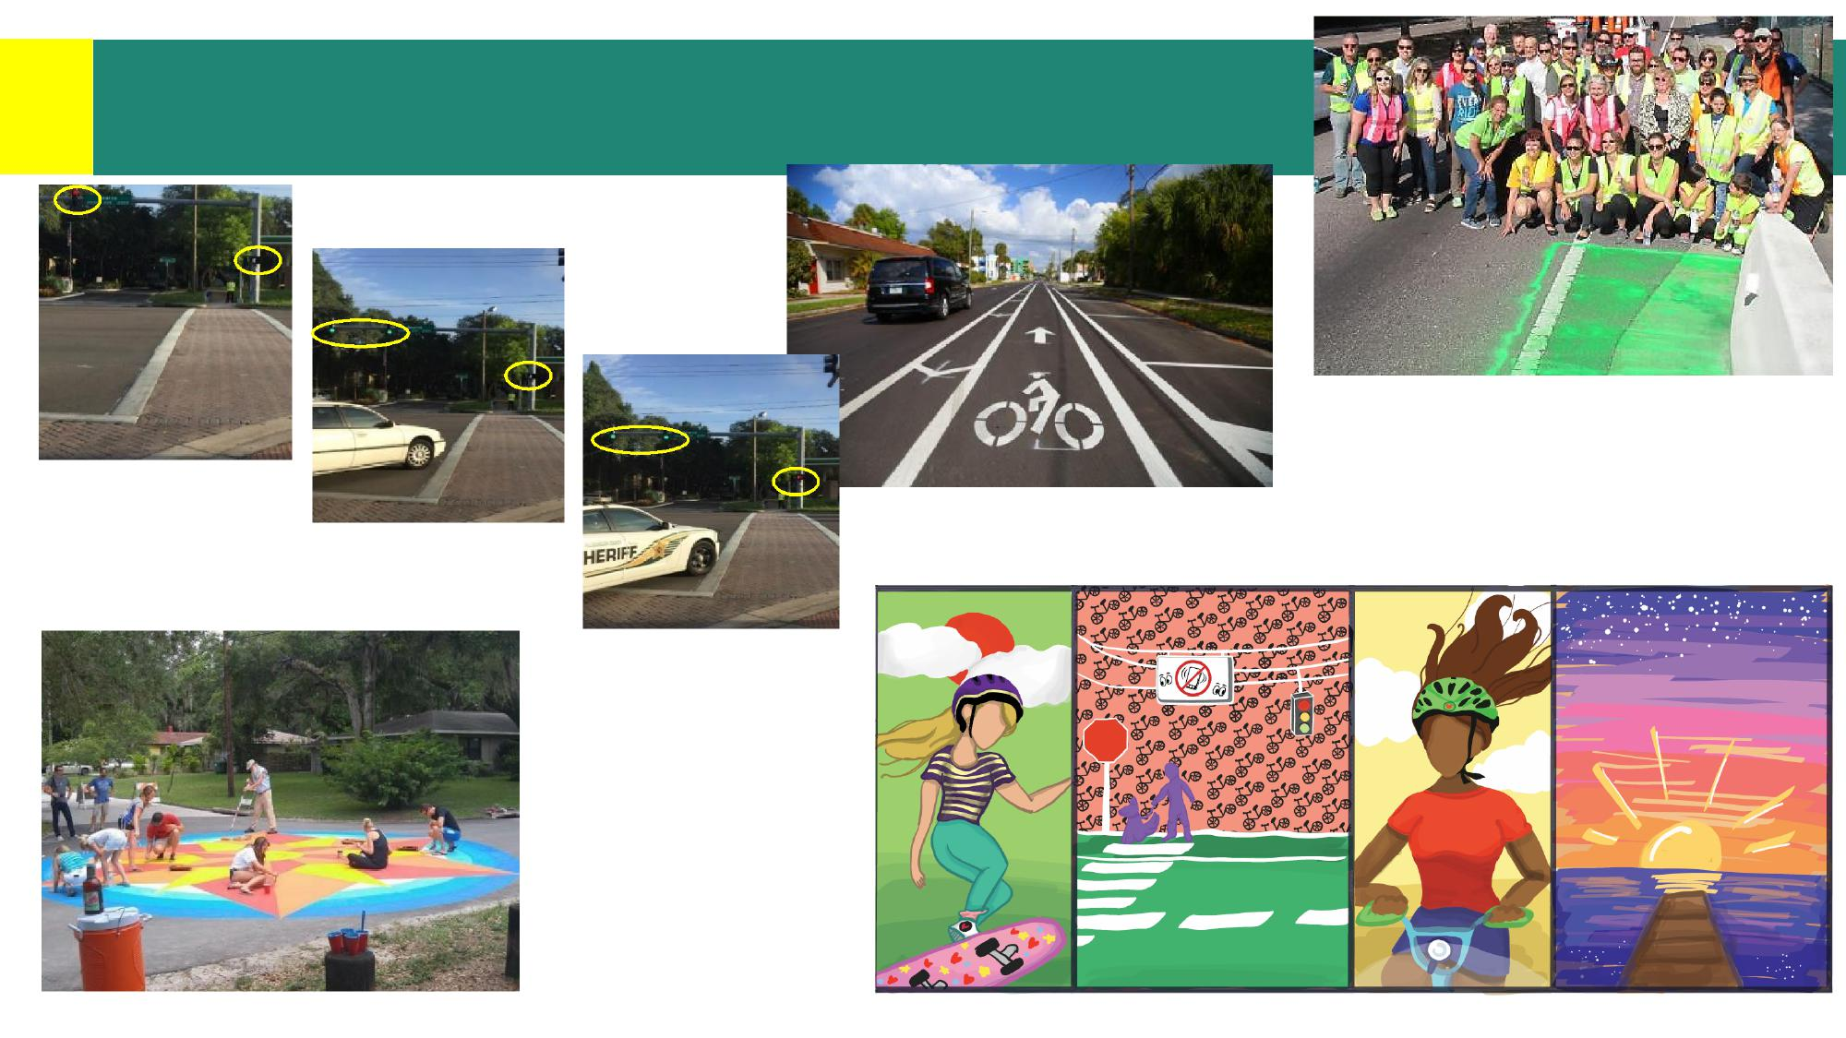
Paint Saves Lives
Start
LPI 5 seconds later
End LPI

Slide 21
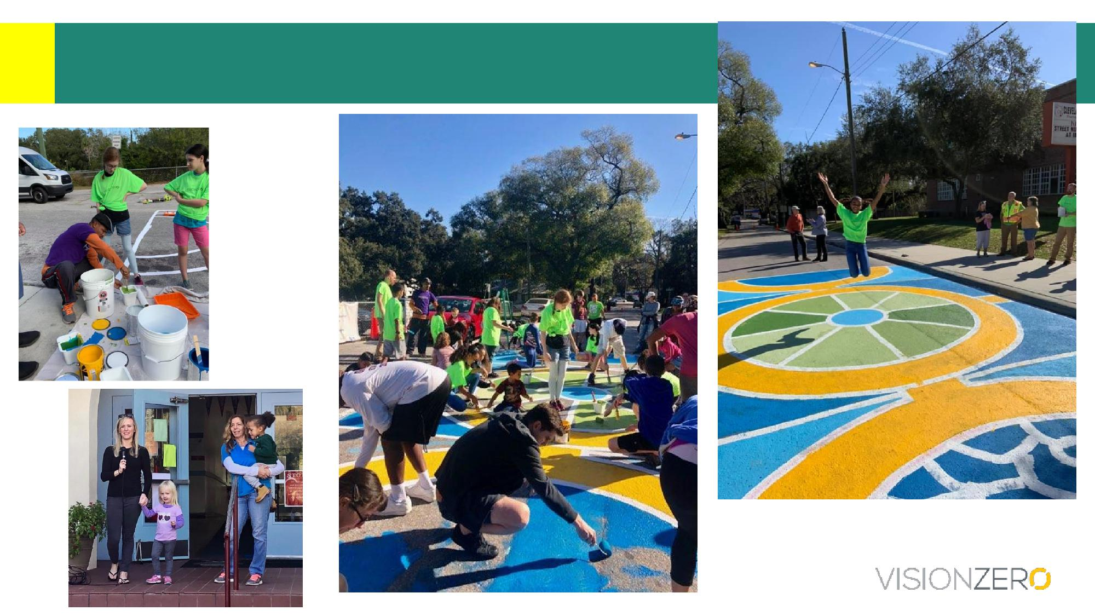
Paint Saves Lives

Slide 22
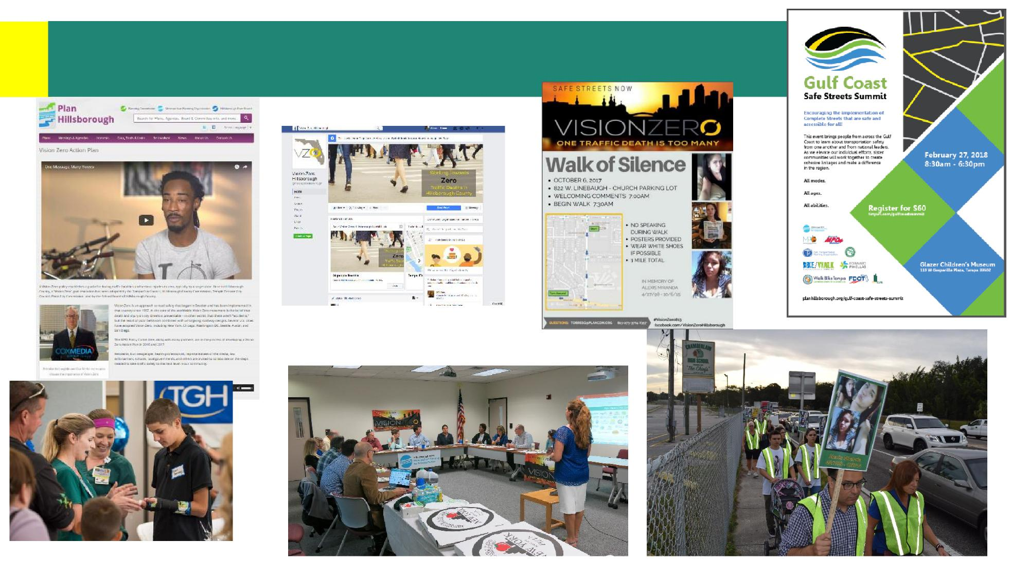
One Message, Many Voices

Slide 23
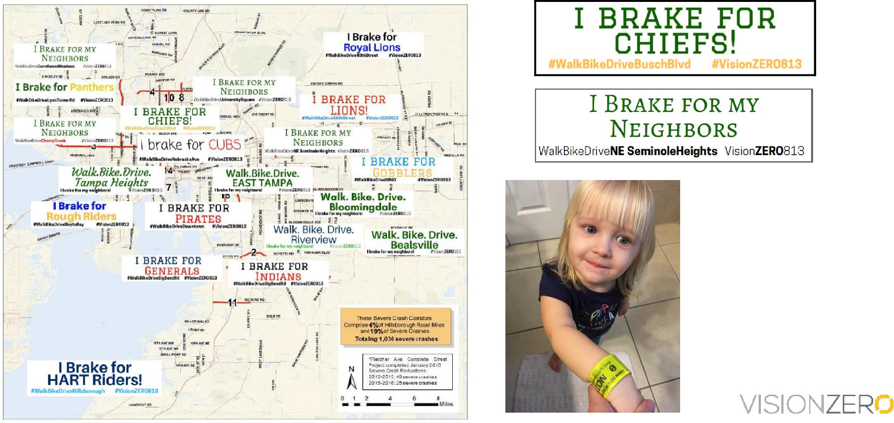
One Message, Many Voices

Slide 24
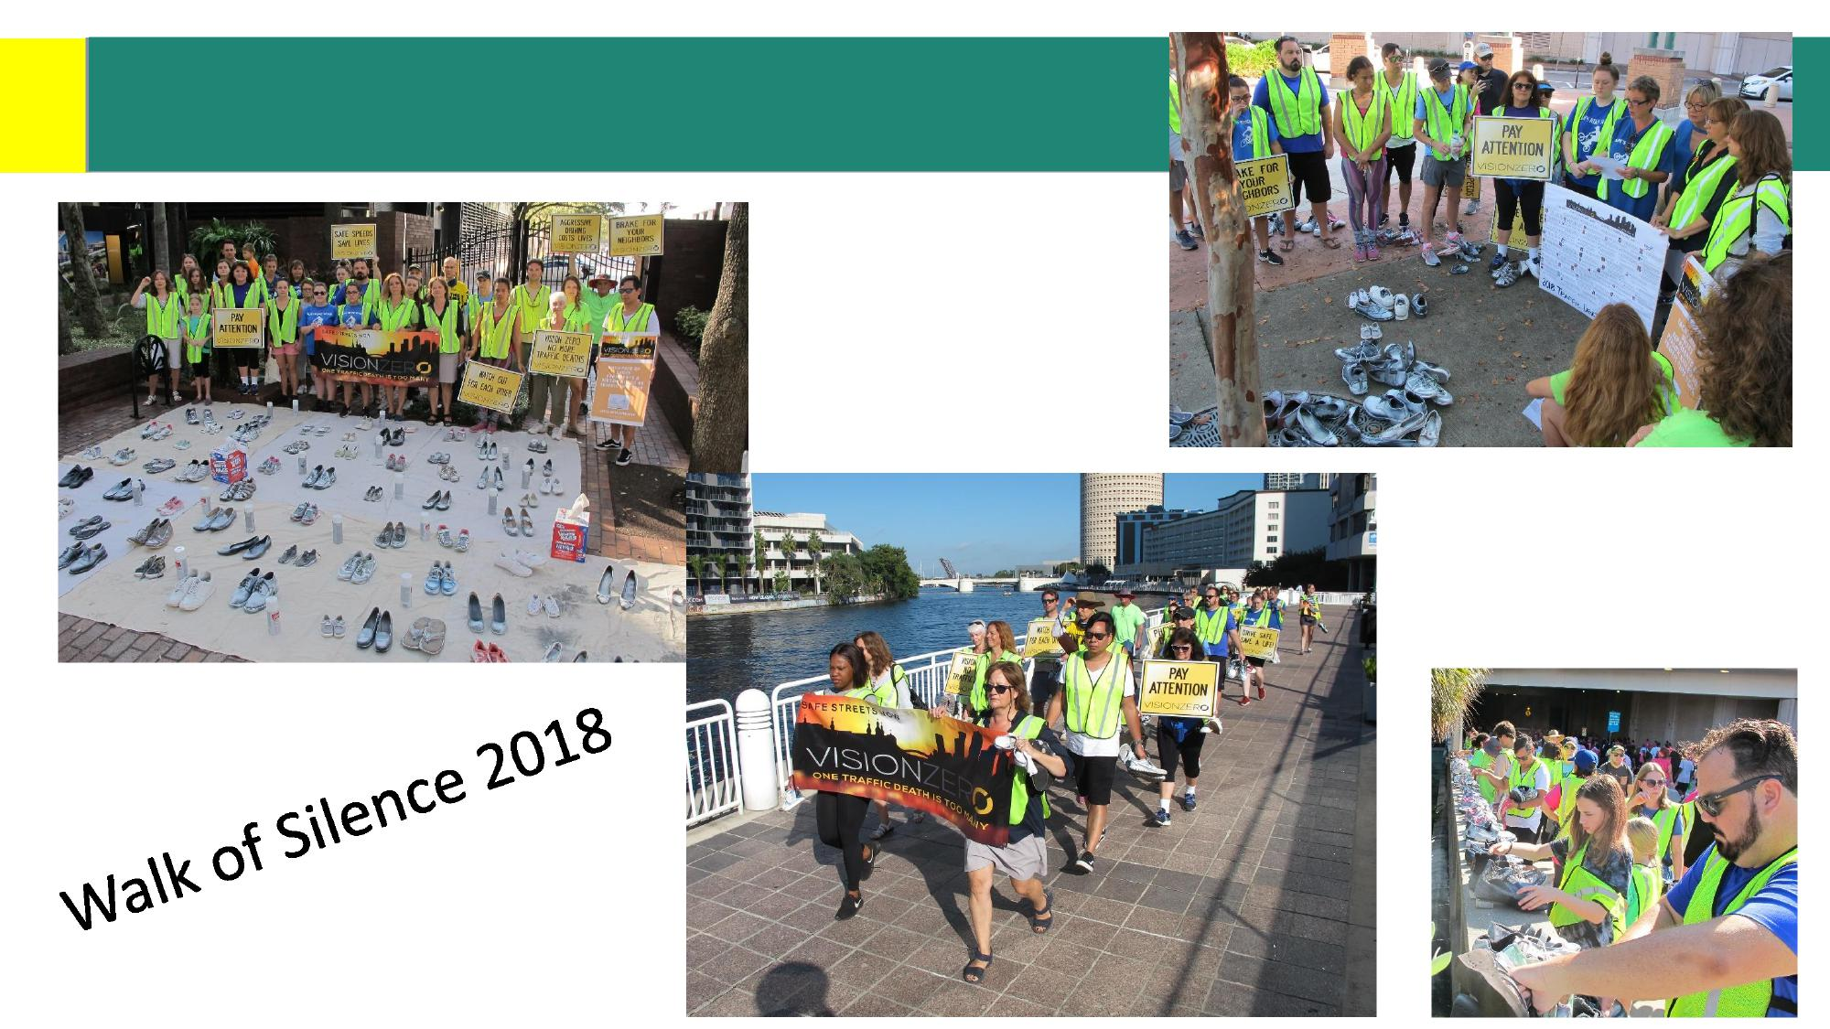
One Message, nMany iVoices

Slide 25
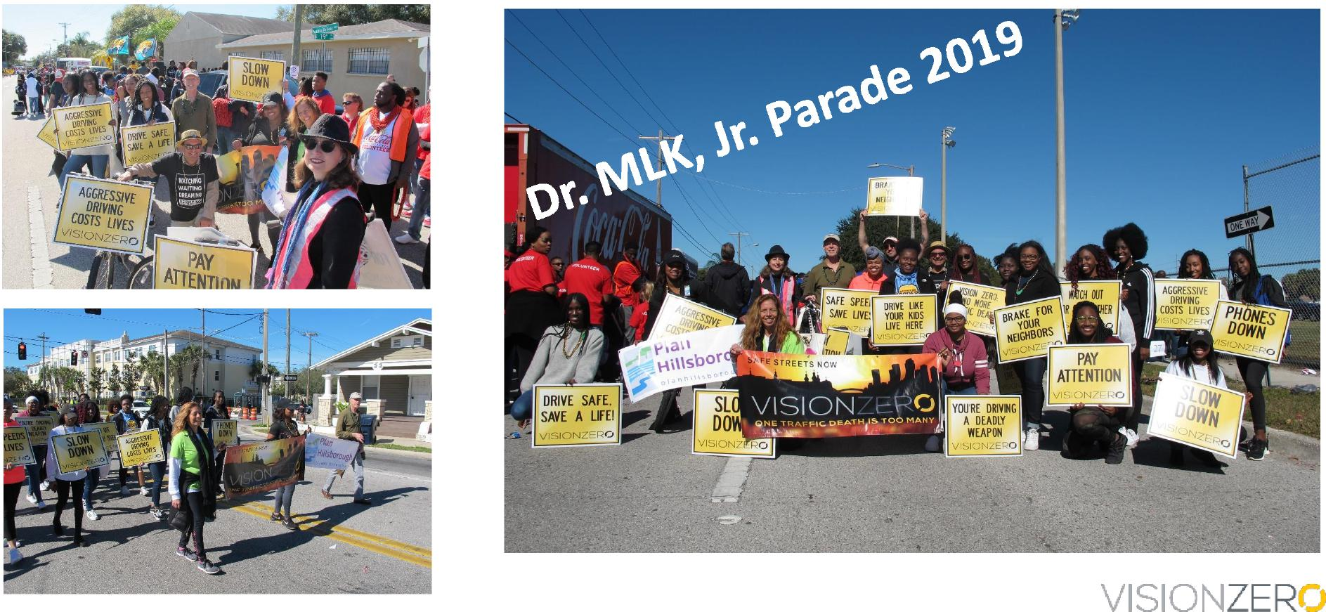
One Message, Many Voices

Slide 26
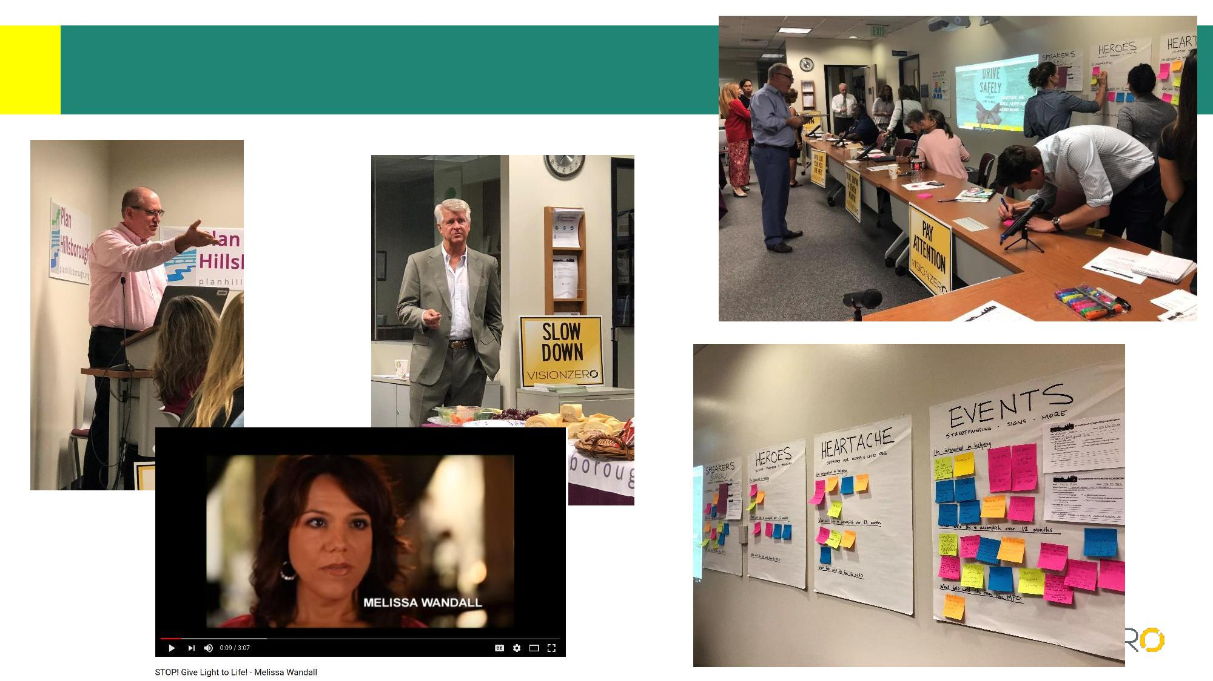
Hold Quarterly Meetings

Slide 27
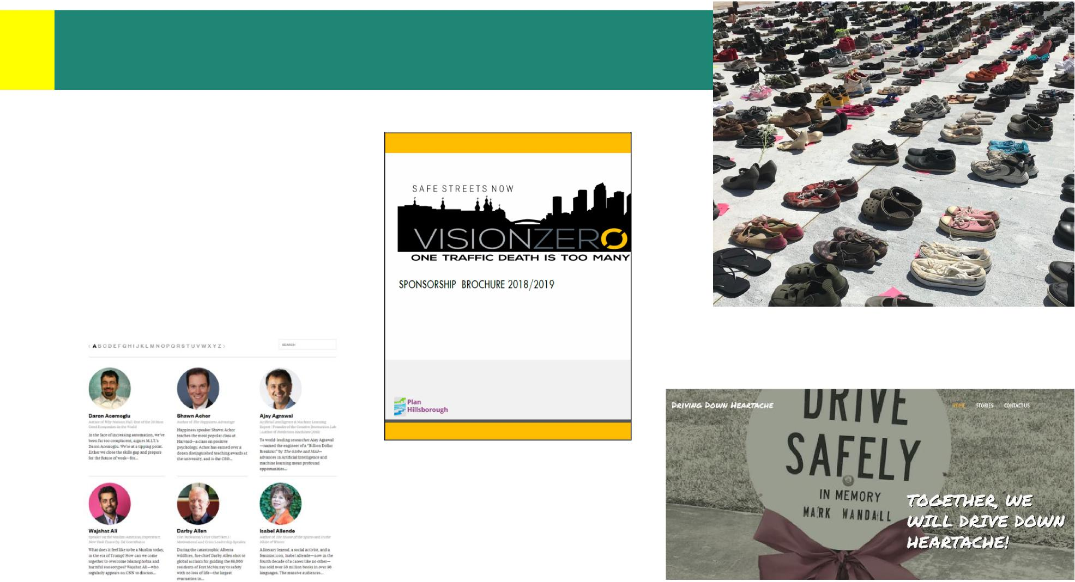
Form an Executive Board
Speakers
Heroes
Events
Heartache
Legislative

Slide 28
What’s next?
Limitations under a government agency
Form a non-profit?
Partner with an existing non-profit?
Revisiting prioritization
Crash Modification Factors
Comprehensive Approach to Speed Management

Slide 29

SAFETY of complete streets
ALL CRASHES
Countermeasure | CMF | Crash Type | Star Quality Rating
Implement automated speed enforcement cameras | 0.46 | All | ****
Improve angle of channelized right turn lane | 0.558 | All | ****
Construct gateway monument (on state-owned road) | 0.68 | All | ***
Road diet (Convert 4-lane undivided road to 2-lanes plus turning lane) | 0.71 | All | *****
Changing left turn phasing from at least one permissive approach to flashing yellow arrow (FYA) | 0.753 | All | *****

Slide 30

SAFETY of complete streets
BIKE/PED CRASHES
Countermeasure | CMF | Crash Type | Star Quality Rating
Modify signal phasing (implement a leading pedestrian interval) | 0.413 | Vehicle/pedestrian | ***
Install pedestrian hybrid beacon (PHB or
HAWK) with advanced yield or stop markings and signs | 0.432 | Vehicle/pedestrian | ****
Allow parking on both sides of road | 0.480 | Vehicle/pedestrian | ***
Install raised median with or without marked crosswalk (uncontrolled) | 0.685 | Vehicle/pedestrian | ***
Install bicycle lanes | 0.860 | Vehicle/bicycle | ***
Permit right-turn-on-red (or No Turn on Red) | 1.690 (0.592) | Vehicle/bicycle, Vehicle/pedestrian | *****

Slide 31
Feeds into:
Congestion Management Process
GOAL 1:
Improve Reliability of Travel
Strategy 1-A:
Reduce the frequency and severity of
crashes focusing on highest crash areas
Safety Target Setting
In order to reach the adopted high-investment goal of reducing
crashes by 51% by 2040...Must Reduce Crashes 3.4% every year
System Performance Report (safety correlated with health & EJ)
Tampa’s food deserts often face: Low sidewalk coverage Low non-motorized access to fresh produce High Respiratory Hazard Index Diabetes, obesity, asthma Poor physical & mental health | Did you know? You are 20% more likely to be in a serious crash if you live in a community of concern in Hillsborough County.

Slide 32
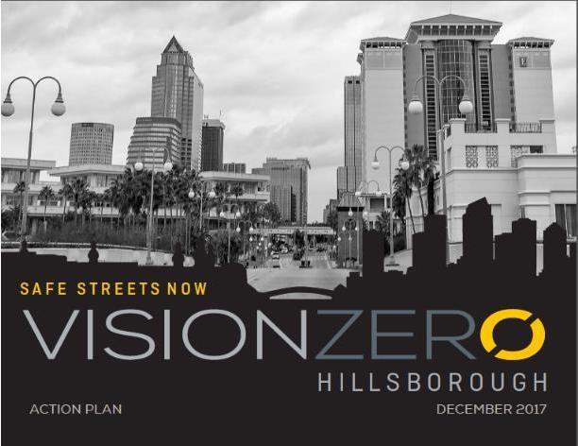


Contact Information
Visit the Vision Zero Hillsborough Webpage http://www.planhillsborough.org/vision-zero/
 | Follow us on Facebook! Vision Zero Hillsborough

