Slide 1
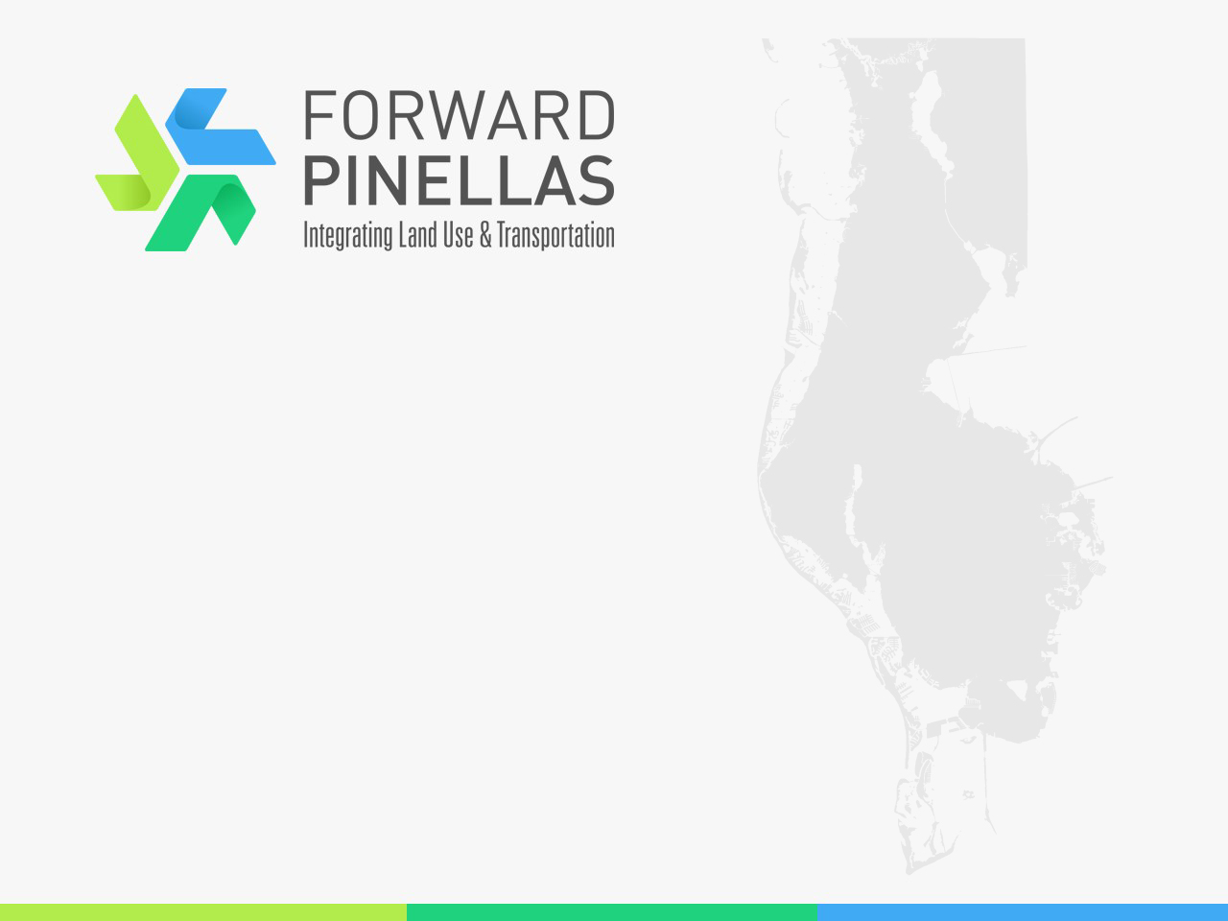
Complete Streets Grant Program

Slide 2

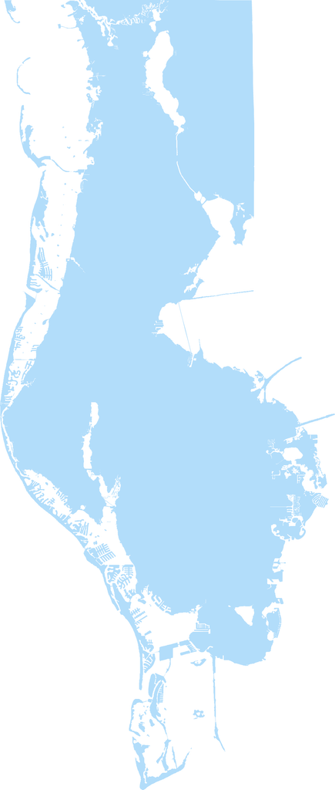



Who is Forward Pinellas?
Special Act in 2014 created a 13-member board for countywide land use and transportation planning
  Rebranded in 2016
Mission:
  Align resources and plans that help to achieve a compelling vision for Pinellas County, our individual communities and our region
Provide leadership and technical assistance for 25 local governments

Slide 3
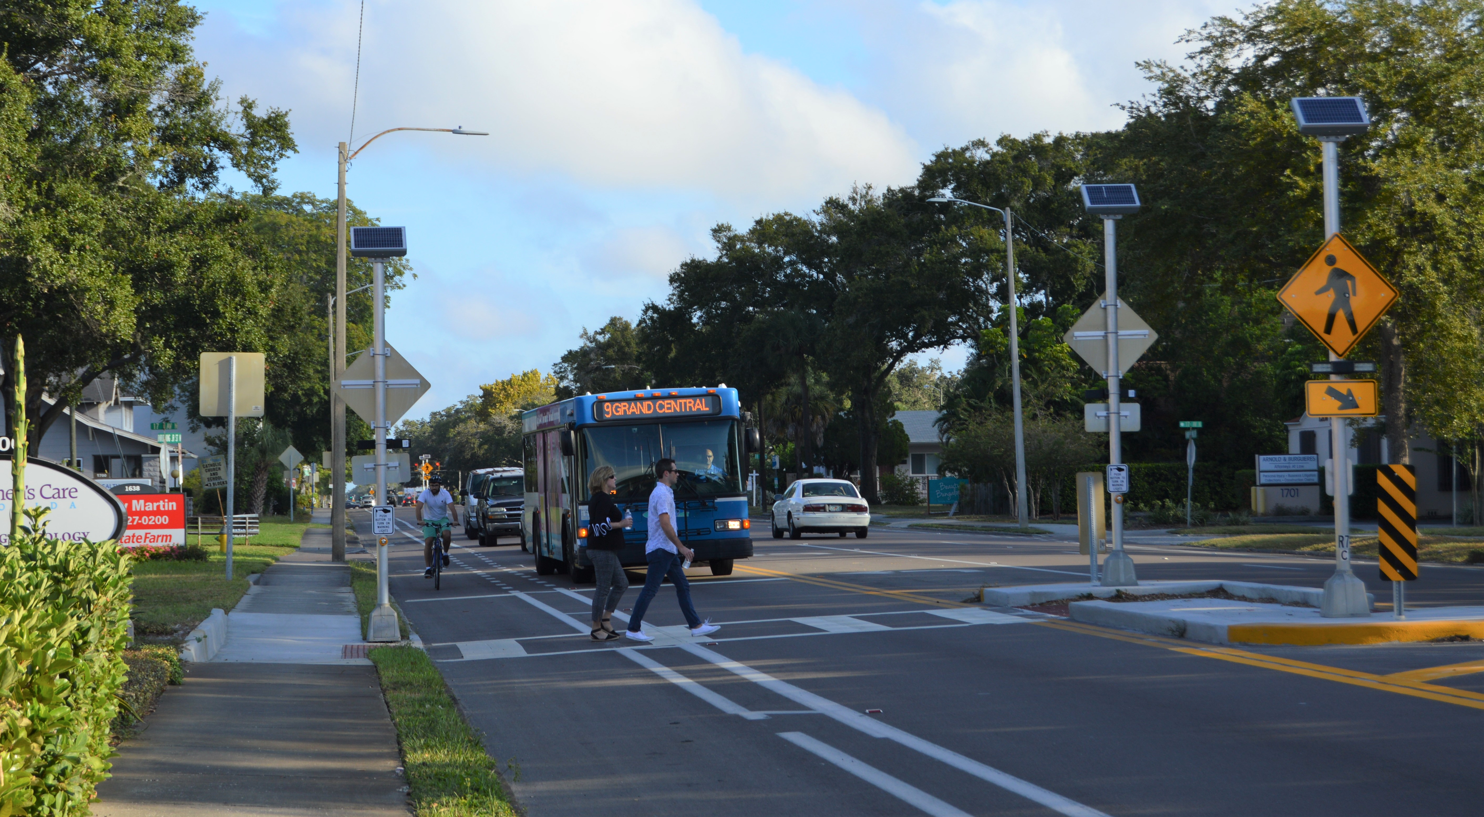
Complete Streets Program
Competitive Grants
$100K for Concept Planning
  Agency planning budget
$1M for Construction
  Programmed in TIP

Slide 4
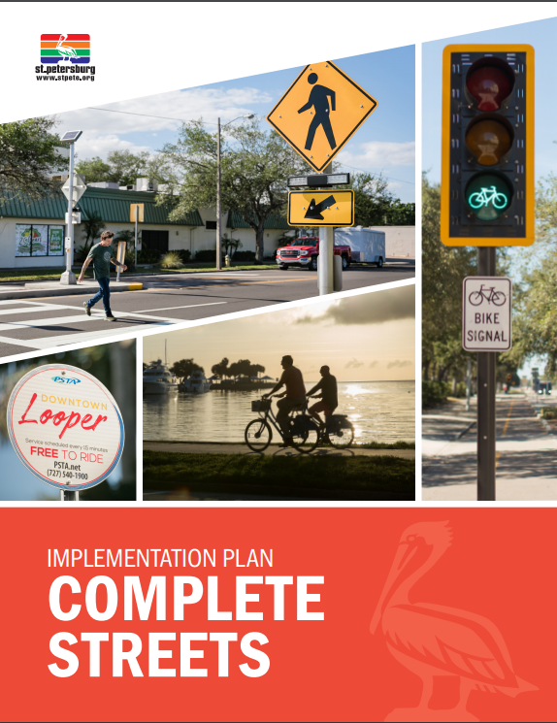
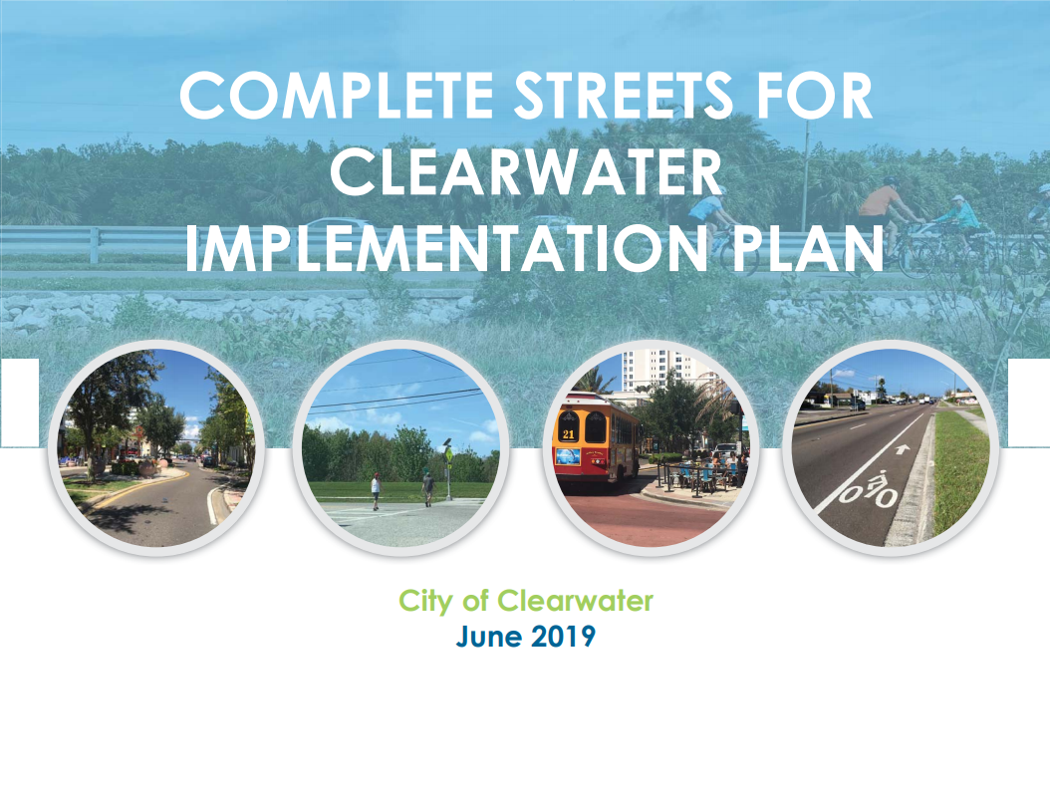
Policy vs Funding
Defer to local policies
Leverage redevelopment with transportation investment
Best ability to implement projects: fund them

Slide 5
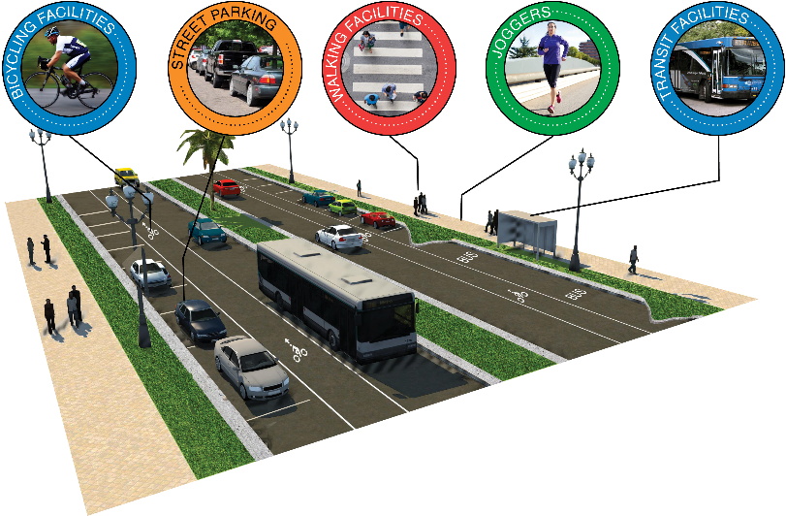
Criteria – Concept Planning Projects
Support from elected board
Demonstrate how project will be a catalyst for transformative change
Supporting information:
  Existing facilities (all modes)
  How project will serve multiple modes
  Local planning requirements along corridor
  Existing land use characteristics
    Vacant and/or underutilized parcels
    Land use diversity
  Demographic info on surrounding area
  Plan for implementation
Added
Added

Slide 6
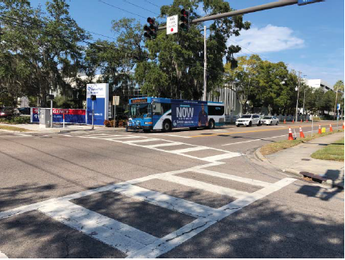
Concept Planning – Example of Funded Project
Clearwater
Linking 3 activity centers with diverse uses
Low vehicle ownership rates
Underutilized properties
Corridor includes Pinellas Trail crossing and transit facilities

Slide 7
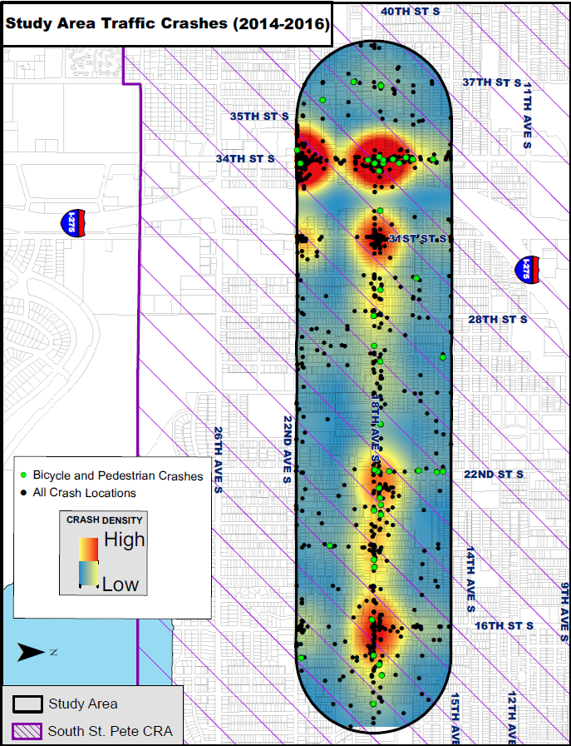
Concept Planning – Example of Funded Project
St. Petersburg
18th Avenue S/Midtown area
Minimal sidewalks
No bicycle lanes
Multiple transit routes
Speed and crash concerns
Mixed use corridor – 17% parcels vacant
Low vehicle ownership rates

Slide 8
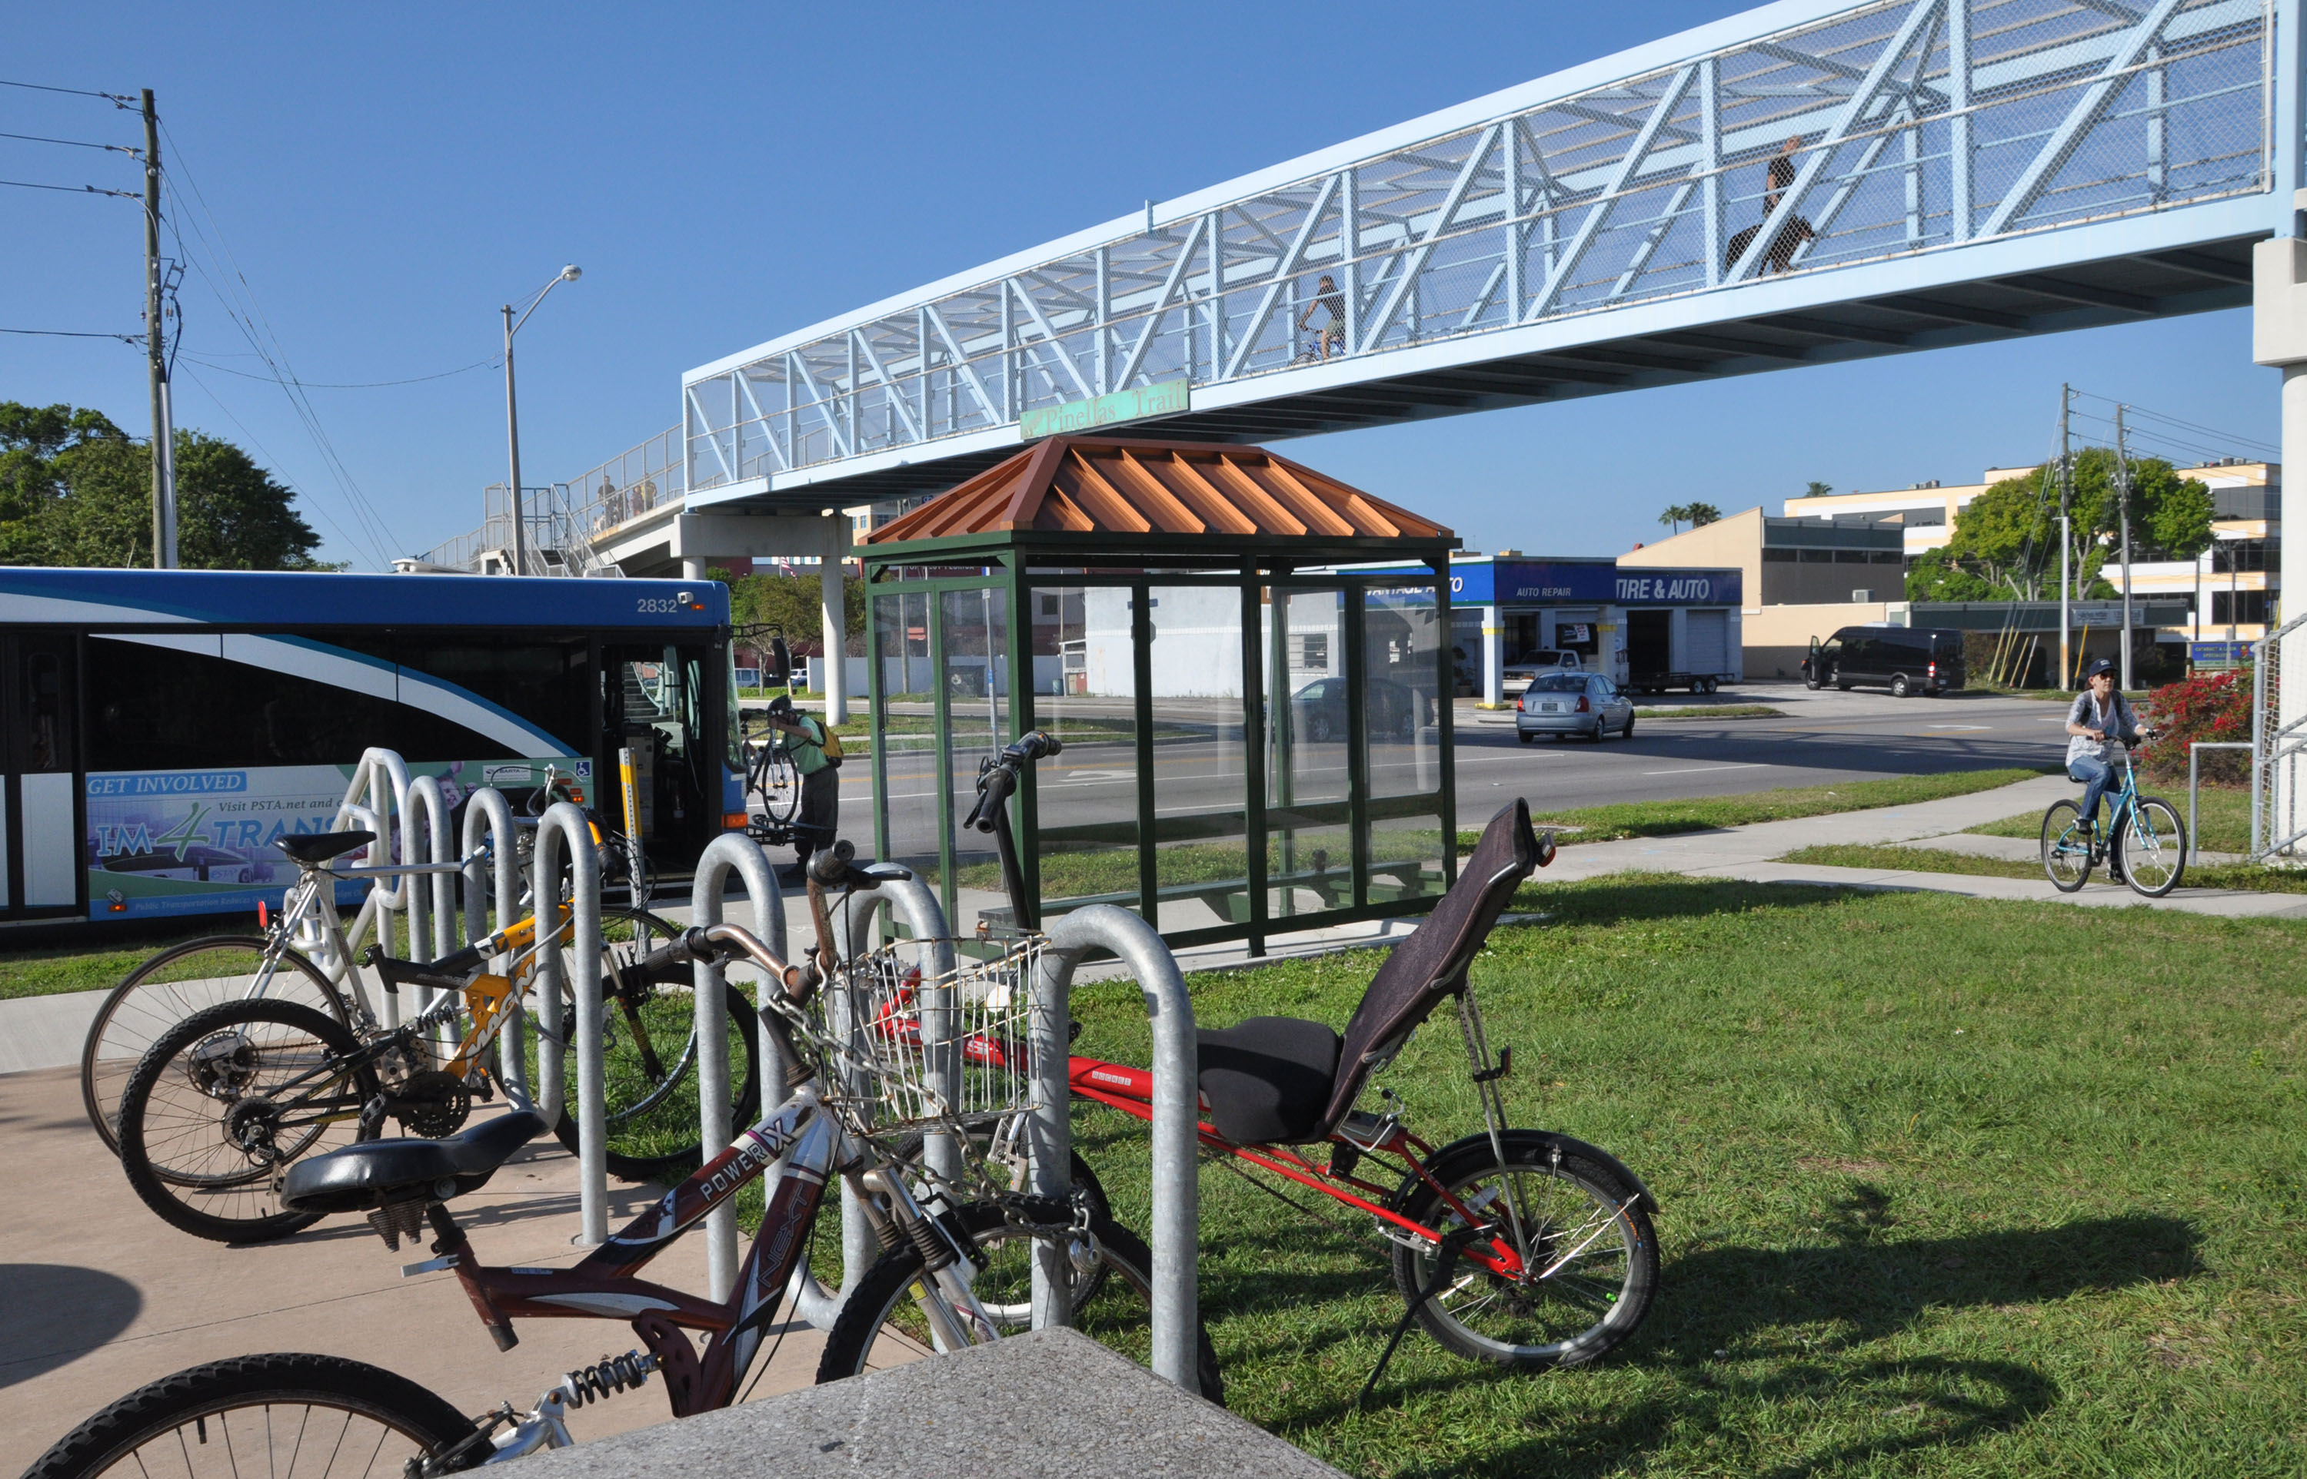
Criteria – Construction Projects
Support from elected board
Must serve multiple modes
Demonstrate how project will be a catalyst for transformative change
LAP Certification
100% of ROW acquired (or easement)

Slide 9
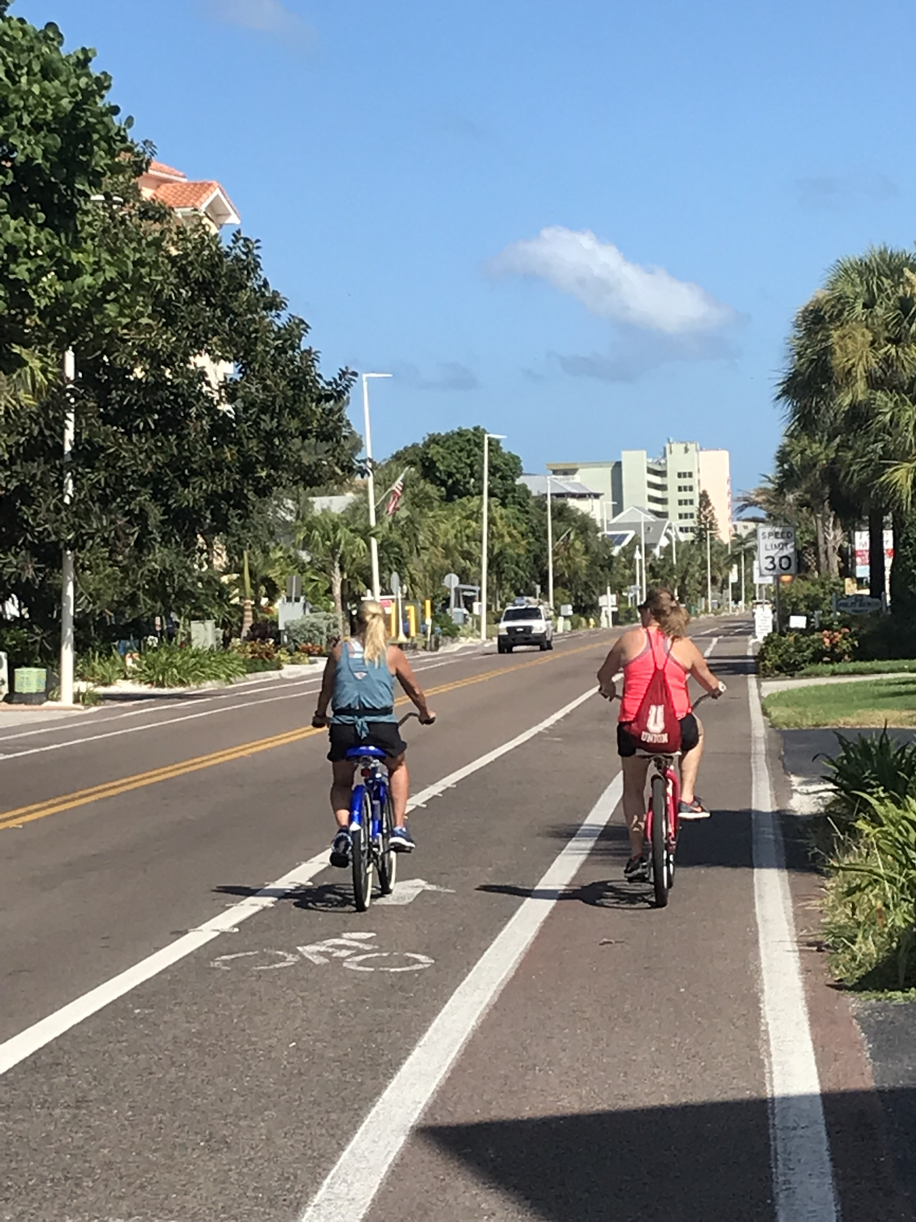
Criteria – Construction Projects
Supporting Information:
  Proposed improvements for all modes
  Safety concerns
  Detailed cost estimates and timeline
  Describe local planning requirements
  Existing land use characteristics
    Vacant and/or underutilized parcels
    Land use diversity within ¼ mile
  Demographic info on surrounding area
    EJ and TD considerations

Slide 10
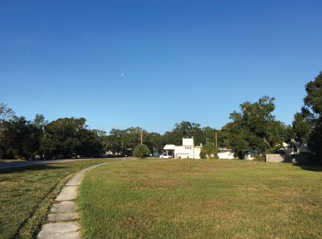
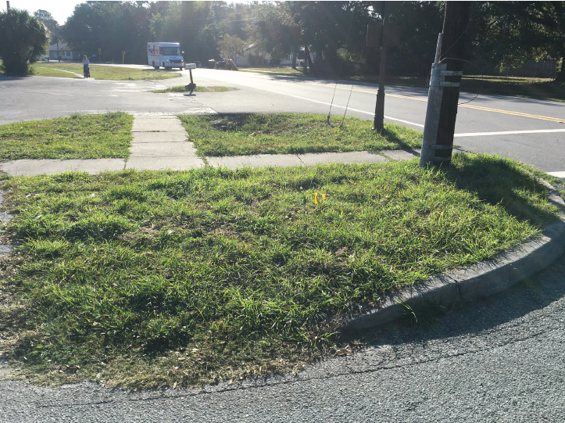
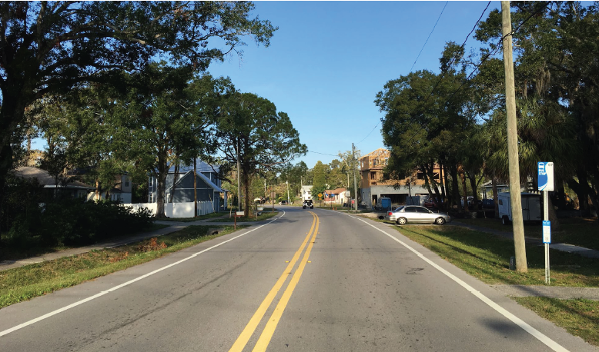
Construction – Example of Funded Project
Oldsmar
½ mile roadway within CRA
Mix of uses along corridor – underdeveloped
No bicycle facilities
Continues completed improvements

Slide 11
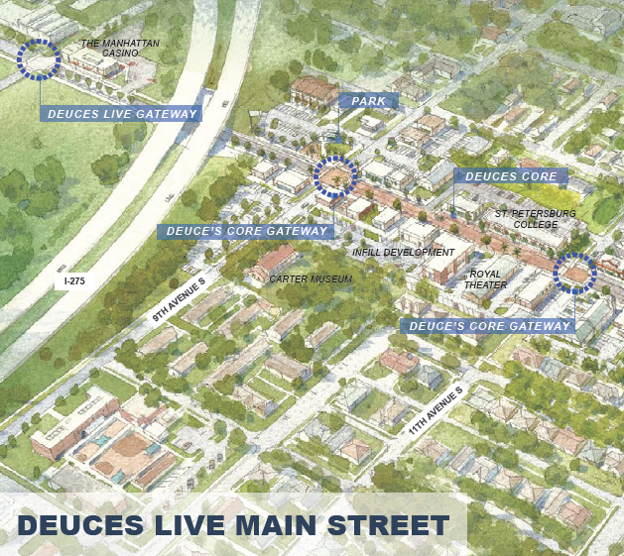
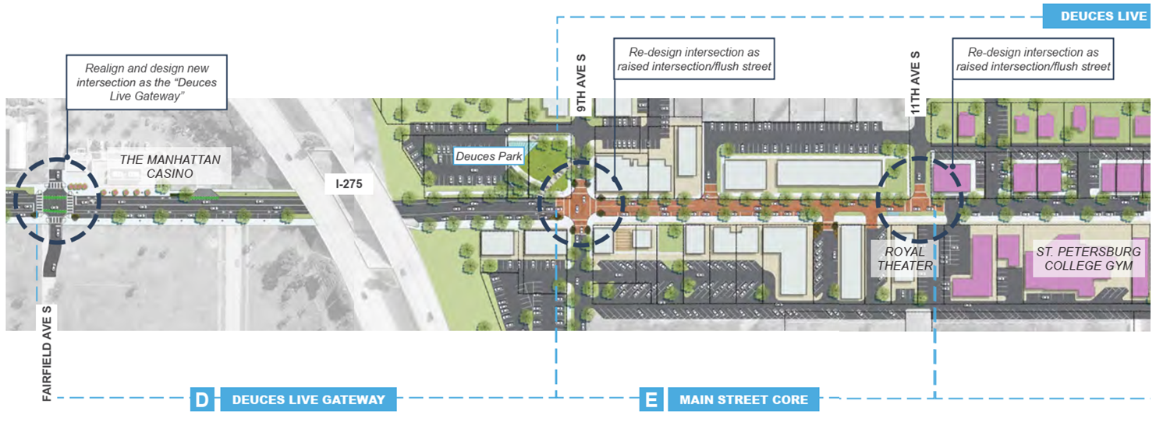
Construction – Example of Funded Project
St. Petersburg
  Add on street parking
  Add bike lanes
  Streetscape enhancements
  Connect 3 parks
  Improve connections to job center
  Includes crossing of Pinellas Trail

Slide 12
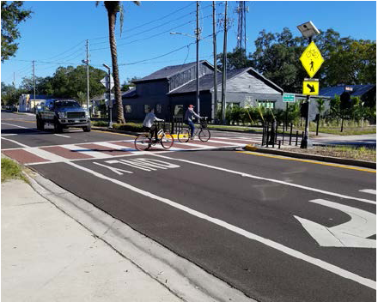
Lessons Learned
Without scoring, strong need for data
  Land use mixture
  Demographics
Establish timeline for projects in advance
  Limitations of grant funding for concept plans
Continuous engagement of board members
LAP is ongoing issue

Slide 13
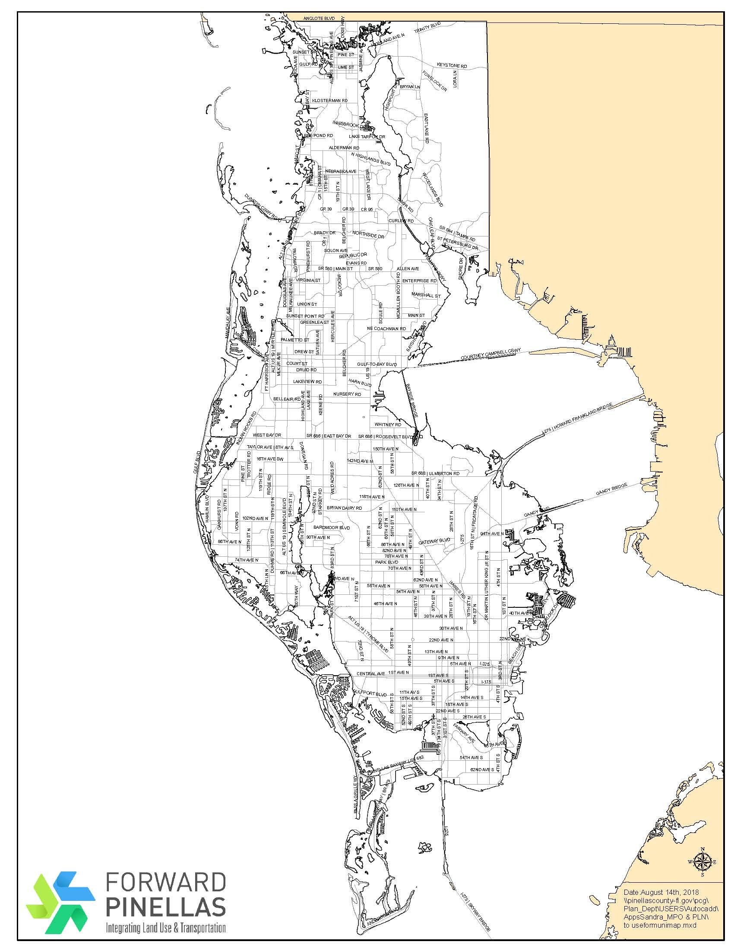


Results – Building Relationships with Partners
3 Years of Funding Complete
Four Construction Projects Programmed in TIP
Five Concept Plans
  3 complete
  2 underway
Added Planning & Place-Making (PPM) grant for land use and redevelopment planning in 2018
Single Call for Projects in 2019:
  Complete Streets
  PPM
  Transportation Alternatives

Slide 14
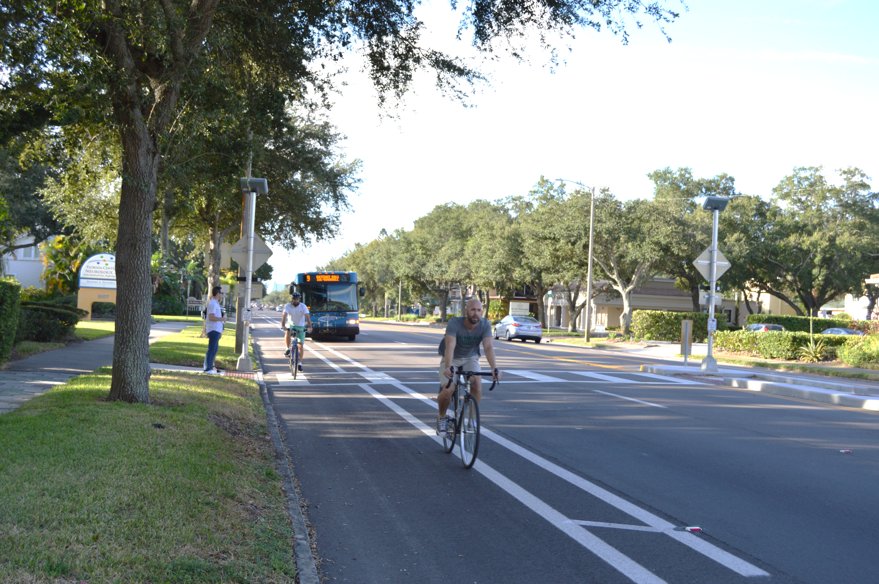
Next Steps
Applications due in December
Evaluate need for additional changes in 2020
Funding set aside in 2045 LRTP to continue program

Slide 15
Questions?
Chelsea Favero, AICP cfavero@forwardpinellas.org

