Slide 1
Florida Metropolitan Planning Organization Advisory Council Meeting
MPOAC Governing Board
January 26, 2017

Slide 2
Call to Order
&
Pledge of Allegiance

Slide 3
Approval of Minutes
July 18, 2016 meeting minutes – in your packet

Slide 4
Public Comments

Slide 5
Executive Directors Report
UPWP Report
  2 Quarterly Reports
  Financial Spreadsheet
MPOAC Weekend Institute Dates for 2017
  April 21-23
  May 19-21

Slide 6
Legislative Update
Overview
Bills Filed
  Texting While Driving – Three Bills
  Local Tax Referenda
  Tolls (HOT and Express Lanes)
  Uber/Lyft Bills
  Please See the MPOAC Legislative Update

Slide 7
Agency Reports
Florida Department of Transportation

Slide 8
Agency Reports
Federal Highway Administration
Florida Division

Slide 9
Bylaws Revision
Staff Directors to meet one month before Governing Board
Will act more like a Technical Advisory Committee
Looked over the bylaws comprehensively

Slide 10
Overview of Changes
Expanded definition of MPO, eliminated TPO definition
No more Chairperson, Chairman, etc – only Chair and Vice-Chair
Allow for two alternates to represent your organization at meetings
No more sub-committees, just committees
Align the appointment of leadership positions with elections
Flexibility in naming member organizations
Agendas distributed 10 days in advance of meeting

Slide 11
Election of Officers
Election of Chair and Vice Chair
  One year terms for each
  Terms start immediately

Slide 12
PL Reserve and Policy
Summary
Have $2M “in the bank”
Unique to Florida
Not subject to Obligation Limitation
  Very generous
Can convert Federal Construction $ to Planning

Slide 13
PL Reserve and Policy
Significant Events
Origins go back further than anyone working today
FY2012/13 - $1,973,525 withdrawal
    Shortfall in funding from SAFETEA-LU to MAP-21
Withdrawal of $700,000 for two new MPOs
What is an appropriate level of $ “in the bank”?

Slide 14
FL LRTP Review
Jeff Kramer, AICP
MPOAC Quarterly Meetings l January 26, 2017

Slide 15
Background/Purpose
Prior Reviews in 1997, 2002, 2008 and 2013
Purpose:
  Observations: identify current practices and compare to previous practices
  Suggestions: prompt change in practice ahead of next update cycle
  Estimate statewide shortfall in metropolitan areas

Slide 16
Example Changes in Practice
Statewide financial guidelines
  Uniform horizon years; “Needs” plan guidance
Statewide funding shortfall estimate
Coordination between LRTPs and other plans
Improved “user friendliness”
  More descriptive LRTPs
Clearer linkages between projects and goals
Notes:
Statewide financial guidelines
Uniform LRTP horizon years; “Needs” plan guidance; Include TIP years
Shortfall estimate used to champion increased transportation spending
Basis for MPOAC Revenue Study and Policy Positions
Coordination between:
LRTPs, FTP and other state plans; input to FTP
Neighboring MPOs; regional coordination studies
Improved “user friendliness”
no model output; executive summaries; brochures
More descriptive LRTPs; fewer “sanitized” plans
Clearer linkages between LRTP projects and goals

Slide 17
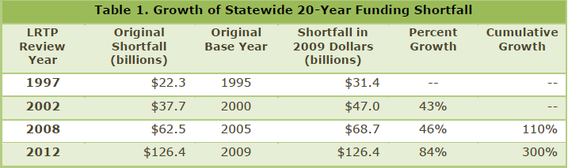
Estimated Statewide Shortfall

Slide 18
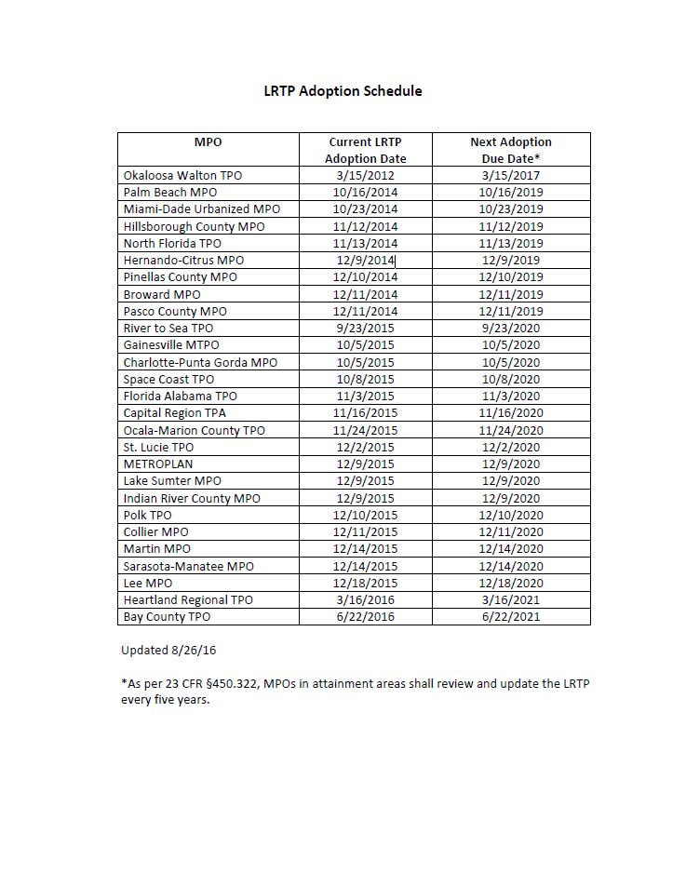
Timing to Review of 2040 LRTPs?
The time is now
  18 month schedule
Last 2040 LRTP
  Adopted 3/2017
First 2045 LRTP
  Adopted 10/2019
Scope in agenda package
  $175K

Slide 19
Questions?
Jeff Kramer
Center for Urban Transportation Research
University of South Florida
kramer@cutr.usf.edu
813-974-1397

Slide 20

Legislative Policy Positions of MPOAC
Carl Mikyska

Slide 21
The MPOAC supports State Legislation that:
Explores new Transportation Revenue.
Restores funding for the TRIP (Transportation Regional Incentive Program)
Makes distracted driving a primary offense.
Allows SIS (Strategic Intermodal System) funds to be used on roads and other transportation facilities not designated on the SIS.
Create predictable funding for transit projects.

Slide 22
Implements the recommendations from the MPOAC transportation revenue study and other options for expanding transportation revenue sources.
Key Recommendations:
Expand the Charter County and Regional Transportation System Surtax to allow municipalities over 150,000 in population (or the largest municipality in a county) and all counties located in MPO areas to enact up to a one cent local option surtax by referendum.
Index local option fuel taxes to the consumer price index in a manner similar to the current indexing of state fuel taxes.
Direct the Florida Department of Transportation to develop a plan and conduct one or more pilot tests to move Florida toward a Mileage Based User Fee, which protects individual privacy, in lieu of the traditional fuel tax.

Slide 23
Regulates distracted driving as a primary offense by prohibiting the use of electronic wireless communications devices and other similar distracting devices while operating a moving motor vehicle.
The 2013 Florida legislature enacted the “Florida Ban on Texting While Driving Law.” The law prohibits operation of a moving motor vehicle while manually typing, sending or reading interpersonal communication (texting, e-mailing, instant messaging, etc.) using a wireless communications device, with certain exceptions. The law provides for enforcement of the ban as a secondary offense, meaning a driver would have to be pulled over for some other violation to get a ticket for violating the ban on texting. The 2014 and 2015 Florida Legislatures underscored the severity of distracted driving by considering bills that would have substantially increased the penalty for distracted driving. This legislative proposal would seek to strengthen the enforcement mechanism for the texting while driving ban by making it a primary offense.

Slide 24
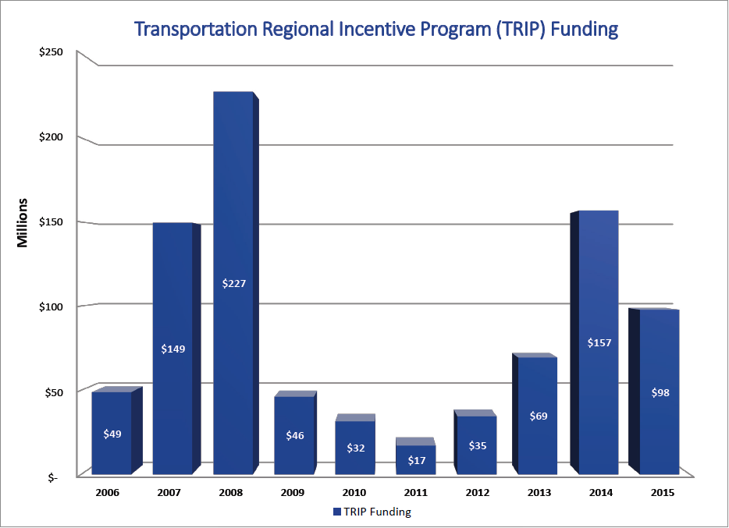
Restores funding for the Transportation Regional Incentive Program in order to promote regional planning and project development through sustainable funding mechanisms, in addition to documentary stamp revenues.

Slide 25
Allows Strategic Intermodal System (SIS) funds to be used on roads and other transportation facilities not designated on the SIS if the improvement will enhance mobility or support freight transportation on the SIS.
Current state law does not permit SIS funds to be spent on roads or other transportation facilities that are not part of the SIS, even if proposed improvements would directly benefit users of SIS facilities by enhancing mobility options or supporting freight movement in a SIS corridor. This legislative proposal would broaden the State’s ability to improve passenger and freight mobility on SIS corridors by making eligible the expenditure of SIS funds on non SIS roads and other transportation facilities where the benefit to users of SIS facilities can be demonstrated.

Slide 26
Establishes flexible and predictable funding for transit projects (capital and operating) identified through the metropolitan transportation planning process.
Current state law limits the amount of funding that can be made available from the STTF for transit projects for both capital and operating expenses. These limitations, which are not in place for roadway funding, makes transit funding from the STTF less predictable for the purposes of planning and project implementation and artificially limits the ability of MPOs to implement priority transit projects. This proposal recognizes the critical role transit plays in moving people and goods within and between Florida’s metropolitan areas by removing the distinction between transit and highway projects for the purpose of spending funds from the STTF.

Slide 27
Potential Policy Position
(12) APPLICATION OF FEDERAL LAW.—
Upon notification by an agency of the Federal Government that any provision of this section conflicts with federal laws or regulations, such federal laws or regulations will take precedence to the extent of the conflict until such conflict is resolved. The department or an M.P.O. may take any necessary action to comply with such federal laws and regulations or to continue to remain eligible to receive federal funds.
Federal monies for the MPOAC or any M.P.O. passed through the State of Florida shall not be regarded as state funds for purposes of expenditure. All such monies shall be expended consistent with federal requirements, laws, or regulations as determined by the MPOAC or the M.P.O., to which the monies have been appropriated, after consultation with the federal agency appropriating the funds. Expenditure of said funds consistent with this paragraph shall be deemed to have been specifically authorized by the legislature, or authorized by necessary implication, to carry out duties or functions imposed or authorized by this section or by federal law, regulation, or requirement.

Slide 28
Strategic Plan Implementation
Carl Mikyska

Slide 29
MPOAC Strategic Plan Working Groups

Slide 30
MPOAC Strategic Plan Working Groups
Next Steps
Form 2 committees
  Bike & Pedestrian Committee
  Best Practices Committee
Select committee members and chair
Direct your Executive Director to work with each chair to develop a work plan for committee approval

Slide 31
New Calendar Dates for 2017 Meetings
No Change to Governing Board Meeting Dates
1st Quarter No Change (January 26th Meetings)
2nd Quarter -Staff Directors - March 2, 2017
        -Governing Board – April 6, 2017 in Cocoa Beach
3rd Quarter -Staff Directors - June 1, 2017
            -Governing Board – July 19, 2017 in Boca Raton
4th Quarter -Staff Directors – October 12, 2017
            -Governing Board – November 7, 2017 in Panama City Beach

Slide 32
NARC Dues Structure
National Association of Regional Councils
  Florida is very active in NARC
NARC is re-structuring their dues
  Consistency and fairness
  No net increase in NARC income
Would increase Florida dues
  From $50K per year
  To $85.5K (interm will be $67,750)

Slide 33
Executive Director Performance Evaluation
Why?
  Required by the MPOAC bylaws
In the Packet
  Evaluation form
  List of Executive Director activities and MPOAC Accomplishments
MPOAC Executive Committee Conducted review
  Overview
Your Feedback and Input?

Slide 34
Communications
Items in your packet
  Thank you note from Florida League of Cities for MPOAC coordination and partnership
  2 sets of comments to the Federal Docket
Thank YOU!!!!
  Your direction on comments
  Jeff for his hard work
  Dave Lee of FDOT
  Doug McLeod of FDOT
  Erich Zimmerman of NARC

Slide 35
Member Comments
Issues and comments for the good of the cause

Slide 36
Adjournment
Next meeting - April 06, 2017
DoubleTree by Hilton Cocoa Beach Oceanfront
2080 North Atlantic Ave
Cocoa Beach, FL 32931

