Slide 1

Think Like A Planner:
Mentoring the Next Generation
Erica Lychak
Communications Manager

Slide 2
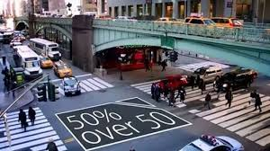

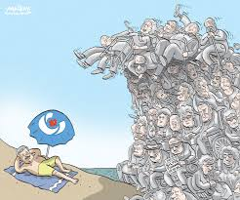
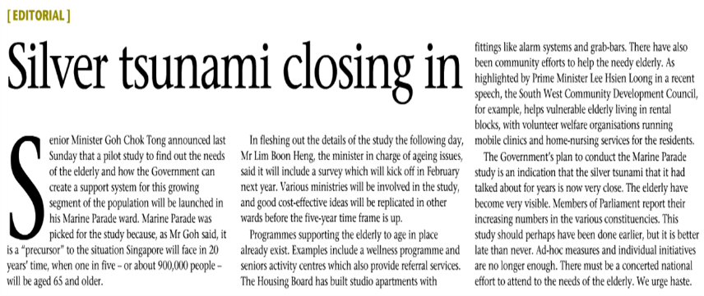
The Silver Tsunami is coming…
How can we actively engage the next generation?
How can we expose students to the world of transportation planning?
How can we interest students in thinking about long term planning and safety?
Notes:
ANTHEA
The phenomenon known as the Silver Tsunami sees Baby Boomers retiring without fresh faces to replace them and poses a serious threat to the future of the transportation industry.
How can we actively engage the next generation?
Going into our schools!
How can we expose students to the world of transportation planning?
By giving them a crash course in what MPOs do, by exposing them to concepts and thought processes that planners have to go through on a daily basis.
How can we interest students in thinking about long term planning and safety?
By Making it PERSONAL, case studies are in the neighborhoods and near schools of students the students. If they are personally invested, they will be more interested.
***MAJOR TAKEAWAY** The exposure that students receive to transportation careers (in an authentic atmosphere) has huge positive impact and does help to address the upcoming gap in the industry. Exposing students (and their teachers by extension) to the MPO and transportation creates awareness and engages a new student group.

Slide 3




Motivating
Factors: the “Why”
Strengthening our connections with the community
Implementing our Board’s vision for the agency
Strengthening our relationships with our partnering agencies
Helping make education curriculum more career-focused
Notes:
Motivating
Factors for Outreach
Why are we doing this?
Strengthening our connections with the community
Implementing our board’s vision for the agency
Increasing visibility in the community
Strengthening partnerships
Tackling silver tsunami issue
Helping make education curriculum more career-focused

Slide 4
Think Like A Planner: The Essentials
Strong Partnership with Broward County School Board
Champion in School Board Member/MPO Board Member in creating connections with career development (e.g. CTACE) and STEM departments
Notes:
Partnership: Program was created in 2015 and came as a result of board member (also is School Board member) who wanted to address the need for creating a link between transportation and the work of the Broward MPO and students: The Next generation. Recognizing the “silver tsunami” that is coming.
The Broward MPO worked closely with the school board and Career, Technical, Adult, Community Education (CTACE) (elaborate here: career skills into education) to create the curriculum and materials that would match with the needs and existing objectives of teachers without taxing them
To execute a program of this magnitude, MPO Staff developed a close working relationship with Broward County Public Schools’ Career, Technical, Adult, Community Education (CTACE) Department. This department has been charged with equipping their students with skills that link education and employment outcomes (LEEO). Together we worked with CTACE to develop rubrics, schedules and the program in its entirety. The CTACE department also supplies the MPO with LEEO schools to participate in the workshops and assists with coordination for this program. The outcome of these workshops is a win for the agency; increasing visibility in the community and raising awareness of the field of transportation planning.

Slide 5
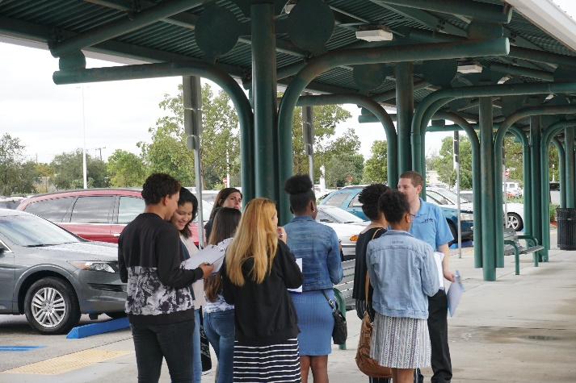
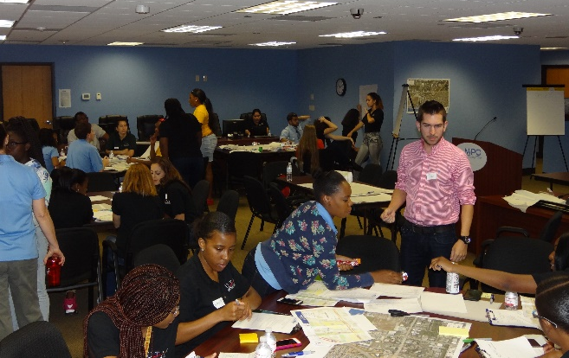
Think Like A Planner: Overview
This event provides each student with the opportunity to shadow transportation professionals and conduct their own short group presentations before elected officials.
A 3-session program
Notes:
The Think Like A Planner Workshop series sends MPO staff into high schools.
We introduce students to transportation planning, hold an interactive session building complete streets (using StreetMix software) and those students then participate in a half-day workshop where they are immersed in a career environment at the Broward MPO office.
This event provides each student with the opportunity to shadow transportation professionals and conduct their own short group presentations before elected officials.
**Coordination with teachers and school= lots of time needed and logistics (Fall start up etc..)
Kick off meeting
Coordination emails and phone calls> have to have a staff member who leads the charge and spearheading
To execute a program of this magnitude, MPO Staff developed a close working relationship with Broward County Public Schools’ Career, Technical, Adult, Community Education (CTACE) Department. This department has been charged with equipping their students with skills that link education and employment outcomes (LEEO). Together we worked with CTACE to develop rubrics, schedules and the program in its entirety. The CTACE department also supplies the MPO with LEEO schools to participate in the workshops and assists with coordination for this program. The outcome of these workshops is a win for the agency; increasing visibility in the community and raising awareness of the field of transportation planning.

Slide 6
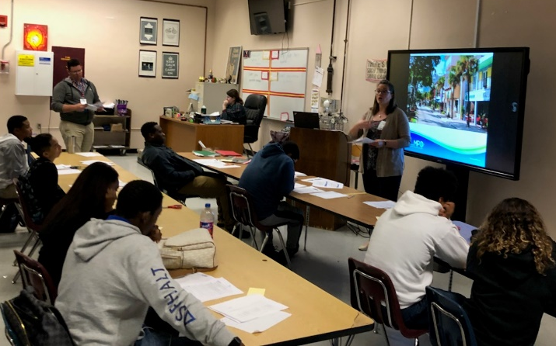
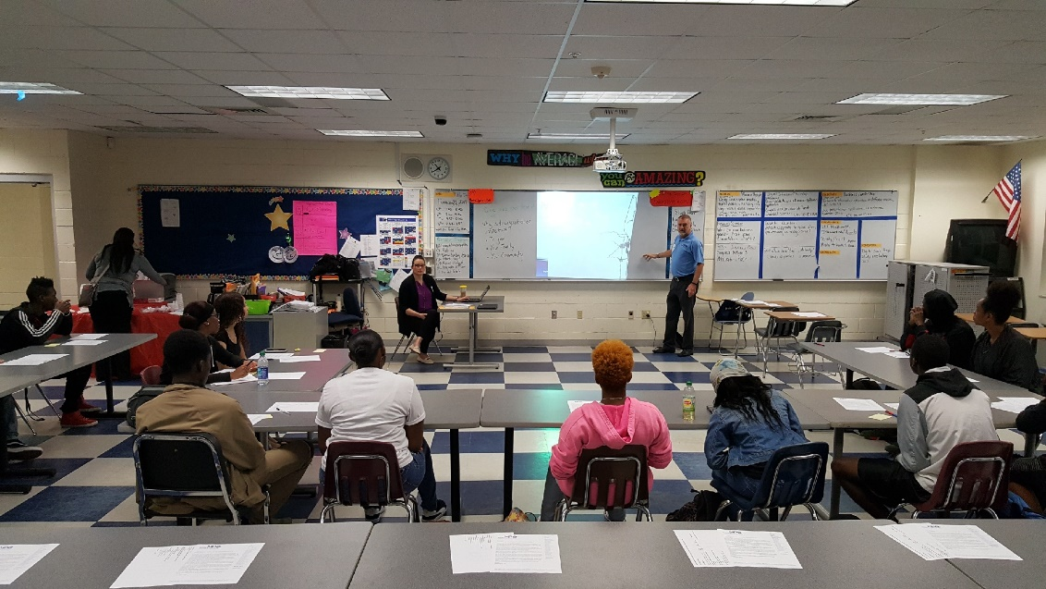
Think Like A Planner: Session #1
School Visit
1 teaching period (45-90 min range)
Topics covered
  MPO (who we are, what we do)
  Civics 101 (Board members, getting involved)
  How transportation affects them
  Why transportation in important
Notes:
- Talk about Housemartins Song “Build”
Think Like A Planner
Started as a charge from our Board Members to work on partnership and relationship with Broward Schools.
Worked with Broward Schools’ Career, Technical, Adult, Community Education (CTACE) department on rubric and program.
During the first session, the MPO introduces students to transportation planning, civics and the role of the MPO
The Think Like A Planner Workshop series sends MPO staff into high schools.
We introduce students to transportation planning, hold an interactive session building complete streets (using StreetMix software) and those students then participate in a half-day workshop where they are immersed in a career environment at the Broward MPO office.
This event provides each student with the opportunity to shadow transportation professionals and conduct their own short group presentations before elected officials.

Slide 7
Think Like A Planner: Session #2
School Visit
1 teaching period (45-90 min range)
Learning Lab: Streetmix
      Students design “Complete Streets”
      Use real right-of-way
Notes:
-hold an interactive session building complete streets (using StreetMix software)
Use real right-of-way on their local roads
Exposes students to the challenges faced by transportation planners when retrofitting a road
**Screenshot of Streemix
take planner with outreach staff and talk about planning
Use streets that students use everyday (ID problems)
Touch on land use and how we have to work with
major arterial
Local road
Street with minimal improvements (face real restrictions)

Slide 8
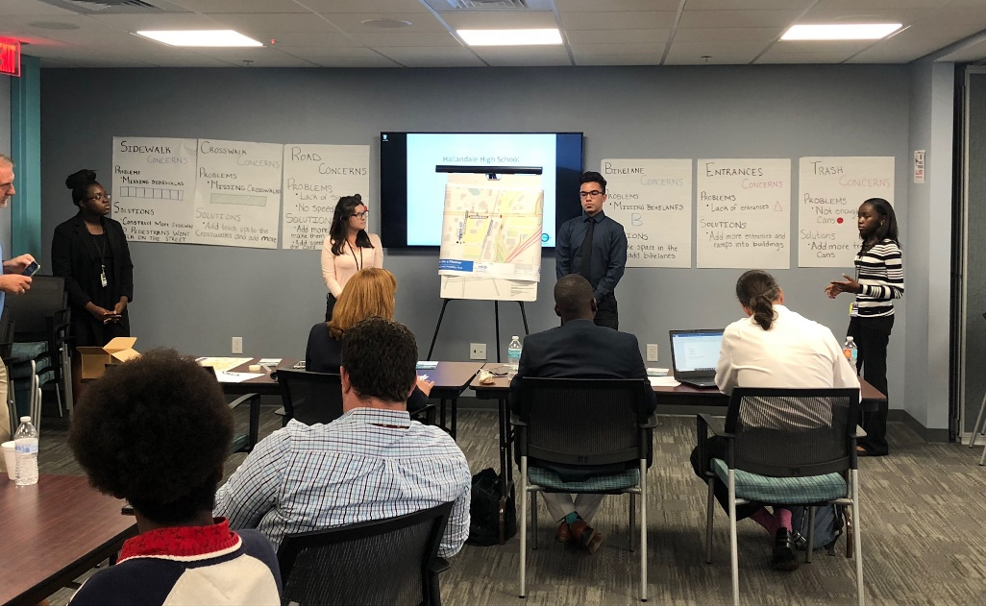
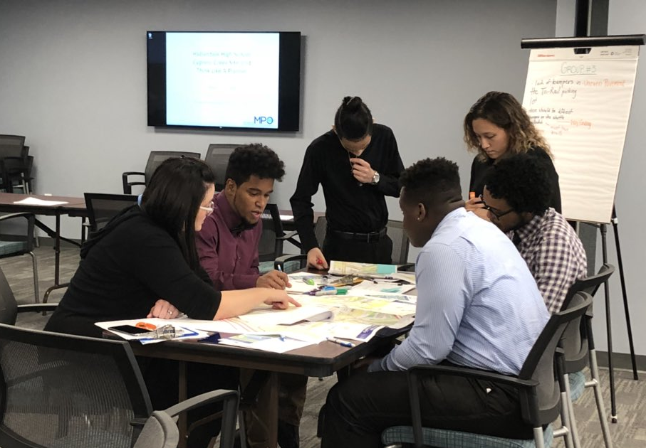
Think Like A Planner: Session #3
A ½ day session
  Students spend the day at MPO office
  Shadow transportation professionals and conduct a walking audit of the surrounding area
  Conduct their own short group presentations before panel of judges (elected officials, transportation professionals)
Notes:
Students then participate in a half-day workshop where they are immersed in a career environment at the Broward MPO office.
Students are paired with staff who mentor them through a walking audit of the area around our office, then prepared for their five-minute presentations on their findings.
They conduct their own short group presentations before elected officials and industry professionals.

Slide 9
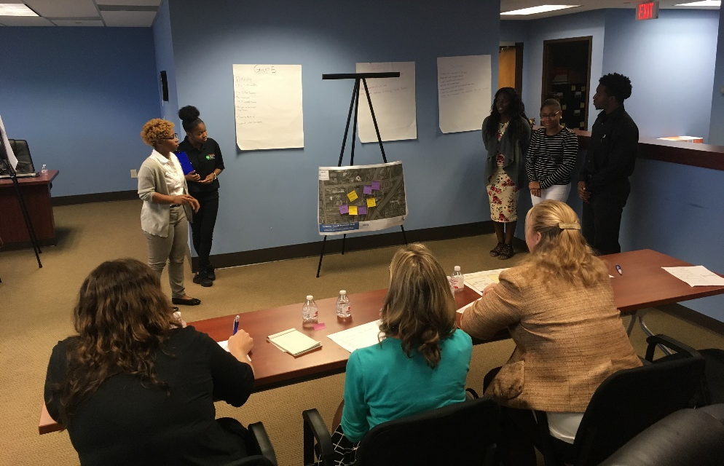
The hook for schools
Group work
Presentation skills
Project centered around Safety and Mobility
Collaterals to send home with students
Critical Thinking
  Discussion on Problem Solving, etc.
Notes:
-link to CTACE as they want to link career skills into the curriculum and get a link to real world work environment and skills
Useful Skills for Students- this will be the sell for schools
Group work
Presentation skills
Presenting to Board Members in a group setting
Use rubric to fill this in; include rubric
Letter to the students explain what MPO does (bring copies of collaterals)
Collaterals to send home with students
Critical Thinking
Discussion on Problem Solving, etc.

Slide 10
How you can do it too!
Do you have:
School Board Members?
Local Schools with Career Development Department?
Local Schools with Magnet Schools/ Science Technology Engineering and Math Departments?
Notes:
Work with the Schools in your area
-If you have a School Board Member on your Board, use them as a resource! Inside Man!
-Career Development Departments can serve as a great resource!
-Bargaining chip are major key. If you have one, use. Ex. CTACE uses our board room for their staff workshops;
-Magnet Schools/STEM in your constituency can serve as a good partner as well since they’re already focused on specialized, career-driven curriculums.
-Schools in EJ Communities can be great to reach out to as well.
Florida Statue: School Board member is on your board (either governing or technical) they can work with you to put you in contact with School Board and correct person –essential to the process

Slide 11
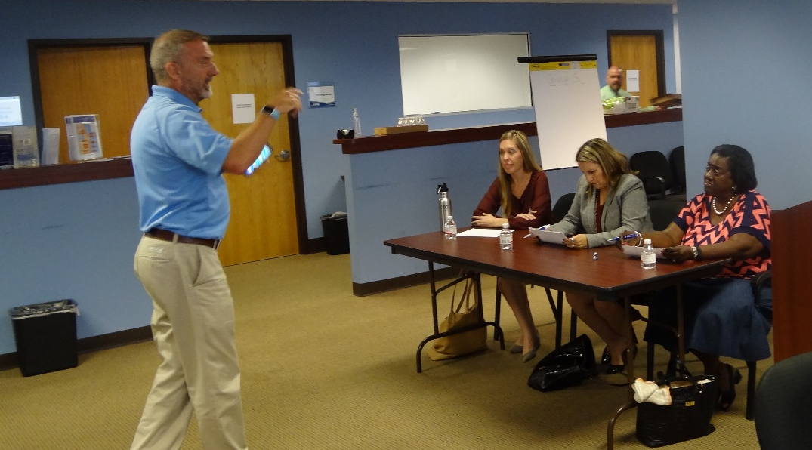
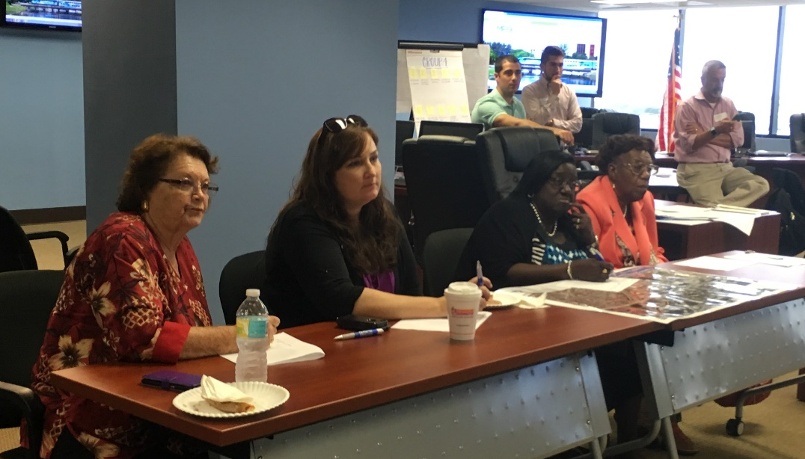
Involve your
Elected Officials
Board Members
Industry Professionals
Partnering agencies
Technical staff
Consultants
Notes:
Involve your Elected Officials
-students interact with those they would not normally do so
- tie back to Civics 101 that we do in session #1
Board Members
Industry Professionals, partnering agencies, consultants, technical staff
Involve the elected from the area where the school is located!
Rotate them in and out to get a diverse panel and to encourage your Board to engage the next generation as well. Build bridge.
Win for the elected because exposure and chance to connect with younger demographic
Hook #1) strategically look for the elected from area that school is in (eg. Tri rail in that area will contact there) key is to have those with direct in that area interacting with the students

Slide 12

Contact Us
Erica Lychak
Communications Manager
(954) 876-0058
Lychake@browardmpo.org
@MPOErica

