Slide 1




Funding Your Journey
Florida Transportation Economics 101
Presenter’s Name
Organization

Slide 2

About Us
CUSTOMIZE TO PRESENTER’S NEEDS
Notes:
[customize to presenter – insert logo]

Slide 3

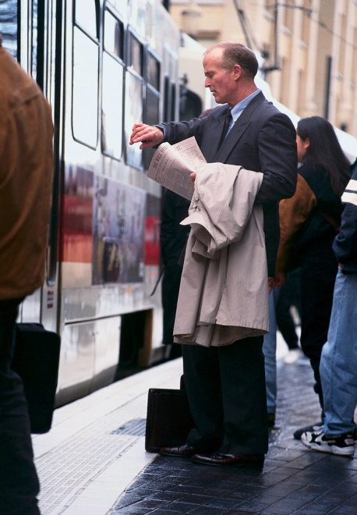
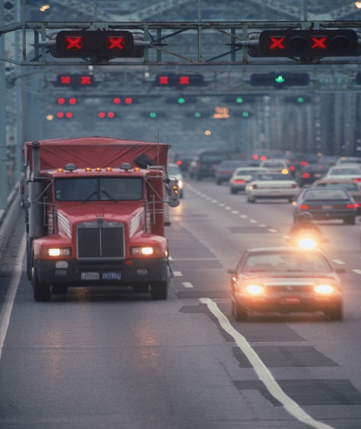

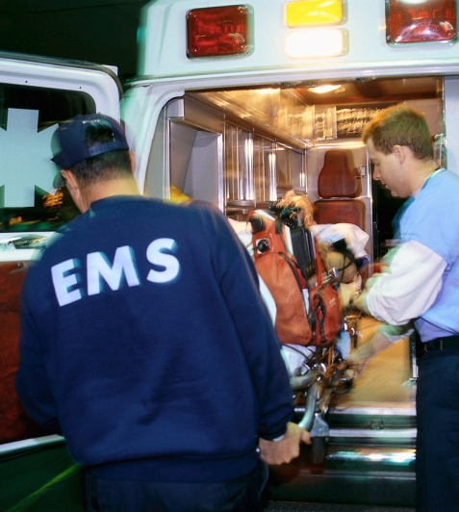


Transportation & the Economy
EFFICIENT SYSTEMS
Benefit Households and Businesses
DEFICIENT SYSTEMS
Cost Households and Businesses
Income
Vehicle Operation
Travel Delays
Access
Productivity
Safety
Ecology
Notes:
Good transportation systems are closely linked with economic health. When transportation systems are efficient, they provide accessibility to markets, employment and additional investments. When they are deficient, they can have economic costs, such as reduced or missed opportunities.
Overall, efficient transportation reduces costs for businesses and households, while inefficient transportation increases costs. A study by the American Society of Civil Engineers estimated that in 2010, deficient transportation systems in the U.S. cost businesses and households some $130 billion dollars.
Facilities in poor conditions led to increased operating costs for trucks, cars, buses and rail vehicles – both through damage to the vehicles and additional travel miles to avoid deteriorated or overly congested roadways. Travel times, vehicle safety and the environment are also affected when transportation systems are not reliable.
The study cites “avoidable” transportation costs that hinder the nation’s economy through road conditions, congestion and poor transit and train conditions. It goes on to say that Americans would earn more personal income and industry would be more productive if transportation systems operated effectively. Their estimate of cumulative costs to businesses and households from inefficient transportation by the year 2020 is $912 billion.

Slide 4
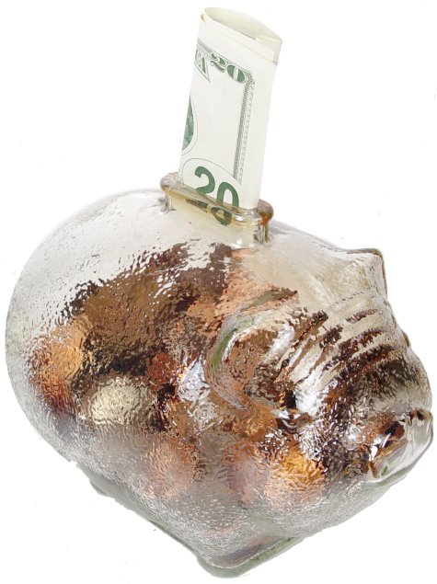
Where the Money Comes From
Federal
State
Local
Tolls
Notes:
Transportation funding comes from four different buckets:
Federal
State
Local
Tolls/User Fees
Emerging pot: private; public-private partnerships
Most of the money for the federal, state and local pots comes from gas tax. But as you’ll see in just a minute, the gas tax is an unsustainable source of transportation funding.

Slide 5

Federal Funding:
Deficit in Highway Trust Fund
Before 2008
2008
2010
2015
$0
$8
Billion
$7
Billion
↓
Cents Per Gallon
Gas = 18.4
Diesel = 24.4
Notes:
Revenues from the tax on highway fuels represent 90 percent of the receipts that accrue to the Federal Highway Trust Fund
Revenues linked to vehicle miles traveled and vehicle fleet efficiency (fuel use)
Federal highway taxes flat cents per gallon, not adjusted for inflation and not adjusted since 1993:
18.4 cents gasoline
24.4 cents diesel
Highway Trust Fund balance has been in a steady decline requiring federal General Fund infusions to ensure its solvency
$8.017 billion in September 2008
$7 billion in August of 2010
Under the current transportation legislation, the trust fund is projected to go back into the red by 2015
The federal fuel tax is not tied to CPI or adjusted for inflation. When adjusted for inflation, our per gallon contributions to reinvestment in transportation are at levels equal to those in the mid 1980s and mid 1970s. For example, if we take these gas and diesel fuel tax rates of 18.4 cents and 24.4 cents and adjust them for inflation, those figures turn into 25.8 cents and 34.2 cents.
The bottom line is that the gas tax is a declining source of transportation funding. It’s unsustainable.

Slide 6




State Transportation Trust Fund
On any given year, 8% is transferred to:
General Fund
Education
Tourism
Other
And then
there are
raids…
2002-2012
676.4
million
Notes:
At the state level, gas taxes make up 68% of revenues going into the State Transportation Trust Fund and are periodically adjusted for inflation. Other revenue sources for the state trust fund include various fees, such as: license fees, rental car surcharge, registration fees and title fees. These sources are not adjusted to inflation, so their buying power diminishes over time.
On any given year, about 8% of the revenues in the State Transportation Trust Fund are diverted for things like general fund service charges, education, tourism, and others like agriculture and environmental issues. Some of these diversions are the result of provisions in the State Constitution (such as the money going to education); others are included in state law, such as a portion of the statewide rental car surcharge going to trade and tourism promotion.
However, there are times when the state legislature finds it necessary to raid the State Transportation Trust Fund to balance the budget. Over the past 10 years, these raids have diverted $680.8 million from the transportation trust fund for non-transportation purposes. Major raids happened in 2004, 2010, and 2012.

Slide 7
Local Projects We Need –
But Can’t Afford
Project One
Project Two
Project Three
Project Four
Project Five
Project Six
CUSTOMIZE TO PRESENTER’S NEEDS
Notes:
[Customize to presenter’s needs – add local unfunded projects]

Slide 8

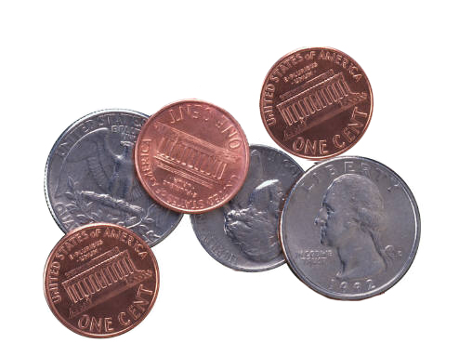
What You Pay to Use the Transportation System
$210 per year
$0.58 per day
Notes:
Here’s some food for thought. If you take a look at what it costs the average Floridian in gas tax per day to drive on the roads, it’s only $210 per year, or 58 cents per day.
This is going on the assumption that a person drives 10,000 per year in a car that gets 20 miles per gallon. They would use 500 gallons of gas in a year. At a cost of about 42 cents per gallon in gas tax (combines federal, state, local), the average driver only pays $210 per year in gas tax to drive on the roads (not including tolls).

Slide 9

Put Another Way…
About 2 cents a mile
$0.32 for the average U.S. commute
Notes:
Here’s another way to look at it. For that same average gas consumer, the cost comes out to a little more than 2 cents a mile. The average commute distance in the U.S. is 16 miles one way, so Floridians who journeyed that far to get to the office would pay about 32 cents one way – 64 cents roundtrip. The cost for highway trip from Orlando to Tampa costs something like $1.79 one way.

Slide 10

About the Revenue Study
Goal: To develop legislative
approaches that produce funding for state
transportation needs
Study advisory committee sought strategies to return transportation funding to the level of a base year -- 2000
Notes:
The study we are going to discuss was commissioned by Florida’s Metropolitan Planning Organization Advisory Council – also known as MPOAC. This group helps set policy for the individual MPOs around the state. The MPOAC has for several years been concerned with the level of funding for transportation investments in Florida and undertook a study to develop recommendations for addressing the issue.
There are several ways to look at what we need to do to restore transportation funding to a level that will not impede our future and will maintain a system that can support economic growth.
The study advisory committee – made up of diverse transportation interests, including MPO staff directors, businesses, local governments, environmental groups and freight interests – chose to set a target level of funding and pursue that. In this case, the committee settled on trying to restore funding investment to a level equivalent to what was spent in 2000.
If you think back to the year 2000 – or Y2K, as we called it then – you’ll remember it as a time of modest growth and a fairly stable economy in our state. It was not as volatile as the “boom years,” when Florida’s real-estate bubble distorted the state’s economy. But it was more prosperous than the “bust” period right after that bubble burst and plunged the state into a deep recession.
Returning state investment to this equivalent level seemed much more realistic than some other approaches. Attempting to find revenue for all current unfunded needs, for instance, would be staggering. That price tag would be more than $74 billion.
So what would it take to restore our investment to the base year 2000 level? One challenge that confronted the study committee was the fact that a dollar in 2000 is not exactly equal to a dollar in 2012. Even though the country has not experienced steep inflation during the past decade, prices have still climbed.

Slide 11


Purchasing Power: 2000 vs. 2012
HOUSEHOLD PURCHASES
For every $1,000 we spend on items such as shoes, groceries and furniture, we need $330 more today than in 2000 – for the same purchases.
TRANSPORTATION
To return transportation to year 2000 levels, we need:
$12.1 billion more
Notes:
The average family has seen this “lost purchasing power” at the store. For every $1,000 we spend on household items such as shoes, groceries and furniture, we need $330 more today than in 2000 – for the same purchases.
In the transportation funding arena, the state also saw the purchasing power of its dollars shrink during the past several years. Researchers determined that $12.1 billion would be needed to restore the state’s investment to that base year 2000 level.
With current funding sources unsustainable over the longhaul to maintain adequate funding levels, MPOAC researched several options return transportation funding to year 2000 levels.
The organization endeavored to develop a set of options that are politically acceptable, sustainable, innovative and that deal with the on-going transportation funding needs of our state. Needless to say this was no small or easy task…especially the politically acceptable part!
The study consisted of four major tasks:
The first was to define the current funding situation through an analysis that recaps the national funding situation, documents current revenue sources and their projected trends, analyzes economic and demographic trends in Florida, and summarizes the transportation needs
The next task was to inventory existing transportation revenue sources and propose any new ones, identify barriers and opportunities, and perform a rough revenue projections.
The list of options was reviewed and pared down by the study advisory committee
Finally, based on this shorter list, more refined revenue forecasts of the options were completed and presented to the MPOAC for adoption.
Next, I’ll talk about the top six options that were considered most doable…

Slide 12

One Cent Municipal Optional Sales Tax
Expands flexibility on sales tax option to allow cities to impose sales tax without county consent
State legislative action and local referendum required
Per Year
State - $830 million
Local - $X million
Notes:
Under current Florida Statute, Charter Counties and those included in a Regional Transportation Authority district may elect to impose up to a one percent sales tax on items up to $5,000 with revenues available for transportation uses. This option would extend that flexibility to cities with a population of 150,000 or more, but could not be duplicative of any County transportation sales tax. For example, today Miami‐Dade County voters approved a one‐half percent sales tax. If the City of Miami wanted to put this in place, it would be limited to an additional one‐half percent. In counties without a city with a population of 150,000, the option would be available to the largest municipality in that county based on the latest available census. If fully implemented, it could generate approximately $830 million to cities in total.
Potential Yields Per Year
State: $830 million
Local: XX

Slide 13
Increase State Fuel Tax
Per Year
State - $803 million
Local - $X million
Increases state fuel tax by 10 cents over five years (2 cents per year); automatically adjusted for inflation
State legislative action required
Notes:
Implementation would raise the State Highway Fuels Sales Tax from the current rate of 12.6 cents per gallon by 2 cents per year for the next five for a total 10 cent increase. This tax is currently adjusted annually by the Consumer Price Index (CPI) as is the State Comprehensive Enhanced Transportation System (SCETS) Tax which is currently at 6.9 cents per gallon. Additional forecast revenues of approximately $183 million in 2013 growing to $1.17 billion by 2020 for the State Transportation Trust Fund (STTF).
Potential Yields Per Year
State: $803 million
Local: XX

Slide 14
Return All Motor Vehicle Fees to
State Transportation Trust Fund
Redirects all motor vehicle fees from state’s general revenue to transportation trust fund
State legislative action required
Per Year
State - $413 million
Local - $X million
Notes:
This recommendation would redirect the increases in the fees that were enacted in 2009 from the State General Revenue Fund to the STTF. These fees have historically been dedicated to the transportation system as a method to further the concept of user fees supporting the transportation system. After a 20 year hiatus of fee adjustments (30 years for registration fees), they were raised in 2009 with the incremental revenue being used to help solve the general budget crisis due to the economic recession. With increasing pressures on transportation funding sources coupled with growing needs, action was taken in the 2012 session of the Florida Legislature to restore a portion of these traditional STTF funds. While the most Title Fees will be remitted to the STTF yielding about $200 million per year, the Motor Vehicle License Fee and Surcharge increases along with the Initial Registration Fee increase are recommended to be returned as well. The annual estimated revenue impact to the STTF is $413 million.
Potential Yields Per Year
State: $413 million
Local: XX

Slide 15
Index All Local Fuel Taxes
Per Year
State - $115 million
Local - $X million
Local fuel taxes would be automatically adjusted for inflation
State legislative and local action required
Notes:
In addition to the State taxes mentioned above, there are several different local option taxes levied on a per gallon basis in addition to the Constitutional Fuel Tax (2 cents per gallon), County Fuel Tax (1 cent per gallon) and the Municipal Fuel Tax (1 cent per gallon). The Constitutional, County and Municipal taxes are collected by the State for distribution to local governments. None of these or the local option fuel tax is indexed to the CPI. This option would index them on the same basis as the State Fuel Sales Tax and the SCETS, providing local governments with the same inflation hedge enjoyed by the STTF and generating approximately $115 million annually for investment in transportation infrastructure. Some of these user fees have not been adjusted since the 1940s.
Potential Yields Per Year
State: $115 million
Local: XX

Slide 16
Five Cent Local Diesel Tax
Adds five cents to local diesel tax, for a total of 12 cents; revenues to be spent on projects helping freight movement
State legislative and local action required
Per Year
State - $72 million
Local - $X million
Notes:
Local option tax rates are fixed in State Law to provide diesel fuel tax rate consistency among counties for purposes of administering the provisions of the International Fuel Tax Agreement. The local option diesel tax rate is currently 7 cents per gallon, while the statewide average for local option gasoline taxes has risen to 9.6 cents per gallon. There has long been recognition that a higher per gallon rate on diesel fuel is appropriate, as the major users of the fuel are heavy trucks. For example, the federal gasoline tax is 18.4 cents per gallon and 24.4 cents for diesel because of the distinction of the demands that are placed on the highway system by heavy trucks and light duty vehicles. This option would establish an additional five cent diesel fuel tax in each county, and the revenues would be required to be expended on projects that serve or enhance commercial highway traffic. This dedicated local source of funding could be used to encourage economic development and improve existing commercial operations. It is estimated to generate about $72 million per year to Florida’s counties.
Potential Yields Per Year
State: $72 million
Local: XX

Slide 17

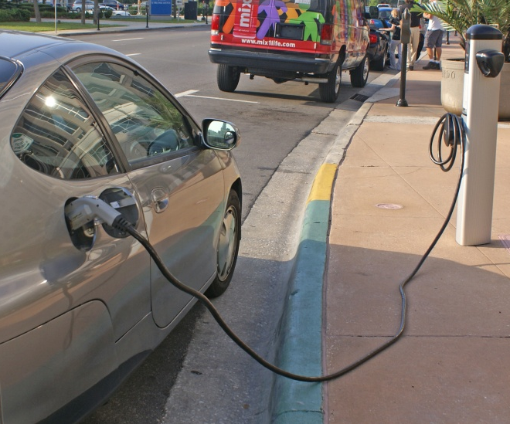
Vehicle Miles Traveled (VMT) Study
Fund an extensive study of replacing fuel tax with a charge on miles traveled
Potential yields not available
State legislative action required
Notes:
This recommendation is to have the Legislature commission and fund an extensive effort to deal with the systemic issues of fuel taxes becoming less sustainable as a primary surrogate for a transportation user fee. While fuel taxes served as an adequate substitute for a true user fee for decades, significant increases in mandated vehicle fuel efficiency and the introduction of all electric and plug‐in hybrid vehicles are eroding transportation revenues. It is recognized that there are significant concerns over the concept of charging users of the highway system based on each mile traveled. These include privacy of citizens, the cost of implementing such a system, and institutional issues associated with revenue sharing. This effort is intended to address these issues at a minimum, deploy a demonstration of the concept and develop a business plan and implementation roadmap to move Florida to a VMT‐based system.
Potential yields not available

Slide 18
Other Options
Revenue Option | Statewide Potential Yield Per Year
Sales Tax on Motor Vehicle Parts & Services (move from general revenue to trans. trust fund) | $666 million
Regional Transportation Financing Authority (@ $100 million/year) | $400 million
New Toll Projects | $306 million
Optional $10 Local Vehicle Registration Fee (to pay for public transportation) | $155 million
Replace State Fuel Tax with 6% Sales Tax | $136 million
Expand State Alternate Fuel Decal Program | $26 million
Electric Vehicle Sales Tax (move from general revenue to trans. trust fund) | $9 million
Toll Rate Making (create independent commission to set rates) | n/a
Notes:
These options were also examined in the study. Ultimately, though, they were deemed less politically acceptable by the MPOAC policy board, made up of elected officials.

Slide 19
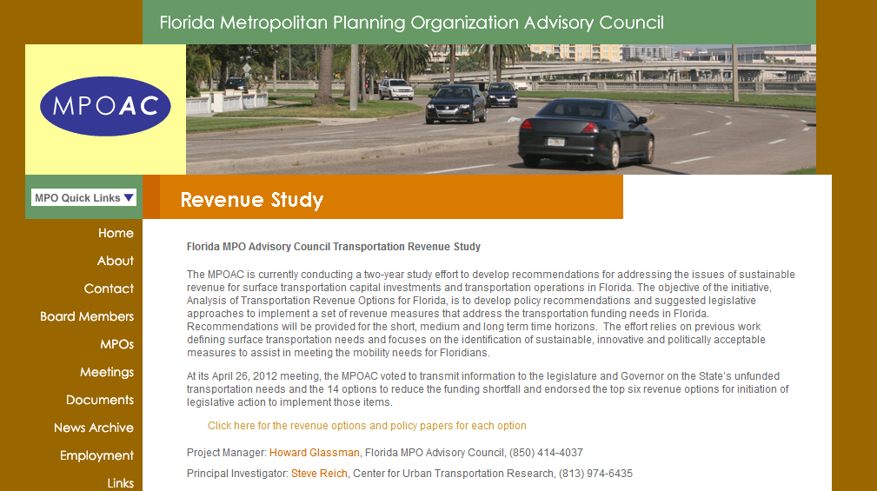
Access the Whole Report Here:
www.mpoac.org/revenuestudy

Slide 20


How You Can Help
Learn more about how transportation works
Help educate your neighbors on the need for investments in transportation
Invite us to speak at other groups you’re involved with

Slide 21
Questions?

