Slide 1

MPOAC TRANSPORTATION REVENUE STUDY
Prepared for Florida’s Metropolitan Planning Organization Advisory Council by
Center for Urban Transportation Research
University of South Florida
July, 2012

Slide 2
Presentation Outline
MPOAC Revenue Study Background
Federal Transportation Funding Overview
State Transportation Funding Overview
MPOAC Funding Recommendations
MPOAC TRANSPORTATION REVENUE STUDY

Slide 3
Revenue Study History
2008
  Florida Senate Bill 1688
  13 member Commission consisting of appointees and representatives of various statewide organizations
  State general revenue funds to finance the study
2009
  Florida Senate Bill 582
  13 member Commission consisting of appointees and representatives of various statewide organizations
  Federal metropolitan planning funds to finance the study
2010
  January 2010 MPOAC Governing Board agrees to proceed without state legislation
  Study commenced June 2010 with the Center for Urban Transportation Research at the University of South Florida
  Revenue Study Advisory Committee established
  Federal metropolitan planning funds to finance the study
MPOAC TRANSPORTATION REVENUE STUDY

Slide 4
Purpose
Develop legislative approaches to implement a set of revenue measures that address transportation funding needs in Florida.
Recommendations will focus on the identification of sustainable, innovative and acceptable measures to assist in meeting the mobility needs for Floridians.
MPOAC TRANSPORTATION REVENUE STUDY

Slide 5
MPOAC Revenue Study Process
MPOAC TRANSPORTATION REVENUE STUDY
Collect Needs Data
Analyze Trends
Frame Current Condition
White Paper
Task 2
Inventory State Sources
“Laundry List”
Assess Stability/ Barriers
Project Revenue
MPOAC Narrows Options
Task 3
New Sources i.e. VMT
Economic Analysis
Revenue Forecasts
Matrix of Options
RSAC Recommends
MPOAC Selects
Task 4
Draft Legislation
Prepare Report/ Presentations
MPOAC Review/ Approve
Final Report Publication
Presentations/ Education
Tasks 5 &6

Slide 6
Revenue Study Advisory Committee
Florida Airports Council
Florida Transportation Builders Association
Florida Chamber of Commerce
Florida League of Cities
Floridians for Better Transportation
Florida Association of Counties
The Nature Conservancy in Florida
Florida Trucking Association
MPOAC Staff Directors Representative - Chair
Florida Ports Council
Chair MPOAC Governing Board
Florida Transportation Commission
American Public Works Association, Florida Chapter
Florida Public Transportation Association
Florida Regional Councils Association
MPOAC TRANSPORTATION REVENUE STUDY

Slide 7
federal revenue sources
MPOAC TRANSPORTATION REVENUE STUDY

Slide 8
National Funding Sources
45.3%
MPOAC TRANSPORTATION REVENUE STUDY

Slide 9
Critical Federal Transportation Funding Issues
Revenues from the tax on highway fuels represent 90 percent of the receipts that accrue to the Federal Highway Trust Fund
Revenues linked to vehicle miles traveled and vehicle fleet efficiency (fuel use)
Federal highway taxes flat cents per gallon, not adjusted for inflation and not adjusted since 1997
  18.4 cents gasoline
  24.4 cents diesel
Highway Trust Fund balance has been in a steady decline requiring federal General Fund infusions to ensure its solvency
  $8.017 billion in September 2008
  $7 billion in August of 2010
MPOAC TRANSPORTATION REVENUE STUDY

Slide 10
Highway Travel Trends
MPOAC TRANSPORTATION REVENUE STUDY

Slide 11
Fuel Efficiency
MPOAC TRANSPORTATION REVENUE STUDY

Slide 12
Inflation Effects
MPOAC TRANSPORTATION REVENUE STUDY

Slide 13
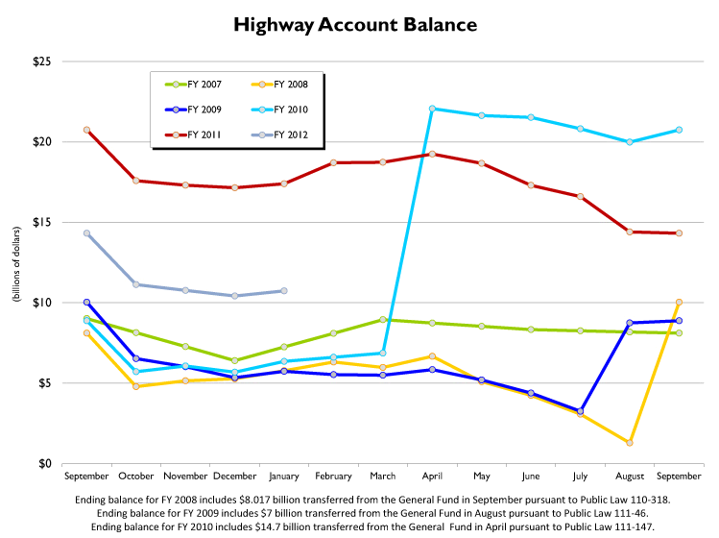
Federal Trust Fund Balances
Source: USDOT, Federal Highway Administration
MPOAC TRANSPORTATION REVENUE STUDY

Slide 14
State Of Florida revenue sources
MPOAC TRANSPORTATION REVENUE STUDY

Slide 15
State of Florida Transportation
Funds
MPOAC TRANSPORTATION REVENUE STUDY

Slide 16
Florida Transportation
Fund Diversion
MPOAC TRANSPORTATION REVENUE STUDY

Slide 17
State Revenue Forecasts
MPOAC TRANSPORTATION REVENUE STUDY

Slide 18
State Trust Fund Purchasing
Power
MPOAC TRANSPORTATION REVENUE STUDY

Slide 19
MPOAC TRANSPORTATION REVENUE STUDY

Slide 20
MPOAC TRANSPORTATION REVENUE STUDY

Slide 21
MPOAC TRANSPORTATION REVENUE STUDY

Slide 22
Options Analyzed by Type
Restoration of funds to State Transportation Trust Fund
Increased flexibility for Local Governments
Protect buying power of existing funds
Recommended uses for new, incremental funds
New/ additional revenue sources
Policy recommendations related to funding
MPOAC TRANSPORTATION REVENUE STUDY

Slide 23
MPOAC Revenue Study Action
At its April 26, 2012 meeting, the MPOAC took the following action:
  Transmit to the Legislature / Governor information on the State’s unfunded transportation needs and the 14 options to reduce the funding shortfall.
  Initiate legislative action on the top six revenue options to implement those items.
MPOAC TRANSPORTATION REVENUE STUDY

Slide 24
MPOAC Revenue Study Selected Options
Revenue Option | 8 yr Total ($millions) | Annual Average ($millions)
Index All Fuel Taxes not Currently Indexed - Local | 918 | 115
1 Cent Municipal Optional Sales Tax- Local | 6,637 | 830
2 Cent Fuel Tax Increase per Year – 5 Years (10 cents) Indexed - State | 6,424 | 803
VMT Study | _ | _
5 Cent Local Diesel Tax - Local | 576 | 72
Return MVL, Reg., Title increases to STTF (From GR to STTF) | 3,301 | 413
State Sales Tax@ 6% in Lieu of Fuel Taxes, w/ floor State | 1,087 | 136
Toll Rate Making | _ | _
Regional Trans Financing Authority @ $100mill/ yr | 3,200 | 400
Sales Tax on Motor Vehicle Parts & Services (From GR to STTF) | 5,331 | 666
Sales Tax BEV to STTF (From GR to STTF) | 73 | 9
County $10 Reg. Fee - Local | 1,242 | 155
Alt. Fuel Decal Expansion - State | 204 | 26
$100 mill in New Toll Projects | 2,450 | 306
MPOAC TRANSPORTATION REVENUE STUDY

Slide 25
Top 6 Revenue Options
Index All Fuel Taxes not Currently Indexed
In addition to the State taxes mentioned above, there are several different local option taxes levied on a per gallon basis in addition to the Constitutional Fuel Tax (2 cents per gallon), County Fuel Tax (1 cent per gallon) and the Municipal Fuel Tax (1 cent per gallon). The Constitutional, County and Municipal taxes are collected by the State for distribution to local governments. None of these or the local option fuel tax is indexed to the CPI. This option would index them on the same basis as the State Fuel Sales Tax and the SCETS, providing local governments with the same inflation hedge enjoyed by the STTF and generating approximately $115 million annually for investment in transportation infrastructure. Some of these user fees have not been adjusted since the 1940s.
One Cent Municipal Optional Sales Tax
Under current Florida Statute, Charter Counties and those included in a Regional Transportation Authority district may elect to impose up to a one percent sales tax on items up to $5,000 with revenues available for transportation uses. This option would extend that flexibility to cities with a population of 150,000 or more, but could not be duplicative of any County transportation sales tax. For example, today Miami‐Dade County voters approved a one‐half percent sales tax. If the City of Miami wanted to put this in place, it would be limited to an additional one‐half percent. In counties without a city with a population of 150,000, the option would be available to the largest municipality in that county based on the latest available census. If fully implemented, it could generate approximately $830 million to cities in total.
Two Cent Fuel Tax Increase per Year – 5 Years (10 cents) Indexed for Inflation
Implementation would raise the State Highway Fuels Sales Tax from the current rate of 12.6 cents per gallon by 2 cents per year for the next five for a total 10 cent increase. This tax is currently adjusted annually by the Consumer Price Index (CPI) as is the State Comprehensive Enhanced Transportation System (SCETS) Tax which is currently at 6.9 cents per gallon. Additional forecast revenues of approximately $183 million in 2013 growing to $1.17 billion by 2020 for the State Transportation Trust Fund (STTF).
MPOAC TRANSPORTATION REVENUE STUDY

Slide 26
Top 6 Revenue Options
Vehicle Miles Traveled Study (VMT)
This recommendation is to have the Legislature commission and fund an extensive effort to deal with the systemic issues of fuel taxes becoming less sustainable as a primary surrogate for a transportation user fee. While fuel taxes served as an adequate substitute for a true user fee for decades, significant increases in mandated vehicle fuel efficiency and the introduction of all electric and plug‐in hybrid vehicles are eroding transportation revenues. It is recognized that there are significant concerns over the concept of charging users of the highway system based on each mile traveled. These include privacy of citizens, the cost of implementing such a system, and institutional issues associated with revenue sharing. This effort is intended to address these issues at a minimum, deploy a demonstration of the concept and develop a business plan and implementation roadmap to move Florida to a VMT‐based system.
Five Cent Local Diesel Tax
Local option tax rates are fixed in State Law to provide diesel fuel tax rate consistency among counties for purposes of administering the provisions of the International Fuel Tax Agreement. The local option diesel tax rate is currently 7 cents per gallon, while the statewide average for local option gasoline taxes has risen to 9.6 cents per gallon. There has long been recognition that a higher per gallon rate on diesel fuel is appropriate, as the major users of the fuel are heavy trucks. For example, the federal gasoline tax is 18.4 cents per gallon and 24.4 cents for diesel because of the distinction of the demands that are placed on the highway system by heavy trucks and light duty vehicles. This option would establish an additional five cent diesel fuel tax in each county, and the revenues would be required to be expended on projects that serve or enhance commercial highway traffic. This dedicated local source of funding could be used to encourage economic development and improve existing commercial operations. It is estimated to generate about $72 million per year to Florida’s counties.
Return Motor Vehicle License, Registration and Titling Fee Increases to the State Transportation Trust Fund
This recommendation would redirect the increases in the fees that were enacted in 2009 from the State General Revenue Fund to the STTF. These fees have historically been dedicated to the transportation system as a method to further the concept of user fees supporting the transportation system. After a 20 year hiatus of fee adjustments (30 years for registration fees), they were raised in 2009 with the incremental revenue being used to help solve the general budget crisis due to the economic recession. With increasing pressures on transportation funding sources coupled with growing needs, action was taken in the 2012 session of the Florida Legislature to restore a portion of these traditional STTF funds. While the most Title Fees will be remitted to the STTF yielding about $200 million per year, the Motor Vehicle License Fee and Surcharge increases along with the Initial Registration Fee increase are recommended to be returned as well. The annual estimated revenue impact to the STTF is $413 million.
MPOAC TRANSPORTATION REVENUE STUDY

Slide 27
Remaining Revenue Options
State Sales Tax@ 6% in Lieu of Both State Fuel Taxes, with a “Floor”
Toll Rates – Transfer toll setting to Florida Transportation Commission
Regional Transportation Financing Authorities
Sales Tax on Motor Vehicle Parts & Services – Shift from General Revenue Fund
Shift Sales Tax on Battery Electric Vehicles to the State Transportation Trust Fund
$10 County Vehicle Registration Fee
Alternative Fuel Decal Expansion
Invest $100 million of Incremental Revenue in New Toll Projects
MPOAC TRANSPORTATION REVENUE STUDY

Slide 28
Questions
For more information Contact:
Mr. Howard Glassman - Howard.Glassman@mpoac.org
MPOAC TRANSPORTATION REVENUE STUDY

