Slide 1

ADA and Best Practices
Equals
Born Accessible
JoAnne Chalom COMS, Ed.S.
jchalom@infocusmobility.com

Slide 2

Did you know?
61 million people have a disability that impacts major life activities.
Source: U.S. Census Bureau: 2016
Individuals between 35 to 64 accounted for more nearly 16 million disabled Americans
Pew Research Center

Slide 3
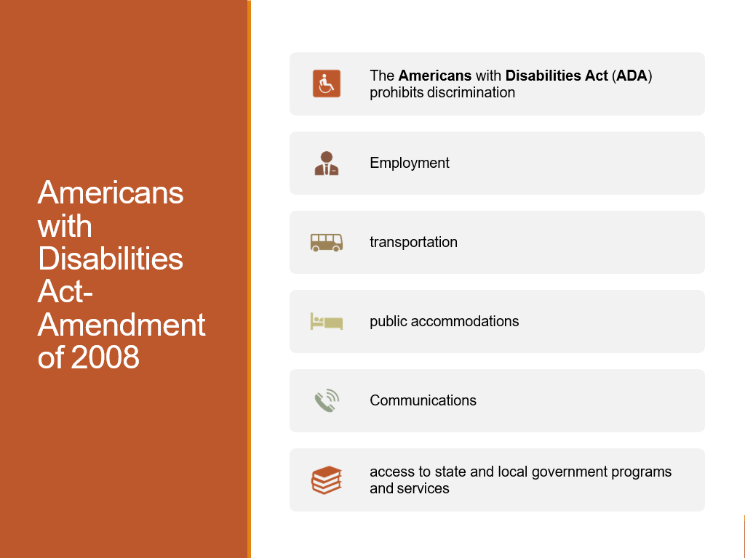
ADAA 2008

Slide 4
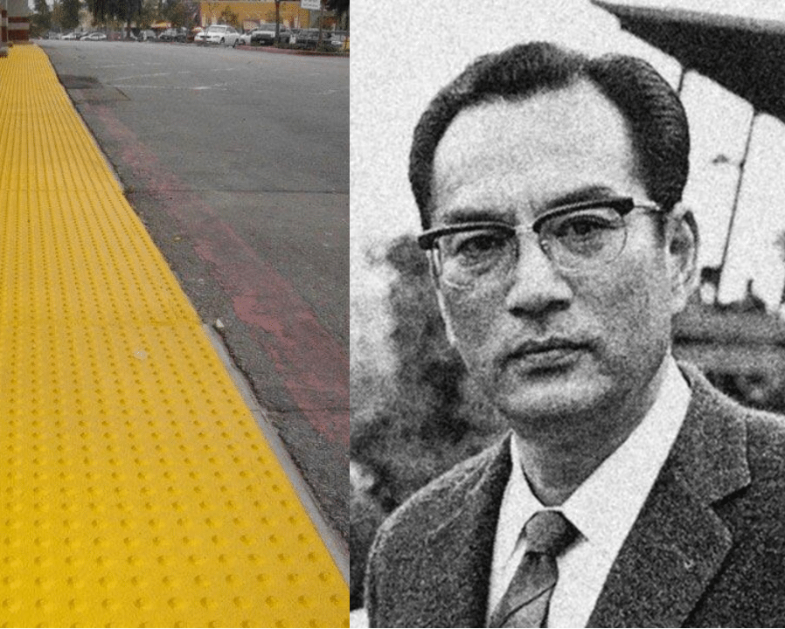
Seiichi Miyake inventor the tactile paving or “tenji block”
The tenji blocks, innovation of Seiichi Miyake were first installed in the Japanese city of Okayama on March 18, 1967,near the Okayama School for the Blind in Okayama City for making it safer and easier to walk around public spaces.

Slide 5
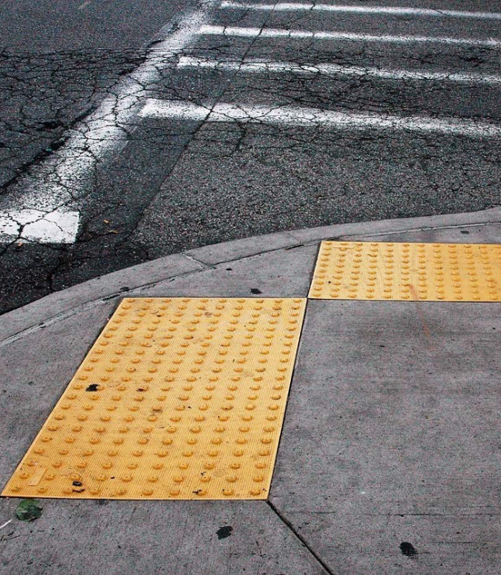
Detectable Warning Surfaces
Truncated Domes
Minimum of 24 inches the direction of pedestrian travel
Sidewalk/street interface at pedestrian street crossings, or crosswalks the adjoining surface,
Either light on dark or dark on light

Slide 6
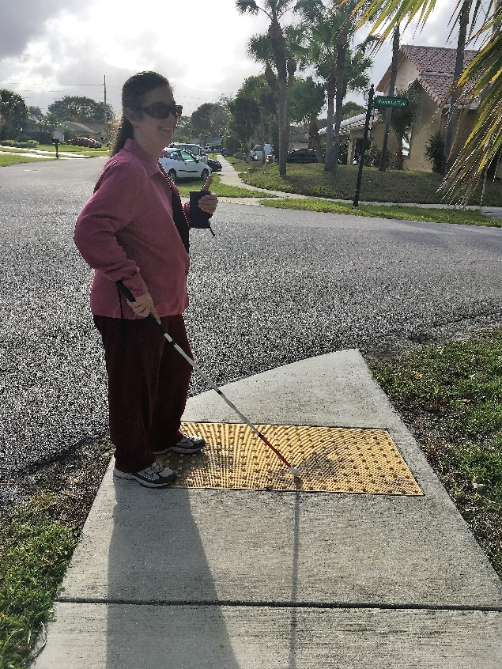
Detectable Warning Surfaces
“The only surface repeatedly demonstrated to be detectable to most blind pedestrians, either under foot or by the use of a long cane, is the truncated dome detectable warning surface.”

Slide 7
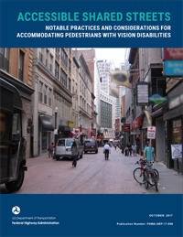
Shared Streets: Notable Practices and Considerations for Accommodating Pedestrians with Vision Disabilities
U.S. Highway Administration Federal Highway Administration (FHWA-HEP-17-096)

Slide 8

Existing Accessibility Requirements
Shared streets need to be detectable
Transitions
  From pedestrian only areas to shared zones
Tactile indicators when entering shared spaces
Transitions from shared streets to conventional vehicular intersections

Slide 9

Accessibility Considerations
Public right-of-way is the United States Access Board’s 2011 Proposed Accessibility Guidelines for Pedestrian Facilities in the Public Right-of-Way (Proposed PROWAG)
Helps public entities meet their obligations to make their programs, services, and activities in the public right-of-way readily accessible to and usable by individuals with disabilities

Slide 10
Accessibility Considerations
FHWA considers the Proposed Public Right-of-Way Accessibility Guidelines (PROWAG) a best practice for the design and construction of sidewalks, pedestrian facilities, and other elements in the public rights-of-way.
Not yet been finalized by the Access Board and adopted by the U.S. Department of Justice or the U.S. Department of Transportation
Notes:
https://www.access-board.gov/guidelines-and-standards/streets-sidewalks/public-rights-of-way

Slide 11
Transit Hubs
Universal Design Elements
“To guide people of all abilities through the street environment. Consistently using detectable surfaces, color contrast, and audible warnings assists all users, enhancing safety and accessibility.”
Notes:
https://nacto.org/publication/transit-street-design-guide/stations-stops/stop-design-factors/universal-design-elements/

Slide 12
Stop Elements
Department of Transportation regulations
Code of Federal Regulations (49 CFR Parts 27, 37, 38)
1003.2 New Construction.
  New stations
    Rapid rail
    Light rail
    Commuter rail
    Intercity bus
    Intercity rail
    High speed rail
    Fixed guideway systems
    Shall comply with the 1003.2.1 through 1003.2.10
Notes:
https://www.access-board.gov/guidelines-and-standards/buildings-and-sites/about-the-ada-standards/background/adaag-review-advisory-committee-report/chapter-10#707
https://dredf.org/ADAtg/stop.shtml

Slide 13
United States Access Board
1003.2.1 Station Entrances.
  Different entrances to a station serve different transportation fixed routes
  Groups of fixed routes
  At least one entrance serving each group or route shall comply with 402.
  All accessible entrances shall, to the maximum extent practicable, coincide with those used by the majority of the general public
Notes:
https://www.access-board.gov/guidelines-and-standards/buildings-and-sites/about-the-ada-standards/background/adaag-review-advisory-committee-report/chapter-10#707
https://dredf.org/ADAtg/stop.shtml

Slide 14
Resources
Disability Statistics
http://www.disabilitystatistics.org/StatusReports/2016-PDF/2016-StatusReport_US.pdf?CFID=19984223&CFTOKEN=aee1a3ac658c28d7-580C1DFE-AFBC-FBE6-274D1DD2D1C9058A
U.S. Access Board (Transportation)
https://www.access-board.gov/guidelines-and-standards/buildings-and-sites/about-the-ada-standards/background/adaag-review-advisory-committee-report/chapter-10#707
U.S. Access Board
Americans with Disability Act Accessorily Guidelines Review Advisory Report
https://www.access-board.gov/guidelines-and-standards/buildings-and-sites/about-the-ada-standards/background/adaag-review-advisory-committee-report/chapter-10#707

Slide 15
Resources
NACTO
Public Transit
https://nacto.org/publication/transit-street-design-guide/
Topic Guides on Transportation
Federal Transit Administration
https://dredf.org/ADAtg/stop.shtml
Transitcenter.org

Slide 16
Resources
Access Board ADAAG Review Advisory Committee Report
https://www.access-board.gov/guidelines-and-standards/buildings-and-sites/about-the-ada-standards/background/adaag-review-advisory-committee-report/chapter-10#707
https://www.access-board.gov/guidelines-and-standards/buildings-and-sites/about-the-ada-standards/background/adaag-review-advisory-committee-report/chapter-10#703.4
Access Board Public-Right-of-Way
https://www.access-board.gov/guidelines-and-standards/streets-sidewalks/public-rights-of-way
Accessible Shared Streets: Notable Practices and Considerations for Accommodating Pedestrians with Vision Disabilities . U.S. Highway Administration Federal Highway Administration (FHWA-HEP-17-096)

Slide 17
Resources
Accessible Shared Streets: Notable Practices and Considerations for Accommodating Pedestrians with Vision Disabilities . U.S. Highway Administration Federal Highway Administration (FHWA-HEP-17-096)
https://www.fhwa.dot.gov/environment/bicycle_pedestrian/publications/accessible_shared_streets/fhwahep17096.pdf

Slide 18
Thank You !
  JoAnne Chalom, Ed.S. COMS
  President, In Focus Mobility, Inc.
  jchalom@infocusmobility.com

