Slide 1
Inventory and ISPE Training:
Product Identification- Guardrail Approach Terminals
&
Crash Cushions
Derwood Sheppard, P.E.
Roadway Design Standards Manager
Central Office, Roadway Design
(850) 414-4334
derwood.sheppard@dot.state.fl.us

Slide 2
Product Identification
Guardrail End Treatments:
Approach Terminal (Formerly: End Anchorage Assembly)
Crashworthy Approach Terminal
Proprietary Products Listed on APL
MELT (2016 and Older Design Standards)
Trailing Anchorage (Type II, End Anchorage)
Non-Crashworthy Trailing End
Anchorage vs. Terminal

Slide 3
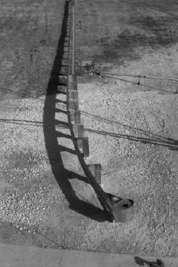
Product Identification
Approach Terminal (End Anchorage Assembly)
Modified Eccentric Loader Terminal (MELT) – Non-Proprietary
Prominent Features:
27” Guardrail Only
Flared Installation
Diaphragm Plate
Full Return Buffered End Section
C-Channel Strut
Offset Block at 2nd Post
6 - CRT Posts
MELT

Slide 4
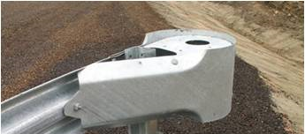
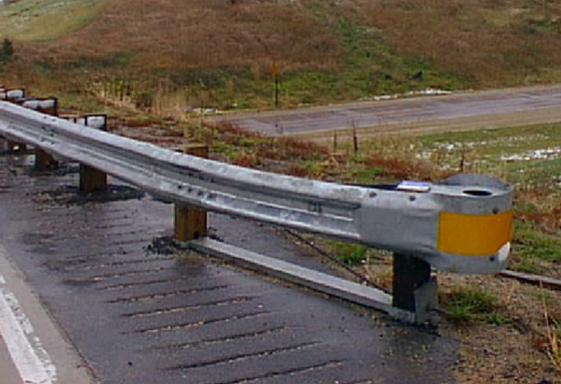
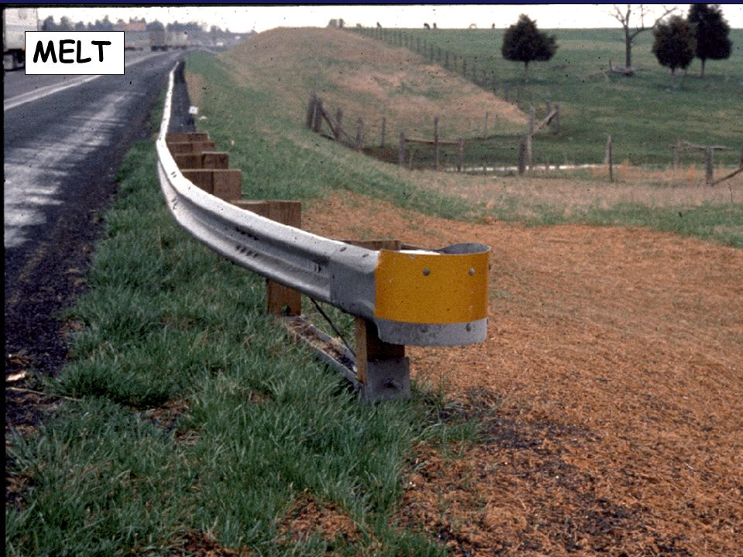
Product Identification
Modified Eccentric Loader Terminal (MELT)
B.
D.
C.
(Steel Post not used by FDOT)
E.
Flared Installation
Diaphragm Plate
Full Return Buffered End Section
Offset Block at 2nd Post
6 – Wood CRT Posts
A.

Slide 5
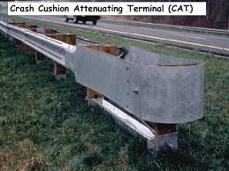
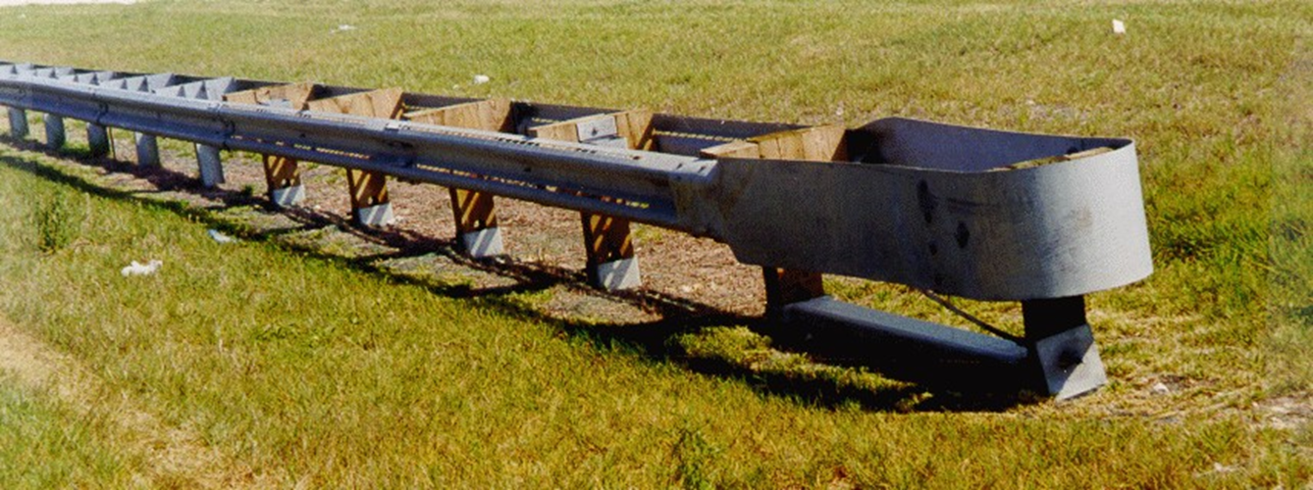
Product Identification
Approach Terminal (End Anchorage Assembly)
Crash Attenuating Terminal
(CAT 350) – Proprietary
Prominent Features:
27” Guardrail Only
Parallel Installation
Double Faced Guardrail
6 – Steel Tube Foundations
2 – Anchorage Cables
CAT 350

Slide 6
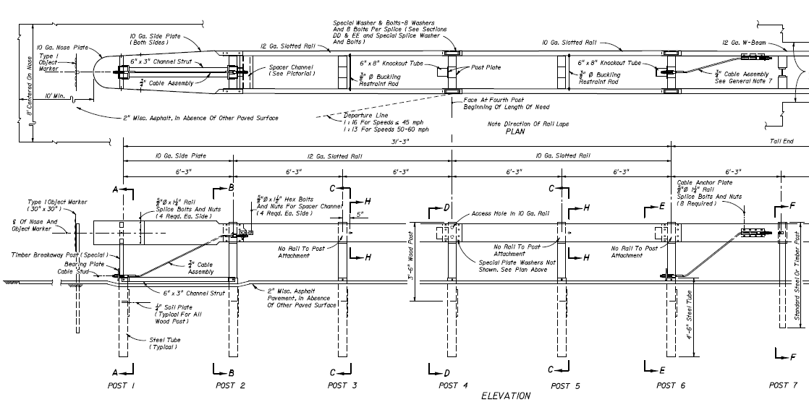
Product Identification
Crash Cushion Attenuating Terminal (CAT 350)
B.
A.
D.
C.
Double Faced Guardrail
Special Length Smooth Nose Plate
6 – Steel Tube Foundations
2 – Anchorage Cable Locations

Slide 7
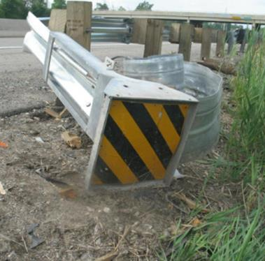
Product Identification
Approach Terminal (End Anchorage Assembly)
Proprietary - Energy Absorbing Terminals
Features:
Extrusion Heads
Discharges Rail
Breakaway Post in Steel Tubes
Cable Anchorage
Products Included:
Trinity Highway Products, LLC.
ET-2000
ET Plus
Road Systems, Inc.
SKT
FLEAT

Slide 8
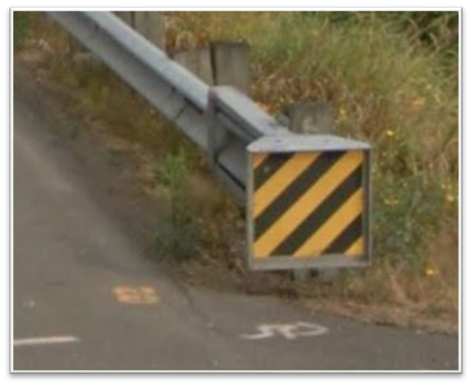
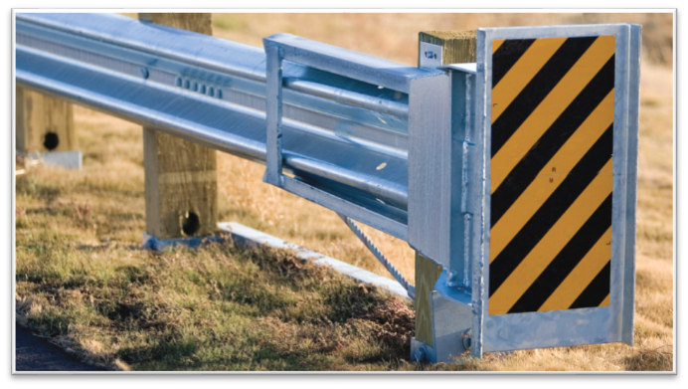
Product Identification
Approach Terminal (End Anchorage Assembly)
Energy Absorbing Terminals
ET-2000 and ET-Plus – Proprietary
Trinity Highway Products, LLC.
Prominent Features:
27” Guardrail Only
Extruding Rail Design
Parallel Treatment
Single Strut on Extrusion Head
ET-2000
Square Head
C-Channel Post Strut
ET-Plus
Rectangular Head
Flanges on Sides of Head Only
Angle Strut
ET-2000
ET-Plus

Slide 9
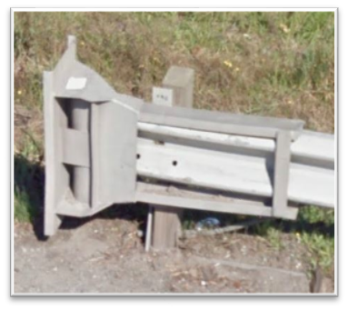
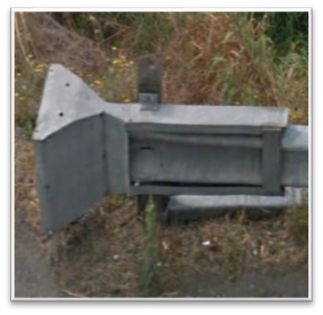
Product Identification
Approach Terminal (End Anchorage Assembly)
ET-2000 and ET-Plus – Proprietary
Trinity Highway Products, LLC.
ET-2000 Unique Features:
Square Head
C-Channel Post Strut
Single Strut on Extrusion Head
a.
c.
b.
ET-Plus
ET-2000
A.
C.
d.
ET-Plus Unique Features:
Rectangular Head
Flanges on Sides of Head Only
Single Angle Strut
Single Strut on Extrusion Head
B.

Slide 10
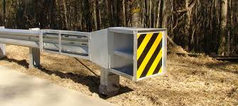
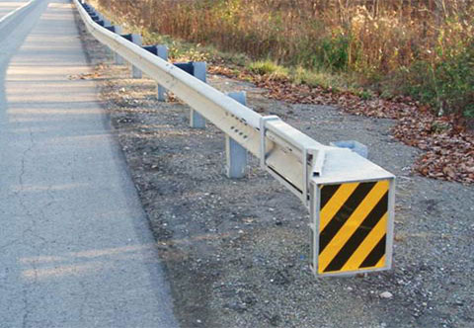
Product Identification
Approach Terminal (End Anchorage Assembly)
Energy Absorbing Terminals
SKT & FLEAT – Proprietary
Road Systems, Inc.
Unique Features:
27” & 31” Guardrail
Extruding Rail Design
Steel and Wood Post Options
SKT (Sequential Kinking Terminal)
Parallel Treatment
Square Head
Rail Extrudes Away From Traffic Lanes
FLEAT (FLared Energy Absorbing Terminal)
Flared Treatment
Somewhat Rectangular Head
Rail Extrudes Towards Traffic Lanes
SKT
FLEAT

Slide 11
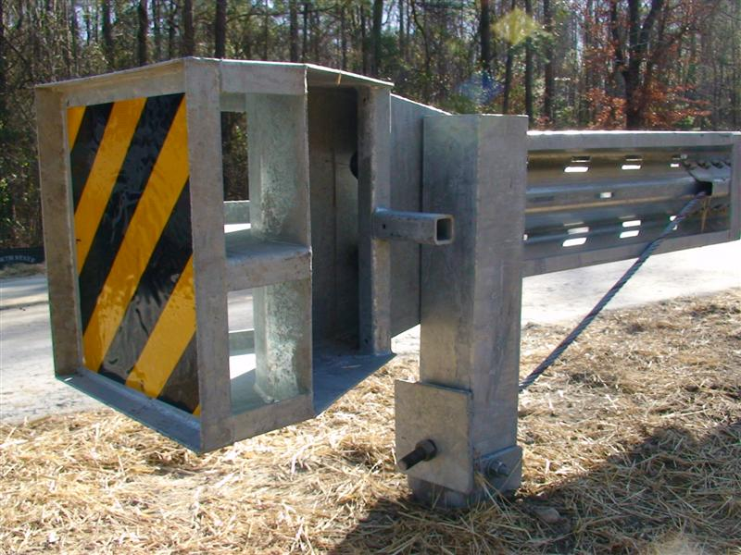
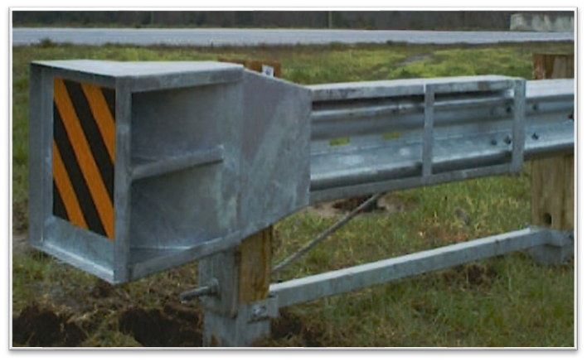
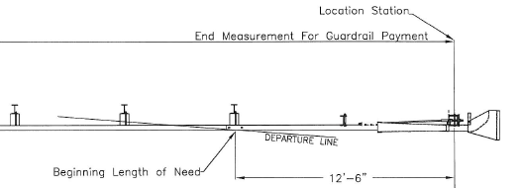
Product Identification
Approach Terminal (End Anchorage Assembly)
SKT (Sequential Kinking Terminal)
Road Systems, Inc.
Unique Features:
Parallel Treatment
Square Head
Rail Extrudes Away From Traffic Lanes
Secondary Struts in Head Unit
C.
SKT
B.
DISCHARGE
D.
A.

Slide 12
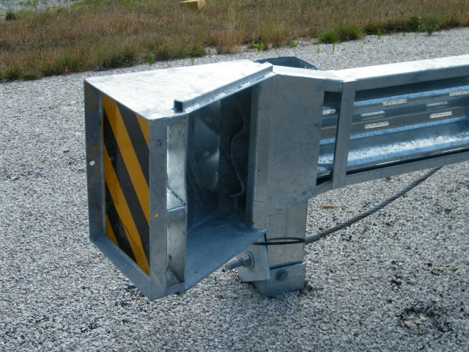
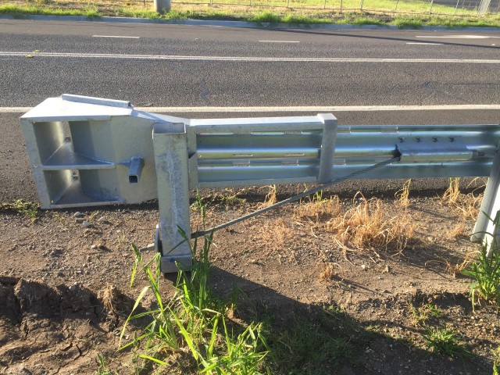
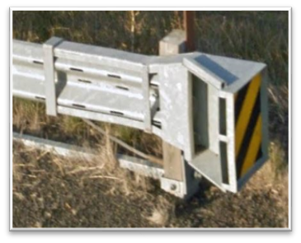
Product Identification
Approach Terminal (End Anchorage Assembly)
FLEAT (FLared Energy Absorbing Terminal)
Road Systems, Inc.
Unique Features:
Flared Treatment
Somewhat Rectangular Head
Rail Extrudes Towards Traffic Lanes
Square Tube On Top Of Head
Duel Struts on Head Unit
c.
FLEAT
d.
DISCHARGE
b.
e.
a.

Slide 13
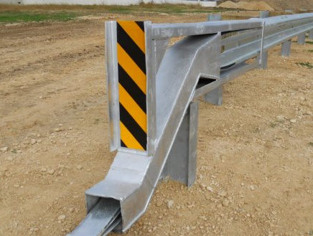
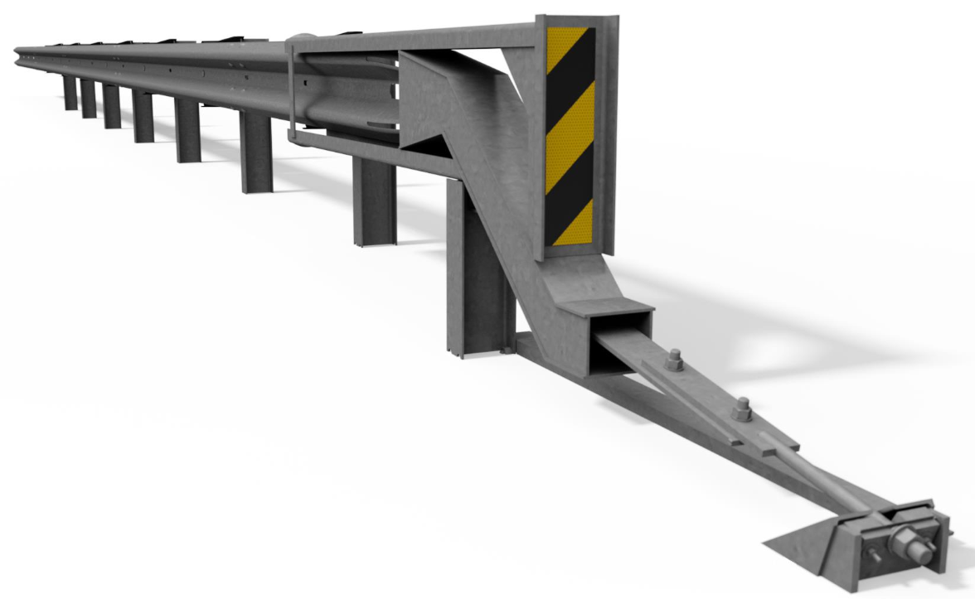
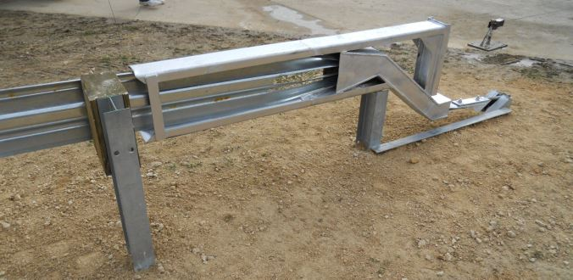
Product Identification
Approach Terminal (End Anchorage Assembly)
Energy Absorbing Terminals
SoftStop – Proprietary
Trinity Highway Products, LLC.
31” Guardrail Only
Parallel Installations
Steel Posts Only
Unique Feature:
Tension Extrusion Head Chute Design
Forward Anchorage
A.
SoftStop
B.

Slide 14
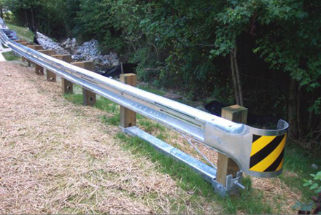
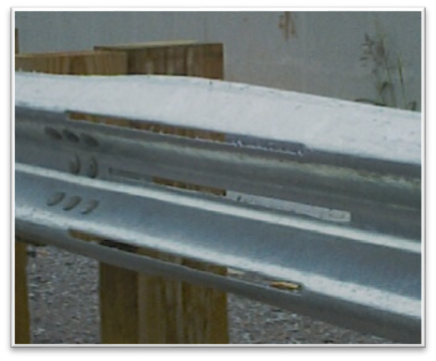
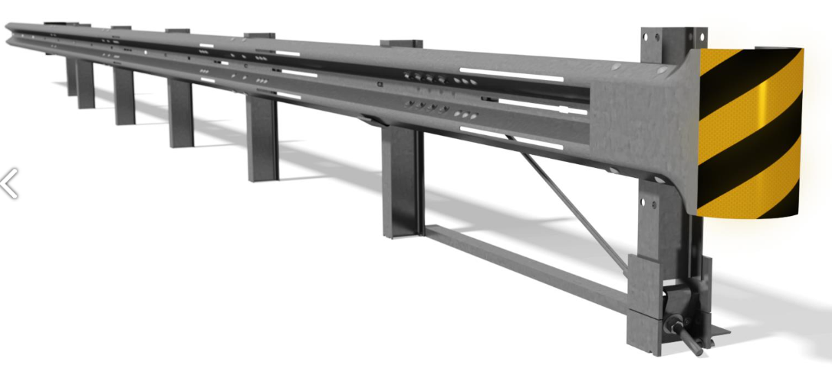
Product Identification
Approach Terminal (End Anchorage Assembly)
Slotted Rail Terminal (SRT) – Proprietary
Trinity Highway Products, LLC.
27” & 31” Guardrail
Flared Installations
Wood & Steel Post Options
Unique Feature:
Slotted Rail
Wood Posts
SRT
Steel Posts
Slotted Rail

Slide 15
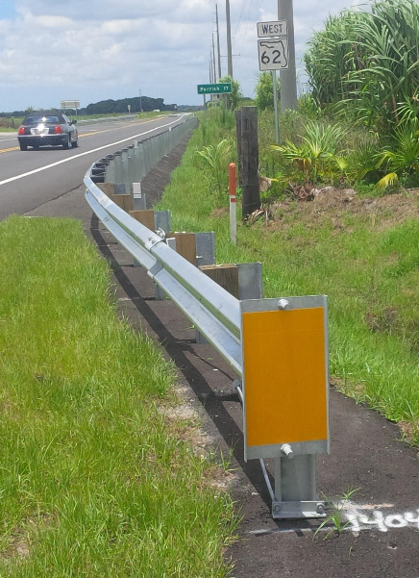
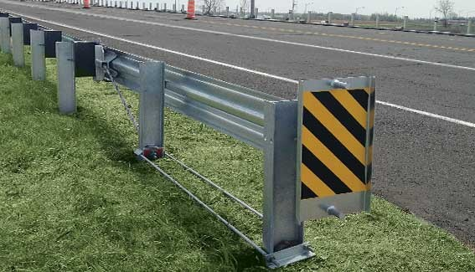
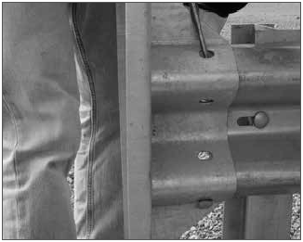
Product Identification
Approach Terminal (End Anchorage Assembly)
X-Lite – Proprietary
Lindsay Transportation Solutions/Barrier Systems
27” & 31” Guardrail
Flared & Parallel Installations
Steel Post Only
Unique Feature:
Direct Mounted Head
Tension Rods (in lieu of Strut)
Slider Bracket
C.
X-LITE
B.
A.

Slide 16
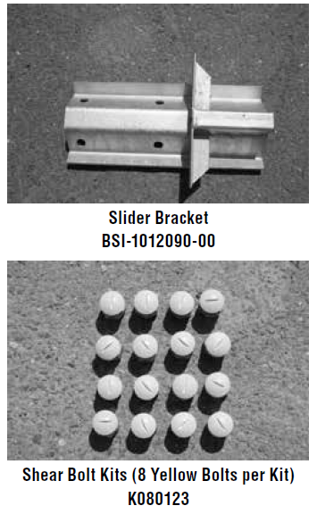
Product Identification
Approach Terminal (End Anchorage Assembly)
X-Lite – Proprietary “Telescoping” System (i.e. Panels Slide/Collapse)
Lindsay Transportation Solutions/Barrier Systems

Slide 17
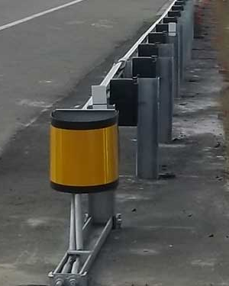
Product Identification
Approach Terminal (End Anchorage Assembly)
X-Tension – Proprietary
Lindsay Transportation Solutions/Barrier Systems
27” & 31” Guardrail
Flared & Parallel Installations
Steel & Wood Posts
Unique Feature:
Direct Mounted Head
Forward Anchorage
Slider Bracket
Duel Tension Cables
X-Tension
B.
D.
C.
A.

Slide 18
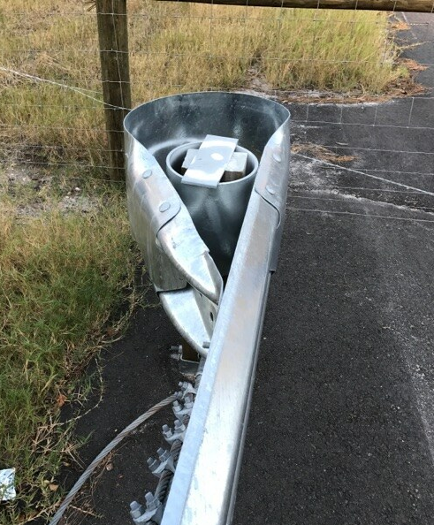
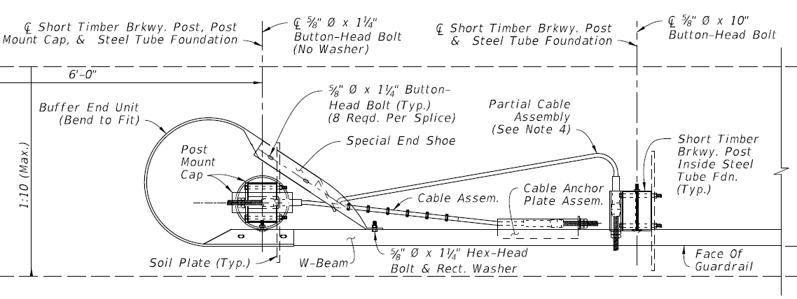
Product Identification
Trailing Anchorages
Controlled Release Terminal (CRT) – Non-Proprietary
Prominent Features:
27” & 31” Installations
Duel Cable Anchorage
Full Return Buffered End Section
No Strut
2 – Steel Tube Foundations
CRT System

Slide 19
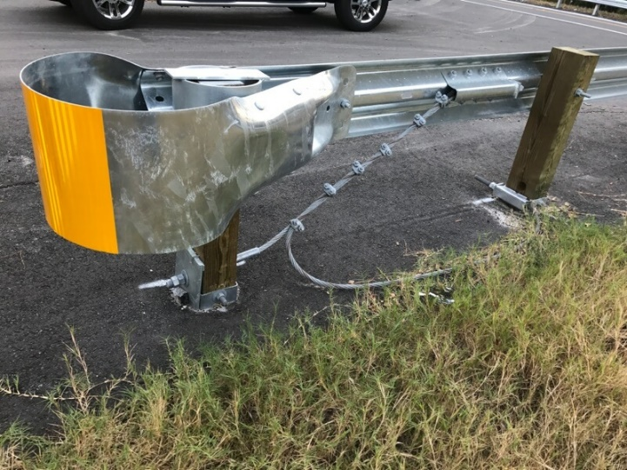
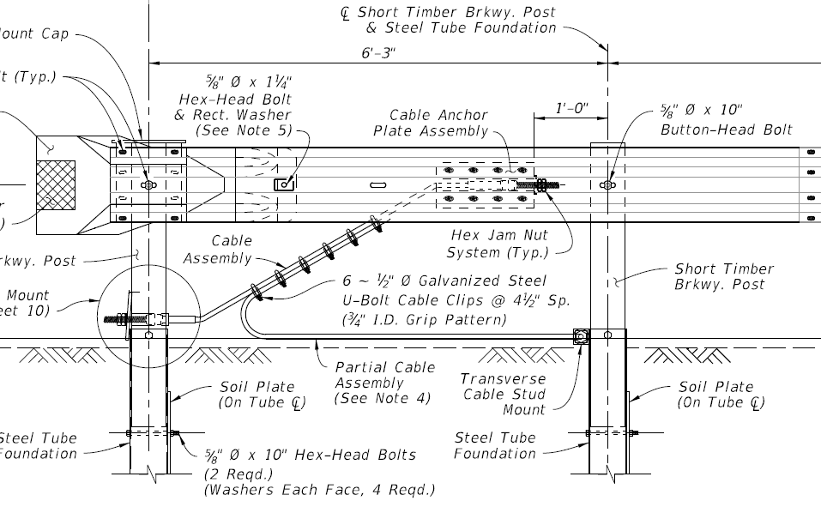
Product Identification
Trailing Anchorages
Controlled Release Terminal (CRT) – Non-Proprietary
Prominent Features:
27” & 31” Installations
Duel Cable Anchorage
Full Return Buffered End Section
No Strut
2 – Steel Tube Foundations
CRT System

Slide 20
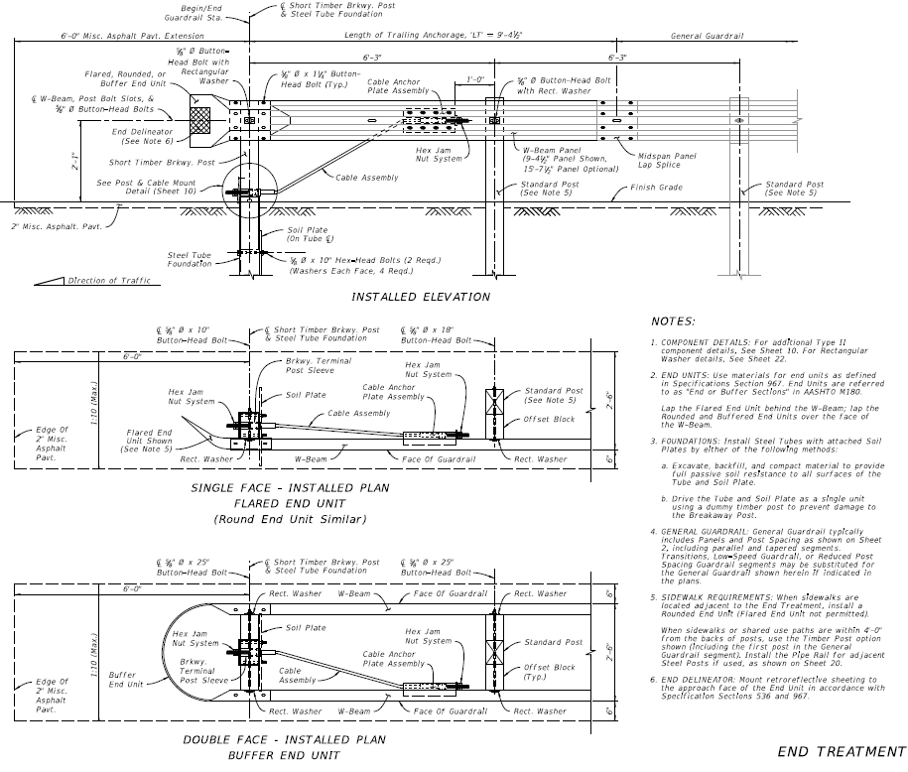
Product Identification
Trailing Anchorages
Type II

Slide 21
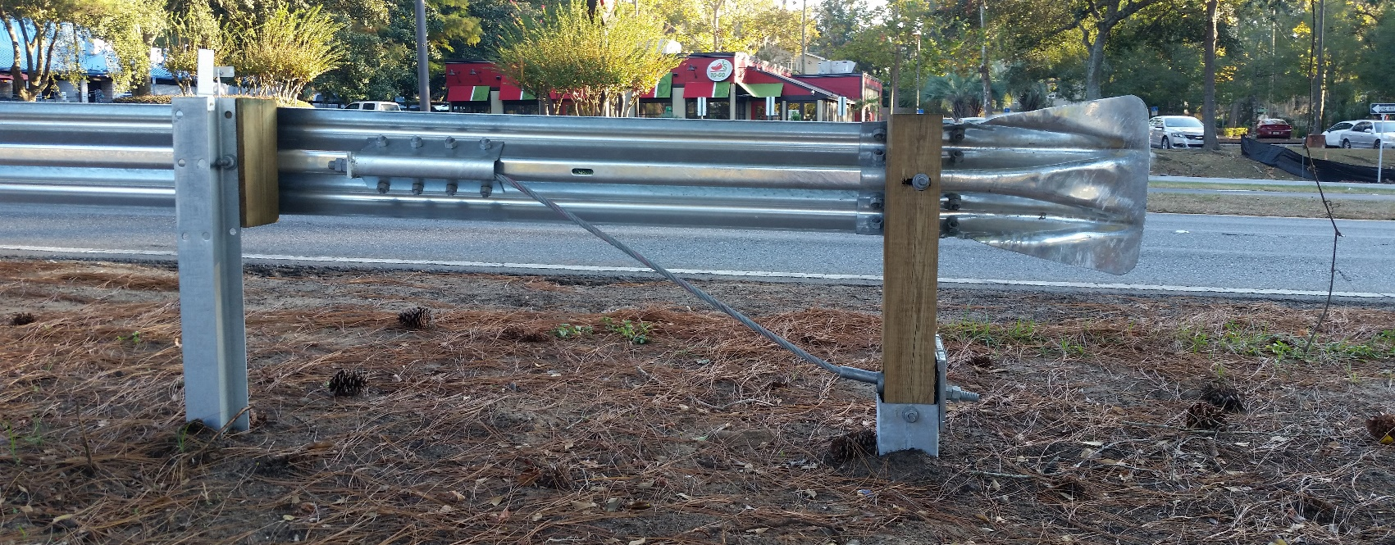
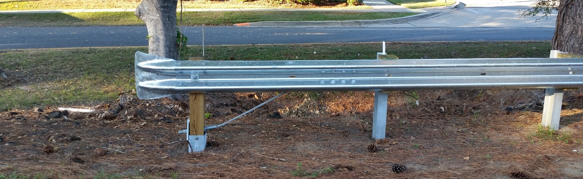
Product Identification
Trailing Anchorages
Type II

Slide 22
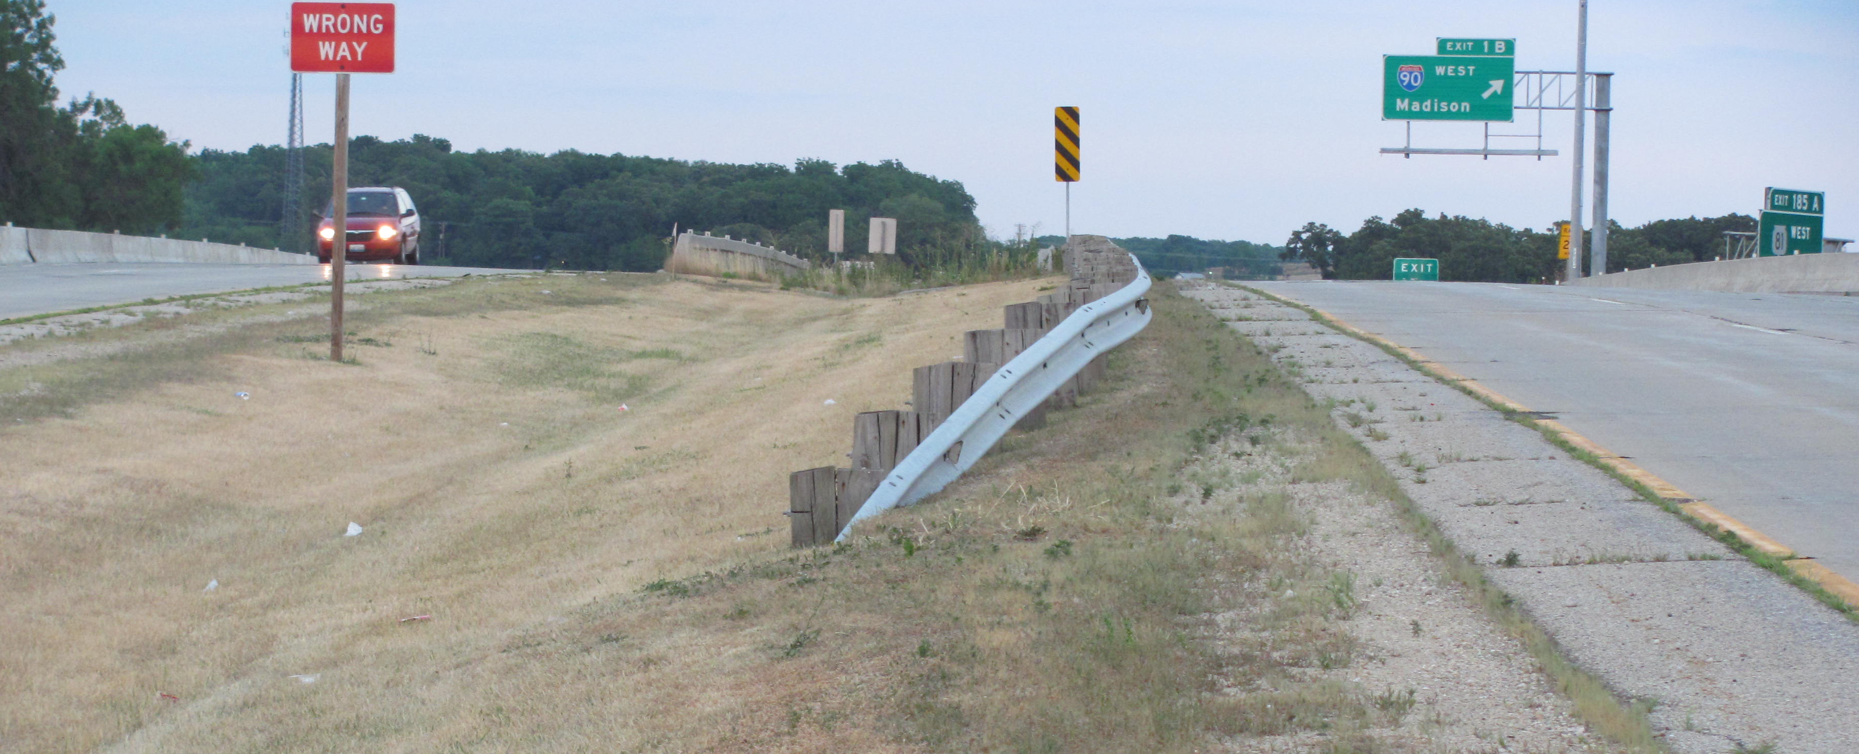
Product Identification
Trailing Anchorages
Turn-Down

Slide 23
Product Identification
Crash Cushions (Impact Attenuators):
Approach Terminal (End Anchorage Assembly)
All Systems are Proprietary Products
Pre NCHRP 350
Hi-Dro Cell
G.R.E.A.T.
Hex Foam
NCHRP 350
QuadGuard (Narrow & Wide)
Sand Barrels (Fitch & Energite)
Brakemaster 350
REACT 350
TRACC
TAU-II
SCI Smart Cushion
EASI-CELL Cluster
MASH (None At This Time)

Slide 24
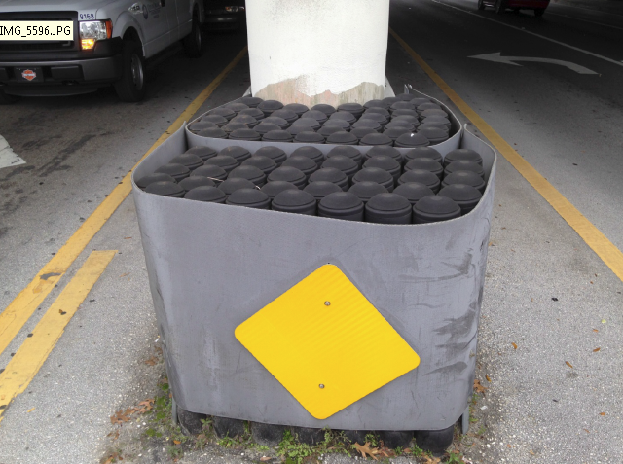
Product Identification
Crash Cushions (Impact Attenuators):
Hi-Dro Cell (Cluster) – Proprietary
Energy Absorption Systems, Inc.
Unique Feature:
Small Diameter Water Filled Cylindrical Cartridges w/Caps
Clustered
Hi-Dro Cell (Cluster)
A.

Slide 25
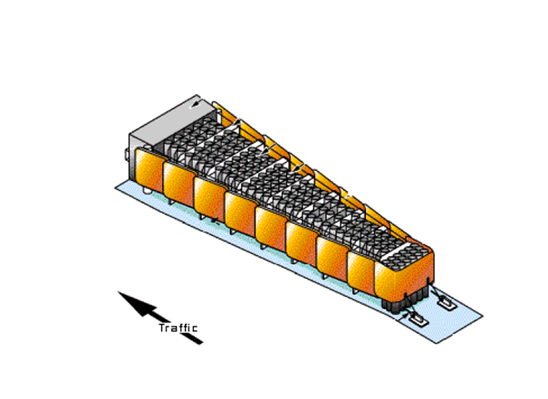
Product Identification
Crash Cushions (Impact Attenuators):
Hi-Dro Cell (Sandwich) – Proprietary
Energy Absorption Systems, Inc.
Unique Feature:
Fiberglass Fender Panels
Small Diameter Cylindrical Cartridges
Hi-Dro Cell (Sandwich)
B.
A.

Slide 26
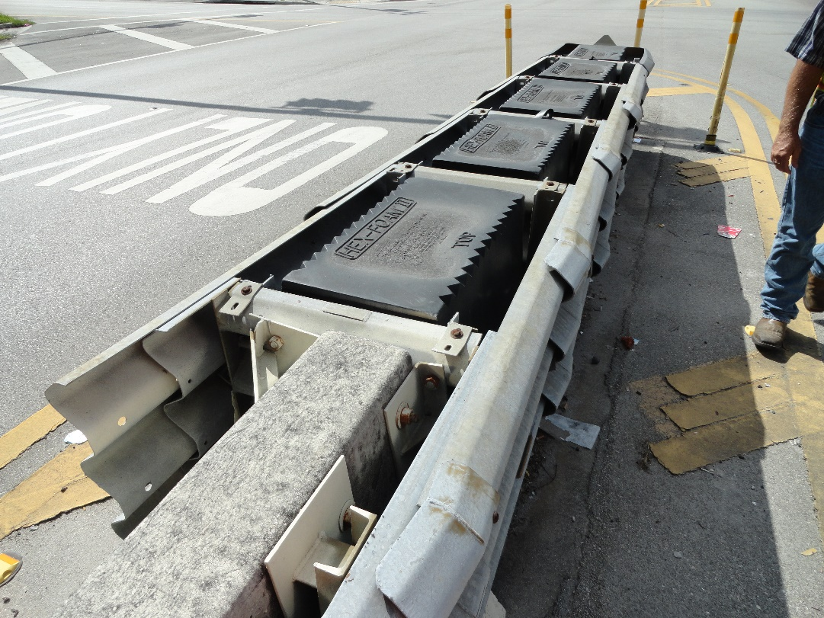
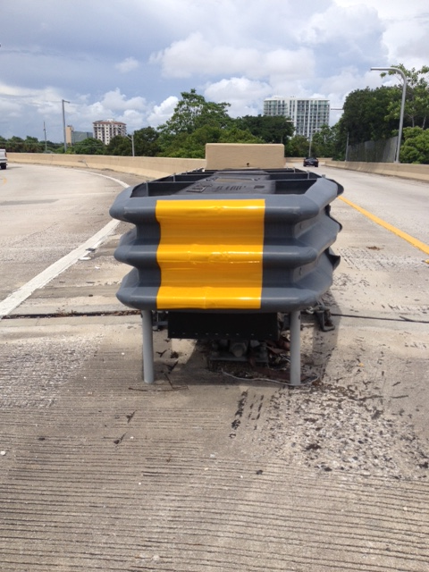
Product Identification
Crash Cushions (Impact Attenuators):
G-R-E-A-T - Proprietary
Energy Absorption Systems, Inc.
Unique Feature:
Hex-Foam Cartridges
Profiled Nose
A.
G-R-E-A-T
B.

Slide 27
Product Identification
Crash Cushions (Impact Attenuators):
Sand (Barrel) Crash Cushion - Proprietary
Energy Absorption Systems, Inc.
Unique Feature:
Fitch – Vertical Sides
Energite – Tapper Sides
Fitch - Sand Barrel
Energite - Sand Barrel
B.
A.

Slide 28
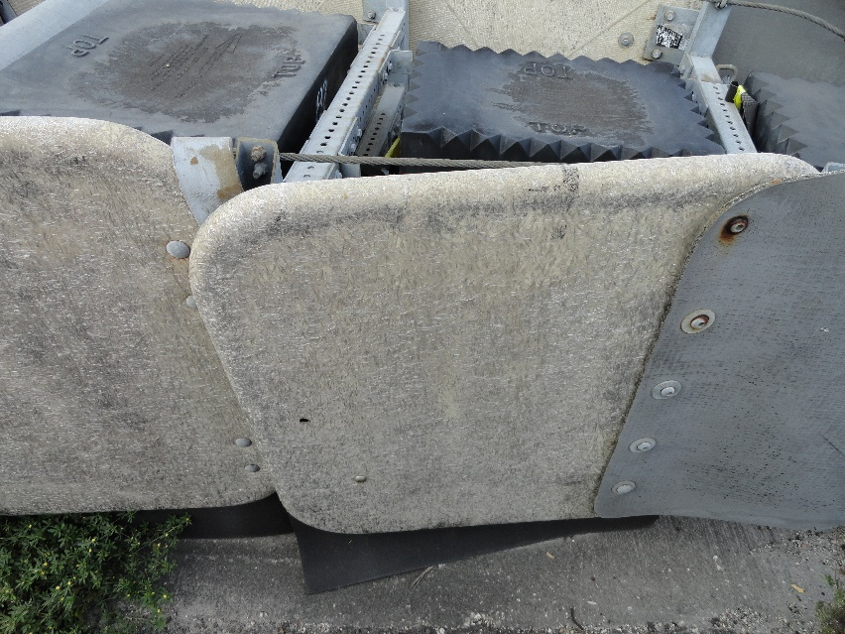
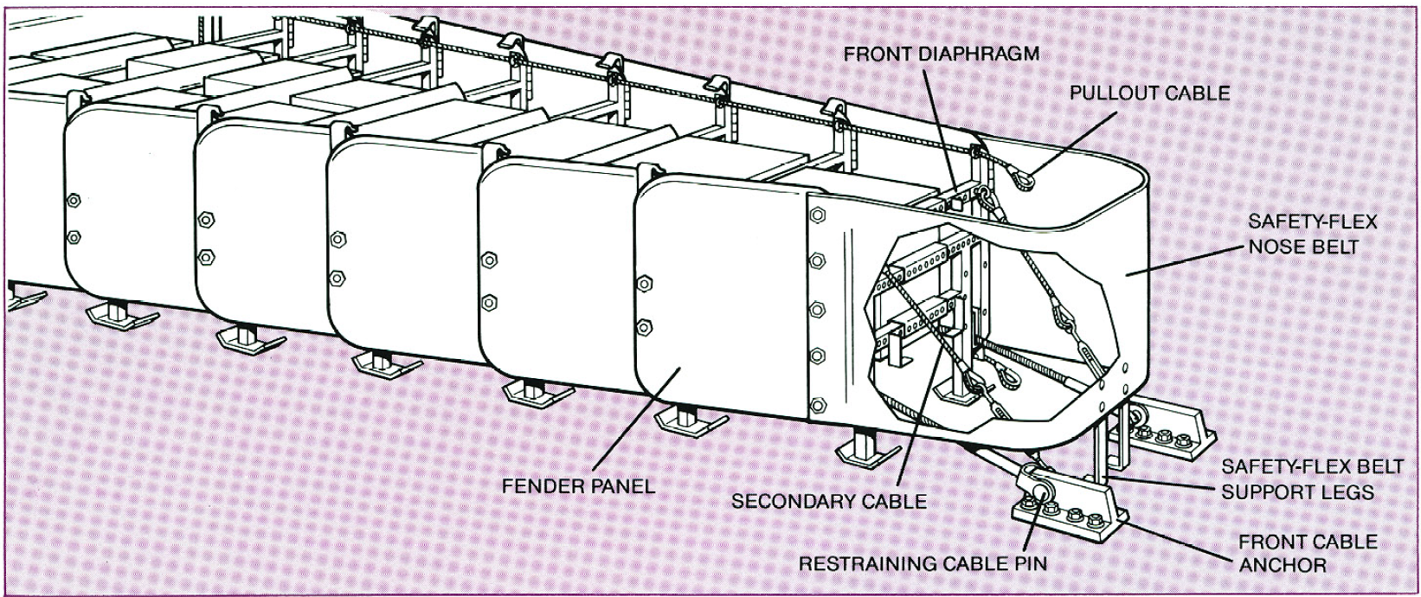
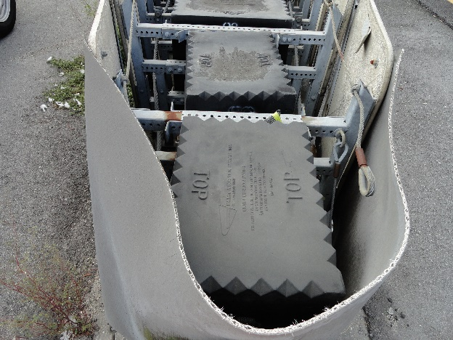
Product Identification
Crash Cushions (Impact Attenuators):
Hex-Foam Sandwich - Proprietary
Energy Absorption Systems, Inc.
Unique Feature:
Fiberglass Fender Panels
Rectangular Cartridges
Flexible Nose “Belt”
Hex-Foam
A.
B.

Slide 29
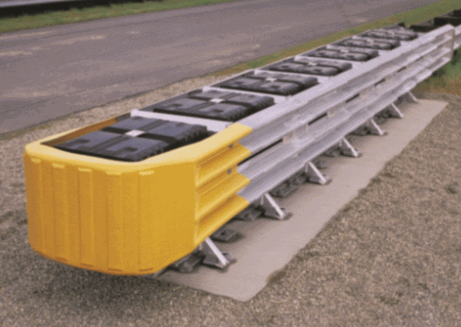
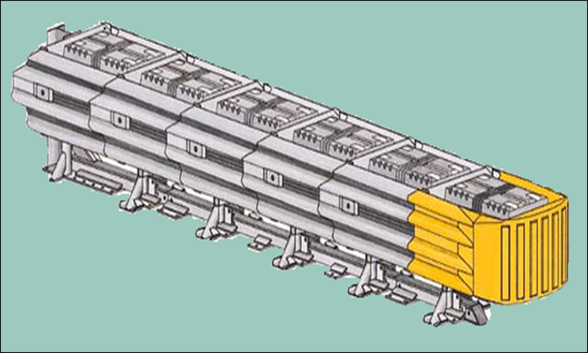
Product Identification
Crash Cushions (Impact Attenuators):
Quadguard (Narrow & Wide) - Proprietary
Energy Absorption Systems, Inc.
Unique Feature:
Quadruple Corrugated Fender Panels
Rectangular Cartridges
Plastic Nose
Monorail Base
C.
A.
Quadguard
B.
D.

Slide 30
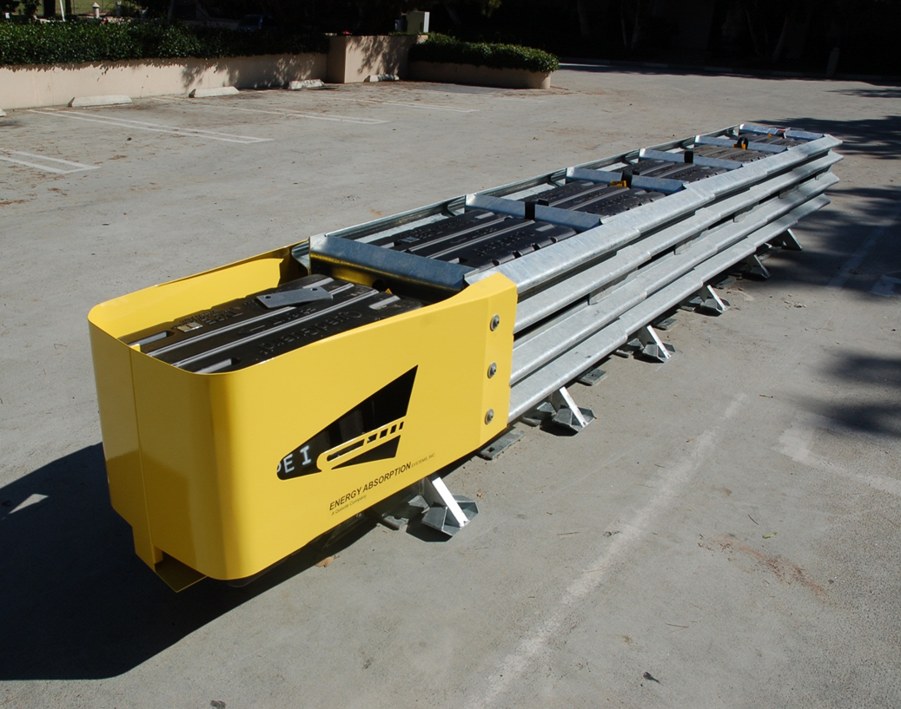
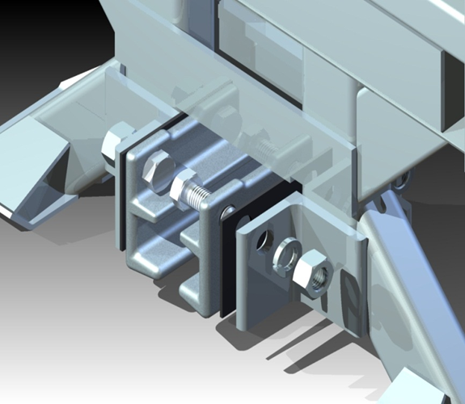
Product Identification
Crash Cushions (Impact Attenuators):
Quadguard II (Narrow & Wide) – Proprietary
(Shorter than the Original Quadguard)
Energy Absorption Systems, Inc.
Unique Feature:
Quadruple Corrugated Fender Panels
Rectangular Cartridges
Steel Nose
Monorail Guide Stabilizers
C.
A.
Quadguard II
B.
D.

Slide 31
Product Identification
Crash Cushions (Impact Attenuators):
Quadguard II (Narrow & Wide) – Proprietary
(Shorter than the Original Quadguard)
Energy Absorption Systems, Inc.
D. Monorail Guide Stabilizers
Quadguard II
D.

Slide 32
Product Identification
Crash Cushions (Impact Attenuators):
Quadguard Elite (Narrow & Wide) – Proprietary
(Reusable Cylinders)
Energy Absorption Systems, Inc.
Unique Feature:
Quadruple Corrugated Fender Panels
HDPE Cylinders
Monorail Base
B.
A.
Quadguard Elite
B.
C.

Slide 33
Product Identification
Crash Cushions (Impact Attenuators):
Brakemaster 350 – Proprietary
Energy Absorption Systems, Inc.
Unique Feature:
W-Beam Fender Panels
Brake Cable & Tension Support
1st – 5 Posts Are Not Embedded
B.
Brakemaster 350
A.
B.
C.
C.

Slide 34
Product Identification
Crash Cushions (Impact Attenuators):
Brakemaster 350 – Proprietary
Energy Absorption Systems, Inc.
Unique Feature:
W-Beam Fender Panels
Brake Cable & Tension Support
1st – 5 Posts Are Not Embedded
B.
A.
Brakemaster 350
C.
B.

Slide 35
Product Identification
Crash Cushions (Impact Attenuators):
REACT 350 – Proprietary
Energy Absorption Systems, Inc.
Unique Feature:
Large Diameter HDPE Cylinders
Redirective Cables
B.
A.
REACT 350
B.

Slide 36
Product Identification
Crash Cushions (Impact Attenuators):
ADIEM 350 – Proprietary
Advanced Dynamic Impact Extension Module (ADIEM)
Trinity Highway Products, LLC.
Unique Feature:
Crushable Concrete Modules
Reinforced Concrete Base
A.
ADIEM 350
B.

Slide 37
Product Identification
Crash Cushions (Impact Attenuators):
TRACC – Proprietary
Trinity Attenuating Crash Cushion (TRACC)
Trinity Highway Products, LLC.
Unique Feature:
Plastic Nose
No Cartridges
Stacked Modified W-Beam Fender Panels
C.
TRACC
B.
A.

Slide 38
Product Identification
Crash Cushions (Impact Attenuators):
TAU II – Proprietary
Lindsay Transportation Solutions/Barrier Systems
Unique Feature:
Plastic Nose
Conical Shaped Cartridges
Modified Thrie-Beam Fender Panels
B.
TAU-II
C.
A.

Slide 39
Product Identification
Crash Cushions (Impact Attenuators):
TAU II – Proprietary
TAU II

Slide 40
Product Identification
Crash Cushions (Impact Attenuators):
SCI Smart Cushion – Proprietary
Work Area Protection, Inc.
Unique Feature:
No Cartridges
Hydraulic Cylinder w/Cable
Blunt/Square Nose
A.
SCI Smart Cushion
C.
A.
B.
C.

Slide 41
Product Identification
Crash Cushions (Impact Attenuators):
EASI-Cell – Proprietary
Energy Absorption Systems, Inc.
Unique Feature:
Small Diameter HDPE Cylinders
No External Hardware
Low Speed (TL-1)
EASI-CELL

Slide 42
Product Identification
Crash Cushions (Impact Attenuators) :
X-MAS – Proprietary
(Double Faced Version of the X-Tension Terminal)
Lindsay Transportation Solutions/Barrier Systems
Unique Feature:
W-Beam Panels w/Slider Bracket
Standard Driven Posts
Forward Anchorage
Duel Tension Cables
D.
X-MAS
A.
C.
B.

Slide 43
Product Identification
Questions?
Derwood Sheppard, P.E.
Roadway Design Standards Publication Manager
Central Office, Roadway Design
(850) 414-4334
derwood.sheppard@dot.state.fl.us

