Slide 1
Florida’s Turnpike Enterprise
Information & Knowledge Management
Aran Lessard & Vincent DePianta

Slide 2
INTRODUCTION
ROADS
Data – Information – Knowledge
Goals & Objectives
Strategies
Processes & Procedures
Tools
Status Update

Slide 3
ROADS
ROADS Program
Improve data reliability
and simplify sharing

Slide 4
DATA – INFORMATION - KNOWLEDGE
Data Rich Information Poor?
DATA
INFORMATION
KNOWLEDGE

Slide 5
DATA – INFORMATION - KNOWLEDGE
KNOWLEDGE
INFORMATION
DATA

Slide 6
GOALS & OBJECTIVES
Ensure that the Right Information
available for the Right People
at the Right Time

Slide 7
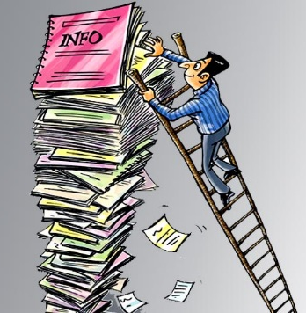
GOALS & OBJECTIVES
Ensure that the Right Information
available for the Right People
at the Right Time
Right Information?
Benefits Organization
Value Can be Multi-Purpose

Slide 8
GOALS & OBJECTIVES
Ensure that the Right Information
available for the Right People
at the Right Time
Right People?
Service Providers
Internal & External

Slide 9
GOALS & OBJECTIVES
Ensure that the Right Information
available for the Right People
at the Right Time
Right Time?
Timing is Everything…
Availability to Meet Needs

Slide 10
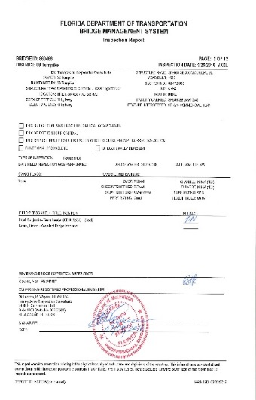
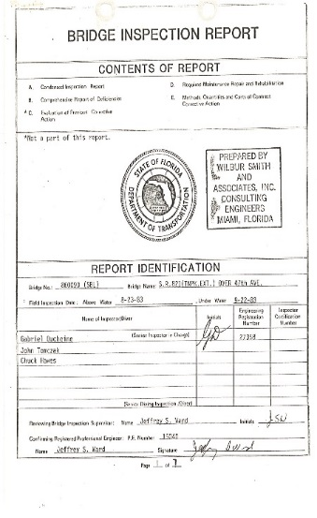
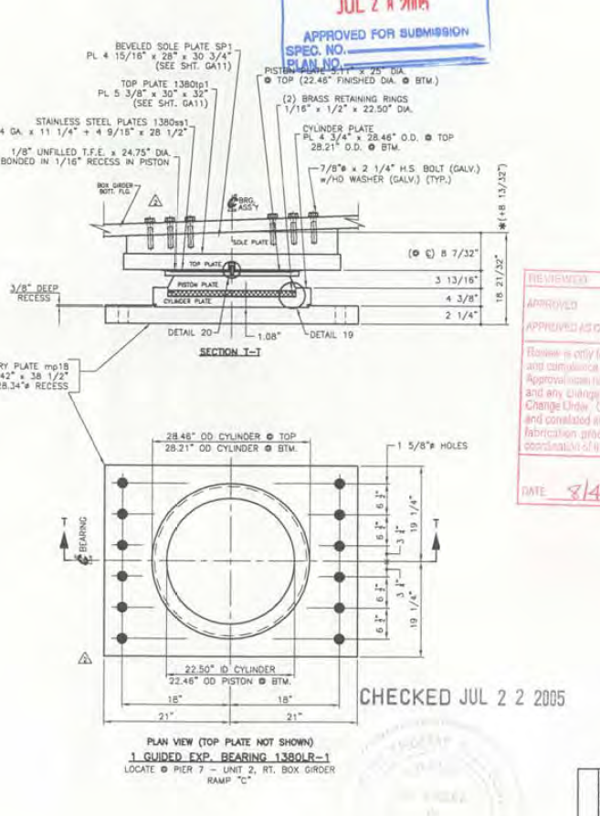
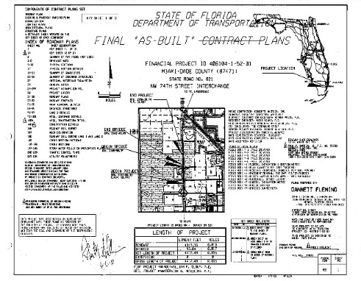
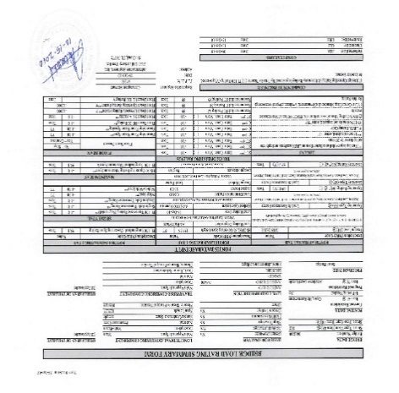
STRATEGIES
Right Information – Right People – Right Time
Organize
Optimize
GIS Based Use
Linked to Resources

Slide 11
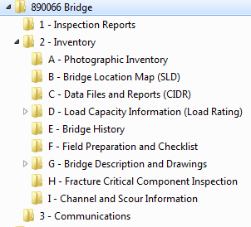
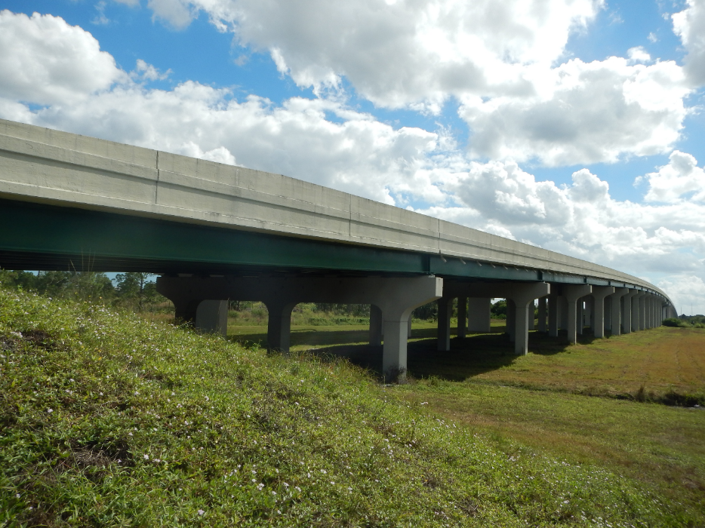
INFORMATION & KNOWLEDGE
“One-Stop-Shop”
All Information on Asset

Slide 12
INFORMATION & KNOWLEDGE
Structure ID
Date (YYYYMMDD)
Information
Standardized File Naming

Slide 13
INFORMATION & KNOWLEDGE
Structure ID
Date (YYYYMMDD)
Information
Files Optimized for Use

Slide 14
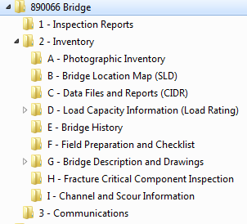
INFORMATION & KNOWLEDGE

Slide 15
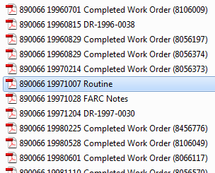
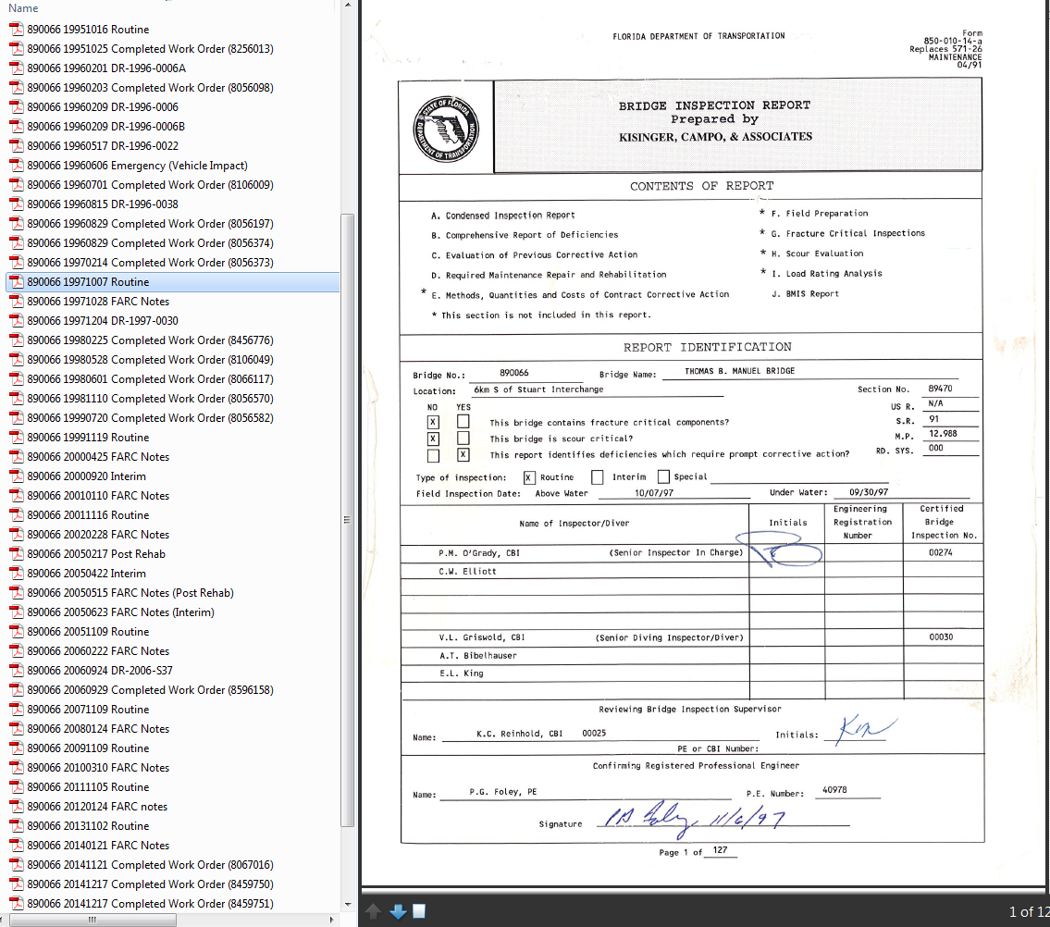
INFORMATION & KNOWLEDGE
Structure ID
Date (YYYYMMDD)
Information
Organized Chronologically

Slide 16
INFORMATION & KNOWLEDGE
Inspection Recommends Repair

Slide 17
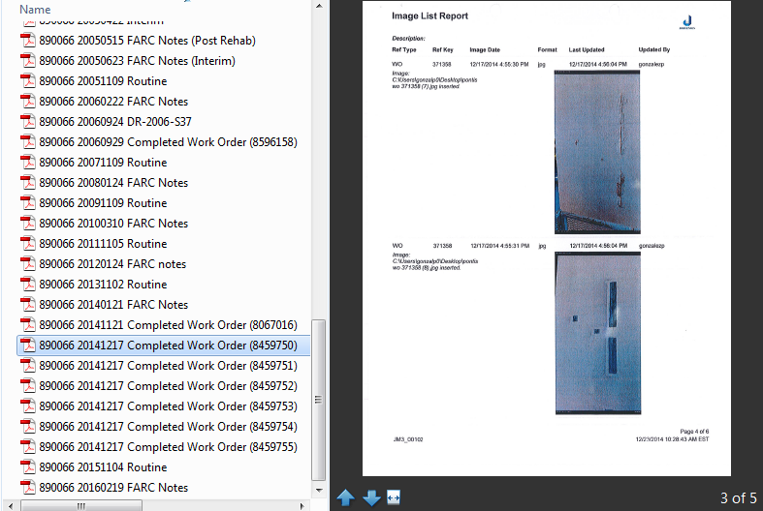
INFORMATION & KNOWLEDGE
Inspection Recommends Repair
Work Order Repair (before & after photos)

Slide 18
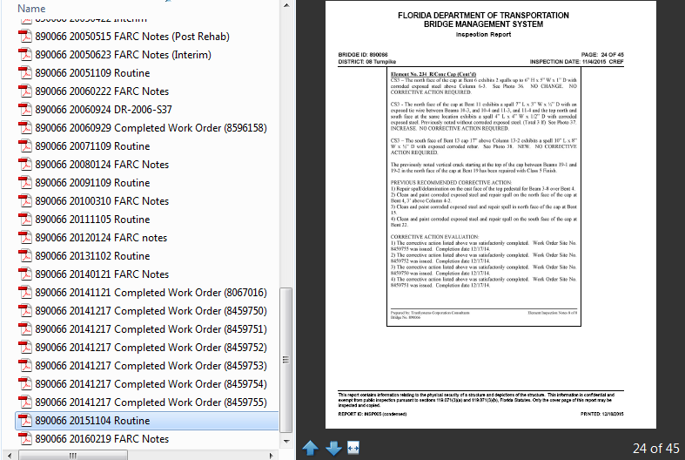
INFORMATION & KNOWLEDGE
Inspection Recommends Repair
Work Order Repair (before & after photos)
Follow-up Review of Quality and Effectiveness

Slide 19
INFORMATION & KNOWLEDGE
Translate Data to .kml File Format:
http://www.earthpoint.us/ExcelToKml.aspx
(or “Excel to kml” in www.Google.com)

Slide 20
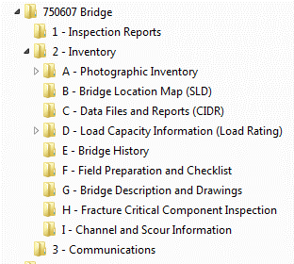
INFORMATION & KNOWLEDGE

Slide 21
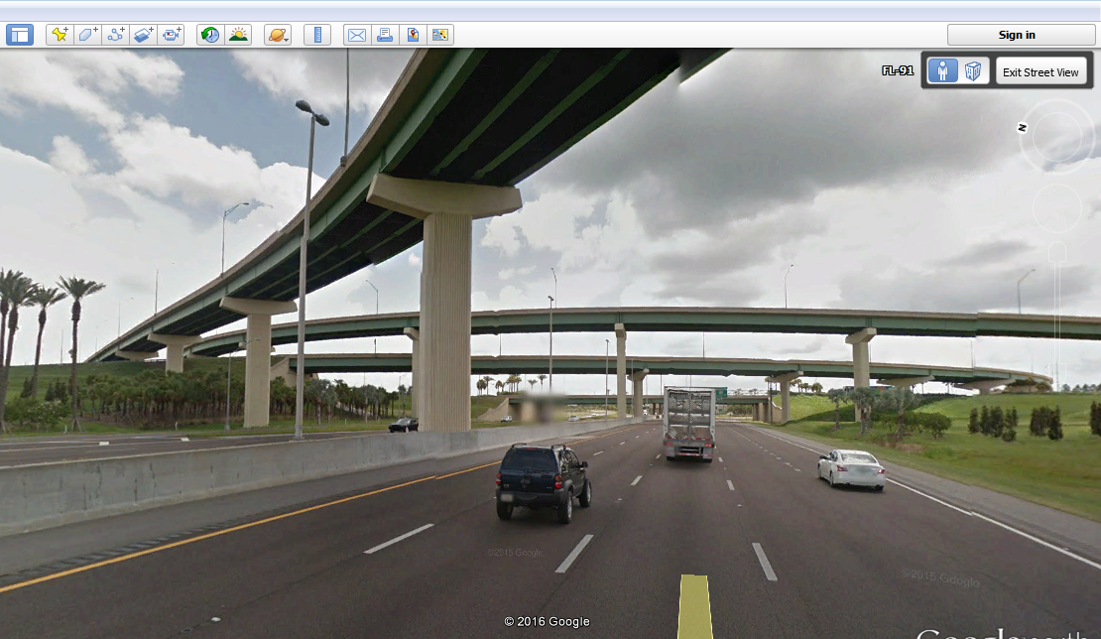
INFORMATION & KNOWLEDGE

Slide 22
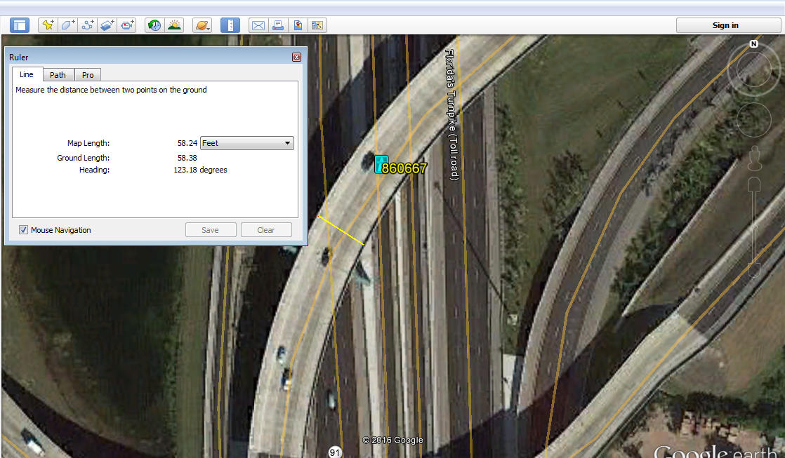
INFORMATION & KNOWLEDGE

Slide 23
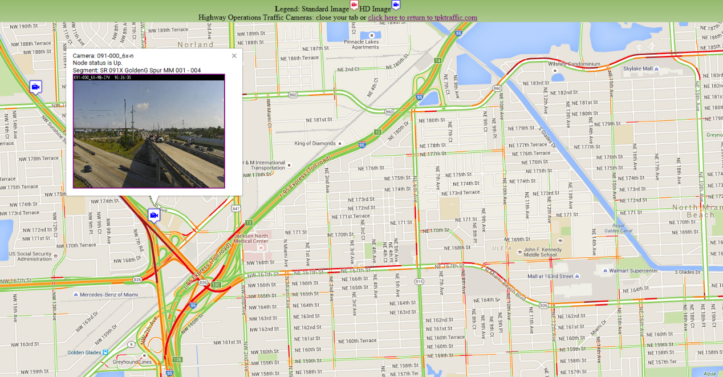
INFORMATION & KNOWLEDGE

Slide 24
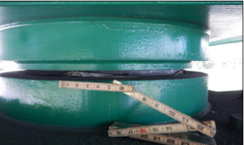
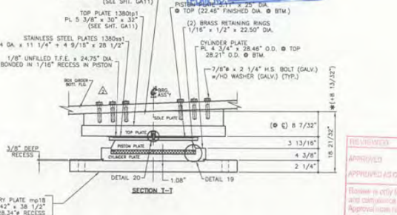
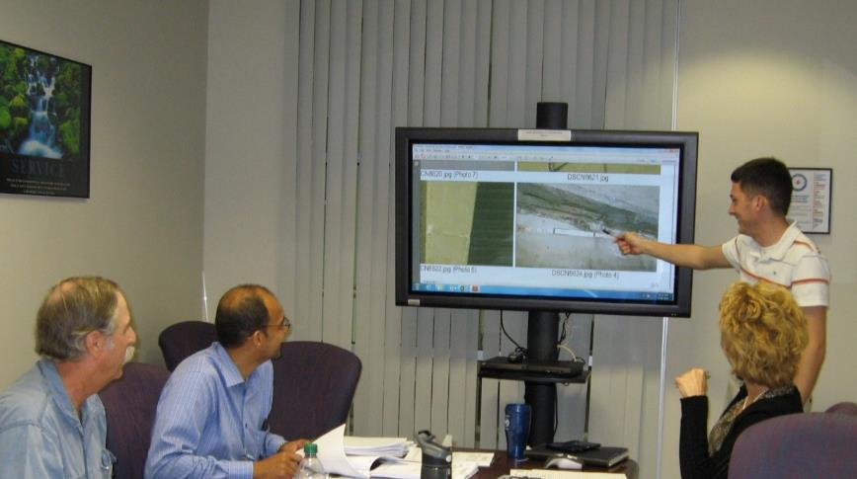
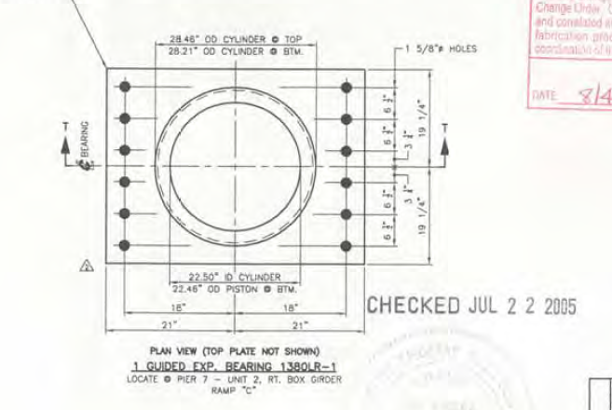
INFORMATION & KNOWLEDGE
High Quality Information = Better Decisions

Slide 25
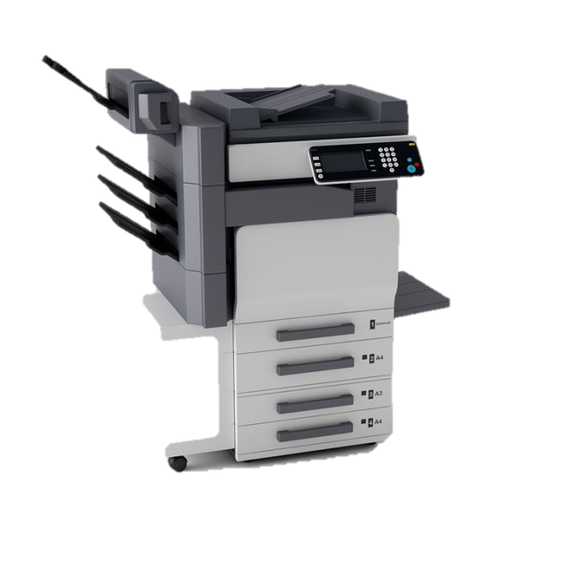
PROCESSES & PROCEDURES
Creation
Initial Quality Review
Attribution for EDMS
Filing and Storage
Quality Assurance

Slide 26
PROCESSES & PROCEDURES
Creation of Electronic Documents
New Documents Generated Electronically
Historical Files Scanned

Slide 27
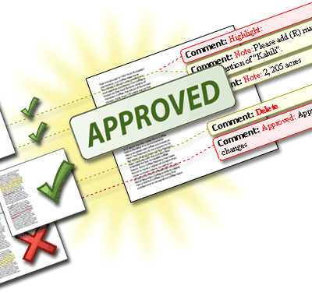
PROCESSES & PROCEDURES
Creation
Initial Quality Review
Attribution for EDMS
Filing and Storage
Quality Assurance

Slide 28
PROCESSES & PROCEDURES
Creation
Initial Quality Review
Attribution for EDMS
Filing and Storage
Quality Assurance

Slide 29
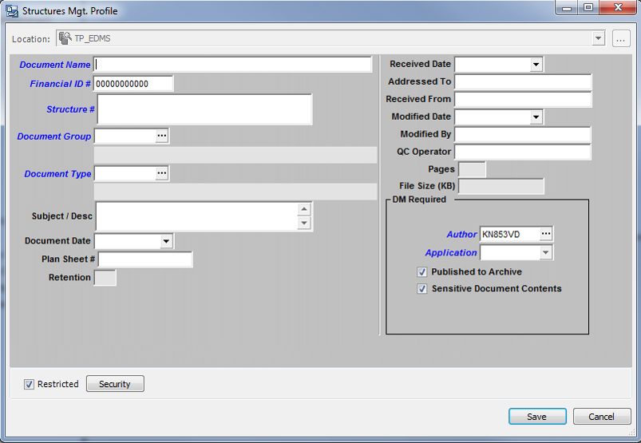
PROCESSES & PROCEDURES

Slide 30
PROCESSES & PROCEDURES

Slide 31
PROCESSES & PROCEDURES
Creation
Initial Quality Review
Attribution for EDMS
Filing and Storage
Quality Assurance

Slide 32
PROCESSES & PROCEDURES
Creation
Initial Quality Review
Attribution for EDMS
Filing and Storage
Quality Assurance

Slide 33
TOOLS & APPLICATIONS
FileRenamer
Excel Macro

Slide 34
TOOLS & APPLICATIONS

Slide 35
Tools & Applications
Email Confirmation of EDMS Upload
With CSV of Actions

Slide 36
CURRENT STATUS
Historical Documents Scanned
Bridges – 100%
Signs – 56%
LNQCs – 100%
HMLTs – 61%
Outlook
Finish Scanning by August ‘17
Destruction of Hard Copies
Go completely electronic

Slide 37
Summary
KNOWLEDGE
Knowledge Management…
Ensure Right Information is available for the Right People at the Right Time.
Data - Information - Knowledge
Organize & Optimize
Create Value – Improve Efficiency
Defined Process for Document Review
Tools & Apps – Improve Efficiency
INFORMATION
DATA

Slide 38
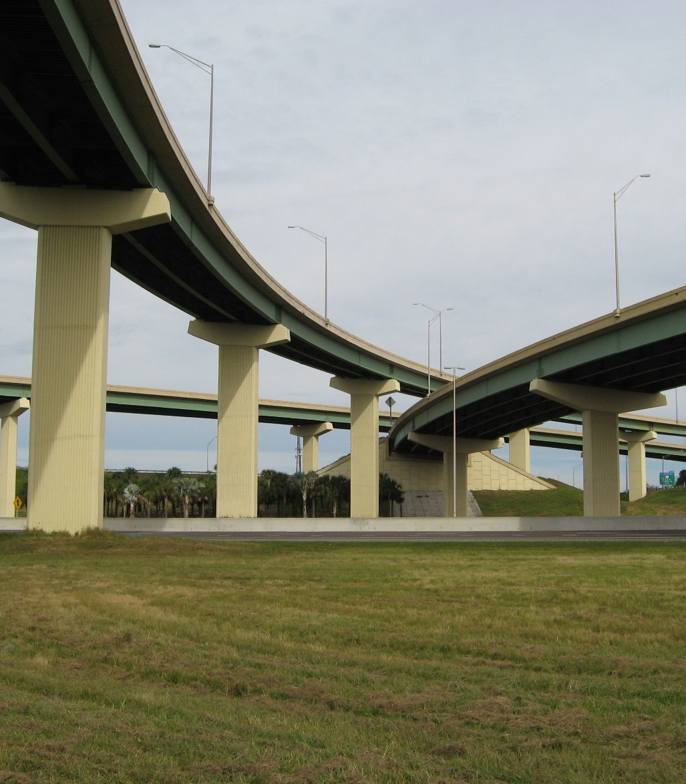
INFORMATION & KNOWLEDGE
Questions?
Aran Lessard
Aran.Lessard@dot.state.fl.us
(954)934-1234
Vincent DePianta
Vincent.DePianta@dot.state.fl.us
(954)934-1367

