Slide 1
Steel Bridge Preservation and Coating Practices
Maintaining a State of Good Repair Using Cost Effective Investment Strategies
Erica Peterson
Steve Stafford
Notes:
Bridges are an integral part of the U.S. highway network, providing links across natural barriers, passage over railroads and highways, and freeway connections.

Slide 2
More than 30 percent of the Nation’s 600,000 bridges have exceeded their 50 year theoretical design life and are in need of various levels of repairs, rehabilitation, or replacement.

Slide 3
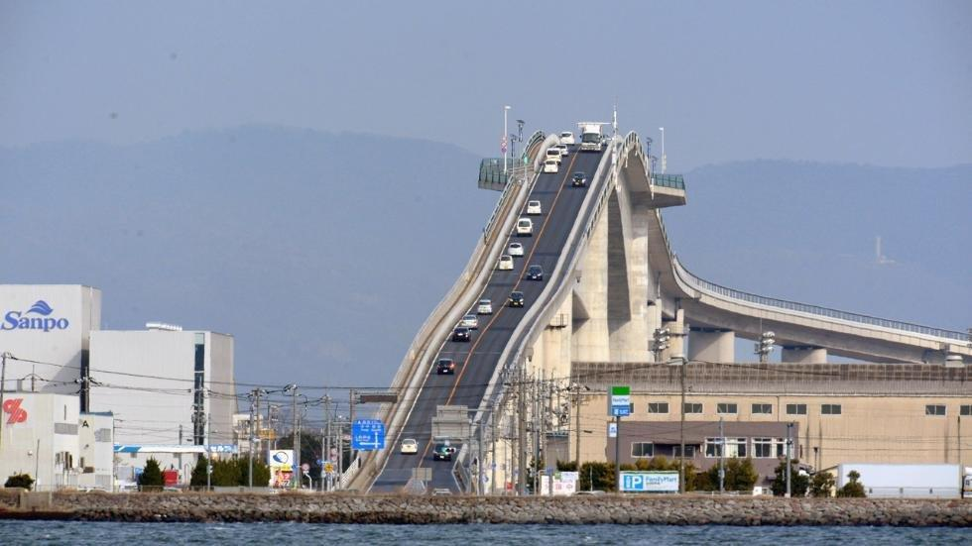
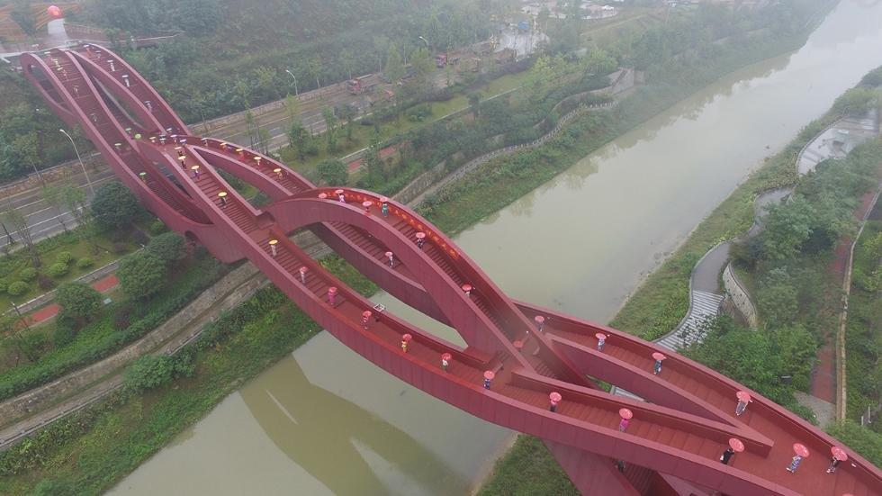
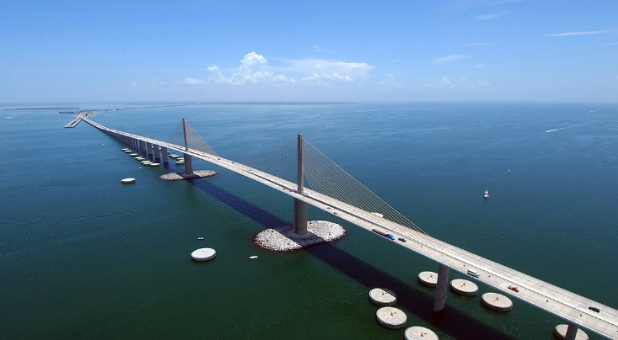
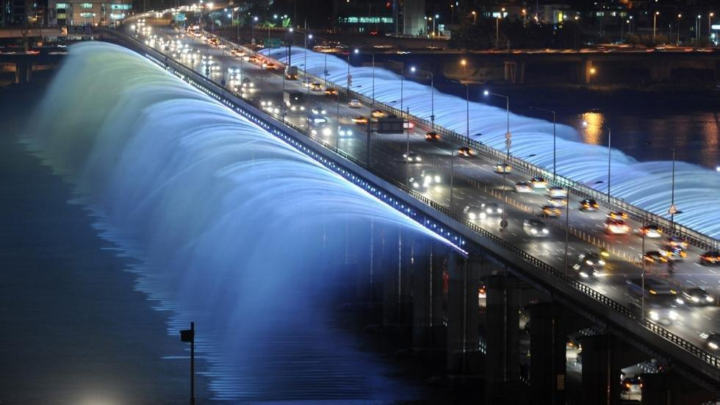
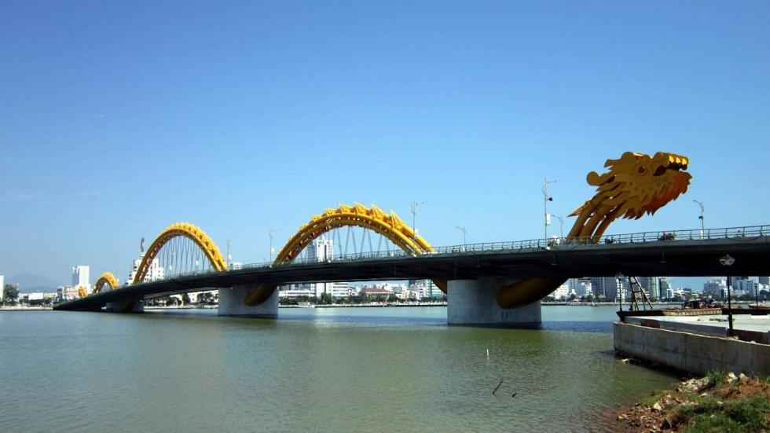
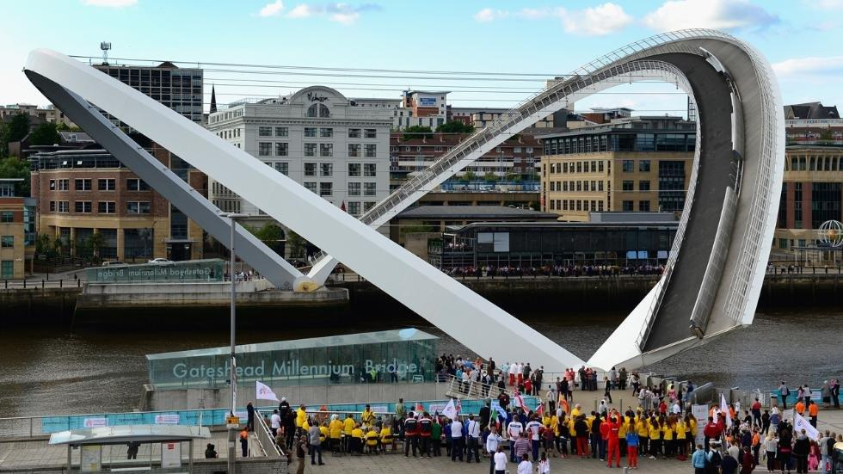
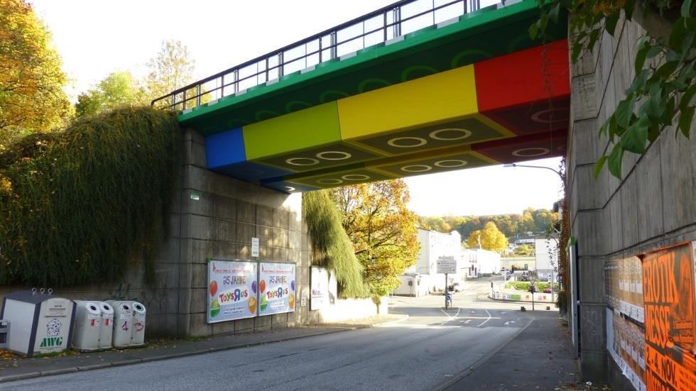
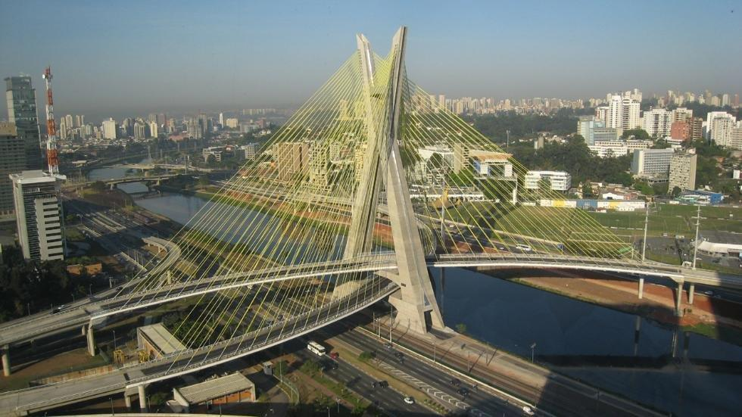
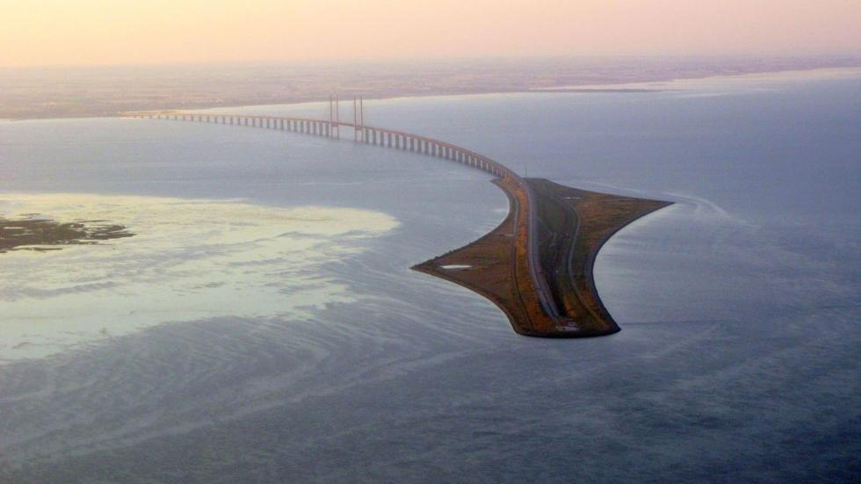
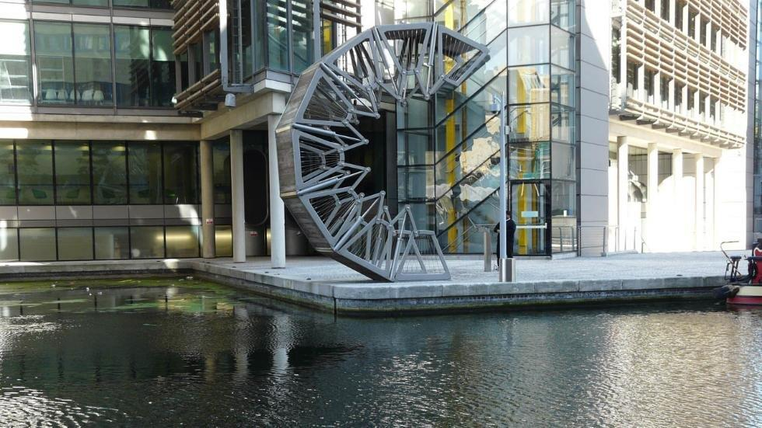
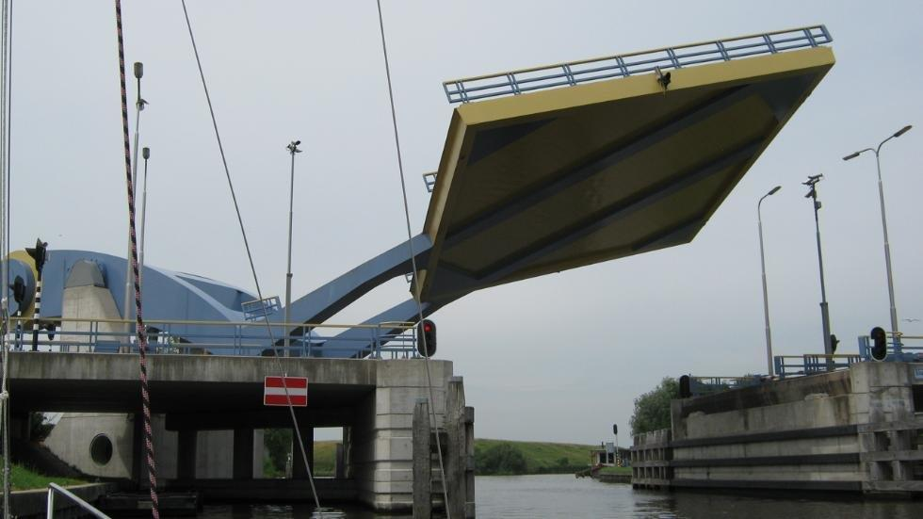
Notes:
The theoretical design life of a bridge has been 50 years, but with the evolution of new design guidelines and construction materials the anticipated service life for newly constructed bridges is 75 years or greater.

Slide 4
More than 25 percent of the existing bridges are rated as structurally deficient or functionally obsolete.
Notes:
A highway bridge is classified as structurally deficient if the deck, superstructure, substructure, or culvert is rated in “poor” condition (0 to 4 on the NBI rating scale). Structurally deficient means there are elements of the bridge that need to be monitored and/or repaired. A functionally obsolete bridge is one that was built to standards that are not used today. Functionally obsolete bridges are those that do not have adequate lane widths, shoulder widths, or vertical clearances to serve current traffic demand.

Slide 5
This issue is exacerbated by increasing travel demands, limited funding, and increasing cost of labor and materials.
Notes:
These circumstances have caused most bridge owners to become more reactive than proactive in their approach to managing and addressing their bridge program needs.

Slide 6
Notes:
A successful bridge program seeks a balanced approach to preservation and replacement.

Slide 7
What is our approach?
Notes:
Our approach is to be proactive and implement systematic processes for bridge preservation. Bridge preservation is defined as actions or strategies that prevent, delay or reduce deterioration of bridges or bridge elements, restore the function of existing bridges, keep bridges in good condition and extend their life. Preservation actions may be preventive or condition-driven.

Slide 8
$1130.00 / Ton $7.2M
Main St.
May 2003

Slide 9
$1,339.97 / Ton $0.732M
Hal Adams
November 2004

Slide 10
$2,066.71 / Ton $26.2M
Hart
December 2008

Slide 11
$2,232.44 / Ton $22.6M
Mathews
May 2011

Slide 12
$6,064.26 / Ton $3.4M
St. Mary’s
December 2012

Slide 13
$1,204.82 / Ton $0.56M
Wilson St.
December 2015

Slide 14
Our newest project of process for preservation, the first of it’s kind in District 2 Structures Maintenance, via contracted work, is to solely treat steel bridge bearings with coating systems.
Notes:
Steel is an alloy consisting of iron and carbon. It has the characteristic that it must be protected against air oxygen, salt and moisture. In order for a steel object to be used sustainably, it must be treated for preservation accordingly. If it is not treated, then nature will eventually claim the object and return it to its original form: iron rust. There are numerous ways of preserving steel. The most common preservation methods are thermic galvanization, wet coating and powder coating.

Slide 15
We are adopting coating practices as an integral component of our overall management of bridge assets.
Notes:
Paint is the most commonly used material to protect steel. Protective systems must be resistant to attack by pollutants such as sulphur dioxide and chlorides.

Slide 16
A bridge bearing is a superstructure element that provides an interface between the superstructure and substructure. The primary functions of a bridge bearing are:
To transmit loads from the superstructure to the substructure
To allow rotation caused by dead load and live load deflection
To permit horizontal movement of the superstructure due to thermal expansion and contraction
Notes:
There are several types of bridge bearings. Moveable and fixed steel bridge bearings are our primary focus for this project.

Slide 17
Being located below the surface of the bridge deck, leaking deck joints often allow bridge deck runoff, deicing salts, grit, and road debris to come in contact with bridge bearings. Often, the sand and other road debris accumulates around the bearings, thus trapping moisture and subjecting the metal components of bearings to constant wetting and the resultant corrosive action.
Notes:
Steel will rust only if water and oxygen are both present and the rusting process is greatly accelerated by pollutants in the atmosphere.

Slide 18
As bearings deteriorate and corrode, or as sliding surfaces become fouled, the bearings can lock up and no longer function properly to accommodate thermal movement and rotation under bridge loading conditions.
Notes:
As a result, structural members that do not see relief of thermal loads or that are restrained from rotation would be subjected to secondary stresses for which they are not designed, and member damage or failure can result.

Slide 19
Bridge coating is a protective and preventative maintenance activity designed to reduce deterioration of the structural steel and/or components and preserve the longevity of the structure by protecting against corrosion.

Slide 20
E2V84 $250,000 Business Development Initiative (BDI)
Notes:
Our new Paint Contract is set to let in the latter part of this year.

Slide 21
The work consist of the preparation and overcoat painting of the steel bearings on 12 designated bridges in Duval County Florida.
Notes:
Bridge selections were based upon bearing condition states of 3 and 4.

Slide 22
Maintenance painting operations which only partially remove existing paint and apply new coatings over a mixed substrate of existing paint, bare steel, and rusted surfaces.
Overcoating

Slide 23
Why Overcoating?
Cost is the most common driver for implementing this maintenance painting strategy versus full removal and replacement of existing paint systems. Due to the dramatic increase in costs for full maintenance painting operations spurred by environmental and worker safety regulations, overcoating has become increasingly popular.
$75
Full Removal and Replacement
$45 to $55
Overcoating
Notes:
Overcoating is a cost effective alternative to complete coating removal and repainting. Present cost for overcoating lie in the range of $45 to $55 per square foot, depending on specified level of cleanliness, while full removal and replacement of paint systems is on average $75 per square foot.

Slide 24
OVERCOATING OPERATIONS

Slide 25
Bridge areas to be repainted must be cleaned to remove all visible grease, oil, lubricants, cutting compounds and or other non-visible contaminants from the surface by cleaning with solvent, vapor, alkali, emulsion, or steam.
Solvent Cleaning
Notes:
Solvent cleaning is generally accomplished using a pressure washer or steam cleaner. Sometimes detergents are specified and various pressures and volumes of water may be used. Solvent cleaning should be included in all maintenance painting operations, as the removal of contaminants from the surface has a significant effect on the performance life of any applied coating system. The goal is to remove surface contaminants and not the existing coating system per se; however, some loose paint and rust will be removed by most washing operations.

Slide 26
Mechanical removal of loose paint and rust generally follows washing. This operation may vary from light hand tool cleaning with scrappers or wire brushes, to remove all visible rust and loose paint with vacuum shrouded power tools or vacuum blasting machines.
Mechanical Surface Preparation
Notes:
The level of cleaning specified is dependent upon the severity of the environment, the extent of paint failure and the degree of corrosion of the steel in the area of failed paint, the expected life of the applied maintenance system, and the budget for the operation. The goal of this step is to remove rust and non-adherent paint while leaving as much of the intact existing coating system as possible.

Slide 27
There are currently many different paint systems sold as “overcoating” or “surface tolerant” coatings. These vary from high-build, single coat systems to multiple coat systems with sacrificial or inhibitive pigments in the primer coats.
Overcoat System Application
Notes:
In general, multicoat systems are intended for spot primer application over the bare steel areas with full overcoating of the structure with one or two additional coats.

Slide 28
Components made of non-weathering steel are generally painted with a multicoat paint system to protect the steel from rust and corrosion.

Slide 29
Based On The
Condition of the existing paint
Extent of corrosion on the substrate
Notes:
These 12 bridges were chosen for this paint project

Slide 30
720026
720050
720081
720165

Slide 31
720193
720173
720182
720297

Slide 32
720299
720300
720301
720305

Slide 33
Within 365 days of the date of notice-to-proceed…
Notes:
418 Steel Bridge Bearings will be…

Slide 34
SSPC-SP1
Notes:
Solvent Cleaning - Pressure washed using portable water to remove all visible and non-visible chemical contamination. A chloride removing detergent (e.g. Chlor*Rid, Chlor*Wash, Chor*Rid DTS, or Hold Tight 102), in this process, will be required to address the chemical contamination issue. Surfaces shall be cleaned to meet the requirements of SSPC-SP1, prior to mechanical cleaning.

Slide 35
According to research, wet surface preparation methods are more effective and result in lower remaining chloride levels than dry methods when cleaning corroded, chloride-contaminated steel surface.
Meade, B., Palle, S., Hopwood, T. and Younce, R., “Effects of Chloride Contamination on Coatings Performance,” Kentucky Transportation Center, Report No. KTC-10-10/SPR366-08-1F, June 2011.

Slide 36
SSPC-SP3
Notes:
Mechanical Surface Preparation - Selection of the power tool and cleaning media is dependent on many factors, including the amount of surface area to be cleaned, the configuration of the surface, and the level of control required for worker and environmental protection. All loosely adhering rust, mill scale and paint will be removed with a hand and/or power tool because of the tight clearance. Power tool cleaning is typically performed with grinders, pneumatic chisels, needle scalers, rotopeen tools and other tools that require an electric or pneumatic power source to operate. Surface shall meet the requirements of SSPC-SP3 at the time of coating applications.

Slide 37
Epoxy Mastic
Notes:
Overcoat System Application - A multicoat system consisting of one stripe coat by brush prior to two full coats of Aluminum Epoxy Mastic shall be applied to the bearings once the steel surfaces have completely dried. The paint color shall contrast with the substrate or preceding coat. Each coat shall be 7 mils DFT.

Slide 38
Older bridges were often painted with coatings that contain toxic metals. These metals can pose a hazard to humans and the environment. These toxic metals typically include lead, cadmium, and hexavalent chromium. Lead and hexavalent chromium were used as corrosion inhibitors in coating formulations, and cadmium provided coatings with bright color.
Notes:
Epoxy Mastic is a high-solids, rust-inhibitive, surface-tolerant coating. It resists solvents, dilute acids and alkali attack. It is ideal for protection of steel. It is also safe to humans and environmentally compliant.

Slide 39
Containment
Notes:
The Contractor shall perform all painting operations within a containment system. The containment shall be in accordance with SSPC Technology Guide No. 6 “Guide for Containing Surface Preparation Debris Generated during Paint Removal Operations;” 3W for pressure cleaning and 3P for power tool cleaning.

Slide 40
This will ensure that the contractor has the capability to collect and test the waste materials as well as protect their workers sufficiently.
SSPC QP2 Contractor
Notes:
A SSPC QP2 person has demonstrated competence in the management of hazardous paint removal projects.

Slide 41
Contract Structure
Project Administrator Steve Stafford
Project Manager Erica Peterson
Project SSPC QP1 (QA) Curtis Henson
Project SSPC QP1 (QA) Wayne Lavis
Contractor QC Inspector
Contractor SSPC QP2

Slide 42
This project is a major step in our bridge preservation program as well as a sample work document for larger scale paint projects on our bridges to come.
Notes:
Discuss future contracts.

Slide 43
Thank You

Slide 44
Questions

