Slide 1
Statewide Spill Prevention, Containment, and Response Training
Robert J. Potts
Senior Scientist
E Sciences, Incorporated

Slide 2
Presentation Overview
Background
Regulatory Basis
Target Audience and Focus
Training Format
Training Content
Spill Prevention
Spill Containment
Spill Reporting

Slide 3
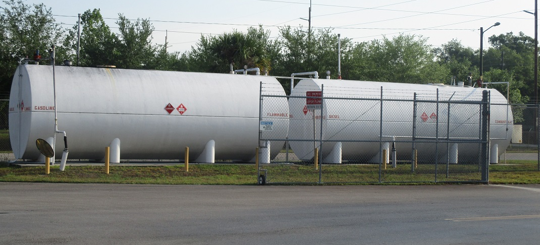
Statewide Spill Prevention, Containment, and Response Training
Background:
Spill Prevention Control and Countermeasure (SPCC) Plans or other Contingency Plans at Maintenance Yards or Operations Facilities with high volume fuel and oil storage containers.

Slide 4
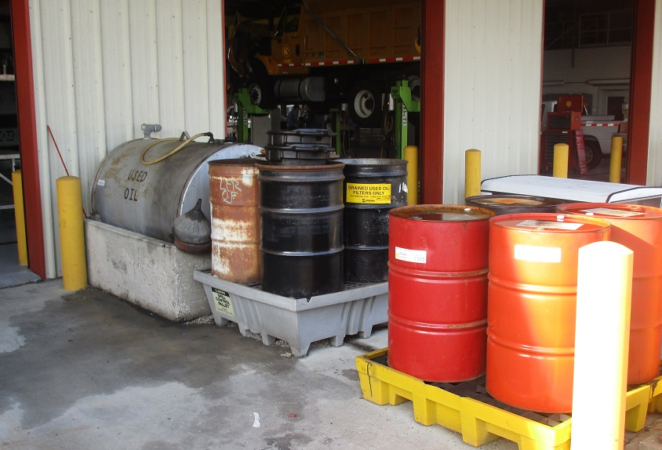
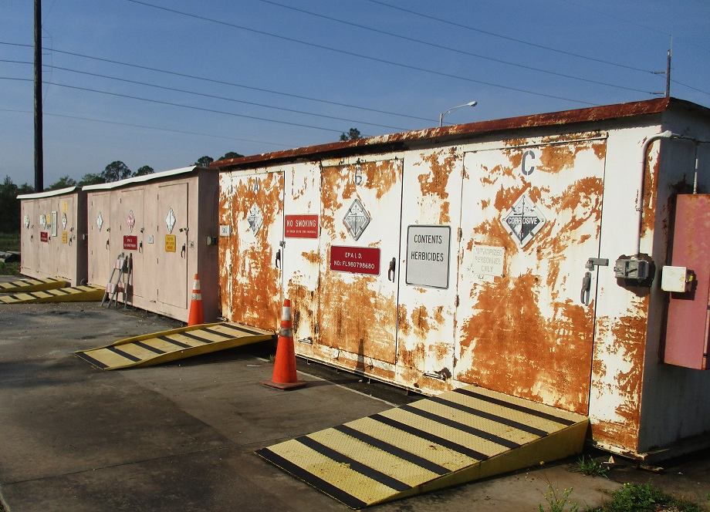
Statewide Spill Prevention, Containment, and Response Training
Background:
FDOT maintenance staff and contractors use petroleum products and other chemicals in daily activities.

Slide 5
Statewide Spill Prevention, Containment, and Response Training
Regulatory Basis:
Part III.A.7(d) NPDES Phase I MS4 Permit
The permittee shall continue to implement procedures to prevent, contain, and respond to spills that may discharge into the MS4.
The training shall include how to prevent a spill, recognize and quickly assess the nature of a spill, contain a spill, and promptly report hazardous material and chemical spills to the appropriate authority.

Slide 6
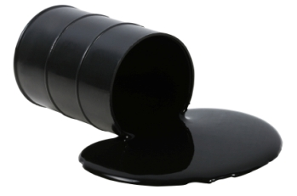
Statewide Spill Prevention, Containment, and Response Training
Target Audience and Focus:
FDOT field maintenance staff
FDOT maintenance contractors
Focus will be:
Non-roadway spills
Small spills at FDOT yards & operations facilities
Spills that may occur in the field

Slide 7
Statewide Spill Prevention, Containment, and Response Training
Training Format:
Similar to IDDE Training
Video
English and Spanish narration
Approximately 15 minutes in duration
Available via the web
Available as a CBT

Slide 8
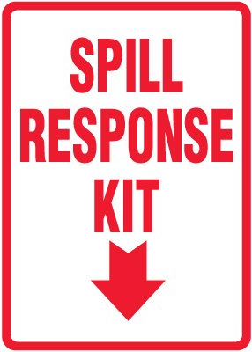
Statewide Spill Prevention, Containment, and Response Training
Training Content:
Spill Prevention
Spill Containment
Spill Response

Slide 9
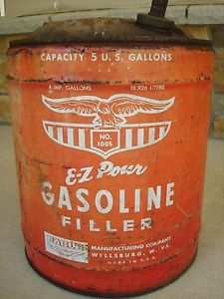
Statewide Spill Prevention, Containment, and Response Training
Spill Prevention:
Observations
Report dangerous or unstable chemical storage or usage practices
Strong chemical odors, burning eyes, staining, and or dead vegetation or animals
Look for sharp objects along spray routes or travel corridors
Replace worn or corroded storage containers

Slide 10
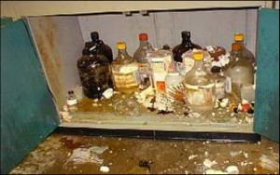
Statewide Spill Prevention, Containment, and Response Training
Spill Prevention:
Best Practices
Ensure containers are properly capped and sealed
Store heavy chemical containers on lower shelf
Replace leaking containers and hoses
Limit exposure of chemical containers to the environment (sun, rain)
Ensure effective secondary containment is present
Identify and eliminate unsafe storage practices
Be aware of surroundings and current activities

Slide 11
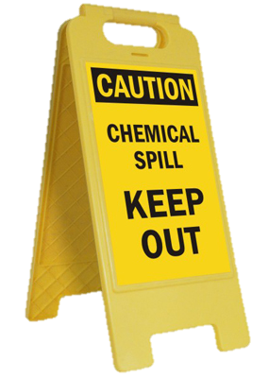
Statewide Spill Prevention, Containment, and Response Training
Spill Containment:
When a spill occurs
Stay calm!
Ensure your safety and others in area first
Remove any non-essential personnel from affected area
Stop and or remove machinery and vehicles from area
Notify supervisor

Slide 12
Statewide Spill Prevention, Containment, and Response Training
Spill Containment:
Evaluate the Situation
Safety first!
Note wind direction – stay up wind of spill
Identify the source of the spill
Estimate size of impacted area
Estimate volume of material spilled
Is the spill spreading?

Slide 13
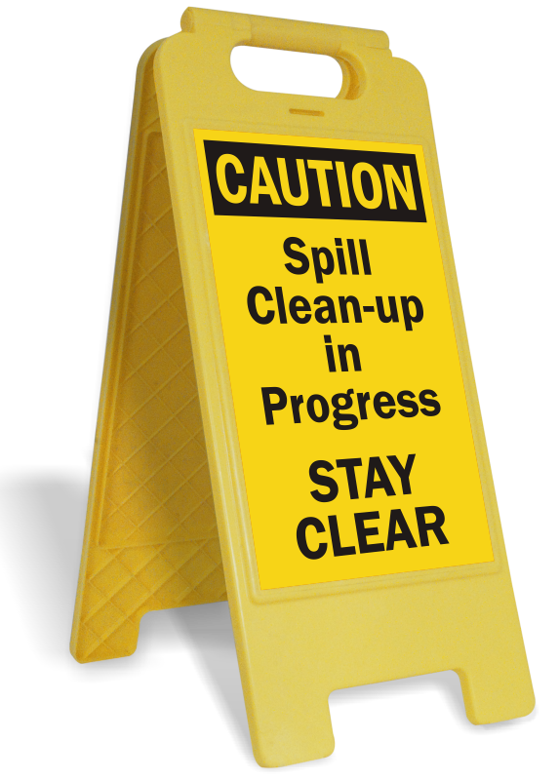
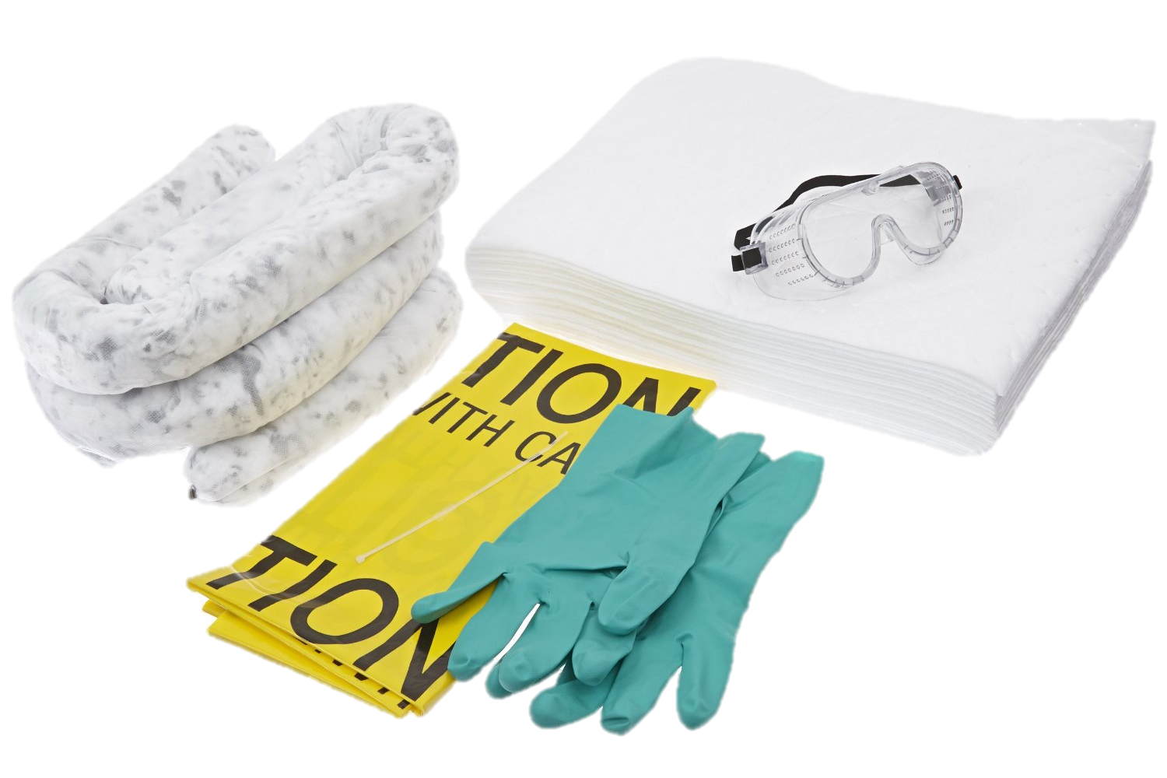
Statewide Spill Prevention, Containment, and Response Training
Spill Containment:
Stop or limit spreading of spill:
Safety first - proceed only if spilled substance is known!
Put on proper personal protective equipment (PPEs)
Secure area and limit access

Slide 14
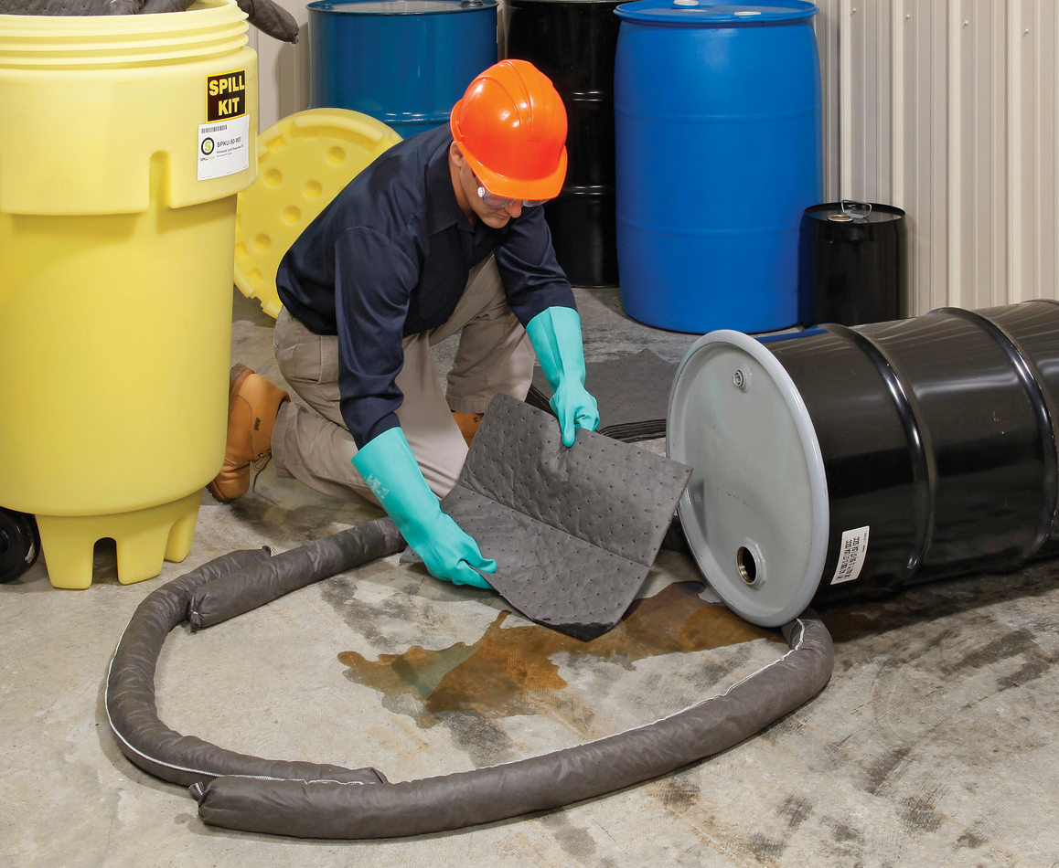
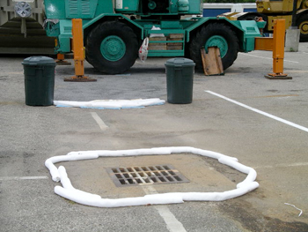
Statewide Spill Prevention, Containment, and Response Training
Spill Containment:
Close valves
Stand up tipped over drum, tank, or barrel
Place absorbent materials
Re-route spill away from inlets or drains
Plug or patch hole in container

Slide 15
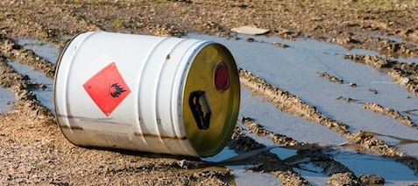
Statewide Spill Prevention, Containment, and Response Training
Spill Response:
Small Spills
Large Spills
Major Spills

Slide 16
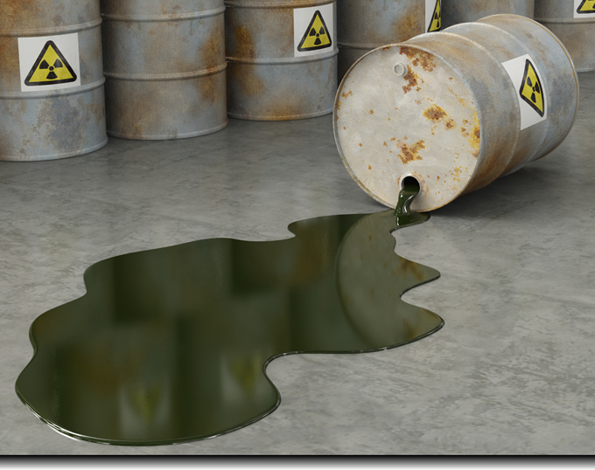
Statewide Spill Prevention, Containment, and Response Training
Small Spills
Generally less than 25 gallons
Occurred on an impervious surface
A known material
Large Spills
Generally more than 25 but less than 100 gallons
Occurred on soil or impervious surface
A known material

Slide 17
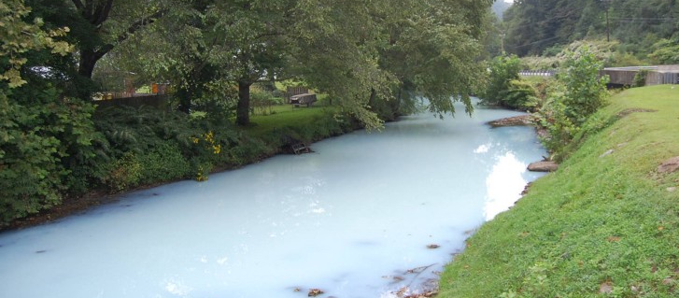
Statewide Spill Prevention, Containment, and Response Training
Major Spills
Generally greater than 100 gallons
Occurred on soil, into the storm sewer, or waterbody
An unknown material

Slide 18
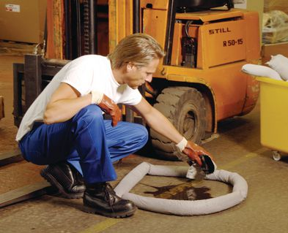
Statewide Spill Prevention, Containment, and Response Training
Small Spill Response
Initiate response only if it can be done safely
Wear proper PPEs
Place absorbents on spilled material
Sweep up absorbents and spilled material
Dispose of material properly
Notify supervisor and District NPDES Coordinator

Slide 19
Statewide Spill Prevention, Containment, and Response Training
Large Spill Response
Follow response protocol
Contact DCIC
Contact District NPDES Coordinator
Contact State Warning Point system
Provide spill information
Identity of spilled material
Identify source of spilled material (if known)
Estimated volume of release
Location and access information where spill occurred

Slide 20
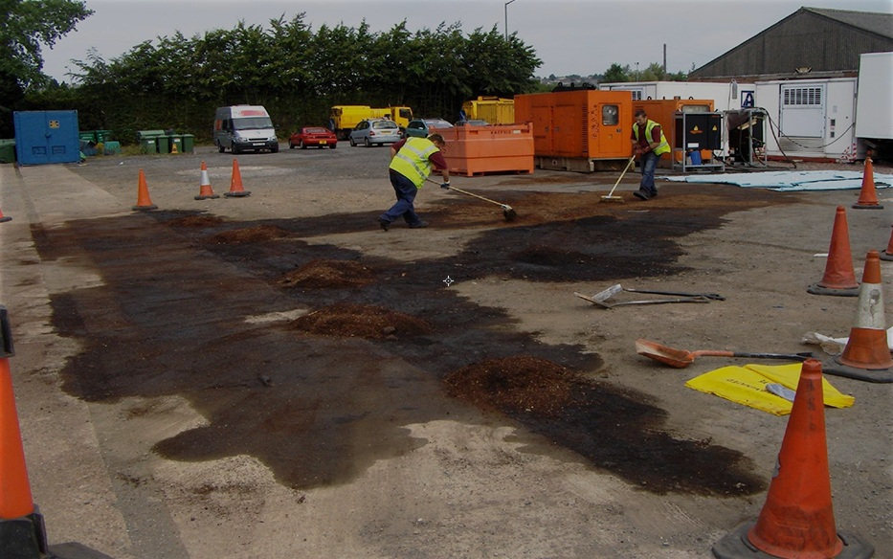
Statewide Spill Prevention, Containment, and Response Training
Large Spill Response
Control or contain spill if able to do so in safe manner
Dike spill with absorbent material
Trench spill to direct away from inlets or waterbody
Secure area
Wait for spill response/ clean up contractor

Slide 21
Statewide Spill Prevention, Containment, and Response Training
Major Spill Response
Follow response protocol
Contact DCIC
Contact District NPDES Coordinator
Contact State Warning Point
Provide spill information
Identity of spilled material (if known)
Identify spill source (if known)
Estimated volume of release
Location and access information where spill occurred
Name of receiving water(s)
Identify affected storm sewer inlets and pipe routes

Slide 22
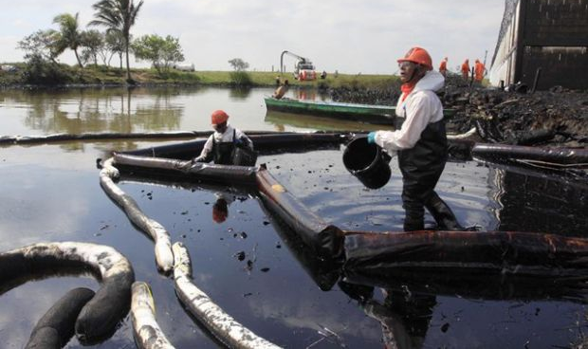
Statewide Spill Prevention, Containment, and Response Training
Major Spill Response
Secure area
Stop machinery and remove vehicles in area
Wait for spill response / clean up contractor

Slide 23
Statewide Spill Prevention, Containment, and Response Training
Hierarchy of Importance
Safety First!! For you and others in area
Minimize exposure by isolating area
Re-route pedestrian traffic, if applicable
Set up cones or barricades around affected area
Minimize environmental impacts
Keep spilled material out of waters and storm sewers
Minimize clean up costs

Slide 24
Questions / Comments?

