Slide 1
Girder Strengthening using CFRP Wrap
SR-404 over Banana River

Slide 2
Bridge Location

Slide 3
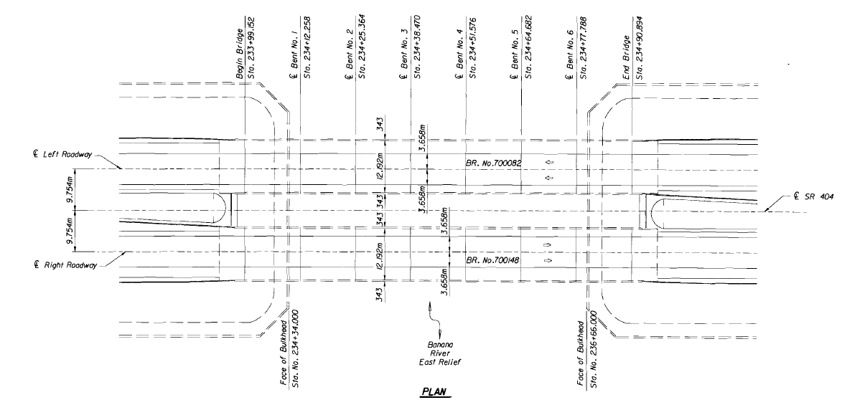
Bridge Information
Parallel Bridges 700082 & 700148
Built in 1971
Span Length 43-ft
7 spans

Slide 4
Repair Locations

Slide 5
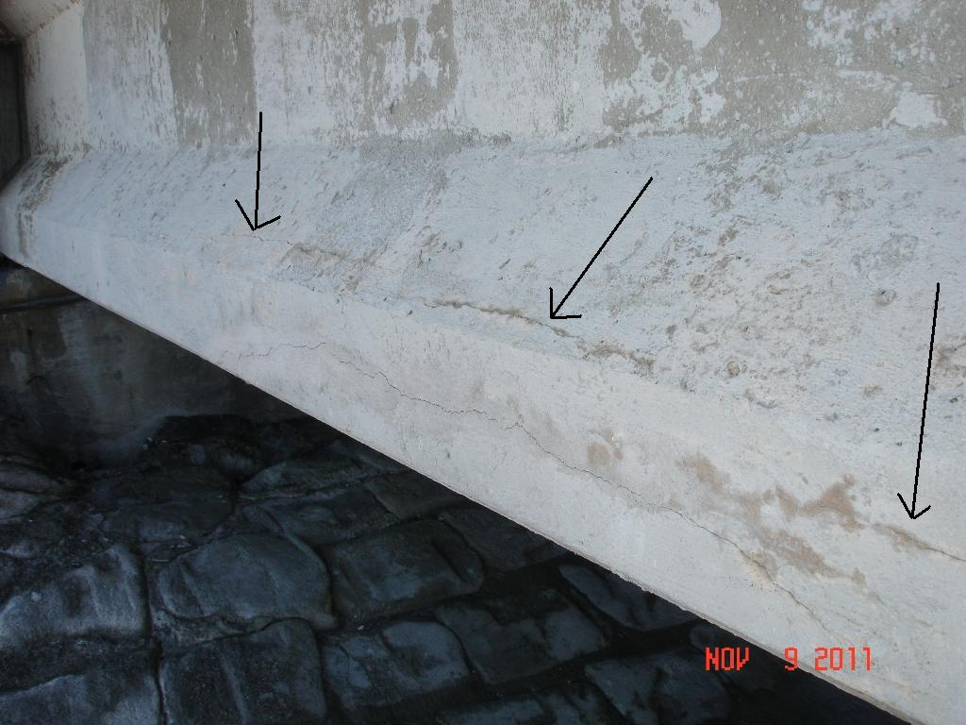
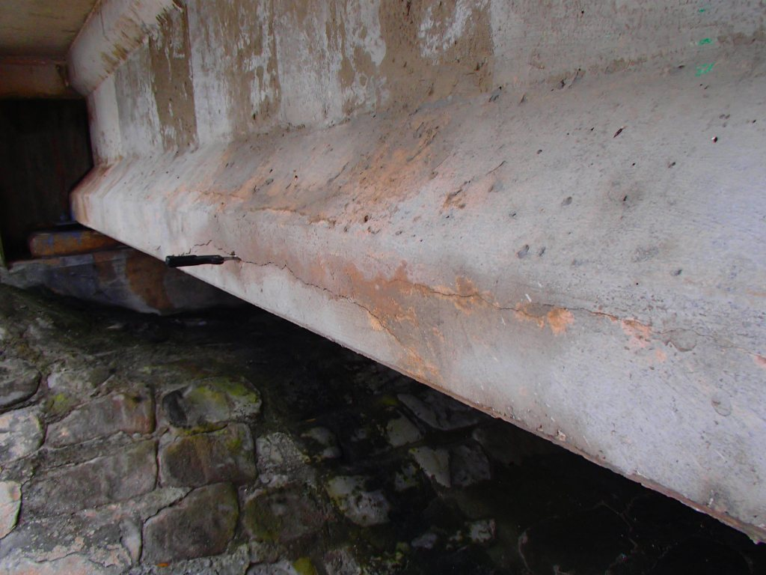
Issue discovered during bridge inspection
2011
Minor cracks were documented
2013
In-place spall
2015
In-place spall
Repair Design started
Bridge # 700082
Notes:
Location 1
Removing spall/loose concrete revealed corroded strands
AASHTO Type II at end of beam
3 strands corroded; 24 strands total

Slide 6
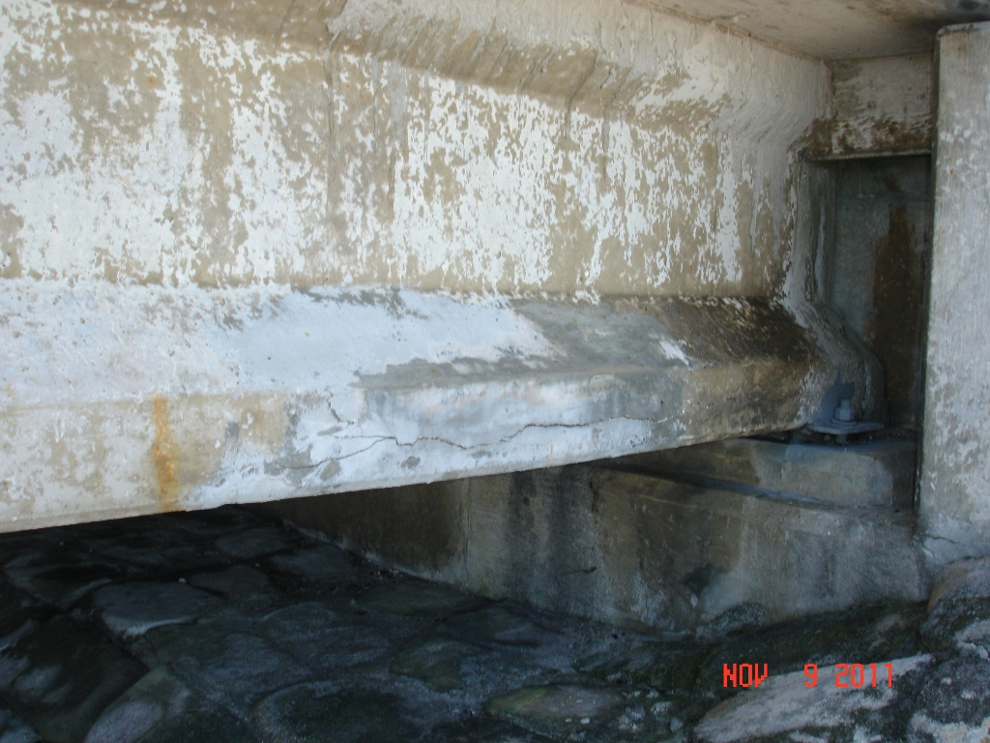
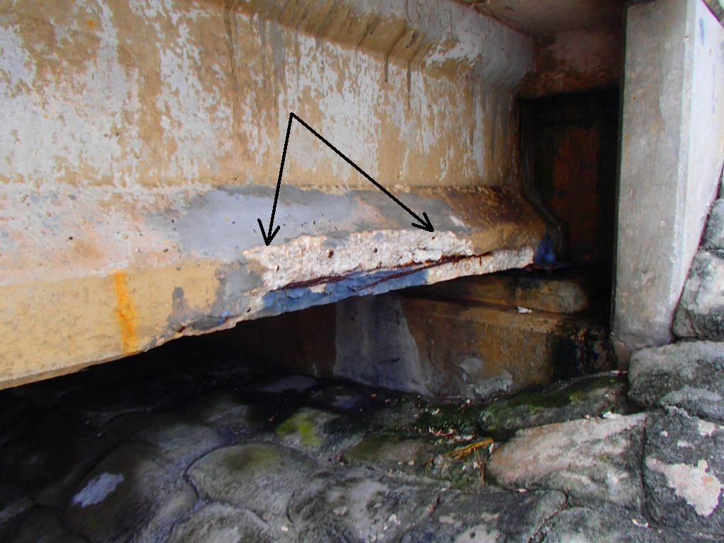
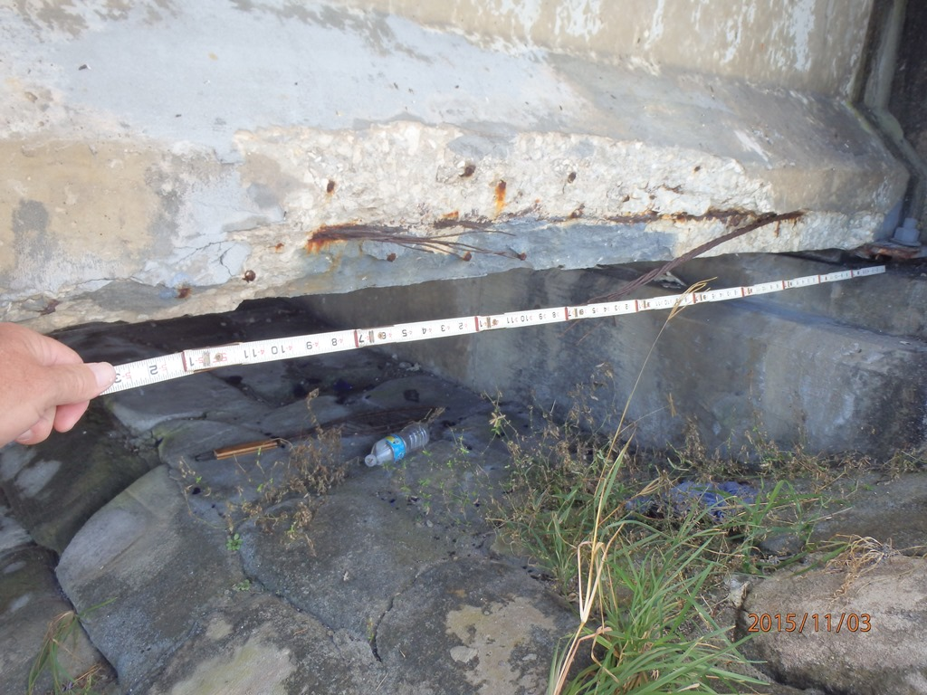
Issue discovered during bridge inspection
2010
Spall was patched
2015
Patch failed
Strand with 100% section loss
Bridge # 700082
Notes:
Location 2
Removing spall/loose concrete revealed corroded strands
AASHTO Type II at end of beam
3 strands corroded; 24 strands total

Slide 7
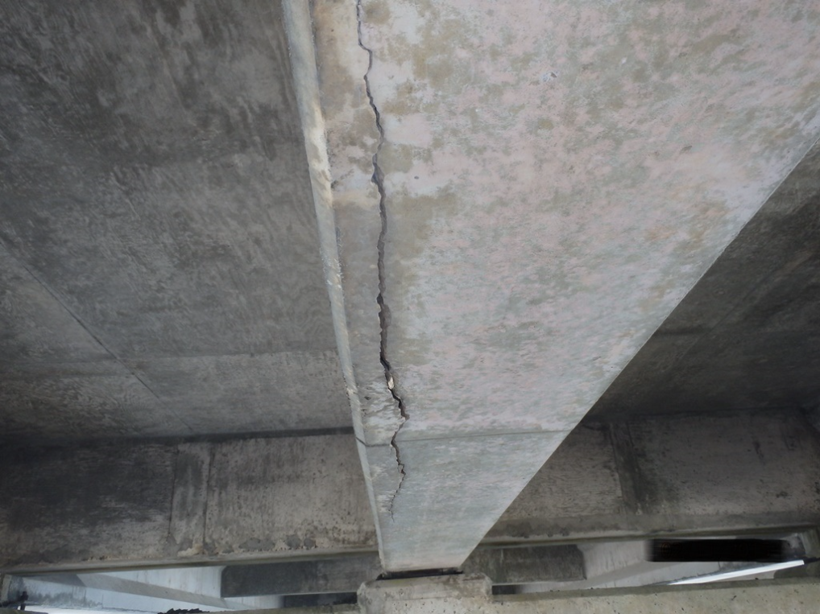
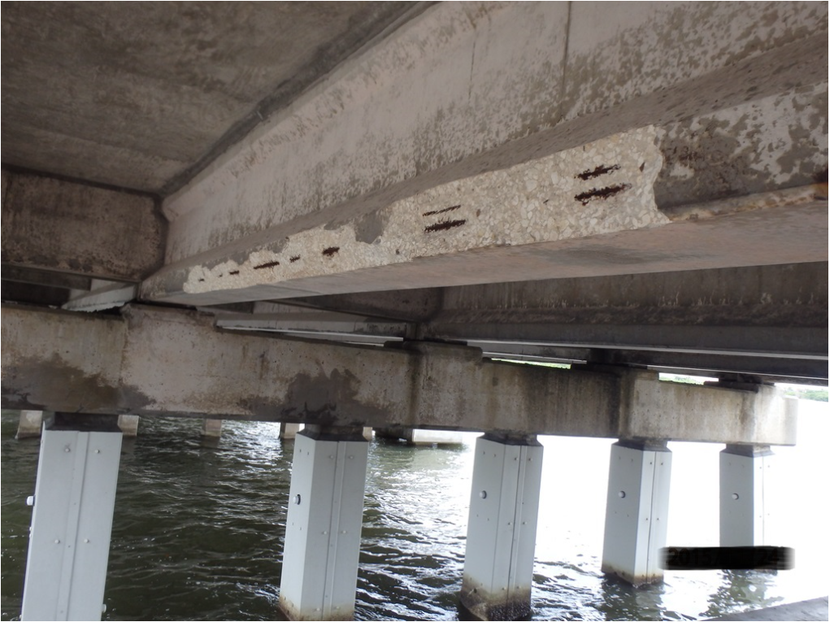
Issue discovered during bridge inspection
2015
In-place spall documented
Bridge # 700148
Notes:
Location 3
Removing spall/loose concrete revealed corroded strands
AASHTO Type II at end of beam
2 strands corroded; 24 strands total

Slide 8
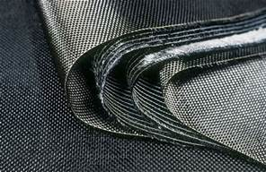
Repair Design
CFRP was selected as the repair method
Consultant developed repair plans
Structure 700082, 3 strands at each location
Structure 700148, 2 strands
Surface Preparation Details
CFRP Repair Details
Time: 2 months

Slide 9
Repair Design
Design Assumed Strands will not be repaired
CFRP Designed to restore beam to original moment and shear capacity
Load Rating Check
Procedure:
Remove loose material
Clean surface and steel
Repair concrete
CFRP installation
Notes:
CFRP installation process included: Primer/saturant application (CFRP resin), CFRP application (wet lay-up), protective UV coating.

Slide 10
CFRP Repair Detail

Slide 11
CFRP Repair Detail

Slide 12
Construction
Construction:
Time: 1 week
Cost: $15,051
Including personnel and equipment
Construction was performed by in-house Heavy Bridge Crew
Construction time: 5 days
Notes:
Construction team included: in-house crew, EOR on site during initial CFRP installation, safety personnel

Slide 13
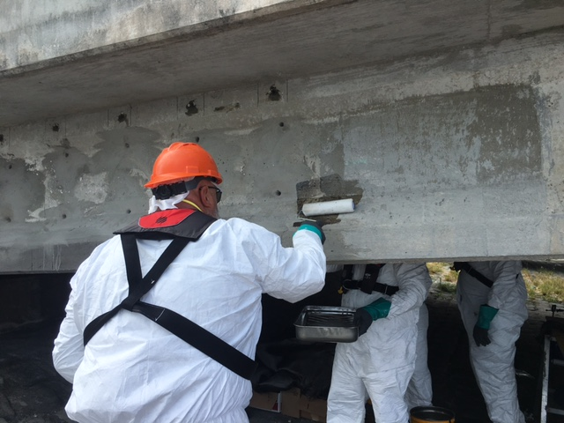
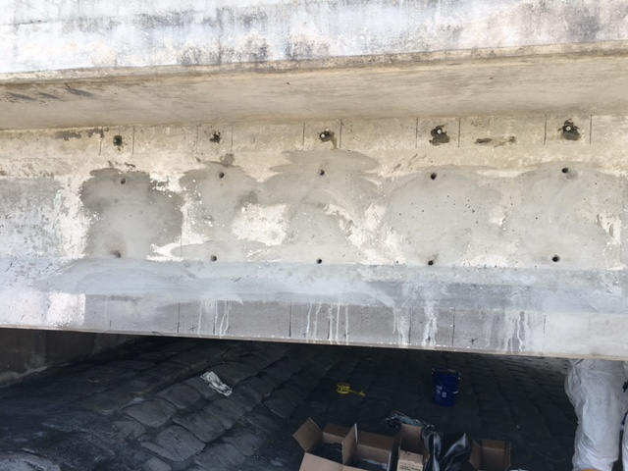
Construction

Slide 14
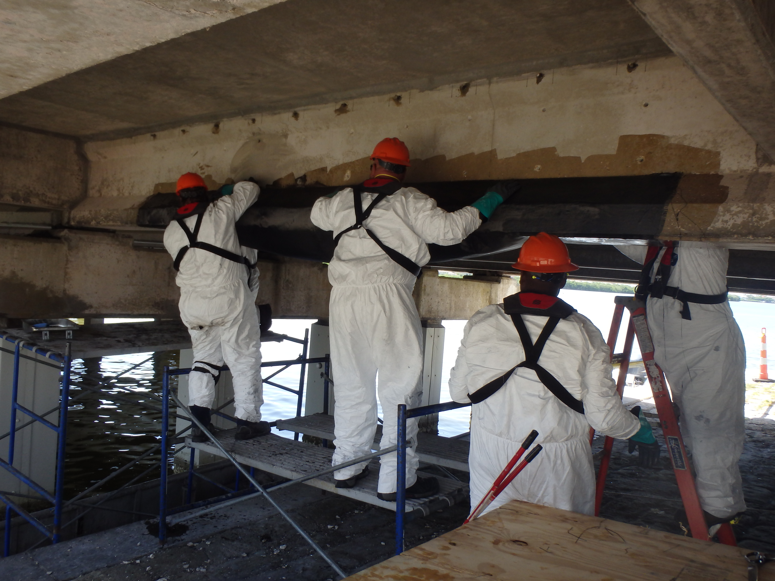
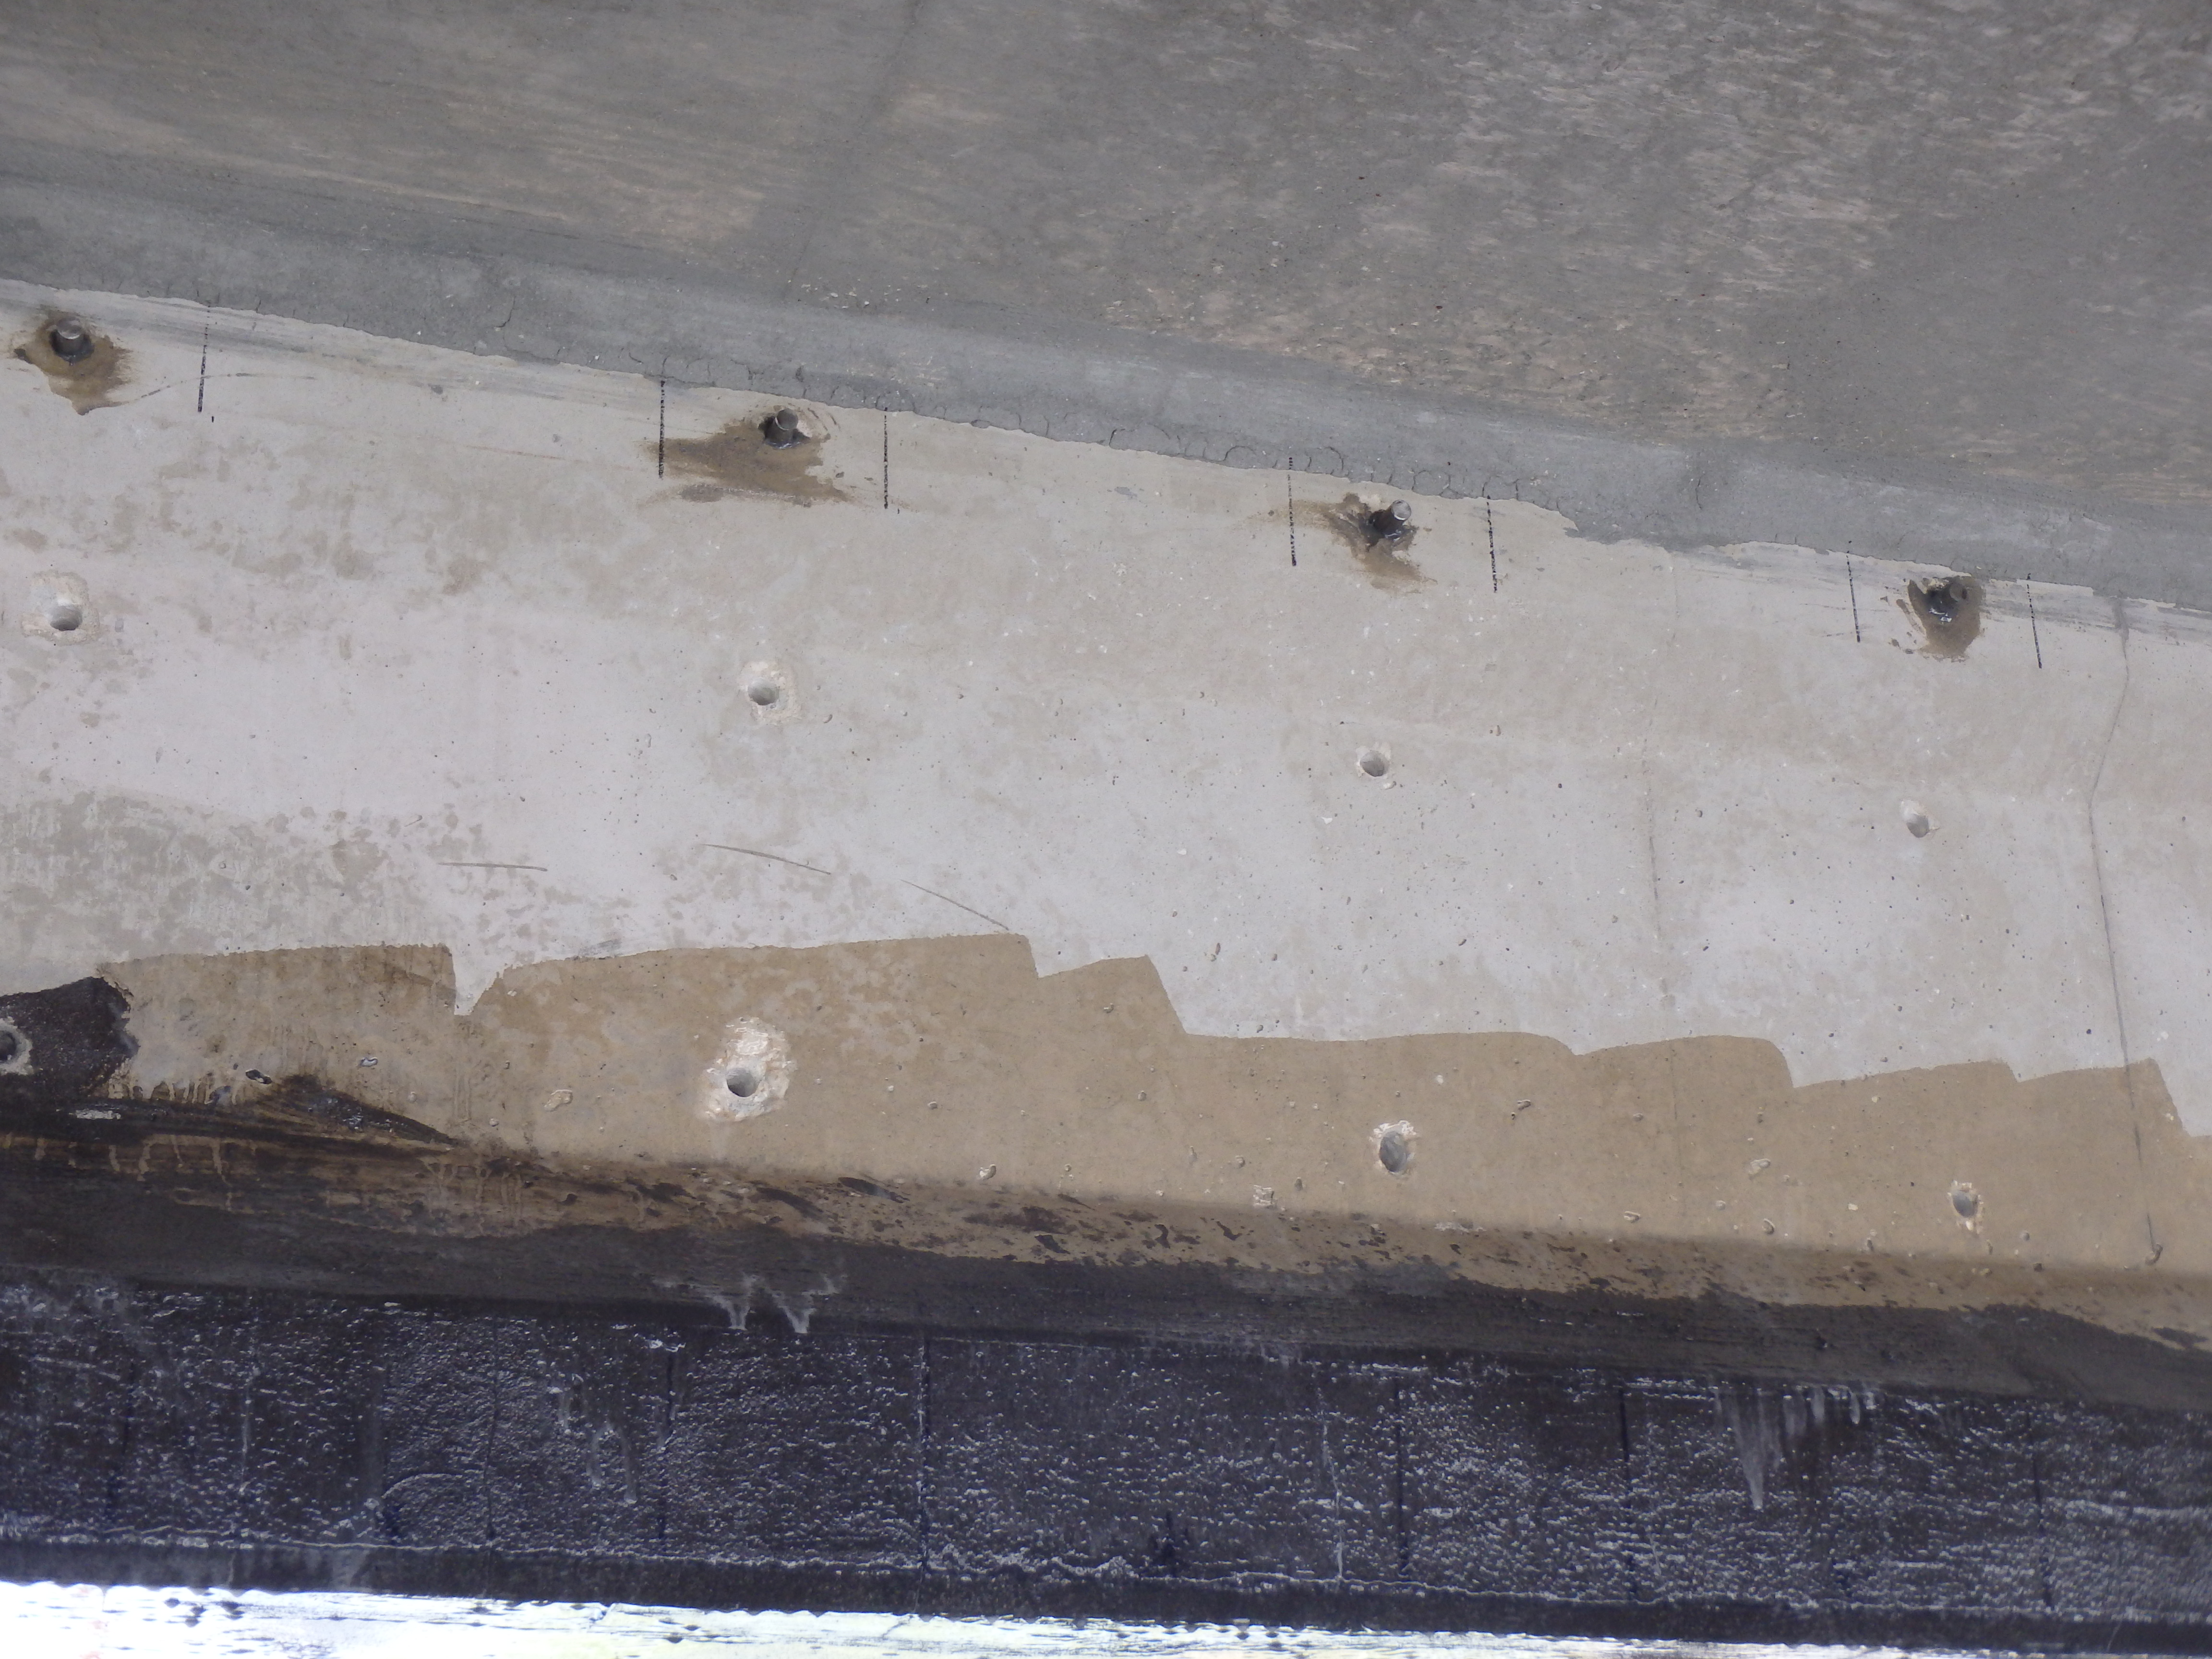
Construction

Slide 15
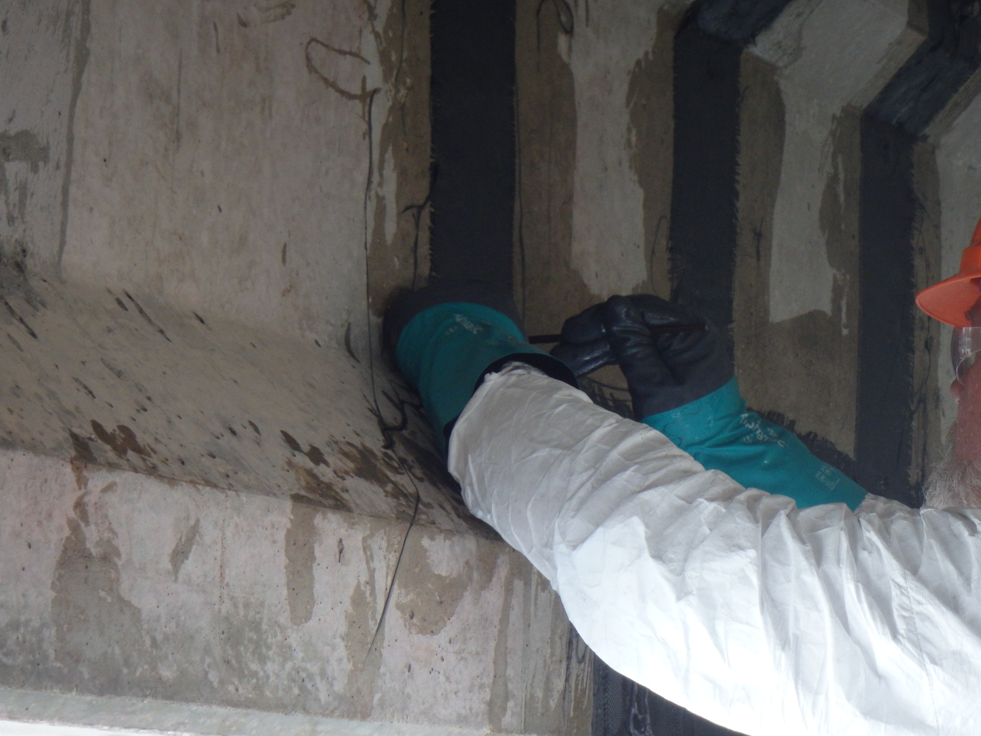
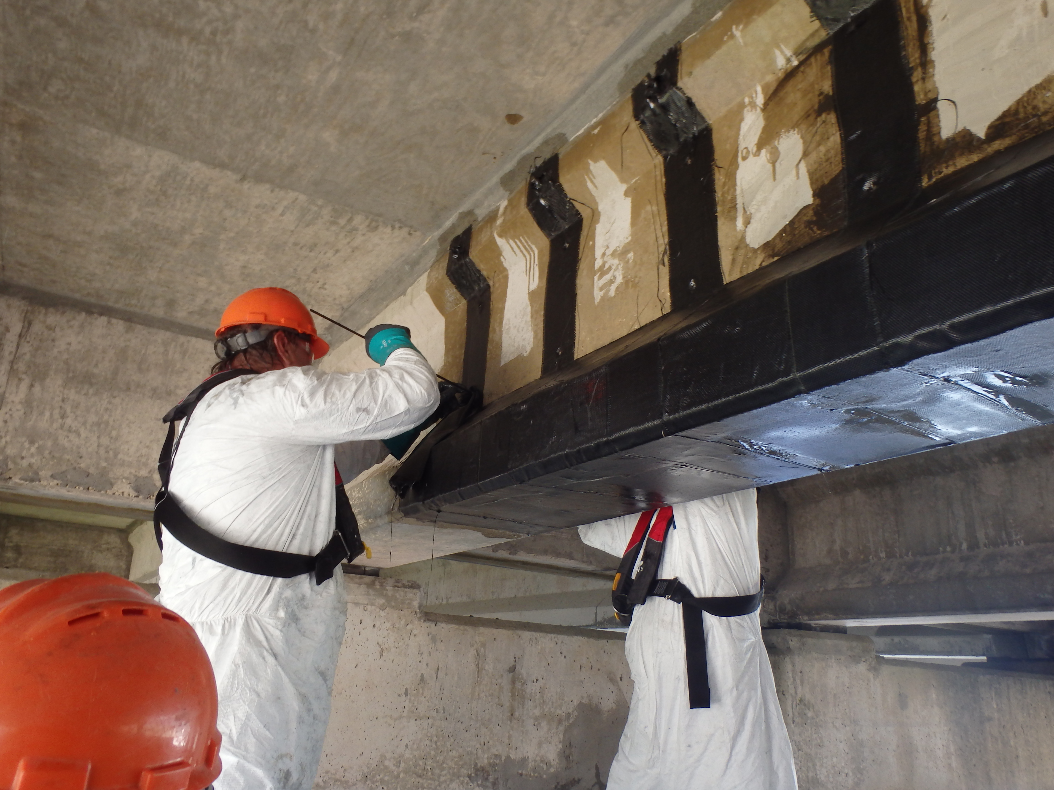

Slide 16
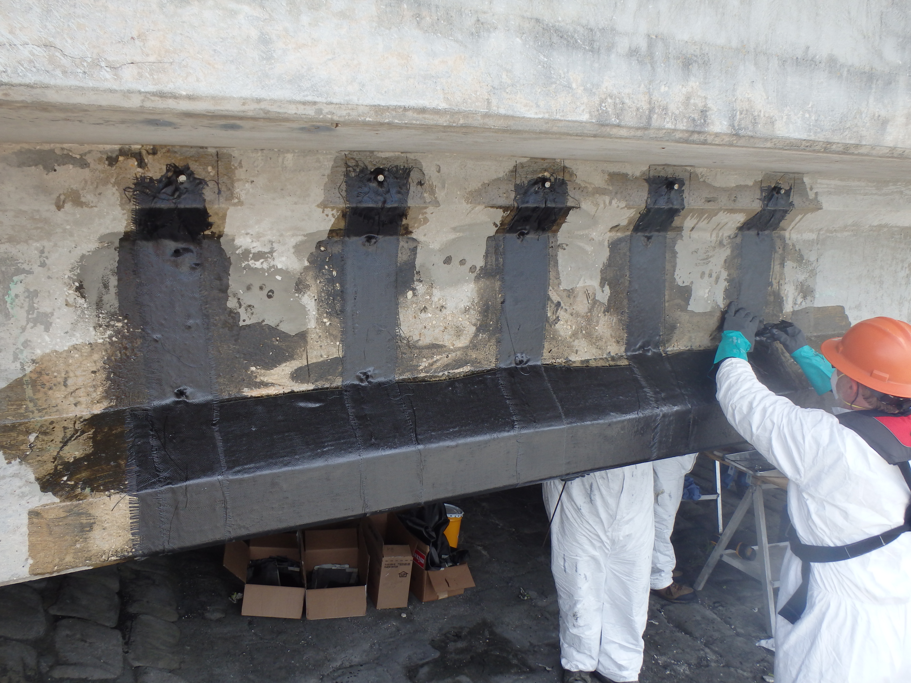
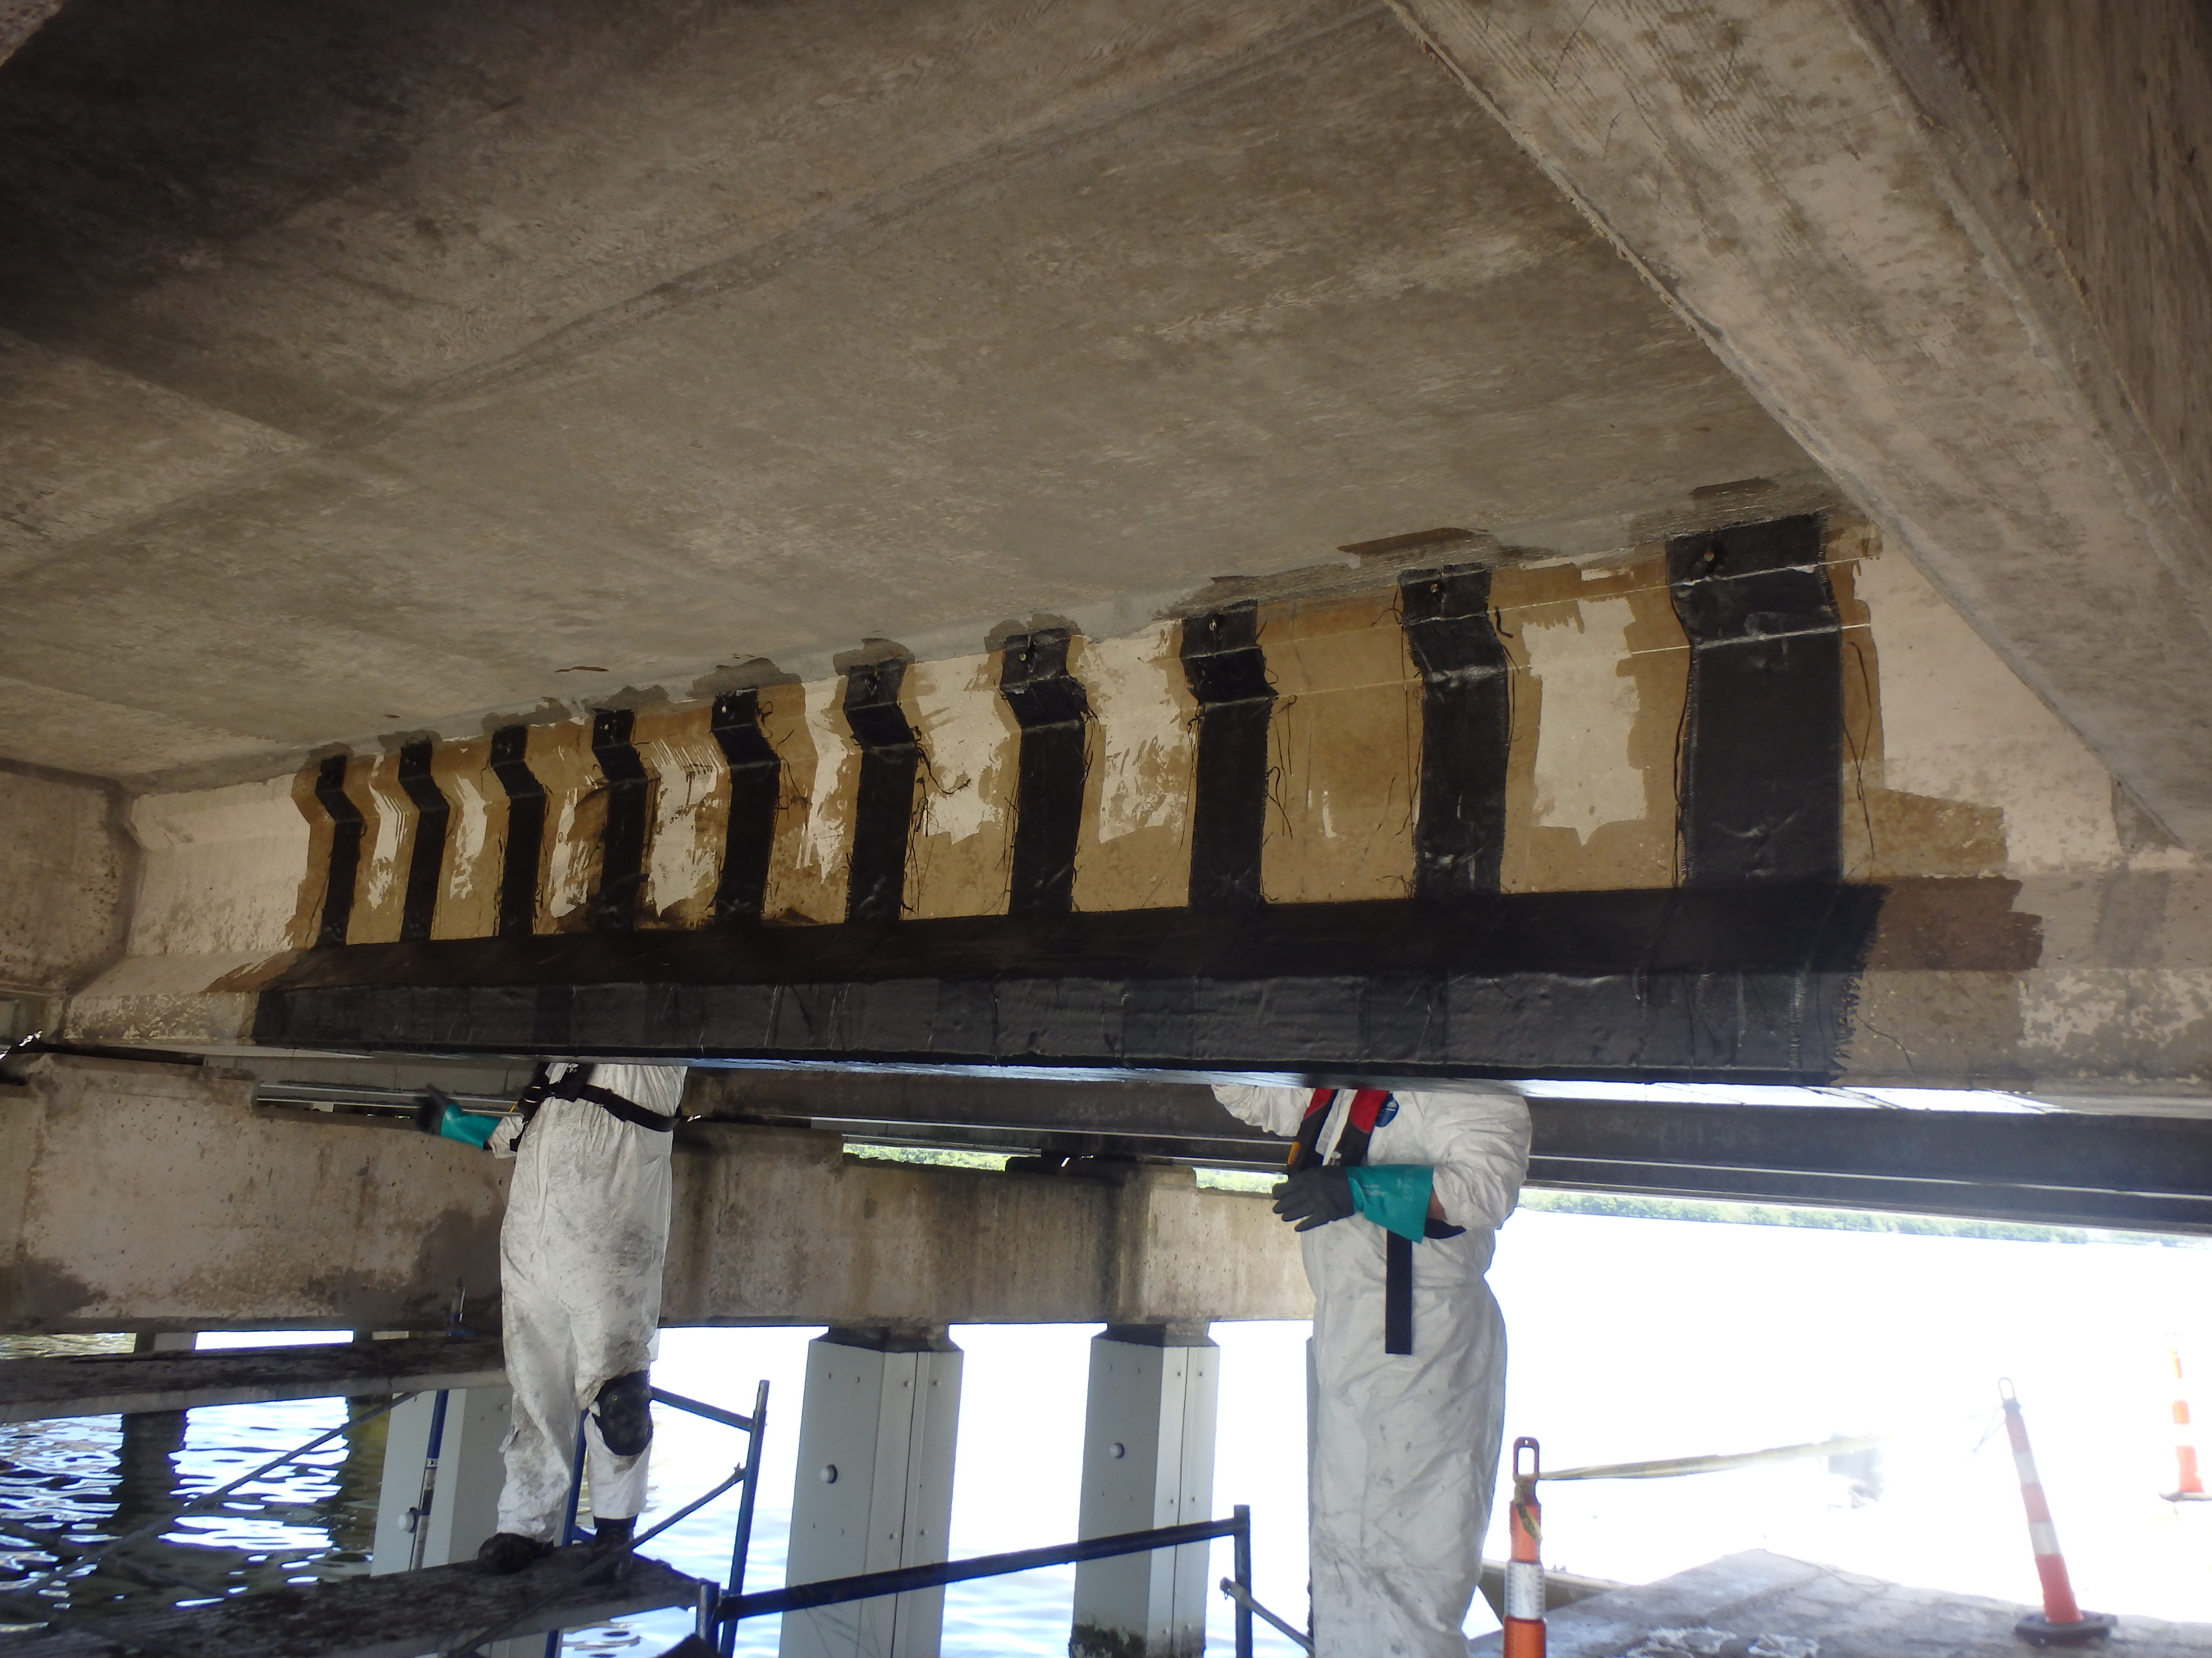

Slide 17
Benefits
Time:
Reduced by avoiding contract development.
Life-Cycle:
corrosion resistance.
Economical Benefit
Low installation cost
Fast turn around

