Slide 1

Trial by fire
Picayune Strand Wildfire Response

Slide 2
Lay of the land
DBI performs asset maintenance services for Districts 1 & 4 that includes 236 centerline miles of I-75 from Hillsborough County to Broward County, to include roadway, roadside, structures, rest areas, recreational areas and weigh stations.
Picayune Strand State Forest is a 78,000-acre forest located in southwest Florida in western Collier County.

Slide 3
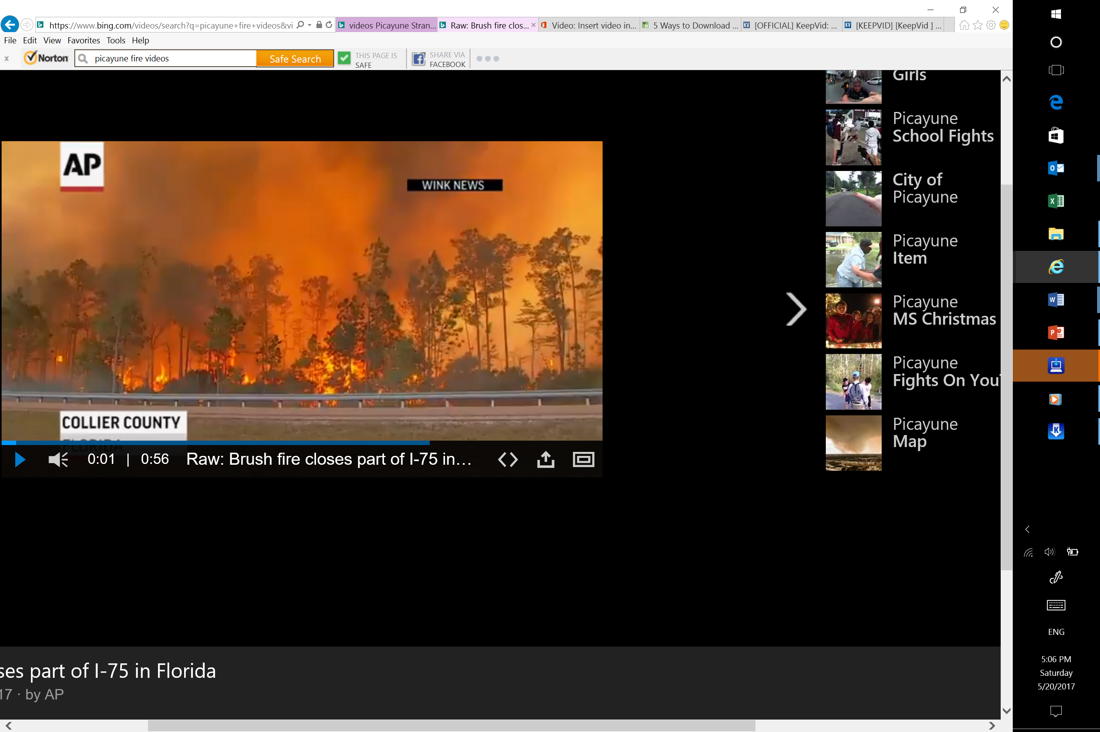
The fire
On Sunday March 5, parts of eastern Collier County were suffering from brush fires, and wind patterns forecasted the fires spreading to the Picayune Strand by mid-week.

Slide 4
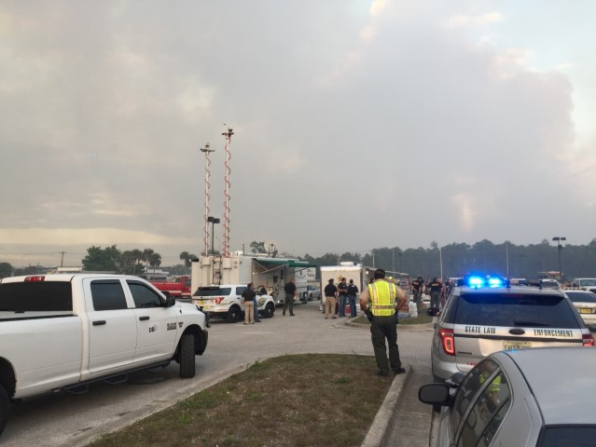
Preparation
Multiple detour and evacuation routes were planned
Coordination between nearby DBI projects to ensure resources were on hand – people, equipment, gas, food, water
Prepped for worst case scenario of a large scale evacuation
Meetings with response team

Slide 5

The team
FDOT
DBI Services I-75 Project with additional resources from nearby DBI projects: D1 Charlotte, City of Pembroke Pines, D6 Miami, D4 Belle Glade projects
FHP
Division of Forestry
Fire/EMS Departments from various locations along the Southwest Coast
Collier County Sheriffs Office
Collier County Emergency Management Team
Federal Southern Regional Red

Slide 6

At 1:30 PM on Tuesday March 8, Florida Highway Patrol issued a full road closure of 25 miles of the I75 mainline from MM105 Golden Gate Parkway to MM80 State Road 29

Slide 7
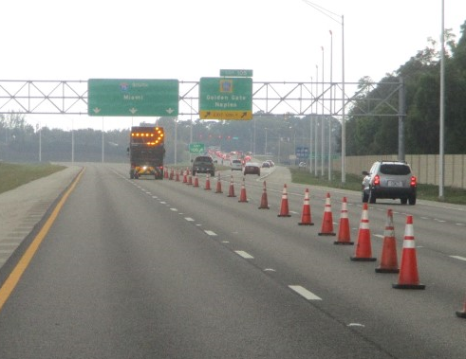
Taking action
DBI’s Response Team was comprised of…
  11 manned locations (Tech + Truck) on rotating shifts
  Participation, oversight, and coordination of 6 Managers
  4 tow-behind arrow boards
  3 light plants
  250 cones
  15 signs (not including 32 signs prepped for large scale evacuation)

Slide 8
detour

Slide 9
containment
This 7,500-acre burn, reaching temperatures of 2,500 degrees Fahrenheit, threatened scores of homes south of Beck Boulevard and Alligator Alley and east of Collier Boulevard
Unfortunately, 4 rural homes were lost to the flames.
Equipment onsite to battle and contain the fire included, but was not limited to
  21 Fire Engines
  21 Bulldozers
  2 Helicopters
  1 Fixed Wing Plane
  3 Swamp Buggies
  2 Brush Cutters
  2 Water Tenders
The 25-mile closure re-opened 33 hours later

Slide 10
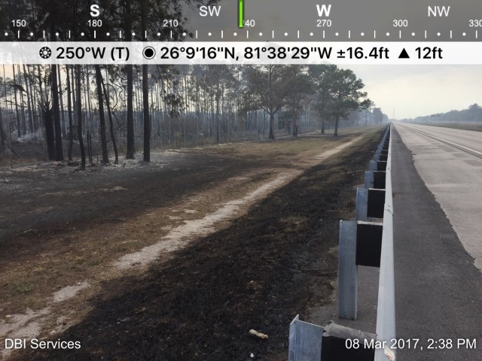
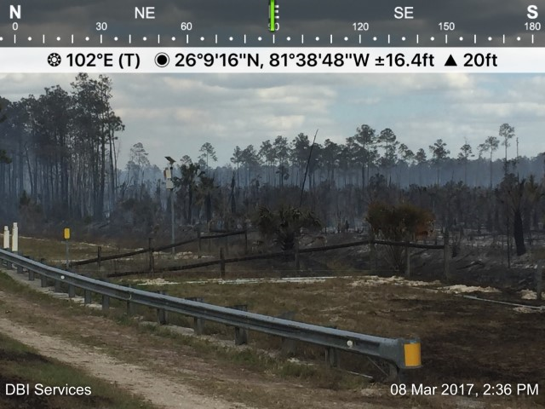
damages
Damage was limited to the turf and fence

Slide 11
challenges
Keeping staff continuously alert
  Employees worked on a rotation schedule
  Additional relief resources were brought in from other projects
Mother nature is unpredictable!
  Required preparation with multiple response options

Slide 12

Sharon Harris – FDOT District 1 Maintenance Administrator
Richard Fimbel – DBI Services Emergency/Incident Manager

