Slide 1
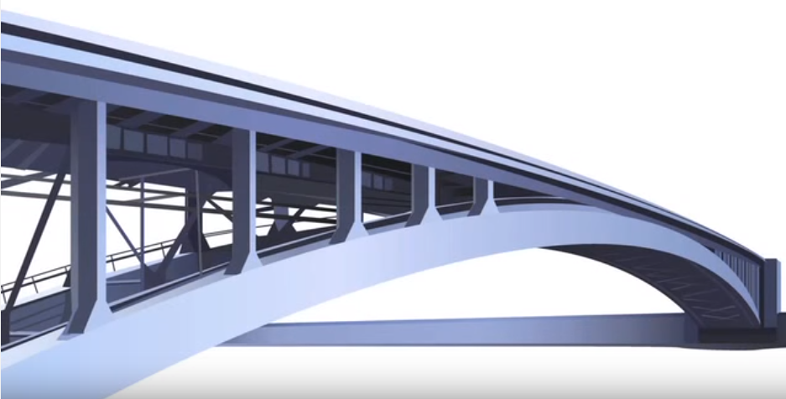
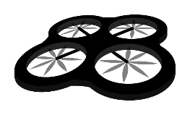
Inspecting Transportation Structures using Unmanned Aerial Systems
From Operational Need to Operational Systems
Dr. Luis Daniel Otero
Associate Professor of Engineering Systems
Director of Transportation Systems Engineering Research (TSER) Lab
Florida Tech, Melbourne, FL
Notes:
Focus on the CONCEPTS, not on the details
Everything begins with an Operational Need → Is there a system COTS to meet the Operational Req? or, Do we need to design a new system?
Operational Needs → A need to improve or provide new capabilities to achieve mission objectives.
The Future Looks Very Bright for the use of UAS for Transportation Applications; and these applications are of High Impact to Society!!

Slide 2
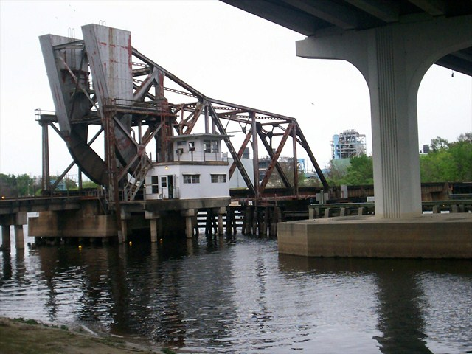
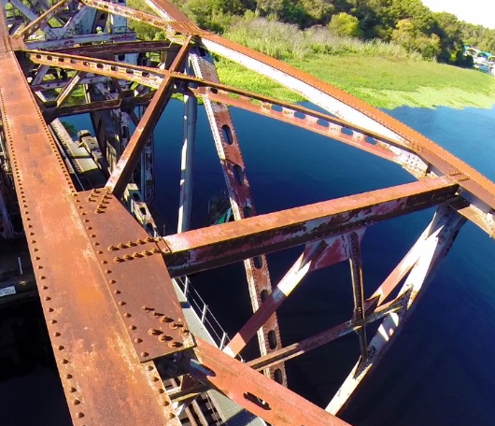
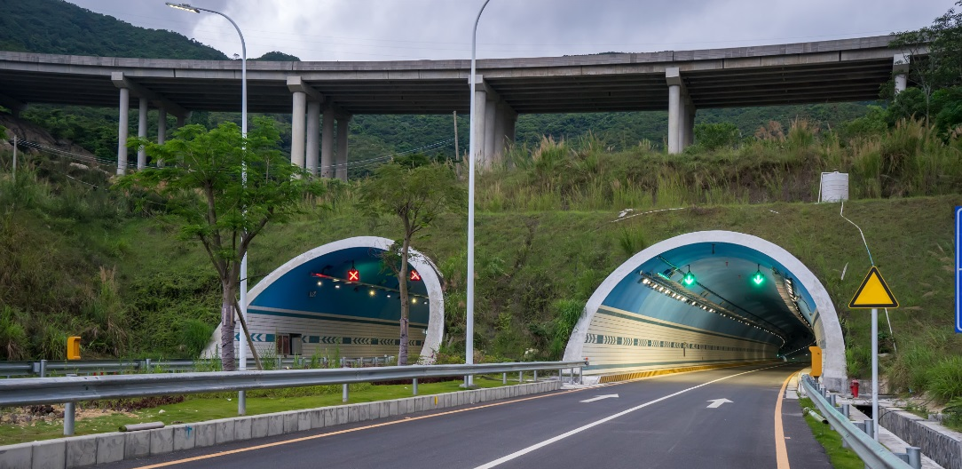
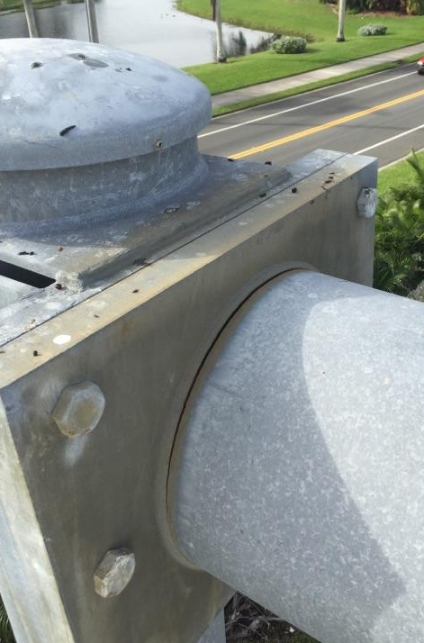
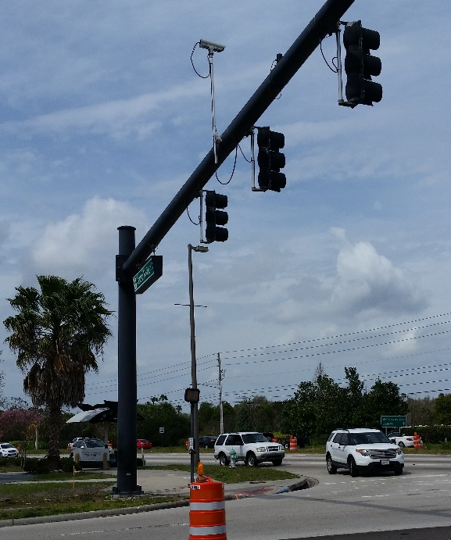
Potential Applications for Visual Inspections (scheduled)
Routine Visual Inspections
Critical Connection
Shown in the Photo:
Tunnels
Road
Luminaires
Highway Bridge
Not Shown:
Other types of Bridges
Signs
Traffic Signal Mast Arm (TSMA)
Notes:
Visual Inspections

Slide 3
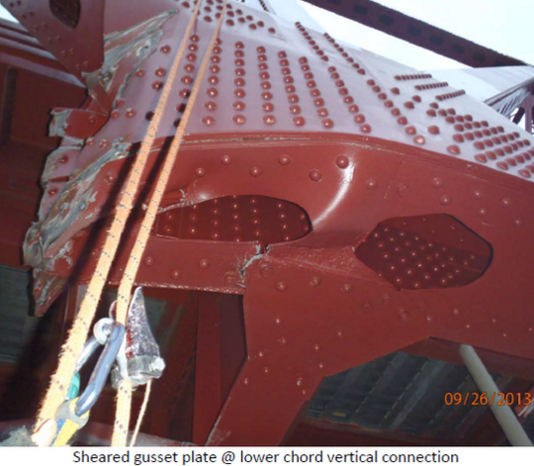
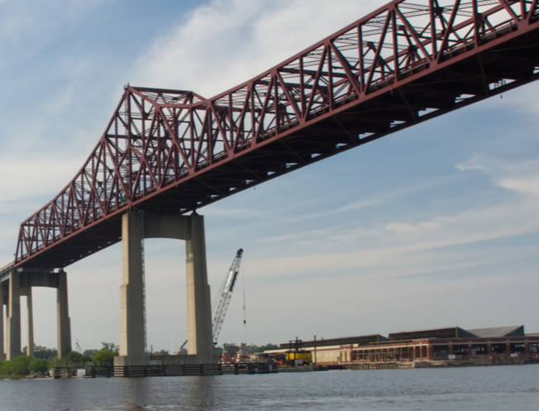
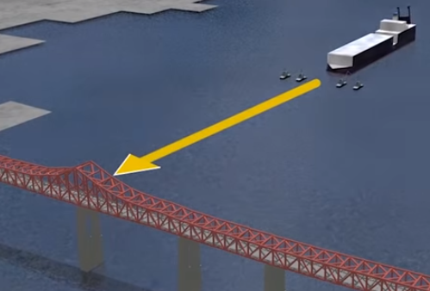
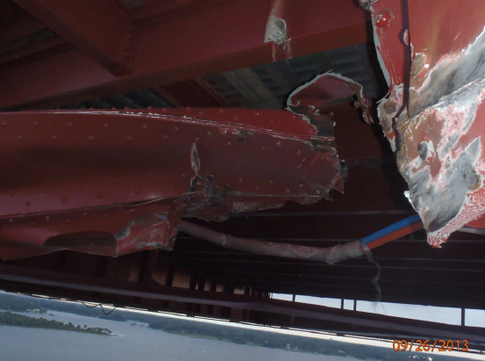
Potential Applications for Visual Inspections (non-scheduled)
Sheared gusset plate @ lower chord vertical connection
Mathews Bridge in Jacksonville, FL
Ship collided with a bridge span
Resulting defects…
Severed lower chord
A small UAS could help to assess the situation in a safe and quick way!
Notes:
Important Bridge → High-Level Intercostal Bridge; Everyday, 50,000 vehicles travel that bridge…
Navy ship was being towed and it collided with a span of the bridge
Pics showing damages are courtesy of FDOT (http://www.wokv.com/gallery/news/local/mathews-bridge-damage/gCDrH/#3929721)
In situations like these, we need to visually inspect the affected area to assess the structural health of the bridge

Slide 4

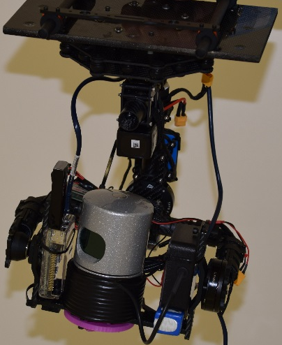
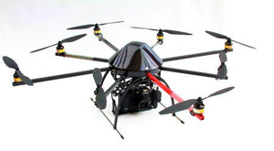


What is an Unmanned Aerial System (UAS)?
Definition by the FAA [1]: “A UAS is an unmanned aircraft and all of the associated support equipment necessary to operate the unmanned aircraft”
Subsystems:
UAV
Sensor Structure
Ground View/Process
Communications & Nav
Power, etc.
e.g., Mission: Collect sensor data of bridge components
1
View data in mobile ground station
UAS collects sensor data
3
Store data and conduct post analyses
Gimbal
Structure
Wi-Fi
4
Send data over Wi-Fi
2
Notes:
Objective: Describe the components that would make a UAS for a specific mission.
Research in UAS means research in one or all of the UAS components with a target mission(s) in mind!
UAV, Sensor, Ground Station (real-time viewing, etc.) → Also think about Real-Time or Post Analyses, Inf. Sys & Data Storage
UAVs solve the issue of ACCESIBILITY of data → access data that otherwise would take heavy equipment to access…
A UAS is used as a remote sensing tool to access data without physical contact with the target
The picture that I’m trying to paint here is that inspecting a structure is a Mission that includes an UAS; Real-Time or Post Analyses; Inf. Sys & Data Storage; Operator Training; etc… So, UAS is not the only part of the mission!! To successfully complete the mission, we need to look at all of its components.

Slide 5
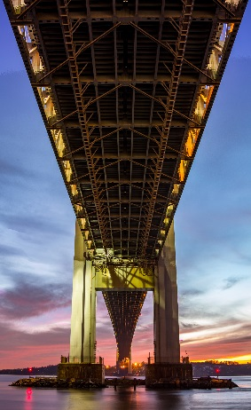
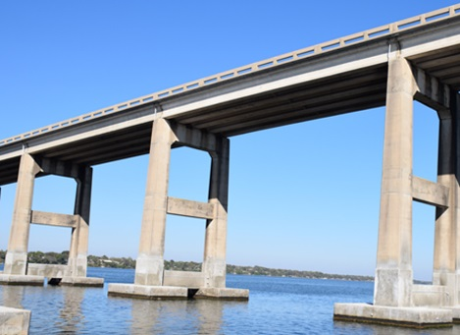
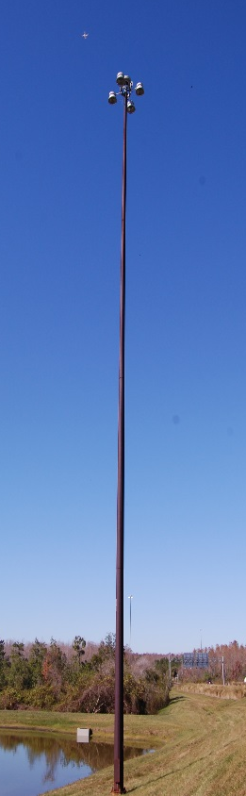
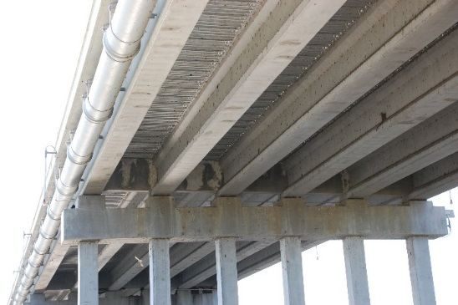
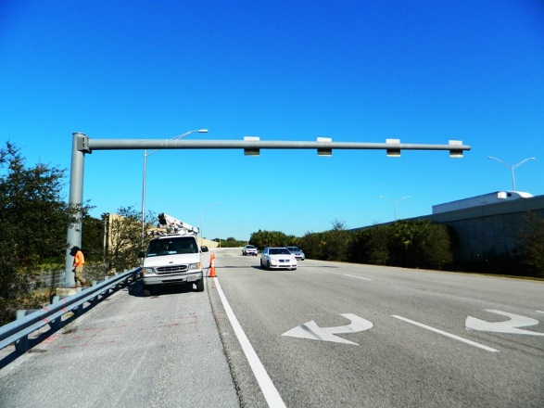
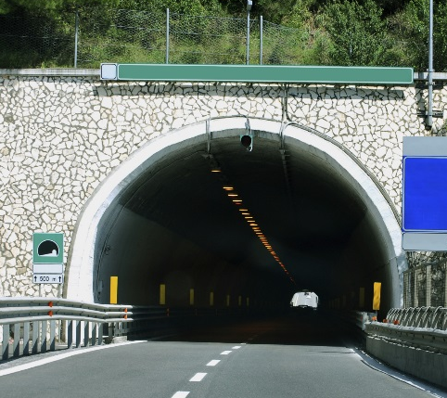
What types of Transportation Structures?
Open Space
Quality Attributes for UAS
Confined Space
Operability
Reliability
Maintainability
Robustness
Safety
Transportability
Etc…
Notes:
Why is so important to make the distinction between Open & Confined Spaces?
Because they represent different UAS requirements! It is like designing a car for a race vs for highway only. Each MISSION has a set of MISSION REQUIREMENTS, which translate into SYSTEM REQ (in this case sUAS REQUIREMENTS).
We have to make a distinction between open/confined space infrastructures bc they represent different mission types.
Let’s think about the scenarios that we have here…their differences….and from there, let’s establish some Quality Attributes…

Slide 6
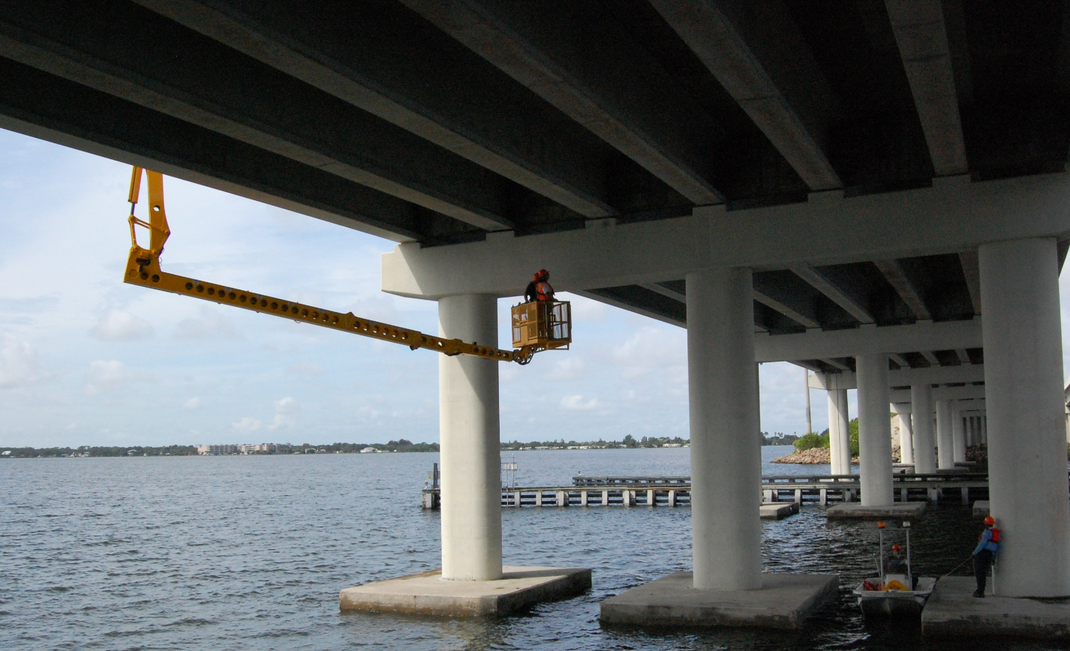
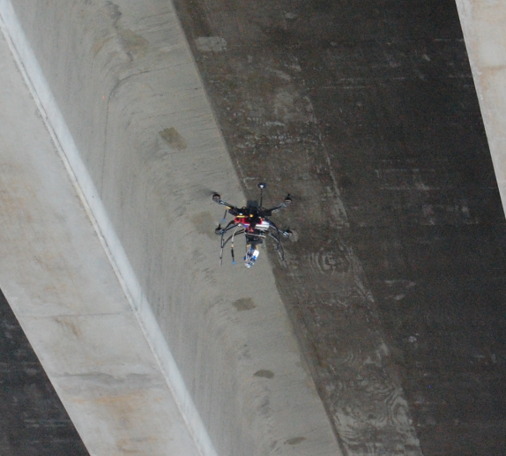
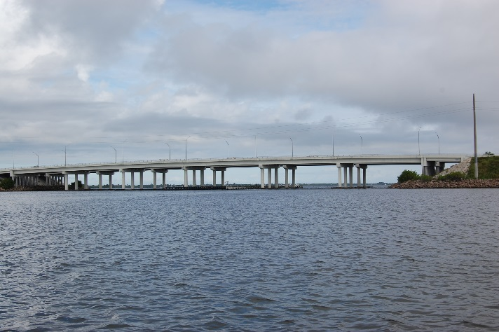
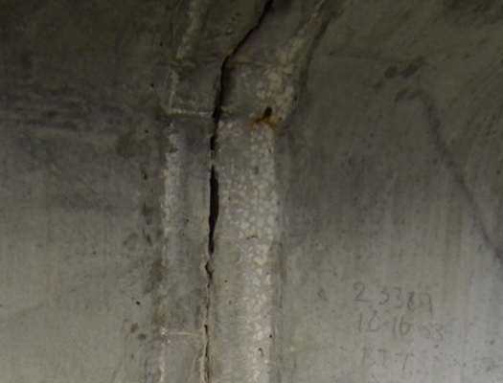
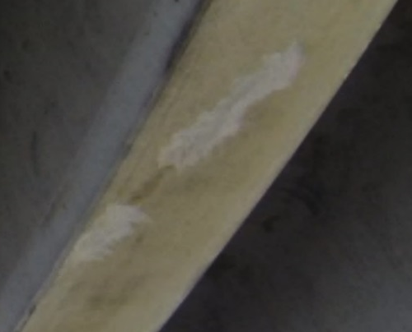
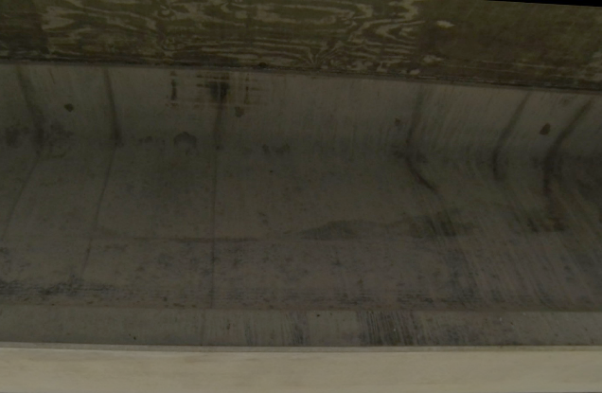
Conventional Methods and Operational Need
Conventional method for visual inspections
2 or 3 Team Members
+3
7 Team Members
+2
UAS to assist inspectors
+2
Similar results!!
Examples of findings…
Rust
Crack through epoxy patch
Indication of water
Notes:
Benefits:
Reducing man-hours
Increasing the flexibility to conduct visual inspections (no need to get heavy equipment, or MOT, etc.)
Reducing costs
Access to image/video data for post evaluation
Increase safety for inspectors and the public
Etc…

Slide 7
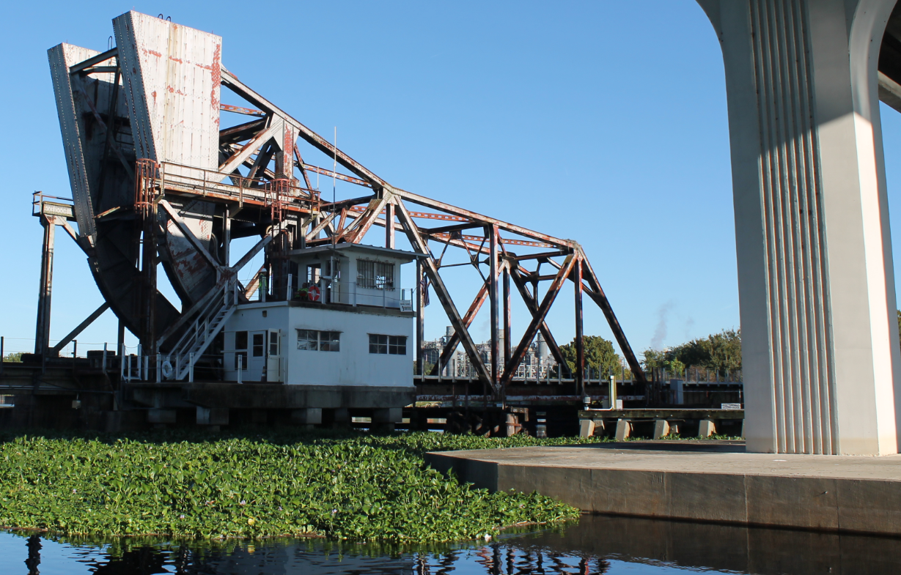
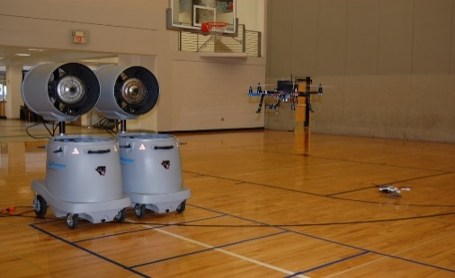
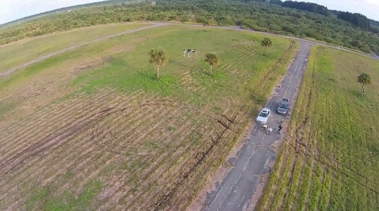
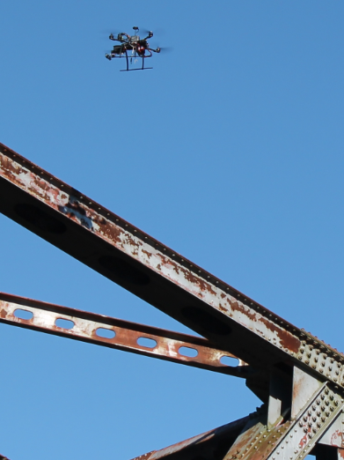
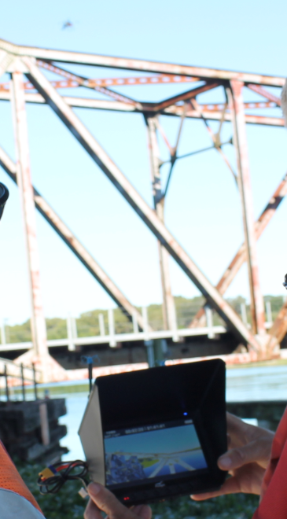
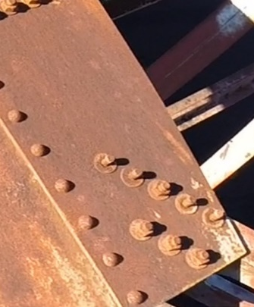
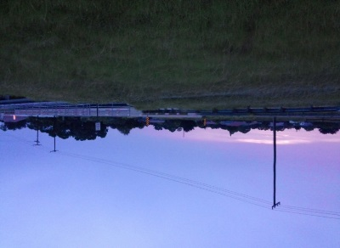
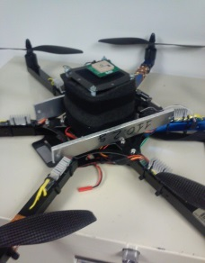
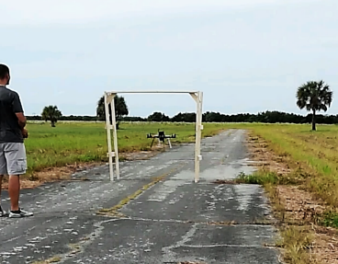
Proof of Concept Study (FDOT)
A Systems Engineering Approach
Main Objective: Understand the expected usefulness of UAS as tools for bridge/HML inspections
Evaluate Image Quality
Vibration Frequency (wind speeds)
Low-Light
UAV Component Evaluation
Altitude
Payload
Maneuverability
Field Tests
HMLs
Bridges
Drawbridge Railway
Aircraft orientation?
Mission: Inspect Gusset Plates
Missing!!
0.25 lbs bars
Notes:
Objective is not to Optimize, but to provide evidence of:
FEASIBILITY
POTENTIAL benefits from using this technology
Understand CAPABILITIES and system LIMITATIONS
We used sUAS built in-house & COTS (DJIs, 3DR, NOVA, Generic)
We used experienced pilots (with private pilot license)
HMLs: Galvanized steel AND Weathered steel
Bridges: Concrete; Concrete with steel mid-span; Steel; Wood

Slide 8
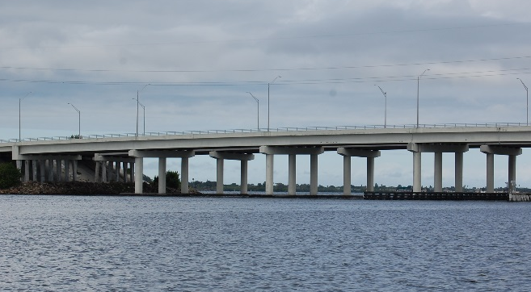
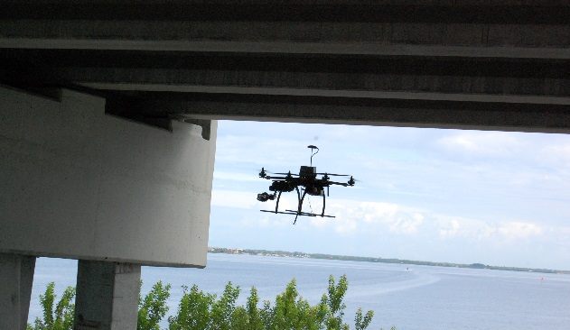
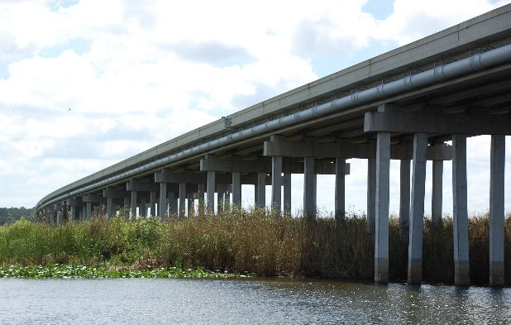
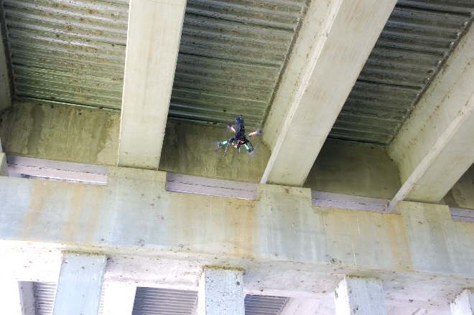
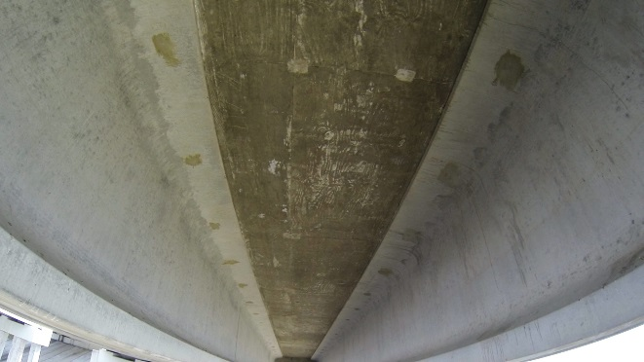

Proof of Concept Study (FDOT) – cont’d
A Systems Engineering Approach
Main Objective: Understand the expected usefulness of UAS as tools for bridge/HML inspections
Concrete highway bridge
UAS arriving to bridge bays
Tall Dense Lake Vegetation Under Bridge
UAS inside bridge bay

Slide 9
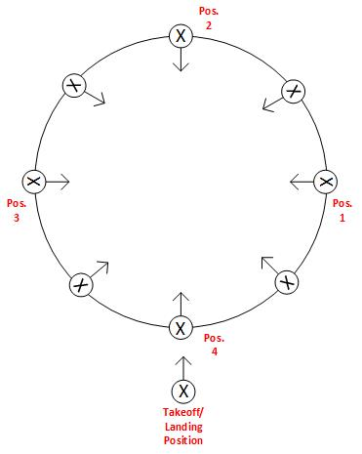
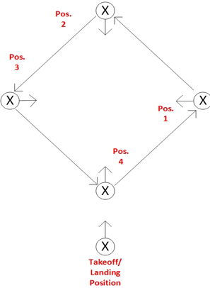
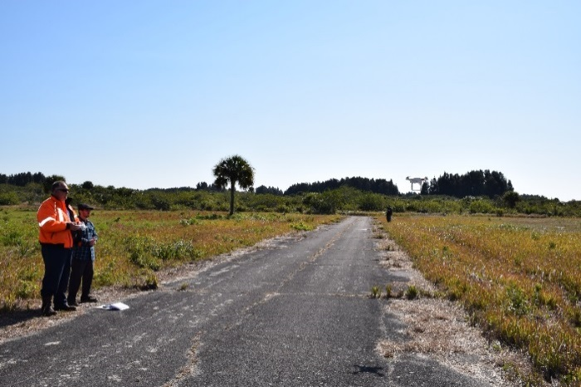
Proof of Concept Study (FDOT) – cont’d
A Systems Engineering Approach
Main Objective: Understand the expected usefulness of UAS as tools for bridge/HML inspections
Basic Flight Training Program
Written instructions & brief lecture
Trainer flight demo
Training modules
Training module –HML
Training module – Bridge Girder

Slide 10
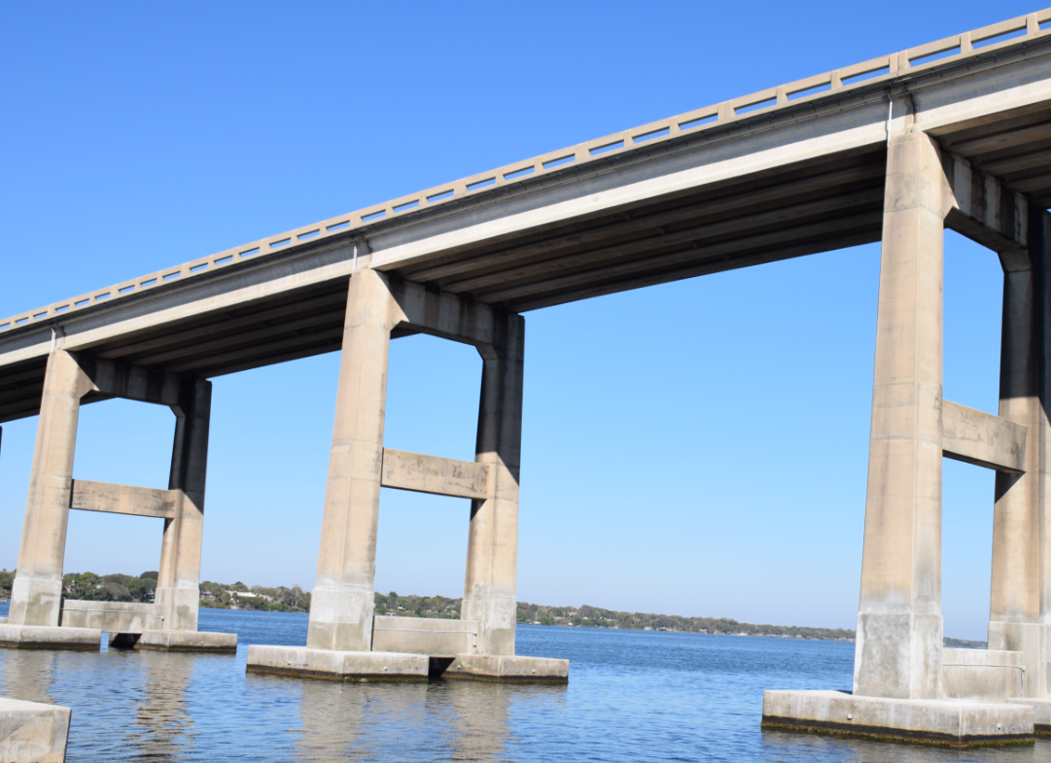

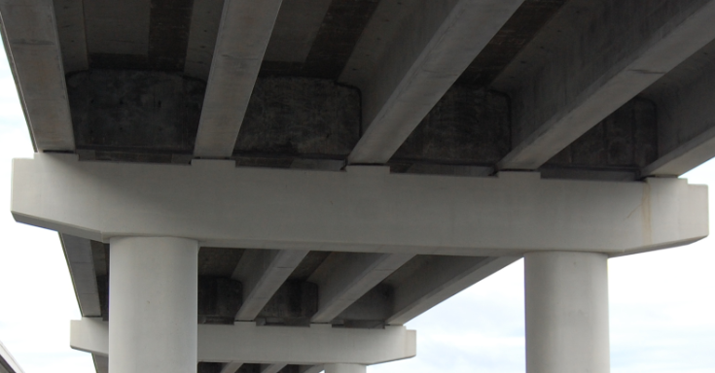
Proof of Concept Study (FDOT) – cont’d
A Systems Engineering Approach
Main Objective: Understand the expected usefulness of UAS as tools for bridge/HML inspections
Costs
Equipment Costs
Video Editing Costs
Operator Costs
Left Bridge Section
Right Bridge Section
Developed simple cost function for TDGT:
Initial Setup Time
Total Section Time
Battery Change Time
Potential Takeoff/Landing Location
Considered bridge elements…
Bay #1
Girders Associated with Bay #1
Expected reduction of man-hours!
Operator training time (inspectors)
Total data gathering time (TDGT)
Pier/Column Cap
Column
Notes:
Conducted a preliminary comparison for cost purposes: Conventional vs sUAS Methods…
Significant reduction in man-hours (not on total inspection time)
Reduced (or eliminated) MOT activities → No need for vehicles to carry traffic cones
No need for an Inspector 62 vehicle (i.e., bucket truck)
Safety of inspection personnel

Slide 11
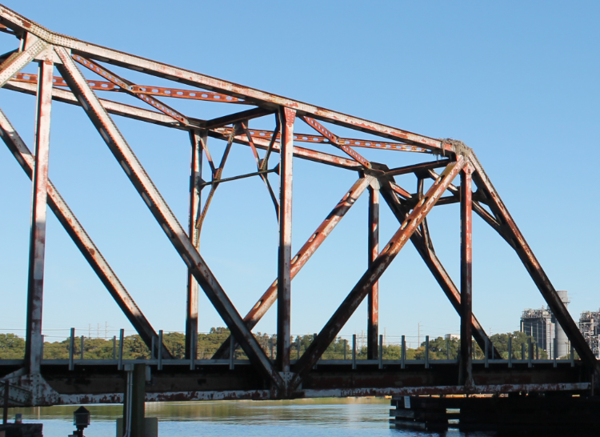
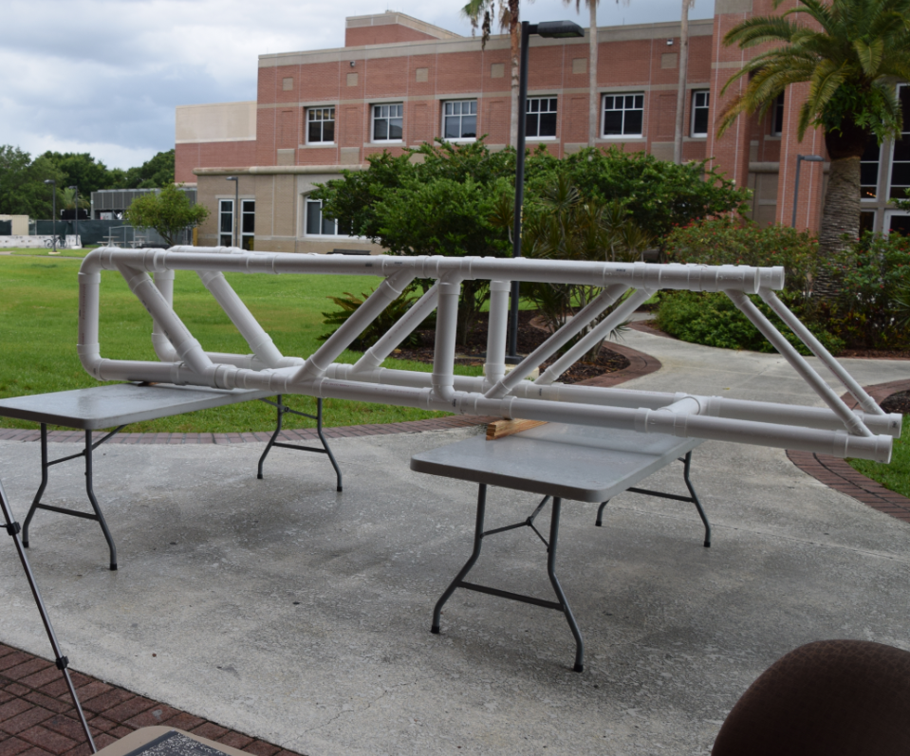
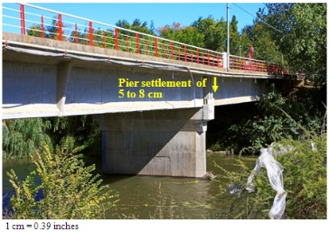
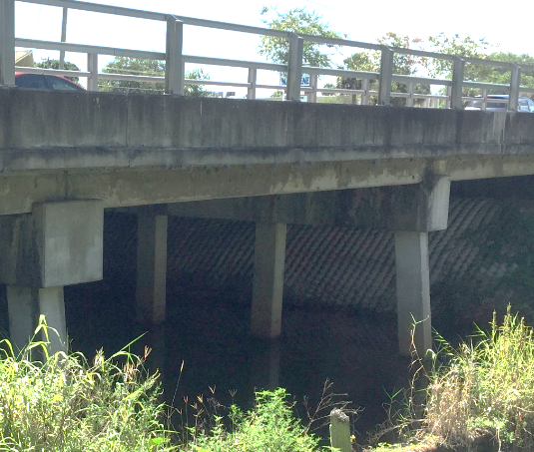
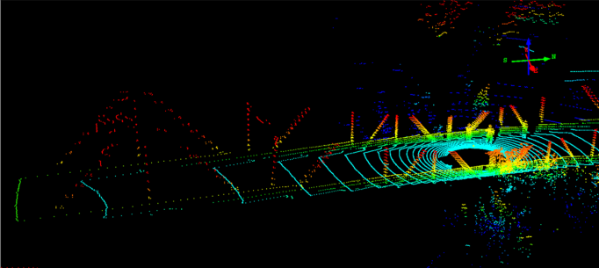
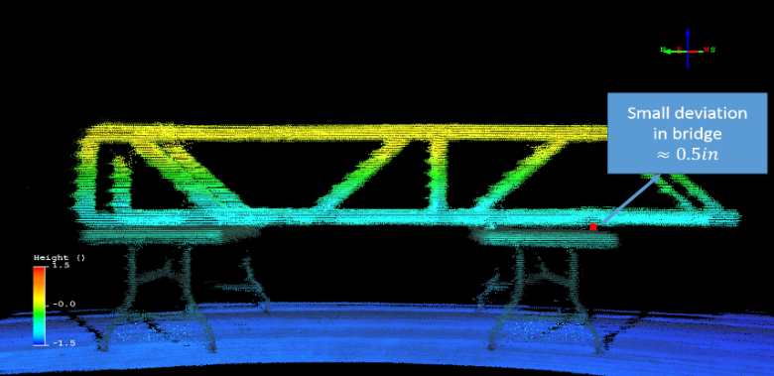
Proof of Concept Study (TRB-FRA)
Objective: Can we detect “Bridge Component Displacements” using 3D models from LiDAR data?
(1) Began testing with real bridge
(3) Built PVC bridge as test platform
Geo-Reference
Process
(2) Initial 3D models showed need to improve geo-referencing
(4) 3D model works!
Battered Piles
(5) Custom build UAV; integrate LiDAR sensor; conduct field tests
Notes:
Outcomes:
Proved that we can utilize LiDAR technology efficiently to detect various types of bridge deviations
Developed geo-referencing approaches, which we could now use/expand for other applications
Developed the knowledge-base at FIT to work with LiDAR technology
Conducted mock bridge and real bridge experiments
Developed image processing algorithm for concrete crack detection/classification that outperforms current algorithms in key areas
Stage 1 → Static tests (using tripod and NO UAS)
Stage 2 → Dynamic tests (using a UAS)

Slide 12

Proof of Concept Study (TRB-FRA) – cont’d
Integrated LiDAR Sensor
Conducted Indoor Tests w/ PVC Bridge
Geo-reference solution works for the UAS approach!
Notes:
UAS fully developed in-house

Slide 13
What Next?
Is there significant expected value from using sUAS during infrastructure inspections?
  Cost
  Lane closures during inspections
  Safety of motorists & inspectors
  Etc…
Can UAS be effectively used for infrastructure inspection purposes?
  Proven to some extent…
What next?
  Continue working to ensure operational systems satisfy operational needs
Notes:
Cost (+); Safety of motorists and inspectors (+,-); Performance (+)…
Can sUAS be effectively used for Transportation Infrastructure Inspection purposes? (we have proven it for some cases = DONE!
From the Industry/Contractor Perspective:
Inspection in “Open Spaces” = Top/Side View of Bridges; Roads
Other Non-TI2: Wind turbines; Mines; Pipelines...; Power lines; etc
Inspection of “Confined Spaces” = Not that much in Transportation (Collision is Unavoidable, wind profiles, etc.); but in other areas we’ve seen systems such as the Gimball (we don’t know if it will provide the level of detail necessary inside bays due to its enclosure..)
From Academia/Research Perspective:
Inspection in “Open Spaces” = HML, Top/Side of Bridges (our FDOT Project) (Lake Monroe Railroad Bridge – Gusset Plates)
Inspection of “Confined Spaces” = Underside Highway Bridges (our FDOT project) up to a certain point
We were the 1st to do this!! Flying inside bays during field tests with inspectors present and viewing data from ground station
What Next?
We must keep a Continuous Improvement mentality!!
Example:
Investigate the use of different sensors
What to do with the vast amount of image/video data? (Database System?)
Do we need to develop an information system with user-friendly interface, etc.?
Reduce camera vibrations (frame and gimbal alternatives)
Improve flight durations
Concrete crack gauge software…
Think about this:
SWARM: Imagine not 1 but a group of UAS working together to gather/analyze bridge data at a fraction of the time that it takes now? Do you think it will be possible? We MUST keep a Continuous Improvement Mind!

Slide 14
References
[1] http://www.faa.gov/uas/faq/#qn1

Slide 15
FDOT Perspectives
FAA Regulations
FHWA Limitations
Equipment Limitations
Operator Training
Consultant Use
Develop/Modify Procedures
Notes:
FAA – restricted around airports, over traffic, over urban areas – 2/day commercial pilots spot sUAVs
New Regulations due out
FWHA – Fracture Critical Inspections are required to be Arms-length
Equipment – Can’t remove debris, can’t sound concrete NDE generally requires hands on use
Operator Training – What training will be required under new rule
Consultant Use – With technology improving is it better to contract this out
Procedures – do we want to alternate drone inspection with standard inspections?

Slide 16
Questions

