Slide 1
Structural Health Monitoring of the Sunshine Skyway Bridge
By: Grant Curtiss

Slide 2
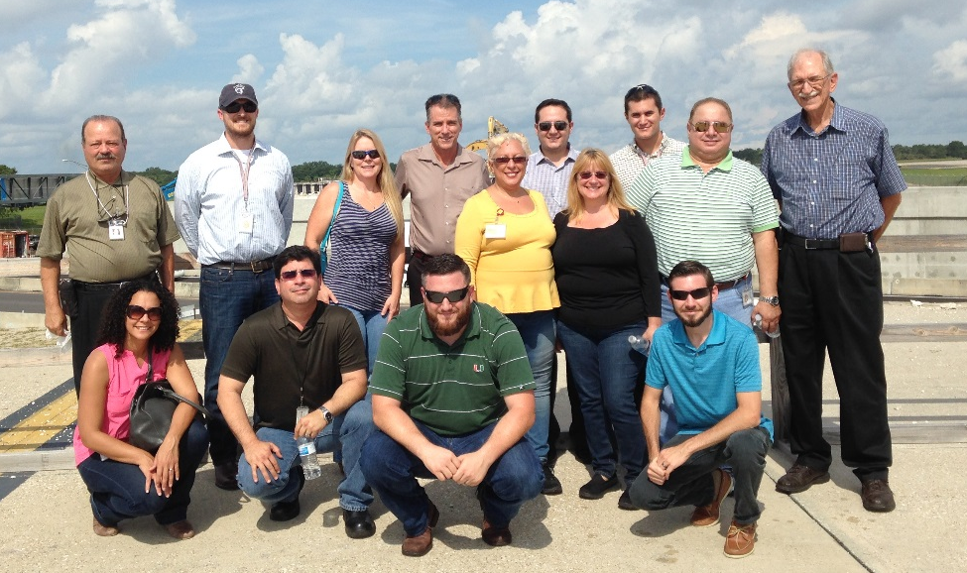
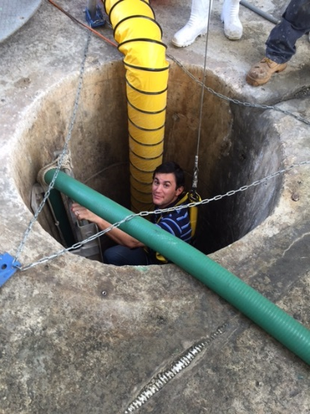
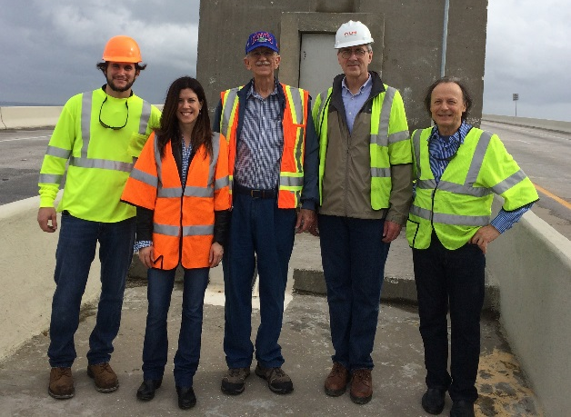
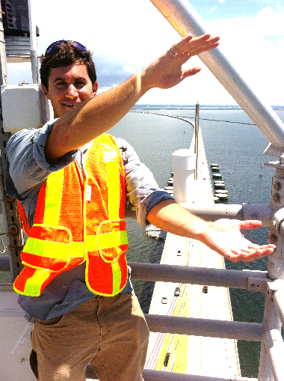
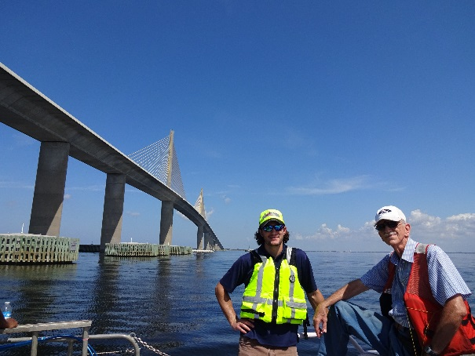
About Me
District 1 & 7 Structures Maintenance Office
Inside the Skyway Footers
Nation’s Top
Cable-Stayed Bridge Engineers
Go Gators!
Masters in Structural Eng.
Underneath the Skyway

Slide 3
Imagine …

Slide 4
Imagine …
A
S ART BRIDGE

Slide 5
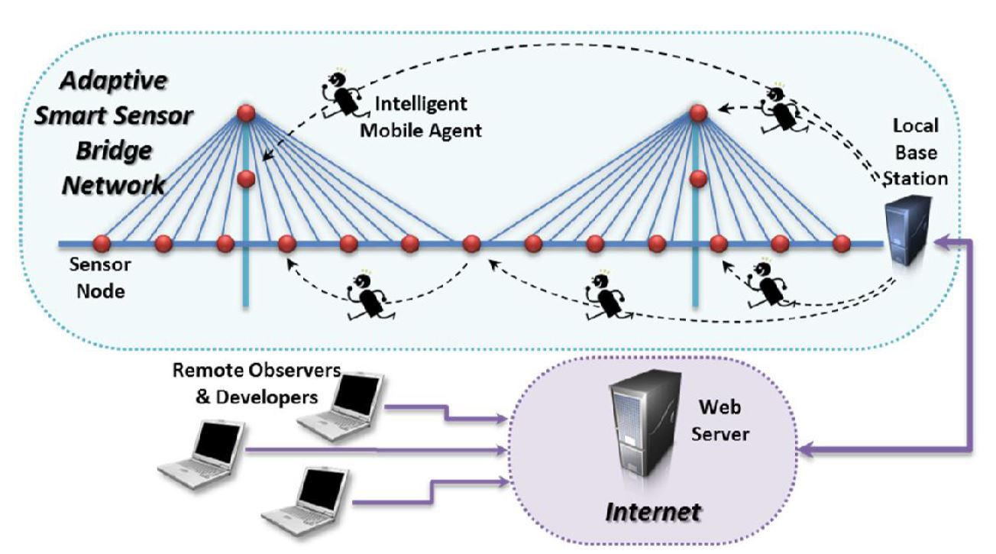
Imagine …
A
S ART BRIDGE

Slide 6
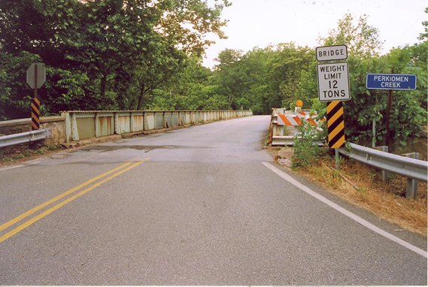
____
Inspect
& Monitor!
Inspect…
>
NOW
FUTURE
Notes:
Paint picture of bridge inspector telling FDOT to close the bridge. What if we didn’t have to close the bridge? Mention Skyway cost to replace at $2 Billion and mention detour length of 75 miles. We inspect Skyway every 2 years.

Slide 7
What is Structural Health Monitoring?

Slide 8
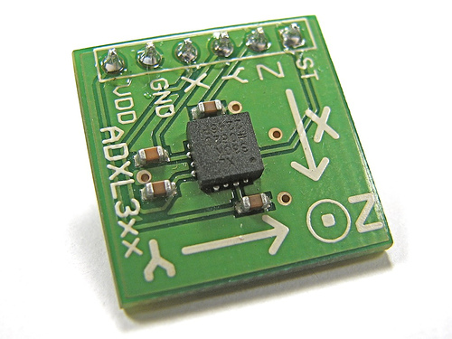
Structural Health Monitoring
1
Sensor
Notes:
Expound upon type of sensor

Slide 9
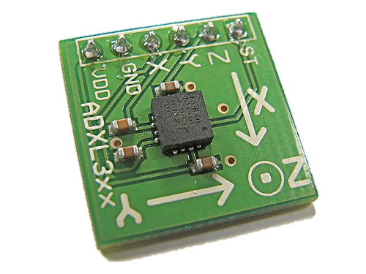
Structural Health Monitoring
2
1
Method of Reading Sensor
Sensor

Slide 10
3
Structural Health Monitoring
2
Method of Storing Data
1
Method of Reading Sensor
Sensor

Slide 11
Notes:
Structural health monitoring is not meant to replace visual inspections…

Slide 12
Obstacles
of a SHM
Power
Data Storage
c
De
e
t
r
a
l
z
a
t
n
i
i
o
n
Staff abilities
Maintenance

Slide 13
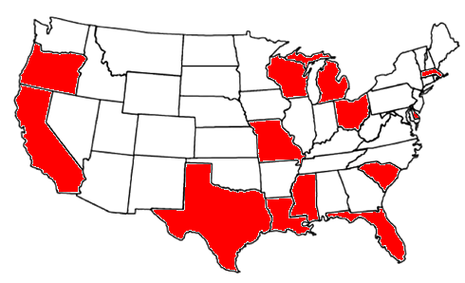
Other States using SHM

Slide 14
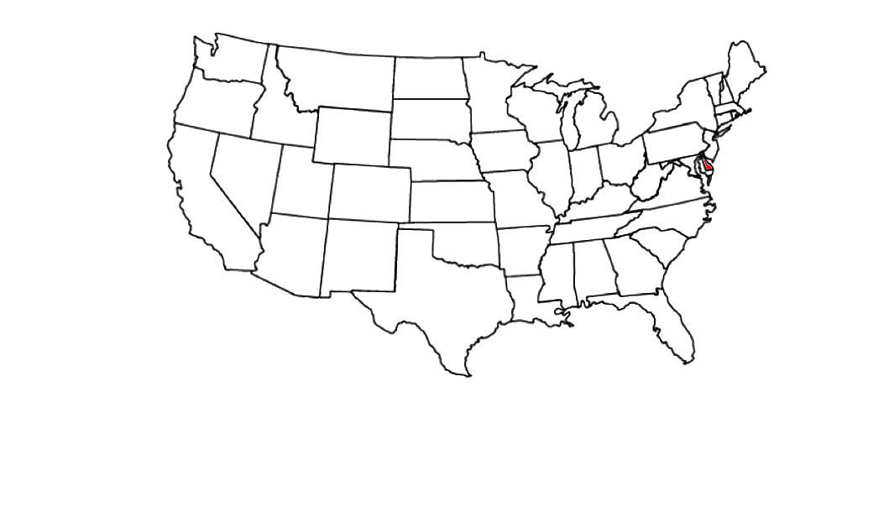
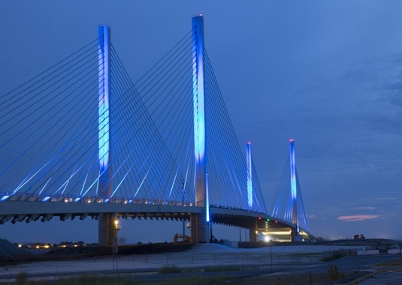
Indian River Inlet Bridge (Delaware)
Delaware DOT in partnership with the University of Delaware

Slide 15
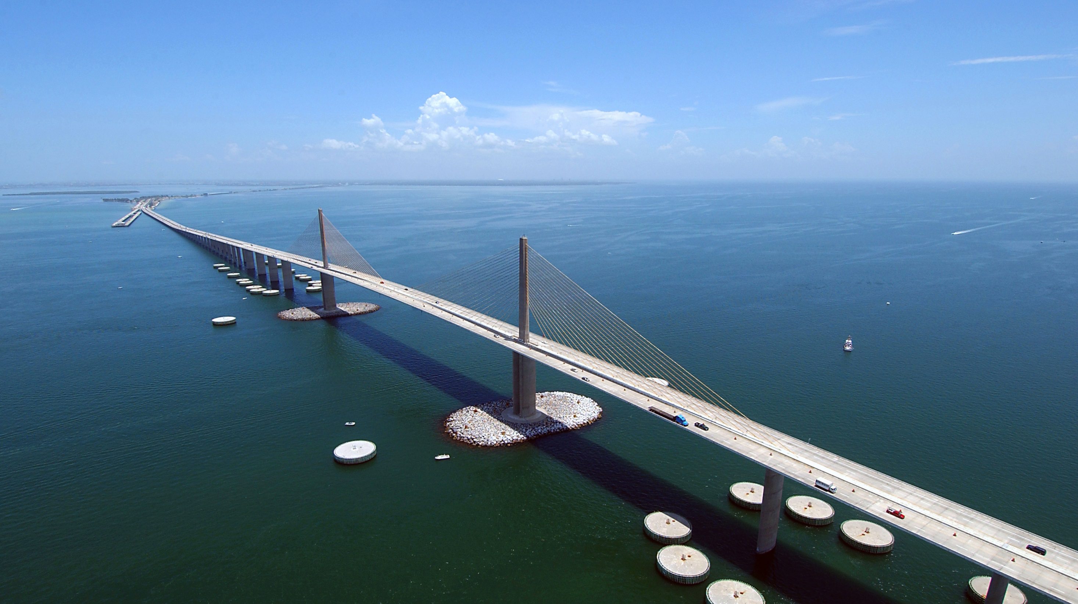
Structural Health Monitoring of the Sunshine Skyway Bridge

Slide 16
Structural Health Monitoring of the Sunshine Skyway Bridge
Notes:
Mention technology advancing, newer instruments added to Skyway

Slide 17
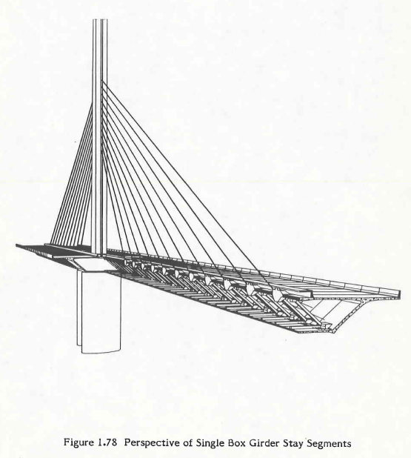
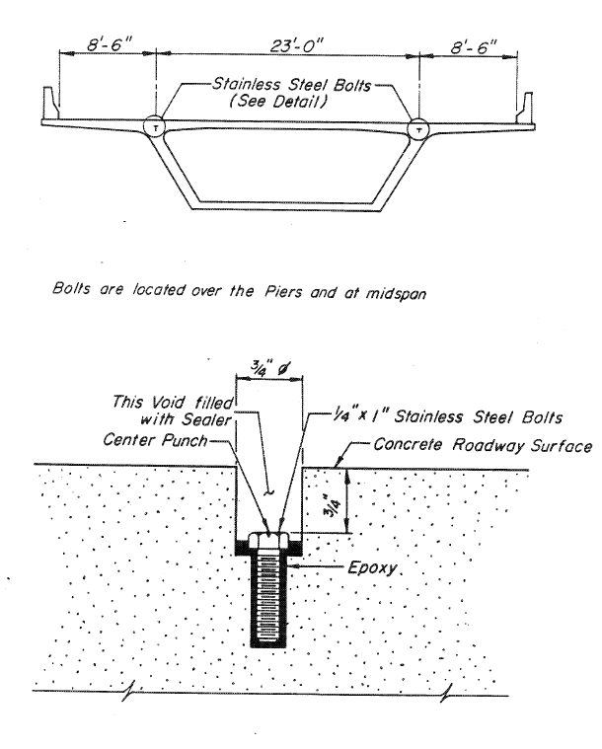
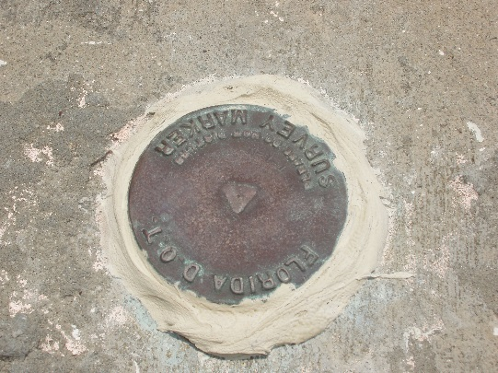
1987 Figg Maintenance Manual
Notes:
Starting point for monitoring Skyway through its design life

Slide 18
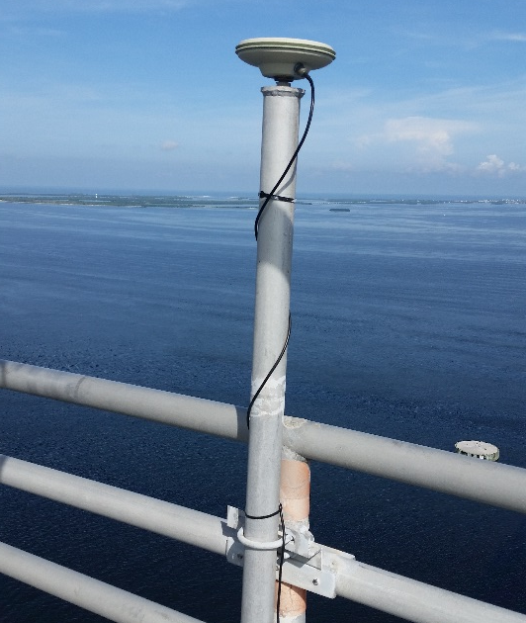
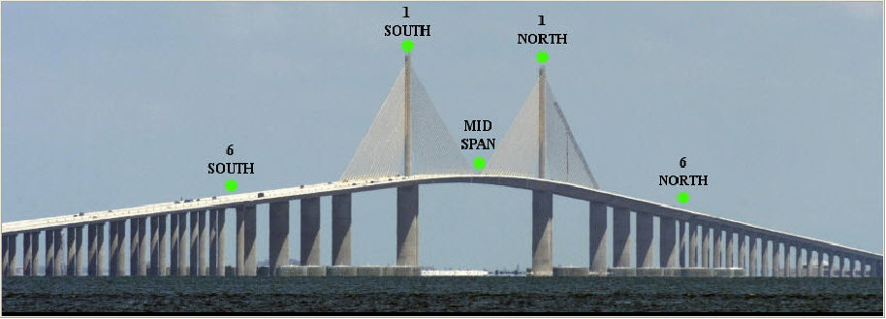
Global Positioning Sensors (GPS) initially installed in 2003
Notes:
1 cm accuracy (1/3”)

Slide 19
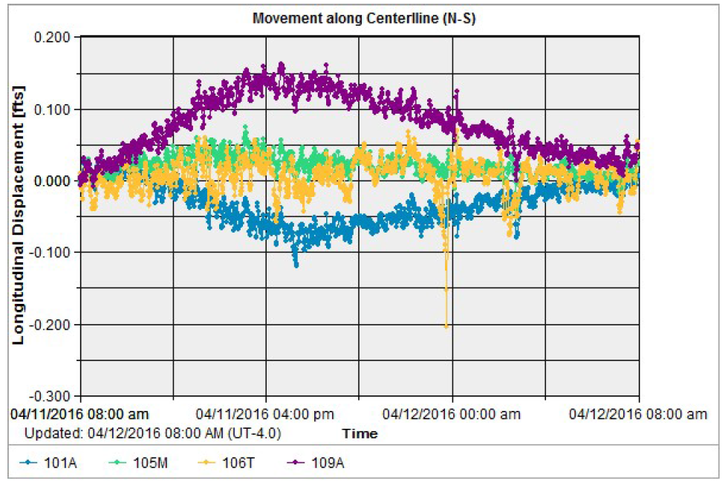
North
South

Slide 20
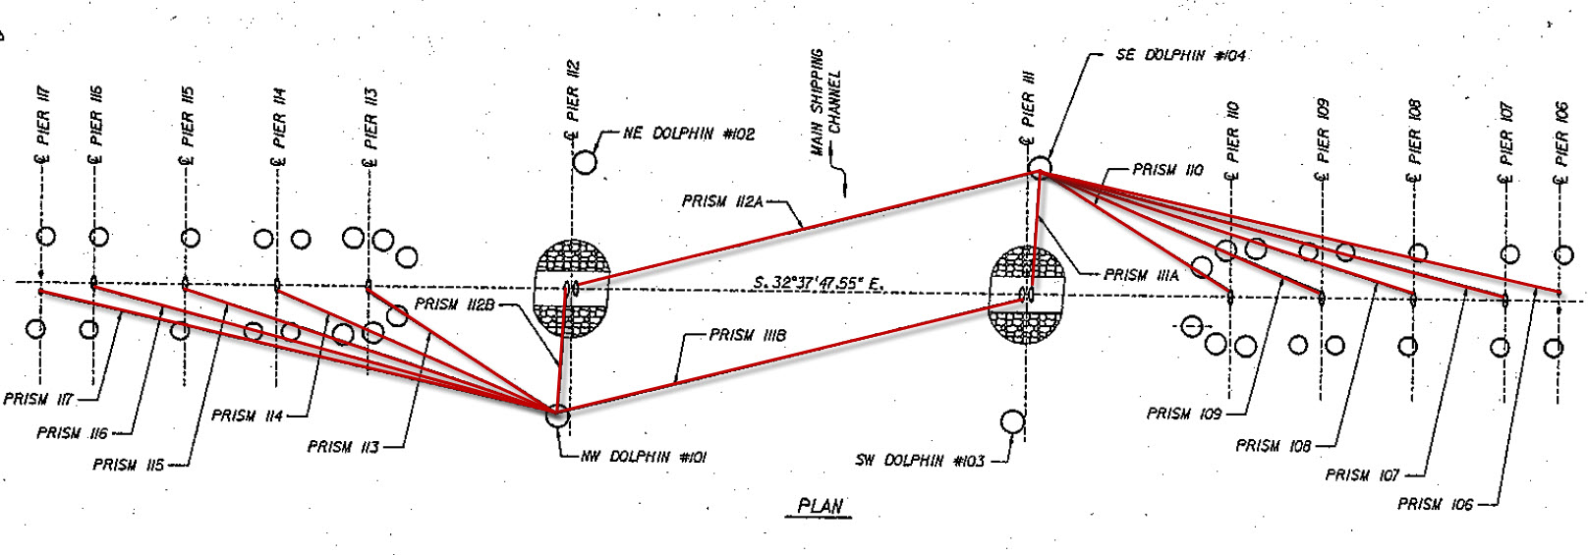
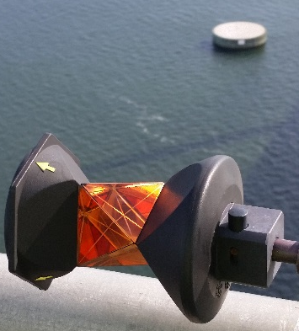
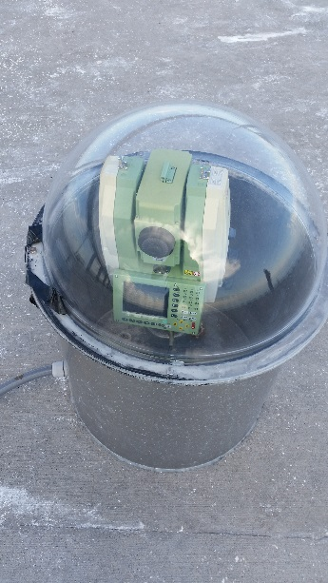
Automatic Total Stations installed in 2008
Prism
Type #1
Prism
Type #2
Notes:
ATS meant to further refine the GPS system, 1 mm accuracy (1/32”), show them the sprinkler

Slide 21
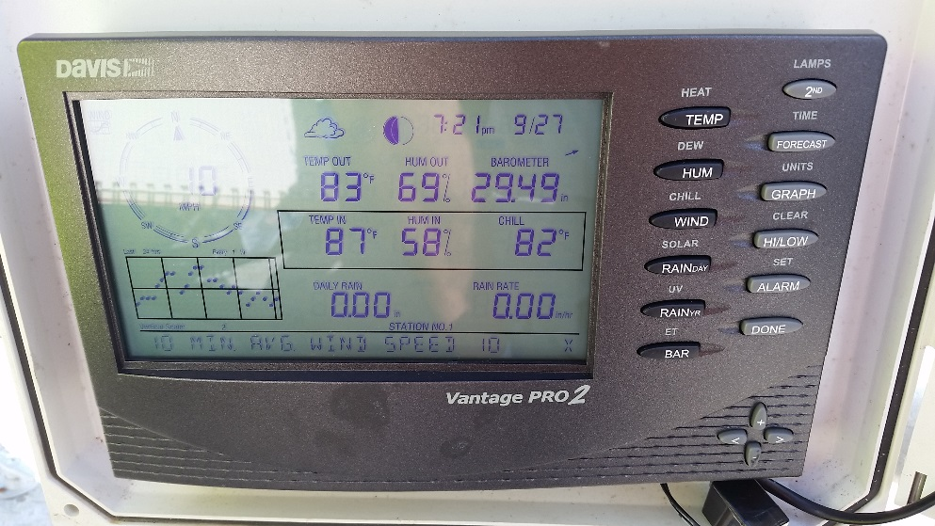
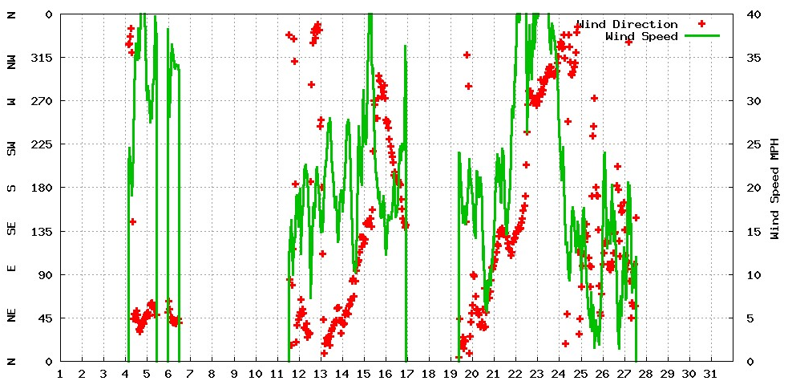
Weather Station installed by State Materials Office
Notes:
Concrete Temp, cameras, rain gauge, wind gauge, temperature gauge

Slide 22
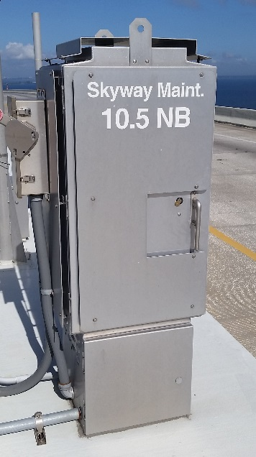
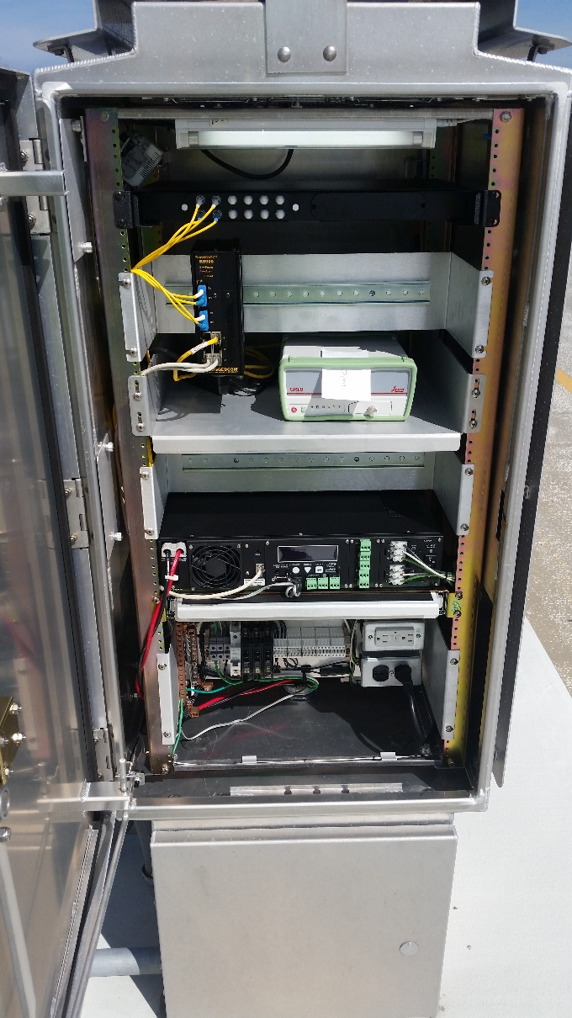
Fiber optic cable and 13 maintenance cabinets installed in 2012
Notes:
Piggy back on an ITS project, maintenance cabinets have access to power, access to backup generator, and FDOT fiber optic network = clean power and high speed internet

Slide 23
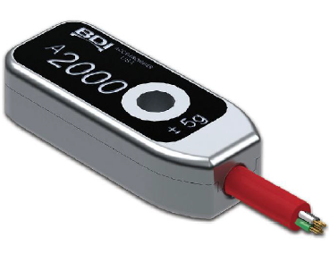
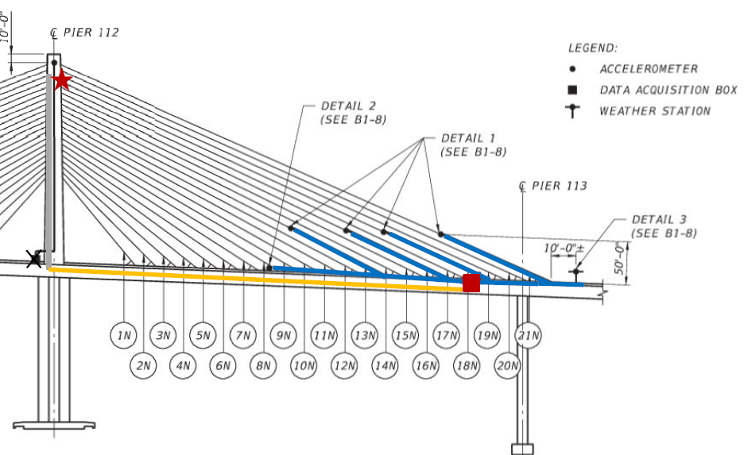
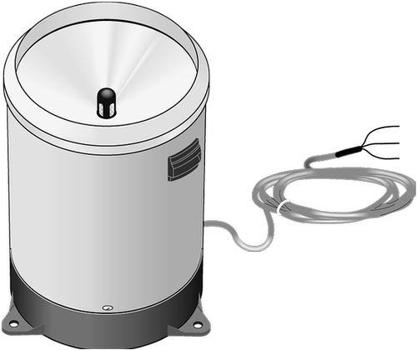
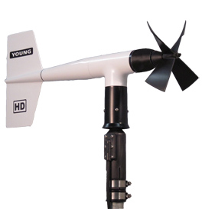
Weather Station and Accelerometers installed in 2015
Accelerometer
`
Rain Gauge
Wind Gauge
Notes:
Accelerometer measures changes in force in all directions (x, y, and z)

Slide 24
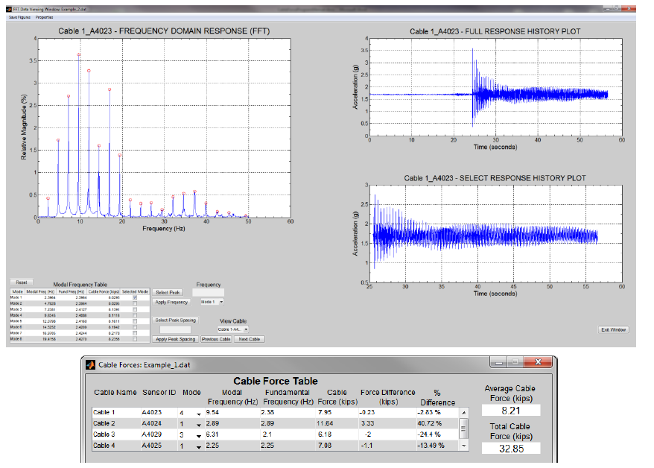

Slide 25
Structural Health Monitoring of the Sunshine Skyway Bridge

Slide 26
Structural Health Monitoring of the Sunshine Skyway Bridge

Slide 27
HELP!
State Materials Office
Traffic Operations (ITS)
Surveying and Mapping
District Structures Maintenance office

Slide 28
The University of Florida
Smart Infrastructure Management Laboratory (SIMLab)
District Structures Maintenance office

Slide 29
The University of Florida
Smart Infrastructure Management Laboratory (SIMLab)
Phase 2
Phase 3
Phase 1
Investigate and provide recommendations
Structural Health Monitoring System
Integrate recommendations
Maintain and refine system

Slide 30
We are here!
Phase 2
Phase 3
Phase 1
Investigate and provide recommendations
Structural Health Monitoring System
Integrate recommendations
Maintain and refine system

Slide 31
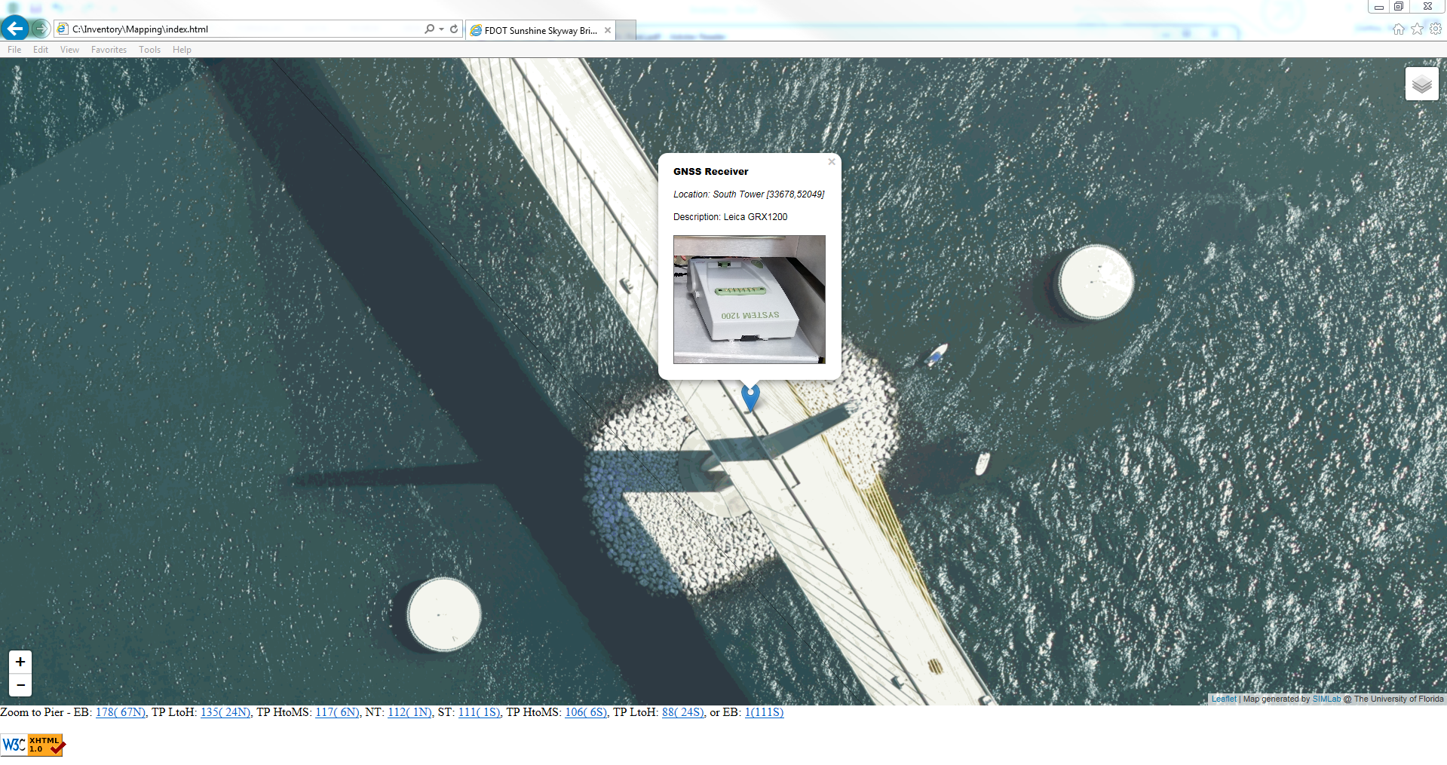
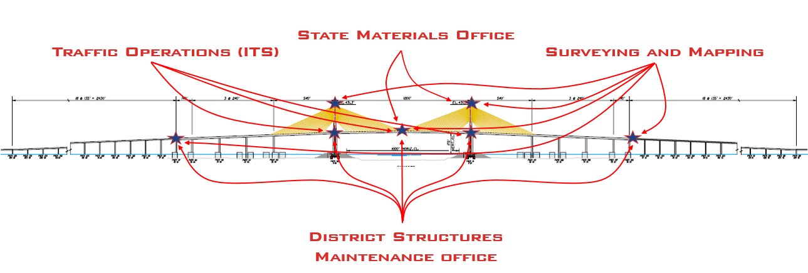
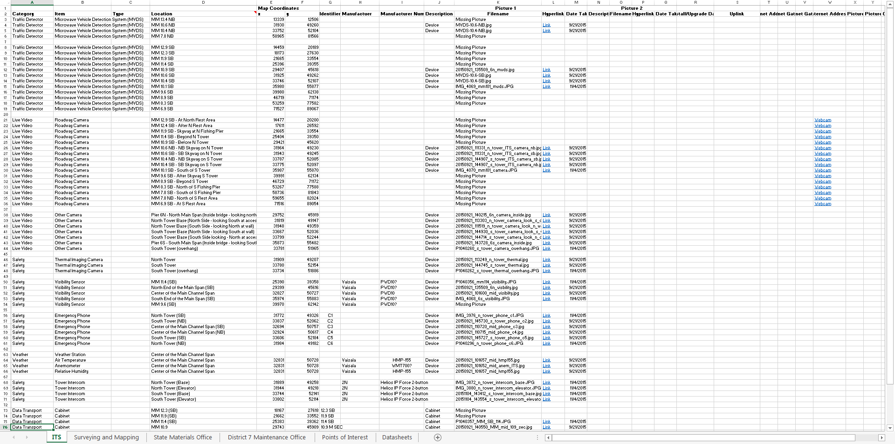
messy…
organized!
Phase 1

Slide 32
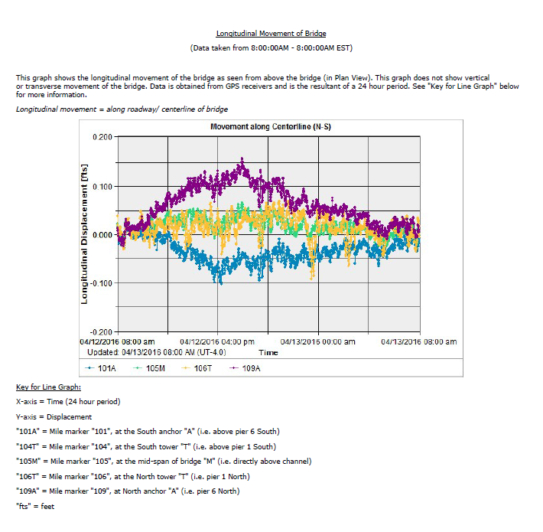
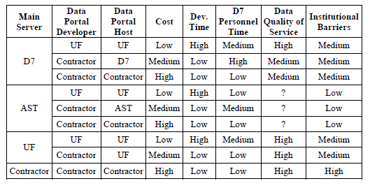
Data, data, and more data…
Data Organized!
Phase 1
Notes:
UF took our inventory and developed an equation that tells us how much data we can expect to get out of our current monitoring system in terms of daily data. This will help us make decisions on how much storage space we will need to store the incoming data. Also, UF has made recommendations on where to store the data.

Slide 33
What have we learned so far?
Establish SHM during design and not after construction
Reliable data transmission source is key (fiber optic vs. modem)
Multiple sensors, on different channels, with various owners is not suggested

Slide 34
Structural Health Monitoring of the Sunshine Skyway Bridge

Slide 35
More sensors!

Slide 36
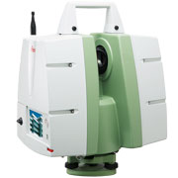
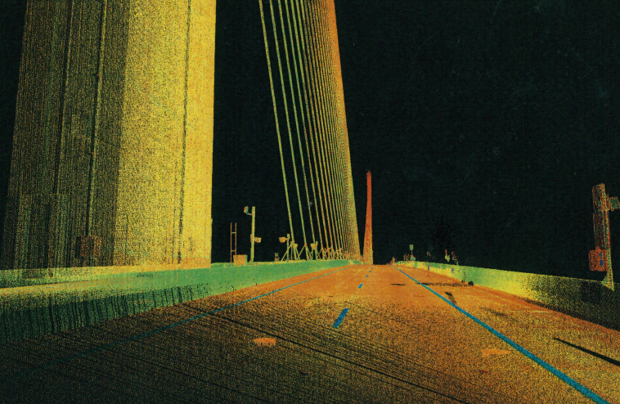
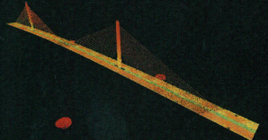
High Definition Survey (HDS) Scan

Slide 37
The Big Picture!
Notes:
Mention alarm system on cell phone

Slide 38
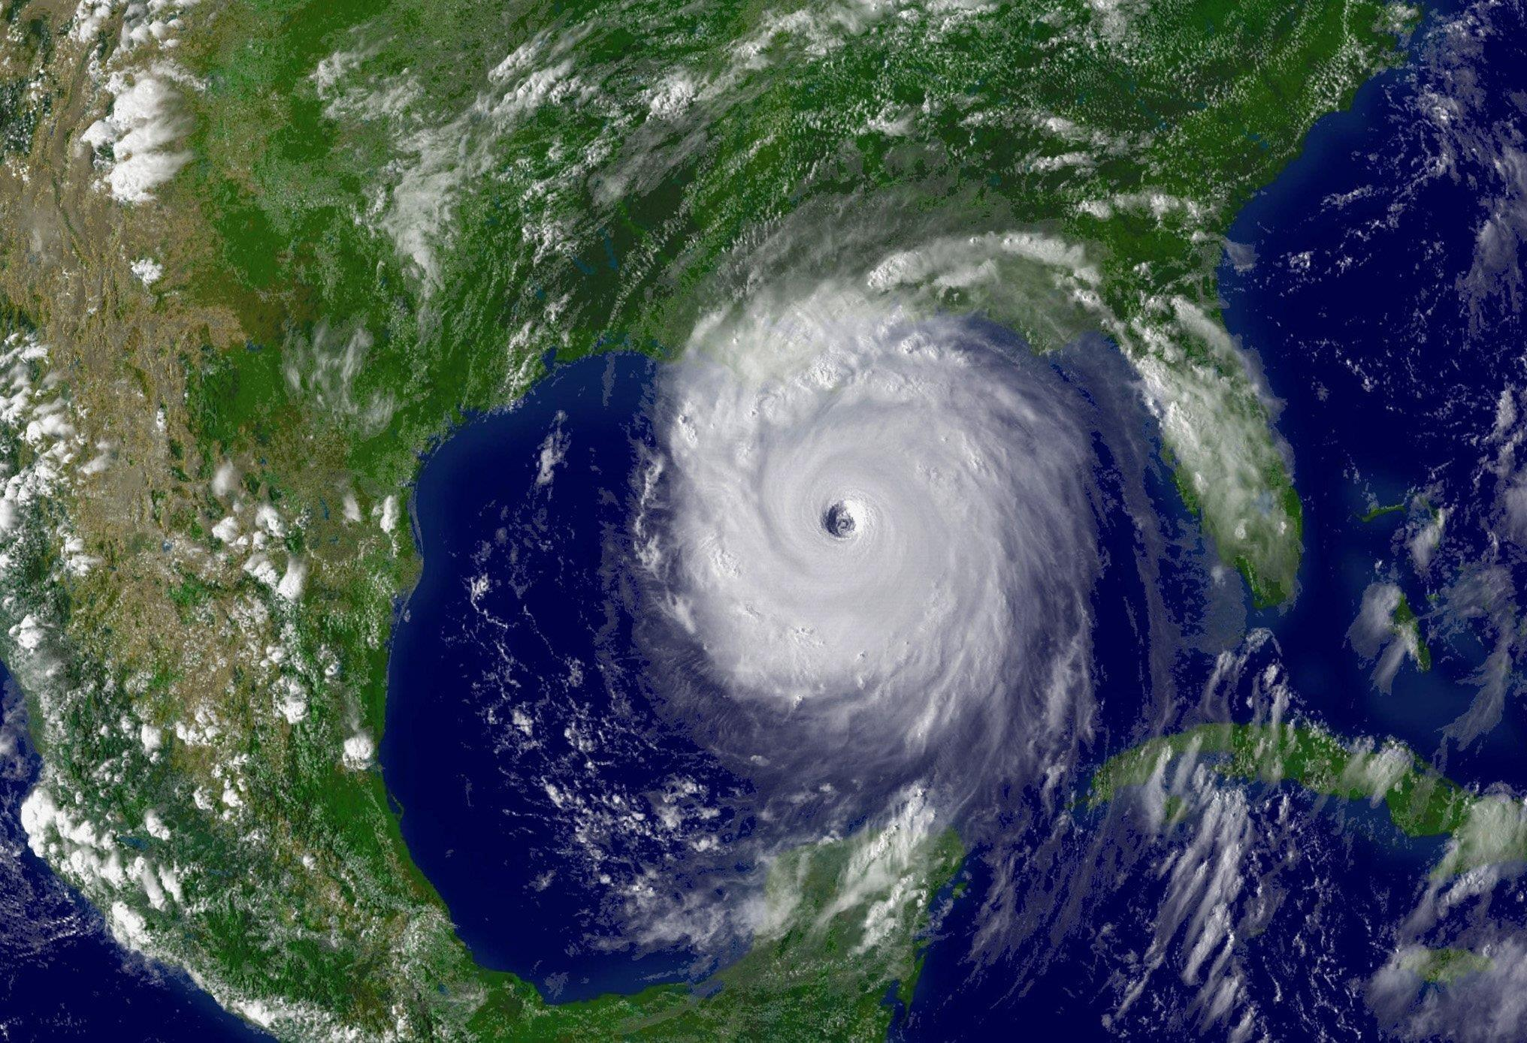
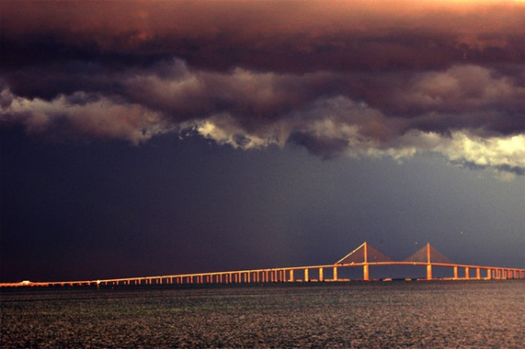

Slide 39
Structural Health Monitoring of the Sunshine Skyway Bridge
Questions

