Slide 1

Steven Peene, PhD
Director of Water Resources
Applied Technology and Management, Inc.
Overview of FDOT’s Statewide Stormwater Management Plan (SSWMP)

Slide 2

What is the SSWMP and why is FDOT required to develop it?
The SSWMP describes activities, methods, and procedures to reduce the discharge of pollutants from the FDOT Phase 1 MS4s
The development of the SSWMP is required under Phase I MS4 permits through FDEP’s NPDES program
Part of the Clean Water Act

Slide 3
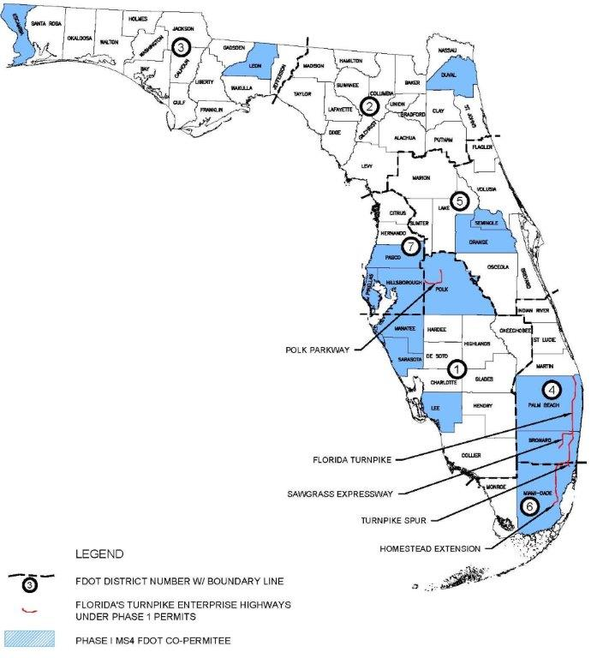
Where does the SSWMP apply?
Legally, the SSWMP only applies in the 15 Phase I Permit Counties
But generally, the practices are applied across the State

Slide 4
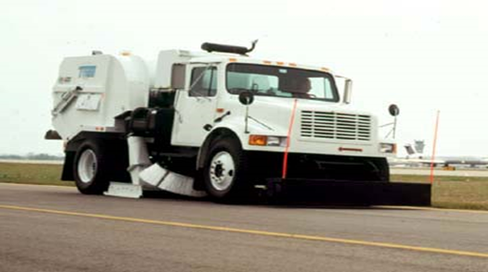
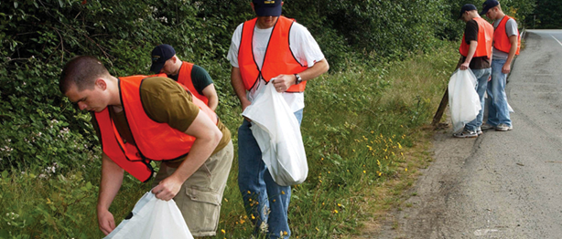
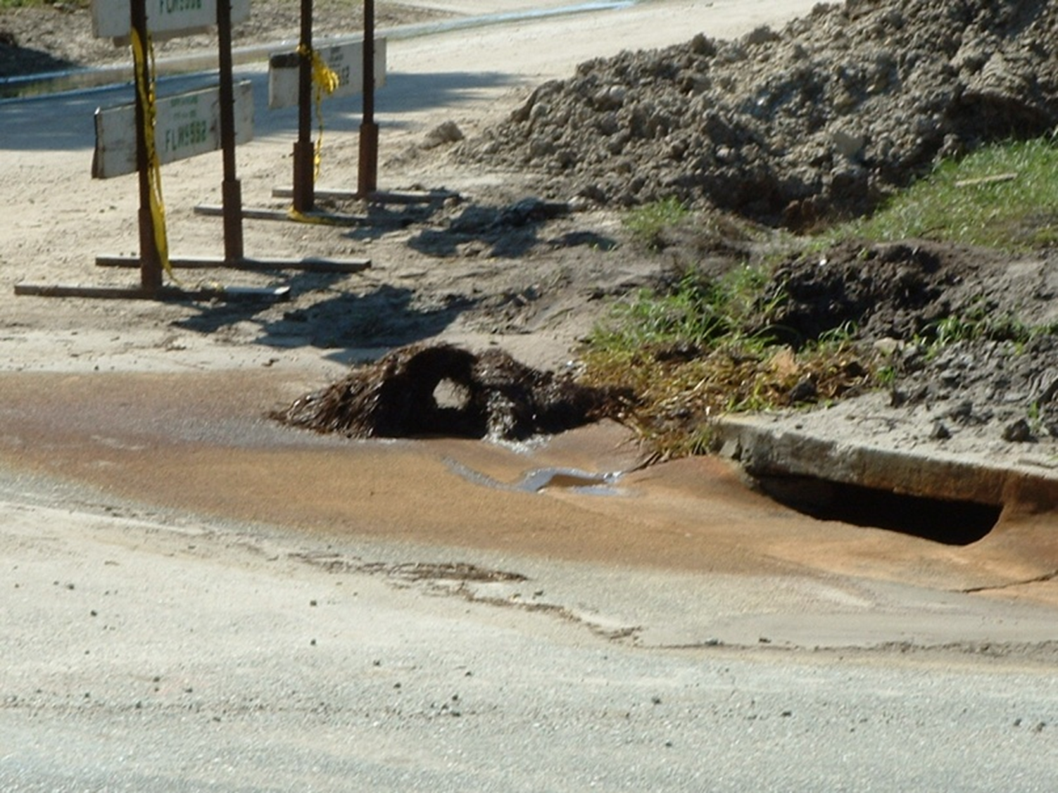
What is in the SSWMP?
Overview of FDOT Structure , Jurisdiction, Authority, and Procedures
FDOT Intergovernmental Coordination
Stormwater Inventory
Stormwater Facilities Inspection and Maintenance
Procedures for New Construction/Development
Erosion Control
Street Sweeping
Litter Control

Slide 5
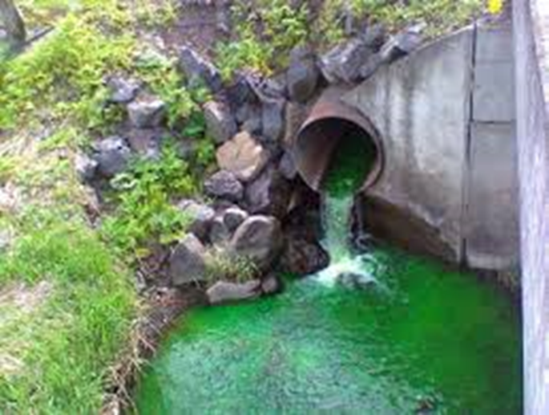
What is in the SSWMP (cont’d)?
Operations Center and Maintenance Yard Stormwater Control
Application of Pesticides, Herbicides, and Fertilizers
Illicit Discharge Detection and Elimination (IDDE) Response and Training
Spill Response and Training
Control of Construction Site Runoff
Public Education
Water Quality Monitoring

Slide 6
Stormwater Facility Inspection/Maintenance
Structural Control | Inspection Frequency | Maintenance Frequency
Wet Detention | New Projects: Once per year for first 2 years. Existing System w/o Chronic Problems: Once per 3 years. Existing System w/ Chronic Problems: Once per year until fixed | As needed per inspection
Dry Retention | New Projects: Once per year for first 2 years. Existing System w/o Chronic Problems: Once per 3 years. Existing System w/ Chronic Problems: Once per year until fixed | As needed per inspection
Dry Detention | New Projects: Once per year for first 2 years. Existing System w/o Chronic Problems: Once per 3 years. Existing System w/ Chronic Problems: Once per year until fixed | As needed per inspection
Dry Detention with Filtration | New Projects: Once per year for first 2 years. Existing System w/o Chronic Problems: Once per 18 months Existing System w/ Chronic Problems: Once per year until fixed | As needed per inspection
Exfiltration Trench/French Drain Systems | New Projects: Once per year for first 2 years. Existing System w/o Chronic Problems: Once per 3 years. Existing System w/ Chronic Problems: Once per year until fixed | As needed per inspection
Dry Treatment Grass Swales | New Projects: Once per year for first 2 years. Existing System w/o Chronic Problems: Once per 3 years. Existing System w/ Chronic Problems: Once per year until fixed | As needed per inspection

Slide 7
Stormwater Facility Inspection/Maintenance
Structural Control | Inspection Frequency | Maintenance Frequency
Pollution Control Boxes | Once per 3 months unless clean out records indicate a more or less frequent schedule is needed | As needed per inspection
Stormwater Pump Stations | Once per 6 months | As needed per inspection
Major Stormwater Outfalls/Canals | Once per year, unless historical operation records demonstrate that a more or less frequent schedule is appropriate. | As needed per inspection
Weirs and Control Structures | MRP | As needed per inspection
Pipes and Culverts | MRP | As needed per inspection
Inlets, Catch Basins Grates, Ditches and Other Stormwater Conveyances | MRP | As needed per inspection

Slide 8
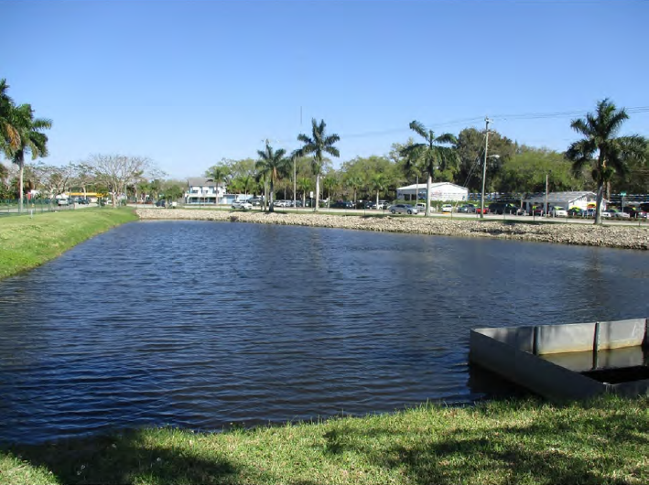
Wet Detention Ponds
1. Remove blockages, restore drawdown capability.
2. Remove accumulated silt.
3. Repair erosion and cracks and remove blockages.
4. Restore healthy grass cover on all slopes and around structures.
5. Remove excess growth of exotics/nuisance species if they impact hydraulic capacity or impede the proper functioning of the pond.
6. Dispose of accumulated sediments properly.
1. Inspect pond/control structure for proper treatment volume drawdown.
2. Inspect pond for silt accumulation in design pond volume.
3. Inspect inflow and outflow structures for cracks, blockages or signs of erosion.
4. Inspect vegetation on side slopes for cover and signs of erosion.
5. Inspect the pond for signs of exotic overgrowth and nuisance species.

Slide 9
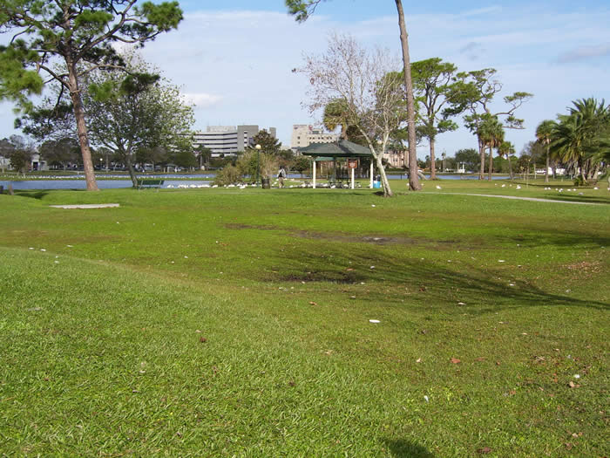
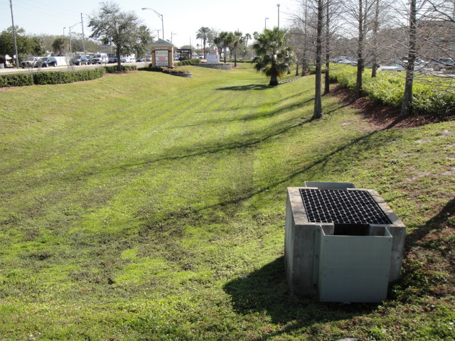
Dry Detention/Retention Ponds
1. Restore the infiltration capacity of the retention basin by scraping, discing, or otherwise aerating the basin bottom.
2. Remove accumulated sediment from retention basin bottom and inflow pipes.
3. Maintain healthy vegetative cover to prevent erosion. Mow as needed.
4. Conduct repairs to prevent undercutting or piping.
5. Remove trash and debris from inflow structures.
6. Note signs of petroleum hydrocarbon contamination and handle appropriately.
1. Inspect pond for proper drawdown, signs of standing water (dead grass) longer than designed, mosquito larvae and/or reduced percolation.
2. Inspect basin bottom for accumulation of silt, lost volume.
3. Inspect for clogging of inflow pipes.
4. Inspect vegetation on side and bottom slopes for proper coverage/no erosion.

Slide 10
Exfiltration Trench/French Drains
1. Conduct minor maintenance measures to restore infiltration rates to acceptable levels.
2. Major maintenance (total rehabilitation) is required to remove accumulated sediment in most cases or to restore recovery rate when minor measures are no longer effective or cannot be performed due to design configuration.
3. Remove trash and debris from diversion facilities and overflow weirs. Clean out sedimentation and oil/grit separators when sediment depth approaches cleanout level and dispose of properly.
4. Remove debris from the outfall or "smart box".
1. If present, inspection ports and observation wells should be checked following three days minimum dry weather for drawdown and sediment accumulation.
2. Inspect upstream appurtenances such as sediment and oil and grit separation traps or catch basins as well as diversion weirs or boxes.

Slide 11
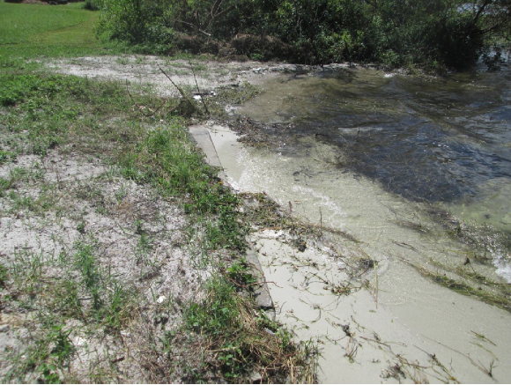
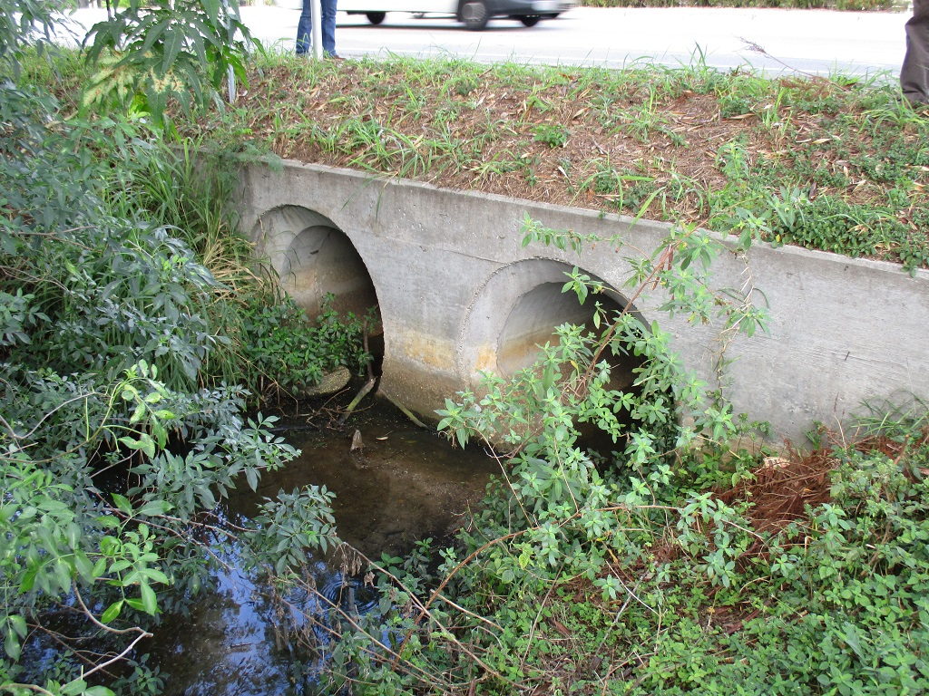
Outfalls
1. Remove debris, litter, and sediments as needed to ensure proper operations. Properly dispose of the litter, sediments and debris collected.
2. Repair any structural damage to assure proper operation.
3. Maintain healthy vegetative cover to prevent erosion of banks near outfall.
4. Ensure that discharges from outfalls are not causing erosion and sedimentation.
Conduct minor maintenance measures to restore infiltration rates to acceptable levels.
1. Inspect outfalls to assure they are not clogged with litter, debris or sediment and they are flowing properly.
2. Inspect for damaged headwalls, seepage, around pipe, erosion of bank around outfall, erosion or sedimentation at outfall discharge point, and damaged or clogged riprap.

Slide 12
Maintenance Yards
Districts are required to develop Standard Operating Procedures (SOP) to reduce potential for introduction of pollutants to stormwater from Maintenance Yards
FDOT procedures for storage, handling and disposal of hazardous materials (including fuels, herbicides, pesticides, etc.)
FDOT procedures for handling and disposal of excess asphalt
Identifies maintenance of documentation
Identifies that annual inspections will occur

Slide 13

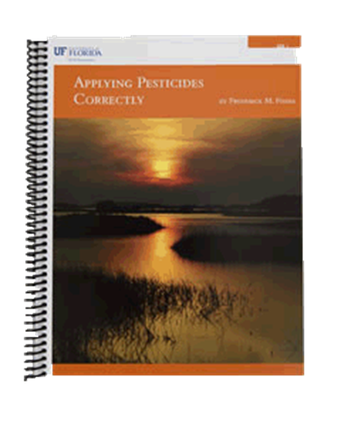

Fertilizer, Herbicides, and Pesticide
Districts are required to develop Standard Operating Procedures (SOP) for the storage, handling and application of fertilizers, herbicides and pesticides
FDOT policy on fertilizer is to limit application to initial periods of seeding and/or turf establishment
Certification required for all FDOT personnel and contractors applying pesticides or herbicides by January 2014
  FDACS
  Green Industry BMP Program
Districts are required to keep a list of persons who are trained

