Slide 1
Roadway Characteristics Inventory (RCI)
Florida Department of
TRANSPORTATION
Kirk Hutchison
Office of Maintenance

Slide 2
RCI
Roadway Characteristic Inventory is a depository of the departments roadway assets.
This would include the amount of lane miles, guardrail, mowing, sidewalk and other items that make up the State Highway System.
Florida Department of Transportation

Slide 3
RCI
There are three major offices that maintain the data in the RCI system.
Planning (Owners of the system)
Maintenance
Traffic Operations
Florida Department of Transportation

Slide 4
RCI
The Office of Maintenance’s budget program depends on the accuracy of the RCI data.
Maintenance is responsible for inputting data into RCI.
The district/area maintenance offices input features and characteristics.
29 Features (description of the characteristic group)
118 Characteristics
Florida Department of Transportation

Slide 5
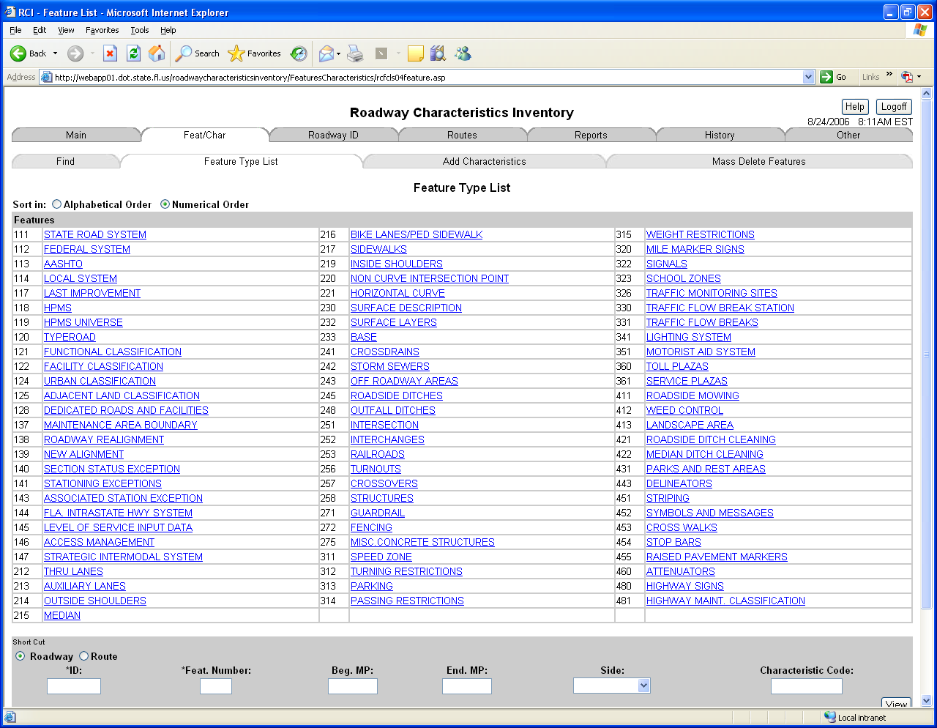
RCI
Florida Department of Transportation

Slide 6
RCI
An example of a feature is:
271 – Guardrail
The characteristics for the guardrail feature are:
Barrier Wall
Double Face Guardrail
Miscellaneous Guardrail
Standard Guardrail
Florida Department of Transportation

Slide 7
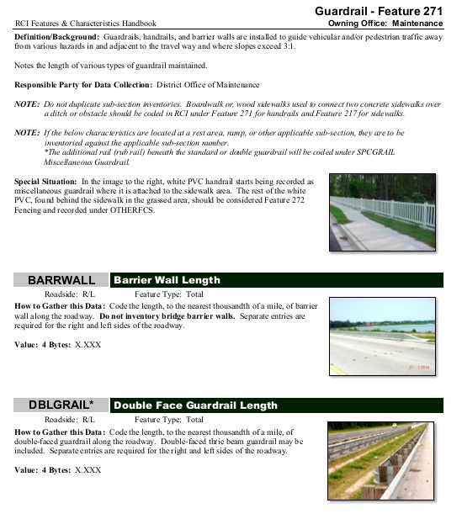
RCI
Florida Department of Transportation

Slide 8
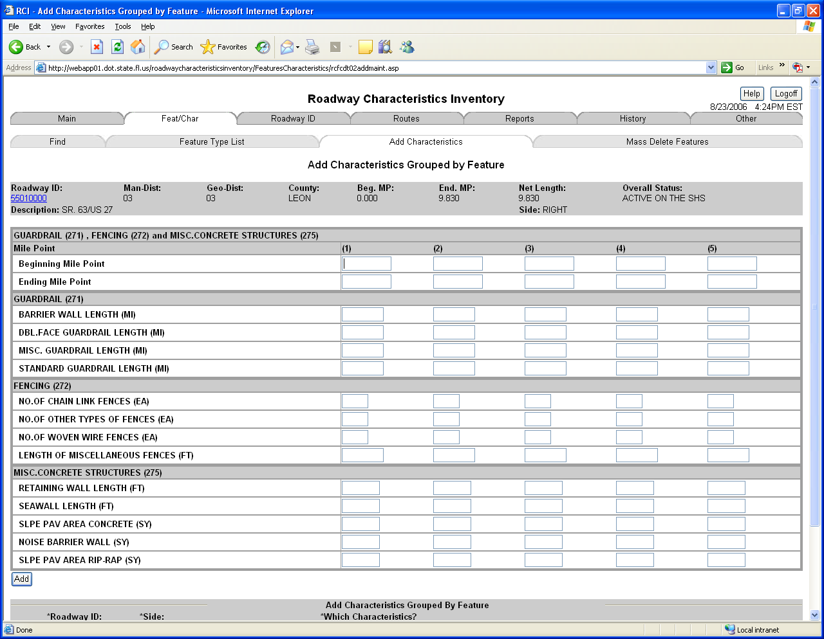
RCI
Florida Department of Transportation

Slide 9
RCI
The Planning Office sets up a roadway number and the status of the road for all new roads constructed. When the status is changed to “active” then the budget program will retrieve the information for calculating the maintenance budget needs.
Florida Department of Transportation

Slide 10
RCI
The Area Maintenance Offices have 90 days to input RCI data after completion of a construction project.
They are also responsible to re-inventory all roads every 5 years.
Since the Maintenance budget is tied directly to the data in RCI we need to verify the information is accurate. (QAR and QC)
Florida Department of Transportation

Slide 11
RCI
Reports will show the total of the characteristics in the RCI database.
You can run a report to find the amount of guardrail in the state, district, cost center or even on a specific road.
Florida Department of Transportation

Slide 12
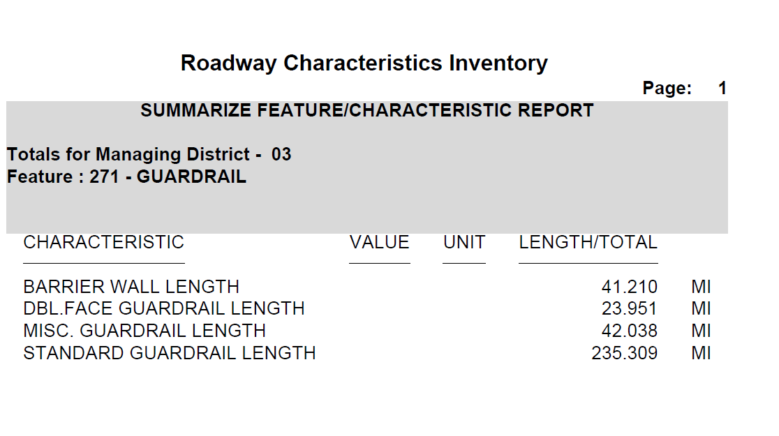
RCI
Florida Department of Transportation

Slide 13
RCI
The Maintenance Budget process accumulates the data from RCI and runs it though a formula program to create the workload for the Maintenance Yard (Area).
This was explained by Mr. Soto.
Florida Department of Transportation

Slide 14
Florida Department of
TRANSPORTATION
Questions???

