Slide 1
Maintenance Management System (MMS)
Florida Department of
TRANSPORTATION
Kirk Hutchison
Office of Maintenance

Slide 2
MMS In-House
MMS is a database of production, personnel, equipment and materials used in maintaining our roads and right of way.
A crew is created from personnel and equipment to perform specific duties.
Florida Department of Transportation

Slide 3
MMS In-House
Florida Department of Transportation

Slide 4
MMS In-House
Florida Department of Transportation

Slide 5
MMS In-House
Florida Department of Transportation

Slide 6
MMS In-House
There are 127 Maintenance Activities.
51 Routine Maintenance Activities
12 Bridge Routine Maintenance Activities
29 Other Maintenance Functions
23 Emergency Maintenance Functions
12 Overhead Functions for Maintenance Employees
Florida Department of Transportation

Slide 7
MMS In-House
Site Numbers are created for specific work to be completed by the maintenance force.
The site number is composed of an activity number with a 4 digit sequential number.
I.E. The first site number for Asphalt Repair would be 4110001.
Florida Department of Transportation

Slide 8
MMS In-House
Florida Department of Transportation

Slide 9
Slide Title
Florida Department of Transportation

Slide 10
MMS In-House
The site number could be for a specific job or an area wide project.
The specific job would be a guardrail hit that we would get reimbursed by the insurance company.
An area wide project could be performing sign cleaning in a county.
Florida Department of Transportation

Slide 11
MMS In-House
After the site number is created, work is assigned to a crew.
When the work is completed for the day, the information is entered back into the MMS database.
Florida Department of Transportation

Slide 12
MMS In-House
Florida Department of Transportation

Slide 13
MMS In-House
At a minimum of every two weeks the information is exported to a transfer file and sent to a Mainframe SAS library for storage.
From this location the data is sent to other systems.
Florida Department of Transportation

Slide 14
MMS In-House
Personnel hours are accumulated and sent to People First for time sheet data.
Equipment usage is entered into a file that is sent to Dept of Management Services (DMS) along with other equipment usage not reported to the MMS.
Many reports can be created from the information that is stored in the mainframe.
Florida Department of Transportation

Slide 15
MMS In-House
Florida Department of Transportation

Slide 16
MMS In-House
Florida Department of Transportation

Slide 17
MMS Contracts
Contract information is collected and paid through the ASSHTOWARE software, formerly known as TRNS*PORT.
This software allows the bidding, letting, awarding and management of contract projects.
Florida Department of Transportation

Slide 18
MMS Contracts
The AASHTOWARE/MMS interface is an application created by the Office of Information Technology at DOT.
Once a week the transfer is performed to update the MMS Contract Library with data that has been processed since the last upload.
Florida Department of Transportation

Slide 19
MMS Contracts
When an estimate is approve through AASHTOWARE, the information is then flagged for transferring to the MMS Contract library.
The pay item data is sent to the interface where MMS Activity and units are entered.
Florida Department of Transportation

Slide 20
MMS Contracts
Florida Department of Transportation

Slide 21
MMS Contracts
Florida Department of Transportation

Slide 22
MMS Contracts
Florida Department of Transportation

Slide 23
MMS Contracts
Florida Department of Transportation

Slide 24
MMS Contracts
Florida Department of Transportation

Slide 25
MMS Contracts
Florida Department of Transportation

Slide 26
MMS Contracts
Florida Department of Transportation

Slide 27
MMS Contracts
Asset Maintenance is different since the contractor receives a set amount each month no matter what work is done.
The contractor reports the number of units that were completed for each Maintenance Activity with no cost associated.
Florida Department of Transportation

Slide 28
MMS Contracts
Florida Department of Transportation

Slide 29
MMS Contracts
Florida Department of Transportation

Slide 30
MMS Contracts
Florida Department of Transportation

Slide 31
MMS Contracts
Florida Department of Transportation

Slide 32
MMS Contracts
Florida Department of Transportation

Slide 33
MMS Contracts
Florida Department of Transportation

Slide 34
MMS
After all the information is collected we can run production and cost reports for both In-House and Contract data.
These reports give us a cost per unit to perform work by either in-house crews or contract crews.
At the end of the fiscal year, unit cost reports are generated to assist in the creation of the unit cost for future years.
Florida Department of Transportation

Slide 35
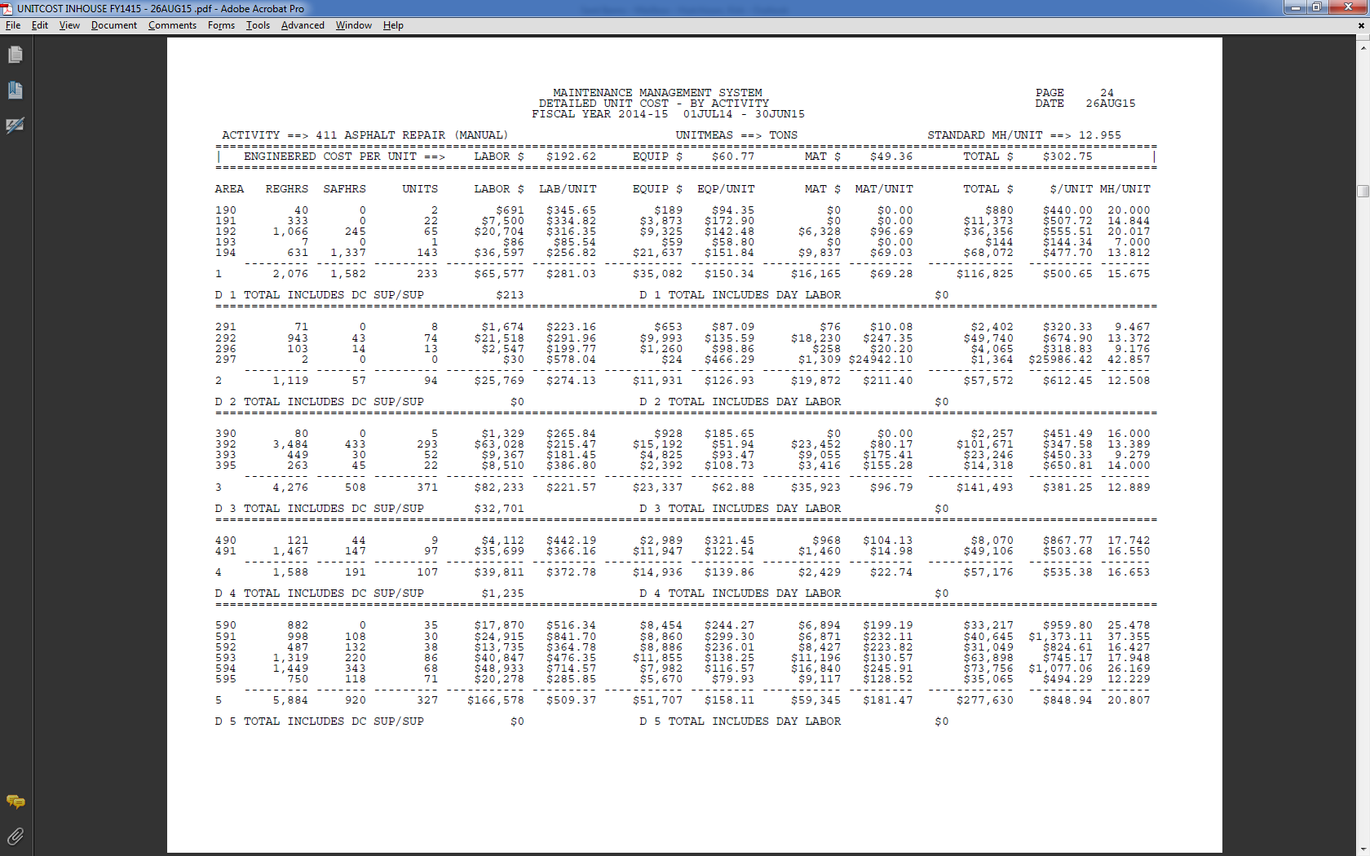
MMS
In-House Unit Cost Report, by activity
Florida Department of Transportation

Slide 36
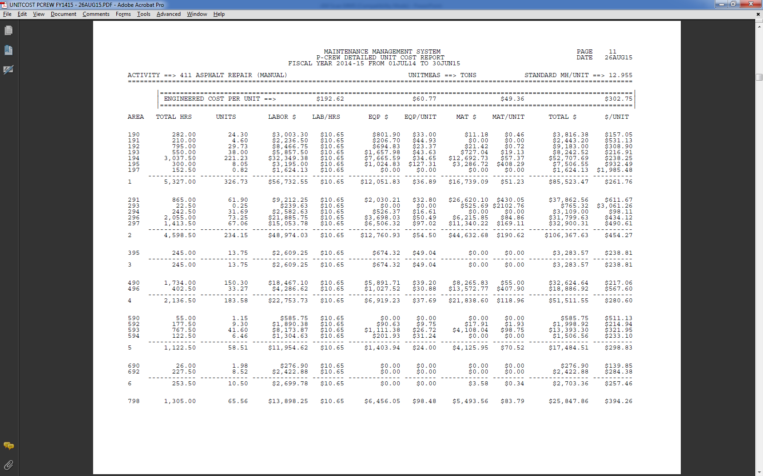
MMS
P-Crew (Department of Corrections Inmate Crews) Unit Cost Report.
Florida Department of Transportation

Slide 37
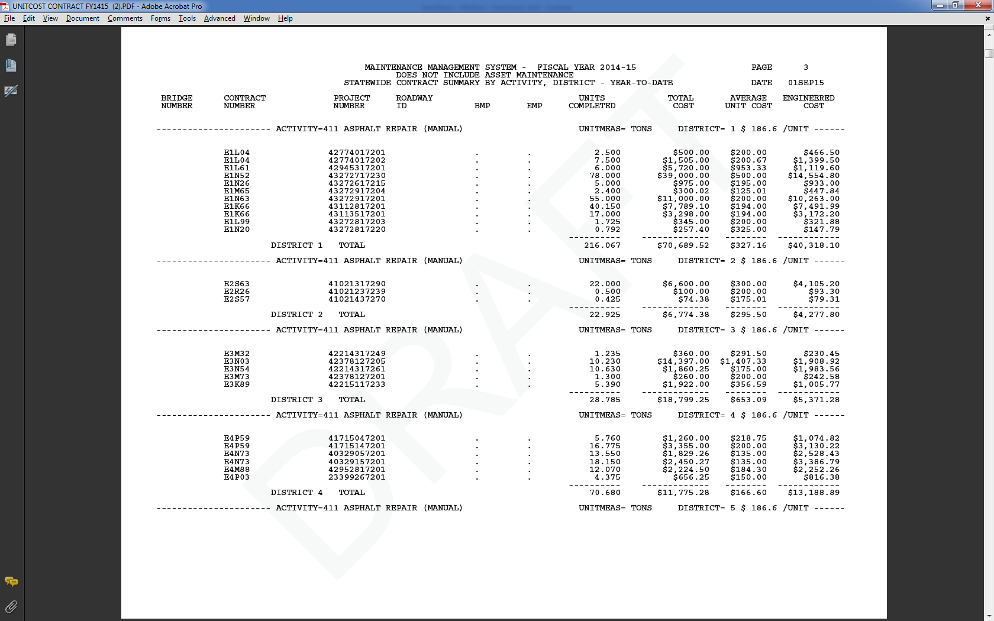
MMS
Contract Unit Cost Report.
Florida Department of Transportation

Slide 38
Florida Department of
TRANSPORTATION
Questions???

