Slide 1
2016 - The Year of the Team

Slide 2
First………….a story….
We need an inspector to look at some lights tonight…
No one available -- short notice
“What about the District-wide Maintenance Engineering Services Contract”?
We need one of “our guys” to look at this
What would you do?
To be continued…..

Slide 3
Why “The Year of the Team”?
Things are changing…
Less FDOT employees
More performance contractors
Less engineering experience and expertise
More engineering consultants
Less Builders and Boomers
More Generation X and Millennials (50% Millennials by 2020)
More technology
More environmental and safety rules

Slide 4
Who is your TEAM?
AUDIENCE PARTICIPATION!
Department Employees
Consultants
Performance Contractors
Other Contractors

Slide 5
Building your Team
AUDIENCE PARTICIPATION!
Staff Meetings
Food events
Recognition
Awards Ceremony Celebration
Meaningful daily interactions

Slide 6
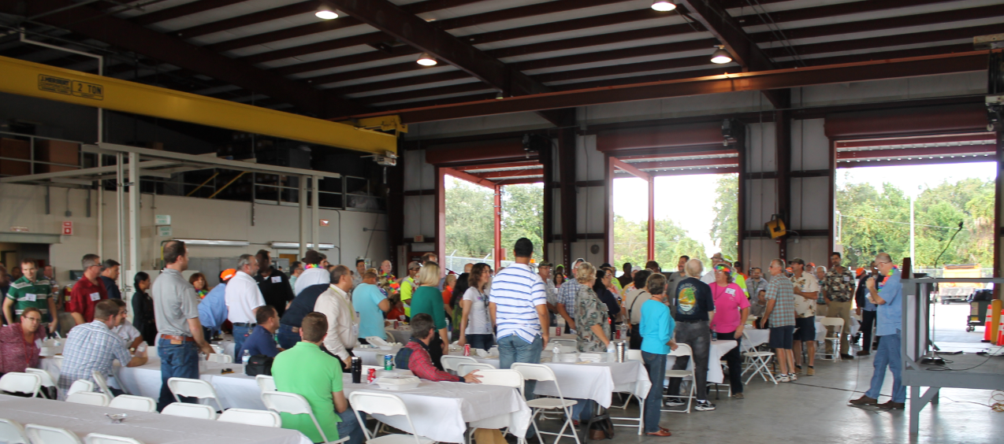
Building your Team
Team Expo
Seminars, presentations, safety competition
Almost 200 attendees

Slide 7
90/10
90% of our team is external!

Slide 8
Something to consider….
Staff Meetings
Food events
Recognition
Awards Ceremony Celebration
Meaningful daily interactions

Slide 9
How are you building your “90% Team”?
AUDIENCE PARTICIPATION!
Should consultants attend internal staff meetings?
Contractors contacting citizens
A request to deal with “Real FDOT” staff
What decisions can only be made in-house?

Slide 10
Strong TEAM benefits
High levels of trust
Higher levels of employee satisfaction – internal and external
High levels of performance
High levels of customer service
Attract high performing industry partners
Better Maintenance and Operations for less $

Slide 11
Back to the story…..
Found a DOT employee to work during the night…
This occurred while I was working on this presentation.

Slide 12
Quote:
At some point we’re going to have a disagreement. I don't want the first interaction we have to be about that disagreement.
J. Edward Tyler
Thank you!

