Slide 1
Outdoor Advertising: Administration and Proposed Legislation
Emily McGraw, PE
October 25, 2017
Southeastern Regional Maintenance Conference

Slide 2
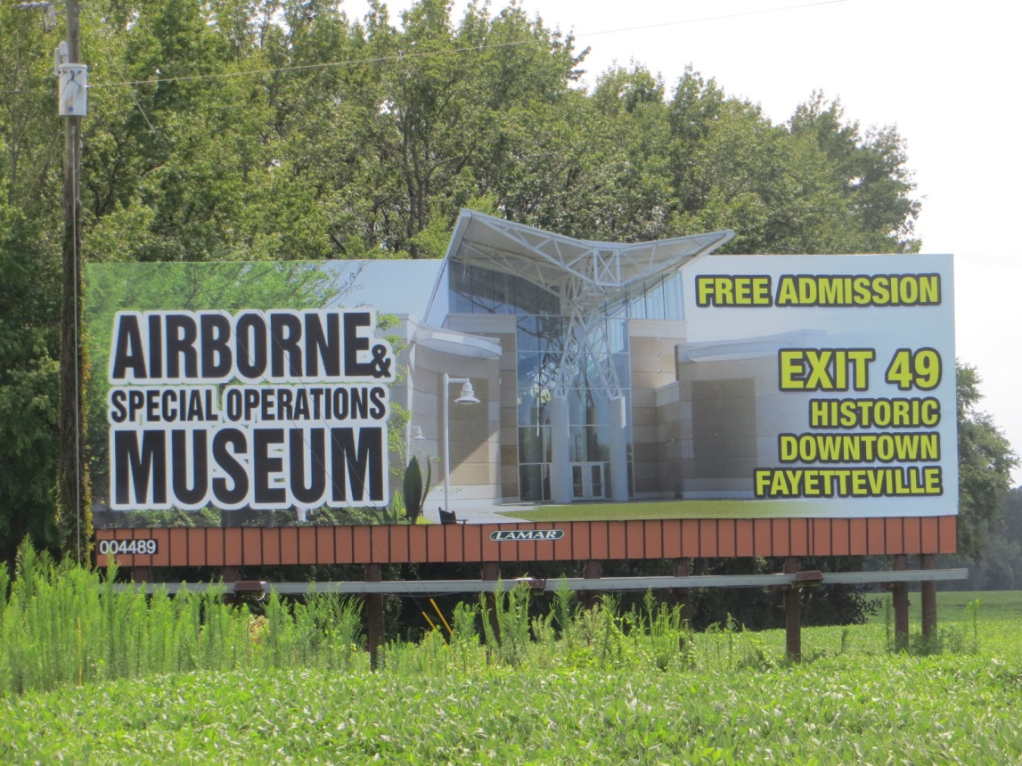
How Many Signs does NCDOT Regulate?
2015 Off-Premise Sign Regulatory Program Biennial Report to NCGA:
7757 Permitted Signs
5587 Conforming Signs
2112 Non-conforming signs
Notes:
Portable Message signs leaving triad heading east

Slide 3
Historical ODA Administration
District Office involvement 1972 - 2012
40 District Engineers & Technicians involved in day to day administration
Maintained paper inventory
Permitted new signs
Facilitated permit renewals
Central Office
Overall coordination of the ODA program
Provided training and support to the 40 District Office
Liaison to Secretary’s Office and Attorney General’s Office for disputes
Notes:
Joint Force Headquarters (JFHQ) – Activated SERT Location

Slide 4
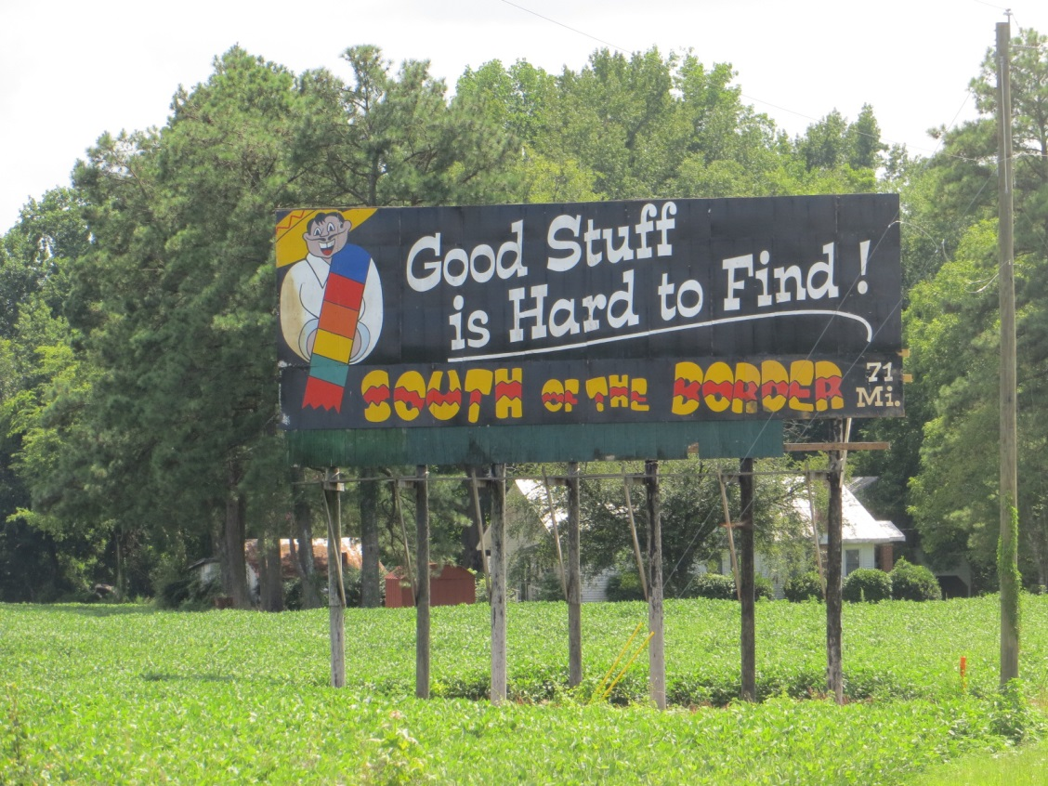
Change to Contract ODA Administration
Streamline Processes
Increase Efficiency
Provide Consistency
Notes:
US 74 Robeson/Columbus County Line

Slide 5
Current ODA Administration 2012-Present
6 Contract Regional Technicians
Develop GPS electronic based inventory
Investigate new sign permit applications
Facilitate renewals
Responsible for approximately 1300 signs
Central Office
Overall coordination of the ODA program
Provided training and support to the 40 District Office
Liaison to Secretary’s Office and Attorney General’s Office for disputes
Notes:
I-95 Flooding Mile Marker 18.5
Fayetteville
NC 55 south of Sandy Bottom

Slide 6
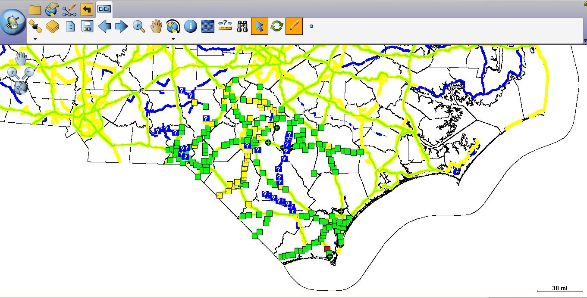
A New Inventory!
Notes:
One of the I-95 Southbound Detours

Slide 7
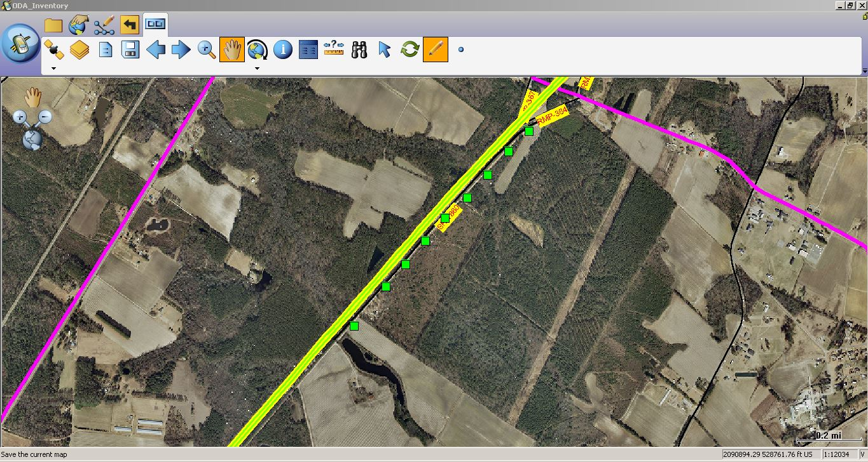
Sign Location Inventory
Notes:
One of the I-95 Southbound Detours

Slide 8
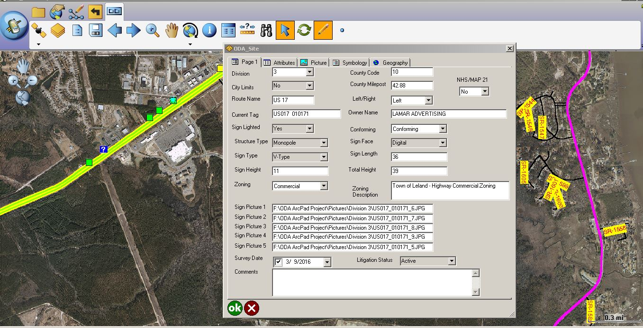
Permit Information with Inventory
Notes:
One of the I-95 Southbound Detours

Slide 9
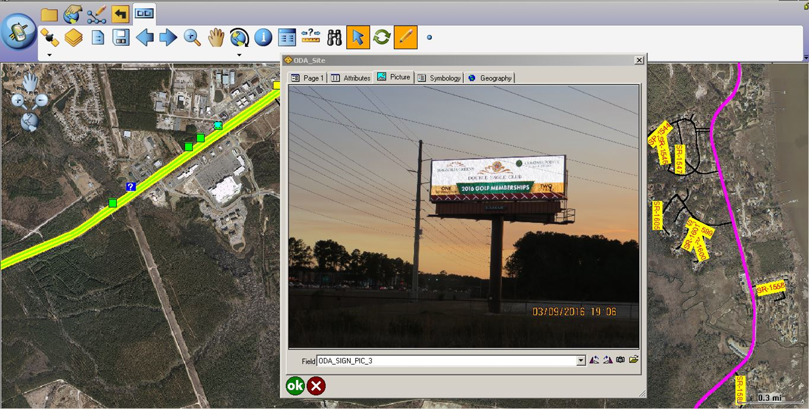
Pictures with Inventory
Notes:
One of the I-95 Southbound Detours

Slide 10
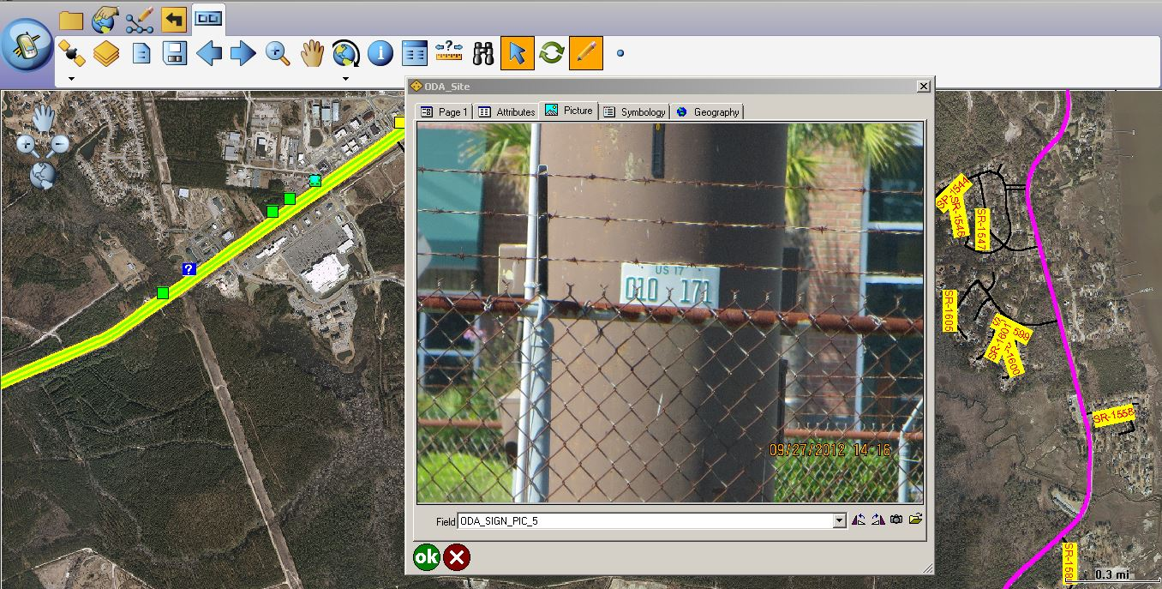
Pictures with Inventory
Notes:
One of the I-95 Southbound Detours

Slide 11
Recent Legislation
2011 – SB 183 Modified SVR cut zone and addressed SVR Fees (Passed)
2013 – HB 74 Addressed Modernization and SVR (Passed)
2015 – SB 320 (Failed)
Provides factors for billboard valuations
Billboards could remain in place until work on a project is within 100’
Modified SVR fees and renewal fees
Notes:
Moving Resources from Division 5 to Division 4

Slide 12
Recent Legislation
2017 – HB 173 (Failed)
Provides factors for billboard valuations
Modifies cut zones and allowed for cutting of medians
Modifies SVR fees
2017 – 4 More Bills (Failed)
HB 578 – Modifies SVR fees and cut zones (medians included)
HB 579 – Addresses just compensation (valuation)
HB 580 – Modifies relocation of billboards & increases height
HB 581 – Addresses modernization
2017 Supreme Court Ruling in NCDOT vs. Adams Outdoor Advertising
Notes:
Moving Resources from Division 5 to Division 4

Slide 13
What is happening in your state with ODA?
Are you seeing proposed legislation addressing ODA?
What initiatives do you see industry promoting?
How often are you having to defend and/or update your ODA program?
How are you addressing modernization of billboards?
How are you valuating billboards?
What are your typical relocation costs?
Notes:
Moving Resources from Division 5 to Division 4

