Slide 1

Impact Attenuator Classification

Slide 2
Influencing Factors
SCDOT Engineering Directive #42
Existing Attenuator Systems
AMOTIA Conference

Slide 3
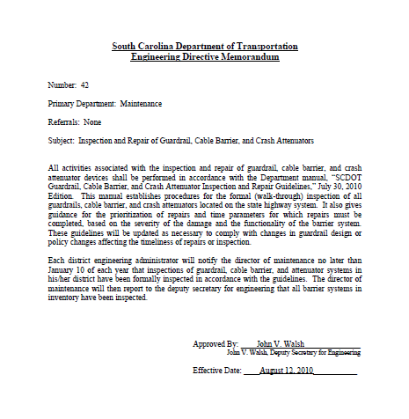
ED #42
Notes:
Engineering Directive #42 defines the replacement policy for SCDOT.

Slide 4
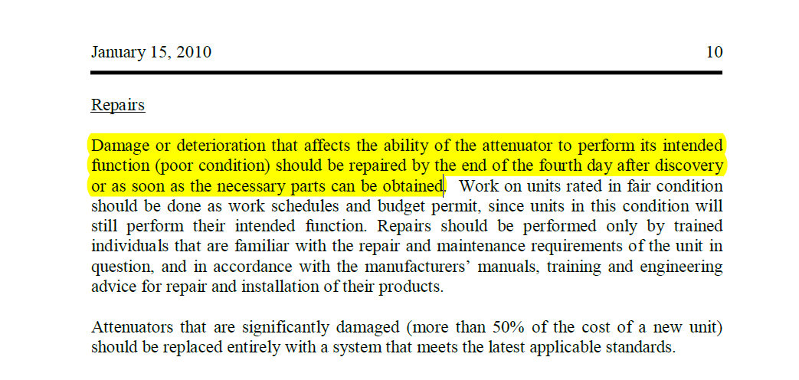

Slide 5
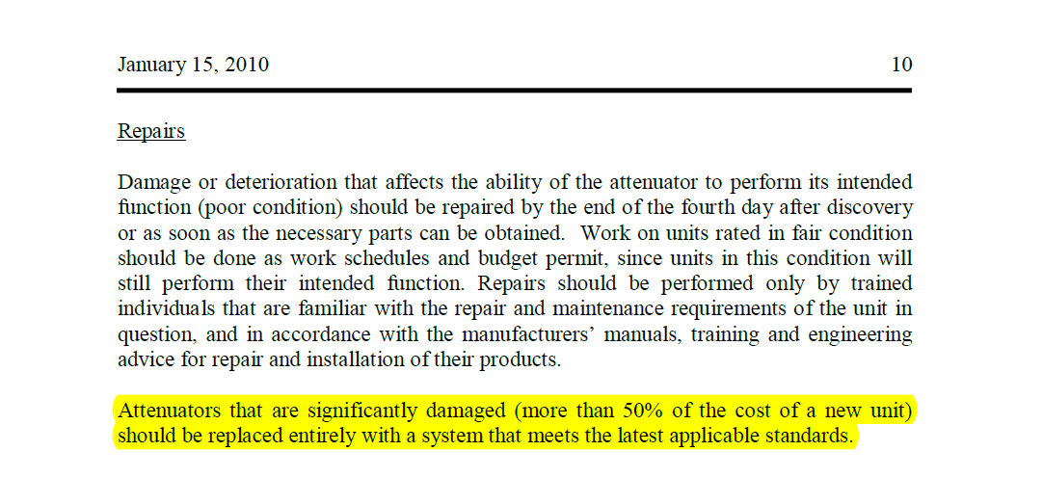

Slide 6
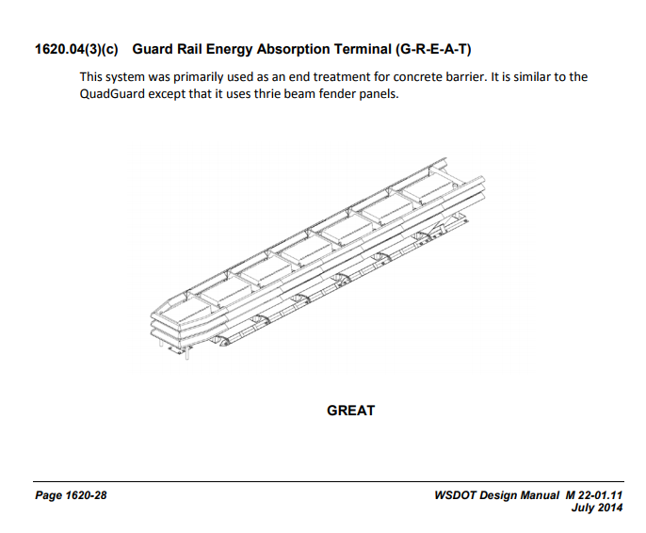

Slide 7
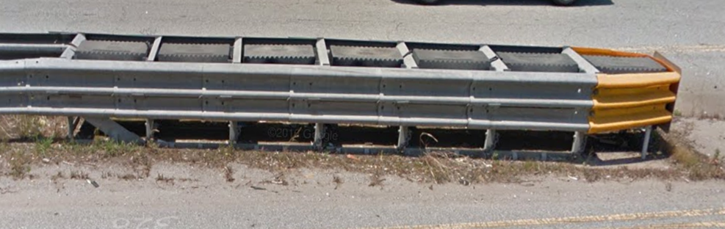
GREAT (Guard Rail Energy Absorbing Terminal)
Existing Impact Attenuators
Notes:
GREAT impact attenuators are very common in SC.

Slide 8
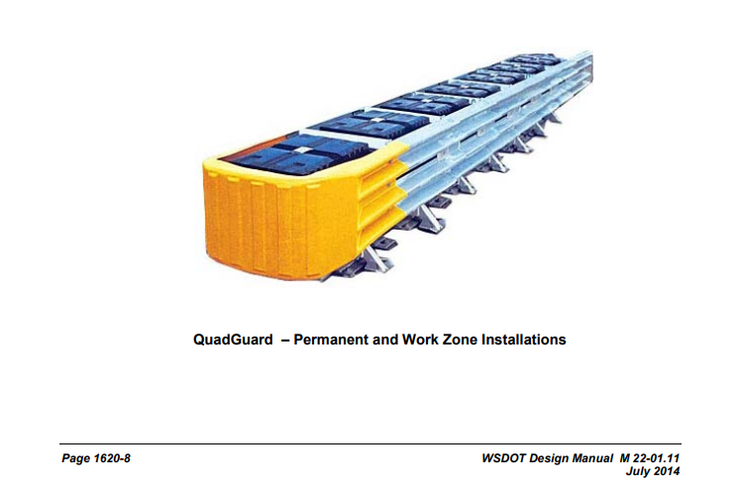

Slide 9
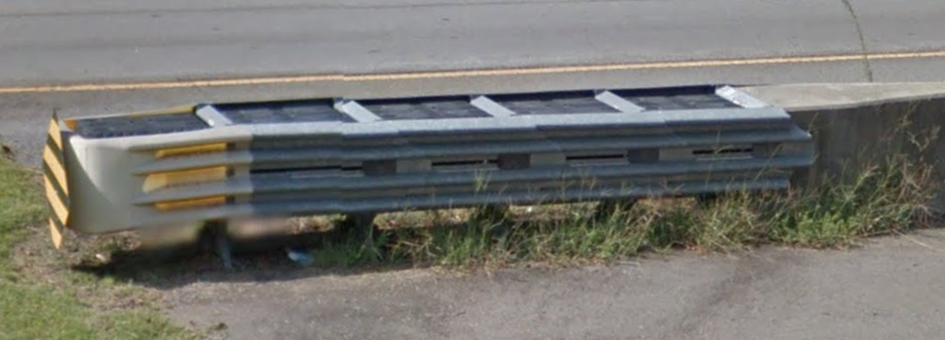
QuadGuard II
Existing Impact Attenuators
Notes:
The other partially reusable impact attenuator throughout SC is the QuadGuard II. These units are very common throughout SC because they are relatively inexpensive. The most common way I.A.s are installed in SC are with a construction project. Historically, SCDOT only had one pay item for a crash attenuator and did not specify beyond appropriate for the specific application. As a result, we ended up with a lot of attenuators with a low initial cost, but were expensive to repair.

Slide 10
AMOTIA Conference
Notes:
AMOTIA Conference – Work Area Protection Corporation was presenting to Asset Management contractors, telling them that a smart way for them to cut their maintenance cost on the road they were managing was by replacing the existing attenuators with a SCI (Smart Cushion Innovations) Smart Cushion. He indicated that they could cut the cost of the repair and the time to repair the units, thus reducing the worker exposure. The company representative, Jeff Smith, presented many charts and graphs indicating such. This specific table shows the material cost that the attenuator manufacturers reported to NCHRP with the crash tests.

Slide 11
AMOTIA Conference
Notes:
This is a similar chart that was adjusted by Jeff Smith based on state DOT’s contract material cost for the replacement of the items that were identified as damaged during the NCHRP crash tests.

Slide 12
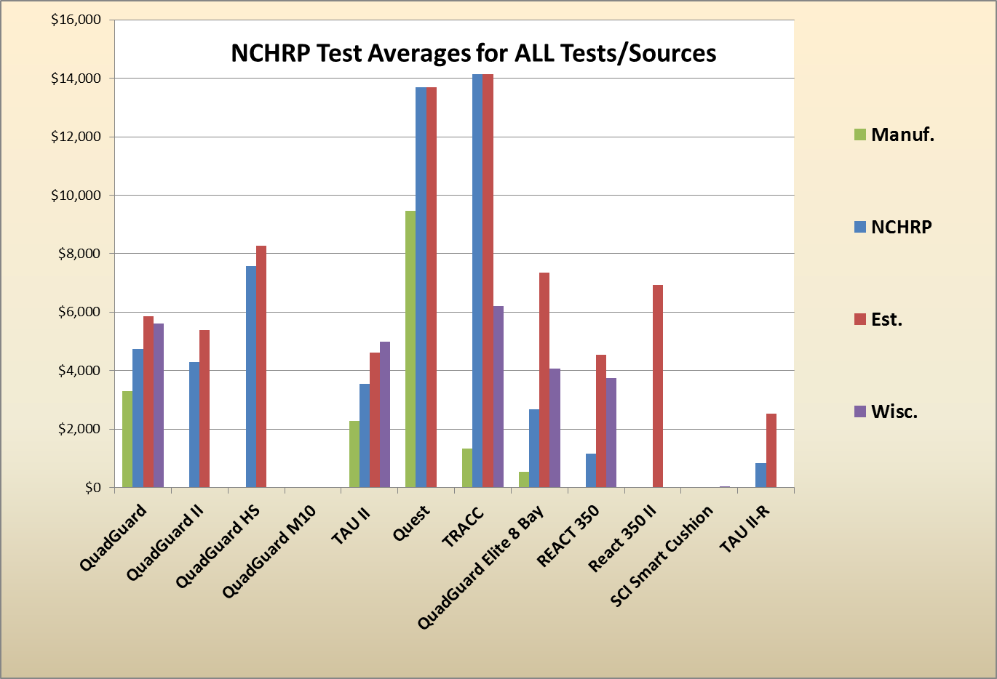
Notes:
This is a similar, visual graph with similar information. This also includes material cost from a pooled fund study performed by Wisconsin DOT.

Slide 13
Notes:
This is a similar chart indicating anticipated cost per year by type of unit based on hit frequency.
I did verify that the SCI unit that was tested for the NCHRP 350 certification sustained three different hits with only the replacement of the shear bolts between each hit.

Slide 14
Replacement Contract
50 Most Frequently Hit Units
  The approved attenuators shall be resettable and reusable and designed for the characteristics of each specific location. The attenuators approved for selection and installation shall be one of the following:
Approved Units:
Smart Cushion Innovations (SCI)
QuadGuard Elite
Tau-II-R
Notes:
APPROVED ATTENUATORS:
The approved attenuators shall be resettable and reusable and designed for the characteristics of each specific location. The attenuators approved for selection and installation shall be one of the following:
Smart Cushion Innovations (SCI)
QuadGuard Elite
Tau-II-R
All attenuators must be appropriate and designed for the application and for which they are used. Four locations will require attenuators that are custom designed to protect areas that are extra wide hazards. Eleven units will require “Wide” units that are designed to protect hazards that are wider than 36 inches. The remaining thirty-four units should be standard units protecting hazards that range from 24 to 36 inches wide.

Slide 15
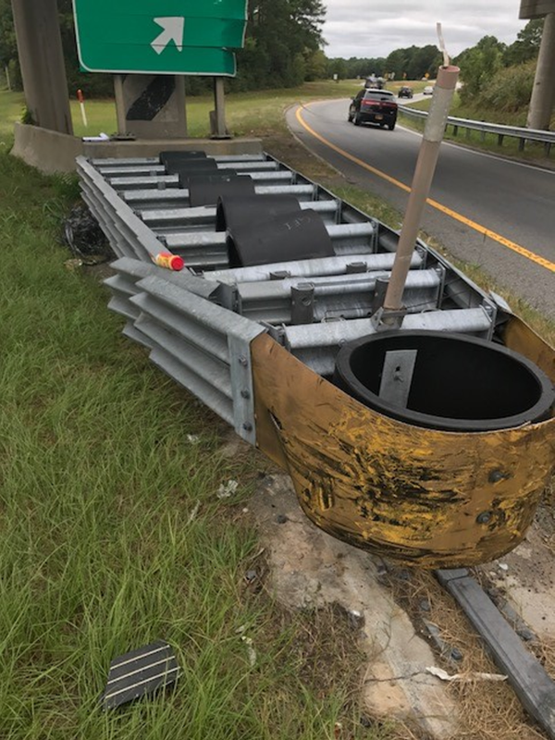
Contract Winner – QuadGuard Elite

Slide 16
Quadguard Elite Concerns
  Time requirement for repair (ED #42)
  Worker safety (stored energy)

Slide 17
Collapsed QuadGuard Elite
Restoring Collapsed System
1) System Restoration
Before starting this procedure, please read and understand the foregoing “Warning” statement. The following instructions outline a set of steps for positioning a large vehicle up against a
compressed system to prevent unexpected system spring-back while maintenance workers are attempting to repair the system.
A) Position a truck of not less than 6000 kg [13,000 lbs.] centered on the system just in front of
the Nose Assembly. The truck should be presenting its strongest bumper to the system. The selected bumper’s height should be such that the center of the bumper rests on the middle of the system’s Nose Assembly (approximately, 610 mm [24”] in height).

Slide 18
Collapsed QuadGuard Elite
B) Drive the truck so that the bumper displaces the systems Nose Cylinder approximately
150 mm [6”]. In the absence of the Nose Assembly, place a protective material between the bumper
and the leading Diaphragm leaving approximately 25 mm [1”] gap between the protective material and
the vehicle’s bumper. The driver should remain in the vehicle depressing the brake pedal after the
vehicle has been placed in position.
Warning: Once the leading bumper is over the system’s Monorail, the vehicle may be subject to
impact by the system due to an unexpected restoration. The driver should be wearing a seat belt and
have the vehicle in the lowest possible gear when approaching the system. In the event that the
system unexpectedly deploys before Step B is completed, the driver should apply the brakes
immediately, bringing the vehicle to a controlled stop. The driver should then put the vehicle in
neutral while still applying the brakes. Gradually release the brakes, allowing the system
to push the vehicle back in a safe and controlled manner.

Slide 19
Collapsed QuadGuard Elite
C) It should now be safe for a maintenance worker to inspect the system to determine where mechanical binding is present. Remove all debris from the system prior to checking for binding. The binding will probably be located at the monorail guides on the forward-most Diaphragm(s) or Fender Panels. Cautiously using a pry bar or jostling the system with a vehicle may aid in releasing the mechanism of binding. Once released,
the driver should allow the system to extend in a safe and controlled manner.

Slide 20
Quadguard Elite Concerns
  Time requirement for repair (ED #42)
  Worker safety (stored energy)
  Need for repair (re-boundable)
  Hit frequency (when to replace?)

Slide 21
Quadguard Elite Product Manual – Life Expectancy
  Environment
  Except due to damage, it is anticipated that he cylinders may survive in a highway environment for a period ranging for five to fifteen years from the date of deployment.
  Impact
  Life expectancy is also affected by:
    1. The number of impacts
    2. The severity of the impacts
    3. The temperature at the time of the impacts
Notes:
SCDOT doesn’t document the number of hits for specific locations. Therefore, there is concern regarding when the HDPE cylinders need to be replaced.

Slide 22
PROBLEMS
Difficulty in meeting repair requirement
  Two Types of Impact Attenuators
  Partially Reusable Units
  Self-Restoring Units with Life Cycle Concerns
Costly repairs
Notes:
Still have a problem.

Slide 23
SCDOT’s Solution
Classification of Impact Attenuators
  Class A – Low Maintenance
  Class B – Self Restoring
  Class C – Partially Reusable
  Class D - Sacrificial
Define appropriate application for classes

Slide 24
Category Classes for Crash Cushions
Class A - Low Maintenance
Category Class A systems require the fewest number of repair parts and have the quickest reset time of all the other category classes. Products within this category class may be used in any location where category class A, B, C, or D has been specified. These systems are preferred on the high volume, high speed areas to minimize worker exposure and lane closure time.

Slide 25
Category Classes for Crash Cushions
Class B - Self Restoring
Category Class B systems are designed to rebound after a design hit to a position that allows the product to sustain a 2nd hit before resetting. These systems generally require significantly fewer repair parts than category C and D systems, but may be periodically subjected to replacement costs of parts vulnerable to weather or repeated hits. These systems are preferred on high volume locations where hit potential is high.

Slide 26
Category Classes for Crash Cushions
Class C - Partially Reusable
Category Class C systems are designed with sacrificial energy absorbing components within a mostly reusable frame/rail. These systems will generally require replacement of the energy absorbing parts as well as repair and adjustment of the frame/rail system. These systems are preferred on moderate to high volume locations where hit potential is moderate or where the site does not accommodate the length required for transitions and sacrificial guardrail end treatments.

Slide 27
Category Classes for Crash Cushions
Class D - Sacrificial
Category Class D systems are limited to flexible & semi-rigid end treatments, and impact attenuators, and are designed for one hit before the system requires replacement. If the system requires a constructed foundation, the foundation should not be damaged by a design hit.

Slide 28
Class A - Low Maintenance
Low Maintenance is suggested when the site has any of the following conditions:
ADT > 70,000
Adjacent Lane Volume (Lane ADT) > 10,000
Gore area with multiple lanes both sides of gore
Sites with more than 2 impacts per year are likely (if known)

Slide 29
Class B - Self Restoring
Self Restoring is suggested when the site has any of the following conditions:
ADT > 20,000
Adjacent Lane Volume (Lane ADT) > 5,000
Sites with more than 1 impact per 2 years are likely (if known)

Slide 30
Class C - Partially Reusable
Partially Reusable is suggested when the site has any of the following conditions:
ADT < 20,000
Sites with less than 1 impact per 2 years is expected (if known)
Notes:
3.4.1 Pre-NCHRP 350
Pre-NCHRP 350 safety hardware devices will be evaluated for replacement based upon the following considerations:
▪ Compatibility with existing barrier connections
▪ Compatibility with existing geometry/site conditions
▪ Availability of tested options
▪ Proximity to clear zone
▪ Future projects that are programmed for the site
Emphasis should be placed on upgrading to a MASH-2016 compliant option. If no MASH-2016 compliant option is deemed feasible based upon the considerations, it is acceptable to utilize a NCHRP 350 compliant option. If neither MASH-2016 nor NCHRP 350 compliant options are deemed feasible based upon the considerations, it is acceptable to replace in-kind.
3.4.2 NCHRP 350
NCHRP 350 full and partial compliant safety hardware devices may be retained if repairable in accordance with manufacturer specifications.
NCHRP 350 full and partial compliant safety hardware devices that are damaged beyond repair will be evaluated for replacement based upon the following considerations:
▪ Compatibility with existing barrier connections
▪ Compatibility with existing geometry/site conditions
▪ Availability of tested options
▪ Proximity to clear zone
▪ Future projects
Emphasis should be placed on upgrading to a MASH-2016 compliant option. If no MASH-2016 compliant option is deemed feasible based upon the considerations, it is acceptable to replace in-kind.

Slide 31
SCDOT Qualified Products List (QPL)

Slide 32
Remaining Issue
Compliance – Unfortunately, I’m not sure that the locations with hits are always being evaluated to identify the proper class attenuator.
Plan – Create a decision matrix form and require it for repair work orders.

Slide 33
Questions/Comments?
David B. Cook, P.E.
Director of Maintenance
CookDB@scdot.org
(803) 737-1290

