Slide 1
Southeastern Regional Maintenance Conference

Slide 2
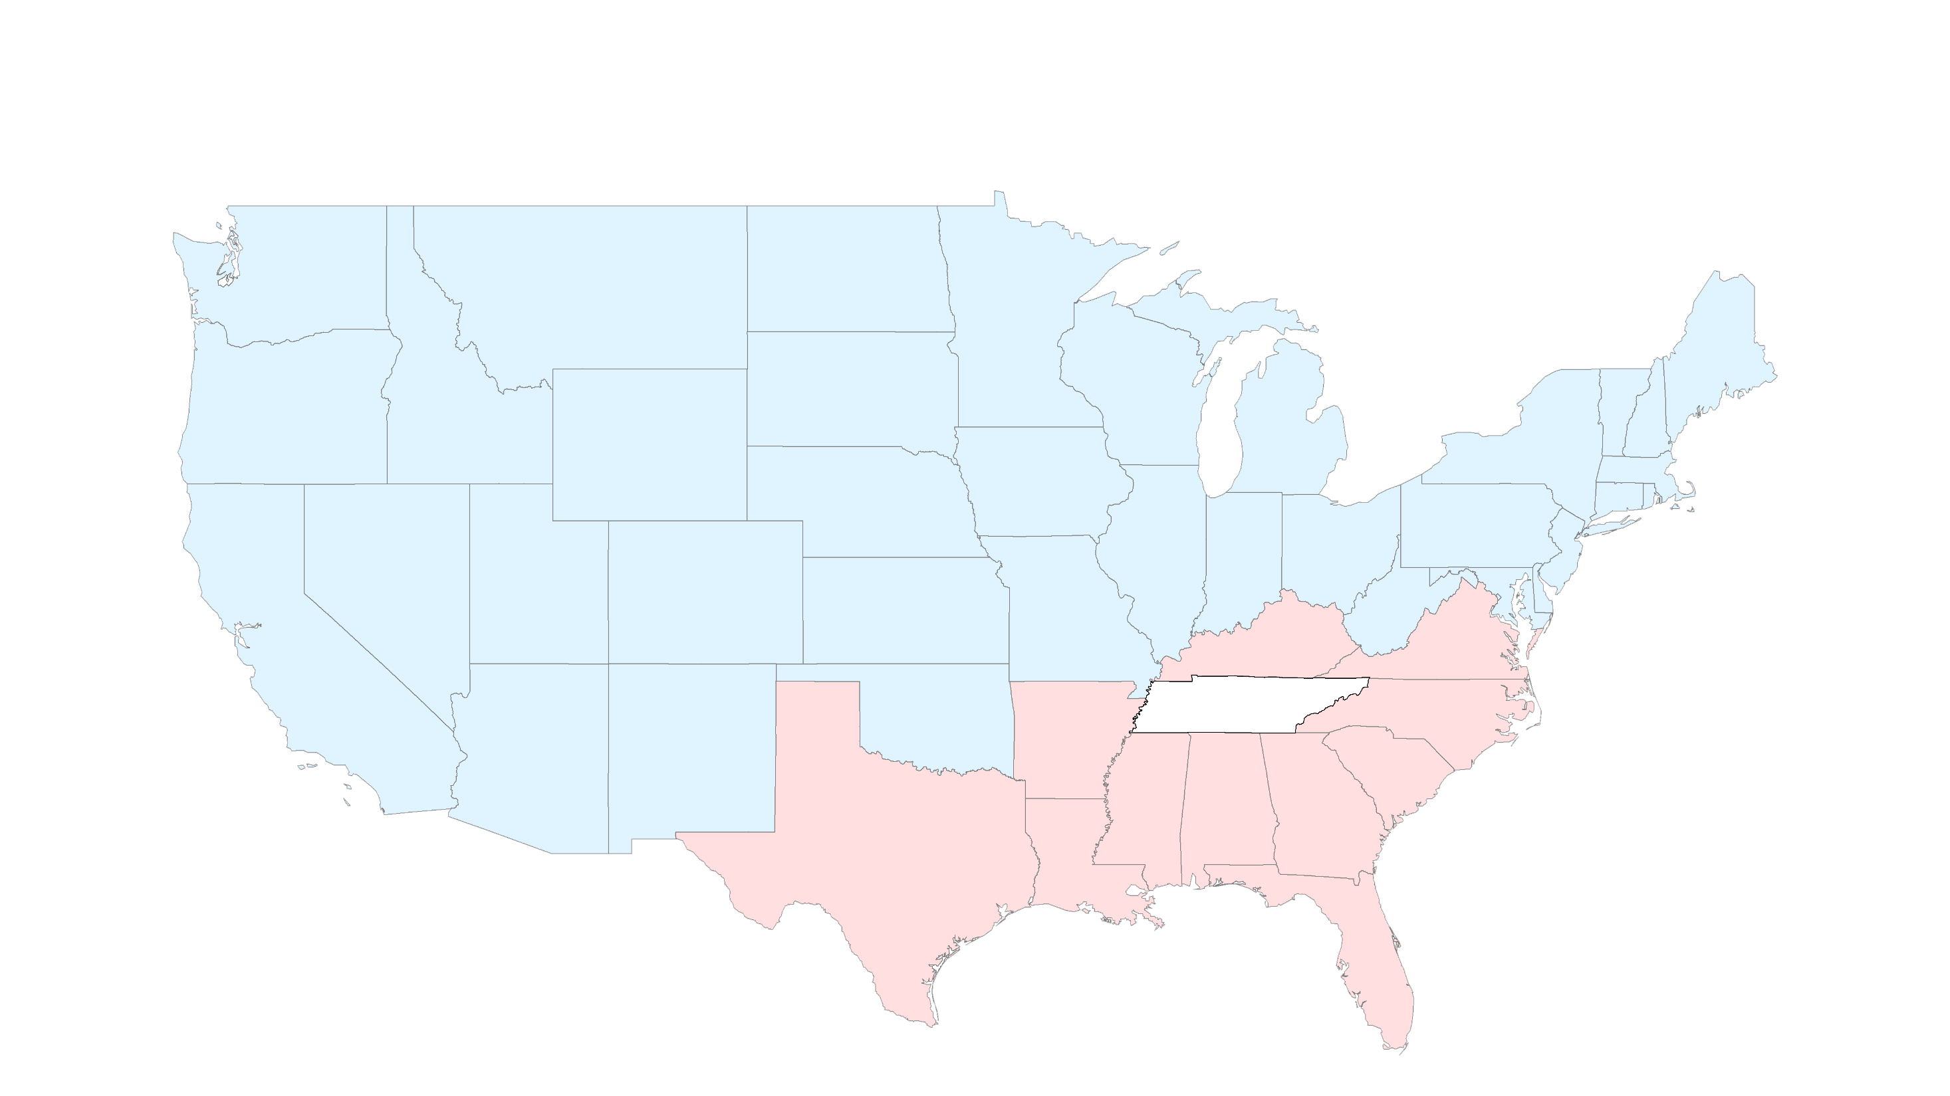
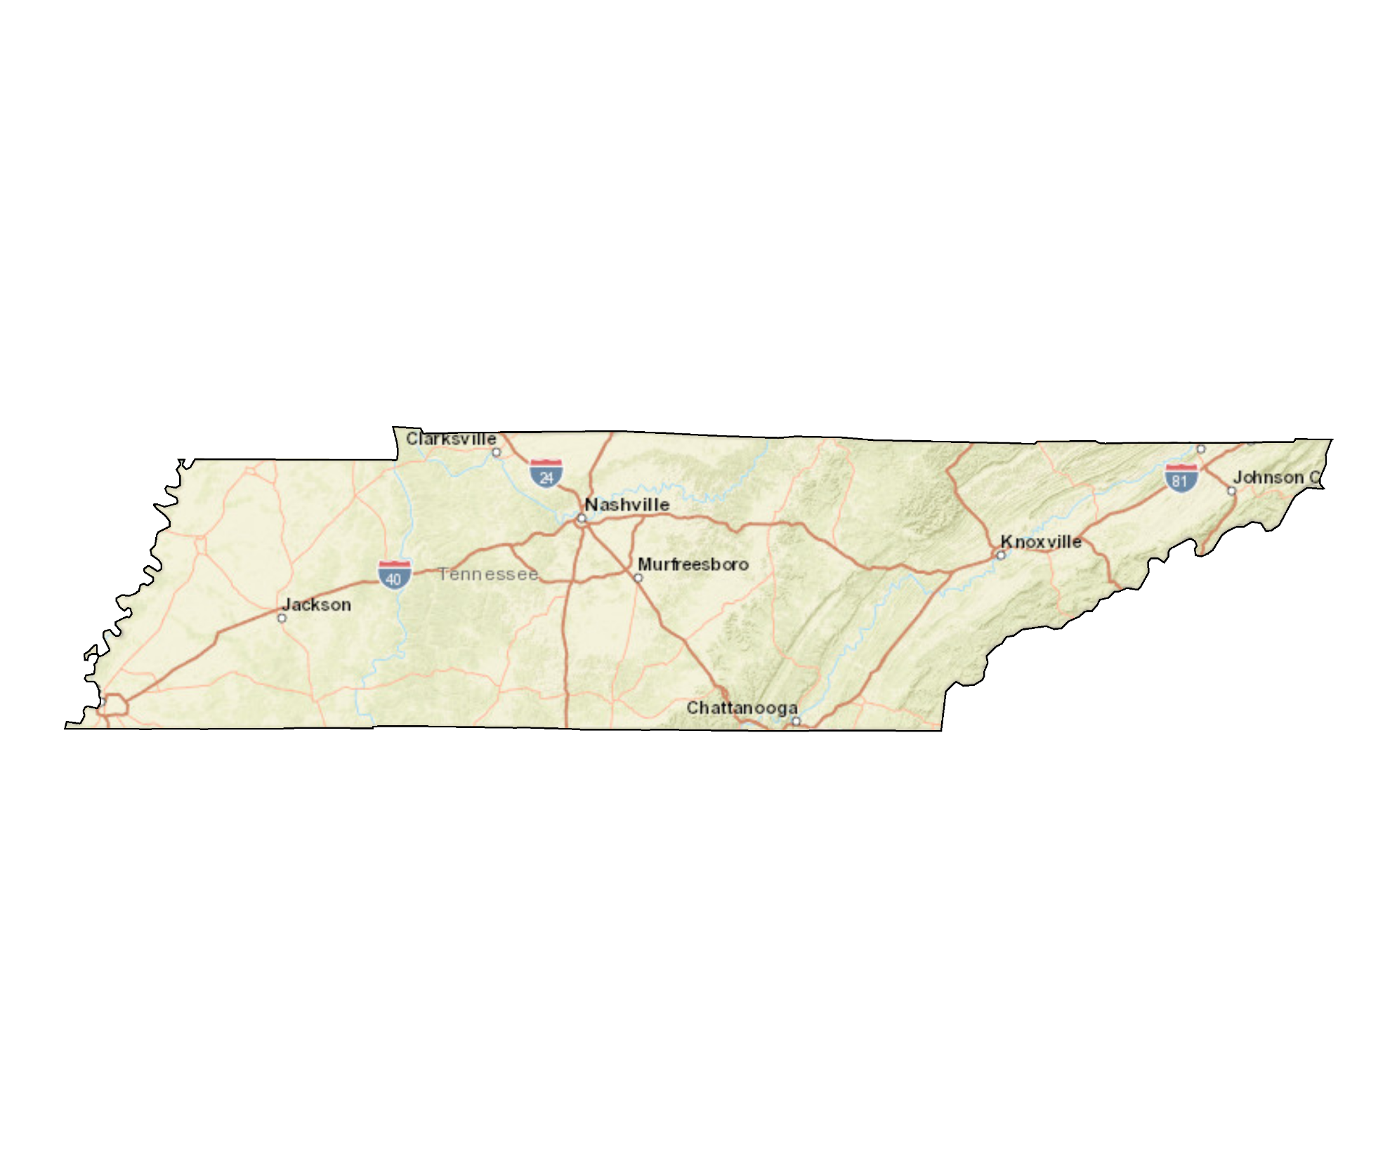
Southeastern Regional Maintenance Conference
Tennessee

Slide 3
Southeastern Regional Maintenance Conference
Tennessee

Slide 4
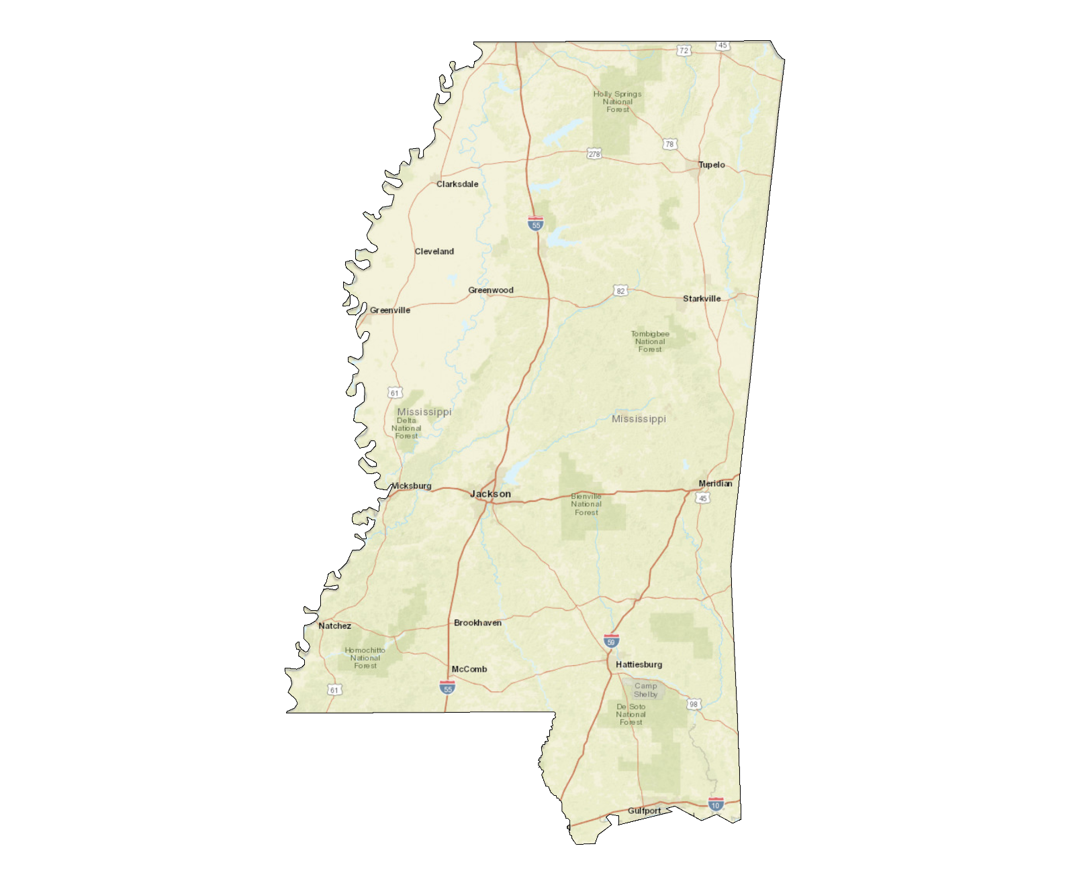
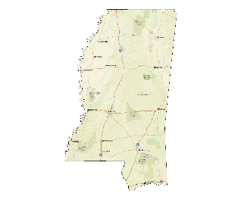
Southeastern Regional Maintenance Conference
Mississippi

Slide 5
Southeastern Regional Maintenance Conference
Mississippi

Slide 6
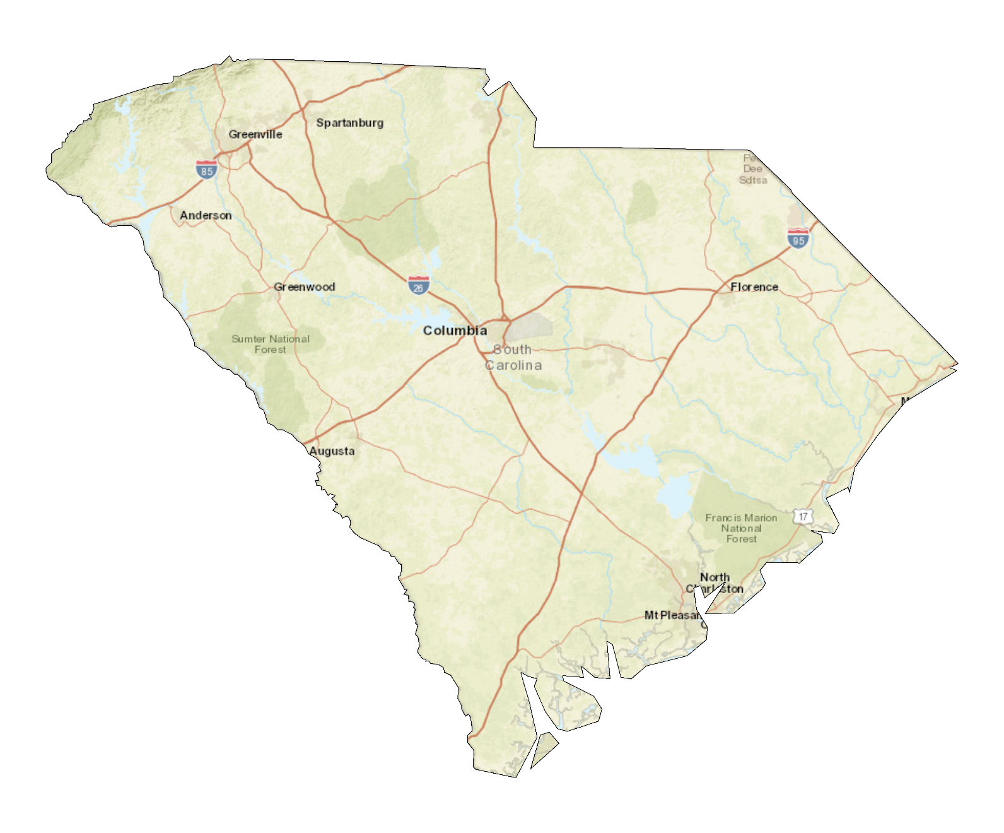
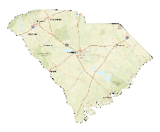
Southeastern Regional Maintenance Conference
South Carolina

Slide 7
Southeastern Regional Maintenance Conference
South Carolina

Slide 8
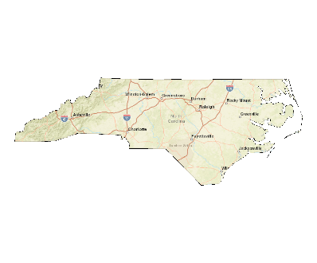
Southeastern Regional Maintenance Conference
North Carolina

Slide 9
Southeastern Regional Maintenance Conference
North Carolina

Slide 10
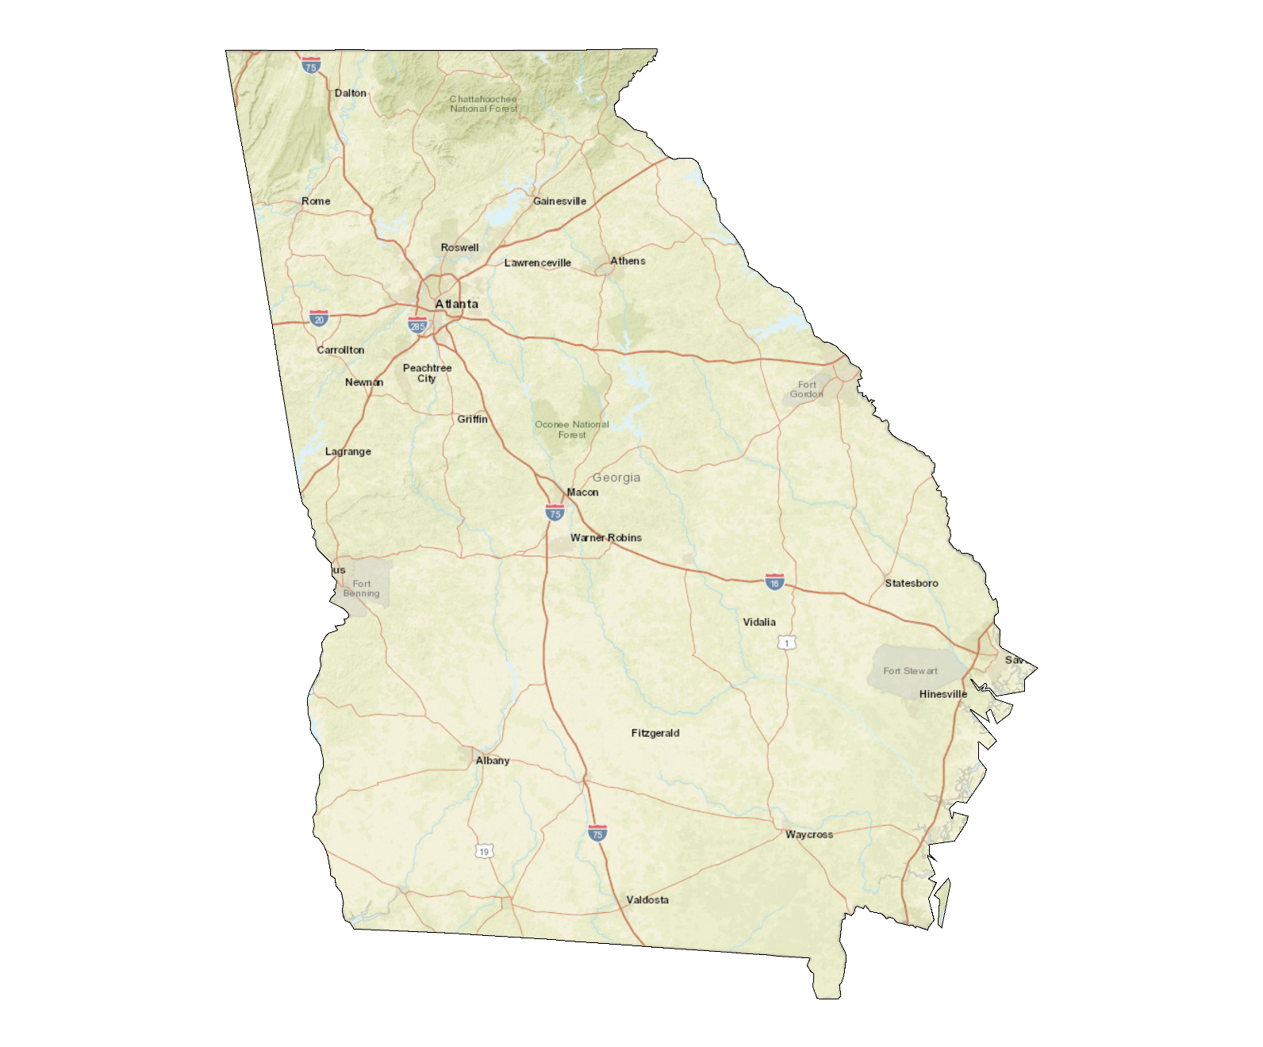
Southeastern Regional Maintenance Conference
Georgia

Slide 11
Southeastern Regional Maintenance Conference
Georgia

Slide 12
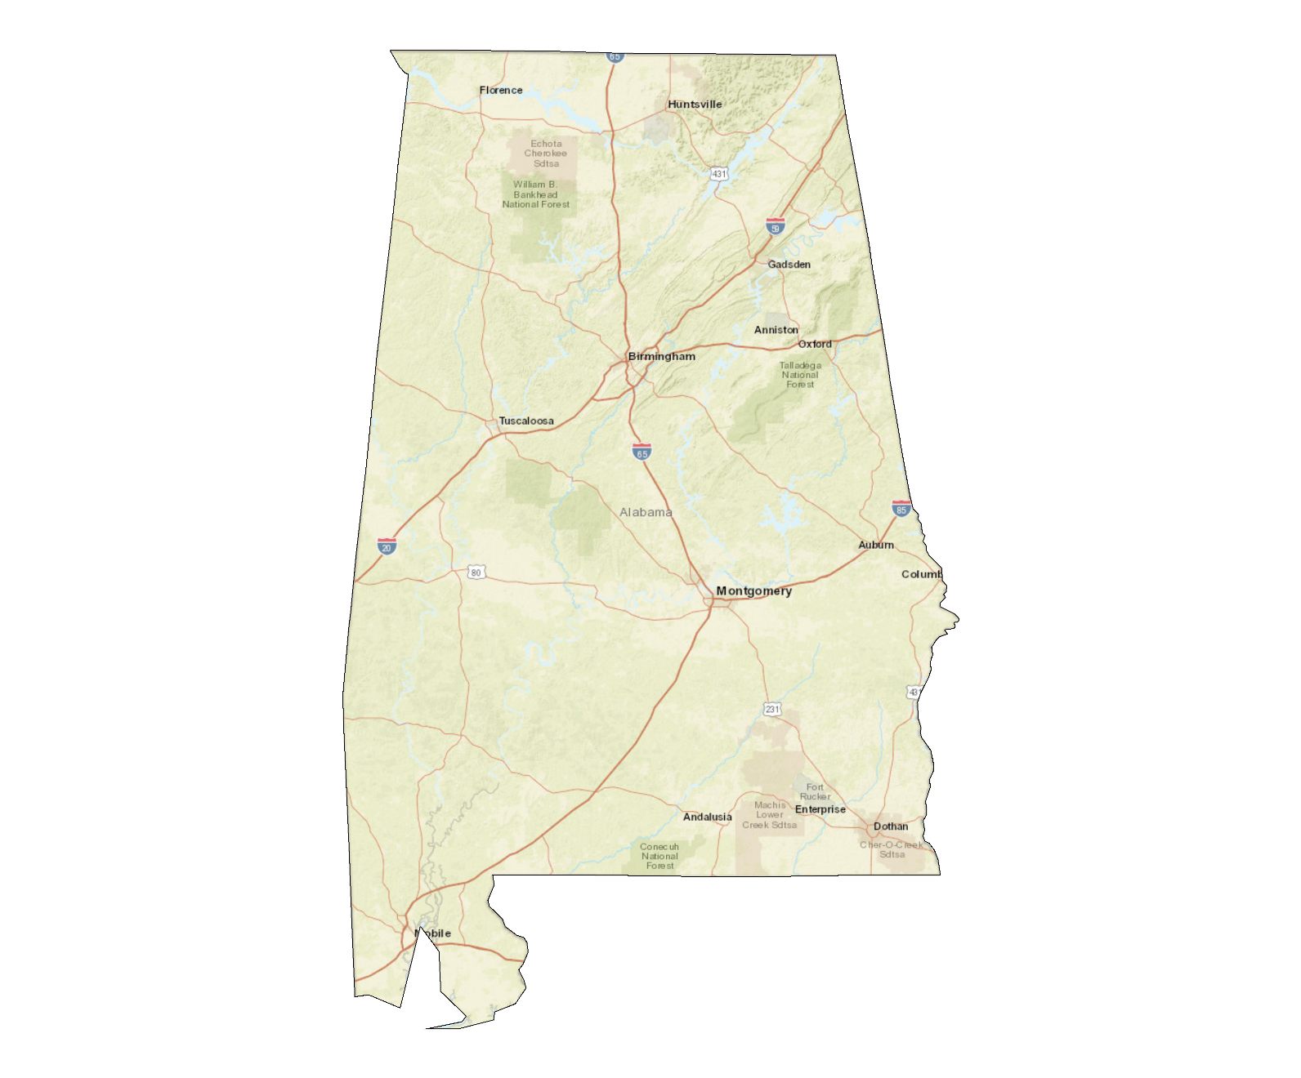
Southeastern Regional Maintenance Conference
Alabama

Slide 13
Southeastern Regional Maintenance Conference
Alabama

Slide 14
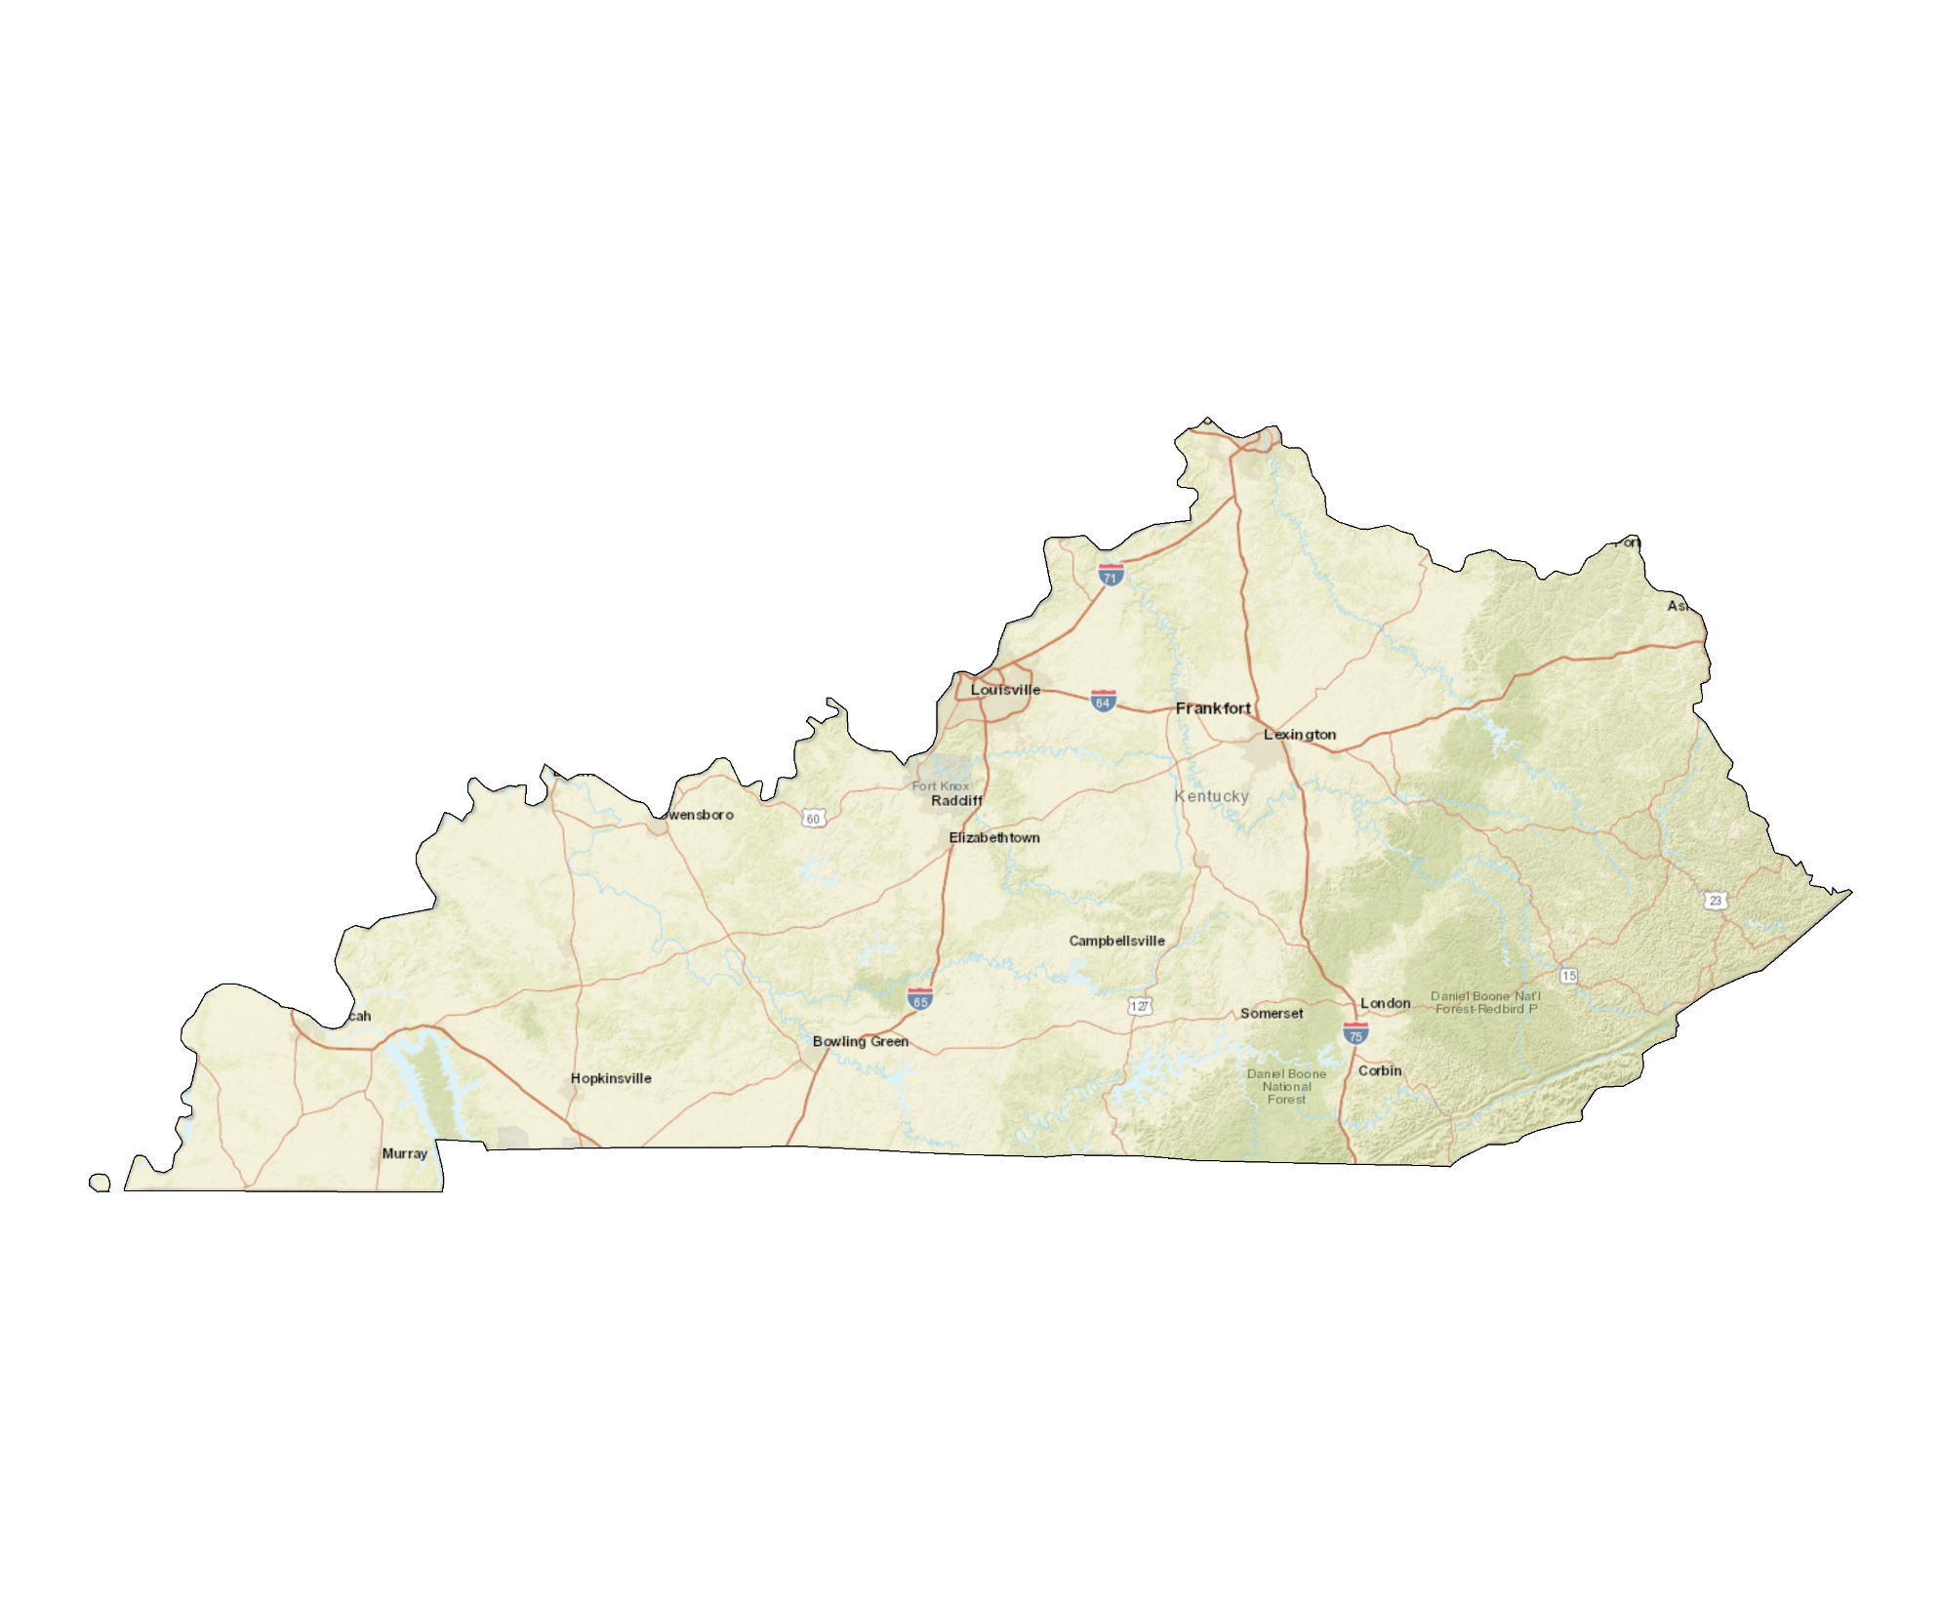
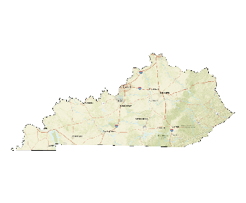
Southeastern Regional Maintenance Conference
Kentucky

Slide 15
Southeastern Regional Maintenance Conference
Kentucky

Slide 16
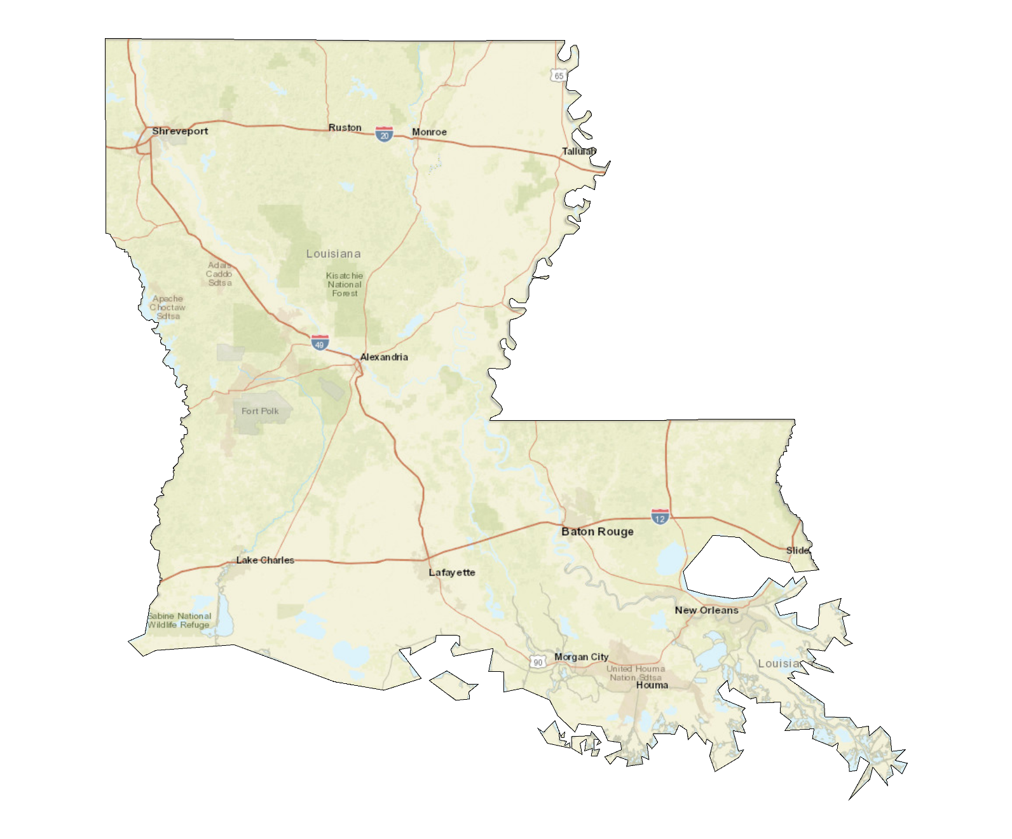
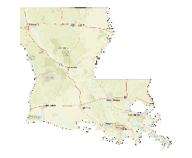
Southeastern Regional Maintenance Conference
Louisiana

Slide 17
Southeastern Regional Maintenance Conference
Louisiana

Slide 18
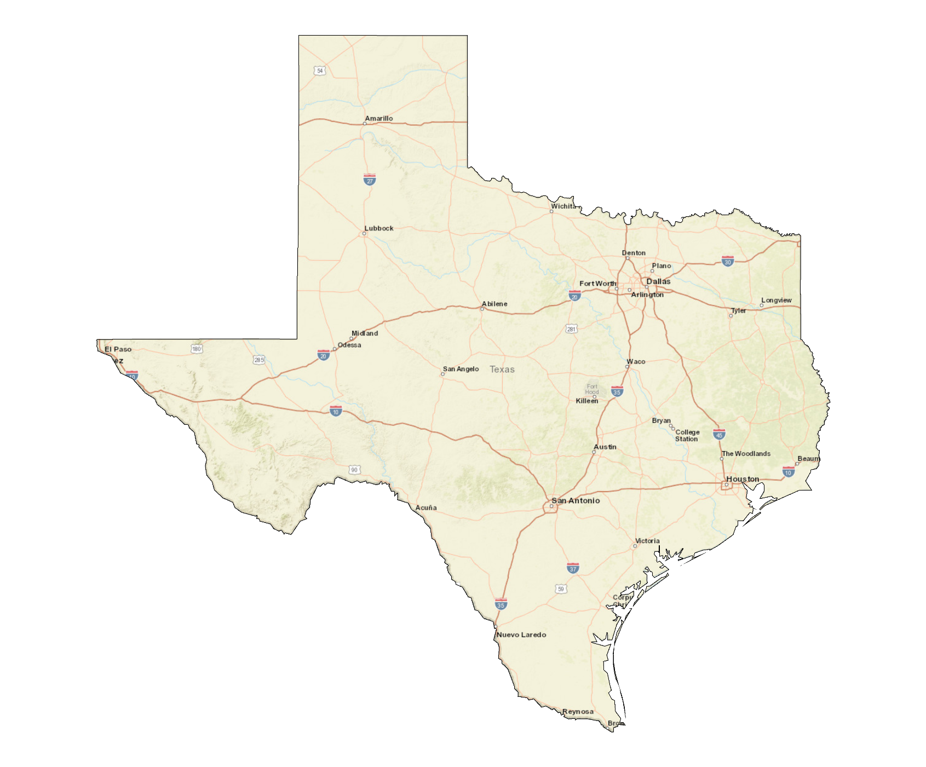
Southeastern Regional Maintenance Conference
Texas

Slide 19
Southeastern Regional Maintenance Conference
Texas

Slide 20
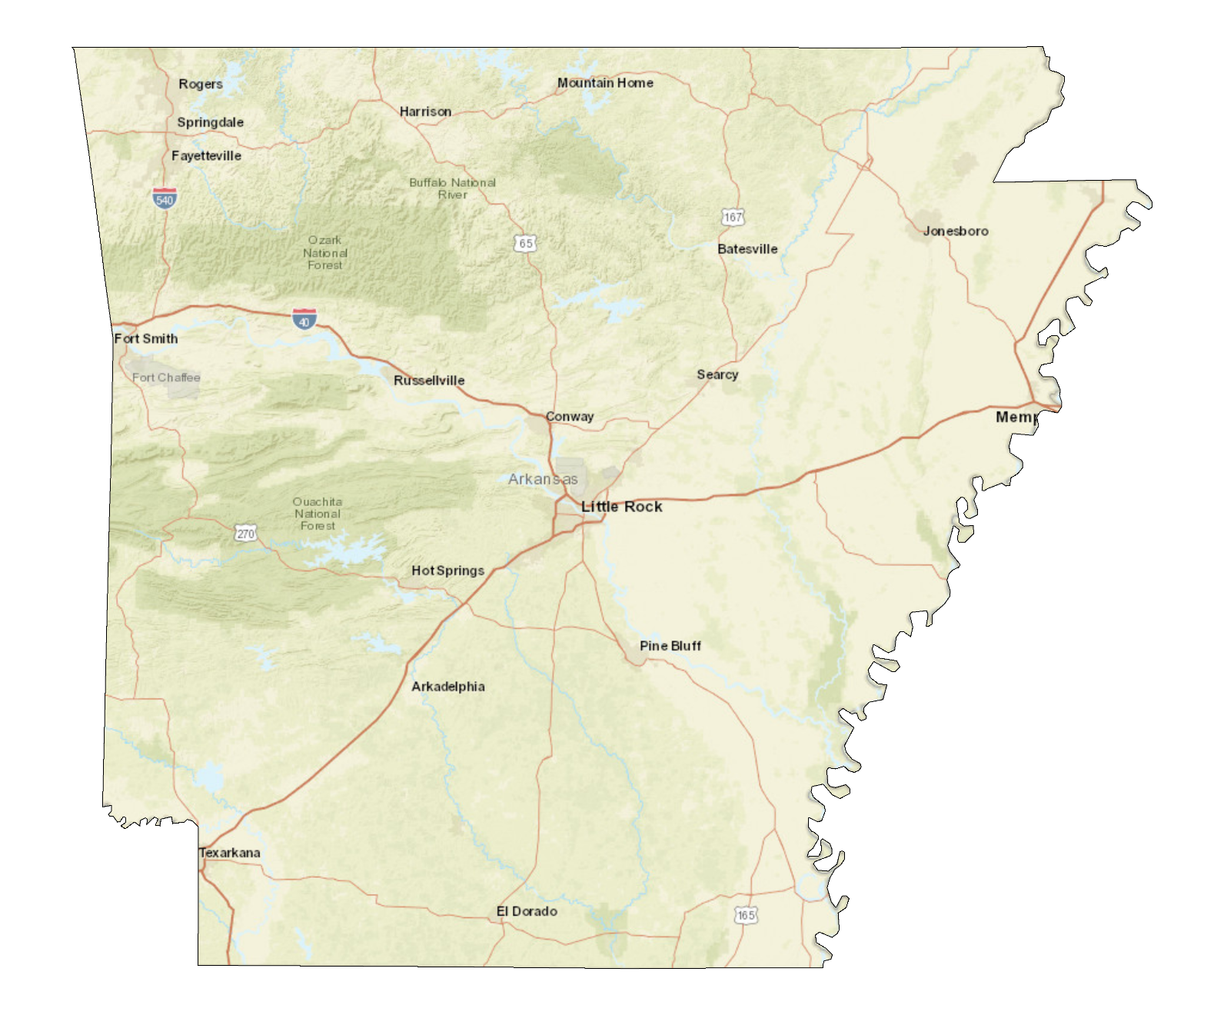
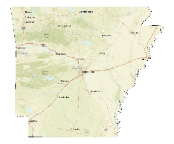
Southeastern Regional Maintenance Conference
Arkansas

Slide 21
Southeastern Regional Maintenance Conference
Arkansas

Slide 22
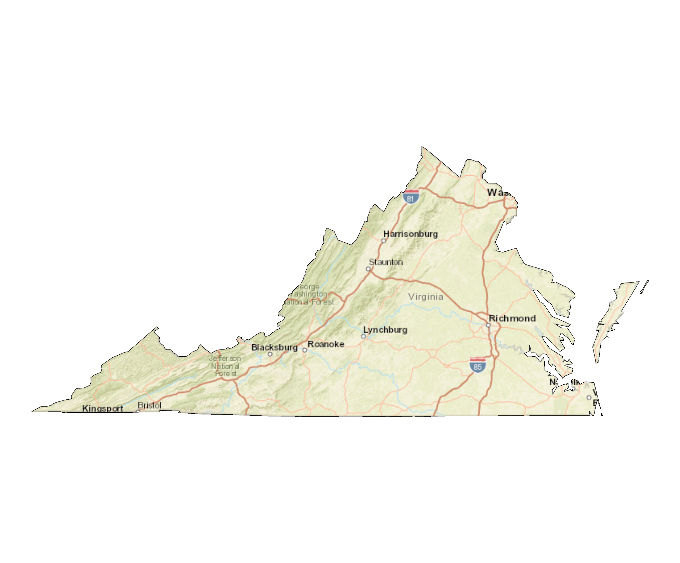
Southeastern Regional Maintenance Conference
Virginia

Slide 23
Southeastern Regional Maintenance Conference
Virginia

Slide 24
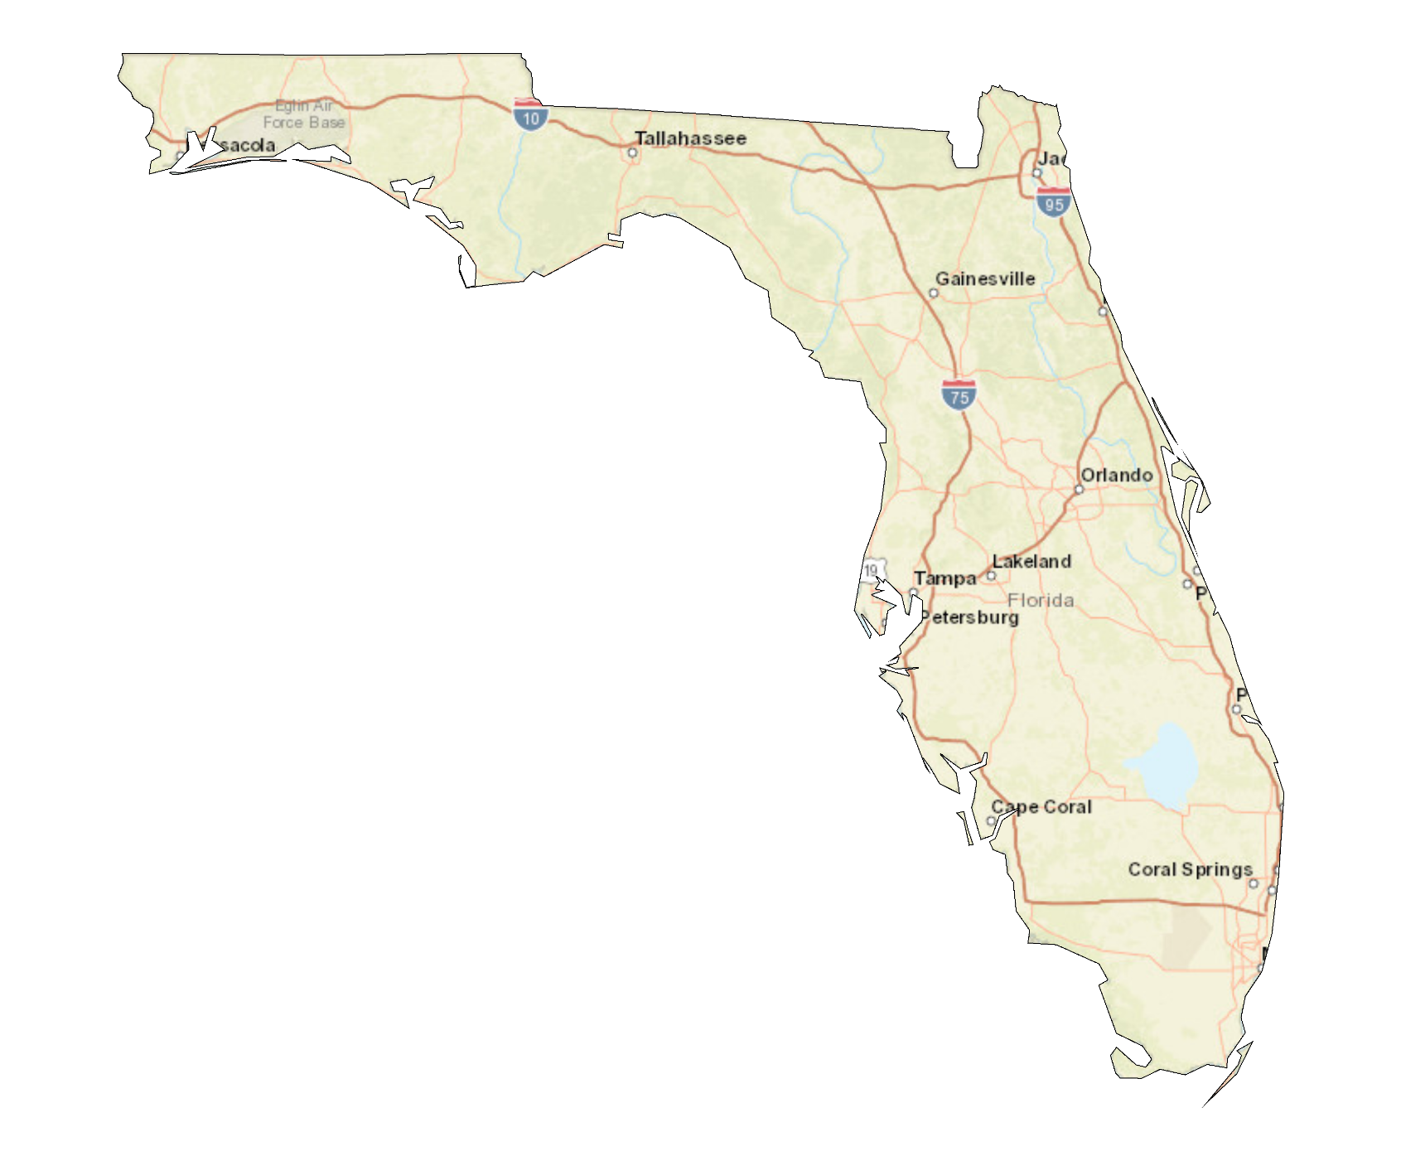
Southeastern Regional Maintenance Conference
Florida

Slide 25
Southeastern Regional Maintenance Conference
Florida

