Slide 1
Right of Way Requirements for LAP Projects
Marcia Cuesta Locke: LAP liaison: Marcia.locke@dot.state.fl.us: 954-777-4263

Slide 2
TOPICS FOR DISCUSSION:
Federal Right of Way requirements: funding and oversight
Federal Right of Way requirements and the Uniform Act
Typical right of way issues and the Uniform Act
More typical right of way issues and the Uniform Act
Right of Way Certification
Certification forms
Construction plans
Communication
Important Websites

Slide 3
FEDERAL RIGHT OF WAY REQUIREMENTS: FUNDING AND OVERSIGHT
FHWA provides funds to FDOT for federal aid highway projects
FDOT gives a portion of the funds to local agencies for LAP projects
Eligibility for the receipt of federal funding is dependent upon compliance with federal laws, regulations and policies
Failure to comply with federal laws, regulations and policies can result in the withdrawal of federal funds and the reimbursement of those funds by the non-compliant agency.

Slide 4
FEDERAL RIGHT OF WAY REQUIREMENTS AND THE UNIFORM ACT: PART I
The Uniform Relocation Assistance and Real Property Acquisition Policies for Federal and Federally Assisted Programs Act (the Uniform Act) is the primary source of regulation for any acquisition or relocation activities on federally funded projects.
Failure to comply with the Uniform Act will result in the denial of federal participation in project costs
The Act is triggered as soon as there is any discussion or intent to pursue federal funding from FDOT
A single dollar of federal funding in any phase of a project generates the need to comply with the Uniform Act

Slide 5
FEDERAL RIGHT OF WAY REQUIREMENTS AND THE UNIFORM ACT: PART II
FDOT has overall responsibility for the acquisition of right of way on federal aid projects
Regulations contained within the Uniform Act are extensive and detailed. Consequences for failure to comply with these regulations can be severe. Therefore, all work for LAP projects must be completed from and within the local agency's existing right of way. Acquisition is not permitted.
Please do not acquire right of way in advance of a project if you have any intention of requesting federal funding.

Slide 6
TYPICAL RIGHT OF WAY ISSUES AND THE UNIFORM ACT:
LICENSE VS TEMPORARY CONSTRUCTION EASEMENT
When will work on private property become a “taking” which triggers compliance with the Uniform Act
When can a license or right of entry be used?
When does a signed license or right of entry become ineffective?
What does “for the benefit of the property owner” mean?

Slide 7
TYPICAL RIGHT OF WAY ISSUES AND THE UNIFORM ACT:
WHEN WILL WORK ON PRIVATE PROPERTY BECOME A TAKING WHICH TRIGGERS THE UNIFORM ACT?
When permanent improvements of any kind are placed in or on private property because of the project
When there is a temporary use of private property in order to construct the project . This would include use of the land to trim or remove trees, to connect utility boxes, or for the construction of fences or ditches which will be placed on agency property.
When it is necessary to use private property to build a connection to the project that is safe and that is within the applicable standards.

Slide 8
TYPICAL RIGHT OF WAY ISSUES AND THE UNIFORM ACT:
WHEN MAY A LICENSE OR RIGHT OF ENTRY BE USED? PART I
When the project can still be constructed properly if the owner does not sign it. A license or right of entry cannot be “needed.”
When a connection that is already safe and already within applicable standards is being improved exclusively for the benefit of the property owner.
When improvements in the license or right of entry area do not need to be maintained or used by the agency and are exclusively for the benefit of the property owner and not because of the project

Slide 9
TYPICAL RIGHT OF WAY ISSUES AND THE UNIFORM ACT:
WHEN MAY A LICENSE OR RIGHT OF ENTRY BE USED (ROE): PART II
It doesn’t matter if the owner agrees to sign the license or ROE. The Uniform Act requires that the owner must be provided an explanation of the acquisition process, including his or her right to just compensation for the temporary or permanent use of their property for the project. If that did not happen, the license or ROE may not be used.
The owner cannot properly give up a right that he or she does not know he or she has
The fact that the use is for a short duration or that any compensation the owner may be due is minor is irrelevant for purposes of the Uniform Act.

Slide 10
TYPICAL RIGHT OF WAY ISSUES AND THE UNIFORM ACT:
WHEN DOES A LICENSE OR RIGHT OF ENTRY BECOME INEFFECTIVE
When the owner changes his or her mind and revokes it
When the property changes ownership
NOTE: Licenses or rights of entry must be approved, as to form, by FDOT legal prior to their use.

Slide 11
TYPICAL RIGHT OF WAY ISSUES AND THE UNIFORM ACT:
WHAT DOES THE PHRASE “FOR THE BENEFIT OF THE PROPERTY OWNER” MEAN?
If the work is needed for the project, or because of the project, the fact that the work also benefits the property owner is irrelevant for purposes of the applicability of the Uniform Act.
“The provisions of this subpart do not apply to temporary easements… solely to perform work intended exclusively for the benefit of the property owner, which work may not be done if agreement cannot be reached.” ( italics and bolding added) ” Uniform Relocation Assistance and Real Property Acquisition for Federal and Federally Assisted Programs , - Applicability of acquisition requirements, 49 CFR Subpart B, Section 24.101 ( c ) (2)

Slide 12
MORE TYPICAL RIGHT OF WAY ISSUES
Use of easements
Encroachments
Work on land owned by other governmental agencies
Work on land in “co ownership” with other governmental agencies

Slide 13
MORE TYPICAL RIGHT OF WAY ISSUES: USE OF EASEMENTS
The use of the property encumbered by the easement must be consistent with the use granted in the easement
The agency must be the entity “holding” the easement/ entitled to use the easement
An agency attorney must review the document to ensure that the use granted in the easement is consistent with its intent
OR/Plat book and page numbers of any easements used for the project must be noted on the plans

Slide 14
MORE TYPICAL RIGHT OF WAY ISSUES: ENCROACHMENTS and IMPROVEMENTS ON PRIVATE PROPERTY
Private encroachments in the right of way that interfere with construction must be removed.
Appropriate rights must exist if there will be access to public improvements on private property

Slide 15
MORE TYPICAL RIGHT OF WAY ISSUES:
USE OF PROPERTY AND OTHER GOVERNMENTAL AGENCIES
A permit must be acquired if the agency will use land which is in the ownership of other governmental agencies
A permit must be acquired if the agency will use land in which other agencies have rights
If the permit is revoked, and federal funds have been used, the funds may need to be repaid.

Slide 16
RIGHT OF WAY CERTIFICATION
Prior to project construction…
The Agency must provide a LAP Certification that indicates compliance with the Uniform Act ( FDOT LAP certification form #575-095-05)
The Agency must also provide an additional form entitled “No Additional Right of Way”
The FDOT District Right of Way Manager will need to verify the information contained in both forms and sign the LAP Certification in order for the project to be authorized for construction / advertised for construction bids

Slide 17
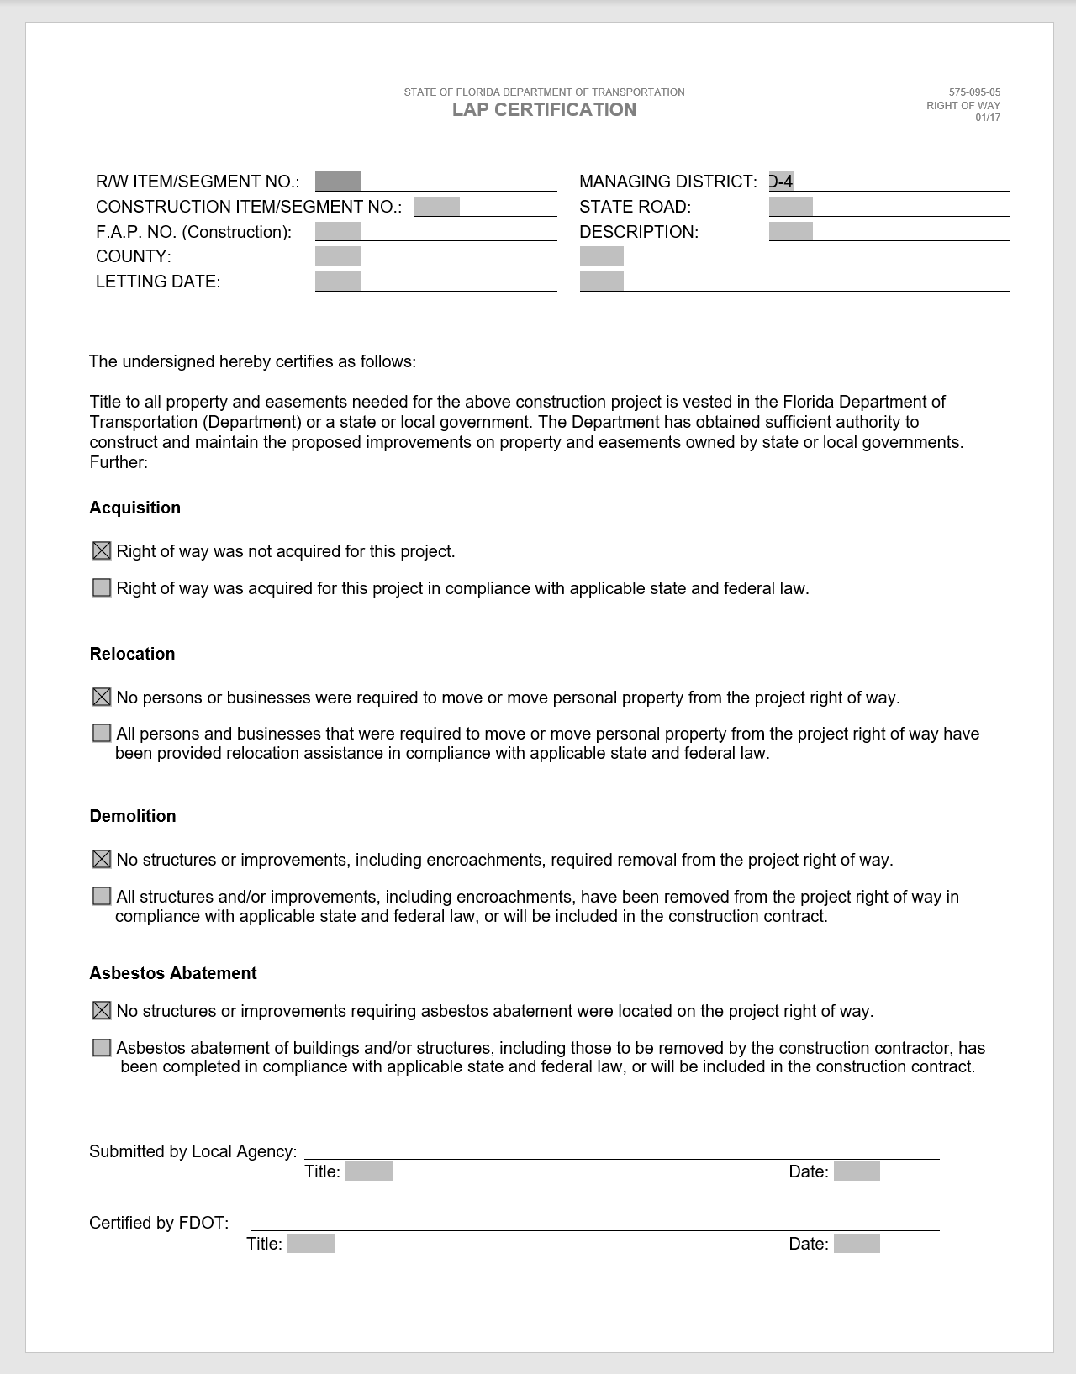
LAP Certification Form

Slide 18
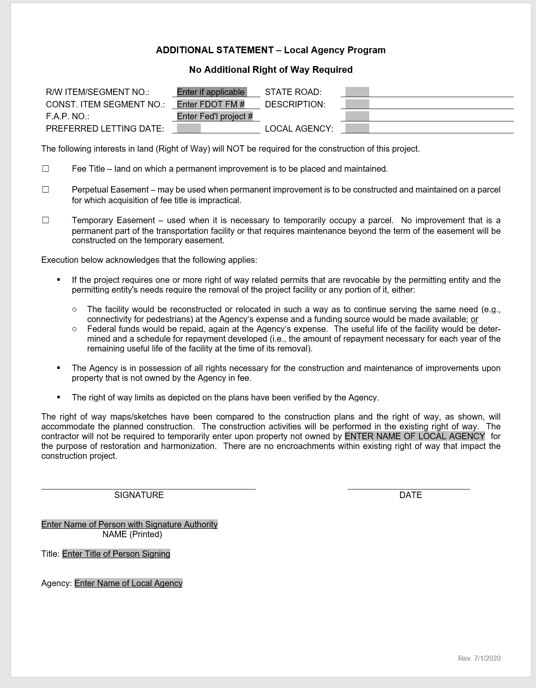
LAP No Additional ROW Form

Slide 19
CERTIFICATION FORMS
Must be filled out in accordance with the guidelines provided by FDOT
Information must be correct as reported in PSEE or any other program being used
Must be signed by a person at the agency with apparent authority
Example: The description of the project in the header of the form must be restated to match exactly the description of the project in the system. It must be followed by the restatement of the “work mix” exactly as it is written in the system. (You do not need to add the FM number identified in the work mix.)

Slide 20
CONSTRUCTION PLANS I
Plans are reviewed to ensure that all work is contained within the existing agency right of way.
A general note must be included stating: All work shall be completed from and within existing right of way.
Right of Way lines must be clearly identified on all plan sheet types including landscaping, signage, drainage, etc. Please avoid use of legends, if possible, where there are similar type markings for the identification of the right of way and for other construction improvements or activities.
As stated earlier, OR/Plat book and page numbers of any easements used for the project must be noted on the plans

Slide 21
CONSTRUCTION PLANS II
If licenses or rights of entry are identified on the plans, they must reflect that no work will be done if a license or right of entry is not obtained for the given area
Work identified as work to be “completed or removed by others” must still be completed in compliance with the Uniform Act. The “others” are still the agency for the purpose of the Uniform Act.
It should be clear on the plans that items on private property connected with project work are to remain

Slide 22
COMMUNICATION: TALK TO ME, PLEASE!!!! (THROUGH THE PROPER CHANNELS)
There are times when it is best to have a quick meeting to discuss an issue. Contact the LAP coordinator when needed. A series of emails and ERC comments can often be substituted for a five-minute meeting.
If a question or comment made is confusing to you or you don’t understand it, ask for clarification.
Things that seem obvious to you may not be obvious to others, so please respond to even seemingly unimportant or “stupid” comments or questions.
If you don’t agree with a comment or request made, contact the LAP coordinator so it can be resolved. The comment or request is not going to go away. The longer it goes unresolved, the worse it will be for the project.

Slide 23
FDOT WEBSITES
Right of Way office
www.dot.state.fl.us/right of way
Right of Way Procedure Manual:
www.dot.state.fl.us/right of way/proceduresmanual.shtm
Common Pitfalls of Right of Way Certification – LAP Projects
https://www.fdot.gov/designsupport/Districts/D4LAP/D4LAP.shtm

Slide 24
FHWA WEBSITES:
Office of Real Estate Services:
www.fhwa.dot.gov/real_estate/indez.cfm
LPA Guide:
www.fhwa.dot.gov/real_estate/uniform_act/program_administration/lpa_guide/index.com
Free Online Uniform Act Course:
www.fhwa.dot.gov/real_estate/right-of-way/training/distlearn.cfm

Slide 25
QUESTIONS?

