Slide 1
BABA Implementation Plan for FDOT:
Design, Construction, Contractors, Manufacturers and Producers
Updated for August 2023 Rules
Presenter: Karen Byram
State Product Evaluation Administrator
Product Evaluation Office
Office of State Materials
November 2023

Slide 2


Outline
Current Federal Guidance
  IIJA: OMB + FHWA
  August 2023 Posting by OMB
  FDOT Implementation
FDOT’s Implementation Plan
  Designers
  Construction & CEIs
  Contractors
  Manufacturers & Producers

Slide 3

Current Federal Guidance- Terminology
IIJA: Infrastructure Investment and Jobs Act, signed by President on Nov 15, 2021
BABA (Build America, Buy America): Provision within IIJA
OMB: Office of Management and Budget
FHWA: Federal Highway Administration
FEMA, DHS, DEP, EPA, etc.: Federal Agencies providing federal funds to local agencies- subject to BABA rules

Slide 4
Current Federal Guidance- Quick Summary
1983 Buy America (Reauthorized in 1993): FHWA Rule for Iron, Steel, and Manufactured Products (waiver)
2021: IIJA Signed, implementation in May 2022 for funds authorized
2022: OMB Issues M-22-11 guidelines.
FHWA Waiver remains in effect for manufactured products
Feb 2023: OMB proposes rule changes- to clarify requirements/definitions.
Mar 2023: FHWA review of Buy America waiver, following OMB proposal.
Aug 23, 2023: OMB and FHWA updated guidance
  Implementation date October 23, 2023 for authorization of funds
  FDOT January 2024 lettings Construction projects

Slide 5
Quick Summary of Content
BABA is Buy America expanded to include construction materials and manufactured products
Domestic production documentation is required like iron and steel
All federal agency grants and agreements
Follow FHWA for iron and steel and manufactured products
Some materials are exempt
Construction Materials now covered by Buy America:
Iron and Steel
All other metals
Plastics
Composites
Glass
Fiber optic cable
Lumber
Engineered wood
Drywall

Slide 6
BABA: New Federal Guidance
Iron and Steel
Construction Material
  Non-Ferrous metals
  Plastics/Polymers, composites
  Glass
  Fiber Optic Cable, optical fiber
  Lumber
  Engineered Wood, Drywall
  ALL US manufactured
Manufactured Product
  Electronics
  55%+ US manufactured
  FHWA Waiver
Specific rules for Coatings, Incidentals, and other unique situations*
  Glass beads vs Coated Glass
  Coated vs Uncoated Materials (incidental coatings)
  Construction Material vs Manufactured Product (Pole with incidentals doesn’t change the pole)
*Call Product Evaluation for assistance.
For most situations, BABA classification is based on FDOT Specifications and how product or material arrives at the construction site.
Iron/Steel
FHWA rule: 23 CFR 635
Construction Material
All manufacturing processes in US
Manufactured Product
Manufactured in US
Other Materials
Temporary
70917(c) Materials
“Aggregates & Binders”
Exempt
Exempt
55% of material costs from US
FHWA Waiver

Slide 7
FDOT’s Implementation Plan:
Product Type
  Product Evaluation will determine BABA classification by specification Product Type and Product
  Posted on APL, by applicable specification Section
Implementation based on Authorization Date
  Existing construction projects: Previous BABA rules apply (M-22-11 for Manufactured Products and FHWA waiver)
  New projects: Lettings starting January 2024
All Construction Projects*
  FHWA waivers from Federal DOT- more information in a moment
    Not intended for project/product exceptions
    Not intended for minor delays or local product shortages
  Federal Funds may be added to a project at a later date
  Federal fund codes may be present within state project number, especially for local agency funds from HUD, EPA, Homeland Security, and other Federal agencies.
*Funding codes will be considered only for specific situations.
Why not exempt all State projects?

Slide 8
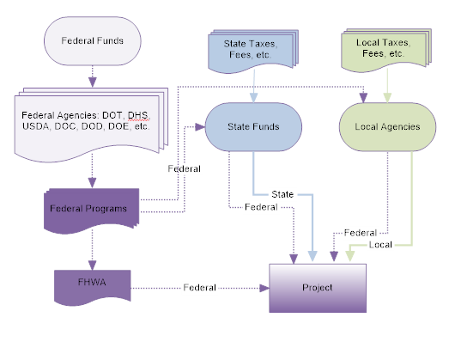
Federal Funds…
…more than the traditional Federal Highway Funds through FHWA:
DHS: Transportation related Cybersecurity
FEMA: Federal Emergency Management Agency
USDA: Landscape, Forest Restoration
USDOT: Safety, Safe Paths to School, Rail Programs, Mass Transit
HUD: Housing & Urban Development- Local Programs
Homeland Security: Local Programs
EPA: Environmental Protection Agency (ponds, drainage, wetlands)
Consider BABA as applicable to ALL PROJECTS- Follow FHWA rules, unless you are certain that the state/local funds are NOT associated with any Federal Funding source – Contact the State Construction Office
Important: Federal Aid ≠ Federal Funds.
Federal Aid is generally the FHWA funding. Many designers recognize this as project with a Federal Aid Project Number in addition to the FPID number.
Federal Funds (FHWA, DHS, HUD, or other) may come through the State or Local Funds. The fund codes/sources are identified within the normal FPID number 123456-1-52-01.
Grants.gov searching for IIJA and other transportation related grants for local governments
Notes:
Important:
Federal Aid is NOT EQUAL to Federal Funds.
Federal Aid is generally the FHWA funding. Many designers recognize this as project with a Federal Aid Project Number in addition to the FPID number.
Federal Funds may come through the State or Local Funds. The fund codes/sources are identified within the normal FPID number 123456-1-52-01.

Slide 9
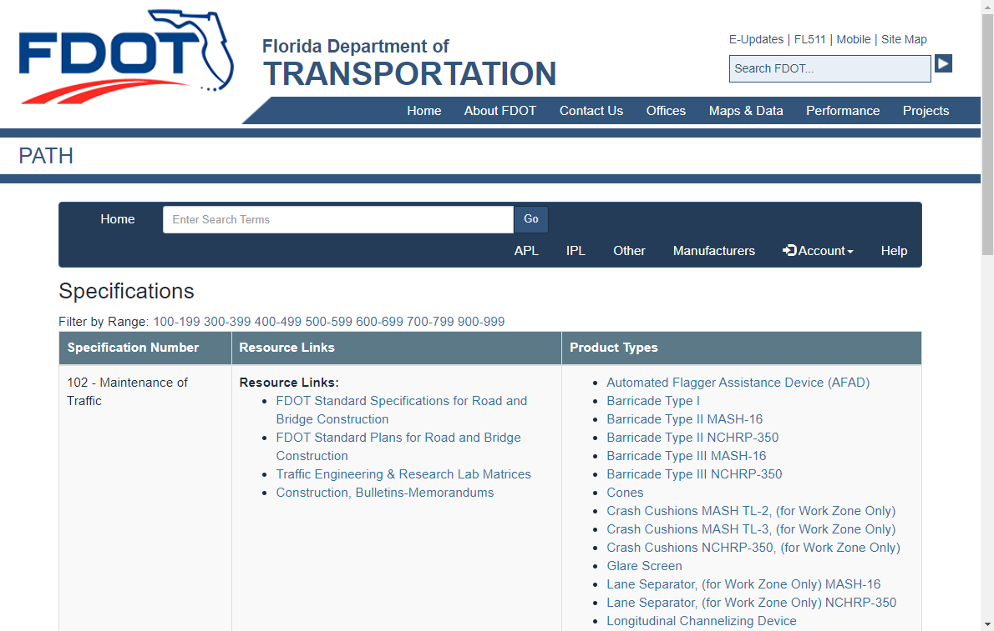
FDOT’s Implementation Plan-
“Big Picture”
Everything is in PATH!
PATH (Product Application Tracking and History): Application, also known as the APL (Approved Product List)
Manufacturers submit documentation
  Product & Packaging Photos
  Label Photos
  Installation Instructions
  Warranty information
  Product Data Sheets
  BABA compliance*
  Other documents, per specifications
*BABA Compliance information is collected through manufacturer; BABA status will be noted on the APL.
Used by Designers, Inspectors, Contractors, Manufacturers, Local Agencies, and others!

Slide 10


Waivers- Calculations
Iron & Steel: 0.1% of Total Costs
Easily documented in FDOT systems
6-5.2.1 Steel and Iron: Buy America provisions of 23 CFR 635.410
  foreign materials does not exceed 0.1% of the total Contract amount or $2,500, whichever is greater
Construction Materials: FHWA Waiver of Buy America Requirements for De Minimis Costs and Small Grants
  The total value of the non-compliant products is no more than the lesser of $1,000,000 or 5% of total applicable costs for the project; or
  The total amount of Federal financial assistance applied to the project, through awards or subawards, is below $500,000.
“Total applicable project costs” are defined as the cost of materials (including the cost of any manufactured products) used in the project that are subject to a domestic preference requirement, including materials that are within the scope of an existing waiver.
Construction Materials:
De Minimis: Fraction of Material Costs alone (no installation or equipment costs)
DO NOT USE. No current FDOT accounting method available.
Material Cost Data not collected from Contractors.

Slide 11
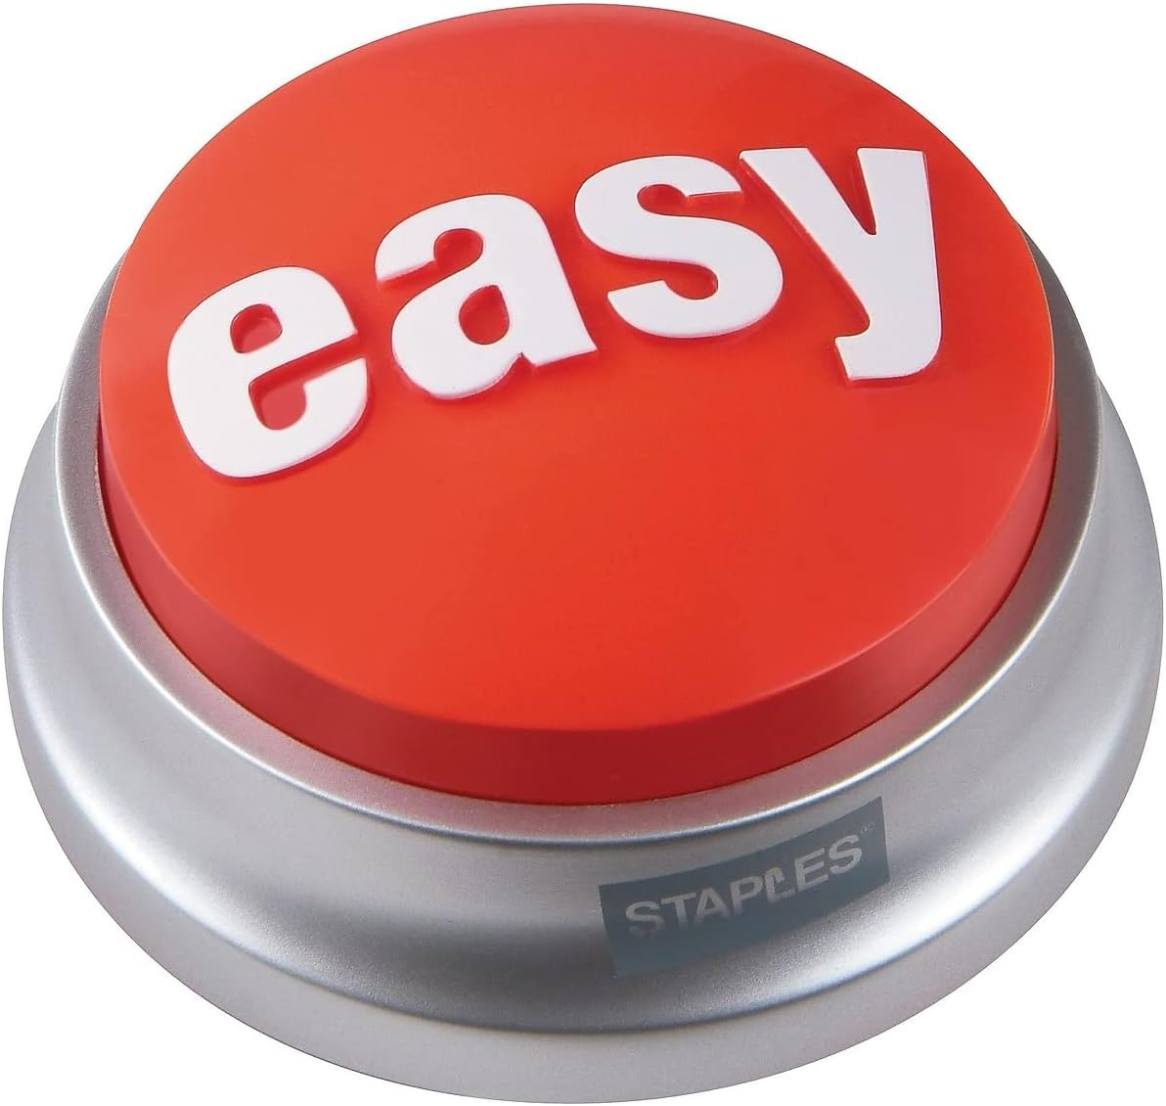
Waivers- Ease of Use
Iron & Steel: 0.1% of Total Costs
Easily documented in FDOT systems
Incidental Iron/Steel: Follow specification for small quantities
Large Items of Foreign Iron/Steel: Non-compliant
  Redesign with other materials/products
  Alternative project funding (contract is non-federalized)
Construction Materials: BABA is intended to apply a domestic procurement preference.
  Develop and Sustain Domestic Manufacturing
  Identify areas for Domestic growth
  Redesign with other materials/products
  Alternative project funding (contract is non-federalized) Cannot just use state funds for the item.
Construction Materials:
De Minimis: Fraction of Material Costs alone (no installation or equipment costs)
DO NOT USE. No current FDOT accounting method available.
Material Cost Data not collected from Contractors.

Slide 12
Implementation Plan
Overview for Everyone
Designer
Construction Engineering Inspector (CEI)
Contractor
Manufacturer or Producer
Others: Local Agency, Maintenance

Slide 13
Implementation- Overview
Everyone uses either the APL or MAC System
APL
  Manufacturer submitted documentation
  BABA Classification
  BABA Compliance: Product eligibility
  Non-standard products, as approved
Materials Acceptance and Certification System (MAC)
  Used to document APL# and quantity for project
Engineer
  Not responsible for project level field determinations for BABA category or compliance.
  Minimize documentation collected in the field.
Consistent, Predictable, Repeatable documentation through APL/MAC systems.
Avoid District, Project, Engineer, Contractor, or Manufacturer differences of opinions in BABA determinations

Slide 14
Iron and Steel
1983 Buy America Rule in effect (Reauthorized in 1993)
No recent changes to FHWA waiver or requirements
Per FDOT specifications,
6-5.2.1 Steel and Iron: Use steel and iron manufactured in the United States, in accordance with the Buy America provisions of 23 CFR 635.410, as amended. Ensure that all manufacturing processes for this material occur in the United States.

Slide 15
Construction Material
Produced in the US
…minor additions to a construction material do not change the categorization of the construction material.
Per FDOT specifications,
6-5.2.3 Construction Materials: Use non-ferrous metals, plastic and polymer based products, glass, lumber, and drywall articles, materials, and supplies that are consumed in, incorporated into, or affixed to an infrastructure project that are manufactured in the United States, in accordance with BABA requirements.

Slide 16
Manufactured Product
Not classified as Iron/steel, Construction Material, or aggregate/binder
Produced in the US
Cost of Components that are “mined, produced, or manufactured is greater than 55% of the total cost of all components”
FHWA waiver may by applicable
Per FDOT specifications,
6-5.2.2 Manufactured Products: Use Manufactured Products that are consumed in, incorporated into, or affixed to an infrastructure project that are manufactured in the United States, in accordance with BABA requirements and applicable waivers.

Slide 17
Disclaimers
Product Types may have multiple material classifications, when allowed by Spec
  527/974 Detectable Warnings- composite products vs cast iron tiles (materials permitted to vary)
Products “with additional materials” does not change the classification
  715 Light pole- Aluminum pole with wires does not change the light pole from a Construction Material to a Manufactured Product
Special Rules for Coatings, incidental components, and kits
  OMB M-24-02 (replaces M-22-11) Guidance
  FDOT Specifications define “included materials”
FDOT’s APL will be updated as Specifications, FHWA guidance, and/or Federal Rules are updated. Contact Product.Evaluation@dot.state.fl.us regarding any product classifications.

Slide 18
Designer
FDOT Designer
Consultant Designer
Reviews and Pre-letting activities

Slide 19
FDOT Implementation-
What does the DESIGNER need to do?
APL Products: Nothing- use the standard specs, whenever possible!
Non-APL Products: Follow the FDM
  MSP- update spec requirements (multiple products allowed)
  MSP + Sole Source (ONLY 1 product)
  Local Agency List* (pending- local agency limits APL; designer includes SP from specs workbook)
*pending approval; additional training will be available later

Slide 20
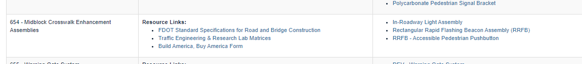
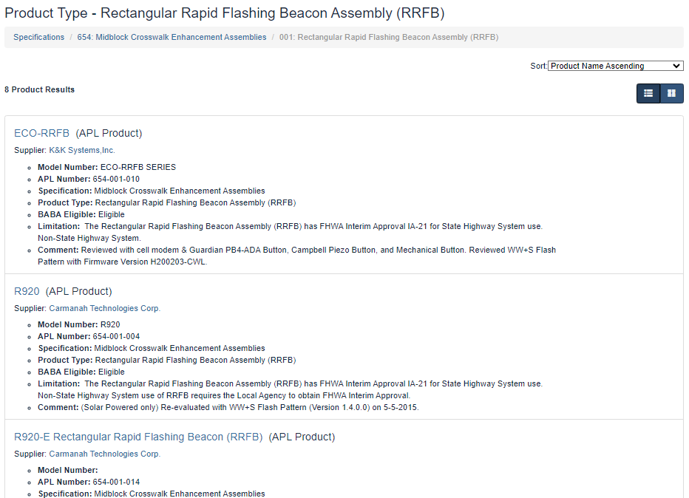
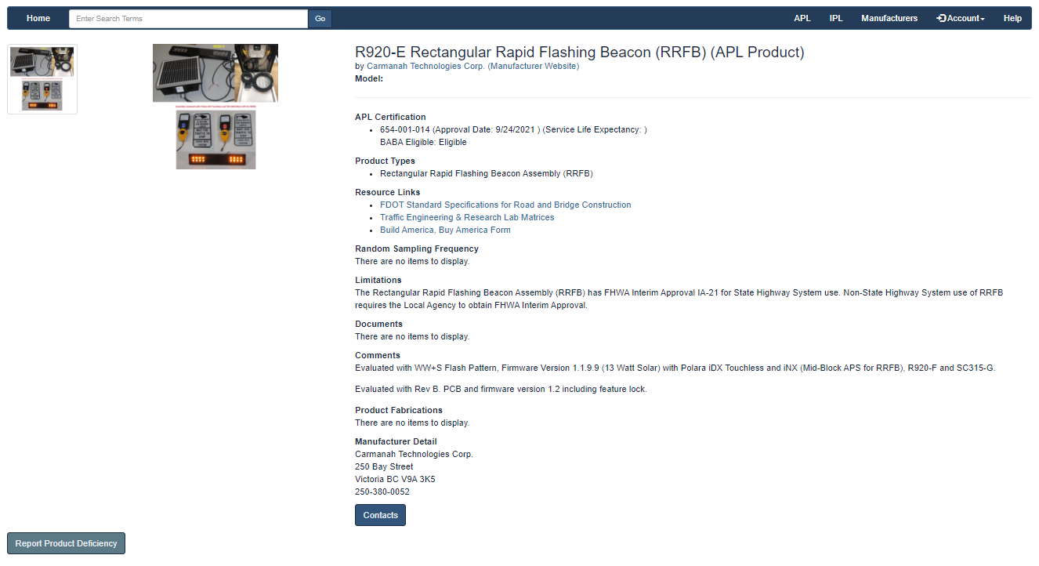
APL Product Example: viewing products
1. Select Product Type from Spec Section
Product Name
APL# and Eligibility
Limitations
Comments
2. Review or Select Product
3. Review Product details, instructions, warranty, and/or photos
Reminder: Contractor selects from all acceptable products, unless there is an approved Sole Source and specification change.

Slide 21
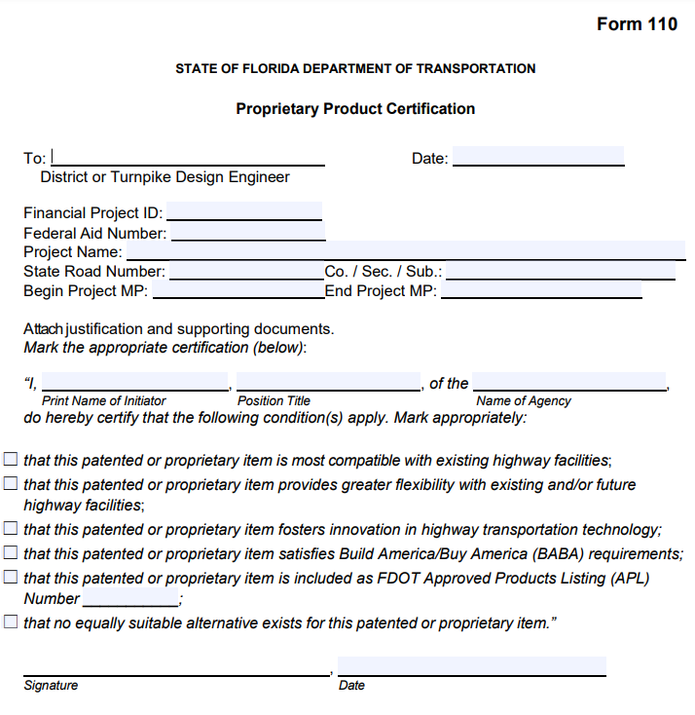
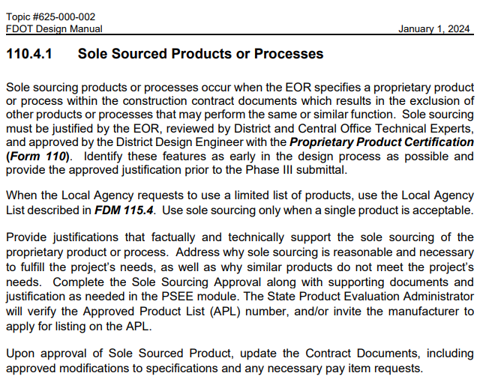
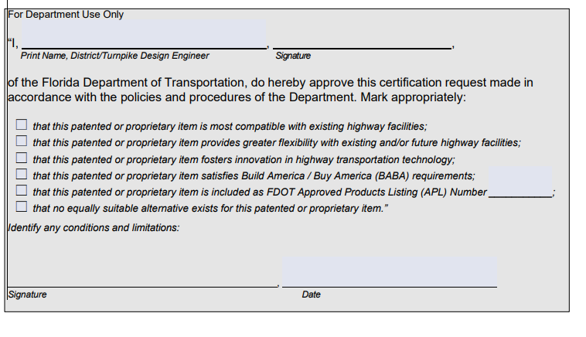
FDOT Implementation-
What does the DESIGNER need to do for non-standard products?
Follow the FDM
Multiple products: MSP- update spec requirements
ONLY 1 product: MSP to identify product and APL#
Local Agency List
Justification should support sole sourcing,… as well as why similar products do not meet the project’s needs.
Not used for selecting “favorites”
NEW

Slide 22
FDOT Implementation-
What does the DESIGNER need to do?
PSEE
  Form 110
  Justification and Supporting documentation:
    Draft of MSP
    Draft of Plan Detail, if applicable
Reviewers: Verify APL# on form
Agency-EOR-FDOT approval; NOT contract language
Contract Package
  Plans: Show the location and/or dimensions
  Specifications:
    MSP for changing Material Requirements
    Local Agency List specification
  Estimates (EQ Report): Document quantities by location
FDOT-Contractor legal language

Slide 23

Designer- Requesting an APL number
Standard Product Types
Requirements included in the Standard Specifications
Do not add “optional equipment” to APL product description
Manufacturers must submit documentation, per the Specifications
Designer or Product Evaluation may invite manufacturer to submit an APL application
Non-Standard Product Types
Follow the FDM
  Form 110
  MSP (expanding/limiting APL)
  TSP (spec Section not in book)
Product Evaluation, with input from manufacturer and applicable Technical Experts, will review documents
APL# available for Project
Next Specification cycle: Technical Expert will consider need for future specification changes

Slide 24
Construction
FDOT Engineer
Construction Engineering Inspector (CEI)

Slide 25
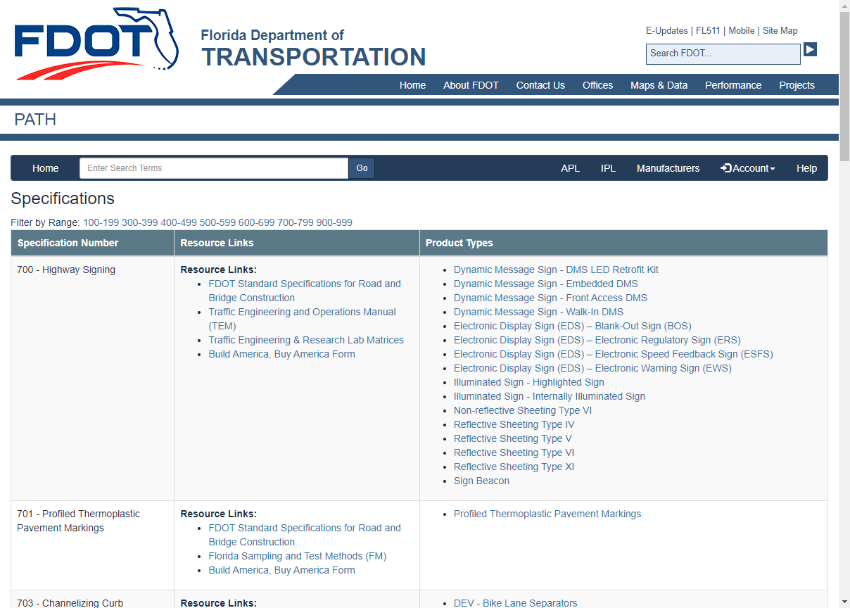
Construction Engineer/CEI
APL Items: Document APL# and quantity in MAC
    Products listed by Brand/Model Number
    Product Type (group) listed by one number for exempt products
    Review Comments and Limitations for the APL#. Note any restrictions to size, model, software version, etc.
    Verify the product/label images with the product supplied in the field
Non-APL Items: Contact Product.Evaluation@dot.state.fl.us
    FDOT Project number
    Applicable specification section number
    Product name and/or model number
    Technical Data Sheet
    Other details showing materials, if available
    Manufacturer and website, if available
ALL Items: Refer to the specification for
    Acceptance requirements (field acceptance)
    Warranty requirements
    Measurement & Payment

Slide 26
APL Product Example: viewing & verifying products
1. Select Product Type from Spec Section
Product Name
APL# and Eligibility
Limitations
Comments
2. Review or Select Product
3. Review Product details, instructions, warranty, and/or photos
Reminder: Contractor selects from all acceptable products, unless there is an approved Sole Source and specification change.

Slide 27
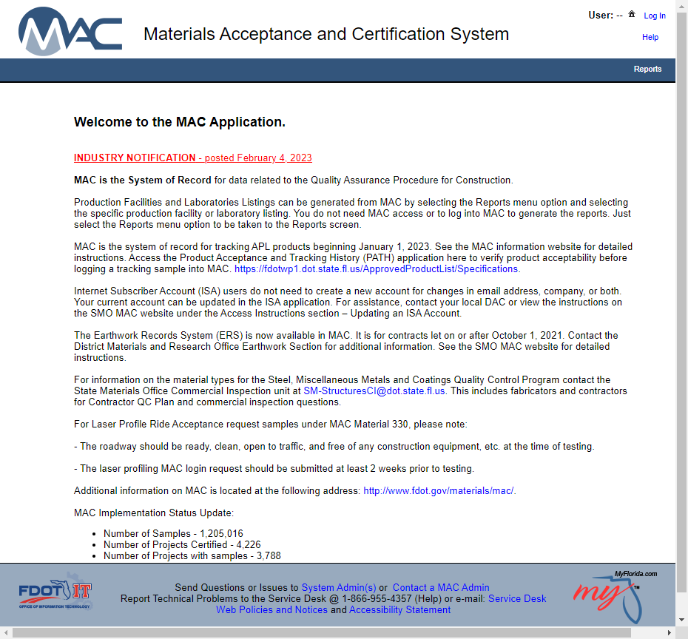
Construction Engineer/CEI
Document in MAC
Refer to MAC web pages for complete instructions and training
Sample Login
Contract/Project
Pay Item
Method of Acceptance
APL#
Date, Quantity, Unit
Batch #, Wall #, Bridge # if applicable
Perform Test, Result Entry: Yes- meets APL requirements
See MAC instructions for pay items with multiple APL#s

Slide 28
Construction Engineer/CEI
Monthly Daily Estimates
Verify that all APL#s have been recorded in MAC for Items and Quantities.
Failure to document products installed on the project could result in loss of federal funds (FHWA and other Federal Funds) for the entire contract.

Slide 29
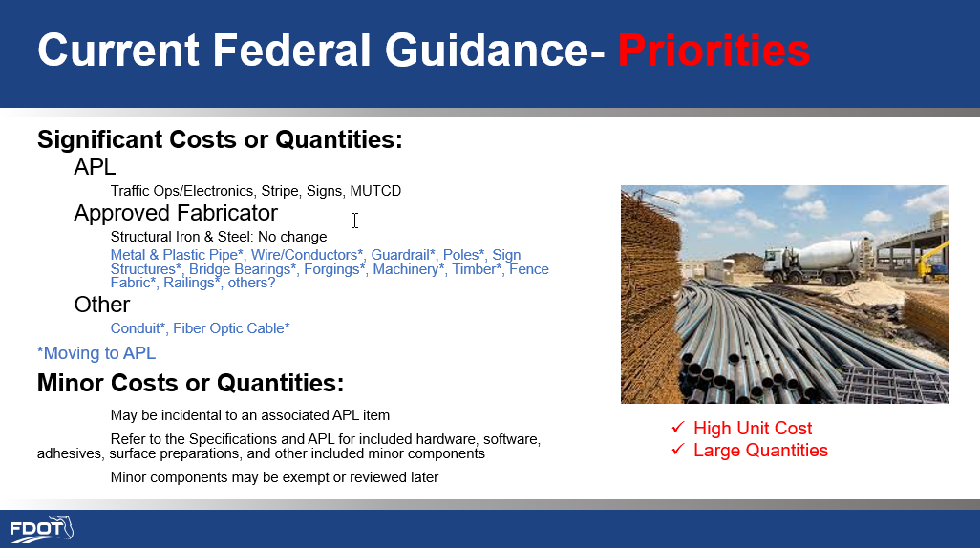
Reviews
Constructability Reviews during design: Ensure products are available on the APL prior to approval.
Construction Reviews- Products and/or Materials Identified during Construction (may include Supplemental Agreements, Work Orders, Shop Drawings, and Push Button Contracts):
Consider the Instructions to Designers, to ensure that APL products are available. Request an APL #, as needed
Comply with all Division I specifications, including
  Section 5 Control of the Work (5.1.2 Shop Drawings)
  Section 6 Control of Materials (Source of Supply and BABA)

Slide 30
Contractor
FTBA Partners, Contractors, Subcontractors, and others performing work on FDOT Contracts

Slide 31
Contractor
Product Types will be added to the APL
  High Cost & High Quantity Construction Materials
    Metal & Plastic Pipe*, Wire/Conductors*, Guardrail*, Poles*, Sign Structures*, Bridge Bearings*, Forgings*, Machinery*, Timber*, Fence Fabric*, Railings*, Conduit*, Fiber Optic Cable*
  Non-Standard Products: Project Specific Approvals
  Other
    Hardware and Incidentals may be associated with other APL products, per the specifications

Slide 32
Contractor
Contractors are invited to submit names of products, suppliers/fabricators, and manufacturers not currently listed on the APL.
Approved Fabricators must comply with State Materials Office requirements, as well as verify BABA compliance. The list of approved fabricators will move from MAC to APL.
For Standard Products, Product Evaluation will reach out to verify BABA compliance, and/or invite the manufacturer to submit an APL application.
  Product.Evaluation@dot.state.fl.us :
    FDOT Project number
    Applicable specification section number
    Product name and/or model number
    Technical Data Sheet or other details showing materials, if available
    Manufacturer and website, if available
For Non-Standard Products, project specific specifications are applicable; products may receive project specific approval, after verifying BABA compliance.
As always, Manufacturers may submit an unassigned product application. Technical Experts will review the application, related specifications, and FDOT needs.

Slide 33
Manufacturer or Producer
Current APL Products
Current Approved Producers (MAC)
Manufacturers & Producers
Construction Materials new to APL
Manufactured Products new to APL
Incidental Products and other non-listed products

Slide 34
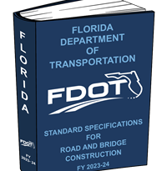
Manufacturer or Producer
Temporary Product or Tool: ¹Exempt from BABA; APL still applies
Aggregate & Binders: ¹Exempt from BABA; specs still apply
Iron or Steel^{1,2}
Construction Material^{1,2}
Manufactured Product^{1,3}
Electronics
Non-electronics
Unlisted Products (Plants, Natural rubber): ¹Exempt from BABA
Requirements
¹See the Specifications (book or Contract Documents) for the applicable use
²Approved Fabricator requirements may apply
³Per the specification, additional production facility requirements may apply

Slide 35
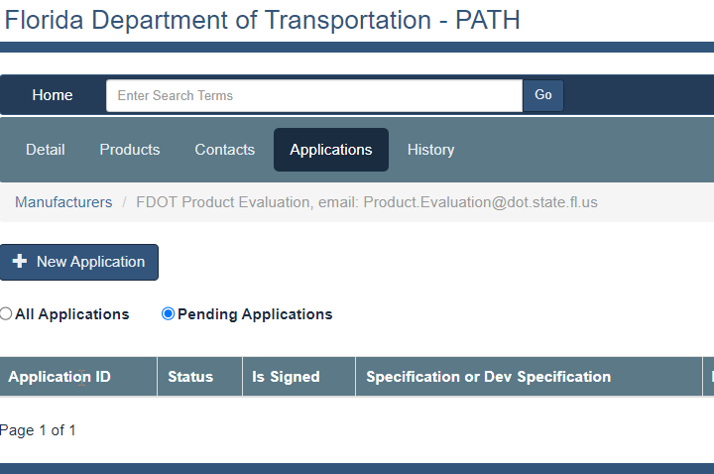
Manufacturer or Producer
Read the Specification to identify Product/Material Requirements
Sign-in to your account
Submit an Application
Helpful Hints:
Include requested documents & photos
Include requested test reports
Include requested manufacturer’s installation instructions
Application will be reviewed by Product Evaluation and/or the Technical Expert for that specification

Slide 36
Local Agencies
Towns, Cities, Counties, and other Maintaining Agencies
See Designer Instructions for design phase activities

Slide 37
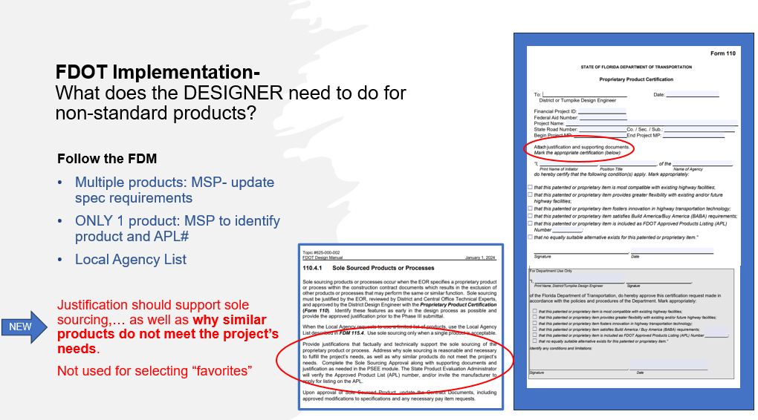
Local Agencies- limiting APL items
See the FDM for coordination activities during Design phases
See the Designer Instructions for non-standard products or materials
NEW Proprietary Product Certification Form
  Justification should support sole sourcing,… as well as why similar products do not meet the project’s needs.
  Not used for selecting “favorites”
Commonly requested Sole Source items:
  Current: MSP to change from “use any APL…” to “use the following APL item…”
  Pending: Local Agency List to limit APL for all projects with that agency (controller, cabinet, and similar compatibility items)

Slide 38
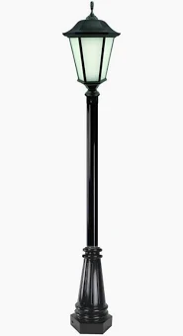
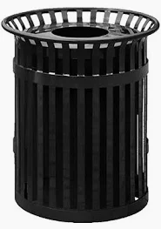
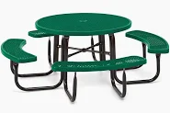

Local Agencies- Unique Products
See the FDM for coordination activities during Design phases
See the Designer Instructions for non-standard products or materials.
Unique Products may require further review.
Other Federal Funds on the contract?
BABA classification of the proposed product or material?
Where is it produced/manufactured- not just sold/distributed?
What is the source of materials? Made from domestic materials?
Are other similar domestic products available?
Failure to identify a domestically sourced product may require a design change. Separate funds cannot be used to circumvent BABA requirements.

Slide 39

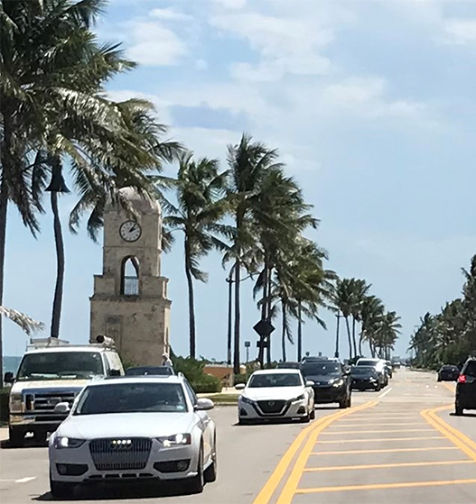
Local Agency Requests and
Florida Statute 316.0745
http://www.leg.state.fl.us/statutes/index.cfm?App_mode=Display_Statute&URL=0300-0399/0316/Sections/0316.0745.html
(3) All official traffic control signals or official traffic control devices purchased and installed in this state by any public body or official shall conform with the manual and specifications published by the Department of Transportation pursuant to subsection (2).
(4) It shall be unlawful for any public body or official to purchase, or for anyone to sell, any traffic control signal or device unless it conforms with the manual and specifications published by the Department of Transportation and is certified to be of such conformance prior to sale. Any manufacturer or vendor who sells any traffic control signal, guide, or directional sign or device without such certification shall be ineligible to bid or furnish traffic control devices to any public body or official for such period of time as may be established by the Department of Transportation; however, such period of time shall be for not less than 1 year from the date of notification of such ineligibility.
(8) The Department of Transportation is authorized to permit traffic control devices not in conformity with the uniform system upon showing of good cause.

Slide 40
Local Agency Projects
Let with FDOT Project
  Any FHWA funding, the entire Contract is Federalized- use APL for all products, including Local Items.
  Other Federal Funds, the entire Contract is Federalized
    Majority FHWA funds, see above
    Majority Other Federal Funds- rules from other Agency apply. FHWA Waiver for Manufactured Products is NOT applicable. Need to determine domestic compliance for all Manufactured Products.
  No known Federal Funds, follow Section 6 and APL.
Let by Local Agency
Any Federal Funds- follow the rules of the agency with the greatest Federal Funding.
No Federal Funds- follow the Local Agency’s specs.
  No domestic compliance rules: BABA is not applicable
  “Follow FDOT Specifications” would require following Section 6 and APL.

Slide 41
Contracts with Local Agency Projects
Contract
(All Projects let together)
Any Project has FHWA Funding
Entire contract is Federalized
Follow Section 6 and APL
FHWA Waiver for Manufactured Products applies
FDOT Projects with no known Federal Funds
“Hidden” Federal Fund codes may be present
Project remains eligible for Federal Funds
Follow Section 6 and APL
FHWA Waiver for Manufactured Products applies. Exceptions may be requested during design for unavailable products
No FDOT or FHWA, other Federal Funds
Entire contract is Federalized
Follow the rules of the Federal Agency providing the greatest funding.
FHWA waiver for Manufactured Products does NOT apply.
No FDOT Projects, No Federal Funds
(Local Agency let)
Follow Local Agency’s Rules
FDOT Contracts
Local Agency Contracts

Slide 42
Utilities
Unique rules apply, as products/materials may be purchased & installed with Federal Funds, but remain the property of the utility upon acceptance

Slide 43
Utilities- Self Certification for materials
Rights & Responsibilities
Utility may certify products meet Federal Rules
Utility must retain documentation for any Federal audit
Optional for Commonly used items
Pipe, conduit, conductors, etc.
Contact Product Evaluation about adding product types to the APL; ongoing discussions between FDOT and Utilities

Slide 44
Summary
Current Federal Guidance
  IIJA: OMB + FHWA
  FDOT Implementation- APL & MAC
Design activities
  Standard Products/Materials
  Non-Standard Products/Materials
  Exceptions/waivers
Local Agency Requests
  Sole Source APL items
  Non-standard Items
  FDM and Specification Changes
More BABA details, as they are available from the Federal level.
APL may be updated to comply with updated guidance.
See product comments and limitations for additional notes.

Slide 45

Notifications from FDOT Product Evaluation: BABA & Spec updates
Manufacturers within PATH
Current contact(s) will be notified, per the Manufacturer’s preferences
Designers, Contractors, FDOT Staff, and all others:
FDOT Contact Management/E-Updates and Contact Mailer will be used https://www.fdot.gov/designsupport/ contactdatabase.shtm
Materials Acceptance and Certification System (MAC)
https://www.fdot.gov/materials/ mac/default.shtm

Slide 46
Questions?
Submit through GoTo
  Answered as time permits
Q&A from all sessions
  Will be posted on Product Evaluation’s web page, following all presentations
Implementation Plan with FAQs will be posted online
PowerPoint will be sent to all registered participants

Slide 47


Contact Us:
Product Evaluation
Karen.Byram@dot.state.fl.us
Administrator
Melissa.Hollis@dot.state.fl.us
Product Specifications Coordinator
Sarah.Smith@dot.state.fl.us
PATH System Support & Manufacturer Coordinator

