Slide 1
PD&E Studies on Interstate System
An Introductory Overview Course
8/9/2018

Slide 2
Learning Outcome
Understand how the interchange access request fits within PD&E studies
Apply the elements of the FHWA Policy for approving Interstate PD&E Studies
NOT covering details of the FDOT IAR approval process

Slide 3
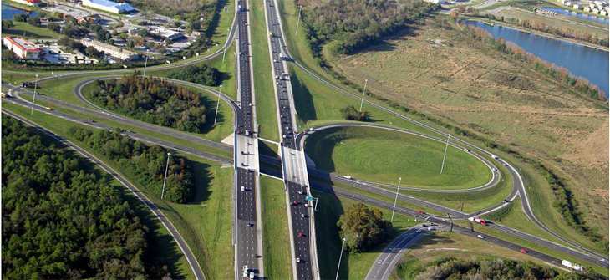
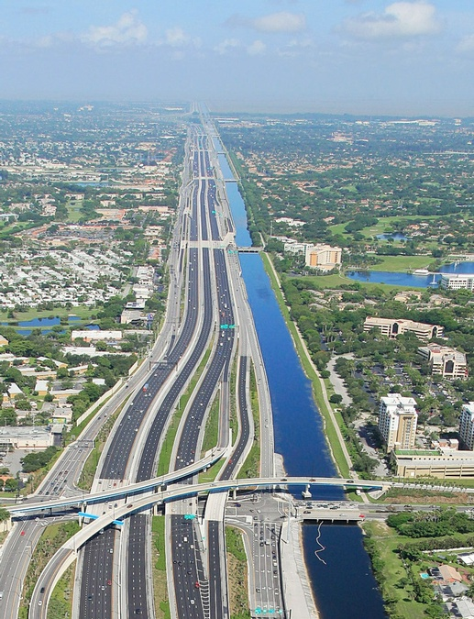
What is an Interstate Access?
A grade separated intersection or Interchange. It is composed of
Entry and exit ramps allow traffic to enter or exit a freeway
Auxiliary lanes connecting entry and exit ramps
Access to collector distributor (CD) systems between a pair of interchanges
A complete interchange accommodates movements in all applicable directions; a partial interchange has some missing connections
Control of Access Rights (Access Management)

Slide 4
Importance of Managing Interstate Access
Managing access (i.e. the location and design of interchanges) is essential to maintaining the safety and efficiency of the Interstate System
Interchanges are essentially points of traffic conflict and may create “turbulence” in the traffic flow under high volume and high speed conditions.
Providing access to the Interstate System from other portions of the highway network is critical to the performance of the system or network. However, poor designs or too closely spaced ramps within a freeway segment can greatly diminish traffic operations and safety.

Slide 5
Importance of Managing Interstate Access
Any proposal to add or change interstate interchanges can potentially have an adverse impact on the ability to effectively and safely accommodate travel demand on a facility.
Any proposal for a new interchange or modification of an existing interchange requires justification and approval.
Justification is completed through the Interchange Access Request (IAR) process—which includes justification report and approval [23 USC 111]

Slide 6
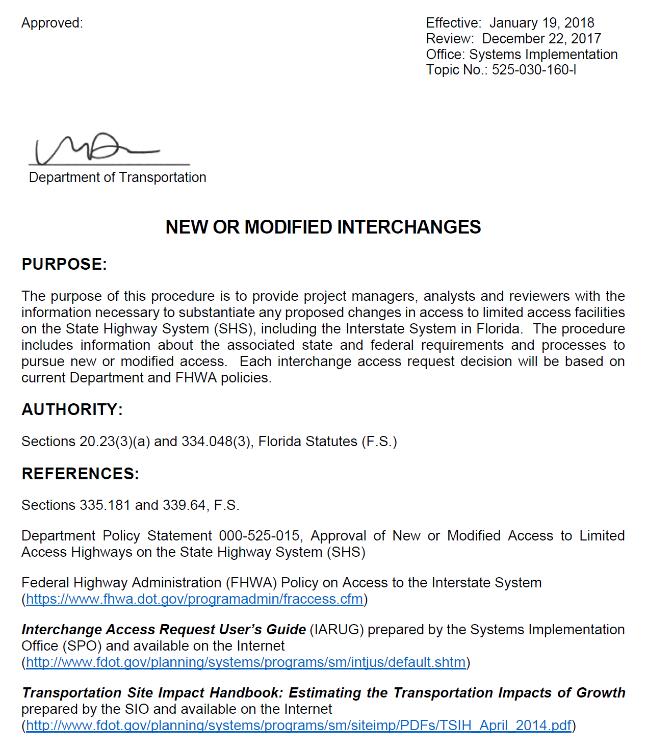
FDOT’s IAR Process
Contain
Analysis requirements
Approval Requirements
Delegation of Approval
IARs are processed by the State Interchange Coordinator from Systems Implementation Office
Interchange Access Request User’s Guide
New or Modified Interchanges Procedure

Slide 7
Types of IARs
Interchange Justification Report (IJR) – for a new interchange. Requires the highest level of analysis and documentation.
Interchange Modification Report (IMR) – for modification of an existing interchange
Systems Interchange Modification Report (SIMR) – for multiple interrelated interchanges on projects involves multiple interchanges. Likely in urban areas
Interchange Operational Analysis Report (IOAR) – for minor modifications to an interchange that does not require an IMR

Slide 8
FHWA Policy on Access to Interstate System
It is in the national interest to preserve and enhance the Interstate System to meet the needs of the 21st Century by assuring that it provides the highest level of service in terms of safety and mobility. Full control of access along the Interstate mainline and ramps, along with control of access on the crossroad at interchanges, is critical to providing such service.
Therefore, the Federal Highway Administration's (FHWA) decision to approve new or revised access points to the Interstate System under Title 23, United States Code (U.S.C.), Section 111, must be supported by substantiated information justifying and documenting that decision. The FHWA's decision to approve a request is dependent on the proposal satisfying and documenting the following requirements:
Current FHWA Policy Effective May 22, 2017

Slide 9
FHWA Policy Considerations and Requirements
An operational and safety analysis has concluded that the proposed change in access does not have a significant adverse impact on the safety and operation of the Interstate facility or on the local street network based on both the current and the planned future traffic projections… [meeting 23 CFR 625.2(a), 655.603(d) and 771.111(f))].
The proposed access connects to a public road only and will provide for all traffic movements. Less than "full interchanges" may be considered on a case-by-case basis for applications requiring special access, such as managed lanes or park and ride lots… [meeting 23 CFR 625.2(a), 625.4(a)(2), and 655.603(d)].

Slide 10
Application of the FHWA Policy
Policy applicable to:
New or revised access points to existing Interstate facilities regardless of the funding
Routes approved as a future part of the Interstate System under 23 U.S.C. 103(c)(4)(B) represent a special case

Slide 11
Application of the FHWA Policy
Each break in the control of access to the Interstate System right-of-way is considered to be an access point.
For the purpose of applying FHWA Policy, each entrance or exit point, including "locked gate" access, is considered to be an access point. For example, a diamond interchange configuration has four access points.
Ramps providing access to rest areas, information centers, and weigh stations within the Interstate controlled access are not considered access points
Any change in the design of an existing access point is considered a change to the interchange configuration

Slide 12
Policy Point One
An operational and safety analysis concludes there is no significant adverse impact
Interstate mainline, ramps, crossroad and intersections
A minimum LOS is not prescribed by FHWA
What constitutes accommodating traffic volumes “safely and efficiently” is based on context and should be agreed upon as part of the project development process.

Slide 13
Policy Point Two
The proposed access connects to a public road only and will provide for all traffic movements.
Intent of this requirement:
Avoid adding Interstate access that exclusively serves a narrow, private interest
Ensure the operational integrity of the crossroad

Slide 14
FHWA Policy
In the memo releasing the 2017 Interstate Access Policy, FHWA stated that
“…The FHWA has identified several areas where the current Policy may be streamlined to eliminate duplication with other project reviews. The new Policy will now focus on the technical feasibility of any proposed change in access in support of FHWA's determination of safety, operational, and engineering acceptability. Consideration of the social, economic, and environmental impacts and planning considerations will be addressed through the National Environmental Policy Act (NEPA) review of the project.
This change will eliminate the potential for duplicative analysis of those issues in the State DOT's Interstate Access report and the NEPA documentation. The change will allow State DOTs to submit only a single technical report describing the types and results of technical analyses conducted to show that the change in access will not have significant negative impact on the safety and operations of the Interstate System…..”
https://www.fhwa.dot.gov/design/interstate/170522memo.cfm
All requests for new or revised access points on completed Interstate highways must closely adhere to the planning and environmental review processes as required in 23 CFR 450 and 771.
The FHWA approval constitutes a Federal action and, as such, requires that the transportation planning, conformity, congestion management process, and the NEPA procedures be followed and their requirements satisfied.
The final FHWA approval of requests for new or revised access cannot precede the completion of these processes or necessary actions.

Slide 15
IAR Environmental Review Requirements
These the other 2009 Policy Requirements not included in 2017 Policy
Typically, PD&E study for interstates projects includes evaluation and documentation of the 2009 Policy Points

Slide 16
2009 Policy Point 1
The need being addressed by the access request proposal cannot be adequately satisfied by existing interchanges to the Interstate, and/or local roads and streets in the corridor can neither provide the desired access, nor can they be reasonably improved.
Documented and discussed in the Purpose and Need Section of the Environmental Document and PER.

Slide 17
Intent of 2009 Policy 1
Convey the purpose and need for the requested access change
Access is needed for regional traffic needs and not only to solve local system or developer needs or problems.
Describe why the existing access points and the existing network is unable to meet those needs
Consider a wide array of alternatives including improvements to existing interchanges and the local system
Capacity improvements to existing interchanges and surface streets
Traffic control modifications
Access management improvements along surface streets
Improving ramp terminals and adjacent intersections

Slide 18
2009 Policy Point 2
The need being addressed by the request cannot be adequately satisfied by reasonable transportation system management alternatives.
Discussed in the Alternatives section of the PER and summarized as appropriate in the EA or EIS.

Slide 19
Intent of 2009 Policy 2
Consider all reasonable alternatives including:
Interchange location
Interchange configurations
Local network modifications
TSM&O improvements

Slide 20
Intent of 2009 Policy 2
The requirement to “ assess ” various options is NOT intended to require extensive and costly engineering analysis for options determined to be impractical
There are many locations where TSM&O options are not applicable
The Policy does NOT require implementing TSM type improvements, but in some instances mitigation strategies such as ramp metering may be necessary for the concept to function properly

Slide 21
2009 Policy Point 5
Evaluation of consistency with local and regional land use and transportation plans.
Consistency with local and regional transportation plans is included in the Planning Consistency Section of the Environmental Document.
Detail evaluation of consistency with local and regional land use plan is included in the PER and summarized in the Social and Economic section of the Environmental Document.

Slide 22
Intent of 2009 Policy 5
Assure the proposal is consistent with the current transportation plan, and that it reflects appropriate coordination.
Complement the federal regulations regarding air quality conformance
The inclusion of a project involving new Interstate access within a current transportation plan is not a guarantee of the approval of access by FHWA.

Slide 23
2009 Policy Point 6
A comprehensive corridor or network study was completed within the context of a longer-range system or network plan if the potential for future multiple interchange additions exist.
If required, this is addressed and documented in the traffic analysis report and also summarized in the Alternatives section of the PER.

Slide 24
Intent of 2009 Policy 6
Avoid conflicts with other proposed changes in access or corridor improvements
Reinforce the need for longer range planning and to be proactive in issues of added or changed access
Assess and account for the cumulative system effects of access changes
Not all Interstate access approvals within a corridor study need to be approved simultaneously – the individual projects may advance at different time frames

Slide 25
2009 Policy Point 7
Appropriate coordination has occurred between the development and any proposed transportation system improvements when the proposal is due to a new, expanded, or substantial change in current or planned future development or land use.
If required, this is addressed through public involvement process and the ETDM process and summarized in the Alternatives and Previous Planning Studies sections of the PER.

Slide 26
Intent of 2009 Policy 7
Ensure alternatives developed have logical termini and independent utility, Avoid the “Interchanges to Nowhere Problem”
Coordinate the proposed improvements with other street system improvements associated with the land development that is driving the request. Some access approvals may require contingencies or “pre-conditions” involving timing of other improvements.

Slide 27
2009 Policy Point 8
The proposal can be expected to be included as an alternative in the required environmental evaluation, review and processing.
This is contained in the Project Description section of the Environmental Document and PER and is part of the alternatives analysis documented in the Alternatives section of the PER.
This is NEPA or PD&E Study

Slide 28
Approval Process (Post NEPA Assignment)
Has three steps
Complete Safety, Operational and Engineering (SO&E)
Complete NEPA, LDCA granted by OEM
Final Approval by FHWA
Two Different Federal Actions…Two Approval Decisions
Before Assignment, IAR Approval composed of 2 steps
Engineering and Operational (E&O) Acceptability
Final Approval when NEPA was signed by FHWA
NEPA Approval
FHWA assigned environmental review responsibilities including approval of NEPA Documents to FDOT on December 14, 2016, under 23 U.S.C 327
Interchange Access Approval
FHWA retains approval of new or revised access points to the Interstate System, under 23 U.S.C 111
Access approval after NEPA Approval

Slide 29
Approval Process (Post NEPA Assignment)
FHWA approval of interstate access request relies on NEPA document (PD&E Study) approval for :
Discussion of need for the change in access
Analysis of environmental impacts
Evaluation of planning consistency and fiscal constraint
Coordination and consistency with current & planned future development and land use plans

Slide 30
Approval Process (Post NEPA Assignment)
2
3
1

Slide 31
Major Steps in IAR/SO&E Acceptability
Methodology
Analysis—Report
Acceptability determination by FDOT and FHWA, as appropriate
FHWA approval of interstate access request relies on NEPA document (PD&E Study) approval

Slide 32
IAR and Pre-Construction Phases
Scope Design
Public Involvement
Planning Consistency/ Fiscal Constraint
Environmental Document
Re-evaluation
Permits
Interchange & Intersection Analysis
Social, Cultural, Natural, Physical Impact Analysis
Preliminary Design and Concept Plans
Type 1 CE Checklist
Programming
Traffic and Safety Analysis
Purpose and Need
Develop Evaluate Alternatives
Need
Planning
Scope PD&E Study
PD&E Study
NEPA
Approval
Design
ACE
Right of Way
Value Engineering
ETDM
Interchange Access Request can occur in one of the three pre-construction phases

Slide 33
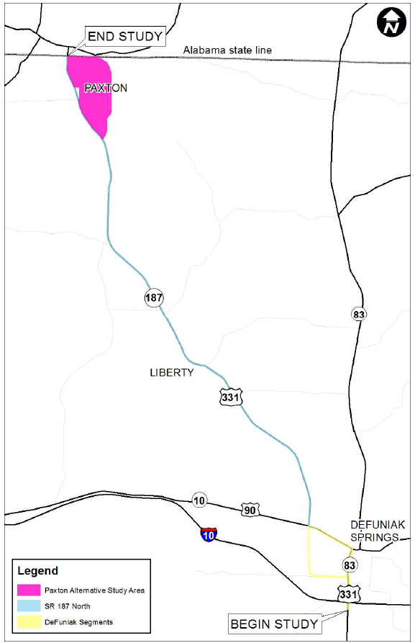
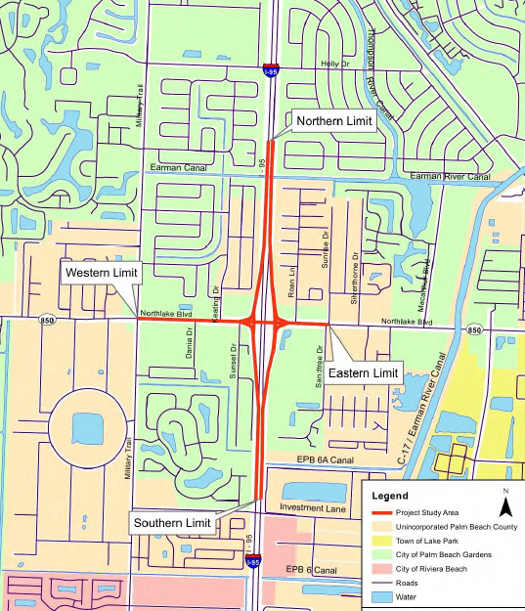
IAR Analysis in NEPA Review
Scope of PD&E Study Vs. Scope of IAR analysis
Coordination between District Interchange Coordinator and the District Environmental Office is required

Slide 34
IAR Analysis in NEPA Documents
A. IAR completed before PD&E Phase
IAR completed concurrent with PD&E Study
IAR on a project that does not require a PD&E Study

Slide 35
IJR completed before PD&E Phase
IAR alternatives are evaluated during the PD&E Study
Reference or adopt IAR analysis in the PD&E Alternatives Evaluation
Document IAR analysis to a standard that can be adopted in NEPA
Use the Alternative Corridor Evaluation (ACE) process for new corridors.

Slide 36
IAR Completed Concurrent with PD&E Study
Two Conditions:
1. Scope of IAR analysis is the same as PD&E Study
PD&E Study traffic analysis is the IAR analysis
Project Traffic Analysis Report is not needed
PER references the IAR analysis report
2. PD&E Study Scope is larger than IAR Scope
IAR analysis is a component of PD&E Study Traffic Analysis
Project Traffic Analysis Report is prepared and reference IAR
PER references Traffic Analysis and IAR analysis

Slide 37
Review of IAR Analysis in NEPA Documents
Review to make sure the IAR proposed that received SO&E acceptability determination is included in the alternatives evaluation
PER and Environmental Document should match IAR concept
Make sure “the other” 6 policy requirements are adequately addressed
If the Preferred alternative is different from SO&E design concept, SO&E would need to be reevaluated.
It is too late to start SO&E re-evaluation after Preferred Alternative is selected
District Interchange Coordinator should work with District Environmental Office
OEM Engineers attend District Interchange Meetings
OEM Engineers review IAR Methodology memo and Reports—No Approvals
Ask questions during Monthly Meetings with District Environmental Office

Slide 38
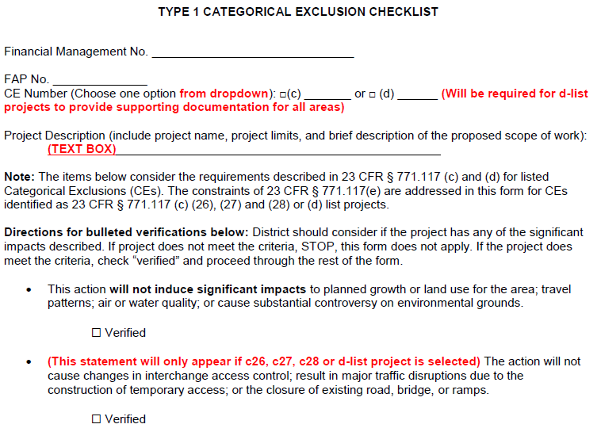
IAR on a Project with NO PD&E Study
Minor projects do not have a PD&E Phase—go straight to design phase
May involve IOAR (or certain types of IMR)
Environmental review is Type 1 Categorical Exclusion Checklist
IAR report is a separate stand-alone document
District Interchange Review Coordinator
Obtain determination of SO&E
Submit letter to FHWA after Type 1 CE is signed by the District Environmental Manager
OEM no involvement other than providing support

Slide 39
Re-evaluation of Interstate PD&E Studies
NEPA Re-evaluation is required
Design changes causing new or additional impacts
Federal-aid authorization for R/W and Construction phase
Project changes due to changes in laws or regulations
IAR Re-evaluation
Should be reevaluated whenever Significant change in conditions occurs (e.g., land use, traffic volumes, roadway configuration or design, or environmental commitments)
May be reevaluated when the project has not progressed to construction within 3 years of IAR approval

Slide 40
Re-evaluation of Interstate PD&E Studies
The three steps still hold!
IAR Re-evaluated
NEPA Re-evaluation Approved
Who is involved here?
When is reevaluation needed?
Who determines updated justification report is needed?
SO&E Determination Re-affirmed

Slide 41
Review of IAR Analysis in NEPA Re-evaluation
Review to make sure the IAR concept is the same as Design concept being re-evaluated
If the Design concept is different from IAR concept, SO&E would need to be reevaluated and final approval requested.
District Interchange Coordinator should work with District Environmental Office
OEM Engineers attend District Interchange Meetings, including those specific for IAR re-evaluation
Ask questions during Monthly Meetings with District Environmental Office

Slide 42
3-Year Re-evaluation Fear!
If the project is not constructed within this time period [3 years], FHWA may evaluate whether an updated justification report based on current and projected future conditions is needed to receive either an affirmative determination of safety, operational, and engineering acceptability, or final approval if all other requirements have been satisfied (23 U.S.C. 111, 23 CFR 625.2(a), and 23 CFR 771.129).
Overcome that “fear”!!!!

Slide 43
3-Year Re-evaluation Fear!
§771.129 Re-evaluations.
(a) A written evaluation of the draft EIS shall be prepared by the applicant in cooperation with the Administration if an acceptable final EIS is not submitted to the Administration within three years from the date of the draft EIS circulation. The purpose of this evaluation is to determine whether or not a supplement to the draft EIS or a new draft EIS is needed.
(b) A written evaluation of the final EIS will be required before further approvals may be granted if major steps to advance the action (e.g., authority to undertake final design, authority to acquire a significant portion of the right-of-way, or approval of the plans, specifications and estimates) have not occurred within three years after the approval of the final EIS, final EIS supplement, or the last major Administration approval or grant.
(c) After approval of the ROD, FONSI, or CE designation, the applicant shall consult with the Administration prior to requesting any major approvals or grants to establish whether or not the approved environmental document or CE designation remains valid for the requested Administration action. These consultations will be documented when determined necessary by the Administration.

Slide 44
Some Observed Issues during IAR Reviews
Policy Misunderstandings
Poor Purpose & Need
Ignoring Alternatives
Ignoring Other Users
Ignoring the Crossroad
Design criteria
Traffic Analysis Assumption and Tools
Inappropriate Traffic Data
Weak Safety Analysis
Improper Signing
Missing or too Much Documentation
“Assessing” vs. “Defending” Re-eval.
Avoid these Disagreements!
Source: FHWA Resource Center
dcisolution.com

Slide 45
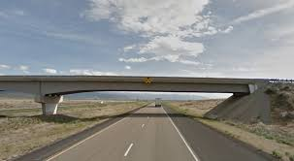
Overpasses, Underpasses
Do not require Interstate Access Request
Require Completion of NEPA
(bridge over Interstate potential a Type 1 CE)
Approval of Plans, Specs and Estimates
R/W Use Agreement

Slide 46
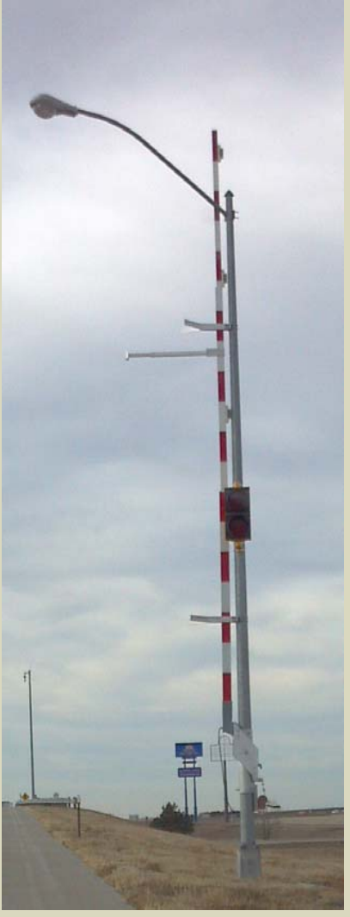
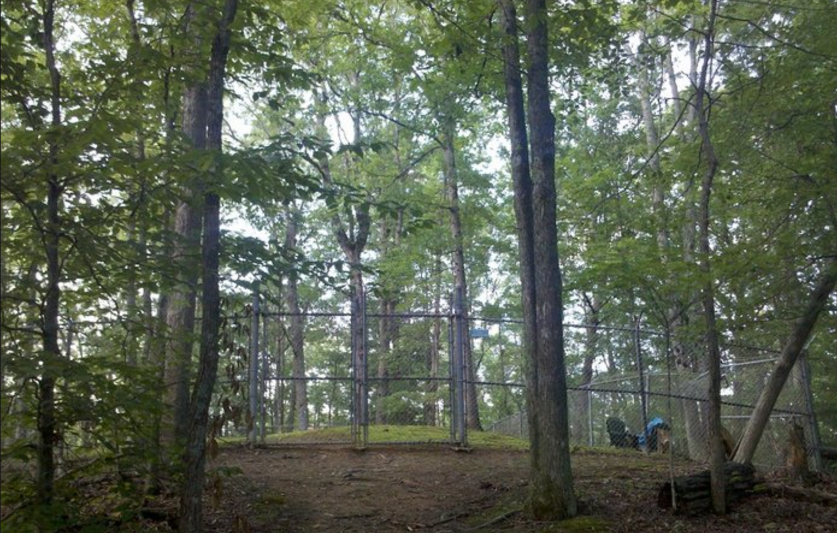
Locked Gate on the Interstate System
Used primarily to provide access for fire, medical and other emergency vehicles to reduce travel time, for maintenance activities at remote utility facilities and as part of the right-of-way consideration, to provide land access in remote locations.
Any request for Each new locked gate access approval needs to incorporate the following conditions:
The gate shall be locked at all times except when opened for passage of the authorized vehicles.
The access roadway will be constructed to discourage unauthorized use.
Require completion of NEPA (likely Type 1 CE)

Slide 47
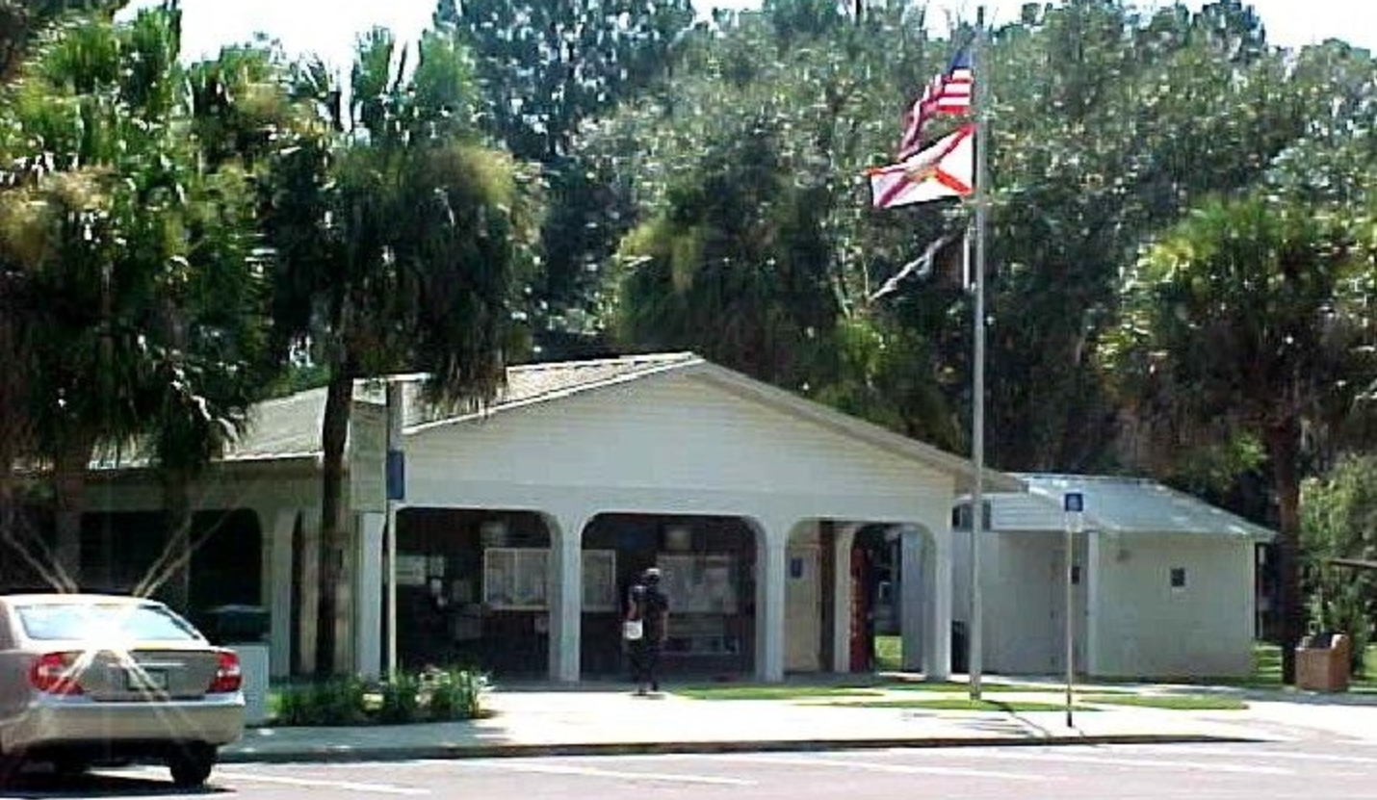
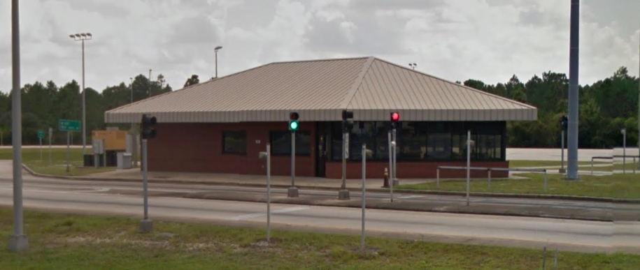
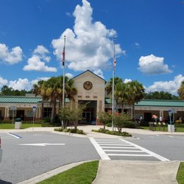
Rest Areas, Weigh Stations, Welcome Centers
Do not require IAR
Completion of NEPA is required

Slide 48
Rest Areas, Weigh Stations, Welcome Centers
Access by vehicles, pedestrians, and bicycles to the Interstate System through rest areas, information centers, or weigh stations from outside the Interstate control of access right of way is prohibited.
The only allowed exception is for access to adjacent publicly owned conservation and recreation areas if access to these areas is only available through the rest area, as allowed under 23 CFR 752.5(d).

Slide 49
Non IAR Improvements on Interstates
See 1.5.5 of Interchange Access Request User’s Guide
List various safety and operational improvements that do not require preparation of IAR.
Most of these due to their scope are Potential Type 1 CEs,
Add Capacity Non IAR Improvements would required higher COA

