Slide 1
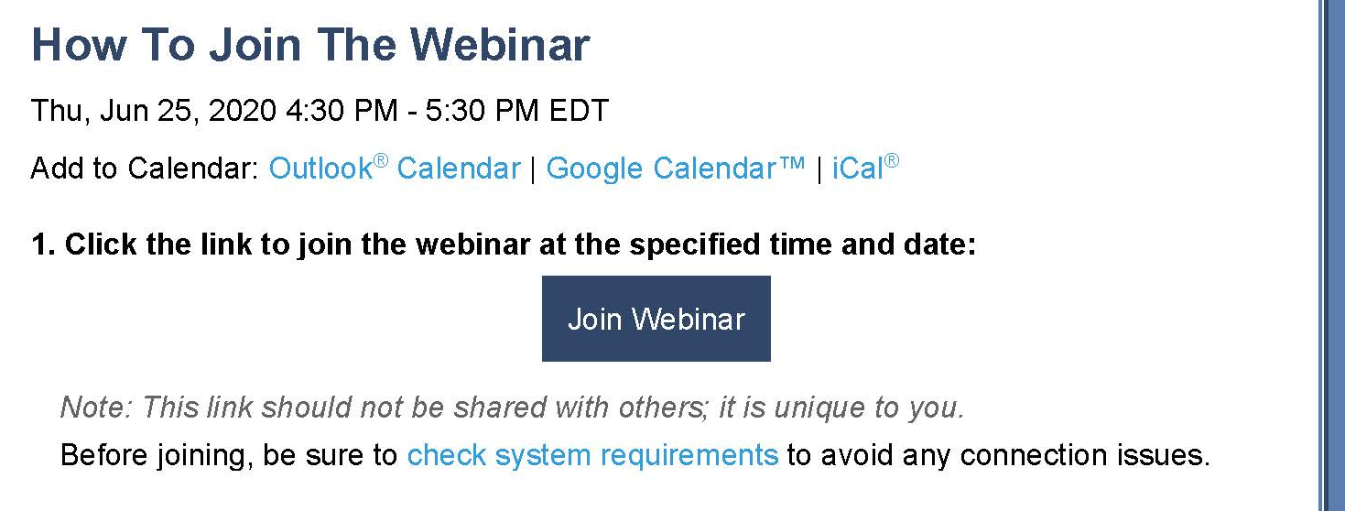
For technical issues, visit GoToWebinar online at:
Support.goto.com
Or through your confirmation email, click on check system requirements (as shown below):
Notes:
Thank you for joining us today. We are presenting in GoToWebinar for today’s training. If you have technical difficulties during the presentation, please refer to the “Support.goto.com” website, or use the “check system requirements” link in your confirmation email.

Slide 2
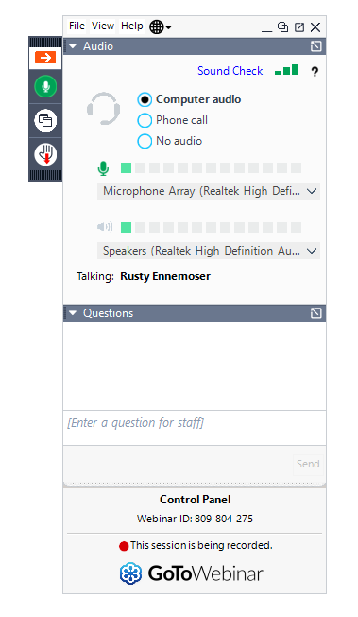
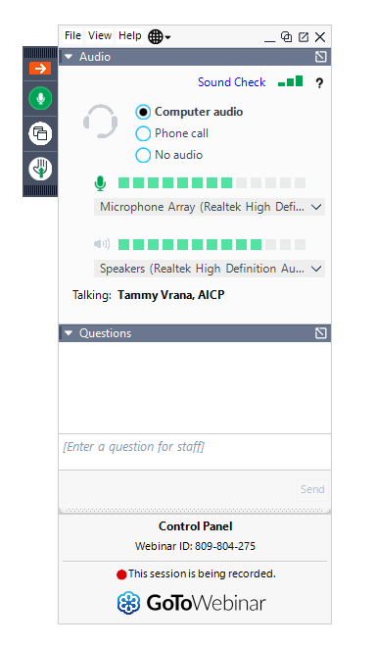

CONTROL PANEL - Computer
Test Attendee
Name, organization, question/ comment
To answer discussion questions, or ask a question during the presentation
Notes:
We wanted to share a few items to help you participate in this meeting. If you are using the legacy GoToWebinar, your screen and control panel may look like this. [HOVER MOUSE OVER CONTROL PANEL]
Depending on the version you have installed, you may also just have icons on the right that represent these options.
To listen to the meeting, your computer or device speakers are selected by default. If you prefer to listen through a phone call and not online, select “Phone call” [HOVER PHONE CALL] in the Audio pane of the control panel and dial-in using the information displayed.
If at any time you don’t see this panel and need to access it, just click on the orange arrow [HOVER ORANGE ARROW] and it will reappear.
We will be using the Question box for discussion during the presentation, as well as any questions you may have as we go along. Please feel free to post your questions and comments here at any time.

Slide 3
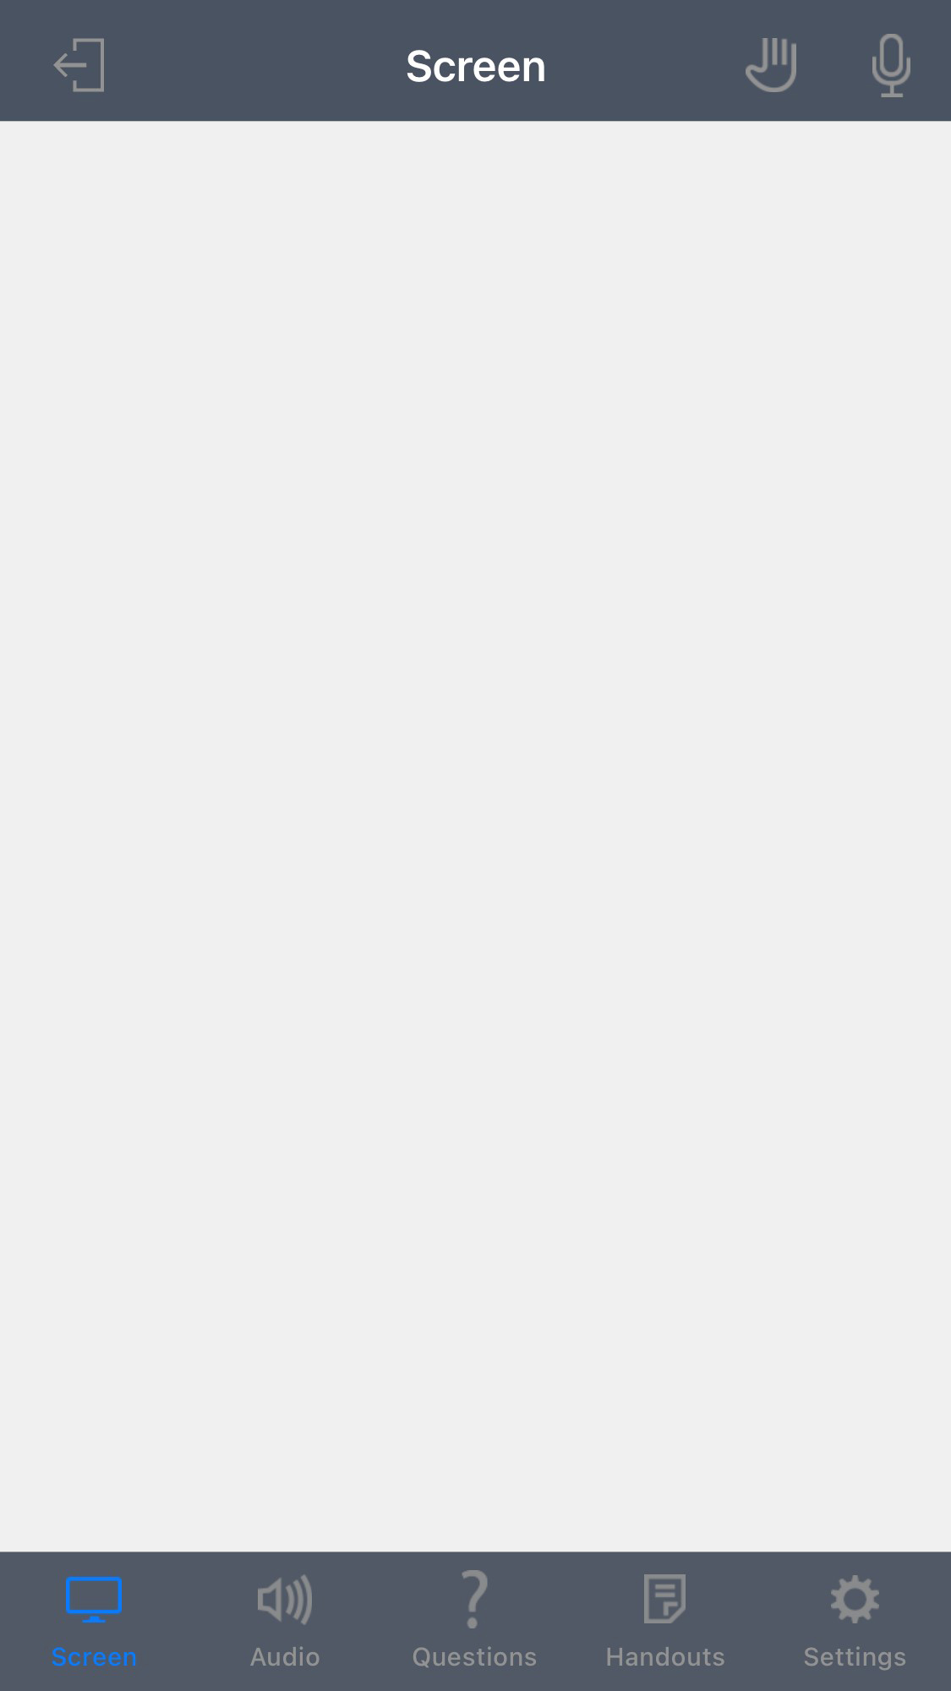

CONTROL PANEL – Mobile/Tablet
Mobile
To answer discussion questions, or ask a question during the presentation
Notes:
If you are using a tablet, you will have icons at the top of your screen or if you are using a phone they are normally at the bottom.

Slide 4
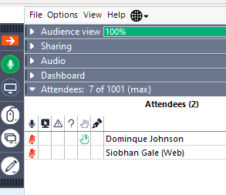
CONTROL PANEL - Computer
Test Attendee
Test Attendee
To raise hand to request to come off mute for discussion
Notes:
During the engagement points, there may be an opportunity to provide feedback based on your experience. If you would like to request to come off mute to discuss a key point, please “raise your hand” in the Attendees box.

Slide 5
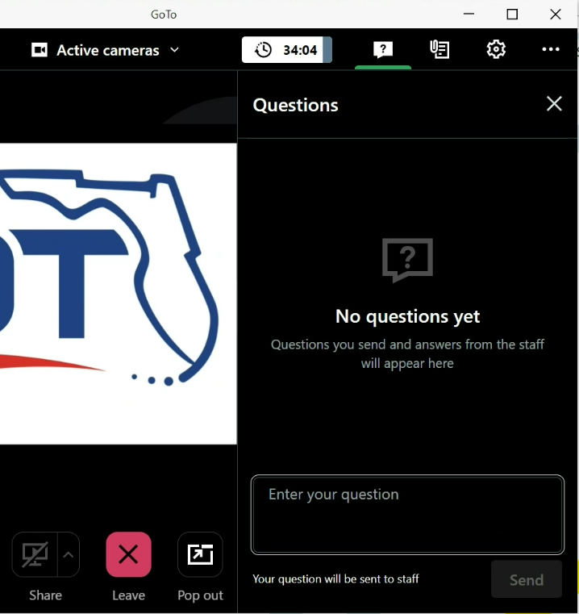
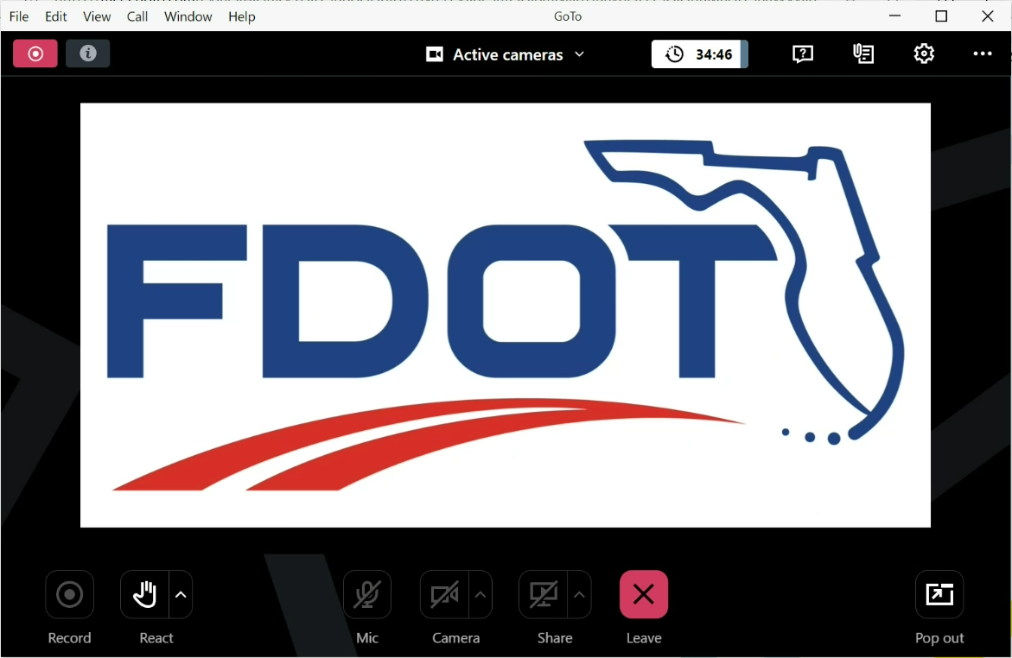
CONTROL PANEL - Computer
Name, organization, question/ comment
To answer discussion questions, or ask a question during the presentation
Notes:
Your screen may look like this if you have the newer versions of GoTo. The Question box will can be found with the question icon for your discussion opportunities and questions throughout the presentation.

Slide 6
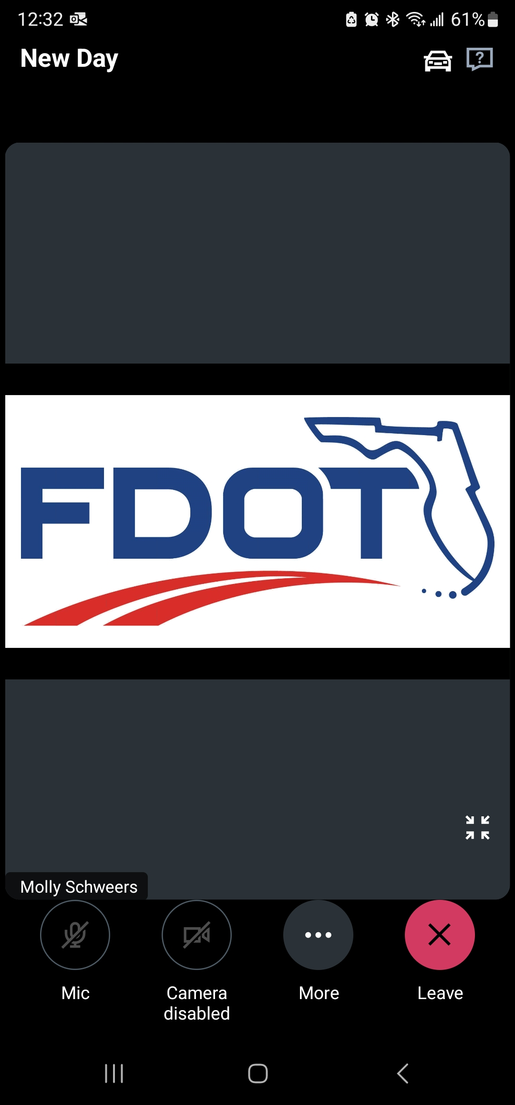
CONTROL PANEL – Mobile/Tablet
GoToWebinar
Mobile
GoToWebinar
To answer discussion questions, or ask a question during the presentation
Notes:
The Question box in the newer version of GoTo may look like this on a mobile device or tablet.
As a final housekeeping item- Please note that this training is being recorded and will be posted to the FDOT website.
Thank you for your attention. We will now begin our presentation.

Slide 7


Watershed Approach to Evaluate Regional Stormwater Solutions
December 5th, 2023
Presenters – Lauren Boes, P.E., Katey Earp, P.E., & Rick Renna P.E.

Slide 8

Presentation Objectives
We are here to:
Review FDOT District responsibilities.
Review WATERSS Process and WATERSS Process Guidebook.
  Learn how to “catch up” PD&E projects if WATERSS wasn’t started in Planning.
Become familiar with WATERSS Scoping and Estimating.
Notes:
Some of you might have attended the WATERSS workshop back in 2021.
Officially rolled out in September of 2021 – now being scoped and used on projects throughout the state. <Please feel free to type in the question box if you have a current or planned WATERSS project in your District>
Continued effort to familiarize everyone with the process.
Housekeeping Items:
We want to make this engaging. We have several places for audience input, and we’d love for everyone to participate to provide a better experience for all participants.

Slide 9
Presentation Outline
What is WATERSS?
What do Districts Need to Know?
WATERSS in the Planning Phase
WATERSS in the PD&E Phase
WATERSS in Design, Construction, and Operations
WATERSS Scoping and Estimating
Notes:
Housekeeping Items:
We want to make this engaging. We have several places for audience input, and we’d love for everyone to participate to provide a better experience for all participants.

Slide 10
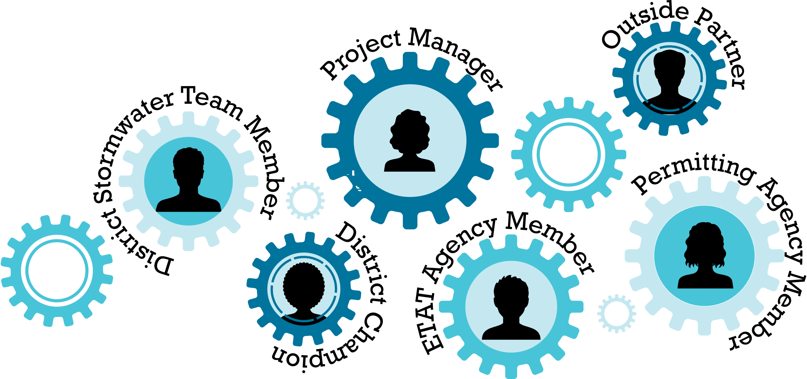
Poll Question Practice…
Who are you here representing?
  FDOT?
  Consultant?
  WMDs?
  Local Municipalities?
  Other?
How familiar are you with WATERSS?
  I helped write the Guidebook. Ask me anything.
  I have been involved in a WATERSS project.
  I have seen a WATERSS presentation.
  No experience. Why can’t you use spell check?
Notes:
Hand off to Rick

Slide 11
What Is ?
Watershed Approach To Evaluate Regional Stormwater Solutions
Step-by-step process to identify and enact innovative approaches to stormwater management
WATERSS process was developed based on successes seen with other innovative stormwater projects across the state
Includes process changes to remedy reported obstacles to innovation reported by the FDOT districts and regulatory WMDs
Notes:
WATERSS is a new statewide stormwater process to facilitate innovation in stormwater design and partnerships. It integrates the pursuit of innovation, into the complex, multi-year FDOT production process
Innovative stormwater management has been practiced since stormwater treatment regulations were promulgated in the 1980s. Years ago, it was common drainage practice to use aerials to find dry-looking golf courses that could benefit from FDOT funded lakes. When successful, we saved millions of dollars in R/W purchases.
We wanted that more often!
When we developed WATERSS, we surveyed lessons learned, both positive and negative, across FDOT and the WMDs, and implemented them into the WATERSS process… here is what we found… <click>

Slide 12

Lessons Adopted into
Champions make things happen
WMD support important
FDOT Management support vital
Multi-disciplinary support needed
Good ideas undercut by inflexible project schedules
Coordination MUST happen early within schedule
Have a viable alternative to partnership!
Notes:
Lessons learned:
FDOT Champions make things happen
WMD support played key role in permitting creative solutions
FDOT Management support vital
Multi-disciplinary support needed – example: R/W and work program, transport and fate of pollutants
Good direction can get undercut by inflexible project schedules
Coordination MUST happen early within project schedule
Be careful to have a viable alternative to partnership!

Slide 13
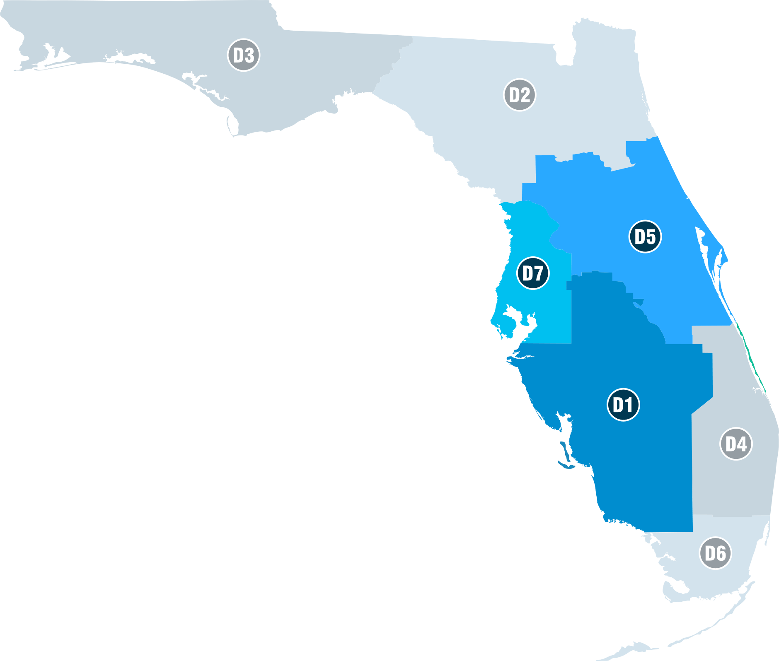
Innovative Strategy Benefits
SR 15/600 Widening
$3.3 Million in Stormwater Pond Savings
Old Tampa Bay
$48 Million in Stormwater Pond Savings
$3.5 Million in Seagrass Credits
A-FIRST
$15 Million in Stormwater Pond and Floodplain Bridge Savings
Water Supply through Stormwater Harvesting
SR 82, Segments 1-4
$4.6 Million in Stormwater Pond Savings
No Long-Term Maintenance
I-75 Bond Ranch
$1.5 Million Budgeted for Ponds Spent for Greater Environmental Benefit
$715,000 in Wetland Mitigation Savings
Notes:
Several recent projects across the state showed the benefits of stormwater innovation:
OLD TAMPA BAY - Direct resource improvement: constructed new bridge to open circulation to sea grasses in Old Tampa Bay
$48 Million in Stormwater Pond Savings
$3.5 Million in Seagrass Credits
A-FIRST – downtown Orlando
$15 Million in Stormwater Pond and Floodplain Bridge Savings
Water Supply through Stormwater Harvesting
Desperation can be the mother of innovation… IF you have champions!
I-75 Bond Ranch
$1.5 Million Budgeted for Ponds Spent for Greater Environmental Benefit
$715,000 in Wetland Mitigation Savings ,
SR 15/600 Widening
$3.3 Million in Stormwater Pond Savings
SR 82, Segments 1-4
$4.6 Million in Stormwater Pond Savings
No Long-Term Maintenance

Slide 14
Anticipated Benefits of Process
Cost Savings
Could Eliminate or Reduce Right-of-Way Process
Environmental Improvement
Greater Return on Investment
Partnerships
Partnerships Allow Increased Environmental Improvements
Improve Cooperation with Agencies and Stakeholders
Public Perception
Recognition from A-FIRST, Old Tampa Bay, and Bond Ranch
Could Eliminate Long-Term Maintenance
Could Serve Multiple Projects
Notes:
EVERY PROJECT FROM THE PREVIOUS SLIDE REALIZED THE BENEFITS LISTED HERE!
Cost Savings
R/W acquisition and perpetual maintenance are expensive – get out of it if you can!
Regional ponds with local municipalities
FDOT buys and builds
Locals maintain in perpetuity
Greater Environmental Lift
Other BMPs such as septic tank conversions and regional ponds have a better C/B ratio…
Especially helpful for estuaries and springsheds
A-FIRST, Old Tampa Bay, and Bond Ranch…
Great press for both FDOT and FDEP
Stunned FDOT Management and the regulatory community
Improved Regional Relationships
Great Publicity!

Slide 15
What Is ?
Watershed Approach To Evaluate Regional Stormwater Solutions
WATERSS…
  Replaces current Environmental Look Around (ELA) Process with a detailed, multi-phased framework for “how to”
  Offers revised pond siting process for when traditional ponds are necessary
See WATERSS Process Guidebook, published September 2021
Notes:
So, what about ELAs? WATERSS replaces the Environmental Look Around (ELA)
FDOT is still eliminating ELA language from the PD&E Manual
ELA
Added as an exploratory effort towards further opening the door for innovative stormwater management.
Reconnaissance mission
Lacked structure – running back with no blockers
Please note that WATERSS includes the option of traditional pond siting when better opportunities are not available. The pond siting process in the WATERSS Guidebook was adopted and amended from a district where it was working well.
Guidebook has been out for over 2 years, and we are starting to see the first projects go through the Planning/PD&E, Environmental Screening Tool (EST).

Slide 16




When Is Implemented?
New alignments, capacity projects, other
high investment projects
Nearby advantageous cooperative initiatives by other entities
Accommodate future FDOT project needs
Environmentally sensitive areas: coral reefs, springsheds, estuaries, OFWs
Notes:
One of the first districts’ concerns was that WATERSS should not be used on all projects… absolutely true:
WATERSS is ideal where FDOT is investing significant funding into stormwater management…
Capacity projects with R/W for ponds.
Use the funding to engage other solutions that will yield better environmental benefits than and/or reduce costs when compared to traditional ponds.
Sometimes, fortuitously, FDOT highway improvements pass close to planned initiatives by developers, municipalities, or others, providing opportunities for environmental credits that can be obtained for future FDOT projects
Examples of opportunities…
WMD or municipal projects
Water quality such as BMAP improvements
Wetland restoration
Groundwater recharge
Large private developments
FDOT can add to or participate in the planned stormwater features
The results are joint-use ponds, sometimes regional ponds
State priorities, beyond FDOT’s immediate work program needs, can also be addressed

Slide 17
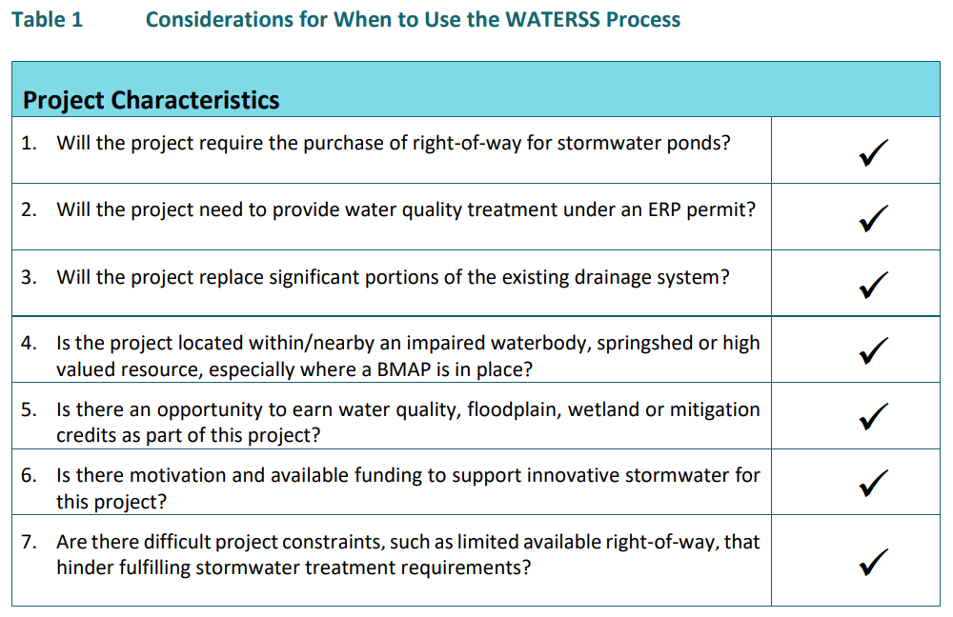

When Is Implemented?
Use Table 1 from the WATERSS Process Guidebook to determine if WATERSS may provide value to any project.
NWFWMD provides insight into large scale development plans in the region.
Notes:
Here is a table, from the Guidebook, as a checklist of specific situations that may trigger scoping WATERSS.
Items 1 – 3: Replacement of drainage system trunk lines = ERP = R/W for ponds
BMAP? …Check FDEP website
Upcoming needs on future projects? …check with PD&E
Motivation and funding? …PM checks with Management
Constraints? … just like Tampa Bay and A-FIRST
Hand off to Lauren

Slide 18
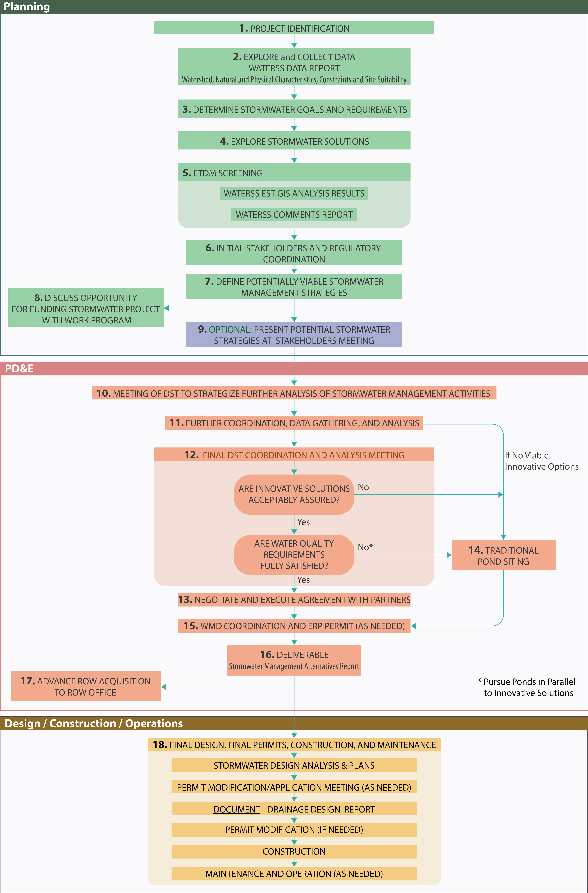
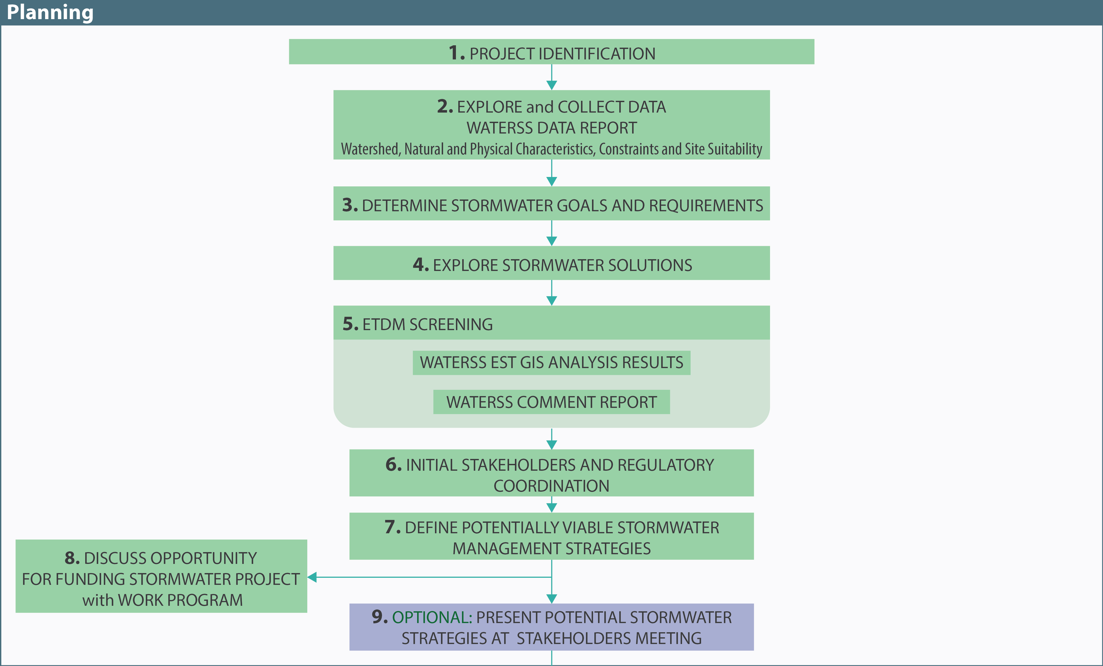
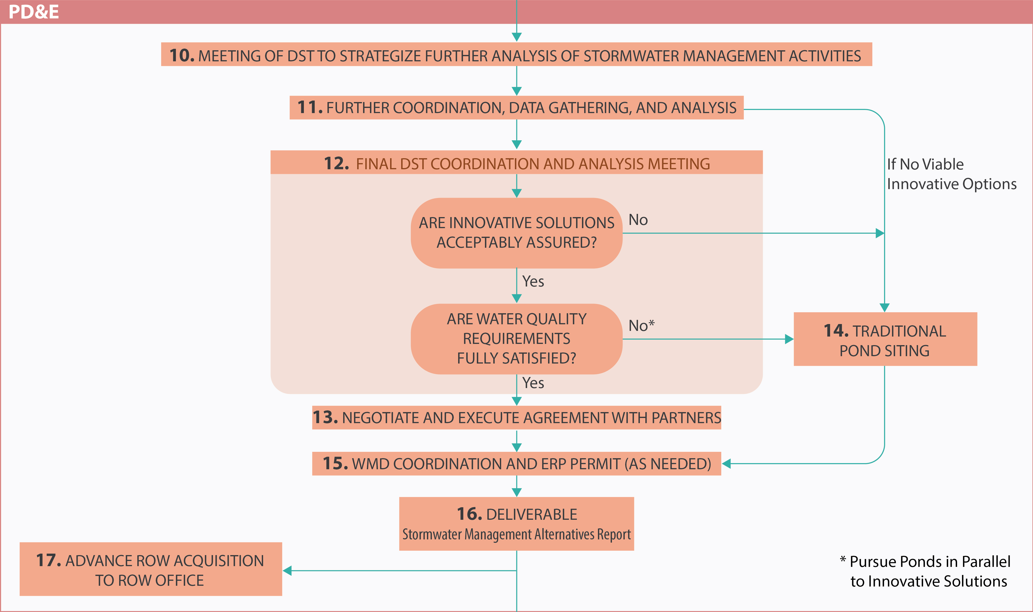
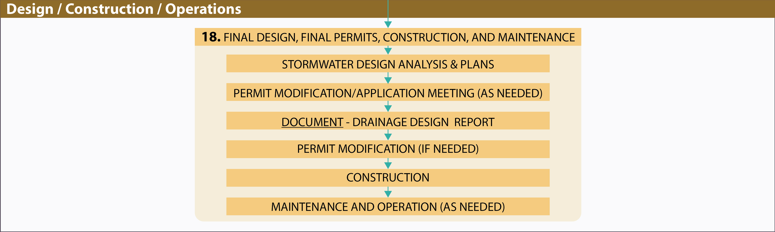
WATERSS Process – Complete Overview
1. IDENTIFICATION
2. EXPLORE
3. GOALS
4. SOLUTIONS
5. SCREENING
6. COORDINATION
7. STRATEGIES
8. FUNDING
9. (MEETING)
10. STRATEGIZE
11. FURTHER WORK
NO VIABLE
OPTIONS
12. FINAL MEETING
ASSURED
Y
N
14. TRADITIONAL
REQUIREMENTS
Y
N
13. AGREEMENT
15. WMD / ERP
16. DELIVERABLE
17. ROW
18. FINAL DESIGN
PLANS
(PERMIT MOD)
REPORT
(PERMIT MOD)
CONSTRUCTION
OPERATION
Notes:
Let’s dive into the meat of the WATERSS process.
Here is the entire process overview and each of the steps are grouped based on where they fall within the project lifecycle.
WATERSS’ goal is the same as ELA, but with the actual foundational framework included for how to do it and do it successfully.

Slide 19
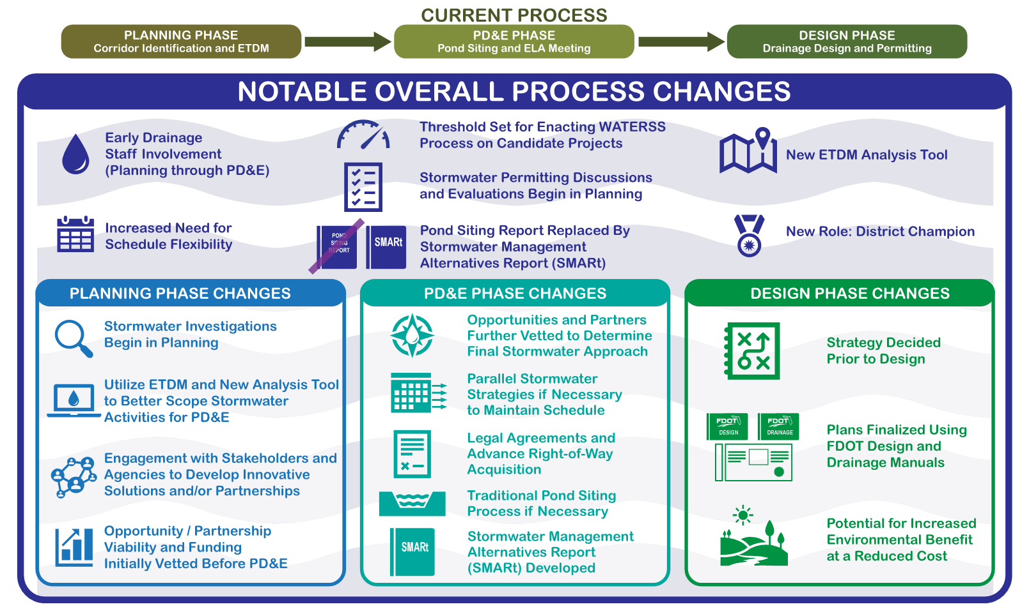
What is Changing?
5. SCREENING
5. SCREENING
5. SCREENING
5. SCREENING
5. SCREENING
5. SCREENING
5. SCREENING
Notes:
EARLY Drainage involvement
ETDM Role
District Champion

Slide 20

WATERSS Process Guidebook- Video
Notes:
Short video to show where to find the WATERSS Process Guidebook
Hand off to Katey

Slide 21

Overview of the Different Roles
Drainage Engineer (DDrE)
District Champion (DC)
Responsible for quantifying the drainage needs for the project.
Point of contact for coordination within and outside of FDOT.
Project Manager (PM)
Partners/
Stakeholders
Overall management through all phases of the project cycle.
Regulatory entities, cities, counties, private developers or non-regulatory environmental partners.
District Stormwater Team
Advisory team typically comprised of the PM, District Champion, DDrE, Permit/NPDES Coordinator, PD&E Engineer, Environmental Manager, and others.
ETDM Coordinator
Responsible for coordinating the ETDM screening process and analysis.
Notes:
There are several key roles that are needed throughout and at different stages within the WATERSS process. And you already know all of these players
Positions that are key to a successful WATERSS process are the Project Manager, Drainage Engineer & PD&E Engineer. The Environmental and NPDES folks are also important as the project moves through permitting. And the ETDM Coordinator can be instrumental in identifying opportunities early on.
There are also two new roles, which are the District Champion and District Stormwater Team, which we will talk about on these next slides.

Slide 22
Roles & Responsibilities
District Champion (DC)
Likely a stormwater, drainage, or environmental expert with permitting and design experience.
Ideally this is a fixed role but could be on a project-by-project basis.
Experience shows this role requires a highly motivated person to navigate the project life-cycle and pursue the opportunities and partners.
Goal: The DC role develops over time and outside entities begin to approach them with opportunities.
Audience Input:
Does anyone come to mind in your District?
Please Share!
Notes:
The District Champion is likely the most critical role on the project, and in the case studies FDOT researched as part of this process development they found that all successful projects had a champion that helped drive the project forward.
This person is likely a stormwater, drainage, or environmental expert with permitting and design experience, who is willing to advocate for watershed solutions and committed to seeing the project through the innovative stormwater process. This person can be could be an FDOT representative or a consultant as appropriate for the District and region.
Ideally, the role should be a fixed role within the District. Because a fixed position will help establish relationships with the various agencies and stakeholders.
But currently what we are seeing as WATERSS gets started is that the DC is happening on a project-by-project basis. And this is normal as this process grows legs, but what I’d like to stress is that the DC role should be somewhat organic and should really align with someone who is committed to seeing a watershed success, because these innovative solutions are tough, and they take perseverance.
Audience Engagement via CHAT Box:
For anyone who has done WATERSS or has had an innovative success in their District or on a project, was there a person who organically took the lead in finding a workable solution?
Does anyone come to mind?
Is this type of responsibility typically undertaken by Drainage, PD&E or a combination of both?

Slide 23
Roles & Responsibilities
District Stormwater Team (DST)
Project Manager (PM), District Champion, District Drainage Engineer (DDrE), District Permit Coordinator, District PD&E Engineer, and District Environmental Manager
Key stages when the DST communication is vital:
  Stakeholder Meetings
  Identifying Viable Solutions
  Pursuing Additional Coordination & Analysis
  Innovative Solutions Evaluations Matrix
  Final Decision Making
1. IDENTIFICATION
2. EXPLORE
3. GOALS
4. SOLUTIONS
5. SCREENING
6. COORDINATION
7. STRATEGIES
8. FUNDING
9. (MEETING)
10. STRATEGIZE
11. FURTHER WORK
NO VIABLE
OPTIONS
12. FINAL MEETING
ASSURED
Y
N
14. TRADITIONAL
REQUIREMENTS
Y
N
13. AGREEMENT
15. WMD / ERP
16. DELIVERABLE
17. ROW
18. FINAL DESIGN
PLANS
(PERMIT MOD)
REPORT
(PERMIT MOD)
CONSTRUCTION
OPERATION
Notes:
The role of the DST is to help advise the PM and District Champion on key decisions regarding the project’s stormwater strategy through the project development process.
The people on the DST should reflect the needs of the District and the specific project. So, keep that in mind – if you have a project located in an area where you’ve experienced permitting issues – it would be critical to bring the District Permit Coordinator in early to the decision-making process. Same thing if the project is likely going to have a large amount of wetland impacts or seagrass impacts, the Environmental Coordinator might be an important add.
The PM might and probably should consult with the DDrE, but ultimately, the PM will make the decision on the make up of the DST. A consultant may take the place of District staff for a particular project.
Something important to note here is that these roles should be defined at the beginning of the WATERSS process. If you find yourself working in the middle of the WATERSS process and your unclear of your role, work with your PM to get a better understanding of the decision makers, decision points and who you should be talking to and receiving input from.
When does the DST get engaged?
The WATERSS process guidebook spells out decision points at which it is recommended the DST engage.
<<move to scoping>>
We’ll talk about this a little further in the scoping section later, but it’s important to define when there will be needed decisions on the project, and these may not be the same for each project. The PM is the chair of the team and the PM should sit down with the District Champion and probably the DDrE to decide on key decisions points regarding the stormwater management strategy.
Please note these communication points should include when consultants should be checking in with the District too. Again, if there is no official stormwater team or District Champion, contact the PM and make sure to get these point defined at the onset.

Slide 24
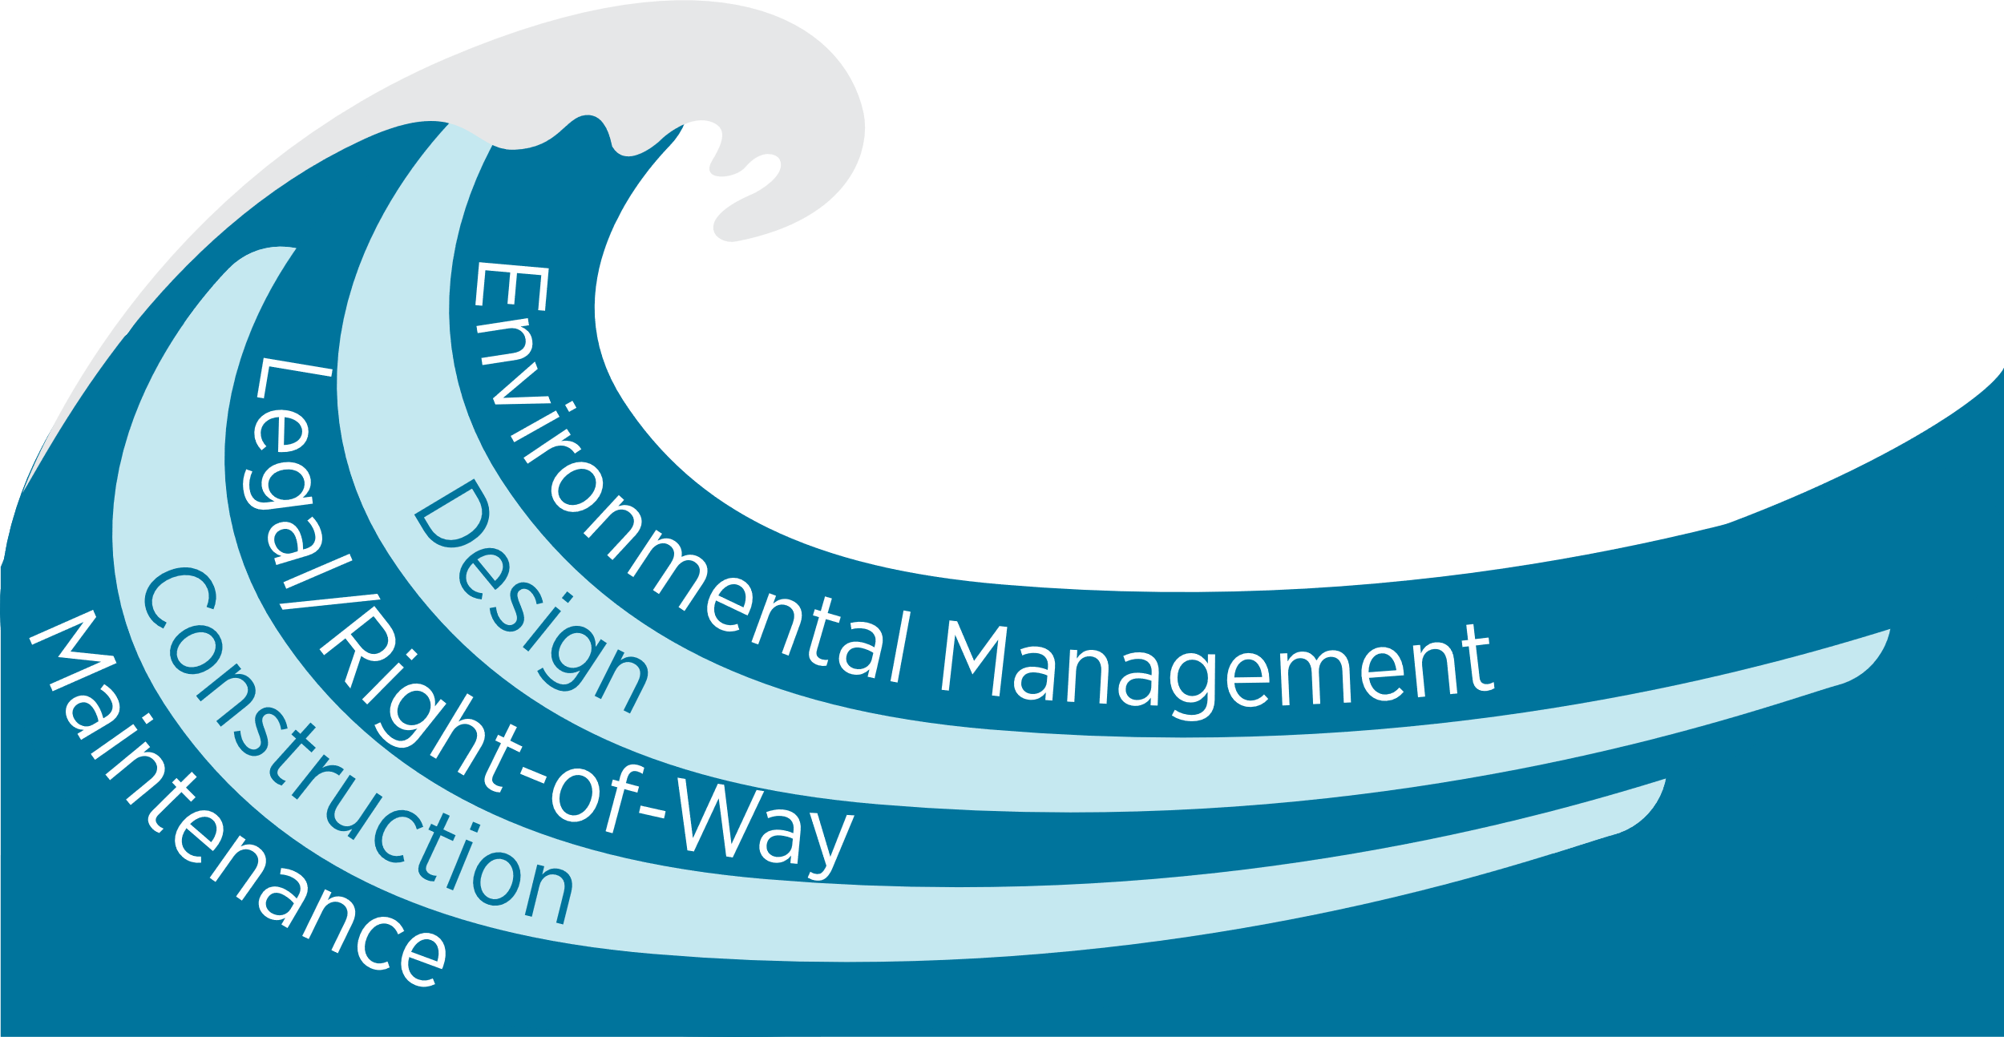
Overlap in Discipline Coordination
Notes:
WATERSS will require an overlap in discipline coordination.
The primary group overlap is likely to occur between PD&E and Drainage Design, however- permitting implications, ROW impacts and legal issues could drive some of your WATERSS solutions, so it’s important to keep the cross-discipline communication early and often.

Slide 25


Overlapping Phase Coordination
ACRONYMS:
Long Range Transportation Plan
Cost Feasible Plan
Transportation Improvement Plan
Planning
- Existing Conditions
- Needs & Assessment
- Planning Analysis
- Travel Demand
- LRTP¹, CFP², TIP³
- Purpose and Need
- Work Program
PD&E
- Federal or State Process
- Purpose and Need
- Alternative Analysis
- Environmental Studies
- Technical Reports
- Env. Doc. Approval
Design
- Detailed Design
Right of Way
- Construction Plans
- Specifications
- Cost Estimates
- Permits
- Env. Reevaluation
Construction
- Appraisal
- Negotiations
- Acquisition
- Relocation
- Build and Deliver
PD&E Scoping
Design Scoping
Advertise / Award Contract
Post construction - Maintenance
PD&E Scoping
ETDM Screening
ETDM Screening
Screening Environmental Issues
Planning and Environmental Linkage
Subarea and Corridor Studies
Alternatives Corridor Evaluation
Interchange Access Study
Public Outreach and Interagency Coordination
Notes:
Here is the overall project process. I want to show you where WATERSS fits into this overall process <CLICK> and the ETDM process.
The greater effort occurs during Planning and PD&E but can actively continue into design where the WATERSS process decisions get solidified and the decisions can move forward into right of way, construction, and operations.

Slide 26
Discussion Point – Collaboration (Question Box)
Question #1: For those with WATERSS experience (or other innovative stormwater projects), how did you establish cross discipline coordination?
  Large team coordination, individual leg work, enlist the support of management…
Question #2: Identify any solutions to improving collaboration?
Notes:
We have talked about how the WATERSS process requires the need for multiple disciplines to work together to find the best solutions to stormwater requirements.
Now we would like to hear from you and you can chat right into the question box.
And if you’d like to share, please raise your hand and we can unmute you.
Hand off to Lauren

Slide 27
WATERSS Process – Planning Phase
Notes:
Stormwater exploration begins in Planning Phase, focusing on data acquisition, and discovering and contacting potential stormwater partners
These steps are outlined in detail in the WATERSS Process Guidebook, so please reference that often to assist with any questions you may have. Please note that the WATERSS guidebook is just that – it is intended to serve as a GUIDE for how to bet accomplish WATERSS. Each project is different and may need to be flexible on timing, solutions, and coordination efforts.

Slide 28


Planning Phase
1 YR 9 MOS
PM
Step 1. Understand potential stormwater needs and project characteristics
Step 2. Data Collection
  Environmental Screening Tool (EST)
  Stormwater related information
Step 3. Obtain concurrence for stormwater goals
Step 4. Begin identification of potential innovative stormwater solutions
5. SCREENING
1. IDENTIFICATION
2. EXPLORE
3. GOALS
4. SOLUTIONS
5. SCREENING
6. COORDINATION
7. STRATEGIES
8. FUNDING
9. (MEETING)
10. STRATEGIZE
11. FURTHER WORK
NO VIABLE
OPTIONS
12. FINAL MEETING
ASSURED
Y
N
14. TRADITIONAL
REQUIREMENTS
Y
N
13. AGREEMENT
15. WMD / ERP
16. DELIVERABLE
17. ROW
18. FINAL DESIGN
PLANS
(PERMIT MOD)
REPORT
(PERMIT MOD)
CONSTRUCTION
OPERATION
Notes:
Step through the slide.
In the guidebook, each of these steps are detailed with the task, the people involved, the expected time frame and the associated deliverable.
And we will talk about this later in the PDE phase…

Slide 29
Planning Phase
1 YR 9 MOS
PM
Step 5. ETDM Programming Screening (NOT Planning Screen)
  ETAT Agency Comments
Step 6. Initial stakeholder engagement
Step 7. Screen stormwater solutions for viability
Step 8. Discuss funding needs for innovative stormwater solutions
Step 9. (Optional) Stakeholder meeting to review potential solutions
5. SCREENING
1. IDENTIFICATION
2. EXPLORE
3. GOALS
4. SOLUTIONS
5. SCREENING
6. COORDINATION
7. STRATEGIES
8. FUNDING
9. (MEETING)
10. STRATEGIZE
11. FURTHER WORK
NO VIABLE
OPTIONS
12. FINAL MEETING
ASSURED
Y
N
14. TRADITIONAL
REQUIREMENTS
Y
N
13. AGREEMENT
15. WMD / ERP
16. DELIVERABLE
17. ROW
18. FINAL DESIGN
PLANS
(PERMIT MOD)
REPORT
(PERMIT MOD)
CONSTRUCTION
OPERATION
Notes:
Step through the slide.

Slide 30
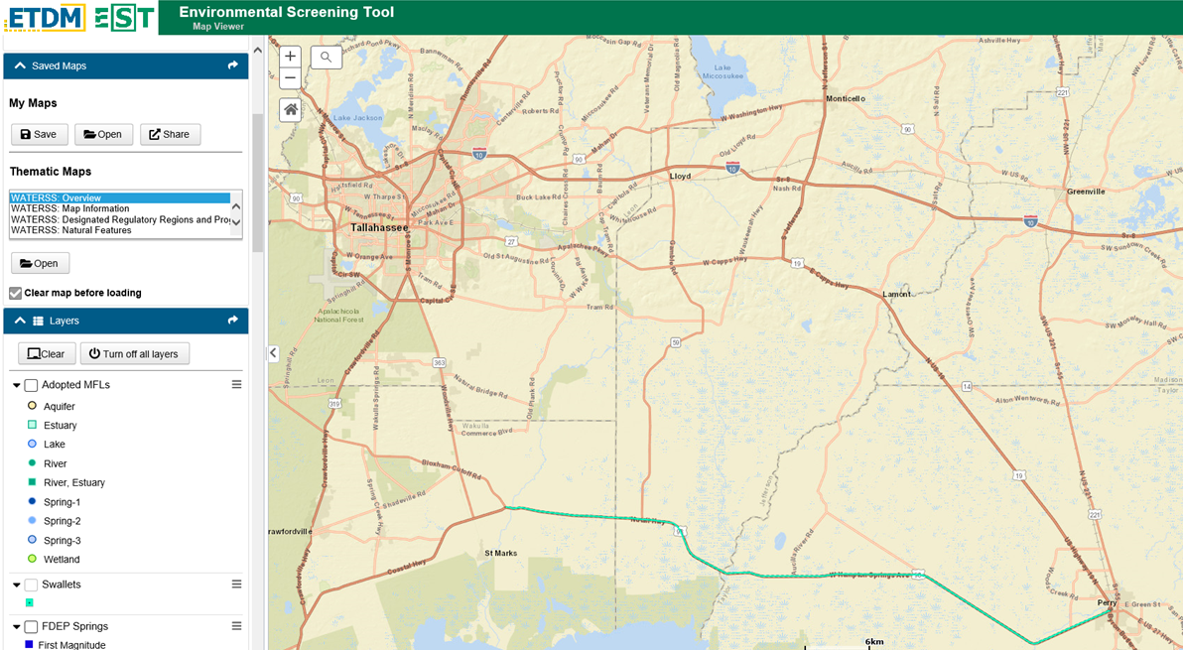
Step 2: Data Gathering - EST WATERSS Analysis Tool
Notes:
Here is a screen shot of the EST interface. We will show a video in a minute to go over the capabilities of this new tool.
Note that the EST interface requires a login. If you already have an EST login for your district and project, the WATERSS capabilities are already available under that same login. If you anticipate using this tool to support WATERSS projects in the future, and don’t already have a login, you will need to request one from the ETDM Helpdesk with permission from your District where the project is located.
A few acronyms to know as we discuss this further:
EST – Environmental Screening Tool
ETAT- Environmental Technical Advisory Team
ETDM- Efficient Transportation Decision Making

Slide 31
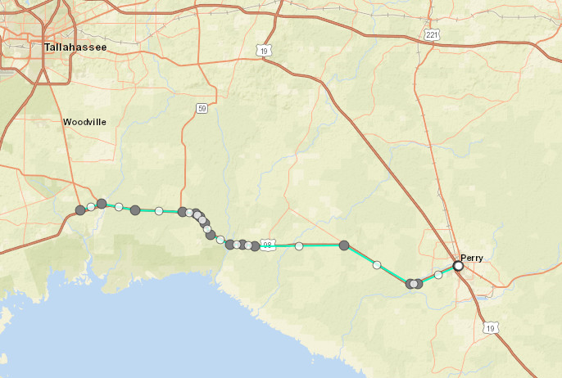
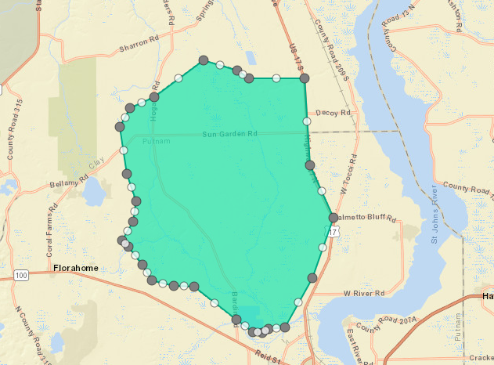

Data Gathering – Create WATERSS GIS Analysis Report
Project Alignment Buffer (Line)
WATERSS Review Area (Polygon)
Notes:
Line, polygon, or combination.
Line: more desirable when large drainage basins are not involved
Polygon: more desirable when springsheds and/or larger drainage basins
A few acronyms to know as we discuss this further:
EST – Environmental Screening Tool
ETAT- Environmental Technical Advisory Team
ETDM- Efficient Transportation Decision Making
AOI- Area of Interest

Slide 32
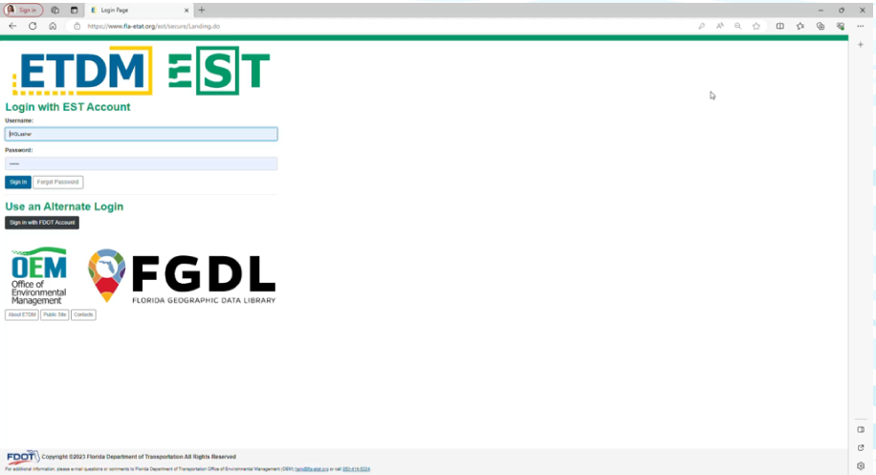
WATERSS EST GIS Analysis Tool- Video
Notes:
Short video to describe the EST WATERSS GIS Analysis tools
To summarize- the Thematic Maps are a great way to explore the available data in the project area to look for any interesting data that would lend to additional review. The AOI can be used to create the WATERSS GIS Analysis Report that is specific the project area and can be included in the SMARt. If you have any further questions as you use the WATERSS GIS Analysis Tools, please don’t hesitate to reach out to the ETDM Helpdesk and/or OEM.

Slide 33





Determine Goals and Explore Solutions
3-4 MOS
PM, DDrE, DE
1. IDENTIFICATION
3. GOALS
2. EXPLORE
3. GOALS
4. SOLUTIONS
4. SOLUTIONS
5. SCREENING
6. COORDINATION
7. STRATEGIES
8. FUNDING
9. (MEETING)
General Regulatory Understanding
Basin Management Action Plan (BMAP) & Impairment
Potential Stakeholder
10. STRATEGIZE
11. FURTHER WORK
NO VIABLE
OPTIONS
12. FINAL MEETING
ASSURED
Y
N
14. TRADITIONAL
Water quality/quantity requirements.
Pre vs Post regulatory requirement for nutrients.
Begin estimating annual loading.
Review BMAP approved/unfunded projects and regional partners.
Begin investigating nutrient removal strategies.
Preliminary site plans or drainage maps.
Opportunities for regional facilities, golf courses or stormwater harvesting (irrigation).
REQUIREMENTS
Y
N
13. AGREEMENT
15. WMD / ERP
16. DELIVERABLE
17. ROW
18. FINAL DESIGN
PLANS
(PERMIT MOD)
REPORT
(PERMIT MOD)
CONSTRUCTION
Preliminary Environmental Discussion (PED)
OPERATION
Notes:
So, what might you find as part of a PLANNING LEVEL analysis?
<click through bullets>
Here are a few of the types of things we can begin to assess from our data gathering in the Planning Phase:
We have a general regulatory understanding.
2) We can begin generally estimating our annual nutrient loadings, reviewing approved/unfunded BMAP projects and looking at appropriate nutrient removal strategies.
3) We can begin looking at any DRIs in greater depth. Is there an approved conceptual permit for the development? Site plans with drainage basins? Do they have a water utility component planned – golf courses, irrigation, reuse, etc

Slide 34
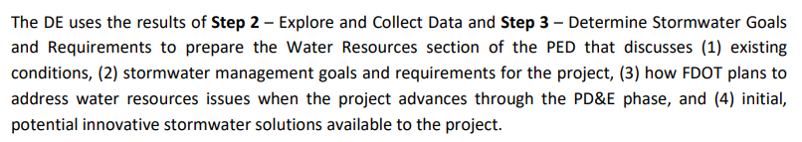
Preliminary Environmental Discussion (PED)
4 MOS
DE, DC, ETDM
The team can provide input on stormwater findings and potential opportunities to the ETAT review agencies in the PED, before the agencies provide comments and effect findings.
1. IDENTIFICATION
2. EXPLORE
3. GOALS
4. SOLUTIONS
5. SCREENING
5. SCREENING
6. COORDINATION
7. STRATEGIES
8. FUNDING
9. (MEETING)
10. STRATEGIZE
11. FURTHER WORK
NO VIABLE
OPTIONS
12. FINAL MEETING
ASSURED
Y
N
14. TRADITIONAL
REQUIREMENTS
Y
N
13. AGREEMENT
15. WMD / ERP
16. DELIVERABLE
17. ROW
18. FINAL DESIGN
PLANS
Source: Process Guidebook,
Section 4.2, Step 5
(PERMIT MOD)
REPORT
(PERMIT MOD)
CONSTRUCTION
OPERATION
Notes:
Note that prior to submitting the project for ETAT review, the project must be flagged on the Update Project Record as a WATERSS project. This triggers the correct input boxes for the ETAT agencies and notification emails in the EST system.

Slide 35
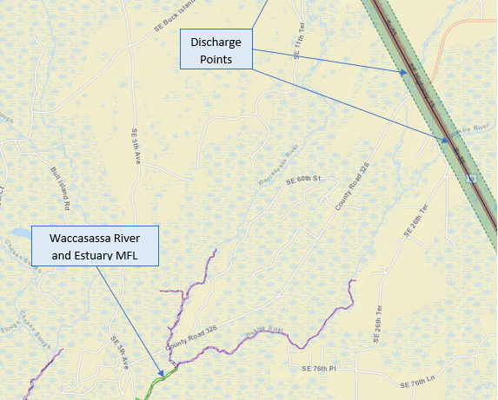
Sample PED Excerpts
WATERSS Narrative for PED
The search for innovative stormwater solutions and partnership opportunities, discussed below, are intended to efficiently satisfy regulatory requirements, with a wholistic watershed focus. These watershed solutions often realize better environmental benefits than traditional onsite treatment approaches.
Regulatory Area Opportunities
The proposed alignment intersects two adopted Basin Management Action Plans (BMAPs) and passes very close to the Big King Spring vent and the Little King Spring vent. Partnership opportunities for groundwater treatment projects within these springsheds are of interest to the FDOT.
The project ends just south of the Fanning Springs Priority Focus Area, which discharges to an Outstanding Florida Spring. The project also intersects the Kings Bay priority focus area at the south end of the corridor. The project abuts the springshed BMAPs.
The alignment crosses the Total Maximum Daily Loads (TMDLs), BMAPs, and impairments, below, listed from south to north:
Cross Florida Barge Canal [WBID: 1329A] – Adopted BMAP
Direct Runoff to Gulf [WBID: 1335] – Verified Impaired, Assumed Total Nitrogen (TN)
Spring Run [WBID: 1333] – Bacteria (verified impairment)
Waccasassa River [WBID 3699]- Bacteria (verified impairment)
Suwannee River [WBID: 3422A] – Adopted BMAP
Questions for FDEP, Division of Environmental Assessment and Restoration (DEAR):
  For the Cross Florida Barge Canal and Suwannee River BMAPs (1 and 5 above), are there unfunded projects pending? Who should we contact for partnership opportunities and follow up discussion?
  Because this project is located in springsheds, the FDOT recognizes that groundwater quality requirements for this project may be addressed on a springshed basis rather than in the immediate vicinity of the project. Are such regional treatment opportunities available?
Stormwater Harvesting Partnership Opportunities
No designated Minimum Flows and Levels waterbodies (MFLs) are noted within the immediate vicinity of the alignment, but the Waccasassa River and Estuary (fed also by the Wekiva River) will likely realize a benefit from discharges at three crossings where they go under US 19:
Questions for SRWMD, Office of Minimum Flows and Levels; SWFWMD Resource Management Division and/or Operation, Lands and Resource Monitoring Division.
  Are there wetland re-hydration needs adjacent to US 19?
  Are there other beneficial uses for stormwater runoff near the project corridor?
Question for SRWMD, Office of Water Supply and Office of Water Use and Water Well; SWFWMD Water Use Permit Bureau and Resource Management Division.
  Are there regional raw water needs for cities and counties along the corridor? If so, do they have collection infrastructure near US 19?
Regional Pond Opportunities
Question for SRWMD, Office of Environmental Resource Permit (ERP) and Environmental Compliance; SWFWMD ERP Bureau.
  Are any regional ponds being constructed near or upstream of the project, especially along the Withlacoochee River?
  Are there opportunities for participating in regional floodplain mitigation?
  Would the WMD recognize Continuous Monitoring and Adaptive Control (CMAC) as contributing to floodplain compensation?
Notes:
Recent, first WATERSS PED for US 27…
Call OEM or ETDM coordinator if help is needed on PED development.

Slide 36

Expands the Roles of ETAT Agencies
New Resource Improvement Role - WATERSS
Existing Regulatory Comment Role
Comments on expected impacts and permit requirements
Degrees of effect
Identify regional pond opportunities
Identify direct resource improvement strategies
Identify and possibly facilitate partnership opportunities
Effects
vs.
Opportunities
Notes:
It should be noted that the ETAT historically has only commented in what is called “degrees of effect”, which is expected impacts and permit requirements associated with the project.
With WATERSS, we are asking the ETAT to shift from just “impacts” to also describe “opportunities”. This is a new concept and behind the scenes, OEM is working with ETAT members on how to best contribute to the WATERSS ETDM request.
As FDOT was researching the WATERSS process we spoke to many WMDs around the state. Many of them said things like “if we had known you guys were going to be widening, constructing, etc.”
If there are ETAT members in attendance today, there is additional information specific to WATERSS for ETAT members on the OEM Website. WATERSS ETAT Meeting (fdot.gov)

Slide 37





ETAT Comments Could Include…
4 MOS
DE, DC, ETDM
Local WMD could provide insight into large scale development plans in the region.
1. IDENTIFICATION
2. EXPLORE
3. GOALS
4. SOLUTIONS
5. SCREENING
5. SCREENING
6. COORDINATION
7. STRATEGIES
8. FUNDING
9. (MEETING)
10. STRATEGIZE
11. FURTHER WORK
NO VIABLE
OPTIONS
12. FINAL MEETING
ASSURED
Y
N
14. TRADITIONAL
REQUIREMENTS
Y
N
13. AGREEMENT
FDEP, as part of the ETAT, could inform on BMAP approved projects and regional partners.
15. WMD / ERP
Local WMD is working on a regional water quality and restoration project to target impairments.
16. DELIVERABLE
17. ROW
18. FINAL DESIGN
PLANS
(PERMIT MOD)
REPORT
(PERMIT MOD)
CONSTRUCTION
OPERATION

Slide 38
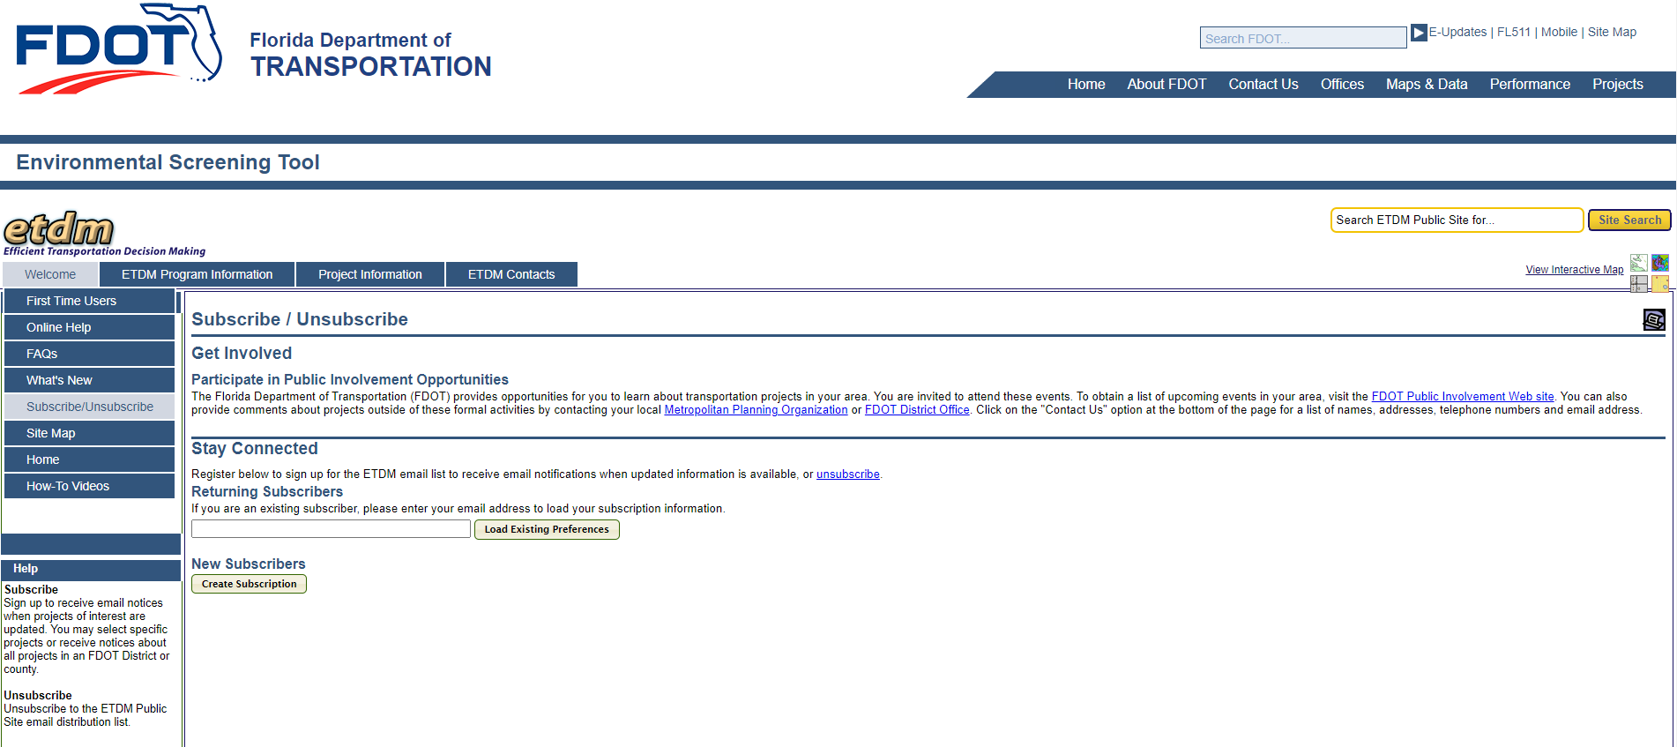
ETDM Public Access Site – Subscribe to Updates
Notes:
Additionally, there is a place within the EST for external entities beyond the ETAT to receive notifications on certain projects in their requested region.
The ETAT is comprised of state and federal regulatory agencies, but cities and counties may become FDOT’s partners as we participate in their water quality projects. Therefore, it is in everyone’s interest to alert local governments to FDOT’s water quality strategies. Other interested parties may also provide comments or insight on proposed alternatives.

Slide 39
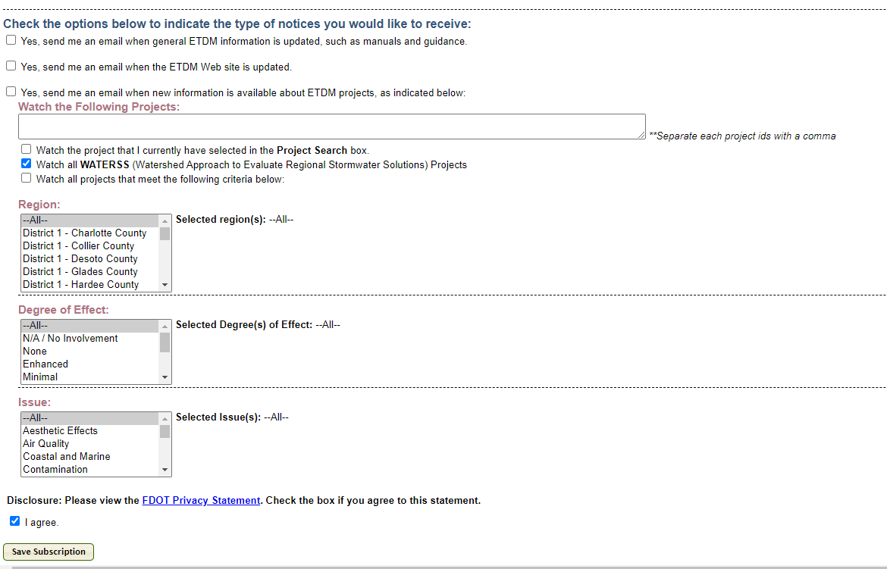
ETDM Public Access Site – Subscribe to Updates

Slide 40
Non-ETAT Comments Could include…
4 MOS
DE, DC, ETDM
Regional Council may invite FDOT to attend regular meetings to discuss regional opportunities.
1. IDENTIFICATION
2. EXPLORE
3. GOALS
4. SOLUTIONS
5. SCREENING
5. SCREENING
6. COORDINATION
7. STRATEGIES
8. FUNDING
9. (MEETING)
10. STRATEGIZE
11. FURTHER WORK
NO VIABLE
OPTIONS
12. FINAL MEETING
ASSURED
Y
N
14. TRADITIONAL
REQUIREMENTS
Y
N
13. AGREEMENT
Local municipality may provide insight on development or improvement plans.
15. WMD / ERP
16. DELIVERABLE
Local interest group may express concerns about project impacts.
17. ROW
18. FINAL DESIGN
PLANS
(PERMIT MOD)
REPORT
(PERMIT MOD)
CONSTRUCTION
OPERATION

Slide 41
Poll Question Practice…
Do you anticipate using the WATERSS EST GIS Analysis Tools?
  I’m an expert and have been running EST on the side.
  Yes, but I have to request an EST login.
  No, but I will coordinate with others who will.
  What is EST again?

Slide 42
Process Overview
BREAK 5 MINS

Slide 43
WATERSS Process – PD&E Phase
Notes:
The goal of WATERSS in the PD&E Phase is to refine possibilities and partnerships found and explored in Planning.
Note that the entire WATERSS process might simplify into siting ponds, if that is the most reasonable solution.

Slide 44
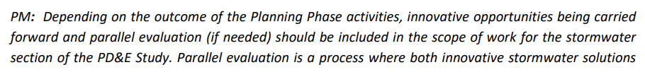
PD&E Phase – Planning Considerations
When Innovative Solutions Emerge in the Planning Phase:
  Scope them!!
  Tailor your PD&E scope with enough detail to determine the viability of the innovation(s).
...
Source: Process Guidebook,
Section 4.3
Notes:
Though obvious, this can be difficult, since one does not know, at the outset, which solutions will provoke further follow up. Because WATERSS is a flexible process, be prepared to add hours if an unexpected number of potential strategies are pursued.
Katey will talk more about some ideas for how to scope WATERSS projects in just a minute.

Slide 45
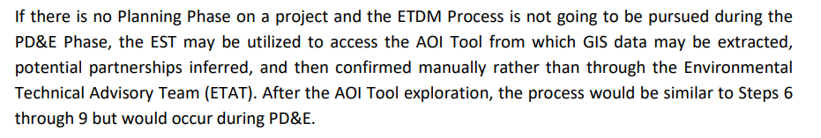
WATERSS Process without a Planning Phase
Considerations for when your project did not include a Planning Phase:
  If ETDM process is not pursued, the WATERSS EST Tool could be used for data gathering only.
  Local GIS data sources could also be used to gather data and look for opportunities.
Source: Process Guidebook,
Section 4.2
Notes:
Not all projects have a Planning Phase, and some do not go through the ETDM Process; still, the AOI Tool still has valuable information on corridor potential for partnerships.

Slide 46
WATERSS Process without a Planning Phase
Considerations for when your project does not include a Planning Phase:
  Determine the need for inserting Planning Phase steps early in PD&E. OR
  Abbreviate Planning Phase steps early in PD&E. Modify your scope and deliverables accordingly.
Notes:
Watch your project schedule!

Slide 47
WATERSS Process – PD&E Phase
Notes:
Ok. Now let’s get back into the meat and potatoes of WATERSS in the PD&E phase.
Remember that PD&E is where the WATERSS team refines possibilities and partnerships found and explored in the Planning steps.

Slide 48
PD&E Phase
2-3 YRS
PM
Step 10. Kickoff PD&E with DST and strategize further analysis of stormwater strategies
Step 11. Further investigate any additional information needed
Step 12. Critical decision point - decide which stormwater solution(s) will be used
Step 13. Facilitate negotiations and agreements for chosen strategies
1. IDENTIFICATION
2. EXPLORE
3. GOALS
4. SOLUTIONS
5. SCREENING
6. COORDINATION
7. STRATEGIES
8. FUNDING
9. (MEETING)
5. SCREENING
10. STRATEGIZE
11. FURTHER WORK
NO VIABLE
OPTIONS
12. FINAL MEETING
ASSURED
Y
N
14. TRADITIONAL
REQUIREMENTS
Y
N
13. AGREEMENT
15. WMD / ERP
16. DELIVERABLE
17. ROW
18. FINAL DESIGN
Audience Input:
What factors have you investigated for determining stormwater viability?
Please Share!
PLANS
(PERMIT MOD)
REPORT
(PERMIT MOD)
CONSTRUCTION
OPERATION
Notes:
The later steps during PD&E are intended to arrive at, pursue, and lock in, a preferred stormwater strategy
Regulatory feasibility: Do we need preliminary meetings with regulatory agencies to determine viability?
Partner reliability/feasibility: What would a potential partner need to finalize agreements to move forward?
Schedule boundaries: Can the partner coordination fit within the project schedule?

Slide 49
Coordination with Stakeholders and Agencies
4-6 MO
PM, DST
Steps 12 and 13 are critical decision-making points for determining if innovative stormwater solutions will continue to move forward.
  These steps will include significant coordination with stakeholders, agencies, the DST, and potentially several offices in FDOT.
1. IDENTIFICATION
2. EXPLORE
3. GOALS
4. SOLUTIONS
5. SCREENING
6. COORDINATION
7. STRATEGIES
8. FUNDING
9. (MEETING)
10. STRATEGIZE
11. FURTHER WORK
12. FINAL MEETING
12. FINAL MEETING
NO VIABLE
OPTIONS
ASSURED
N
13. AGREEMENTS
REQUIREMENTS
Y
N
14. TRADITIONAL
Y
13. AGREEMENT
15. WMD / ERP
16. DELIVERABLE
17. ROW
18. FINAL DESIGN
PLANS
(PERMIT MOD)
REPORT
(PERMIT MOD)
CONSTRUCTION
OPERATION
Notes:
Follow through on design changes
External partners can have a change in staff or leadership – offer to meet with new arrivals
Keep EMO involved, especially if design changes modify a permit

Slide 50
PD&E Phase
2-3 YRS
PM
1. IDENTIFICATION
Step 14. Facilitate Pond Siting (if in parallel or as primary stormwater solution)
Step 15. Review permit strategies
Step 16. Finalize Stormwater Management Alternatives Report
Step 17. Evaluate advance ROW acquisition opportunities
2. EXPLORE
3. GOALS
4. SOLUTIONS
5. SCREENING
6. COORDINATION
7. STRATEGIES
8. FUNDING
9. (MEETING)
5. SCREENING
10. STRATEGIZE
11. FURTHER WORK
NO VIABLE
OPTIONS
12. FINAL MEETING
ASSURED
Y
N
14. TRADITIONAL
REQUIREMENTS
Y
N
13. AGREEMENT
15. WMD / ERP
16. DELIVERABLE
17. ROW
18. FINAL DESIGN
PLANS
(PERMIT MOD)
REPORT
(PERMIT MOD)
CONSTRUCTION
OPERATION
Notes:
Hand off to Rick

Slide 51
Occasions for Pond Siting in the WATERSS Process
Potential Innovative Solutions?
No
Proceed with pond siting process
Yes
…Next Slide
To recap, projects will likely fall into one the following categories:
1. IDENTIFICATION
2. EXPLORE
3. GOALS
4. SOLUTIONS
5. SCREENING
6. COORDINATION
7. STRATEGIES
8. FUNDING
9. (MEETING)
10. STRATEGIZE
11. FURTHER WORK
12. FINAL MEETING
12. FINAL MEETING
NO VIABLE
OPTIONS
ASSURED
N
14. TRADITIONAL
REQUIREMENTS
Y
N
14. TRADITIONAL
Y
13. AGREEMENT
15. WMD / ERP
16. DELIVERABLE
17. ROW
18. FINAL DESIGN
PLANS
(PERMIT MOD)
REPORT
(PERMIT MOD)
CONSTRUCTION
OPERATION
Notes:
As Lauren stated, one of the most important decisions of the WATERSS process is whether to go with innovative approaches or to pursue pond siting
No innovative solutions? …. Proceed to pond siting… simple
There is a pond siting process within the WATERSS process that may be used
Even if no innovative solutions are found, document eliminated solutions
Available innovative solutions? Next slide… <click>

Slide 52
CONFIDENCE in innovative solution(s)
1. IDENTIFICATION
2. EXPLORE
3. GOALS
Proceed with parallel pond siting process
Defer pond siting
4. SOLUTIONS
5. SCREENING
6. COORDINATION
7. STRATEGIES
8. FUNDING
COVERAGE
of innovative
solution(s)
9. (MEETING)
10. STRATEGIZE
11. FURTHER WORK
12. FINAL MEETING
12. FINAL MEETING
NO VIABLE
OPTIONS
ASSURED
N
14. TRADITIONAL
REQUIREMENTS
Y
N
14. TRADITIONAL
Y
13. AGREEMENT
15. WMD / ERP
16. DELIVERABLE
Proceed with parallel pond siting process
17. ROW
18. FINAL DESIGN
PLANS
(PERMIT MOD)
REPORT
(PERMIT MOD)
CONSTRUCTION
OPERATION
Notes:
Y-axis: Increasing confidence… For example, say…
Potential partner is motivated, but searching for funds
Current mayor is supportive, but elections are coming before the legal agreement can be signed
PP is repetitively seeking more funding from the Department
X-axis: increasing coverage…For example, say…
Your project has 5 regional basins, but not all have innovative solutions
Your innovative solutions satisfy water quality requirements but not attenuation or flood plain compensation
Start with low confidence, then go to high confidence

Slide 53
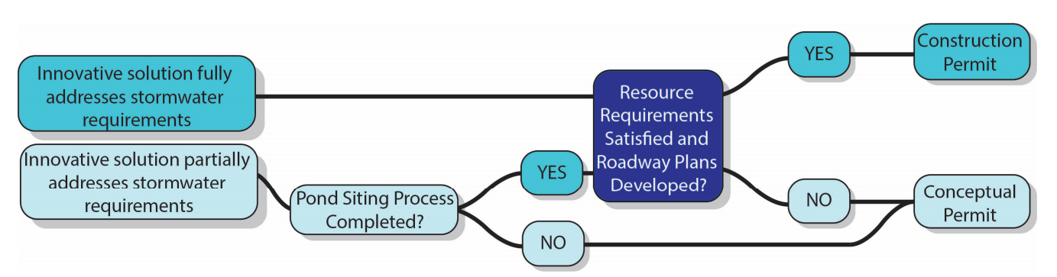
.
Permitting Scenarios
Source: Process Guidebook,
Figure 5
Notes:
Here are some scenarios and how we might respond in pursuing permitting:
Scenario 1: Full innovative coverage in place – no ponds needed
Develop plans and obtain highway permit!
If plans prep is delayed, lock in the innovative solution with a conceptual permit
Scenario 2: Partial innovative coverage in place – ponds needed
2A - Pond siting completed
Develop plans and obtain construction permit
If plans prep is delayed, lock in the innovative solution with a conceptual permit
2B - Pond siting NOT completed
Obtain conceptual permit to lock in innovative solution(s)

Slide 54
Advancing ROW Acquisition and Project Funding
1. IDENTIFICATION
2. EXPLORE
3. GOALS
4. SOLUTIONS
5. SCREENING
6. COORDINATION
7. STRATEGIES
8. FUNDING
9. (MEETING)
10. STRATEGIZE
11. FURTHER WORK
NO VIABLE
OPTIONS
12. FINAL MEETING
ASSURED
Y
N
14. TRADITIONAL
REQUIREMENTS
Y
N
13. AGREEMENT
15. WMD / ERP
16. DELIVERABLE
17. ADVANCE ROW
17. ROW
18. FINAL DESIGN
PLANS
(PERMIT MOD)
REPORT
(PERMIT MOD)
5. SCREENING
CONSTRUCTION
OPERATION
Notes:
Remember to align the R/W and funding far enough in advance to not compromise the project schedule.
Talk to your ROW staff to understand the lead time they need to deliver property on time to finalize deals with partners or to prevent RoW acquisition from becoming stale.
The flow chart shows funding as Step 17, but it can be ANYTIME
Especially important to be able to move on partnerships while the door is open.

Slide 55
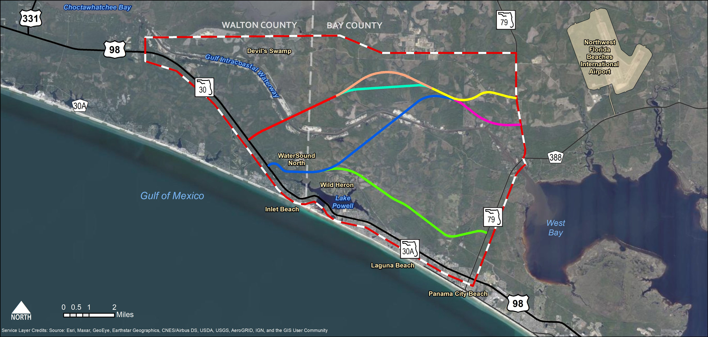
Exercise: To Site or Not to Site Ponds…
St. Lough DRI
Existing BMAP
EXAMPLE PROJECT
Impaired Waterbody
EXAMPLE PROJECT
Notes:
Note the water quality and development within our corridor’s vicinity – one PD&E project with multiple alternatives
The corridor is divided into 3 sections <click>

Slide 56
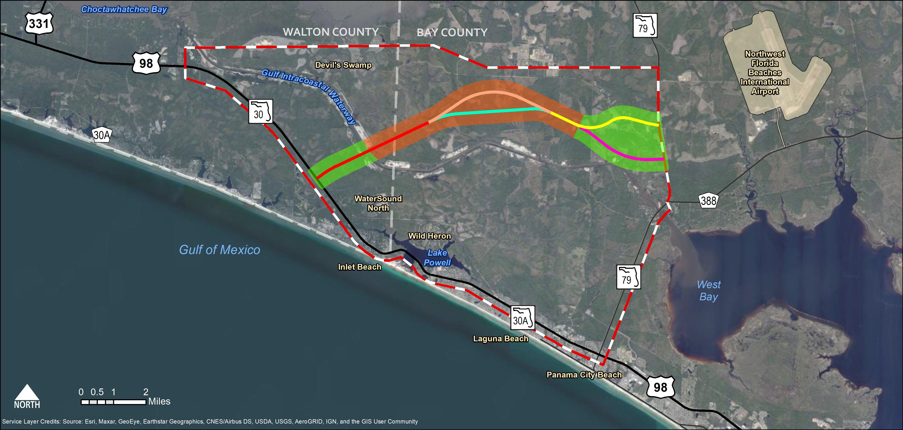


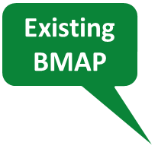

Do We Pursue Traditional Pond Siting?
1. IDENTIFICATION
2. EXPLORE
3. GOALS
B
4. SOLUTIONS
5. SCREENING
6. COORDINATION
7. STRATEGIES
8. FUNDING
9. (MEETING)
10. STRATEGIZE
C
11. FURTHER WORK
A
12. FINAL MEETING
12. FINAL MEETING
NO VIABLE
OPTIONS
ASSURED
N
14. TRADITIONAL
REQUIREMENTS
Y
N
14. TRADITIONAL
Y
13. AGREEMENT
15. WMD / ERP
16. DELIVERABLE
17. ROW
18. FINAL DESIGN
PLANS
(PERMIT MOD)
REPORT
(PERMIT MOD)
CONSTRUCTION
OPERATION
EXAMPLE PROJECT
Notes:
For example, after multiple alignments have been eliminated and multiple conversations with the agencies, we are down to 3 possible innovative solutions:
Segment A: Participate in future Regional County Pond at A – satisfies water quality, floodplain compensation, and attenuation – pond scheduled to be finished 2 years before construction begins on Segment A
Segment B: DRI in Segment B, but timing is uncertain and local permitting not yet applied for
Segment C: Fund Bay County BMAP project at C, satisfies water quality and County has committed to complete the project in the next 5 years – Segment C is 7 years out

Slide 57
Audience Poll….
Question 1:
Would you site ponds in Segment A?
B
Participate in future Walton County Regional Pond in Segment A?
Satisfies water quality, attenuation, and floodplain compensation – pond scheduled to be before construction begins on Segment A
A
C
Choices
Defer pond siting and move forward to innovative solution
Proceed with parallel pond siting process
EXAMPLE PROJECT
Notes:
How confident are we in these innovative solutions?
Participate in future Walton County Regional Pond in Segment A?
Satisfies water quality, attenuation, and floodplain comp
Pond scheduled to be before construction begins on Segment A
Likely, the pond will be under construction in plenty of time and you have the time to wait and still make schedule
What would you do? Poll
What could go wrong?
Sign agreements with County and get in on the permitting to lock in your innovative solution

Slide 58
Audience Poll….
Question 2:
Would you site ponds in Segment B?
B
A
C
Choices
Defer pond siting and move forward to innovative solution
Proceed with parallel pond siting process
DRI in Segment B – avoids R/W costs, but timing is uncertain and local permitting not yet applied for
EXAMPLE PROJECT
Notes:
How confident are we in these innovative solutions?
DRI in Segment B – avoids R/W costs, but timing is uncertain and local permitting not yet applied for
Wait for DRI but know when to site ponds in time to make Segment B schedule
Low confidence, but likely a good solution, if the DRI moves forward expeditiously
Build DRI J/U permitting path time into schedule
Not a new concept for WMD
What would you do? Poll
What could go wrong?

Slide 59
Audience Poll….
Fund BMAP project at C, satisfies water quality and Bay County has committed to complete the project in advance of Segment C
B
Question 3:
What about Segment C?
A
C
Choices
Defer pond siting and move forward to innovative solution
Proceed with parallel pond siting process
EXAMPLE PROJECT
Notes:
How confident are we in these innovative solutions?
What could go wrong?
Fund BMAP project at C, satisfies water quality
Secure County commitment to complete the project in advance of Segment C
BMAP project would likely be water quality only, not attenuation or FPC
Might still need ponds, but they would be smaller with less restrictive criteria
Sign agreements with County and get in on the permitting to lock in your innovative solution
Hand off to Katey

Slide 60



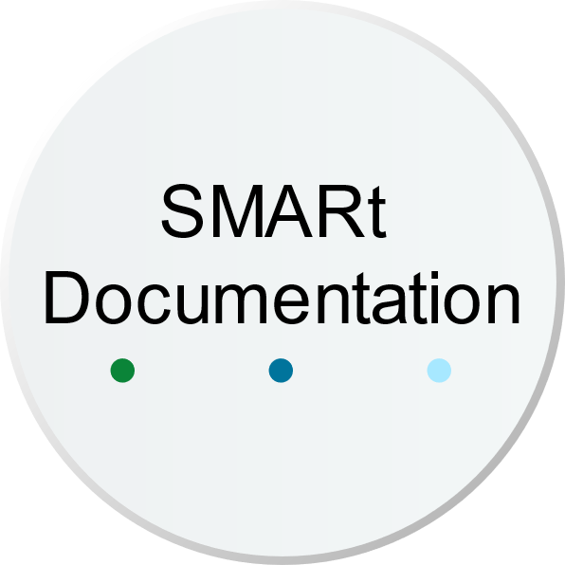








Stormwater Management Alternatives Report Documentation
Stormwater Alternatives Analysis
DST Meeting Minutes
Permits
Stakeholder Communication
WQIE
LHR
WATERSS Analysis Report from ETDM
Legal Agreements
Pond Siting Report
Notes:
If you are performing a WATERSS study, you will be documenting your efforts into the Stormwater Management Alternatives Report. Even if you started WATERSS and did not find any workable innovative solutions – this should be documented and retained for the future. It’s still valuable to understand what didn’t work and why, so history doesn’t repeat itself.
SMARt should include
Stormwater alternatives considered, how the decisions were made
Permit Documents
Legal Agreements
Repository of Internal DST discussions
External Communications
ETDM WATERSS Analysis report (unless WATERSS started after ETDM)
If you end up doing traditional pond siting, this will be included in the SMARt too. The Pond Siting Report essentially becomes a section within the SMARt.
WQIE and LHR can be rolled up into the SMARt to condense all stormwater related documentation
The SMARt is the documentation of the entire process and is delivered at the end of PD&E. But it’s important to remember that interim deliverables are likely necessary to document progress throughout the WATERSS process. These interim deliverables are not formal in a NEPA sense, but the PM, with help from the DST, should scope the deliverables they feel are necessary for the project at hand.

Slide 61
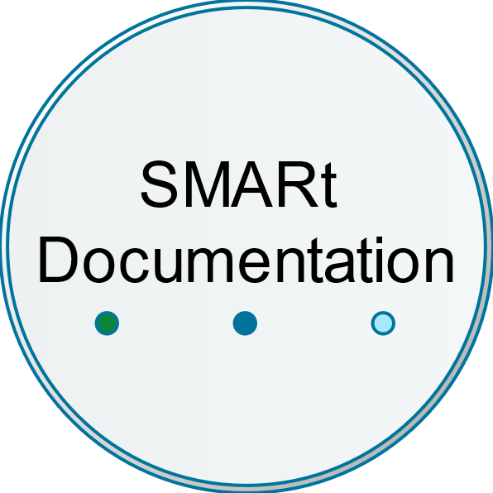

New Pond Siting Process!
AND / OR
Pond Siting Report
APPENDIX D
New PSR Process!
Notes:
I’ll take a minute to note here that the WATERSS process guidebook contains a newly published Pond Siting Process in Appendix D. This is a process that has been used at the District level with a great amount of success and is now published statewide. I encourage you all the check it out.

Slide 62
WATERSS Process – Design, Construction, & Ops Phases
Notes:
“here are the steps after PD&E to wrap up the WATERSS process.
Note there are no WATERSS specific staff hours for the design phase.
But as you enter Design you should have specific designs/concepts that you are pursuing, and these specific efforts would be scoped within the Design staffing hours.

Slide 63
Finalize Design and Permitting
VARIES
PM, DC, District Staff
Design plans including stormwater, drainage, and floodplain management features will be developed in the Design Phase.
Construction permits must be finalized, or modified if obtained during PD&E.
Develop Drainage Design Report to document drainage design features and calculations that support the final construction plans.
Coordinate PD&E Re-evaluation if needed.
  See PD&E Manual Part 1 Chapter 13 for when a re-evaluation is necessary.
1. IDENTIFICATION
2. EXPLORE
3. GOALS
4. SOLUTIONS
5. SCREENING
6. COORDINATION
7. STRATEGIES
8. FUNDING
9. (MEETING)
10. STRATEGIZE
11. FURTHER WORK
NO VIABLE
OPTIONS
12. FINAL MEETING
ASSURED
Y
N
14. TRADITIONAL
REQUIREMENTS
Y
N
13. AGREEMENT
15. WMD / ERP
16. DELIVERABLE
17. ROW
18. FINAL DESIGN
18. FINAL DESIGN
PLANS
(PERMIT MOD)
REPORT
(PERMIT MOD)
CONSTRUCTION
OPERATION
Notes:
The Analysis and Plans production will continue to be further developed in the design phase.
Permitting will be finalized. If you acquired a conceptual permit, this will be converted to a construction permit. If you received a construction permit that possibly changed during design, a permit mod is acquired.
All of the drainage design is documented in the Drainage Design Report
Coordinate whether or not a PD&E Re-evaluation is needed due to any design changes. For reference, refer to the PD&E Manual Part 1, Ch 13 is where the re-evaluation criteria is listed.

Slide 64
Design Phase - Continued Communication
VARIES
PM, DC, District Staff
Stay in touch with external partners
  Adjust agreements, as needed, to reflect changes made in final design.
  Remain aware to changes in leadership within partners.
  Transfer maintenance responsibility if agreed upon in partnership.
Coordinate with the District EMO
  Environmental Re-evaluations needed?
  Permit modifications needed?
Coordinate with Department legal staff
  Adjust agreements, as needed, to reflect changes made in final design.
1. IDENTIFICATION
2. EXPLORE
3. GOALS
4. SOLUTIONS
5. SCREENING
6. COORDINATION
7. STRATEGIES
8. FUNDING
9. (MEETING)
10. STRATEGIZE
11. FURTHER WORK
NO VIABLE
OPTIONS
12. FINAL MEETING
ASSURED
Y
N
14. TRADITIONAL
REQUIREMENTS
Y
N
13. AGREEMENT
15. WMD / ERP
16. DELIVERABLE
17. ROW
18. FINAL DESIGN
18. FINAL DESIGN
PLANS
(PERMIT MOD)
REPORT
(PERMIT MOD)
CONSTRUCTION
OPERATION
Notes:
You’ll still be in close contact with any external partners that are involved in an innovative solution, this is likely to be as the legal documents are finalized and construction and operation terms are being negotiated.
Keep EMO involved, especially if design changes modify a permit
And of course, keep your legal team apprised of anything that might come up during design.

Slide 65
Poll Question for Scoping-
Have you tried to scope WATERSS in Planning or PD&E?
  Yes
  No
Question box:
How did it go?
What would you do differently?

Slide 66




Including WATERSS in Project Scopes and Estimates
Limited scoping guidance for planning studies.
PD&E Scope covers preliminary drainage, floodplain, and stormwater analyses.
Design Scope covers detailed drainage, floodplain, and stormwater design.
WATERSS can be incorporated into project scope(s) as needed.
Notes:
You’ve heard us talk about scoping WATERSS throughout this presentation and in this section, we’ll dive a little deeper.
Planning:
There is usually limited scoping guidance for planning studies, so right now we are seeing a fair amount of WATERSS being scoped in PD&E after ETDM has passed.
This is not the end of the world. Starting in PD&E can still yield fruitful ideas, but it’s a bit of a miss in the sense that ETDM is our first opportunity to make contact with the regulatory agencies. Remember, it was the WMDs that asked FDOT to start the discussion on innovative stormwater in ETDM.
PD&E
The Office of Environmental Management is set to release scope and staffing hour guidance for WATESS in the next release, which is coming soon
This will help guide folks, but it really takes the PM and key members of the DST, like the DDrE the PD&E engineer or other members o the DST to huddle up ahead of scoping and decide how to scope WATERSS for the specific project. Remember WATERSS is a scalable process!
If you are in a rural area with say just a few stakeholders, maybe you don’t hold formal stakeholder meetings and simply meet individually for decision making. In this case, you don’t scope hours for a formal stakeholder meeting.
Alternatively, if you’re in a sensitive BMAP area, with many stakeholders, you might need to be more formal with additional deliverables for DST review and you could scope as a milestone check-in point.
Design:
Note there are no WATERSS specific staff hours for the design phase.
But as you enter Design you should have specific designs/concepts that you are pursuing, and these specific efforts would be scoped based within the Design staffing hours.

Slide 67
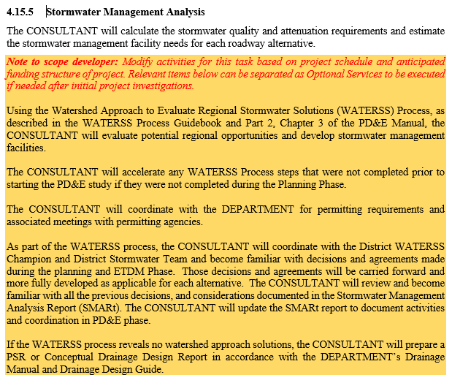
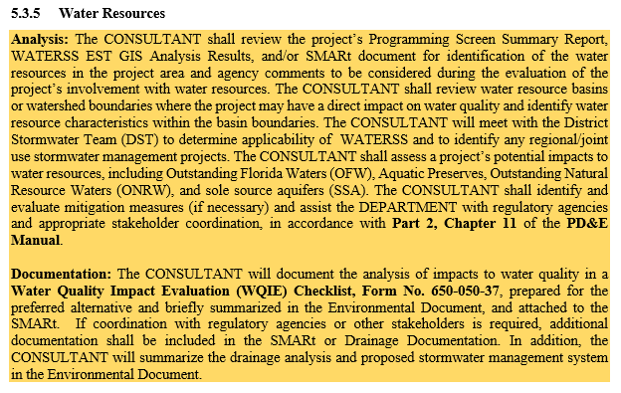
Example PD&E Scoping Language
DRAFT
DRAFT
Notes:
Here are a few screen grabs of the upcoming Scope edits for WATERSS.
Again, keep in mind that WATERSS is optional and all scope items in the goldenrod box are only to be included when appropriate for the project. This standard language is meant to be flexible, and able to be modified for project specific needs.

Slide 68

WATERSS Scoping Development
Suggestion #1
  Use experience from Planning Phase
  Investigate the ETDM Report
Suggestion #2
  Consult internal staff
  Previous experience with ELA
Suggestion #3
  Use your consultant’s regional experience
This Photo by Unknown Author is licensed under CC BY-NC-ND
Notes:
Some of you might be asking well, we don’t know what we are going to find, so how do we plan and scope for that. And I would say, yes, I agree! It’s tough.
Suggestion #1 would be to use earlier project phases to inform later phase scopes. If you completed the ETDM GIS WATERSS report, use that and any feedback from ETAT to get you started.
Suggestion #2 if you are scoping WATERSS after ETDM, work with your DDrE and Permit coordinators who know the region and the players. Experience from years of ELAs have given these team members an understanding of the landscape and that can help.
Suggestion #3 If you’re still unsure that you’ve scoped WATERSS well enough, discuss this openly with the selected consultant. The selected consultant is likely (hopefully) knowledgeable of the region and is also likely working for WMDs, city, Counties and might have helpful insight into potential opportunies before you even get started. Adjust as needed during negotiations!

Slide 69



WATERSS Scoping Development
Suggestion #4: Phased hours approach
Build flexibility and check-in points into the scope
  Investigation Phase (look for solutions) Planning Phase
  Initial Viability Phase (could it work?) PD&E Phase
  Detailed Phase (does it work? and can we permit it?) PD&E Phase
Notes:
Suggestion #4, phased hours approach. We’ve received feedback that “oh, we can’t do WATERSS that’s too expensive” to which I say phase it. Scope and fund the initial investigation phase and if something shakes out that you’d like to pursue, write an SA to investigate viability. Proceed accordingly.
And if there are ever any questions, Districts, please….Call OEM!

Slide 70
What About Uncertainty?
Methods for addressing uncertainty in scoping
Methods to manage funding
GEC
Districtwide/ Continuing Services
Variable funding
Contingent Items (Optional Services)
Supplemental Agreements
“Not to Exceed” Contractual Approach
Notes:
Funding can also be challenging, but it’s important to use tools such as
Adding contingent items to your initial scope, if they are known at the time.
Discuss openly, and plan for the option of supplemental agreements if ideas are found.
Or consider a not to exceed contract.
Other options are to think creatively about funding….use GEC, Districtwide contracts when feasible or look for variable funding sources.

Slide 71
Question for Scoping – Question Box
For those of you who have scoped WATERSS did you use any of the suggested approaches, or was another method successful?

Slide 72

Upcoming Training for WATERSS
Training Activities
  ETAT and permitting agency training
  FDOT and consultant practitioners training
Notes:
Please write Catherine Bradley to suggest other WATERSS training topics you foresee needing.

Slide 73




Contact
FDOT Office of Environmental Management
Catherine Bradley, P.E.
State Environmental Development Engineer​
Office of Environmental Management​
605 Suwannee Street, MS 37​
Tallahassee, FL 32399-0450
Phone: 850-414-5209​
Email: Catherine.Bradley@dot.state.fl.us​
​
73

Slide 74
Thank you!
Questions and Discussion
Process Overview

