Slide 1
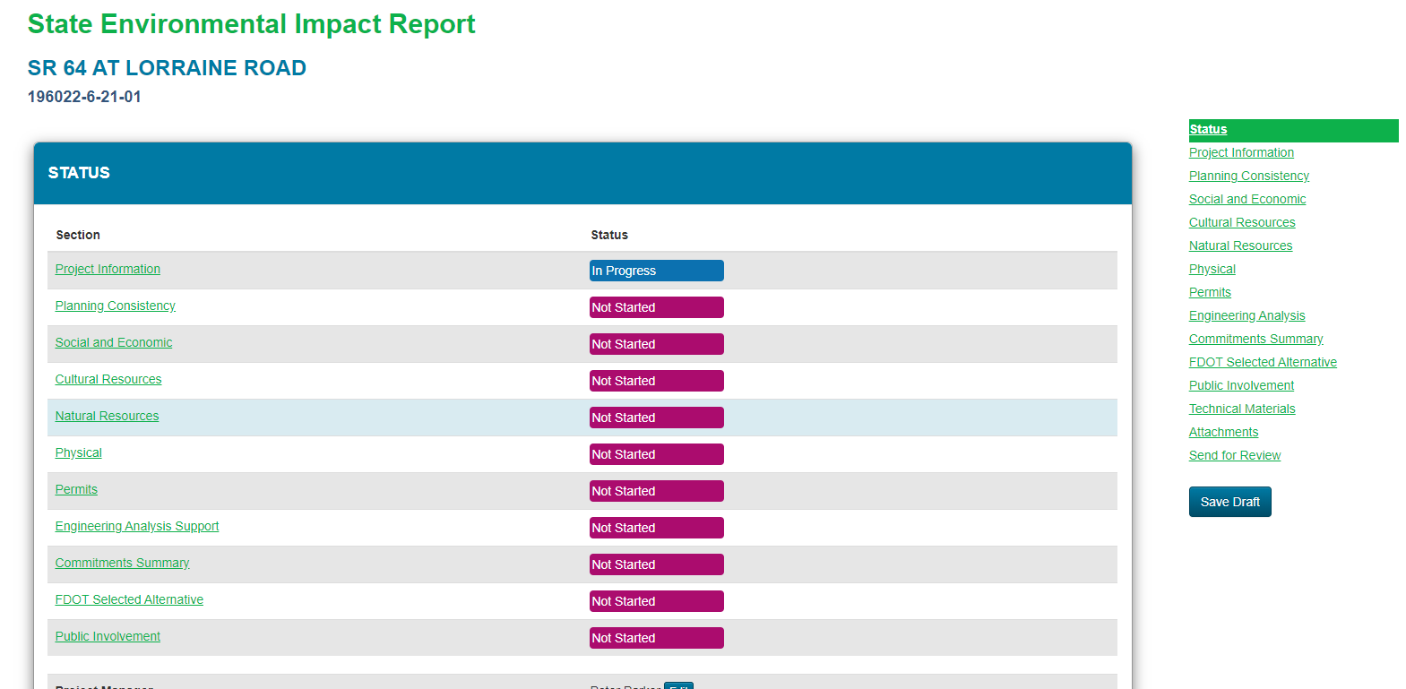
How to Prepare a SEIR in SWEPT
October 21, 2020

Slide 2
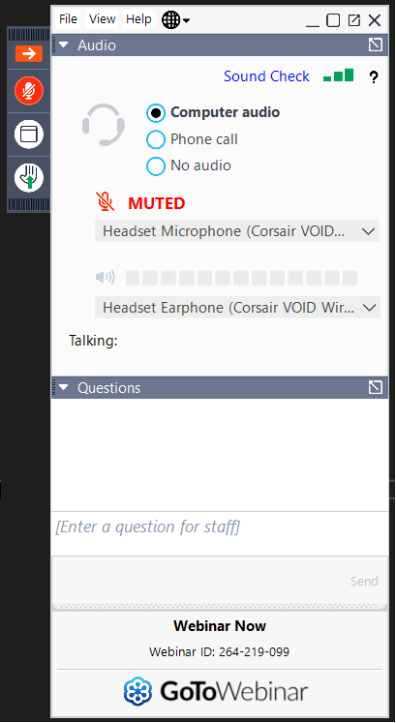
Sound Check!
If you can’t hear me, try the following (in this order):
  Go to Audio settings and make sure the correct device is selected
  If it is correct, try toggling to another option and back again
  If that doesn’t work, try changing to Phone call, and use your phone for the audio
If it still doesn’t work, send us a chat and one of the organizers will try to help you troubleshoot

Slide 3
Logistics
Attendees are automatically muted throughout the webinar.
Please submit any questions via the questions dialog tool.
Questions may be answered within the dialog box or may be addressed at the end of the presentation.
Webinar is being recorded
The recording, SWEPT demonstration videos, and PowerPoint presentation will be available on the OEM website.

Slide 4
Using SWEPT’s State Environmental Impact Report Tool
SEIR WorkFlow
Preparing
Reviewing
Approving

Slide 5
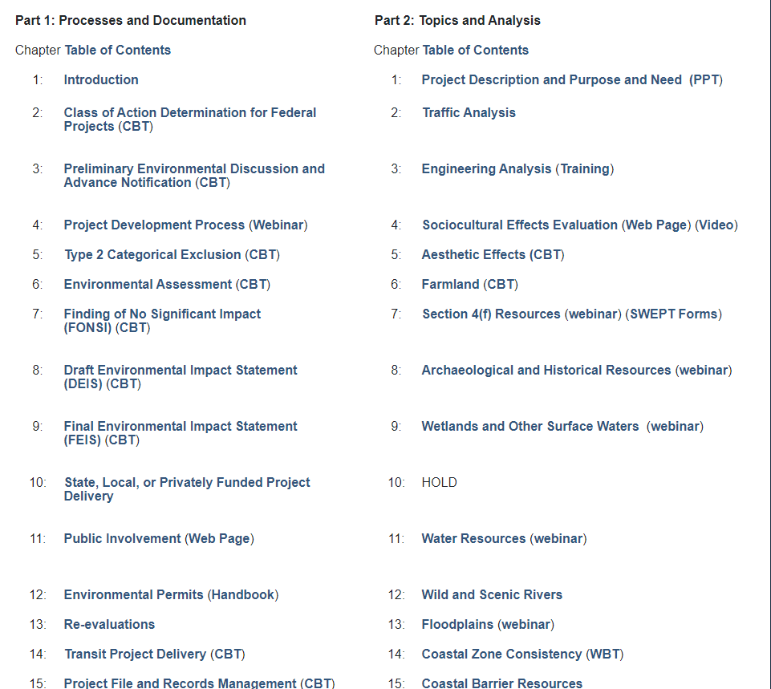
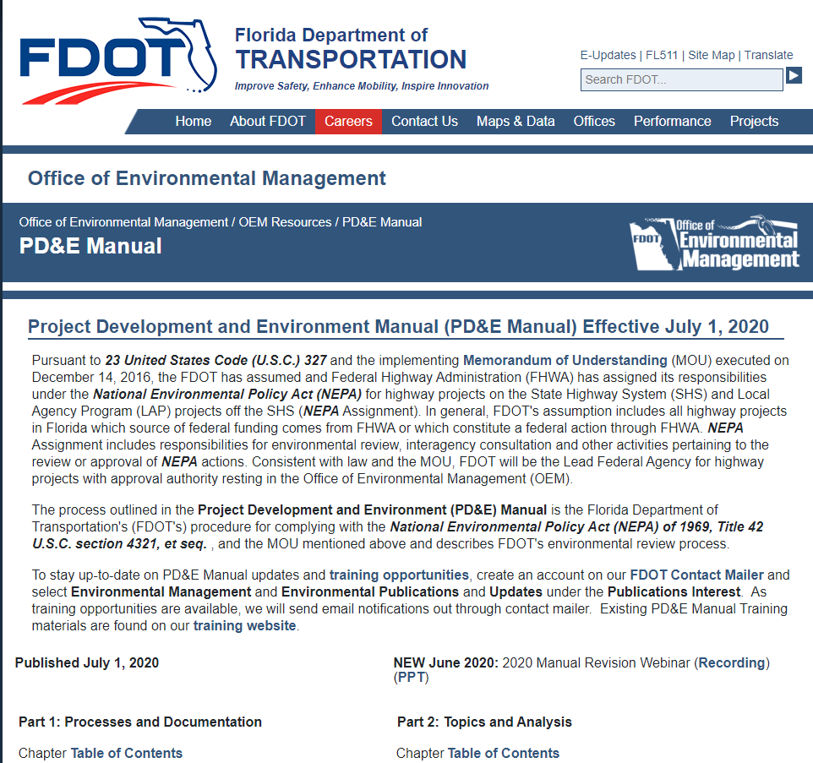
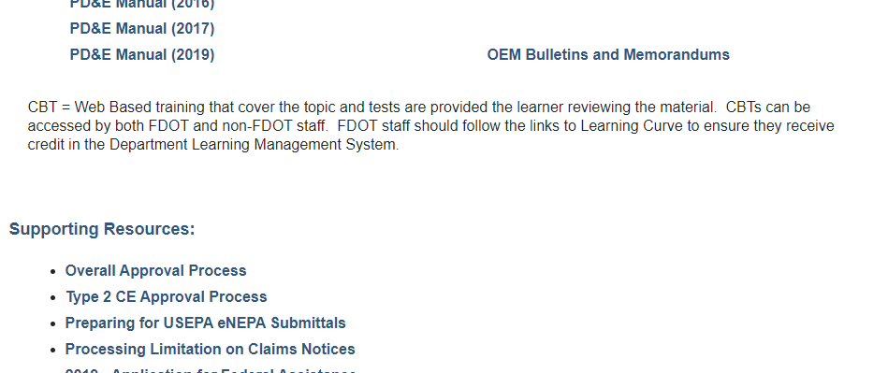
Additional Training Resources
PD&E Manual
https://www.fdot.gov/environment/pubs/pdeman/pdeman-current

Slide 6
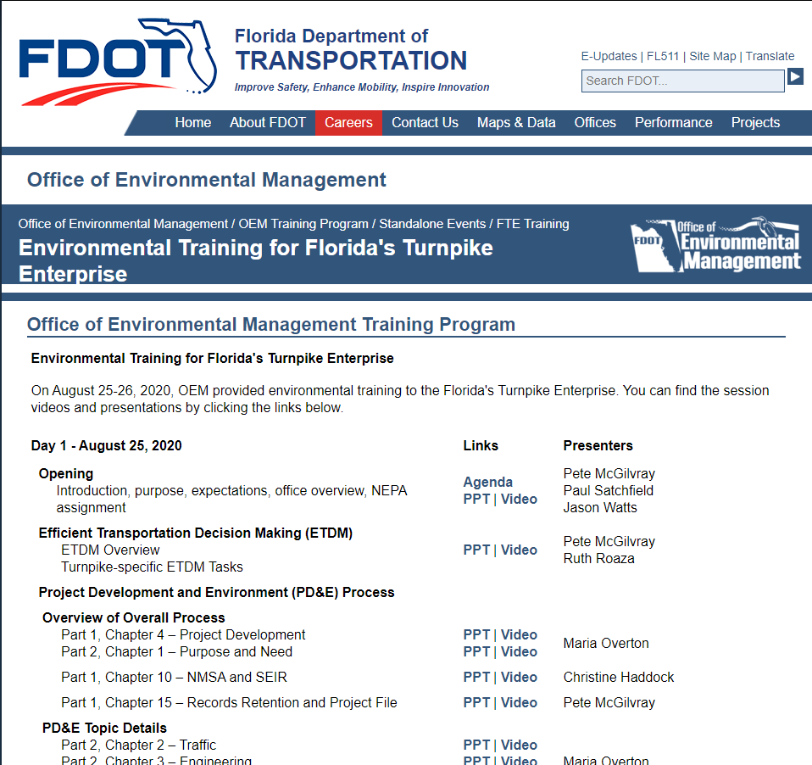
Additional Training Resources
SEIR-focused Environmental Training
Videos from Environmental Training Provided to Florida’s Turnpike Enterprise
https://www.fdot.gov/environment/sched/standalone.shtm/FTE-August2020.shtm

Slide 7
SEIR Workflow
Editor
Project Manager
DEM & PDE*
SEIR Approver
Create/edit
Send for review
Create/edit
Send for approval or return with comment
Review
Review
Approve or return with comments
Upon approval, digital signature stamp appears on cover
Review
Recommend for approval or return with comments
May delegate
May delegate
Project-specific team assignments
District or Turnpike-wide assignments
*District Environmental Manager & District Project Development Engineer

Slide 8
Demonstration
Preparing and Reviewing the SEIR

Slide 9


SEIR Workflow
We are here
Editor
Project Manager
DEM & PDE*
SEIR Approver
Create/edit
Send for review
Create/edit
Send for approval or return with comment
Review
Review
Approve or return with comments
Upon approval, digital signature stamp appears on cover
Review
Recommend for approval or return with comments
May delegate
May delegate
Project-specific team assignments
District or Turnpike-wide assignments
*District Environmental Manager & District Project Development Engineer

Slide 10
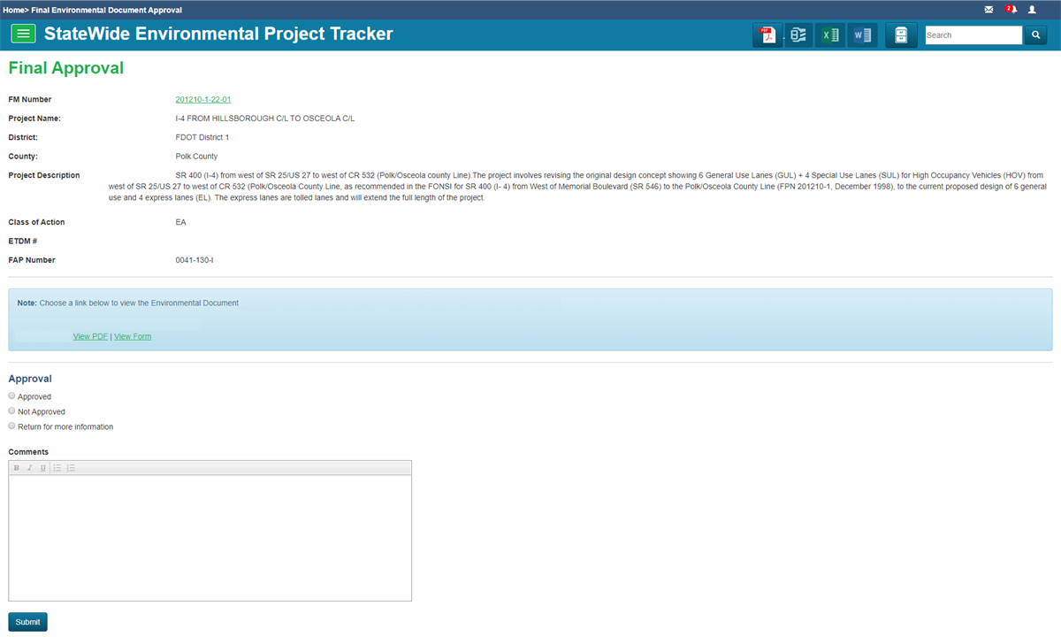
Demonstration
Test Project
SEIR
SEIR Approver

Slide 11
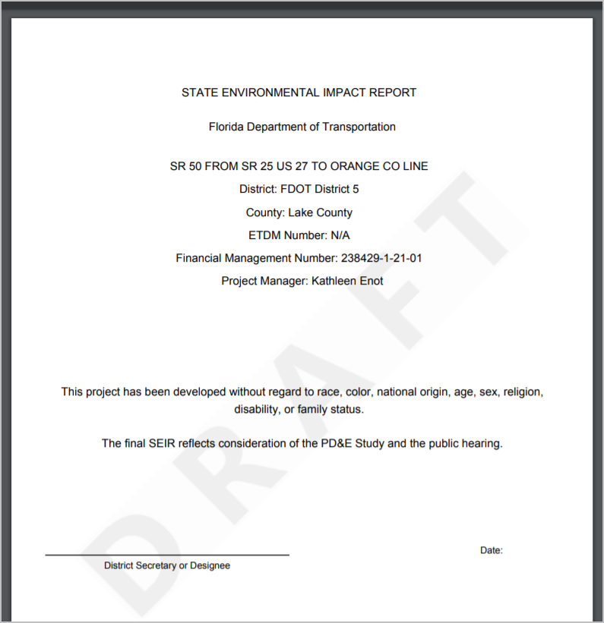
Let’s look at a draft SEIR PDF

Slide 12
Questions?

Slide 13
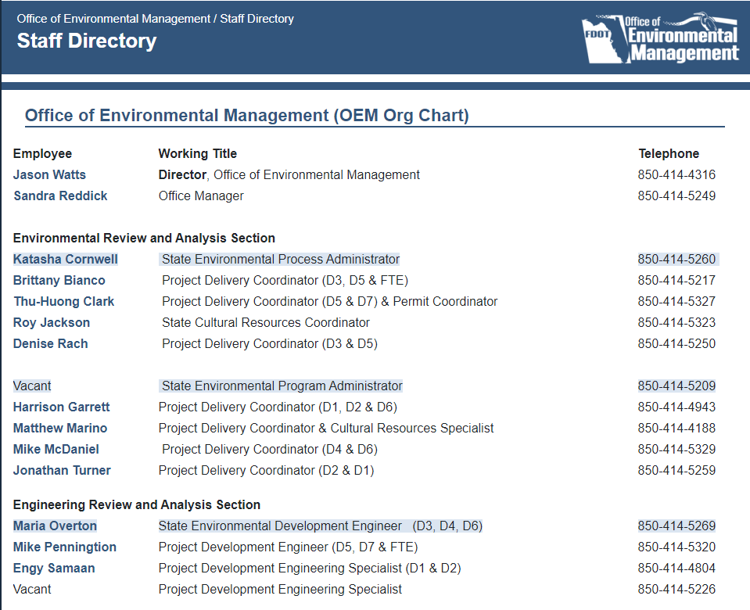
For More Information
Project-Specific Guidance
OEM Project Development Coordinators/Engineers
https://www.fdot.gov/environment/staff.shtm
SWEPT Assistance
OEM Help Desk
(850) 414-5339
swept@fla-etat.org
Ruth Roaza
(850)414-4620
Ruth.Roaza@dot.state.fl.us

