Slide 1
2019 NEPA Self-Assessment: May 1, 2018 – August 21, 2019
Replace with image or photo
Statewide Kick-off Meeting
April 29, 2019
Replace with image or photo
The environmental review, consultation, and other actions required by applicable federal environmental laws described in this webinar are carried out by FDOT pursuant to 23 U.S.C. §327 and a Memorandum of Understanding dated December 14, 2016, executed by FHWA and FDOT.
Notes:
Welcome to this presentation on the 2019 NEPA Assignment Self-Assessment. This is the 3rd of annually required self-assessments. We will review a year of NEPA Project Approvals from May 1, 2018 to April 30, 2019 Our reviews ensure our environmental documents are complete and compliant, and we may involve interaction with the Districts should questions arise.

Slide 2
OEM Representatives
Jason Watts,
Director, Office of Environmental Management
Jason.Watts@dot.state.fl.us
(850) 414-4316
Peter McGilvray,
State Environmental Quality and Performance Administrator
Office of Environmental Management
Peter.McGilvray@dot.state.fl.us
(850) 414-5330
Eric Whitehead,
Quality Assurance and Quality Control Coordinator
Office of Environmental Management
Eric.Whitehead@dot.state.fl.us
(850) 414-5326
Notes:
Presenters today are Jason Watts, OEM Director, Pete McGilvray, State Environmental Quality and Performance Administrator, and Eric Whitehead, QA/QC Coordinator. Pete and I will be planning and coordinating the self-assessment process. Here is our contact information.

Slide 3
Meeting Objectives
Authority
2018 Self-Assessment and Audit Outcomes
Overview of the NEPA Self-Assessment Scope
Self-Assessment Target Topics
Overview of the NEPA Self-Assessment Process
Important Dates to remember
Notes:
The objectives for this presentation include an Overview of Federal Highway Administration (FHWA) requirements, 2018 assessment outcomes, the NEPA Self-Assessment Scope, Self-Assessment Focus Topics, the NEPA Self-Assessment Process, and Important Dates to remember.

Slide 4
Authority for Self-Assessment
Section | Requirement
FDOT Topic 001-260-001 Section 8.2.5: MOU Section 8.2.6: MOU Section 10.1.3: MOU | Quality Assurance and Quality Control Policy requiring OEM to conduct an annual Quality Assurance Review.
 | FDOT shall perform annual self-assessments of its QA/QC process and performance to determine if its process is working as intended.
 | Upon the Effective Date of this MOU, FDOT will maintain a list of NEPA approvals and decisions … it makes under this MOU. FDOT will provide this list to FHWA on a quarterly basis …
 | FDOT shall collect and maintain necessary and appropriate data related to the performance measures … FDOT shall monitor its progress toward meeting the performance measures and include its progress in the self-assessment …
Notes:
The requirements for conducting annual self-assessments are found in FDOT Topic 001-260-001, and in MOU Section 8.2.5…., Section 8.2.6…., and Section 10.1.3….

Slide 5
Purpose of Self-Assessment and Review Team Members
Purpose is to annually assess FDOT performance and compliance with the MOU, NEPA, and environmental laws and regulations
The SA Review Team consists of 12 members
2019 SELF-ASSESSMENT REVIEW TEAM
Name | Unit
Eric Whitehead | Quality Assurance and Performance
Mariano Berrios | Environmental Review and Analysis
Brittany Bianco | Environmental Review and Analysis
Katie Britt | Environmental Review and Analysis
Thu-Huong Clark | Environmental Review and Analysis
Heidi Coggins | Engineering Review and Analysis
Lindsay Guthrie | Environmental Review and Analysis
Roy Jackson | Environmental Review and Analysis
Matt Marino | Environmental Review and Analysis
Ruth Roaza | Quality Assurance and Performance
Michael Sykes | Engineering Review and Analysis
Mike McDaniel | Environmental Review and Analysis
Notes:
The purpose of the Self-Assessment is to annually evaluate FDOT performance and compliance with the MOU, NEPA, and environmental laws and regulations.
To perform the evaluation, OEM Management has assigned a 2019 Self-Assessment Review Team consisting of 13 members shown here.

Slide 6
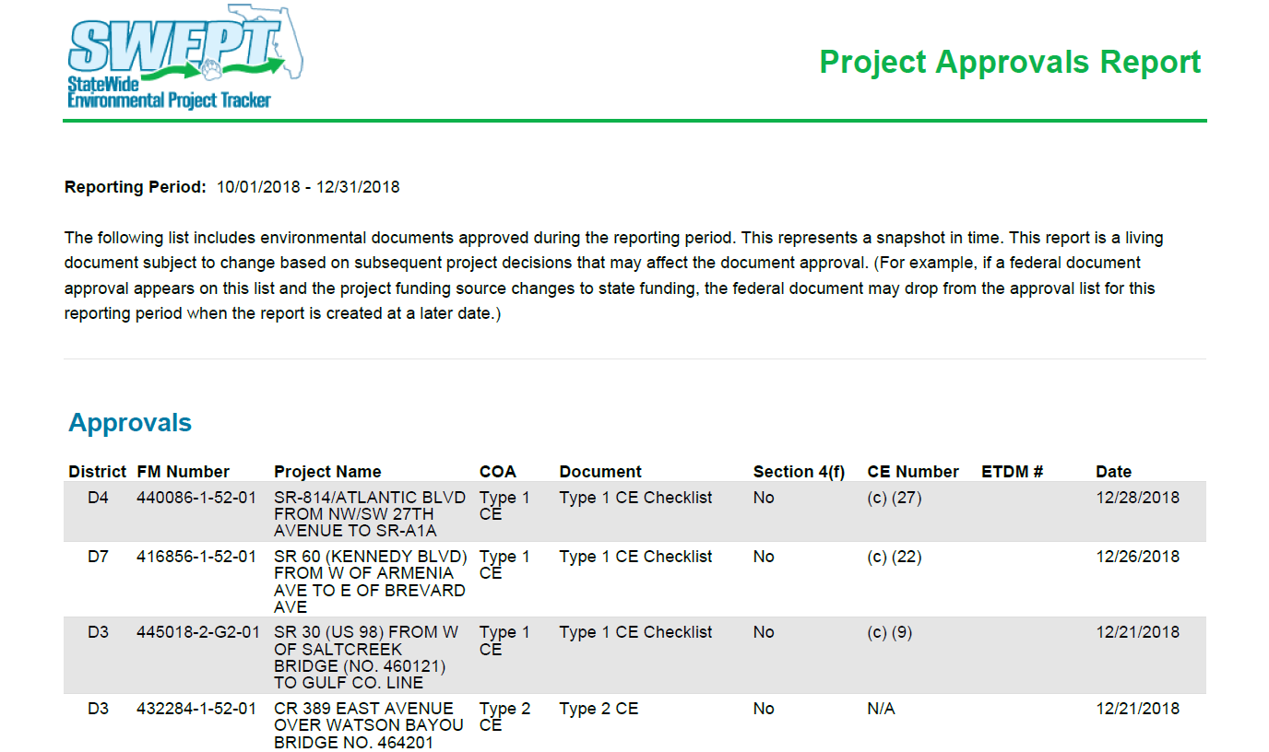
Project Approvals Report
FHWA requires FDOT provide a quarterly list of certified Approvals and Decisions for NEPA projects
The list includes; Type 1 CEs, Type 2 CEs, EAs, FONSIs, DEISs, FEISs, FEIS/RODs, RODs, Section 4(f) Determinations, and Re-evaluations
Notes:
OEM is required to provide FHWA a quarterly Project Approvals Report, which is a list of NEPA Approvals and Decisions. This list will be the source of NEPA projects for the desk review, and includes Type 1 CEs, Type 2 CEs, EA, FONSI, DEIS, FEIS, FEIS/ROD, ROD and Section 4(f) Determinations. In 2018, Type 1 CEs comprised 90% of all project approvals (Out of a total of 735 project approvals, 662 were Type 1 CEs).
Here is an example of a Project Approvals Report, which shows the District, FM #, Project Name, Class of Action, Document Type, Section 4(f) designation, CE Number if Type 1 CE, ETDM # if applicable, and date of project approval.

Slide 7
2019 Target Topics
NEPA Assignment Self-Assessment Project-Related Review Topics
No. | Topics | Lead Reviewer | Review Teams
1 | Noise, MOU Standard Statement, Relocation* | Pete McGilvray | Thu, Mariano, Mike
2 | Interchange Policy | Victor Muchuruza | Roy, Heidi, Lindsay
3 | Public Involvement Plan | Katasha Cornwell | Matthew, Michael, Katie
4 | Sociocultural Evaluation | Margie Kirby | Ruth, Brittany
*Required follow-up topics from 2018 Self-Assessment
Notes:
Annually, OEM management will select topics to focus on during the desk review of approved NEPA projects. This year, the focus topics include Noise, MOU Standard Statement and Relocation as follow-up from the 2018 Self-Assessment, and Interchange Policy, Public Involvement Plan and Sociocultural Evaluation new for 2019.

Slide 8
2018 Self-Assessment Outcomes
Performance results showed FDOT meeting or exceeding performance targets for all qualifying projects for nine metrics
Found 2 successful practices on re-checking contamination data quality, and providing detailed narratives for effect determinations of protected species and habitat and how effective determinations reached for Type 1 CEs
Found 8 opportunities for improvement for documentation quality, clear and appropriate explanations and statements for species and habitat determinations, processing emergency projects, and whether relocation is anticipated
Found 4 non-compliance observations on Noise, MOU Standard Statements, and Relocation – OEM updated the PD&E Manual, notified all Districts of changes, and requested Districts to take the necessary steps in their QA/QC processes to resolve these actions moving forward
Notes:
The 2018 Self-Assessment found FDOT met or exceeded all nine metrics which had qualifying projects, found 2 successful practices focused on data quality and clarity if narratives, found 8 opportunities for improvement, and found 4 non-compliance observations on Noise, MOU Standard Statement, and Relocation.
OEM updated the PD&E Manual January 14, 2019, notified all Districts of changes, and requested Districts to take the necessary steps in their QA/QC processes to resolve these observations moving forward.

Slide 9
Self-Assessment Scope
Review period of May 1, 2018 through April 30, 2019, selected to be consistent with FHWA audit period
All NEPA Performance Measures with qualifying projects (Compliance with NEPA and federal environmental laws, QA/QC of NEPA Decisions, Relationships with Agencies and the Public, and Increased Efficiency and Timeliness of NEPA Process)
Sample of Project Approvals to review based upon NEPA focus topics
Notes:
Scope covers the NEPA project approval period of May 1, 2018 through April 30, 2019, selected to be consistent with the FHWA audit period. The Scope also covers all NEPA performance measures, and a sample of NEPA Project Approvals to review for compliance based upon focus topics.

Slide 10
Overview of Self-Assessment Process
Identification of NEPA target topics , review criteria, and sample of NEPA project approvals
OEM team will conduct desk review of project documentation and contact District staff as needed for feedback
OEM will prepare a report of successful practices, opportunities for improvement, and any non-compliance observations
Two-week District review period for draft report, followed by management review
OEM will provide final report to Districts and a summary to FHWA
Notes:
The self-assessment process involves identification of NEPA target topics, review criteria, and a sample NEPA project approvals. Sample of approved Type 1s will be selected randomly stratified by District. All higher level Classes of Action, such as EISs, EAs, Type 2 CEs, and re-evaluations may be selected. The OEM Self-Assessment team will conduct a desk review of project documentation and contact District staff as needed for clarification and feedback. OEM will prepare a report of successful practices, opportunities for improvement, and any non-compliance observations. Districts will have a 2-week draft report review period. Draft report is also reviewed by OEM management with final approval by OEM Director. OEM will provide the final report to Districts and a summary to FHWA in August.

Slide 11
2nd FHWA Audit Report Findings (2018)
Version | # of Successful Practices | # of Observations | # of Non-Compliant Observations
Debriefing after Interviews | 11 | 1 | 4
Pre-Register Draft | 11 (expected to rise) | 1 | 2
2-Non-Compliance Findings:
FDOT’s definition of “commitment” excludes necessary mitigation as required by Federal regulation – FDOT disagrees with this assertion and is actively working with FHWA audit team to resolve
Some FDOT project files contain insufficient documentation to support the environmental analysis or decision. – FDOT has provided details responses on all project files and is actively coordinating with the FHWA audit team to remove projects from this non-compliance observation
1-Observation:
ESA assessment was unsupported on certain projects. – FDOT has worked with USFWS and received approval to use their Species Key and make no-effect determinations as the lead federal agency
Notes:
For the non-compliance observation on insufficient project documentation, FDOT reviewed cited files and provided FHWA clarifying information to show some files were properly documented, and agreed to further examine other files for appropriate actions as needed.

Slide 12
2nd FHWA Audit Report Findings (2018)
11 Successful Practices (expected to rise)
Good District communications
Great working relationship with agencies
SWEPT enhancements – required files before approval – SMART forms
Tracking system for federal guidance – spreadsheet tracker with action captured
District review of NEPA documents – some additional reviews by individuals beyond what is required in the existing processes
Strides in addressing planning consistency
Notes:
FHWA found 11 FDOT successful practices, including:
Good District communications
Great working relationship with agencies
SWEPT enhancements – required files before approval – SMART forms
Tracking system for federal guidance – spreadsheet tracker with action captured
District review of NEPA documents – some additional reviews by individuals beyond what is required in the existing processes
Strides in addressing planning consistency

Slide 13
2nd FHWA Audit Report Findings (2018)
11 Successful Practices (expected to rise)
QA/QC process new tools – QC Templates, multilayer reviews, training, webinars, updates to procedures
Enhanced PD&E manual update process – dedicated resource to manage manual chapters, multilayers of review in OEM, District, and Department
Performance measure active monitoring process – ability to work measures in real-time
Training program constantly improving with over 2000 trained last fiscal year
Mentoring new staff – evident in their understanding of processes
Notes:
Here are remaining successful practices:
QA/QC process new tools – QC Templates, multilayer reviews, training, webinars, updates to procedures
Enhanced PD&E manual update process – dedicated resource to manage manual chapters, multilayers of review in OEM, District, and Department
Performance measure active monitoring process – ability to work measures in real-time
Training program constantly improving with over 2000 trained last fiscal year
Mentoring new staff – evident in their understanding of processes

Slide 14
FHWA Audit Readiness for 2019
FHWA Auditors will draw audit sample of projects from all Districts
Audit visit scheduled September 23rd and 24th; and FHWA has identified the following Districts 1, 2, 3, 4, and 5 to be interviewed
Auditors begin reviewing FDOT NEPA project files on May 1st
Last year, FHWA expressed concern about tracking and accounting for commitments, and missing or incomplete project documentation; now is time for Districts to double check documentation in SWEPT and make sure commitments are recorded on the Project Commitment Record in Project Suite
Before September 23rd visit, Districts should make sure all new management, staff and consultants have completed NEPA Assignment training in Learning Curve or at OEM website; refreshers as needed
OEM will be reaching out to Districts and communicating important details relating to FHWA Audit as September approaches
Notes:
As indicated earlier, OEM will provide a summary report to FHWA of the 2019 Self-Assessment, which FHWA will use to prepare for their audit. We know now that the FHWA Audit Team will start looking at FDOT NEPA project files May 1st, and will draw audit sample from all Districts. Audit visit September 23rd and 24^{th.}, Audit visit scheduled September 23rd and 24th; and FHWA has identified the following Districts 1, 2, 3, 4, and 5 to be interviewed
. We will communicate once confirmed, but all Districts should set aside September 23rd and 24th.
OEM and District readiness for the FHWA audit is most important. Here are a few steps we can take to be ready.
Last year, FHWA expressed concern about tracking and accounting for commitments, and missing or incomplete project documentation; now is time for Districts to double check documentation in SWEPT and make sure commitments are recorded on the Project Commitment Record in Project Suite
Before September 23rd visit, Districts should make sure all new management, staff and consultants have completed NEPA Assignment training in Learning Curve or at the OEM website. Now is also a good time for refresher training for anyone who needs it.
OEM will be reaching out to Districts and communicating important details relating to FHWA Audit as September approaches.

Slide 15
FHWA 2019 Audit Team
Team Members:
Name | Title, Office | Role | Sub-Team
Karen Brunelle | Dir, Proj Develop, FL Div | Team Sponsor, Sub-team Lead | Legal Sufficiency
Joseph Sullivan | Env Specialist, FL Div | Team Co-Leader, Sub-team Lead | Documentation
Jorge Rivera | Transp Engineer, FL Div | Sub-team Lead | QA/QC
Luis Lopez | Sr. Env Specialist, FL Div | Team Co-Leader, Sub-team Lead | Training/Performance Measures
Marisel Lopez-Cruz | Env. Specialist, HEPE | Team Co-Leader, Sub-team Lead | Program Management
Owen Lindauer | Env. Specialist, HEPE | Team member | Training/Performance Measures
Cathy Kendall | Planning Team Lead, FL Div | Team member | QA/QC
Mark Clasgens | Transp Engineer, FL Div | Team member | Documentation
Gloria Hardiman-Tobin* | HCC-SO, Legal Staff | Team member | Legal Sufficiency
Tom Bruechert | Env Coordinator, Tx Div | Team member | Program Management
Michele Palicka | Resource Center | Team member | Program Management
*Scott Jones, HCC-SO, is an alternate Legal Staff participant.
Notes:
This table includes the 2019 Audit Team Members. Please note team has been reduced from 15 in 2018 to 11 for 2019. Any other changes will be shared as we receive them.

Slide 16
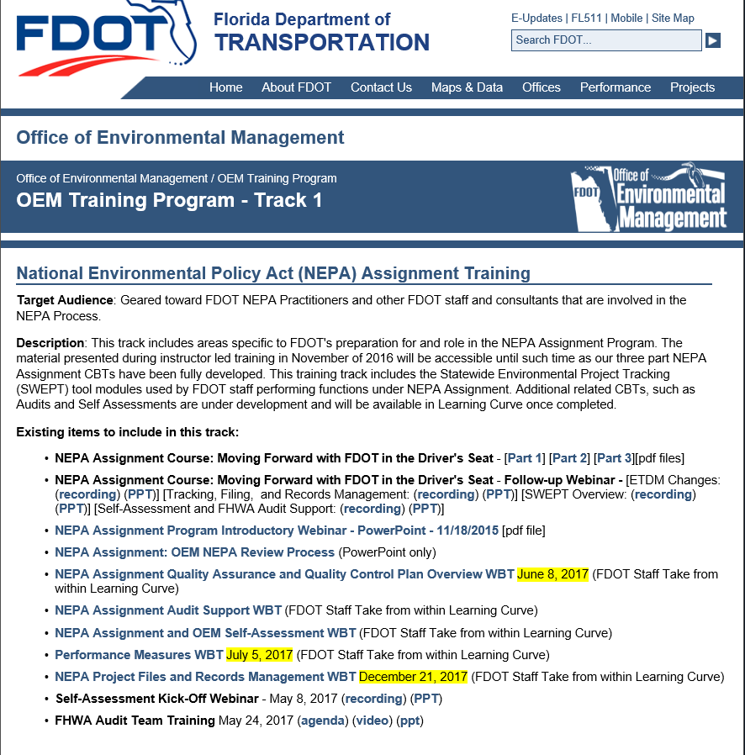
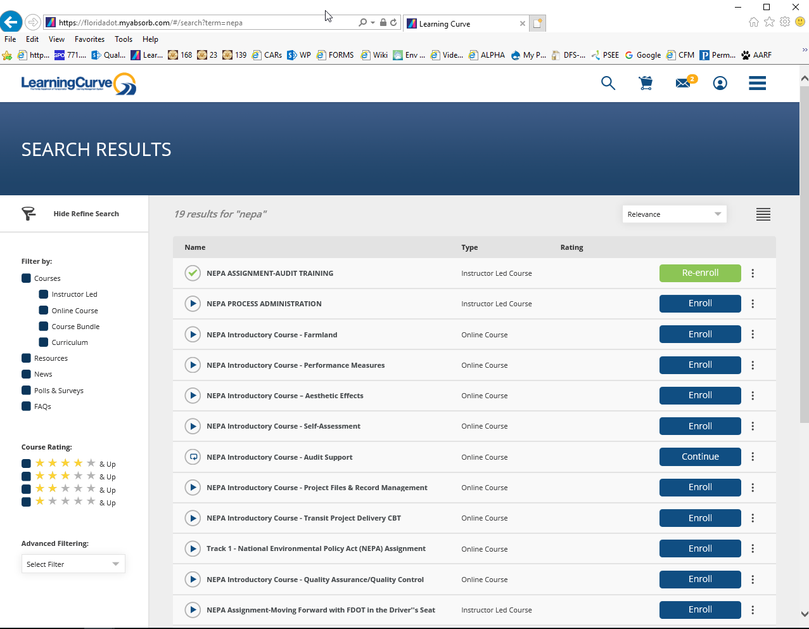
Learn or Refresh, Refresh, Refresh
Familiarize yourself with the CBTs
Available in Learning Curve (FDOT) and on our training website (Consultants):
http://www.fdot.gov/environment/sched/track1.shtm
Notes:
New personnel and consultants should take the self-directed NEPA Assignment computer-based courses in Learning Curve for FDOT employees and on the OEM website for consultants. For veteran personnel and consultants, it is a good idea to refresh your knowledge if you have any questions relating to NEPA or have not dealt with or thought about key NEPA concepts, practices, or processes, such as Quality Assurance and Quality Control, Performance Management, Self-Assessment, and FHWA Audit Support. These course are all concise and user-friendly to take as you have time.

Slide 17
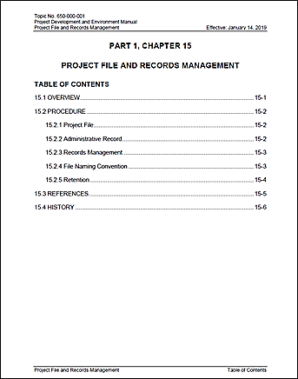
What is included in the project file?
PD&E Manual, Part 1, Chapter 15:
A project file refers to the files maintained by the project team to support development of the PD&E Study and resulting NEPA decision or approval.
Notes:
PD&E Manual, Part 1, Chapter 15:
A project file refers to the files maintained by the project team to support development of the PD&E Study and resulting NEPA decision or approval.

Slide 18
What is included in the project file?
Documents maintained in the project file for each PD&E project include, but are not limited to:
Environmental document
Technical reports and studies
Letters, correspondence, and emails
Comments, responses, and meeting minutes
Documentation of contrary opinions or conflicting data and resolution of issues or concerns raised and any resolution made in response
FDOT Training available at: http://wbt.dot.state.fl.us/ois/NEPA/PFRMCBT/PFRM.htm
Notes:
Documents maintained in the project file for each PD&E project include, but are not limited to:
Environmental document
Technical reports and studies
Letters, correspondence, and emails
Comments, responses, and meeting minutes
Documentation of contrary opinions or conflicting data and resolution of issues or concerns raised and any resolution made in response

Slide 19
Dates to Remember
DEADLINES TO REMEMBER | ACTION
April 29, 2019 | Kick-off Meeting for Districts
May 1, 2019 | FHWA starts reviewing projects for the 2019 FHWA Audit; and OEM Review Team starts Self-Assessment desk review
June 26, 2019 | OEM Review Team completes desk review, including any contacts with Districts regarding project files
July 19, 2019 | Draft report to Districts for review
August 2, 2019 | Deadline for District feedback
August 16, 2019 | OEM Director review and finalize the report
August 19,2019 | Final Report to Districts and FDOT leadership
August 21, 2019 | Summary sent to FHWA
Notes:
Important dates to remember are ….

Slide 20
Next Steps
Review Team will conduct desk review from May 1st through June 26th and Districts may be contacted during this period
This Go-To-Meeting will be posted on the FDOT website, and training on Self-Assessments available at: http://wbt.dot.state.fl.us/ois/NEPA/SelfAssessmentCBT/SelfAssessmentCBT.htm
Draft Report goes to Districts for review July 19th with 2 weeks to respond and provide feedback
Final Report to Districts August 19th
Notes:
Next steps to remember include Review Team will conduct desk review from May 1st through June 26th . Districts may be contacted anytime during this period. A recording of this go-to-meeting will be posted at the FDOT website. Also, Self-Assessment and courses on various aspects of NEPA Assignment are available in the Learning Curve and at the OEM website. The link here will take you to both.
The Draft Report goes to Districts July 19th with a 2 week review period. Final Report will be sent to the Districts August 19th .
And remember, double check your NEPA documentation, make sure your commitments are on the PCR in Project Suite, and take training as needed to prepare for the FHWA Audit. While you will not hear from FHWA until September during their audit team visits to Districts 3, 4, 6 and Central Office, they will start reviewing project files May 1st.

Slide 21
Participants
Questions and Answers
Notes:
Are there any questions at this time?

Slide 22
Contact Information
If you have questions later, please contact:
Eric Whitehead
Eric.Whitehead@dot.state.fl.us
(850) 414-5326
Thank you for attending this Go-to-Meeting
Notes:
This concludes today’s presentation. If there are questions afterwards, please contact Eric Whitehead as listed here. This presentation will be recorded and posted at the FDOT website. Thank you for attending this go-to-meeting.

